Slide 1
Colorwheel task

Slide 2
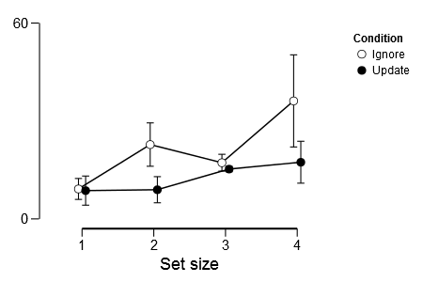
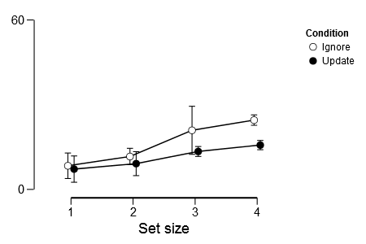
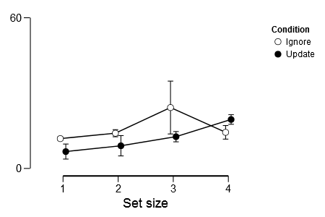
Colorwheel task Deviance: 6 subjects *3 sessions *128 trials
Session 1
Session 2
Session 3

Slide 3
Descriptives
Condition |  | Set size |  | session |  | Mean |  | SD |  | N
Ignore |  | 1 |  | 1 |  | 9.174 |  | 5.091 |  | 6
 |  |  |  | 2 |  | 8.360 |  | 2.862 |  | 6
 |  |  |  | 3 |  | 11.871 |  | 10.520 |  | 6
 |  | 2 |  | 1 |  | 22.769 |  | 26.162 |  | 6
 |  |  |  | 2 |  | 11.644 |  | 6.284 |  | 6
 |  |  |  | 3 |  | 14.027 |  | 8.224 |  | 6
 |  | 3 |  | 1 |  | 17.209 |  | 16.062 |  | 6
 |  |  |  | 2 |  | 20.923 |  | 30.596 |  | 6
 |  |  |  | 3 |  | 24.245 |  | 35.534 |  | 6
 |  | 4 |  | 1 |  | 36.152 |  | 44.061 |  | 6
 |  |  |  | 2 |  | 24.543 |  | 12.637 |  | 6
 |  |  |  | 3 |  | 14.375 |  | 4.357 |  | 6
Update |  | 1 |  | 1 |  | 8.667 |  | 2.652 |  | 6
 |  |  |  | 2 |  | 7.184 |  | 2.061 |  | 6
 |  |  |  | 3 |  | 6.716 |  | 3.353 |  | 6
 |  | 2 |  | 1 |  | 8.936 |  | 2.086 |  | 6
 |  |  |  | 2 |  | 9.113 |  | 0.885 |  | 6
 |  |  |  | 3 |  | 9.023 |  | 1.195 |  | 6
 |  | 3 |  | 1 |  | 15.260 |  | 9.743 |  | 6
 |  |  |  | 2 |  | 13.433 |  | 9.758 |  | 6
 |  |  |  | 3 |  | 12.643 |  | 6.466 |  | 6
 |  | 4 |  | 1 |  | 17.359 |  | 12.240 |  | 6
 |  |  |  | 2 |  | 15.694 |  | 12.828 |  | 6
 |  |  |  | 3 |  | 19.493 |  | 13.840 |  | 6

Slide 4
Model Comparison - dependent
Models |  | P(M) |  | P(M|data) |  | BF _{M} |  | BF ₁₀ |  | % error
Null model (incl. subject) |  | 0.053 |  | 0.001 |  | 0.019 |  | 1.000
Condition |  | 0.053 |  | 0.005 |  | 0.099 |  | 5.232 |  | 3.268
Set size |  | 0.053 |  | 0.087 |  | 1.711 |  | 83.356 |  | 0.802
Condition + Set size |  | 0.053 |  | 0.679 |  | 38.034 |  | 651.788 |  | 1.729
Condition + Set size + Condition ✻ Set size |  | 0.053 |  | 0.074 |  | 1.447 |  | 71.436 |  | 1.896
Session |  | 0.053 |  | 1.396e -4 |  | 0.003 |  | 0.134 |  | 1.413
Condition + Session |  | 0.053 |  | 6.951e -4 |  | 0.013 |  | 0.667 |  | 1.926
Set size + Session |  | 0.053 |  | 0.013 |  | 0.232 |  | 12.199 |  | 1.276
Condition + Set size + Session |  | 0.053 |  | 0.099 |  | 1.986 |  | 95.399 |  | 1.721
Condition + Set size + Condition ✻ Set size + Session |  | 0.053 |  | 0.011 |  | 0.197 |  | 10.396 |  | 3.059
Condition + Session + Condition ✻ Session |  | 0.053 |  | 1.176e -4 |  | 0.002 |  | 0.113 |  | 4.376
Condition + Set size + Session + Condition ✻ Session |  | 0.053 |  | 0.017 |  | 0.303 |  | 15.873 |  | 3.239
Condition + Set size + Condition ✻ Set size + Session + Condition ✻ Session |  | 0.053 |  | 0.002 |  | 0.032 |  | 1.707 |  | 2.081
Set size + Session + Set size ✻ Session |  | 0.053 |  | 9.820e -4 |  | 0.018 |  | 0.943 |  | 1.212
Condition + Set size + Session + Set size ✻ Session |  | 0.053 |  | 0.008 |  | 0.145 |  | 7.682 |  | 1.697
Condition + Set size + Condition ✻ Set size + Session + Set size ✻ Session |  | 0.053 |  | 9.023e -4 |  | 0.016 |  | 0.866 |  | 2.301
Condition + Set size + Session + Condition ✻ Session + Set size ✻ Session |  | 0.053 |  | 0.001 |  | 0.024 |  | 1.266 |  | 1.578
Condition + Set size + Condition ✻ Set size + Session + Condition ✻ Session + Set size ✻ Session |  | 0.053 |  | 1.483e -4 |  | 0.003 |  | 0.142 |  | 2.866
Condition + Set size + Condition ✻ Set size + Session + Condition ✻ Session + Set size ✻ Session + Condition ✻ Set size ✻ Session |  | 0.053 |  | 6.026e -5 |  | 0.001 |  | 0.058 |  | 3.461
Note. All models include subject.

Slide 5
Within Subjects Effects
 |  | Sum of Squares |  | df |  | Mean Square |  | F |  | p
Condition |  | 3.400 |  | 1 |  | 3.400 |  | 7.705 |  | 0.039
Residual |  | 2.206 |  | 5 |  | 0.441
Set size |  | 12.713 |  | 3 |  | 4.238 |  | 6.791 |  | 0.004
Residual |  | 9.360 |  | 15 |  | 0.624
Session |  | 1.224 |  | 2 |  | 0.612 |  | 2.453 |  | 0.136
Residual |  | 2.494 |  | 10 |  | 0.249
Condition ✻ Set size |  | 6.072 |  | 3 |  | 2.024 |  | 4.861 |  | 0.015
Residual |  | 6.246 |  | 15 |  | 0.416
Condition ✻ Session |  | 0.374 |  | 2 |  | 0.187 |  | 0.647 |  | 0.544
Residual |  | 2.888 |  | 10 |  | 0.289
Set size ✻ Session |  | 2.110 |  | 6 |  | 0.352 |  | 1.490 |  | 0.215
Residual |  | 7.081 |  | 30 |  | 0.236
Condition ✻ Set size ✻ Session |  | 1.341 |  | 6 |  | 0.224 |  | 0.846 |  | 0.545
Residual |  | 7.930 |  | 30 |  | 0.264
Note. Type III Sum of Squares

Slide 6
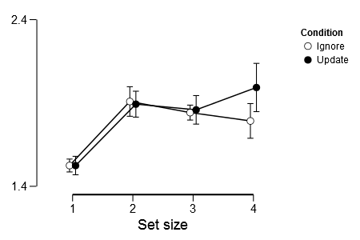
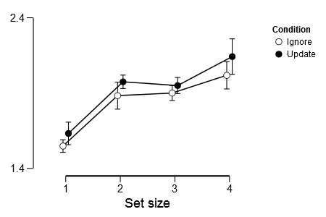
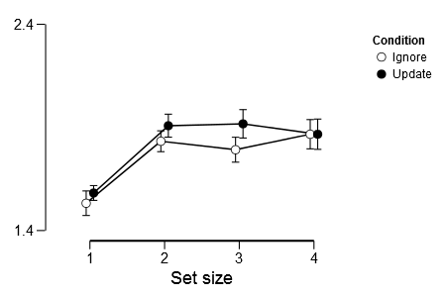
Colorwheel task RTs: 6 subjects *3 sessions *128 trials
Session 1
Session 2
Session 3

Slide 7
Descriptives
Condition |  | Set size |  | Session |  | Mean |  | SD |  | N
Ignore |  | 1 |  | 1 |  | 1.525 |  | 0.268 |  | 6
 |  |  |  | 2 |  | 1.549 |  | 0.205 |  | 6
 |  |  |  | 3 |  | 1.532 |  | 0.199 |  | 6
 |  | 2 |  | 1 |  | 1.909 |  | 0.389 |  | 6
 |  |  |  | 2 |  | 1.883 |  | 0.389 |  | 6
 |  |  |  | 3 |  | 1.833 |  | 0.365 |  | 6
 |  | 3 |  | 1 |  | 1.842 |  | 0.218 |  | 6
 |  |  |  | 2 |  | 1.900 |  | 0.362 |  | 6
 |  |  |  | 3 |  | 1.792 |  | 0.392 |  | 6
 |  | 4 |  | 1 |  | 1.792 |  | 0.464 |  | 6
 |  |  |  | 2 |  | 2.018 |  | 0.452 |  | 6
 |  |  |  | 3 |  | 1.867 |  | 0.356 |  | 6
Update |  | 1 |  | 1 |  | 1.524 |  | 0.214 |  | 6
 |  |  |  | 2 |  | 1.632 |  | 0.319 |  | 6
 |  |  |  | 3 |  | 1.582 |  | 0.242 |  | 6
 |  | 2 |  | 1 |  | 1.893 |  | 0.291 |  | 6
 |  |  |  | 2 |  | 1.975 |  | 0.371 |  | 6
 |  |  |  | 3 |  | 1.908 |  | 0.294 |  | 6
 |  | 3 |  | 1 |  | 1.859 |  | 0.228 |  | 6
 |  |  |  | 2 |  | 1.950 |  | 0.354 |  | 6
 |  |  |  | 3 |  | 1.917 |  | 0.373 |  | 6
 |  | 4 |  | 1 |  | 1.993 |  | 0.316 |  | 6
 |  |  |  | 2 |  | 2.142 |  | 0.380 |  | 6
 |  |  |  | 3 |  | 1.867 |  | 0.409 |  | 6

Slide 8
Model Comparison - dependent
Models |  | P(M) |  | P(M|data) |  | BF _{M} |  | BF ₁₀ |  | % error
Null model (incl. subject) |  | 0.053 |  | 4.692e -15 |  | 8.446e -14 |  | 1.000
Condition |  | 0.053 |  | 2.973e -15 |  | 5.352e -14 |  | 0.634 |  | 1.414
Set size |  | 0.053 |  | 0.101 |  | 2.014 |  | 2.144e +13 |  | 5.005
Condition + Set size |  | 0.053 |  | 0.153 |  | 3.250 |  | 3.259e +13 |  | 3.131
Condition + Set size + Condition ✻ Set size |  | 0.053 |  | 0.015 |  | 0.268 |  | 3.130e +12 |  | 2.154
Session |  | 0.053 |  | 2.299e -15 |  | 4.138e -14 |  | 0.490 |  | 0.700
Condition + Session |  | 0.053 |  | 1.520e -15 |  | 2.736e -14 |  | 0.324 |  | 1.399
Set size + Session |  | 0.053 |  | 0.203 |  | 4.586 |  | 4.327e +13 |  | 1.141
Condition + Set size + Session |  | 0.053 |  | 0.370 |  | 10.593 |  | 7.896e +13 |  | 3.169
Condition + Set size + Condition ✻ Set size + Session |  | 0.053 |  | 0.035 |  | 0.647 |  | 7.393e +12 |  | 2.375
Condition + Session + Condition ✻ Session |  | 0.053 |  | 1.843e -16 |  | 3.318e -15 |  | 0.039 |  | 1.885
Condition + Set size + Session + Condition ✻ Session |  | 0.053 |  | 0.049 |  | 0.937 |  | 1.054e +13 |  | 3.714
Condition + Set size + Condition ✻ Set size + Session + Condition ✻ Session |  | 0.053 |  | 0.005 |  | 0.083 |  | 9.781e +11 |  | 2.485
Set size + Session + Set size ✻ Session |  | 0.053 |  | 0.021 |  | 0.385 |  | 4.464e +12 |  | 1.643
Condition + Set size + Session + Set size ✻ Session |  | 0.053 |  | 0.039 |  | 0.732 |  | 8.332e +12 |  | 1.997
Condition + Set size + Condition ✻ Set size + Session + Set size ✻ Session |  | 0.053 |  | 0.004 |  | 0.068 |  | 8.026e +11 |  | 2.988
Condition + Set size + Session + Condition ✻ Session + Set size ✻ Session |  | 0.053 |  | 0.005 |  | 0.091 |  | 1.068e +12 |  | 1.781
Condition + Set size + Condition ✻ Set size + Session + Condition ✻ Session + Set size ✻ Session |  | 0.053 |  | 5.574e -4 |  | 0.010 |  | 1.188e +11 |  | 9.261
Condition + Set size + Condition ✻ Set size + Session + Condition ✻ Session + Set size ✻ Session + Condition ✻ Set size ✻ Session |  | 0.053 |  | 8.165e -5 |  | 0.001 |  | 1.740e +10 |  | 4.778
Note. All models include subject.

Slide 9
Within Subjects Effects
 |  | Sum of Squares |  | df |  | Mean Square |  | F |  | p
Condition |  | 0.160 |  | 1 |  | 0.160 |  | 4.586 |  | 0.085
Residual |  | 0.175 |  | 5 |  | 0.035
Set size |  | 3.406 |  | 3 |  | 1.135 |  | 38.097 |  | < .001
Residual |  | 0.447 |  | 15 |  | 0.030
Session |  | 0.268 |  | 2 |  | 0.134 |  | 0.940 |  | 0.422
Residual |  | 1.426 |  | 10 |  | 0.143
Condition ✻ Set size |  | 0.023 |  | 3 |  | 0.008 |  | 0.683 |  | 0.576
Residual |  | 0.165 |  | 15 |  | 0.011
Condition ✻ Session |  | 0.009 |  | 2 |  | 0.004 |  | 0.112 |  | 0.895
Residual |  | 0.382 |  | 10 |  | 0.038
Set size ✻ Session |  | 0.146 |  | 6 |  | 0.024 |  | 0.944 |  | 0.478
Residual |  | 0.770 |  | 30 |  | 0.026
Condition ✻ Set size ✻ Session |  | 0.103 |  | 6 |  | 0.017 |  | 1.070 |  | 0.402
Residual |  | 0.479 |  | 30 |  | 0.016
Note. Type III Sum of Squares

Slide 10
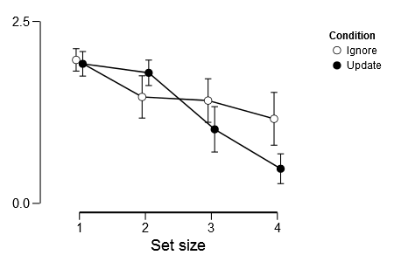
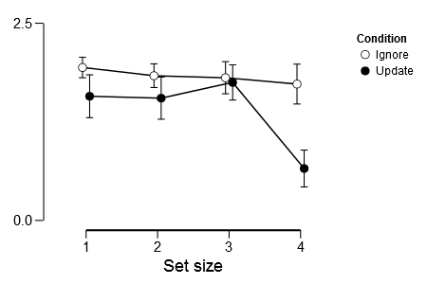
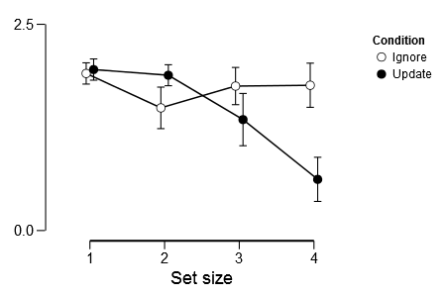
Task vs No Redo: 6 subjects *3 sessions *288 trials
Session 1
Session 2
Session 3

Slide 11
Descriptives
Condition |  | Set size |  | Session |  | Mean |  | SD |  | N
Ignore |  | 1 |  | 1 |  | 1.972 |  | 0.189 |  | 6
 |  |  |  | 2 |  | 1.939 |  | 0.155 |  | 6
 |  |  |  | 3 |  | 1.904 |  | 0.149 |  | 6
 |  | 2 |  | 1 |  | 1.462 |  | 0.746 |  | 6
 |  |  |  | 2 |  | 1.835 |  | 0.235 |  | 6
 |  |  |  | 3 |  | 1.487 |  | 0.692 |  | 6
 |  | 3 |  | 1 |  | 1.413 |  | 0.747 |  | 6
 |  |  |  | 2 |  | 1.809 |  | 0.498 |  | 6
 |  |  |  | 3 |  | 1.751 |  | 0.562 |  | 6
 |  | 4 |  | 1 |  | 1.162 |  | 0.928 |  | 6
 |  |  |  | 2 |  | 1.729 |  | 0.596 |  | 6
 |  |  |  | 3 |  | 1.761 |  | 0.691 |  | 6
Update |  | 1 |  | 1 |  | 1.918 |  | 0.264 |  | 6
 |  |  |  | 2 |  | 1.575 |  | 0.732 |  | 6
 |  |  |  | 3 |  | 1.951 |  | 0.145 |  | 6
 |  | 2 |  | 1 |  | 1.794 |  | 0.351 |  | 6
 |  |  |  | 2 |  | 1.550 |  | 0.734 |  | 6
 |  |  |  | 3 |  | 1.883 |  | 0.194 |  | 6
 |  | 3 |  | 1 |  | 1.017 |  | 0.931 |  | 6
 |  |  |  | 2 |  | 1.749 |  | 0.553 |  | 6
 |  |  |  | 3 |  | 1.345 |  | 0.906 |  | 6
 |  | 4 |  | 1 |  | 0.476 |  | 0.613 |  | 6
 |  |  |  | 2 |  | 0.658 |  | 0.660 |  | 6
 |  |  |  | 3 |  | 0.620 |  | 0.801 |  | 6

Slide 12
Model Comparison - dependent
Models |  | P(M) |  | P(M|data) |  | BF _{M} |  | BF ₁₀ |  | % error
Null model (incl. subject) |  | 0.053 |  | 7.882e -8 |  | 1.419e -6 |  | 1.000
Condition |  | 0.053 |  | 4.357e -7 |  | 7.843e -6 |  | 5.528 |  | 0.869
Set size |  | 0.053 |  | 9.622e -4 |  | 0.017 |  | 12207.953 |  | 0.999
Condition + Set size |  | 0.053 |  | 0.013 |  | 0.236 |  | 163876.143 |  | 10.853
Condition + Set size + Condition ✻ Set size |  | 0.053 |  | 0.662 |  | 35.253 |  | 8.399e +6 |  | 1.386
Session |  | 0.053 |  | 1.666e -8 |  | 2.999e -7 |  | 0.211 |  | 1.762
Condition + Session |  | 0.053 |  | 1.055e -7 |  | 1.898e -6 |  | 1.338 |  | 7.510
Set size + Session |  | 0.053 |  | 2.546e -4 |  | 0.005 |  | 3230.888 |  | 1.693
Condition + Set size + Session |  | 0.053 |  | 0.003 |  | 0.059 |  | 41344.923 |  | 1.474
Condition + Set size + Condition ✻ Set size + Session |  | 0.053 |  | 0.225 |  | 5.214 |  | 2.850e +6 |  | 1.936
Condition + Session + Condition ✻ Session |  | 0.053 |  | 1.546e -8 |  | 2.782e -7 |  | 0.196 |  | 1.689
Condition + Set size + Session + Condition ✻ Session |  | 0.053 |  | 5.806e -4 |  | 0.010 |  | 7366.559 |  | 1.867
Condition + Set size + Condition ✻ Set size + Session + Condition ✻ Session |  | 0.053 |  | 0.041 |  | 0.771 |  | 520975.197 |  | 2.236
Set size + Session + Set size ✻ Session |  | 0.053 |  | 3.501e -5 |  | 6.301e -4 |  | 444.149 |  | 1.629
Condition + Set size + Session + Set size ✻ Session |  | 0.053 |  | 5.085e -4 |  | 0.009 |  | 6451.892 |  | 1.589
Condition + Set size + Condition ✻ Set size + Session + Set size ✻ Session |  | 0.053 |  | 0.044 |  | 0.825 |  | 556252.887 |  | 2.255
Condition + Set size + Session + Condition ✻ Session + Set size ✻ Session |  | 0.053 |  | 4.994e -4 |  | 0.009 |  | 6336.497 |  | 82.707
Condition + Set size + Condition ✻ Set size + Session + Condition ✻ Session + Set size ✻ Session |  | 0.053 |  | 0.008 |  | 0.144 |  | 100689.625 |  | 2.613
Condition + Set size + Condition ✻ Set size + Session + Condition ✻ Session + Set size ✻ Session + Condition ✻ Set size ✻ Session |  | 0.053 |  | 0.002 |  | 0.028 |  | 19782.438 |  | 4.689
Note. All models include subject.

Slide 13
Within Subjects Effects
 |  | Sum of Squares |  | df |  | Mean Square |  | F |  | p
Condition |  | 3.400 |  | 1 |  | 3.400 |  | 7.705 |  | 0.039
Residual |  | 2.206 |  | 5 |  | 0.441
Set size |  | 12.713 |  | 3 |  | 4.238 |  | 6.791 |  | 0.004
Residual |  | 9.360 |  | 15 |  | 0.624
Session |  | 1.224 |  | 2 |  | 0.612 |  | 2.453 |  | 0.136
Residual |  | 2.494 |  | 10 |  | 0.249
Condition ✻ Set size |  | 6.072 |  | 3 |  | 2.024 |  | 4.861 |  | 0.015
Residual |  | 6.246 |  | 15 |  | 0.416
Condition ✻ Session |  | 0.374 |  | 2 |  | 0.187 |  | 0.647 |  | 0.544
Residual |  | 2.888 |  | 10 |  | 0.289
Set size ✻ Session |  | 2.110 |  | 6 |  | 0.352 |  | 1.490 |  | 0.215
Residual |  | 7.081 |  | 30 |  | 0.236
Condition ✻ Set size ✻ Session |  | 1.341 |  | 6 |  | 0.224 |  | 0.846 |  | 0.545
Residual |  | 7.930 |  | 30 |  | 0.264
Note. Type III Sum of Squares

Slide 14
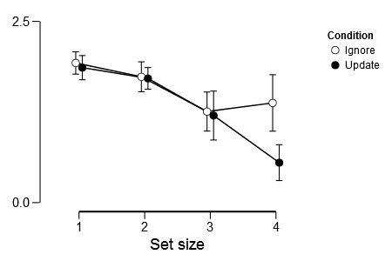
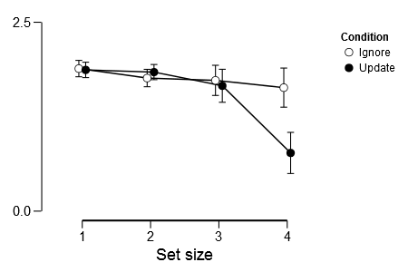
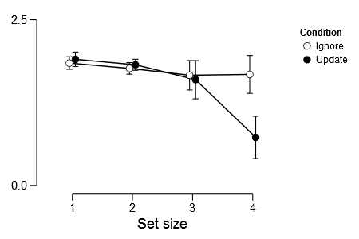
Task vs No Redo: 5 subjects *3 sessions *288 trials
Session 1
Session 2
Session 3

Slide 15
Model Comparison - dependent
Models |  | P(M) |  | P(M|data) |  | BF _{M} |  | BF ₁₀ |  | % error
Null model (incl. subject) |  | 0.053 |  | 0.001 |  | 0.019 |  | 1.000
Condition |  | 0.053 |  | 2.525e -4 |  | 0.005 |  | 0.238 |  | 2.795
Set size |  | 0.053 |  | 0.013 |  | 0.245 |  | 12.635 |  | 1.144
Condition + Set size |  | 0.053 |  | 0.003 |  | 0.062 |  | 3.238 |  | 5.591
Condition + Set size + Condition ✻ Set size |  | 0.053 |  | 0.011 |  | 0.195 |  | 10.098 |  | 1.955
Session |  | 0.053 |  | 2.470e -4 |  | 0.004 |  | 0.232 |  | 0.920
Condition + Session |  | 0.053 |  | 5.732e -5 |  | 0.001 |  | 0.054 |  | 1.385
Set size + Session |  | 0.053 |  | 0.004 |  | 0.064 |  | 3.333 |  | 1.868
Condition + Set size + Session |  | 0.053 |  | 8.535e -4 |  | 0.015 |  | 0.803 |  | 1.766
Condition + Set size + Condition ✻ Set size + Session |  | 0.053 |  | 0.003 |  | 0.055 |  | 2.850 |  | 1.990
Condition + Session + Condition ✻ Session |  | 0.053 |  | 4.691e -5 |  | 8.444e -4 |  | 0.044 |  | 3.454
Condition + Set size + Session + Condition ✻ Session |  | 0.053 |  | 7.837e -4 |  | 0.014 |  | 0.737 |  | 2.087
Condition + Set size + Condition ✻ Set size + Session + Condition ✻ Session |  | 0.053 |  | 0.003 |  | 0.063 |  | 3.282 |  | 3.675
Set size + Session + Set size ✻ Session |  | 0.053 |  | 0.144 |  | 3.018 |  | 135.105 |  | 1.001
Condition + Set size + Session + Set size ✻ Session |  | 0.053 |  | 0.036 |  | 0.680 |  | 34.259 |  | 1.787
Condition + Set size + Condition ✻ Set size + Session + Set size ✻ Session |  | 0.053 |  | 0.256 |  | 6.207 |  | 241.240 |  | 3.390
Condition + Set size + Session + Condition ✻ Session + Set size ✻ Session |  | 0.053 |  | 0.048 |  | 0.906 |  | 45.070 |  | 2.782
Condition + Set size + Condition ✻ Set size + Session + Condition ✻ Session + Set size ✻ Session |  | 0.053 |  | 0.370 |  | 10.568 |  | 348.010 |  | 6.179
Condition + Set size + Condition ✻ Set size + Session + Condition ✻ Session + Set size ✻ Session + Condition ✻ Set size ✻ Session |  | 0.053 |  | 0.105 |  | 2.106 |  | 98.547 |  | 1.714
Note. All models include subject.

Slide 16
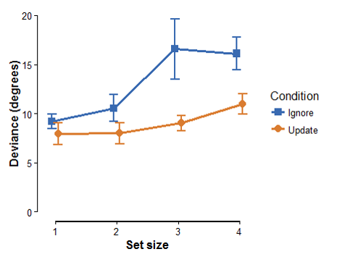
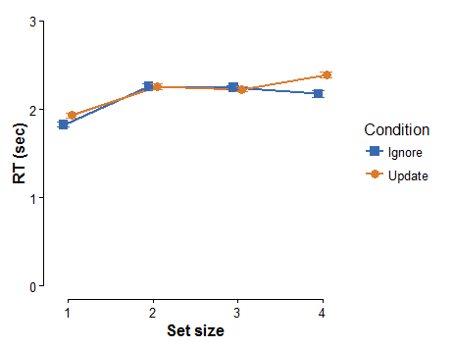
Colorwheel task performance: results from 24 participants
Condition: F=9.986, p=0.004, BF_{1INC}104
Set size: F=4.676, p=0.022, BF_{INC}=15
Condition* Set size: F=2.320, p=0.122, BF_{INC}=1.4
Condition: F=20.111, p<0.001, BF_{INC}=310
Set size: F=51.617, p<0.001, BF_{INCc}=∞
Best model: Condition+ Set size (BF10 =1179)
Best model: Condition+ Set size +Condition*Set size (BF10 =1.667e+26)

Slide 17
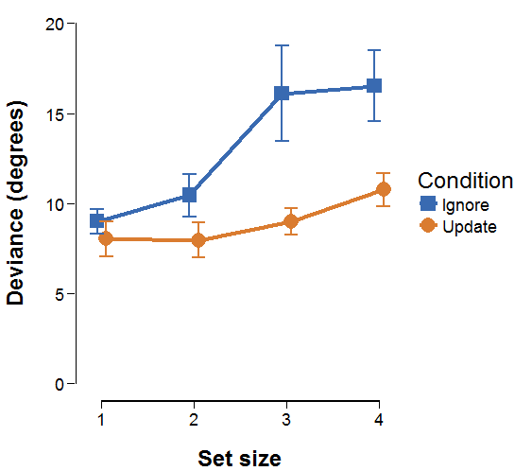
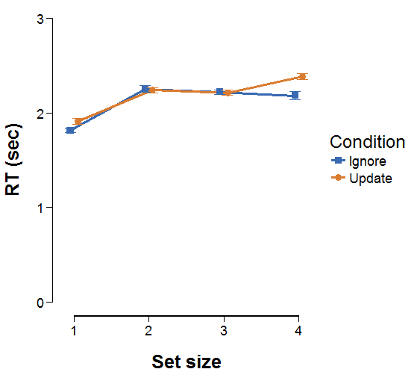
Colorwheel task performance: results from 28 participants
Condition: F=11, p=0.003, BF_{1INC}201
Set size: F=5.5, p=0.009, BF_{INC}=40
Condition* Set size: F=2.6, p=0.085, BF_{INC}=1.7
Condition: F=18.85, p<0.001, BF_{INC}=237
Set size: F=61, p<0.001, BF₁₀=∞
Best model: Condition+ Set size (BF10 =5188)
Best model: Condition+ Set size +Condition*Set size (BF10 =1.75e+30)

Slide 18
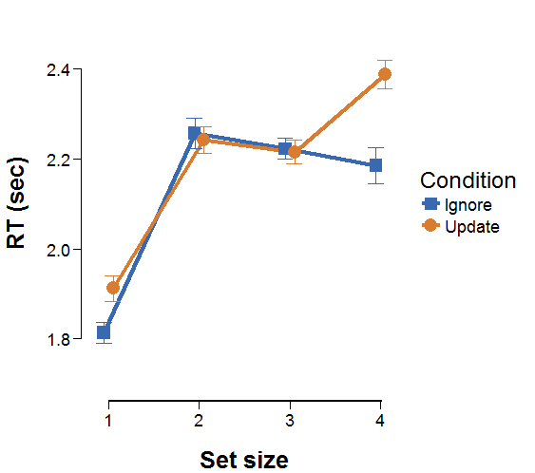
Colorwheel task performance: results from 28 participants
Condition: F=11, p=0.003, BF_{1INC}201
Set size: F=5.5, p=0.009, BF_{INC}=40
Condition* Set size: F=2.6, p=0.085, BF_{INC}=1.7
Condition: F=18.85, p<0.001, BF_{INC}=237
Set size: F=61, p<0.001, BF₁₀=∞
Best model: Condition+ Set size (BF10 =5188)
Best model: Condition+ Set size +Condition*Set size (BF10 =1.75e+30)

Slide 19
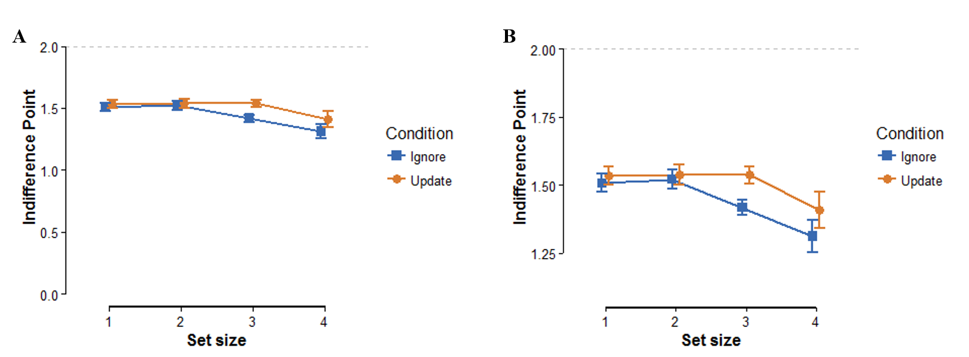
Discounting choice task- task vs No Redo (20 subjects)
*
Condition: F=6.901, p=0.017, BF_{INC}=1.08
Set size: F=4.145, p=0.043, BF_{INC}=48
Condition* Set size: F=1.342, p=0.270, BF_{INC}=0.34
Best model: Condition+ Set size (BF10 =85)
Notes:
relate the difference between 1.5 and 1.9

Slide 20
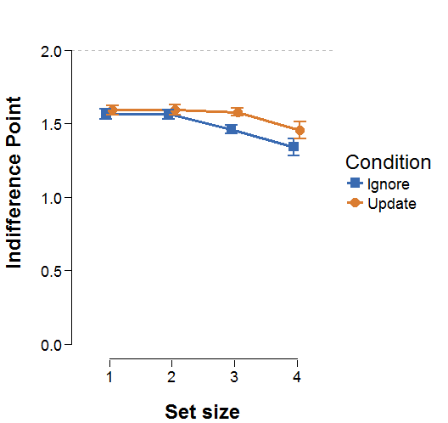
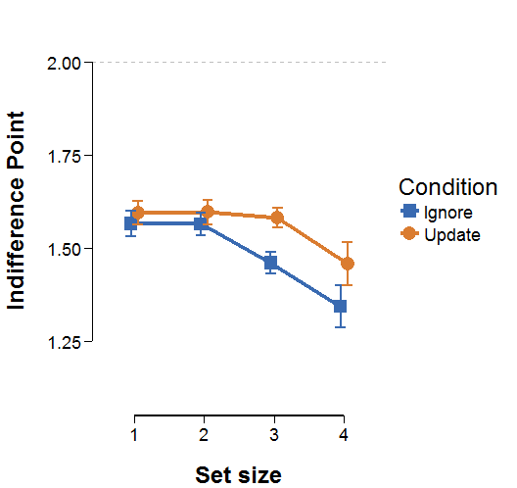
Discounting choice task- task vs No Redo (24 subjects)
*
Condition: F=10.92, p=0.003, BF_{INC}=3.1
Set size: F=5.67, p=0.0016, BF_{INC}=1240
Condition* Set size: F=1.799, p=0.168, BF_{INC}=0.46
Best model: Condition+ Set size (BF10 =5002)
Notes:
relate the difference between 1.5 and 1.9

Slide 21
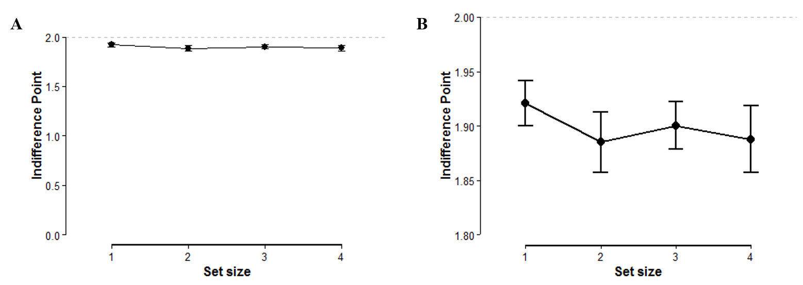
Discounting choice task- Ignore vs Update (22 subjects)
T test (IP<2): t=-1.848, p=0.039, BF₁₀= 1.803
ANOVA: F=0.407, p=0.687, BF₁₀=0.096

Slide 22
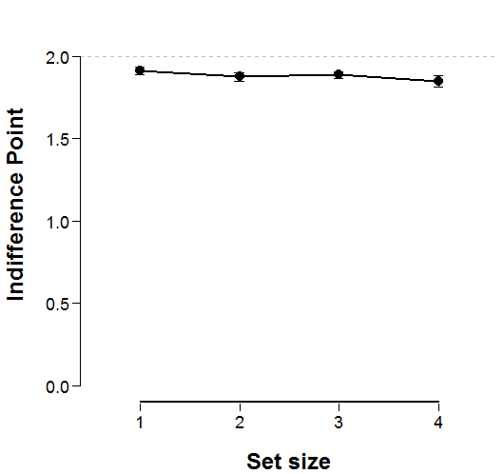
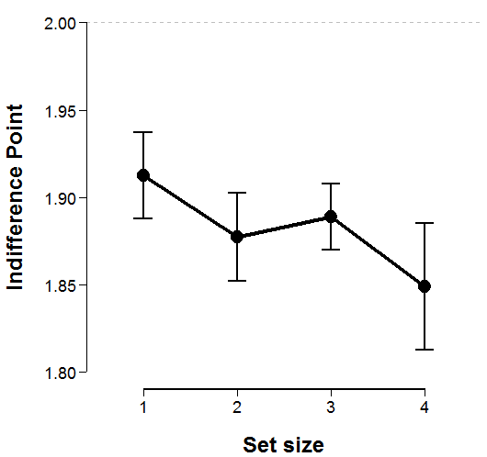
Discounting choice task- Ignore vs Update (26 subjects)
T test (IP<2): t=-2.44, p=0.011, BF₁₀= 4.8
ANOVA: F=0.96, p=0.382, BF₁₀=0.149

Slide 23
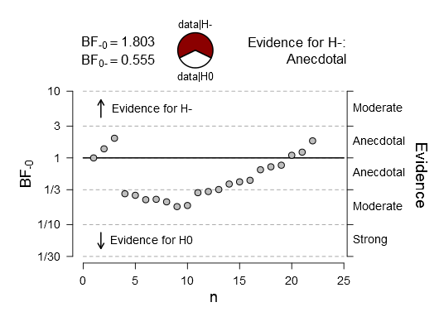
Sequential analysis (22 participants)
Notes:
is prior updated? maybe then add that about Bayes factor that can continue sampling

Slide 24
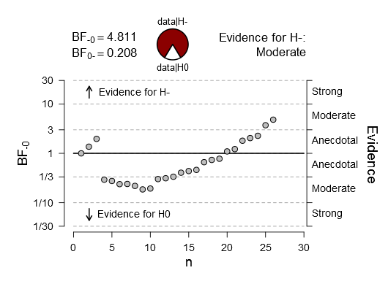
Sequential analysis (26 participants)
Do we continue sampling?
Notes:
is prior updated? maybe then add that about Bayes factor that can continue sampling

Slide 25
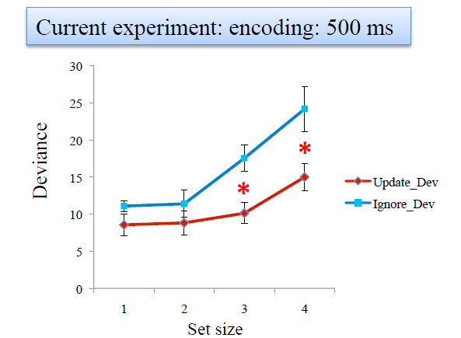
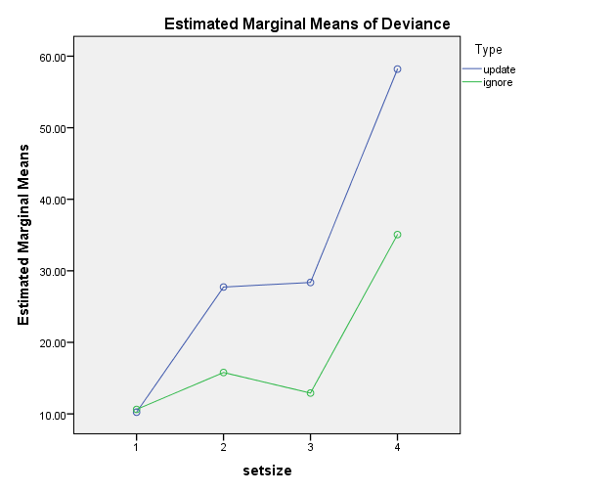
Yingying’s experiment (encoding: 500ms)
Lieke’s experiment (encoding: 900ms)
Danae’s experiment (encoding: 2000ms)

Slide 26
Questions?

Slide 27
Shortening color wheel task
Colour sensitivity task: 24→12 trials. Only first time?
Reducing presentation times from 2:1sec (128 trials 19min).
Reduce overall trials from 128 to 112 (26min, more trials, more discounting)
Removing set size 1 (96 trials, 22min)
Huge Redo instead of repeating colorwheel task for following sessions?

Slide 28
Shortening choice task
Now choice task: 55min (30min No Redo, 25min Direct comparison)
Goal: 30min
Removing direct comparison (can we claim preference?) /Staircase? 30min
Removing set size 1 completely and comparing with No Redo 30min
Compare with set size 1 instead of No Redo 35min
Reduce response time (5% more than 3sec, 1-2% more than 4sec maxRT=2.1) 27min
Reduce response time after each block (5→4→3) 27min
Reduce number of repetitions (discounting decreased on 2nd and increased on 3rd block) 27min
Reduce easy offer range (0.6 to 2.2 in steps of 0.2) 30min
Notes:
numChoices1: 288
numChoices2: 252 3-4 sec to respond but give time to slow ones?

Slide 29
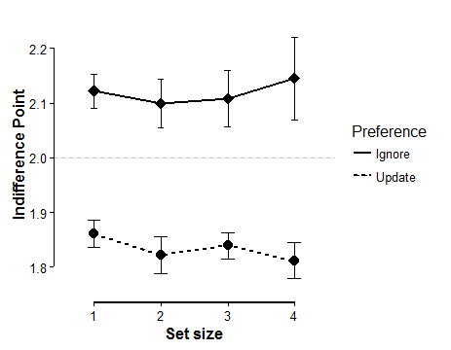
Discussion: Are there two groups? Groups based on written preference
Ignore (5 ppts)
T test (IP>2): t=0.645, p=0.277, cohen’s d=0.288, BF₁₀= 0.663
Update (17 ppts)
T test (IP<2): t=-4.306, p=<0.001, cohen’s d=-1.044, BF₁₀= 128

Slide 30
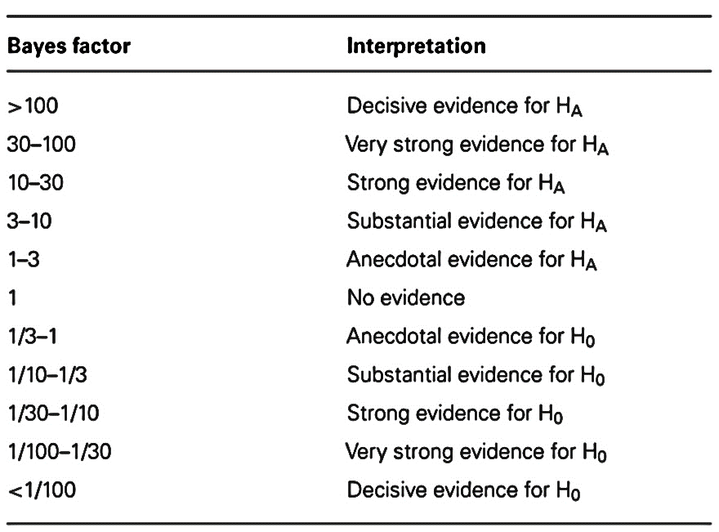
HA evidence
Ho evidence
Notes:
probability is a relative comparison . check bram’s preregistration

Slide 31
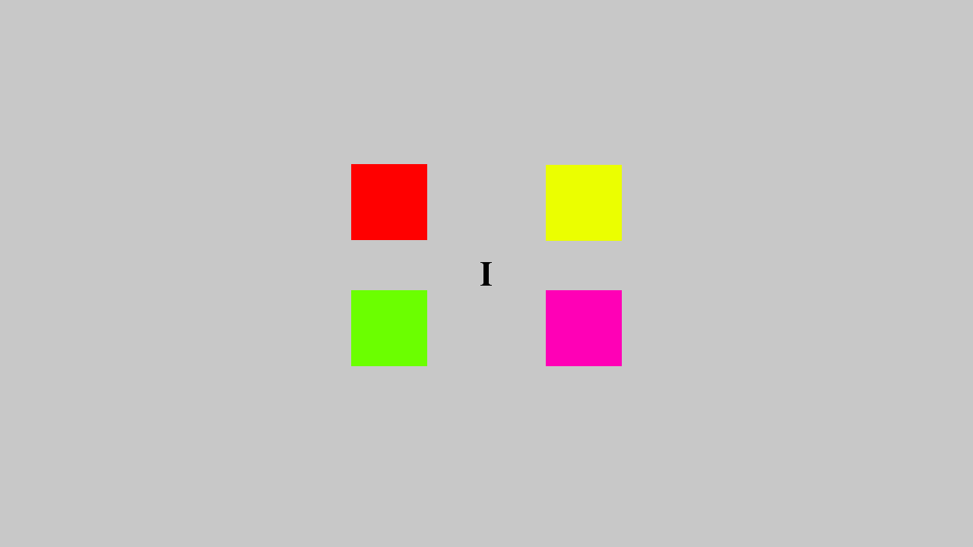
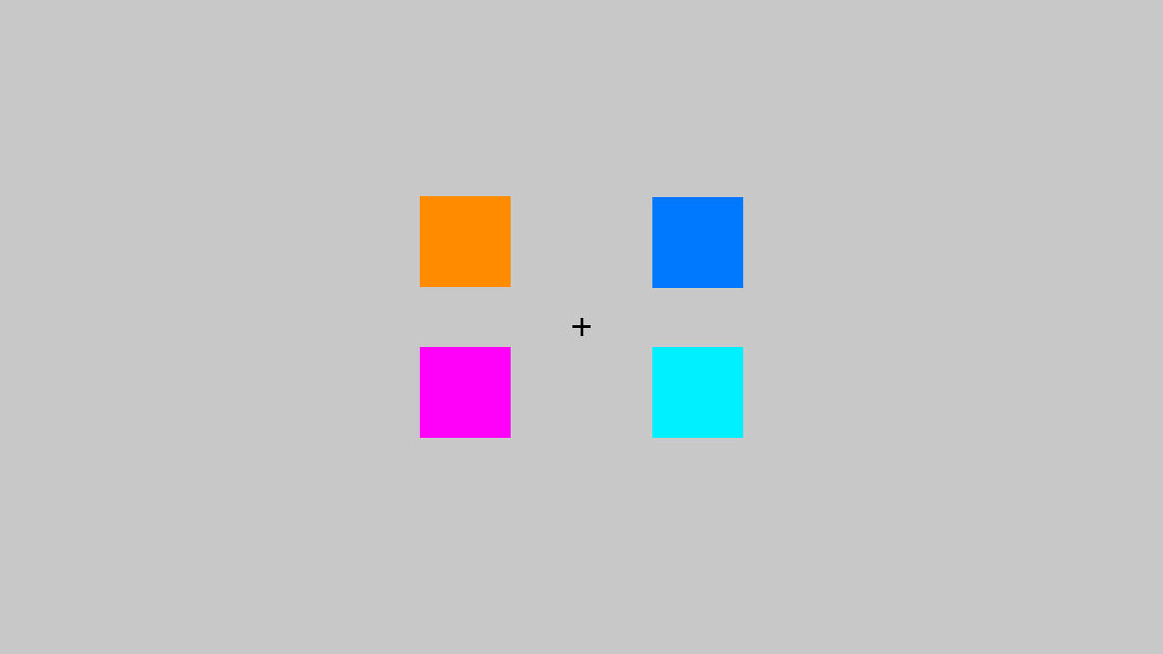
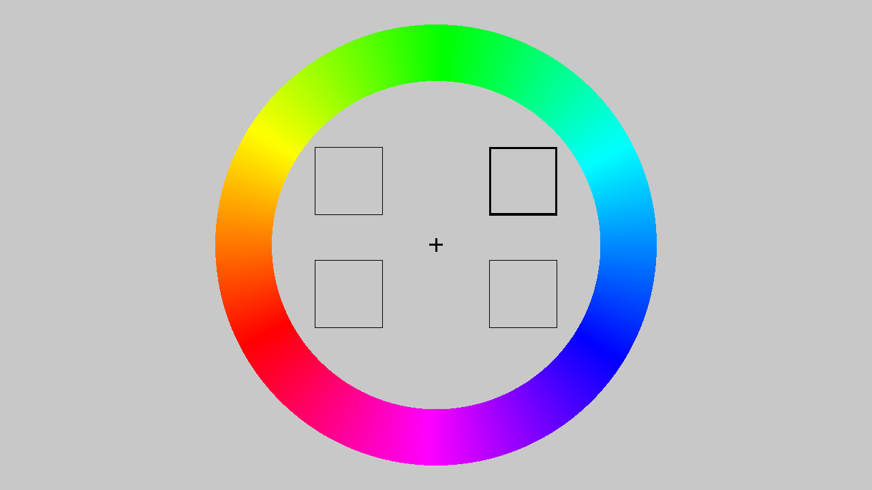
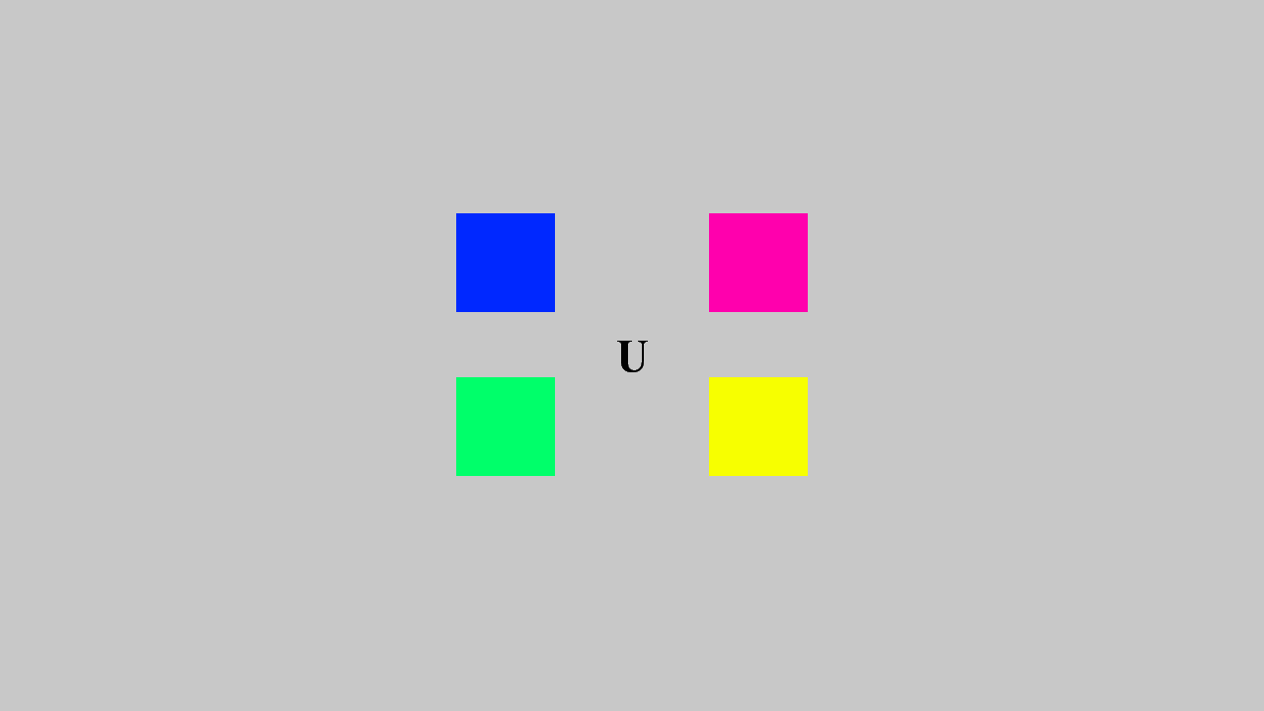
Methods: Color wheel memory task
Dependent variables:
Deviance in degrees from target color
Reaction time
Independent variables:
Condition
Ignore (distracter resistance)
Update (flexible updating)
Set size
4 levels of difficulty
Encoding Interference Response
2 blocks of 64 trials
Color wheel task strengths
Subjective value estimation requires levels of difficulty.
Sensitivity: continuous dependent variable.
Time between relevant stimuli and color wheel same for both Ignore and Update
Stimuli counterbalanced between conditions

Slide 32
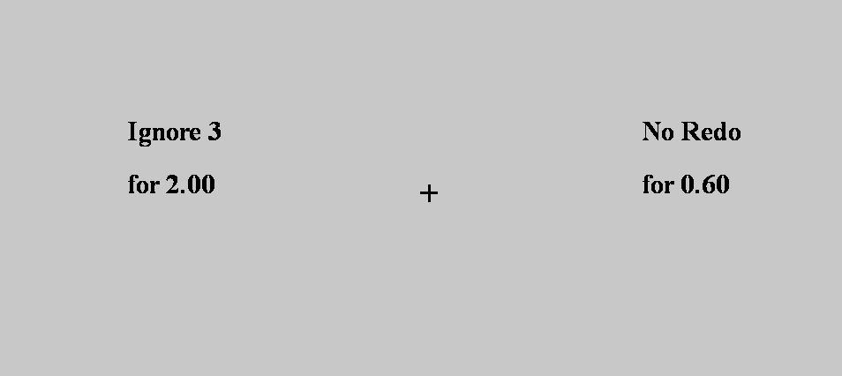
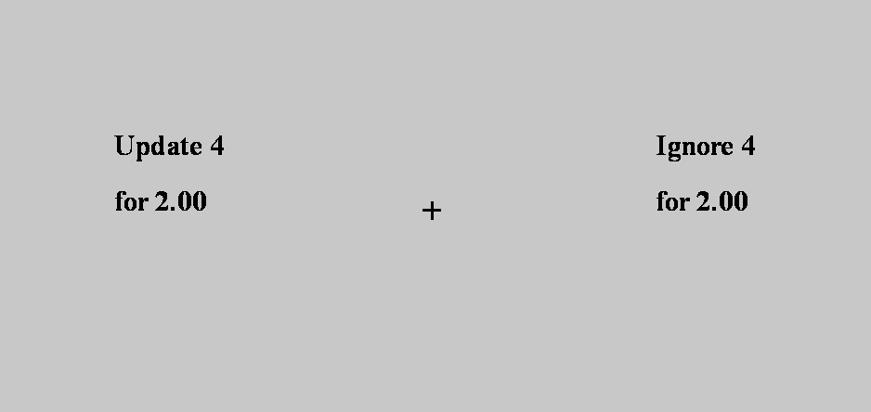
Methods: Discounting choice task
Version 1
Version 2
Task vs No Redo
Ignore vs Update
RQ1: Are they costly?
Task vs no redo
Task fixed: 2 euros
No Redo: from 0.1 to 2.2 euros
96 pairs: 12 amounts*2 conditions*4 set sizes
RQ2: Is update less costly?
Direct comparison Ignore/Update
Ignore fixed: 2 euros
Update: from 0.1 to 4 euros
84 pairs: 21 amounts*4 set sizes
Choice probabilistic: Three repetitions per offered pair

Slide 33
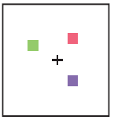
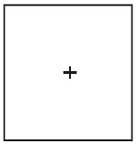

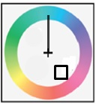
Methods: Color wheel memory task
IGNORE
UPDATE
Independent variables:
Condition
Ignore (distracter resistance)
Update (flexible updating)
Set size
4 levels of difficulty
2 s
2 s
2 s
I
2 s
U
2 s
2 s
2 s
6 s
4 s
Dependent variables:
Deviance in degrees from target color
Reaction time
4 s
Color wheel task strengths
Subjective value estimation requires levels of difficulty.
Sensitivity: continuous dependent variable.
Time between relevant stimuli and color wheel same for both Ignore and Update
Stimuli counterbalanced between conditions
Notes:
add

Slide 34
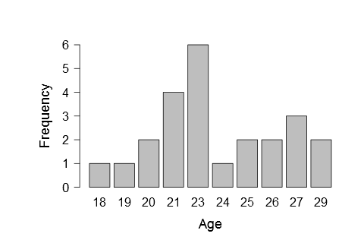
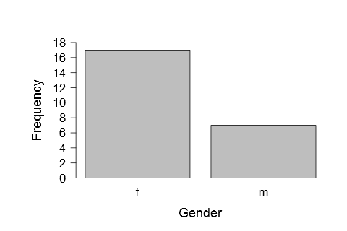
Methods: Participants
Tested: 28 participants (19 women), age 19-29
Full data: 24 participants (17 women), age 19-29 (mean: 23.5)
Exclusion criteria: Color blindness
Notes:
leave this out

Slide 35
Discounting results: Logistic regression analysis
Indifference points estimated by logistic regression function
Subjective Value=IP/hard offer
f(x)/(1-f(x))=e^(β0+β1*x).

