Slide 1
Facebook Stock Data Analysis
End-to-End Data Analysis and Insights
Name: Dana Elshrbiny
Under Supervision: Dr. Sayed Abdelgaber

Slide 2
Objective:
To perform exploratory data analysis (EDA), visualize trends, and derive insights about Facebook stock performance.
Key Components:
Data Loading and Preprocessing
Exploratory Data Analysis (EDA)
Data Visualization
Feature Engineering
Insights and Observations
Conclusion

Slide 3
Data Loading and Preprocessing

Slide 4
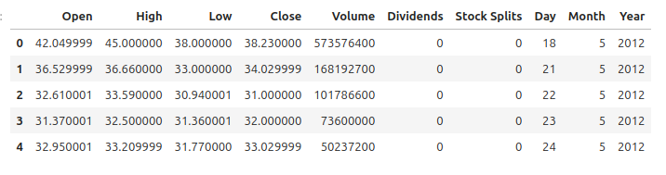
Data Loading and Preprocessing
Steps:
Loaded historical Facebook stock data.
Converted the Date column into Day, Month, and Year for better analysis.

Slide 5
Exploratory Data Analysis (EDA)

Slide 6
Exploratory Data Analysis (EDA)
Summary Statistics: Measures of central tendency (mean, median) and dispersion (variance, standard deviation).
Missing Data Check: Ensured data quality by handling missing values.
Correlation Matrix: Visualized relationships between features using a heatmap.

Slide 7
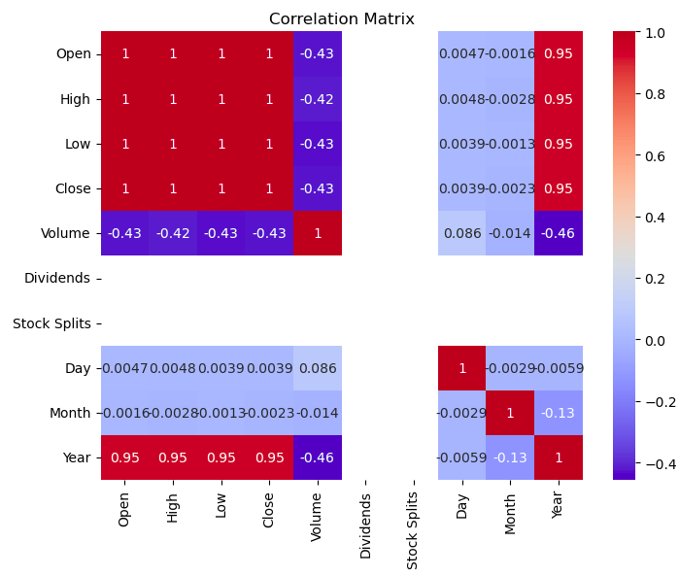

Slide 8
Data Visualization

Slide 9
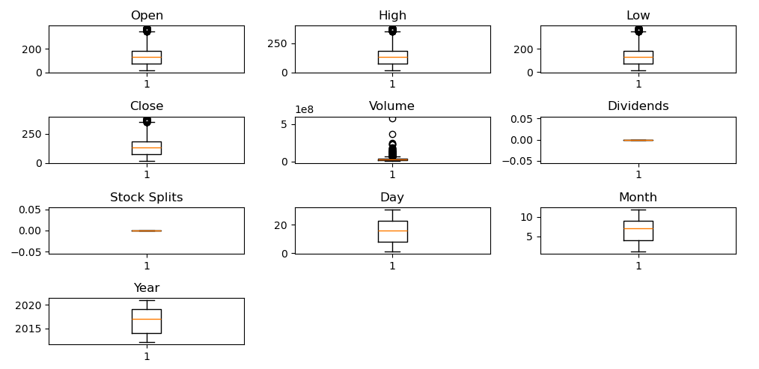
Box Plots
Visualized numerical features to detect outliers.

Slide 10
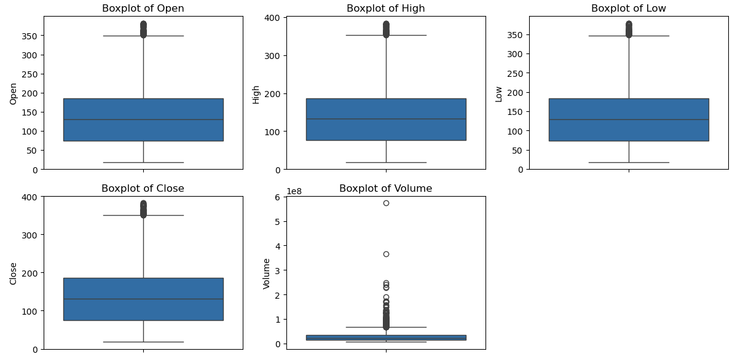

Slide 11
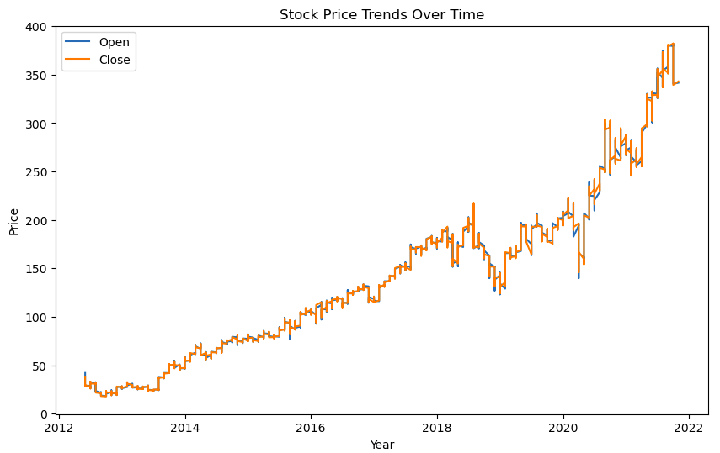
Line Plots
Showed stock trends over time (Open and Close prices).

Slide 12
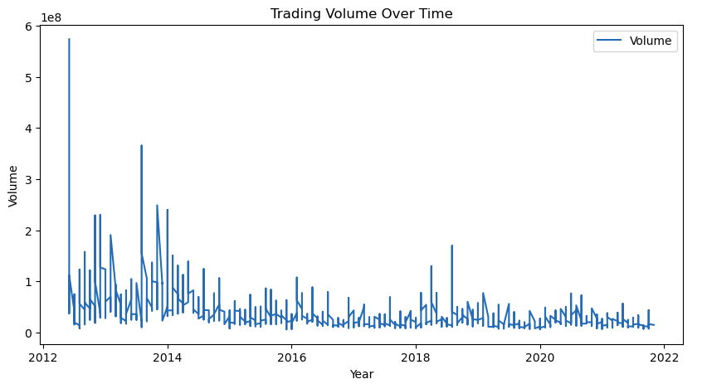
Volume Trends
Analyzed trading activity.

Slide 13
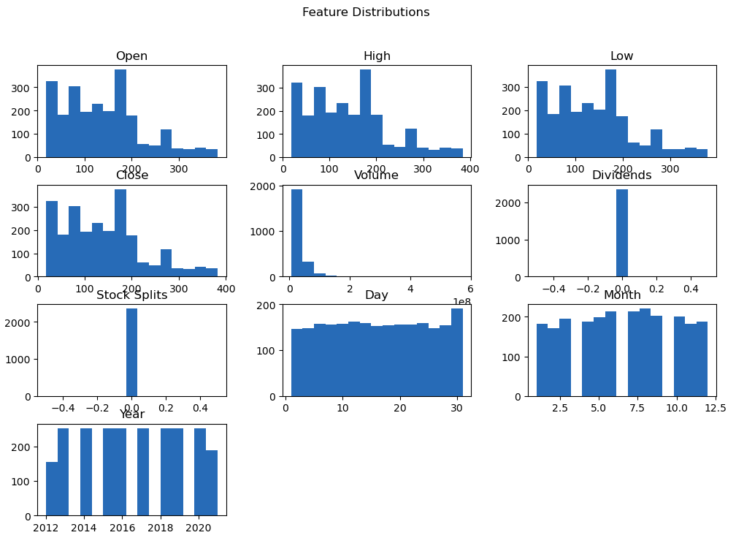
Histograms
Explored the distribution of features.

Slide 14
Feature Engineering

Slide 15
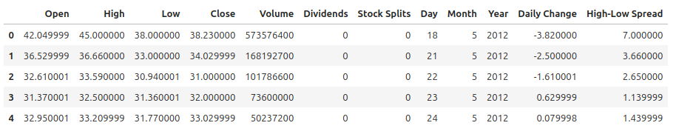
Feature Engineering
Derived Features:
Daily Price Change = Close - Open.
High-Low Spread = High - Low.
Purpose: To create new variables for deeper analysis of stock performance.

Slide 16
Insights and Observations

Slide 17
Insights and Observations
Key Findings:
Trends in stock prices and trading volume.
Outlier detection and its implications.
Correlations between stock features.
Summary: This analysis offers a detailed exploration of Facebook stock data, helping traders and analysts understand performance trends and trading activity.

Slide 18
Thank You

