Slide 1

Apache Spark
Swiss Army knife of big data analytics

Slide 2
Presented by:
Yomna Tarek Gamal
Dana aboelyazed elshrbiny
Supervised by :
Dr/ Ahmed elsayed

Slide 3


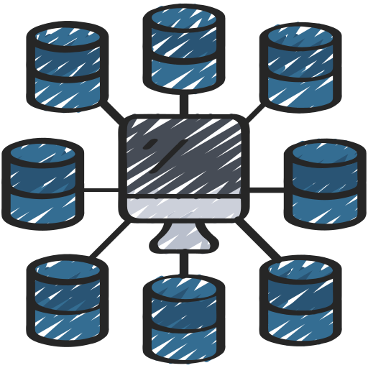
Table of content
01
What’s spark and it’s Evolution
02
Why Spark
03
Ecosystem Components
04
Resilient Distributed Datasets (RDD)

Slide 4
01
What’s spark and it’s Evolution

Slide 5
Apache spark
Apache Spark is an open-source, distributed processing system used for big data workloads. It is most commonly used for large data sets. Apache Spark often called just ‘Spark’, is an open-source data processing engine created for Big data requirements. It is designed to deliver scalability, speed, and programmability for handling big data for machine learning, artificial intelligence, streaming data, and graph data applications.

Slide 6
Evolution of Apache Spark
Spark was first developed at UC Berkley in 2009. Now, it is handled & owned by Apache Software Foundation. Apache Spark has the largest open source community in big data. It has more than 1000 contributors. Now, its also being included as one of the core components in several commercial extensive data offerings.

Slide 7
02
Features of Apache spark

Slide 8
Features of Apache Spark
spark decreases the number of reads and write operations on the disk. Spark stores the intermediate steps in memory
Speed
Spark supports Machine Learning, Artificial Intelligence, SQL queries, and Graph Algorithms.
Features of Apache Spark
Advanced Analytics
Spark provides built-in APIs in many languages, including Python, Java, and Scala. So, you can write your application in any language
Supports Multiple Languages
Spark code can be used for batch-processing, joining streaming data against historical data as well as running ad-hoc queries on streaming state.
It offers support to multiple file formats like parquet, json, csv, ORC, Avro etc. Hadoop can be easily leveraged with Spark as an input data source or destination.

Slide 9
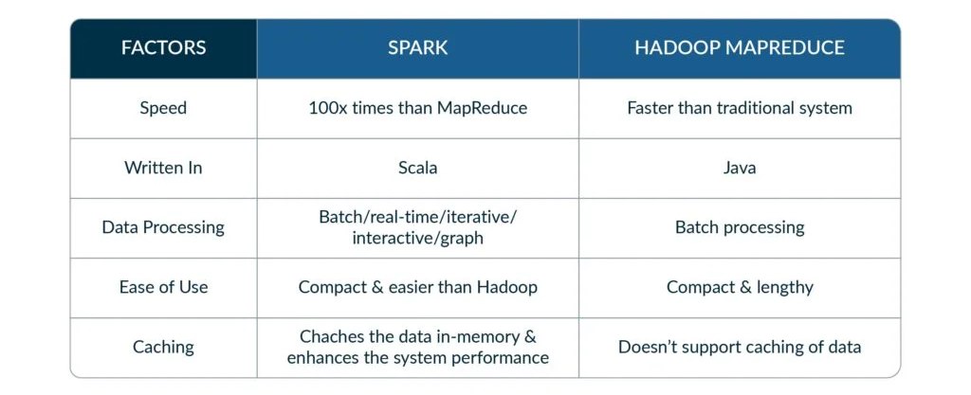
MapReduce vs spark

Slide 10
03
Ecosystem Components

Slide 11
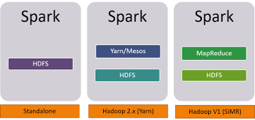
Spark Built on Hadoop

Slide 12
Standalone: Spark Standalone deployment means Spark occupies the place on top of HDFS(Hadoop Distributed File System) and space is allocated for HDFS, explicitly. Here, Spark and MapReduce will run side by side to cover all spark jobs on cluster.
Hadoop Yarn: Hadoop Yarn deployment means, simply, spark runs on Yarn without any pre-installation or root access required. It helps to integrate Spark into Hadoop ecosystem or Hadoop stack. It allows other components to run on top of stack.
Spark in MapReduce (SIMR): Spark in MapReduce is used to launch spark job in addition to standalone deployment. With SIMR, user can start Spark and uses its shell without any administrative access.

Slide 13
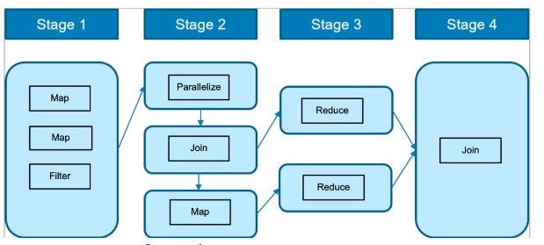
DAG (Directed Acyclic Graph)
A DAG in Apache Spark is used to implement the execution of the processing workflow.
A DAG is a set of vertices and edges with no cycles that are directed backwards. Every edge must be directed from an earlier stage to a later stage. In Spark, the vertices represent the RDDs (objects) and the edges represent the tasks.
The DAG is implemented by the DAGScheduler, which interprets the code, creates an operator graph, plans the various stages of the operator graph and passes it to a Task Scheduler. The worker nodes then execute the tasks on slave machines.

Slide 14
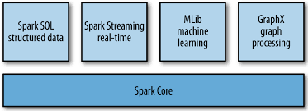
Spark main components

Slide 15
Spark Core: Spark Core is a basic engine for a large-scale parallel and distributed data processing.
The core is responsible for:
memory management and recovery after failures.
planning, distribution, and tracking of tasks in a cluster.
interaction with storage systems.
Spark SQL: Spark SQL is a component on top of Spark Core that introduces a new data abstraction called ”SchemaRDD”, which provides support for structured and semi-structured data. Enables users to query data via SQL.
Spark Streaming: Spark Streaming leverages Spark Core's fast scheduling capability to perform streaming analytics and enables to build applications that analyze and present data in real-time.
Mllib: Mllib is a distributed machine learning framework above Spark because of the distributed memory-based Spark architecture.
GraphX: GraphX is a distributed graph-processing framework on top of Spark. It provides an API for expressing graph computation that can model the user-defined graphs by using Pregl abstraction API. It also provides an optimized runtime for this abstraction.

Slide 16
04
Resilient Distributed Datasets (RDD)

Slide 17
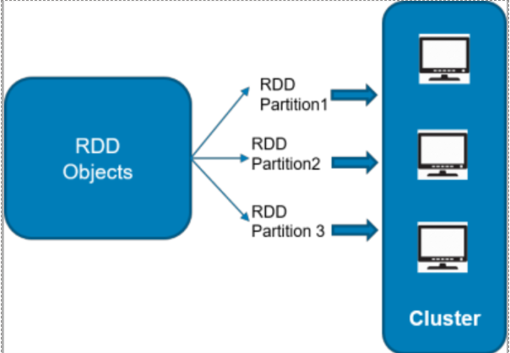
Resilient Distributed Datasets (RDDs): is a fundamental data structure of Spark. It is an immutable distributed collection of objects. Each dataset in RDD is divided into logical partitions, which may be computed on different nodes of the cluster. RDDs can contain any type of Python, Java, or Scala objects, including user-defined classes.

Slide 18
Resilient Distributed Datasets are the core abstraction of Apache Spark.
Resilient : Ability to be recomputed from history. The goal of resilience is fault tolerance
Distributed: The data is spread across nodes across a cluster to achieve parallelization
Dataset: The data could be text, hive, csv, json or any NoSQL databases such as Cassandra
Creating RDDs
External Dataset: Read method can be used to import datasets <JSON, CSV and text files> and RDDs can be created.
Parallelized Connections: Any collection of objects, Arrays, Lists, Tuples can be imported and converted to RDDs using parallelize method.
Existing RDDs: Parallelize method can be used to take existing RDDs and transform them into new RDDs.

Slide 19
Data Sharing using Spark RDD
Data sharing is slow in MapReduce due to replication, serialization, and disk IO. Most of the Hadoop applications, they spend more than 90% of the time doing HDFS read-write operations.
Recognizing this problem, researchers developed a specialized framework called Apache Spark. The key idea of spark is Resilient Distributed Datasets (RDD); it supports in-memory processing computation. This means, it stores the state of memory as an object across the jobs and the object is sharable between those jobs. Data sharing in memory is 10 to 100 times faster than network and Disk.

Slide 20
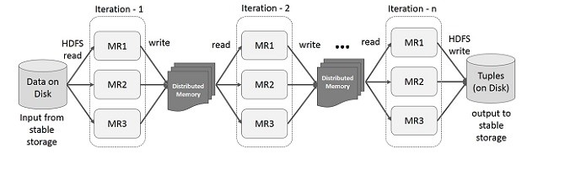
Interactive Operations on Spark RDD
It will store intermediate results in a distributed memory instead of Stable storage (Disk) and make the system faster.
If the Distributed memory (RAM) is not sufficient to store intermediate results (State of the JOB), then it will store those results on the disk.

Slide 21
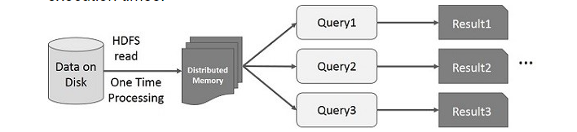
Interactive Operations on Spark RDD
If different queries are run on the same set of data repeatedly, this particular data can be kept in memory for better execution times.
By default, each transformed RDD may be recomputed each time you run an action on it. However, you may also persist an RDD in memory, in which case Spark will keep the elements around on the cluster for much faster access, the next time you query it. There is also support for persisting RDDs on disk, or replicated across multiple nodes. Once an RDD becomes persistent, it becomes immutable.

Slide 22
Resources
Books
Learning Spark (O'Reilly)
Documentations
Hadoop vs spark
spark tutorial
Medium Article: Why Do You Need to Use Apache Spark for Your Big Data Project?
Turing Knowledge Base: What is Apache Spark?
Apache Spark Tutorial: Features Overview
notebook simplify documentation
Code
Check code on GitHub

