Slide 1

Knowledge Mobilization Gaps in the
Communication of Ovarian Cancer Detection
Without Population Screening
Dana Haidar
Advanced Health Care Practice | Western University
Field Mentor: Dr. Melanie Barwick, SickKids | Academic Lead: Dr. Marcy Saxe-Braithwaite | June 2026
AHCP Capstone Conference 2026

Slide 2
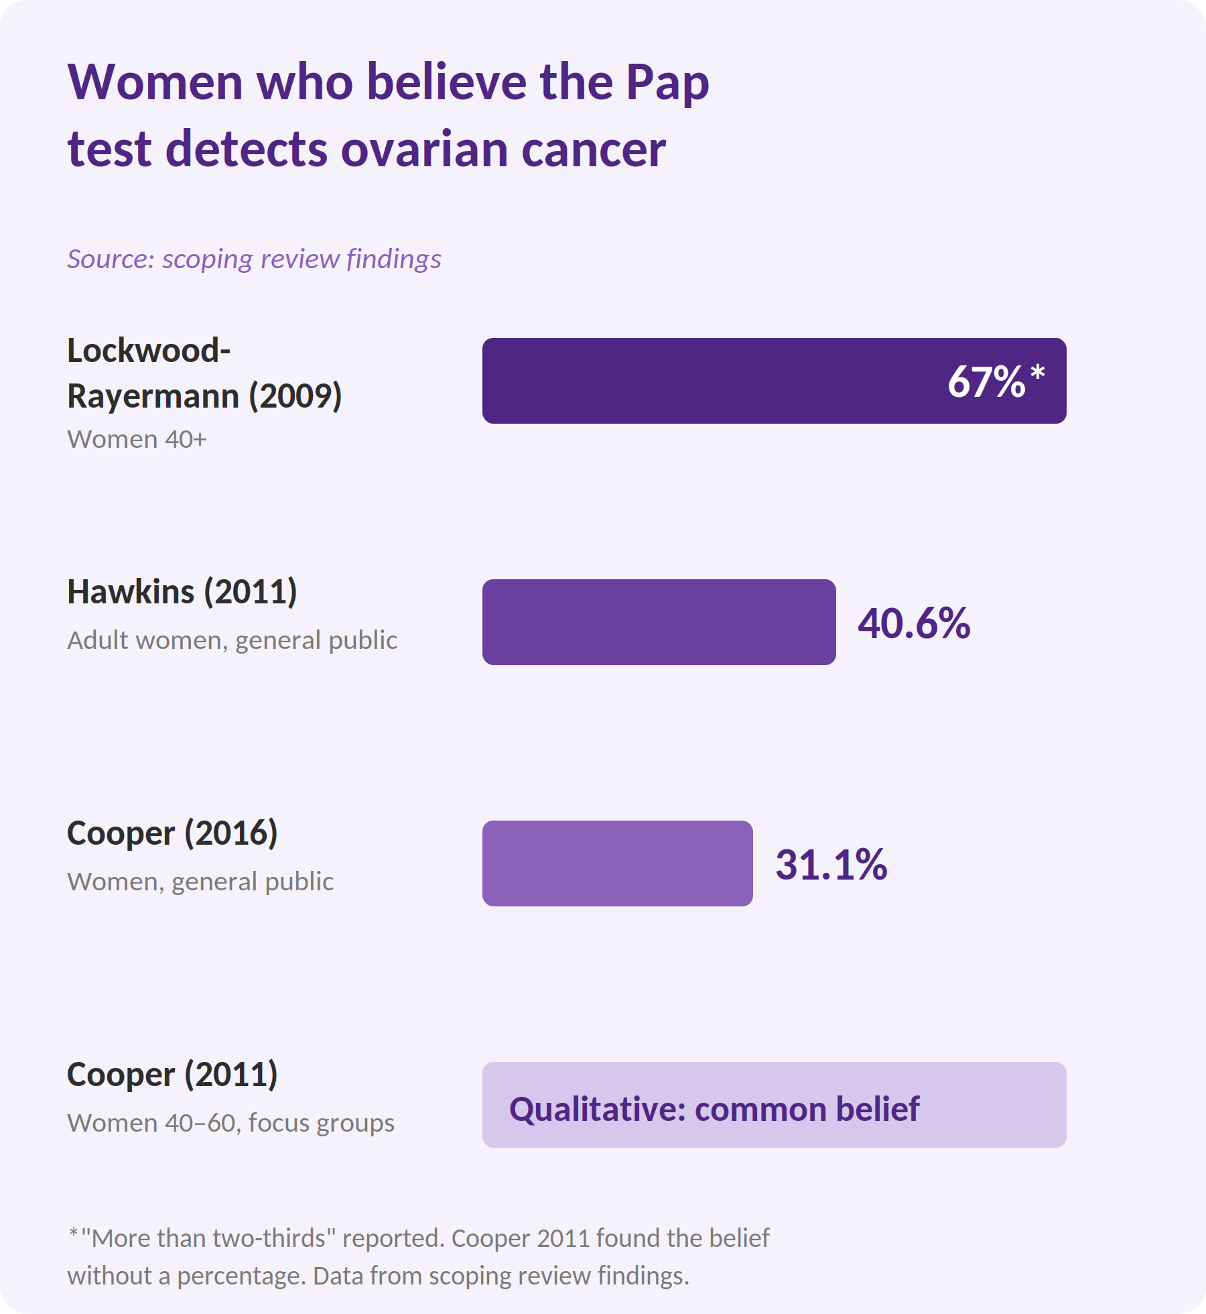
1
INTRODUCTION / BACKGROUND
The Gap Between Evidence and Understanding
There is no population-based screening test anywhere.
CA-125 (blood tumor marker test) and transvaginal ultrasound (an internal pelvic ultrasound) have not reduced deaths in routine screening.
Pap test misconceptions are common.
False reassurance can make people less likely to notice symptoms or seek care.
Notes:
This is why knowledge mobilization matters. Without reliable population screening, people need clear information about what Pap tests do not detect, what symptoms to watch for, and when to seek care.

Slide 3
2
OBJECTIVES / CAPSTONE AIM
Research Question & Project Aim
Primary aim: identify knowledge mobilization gaps in how ovarian cancer detection is communicated when no population-based screening exists.
Research question: What evidence and knowledge mobilization resources address the communication of ovarian cancer detection in the absence of population-based screening?
Map how detection is communicated across public and clinical sources, then build tools that respond directly to where it is failing.
Women with early symptoms, primary care providers, and community organizations benefit from clearer, evidence-based communication.

Slide 4
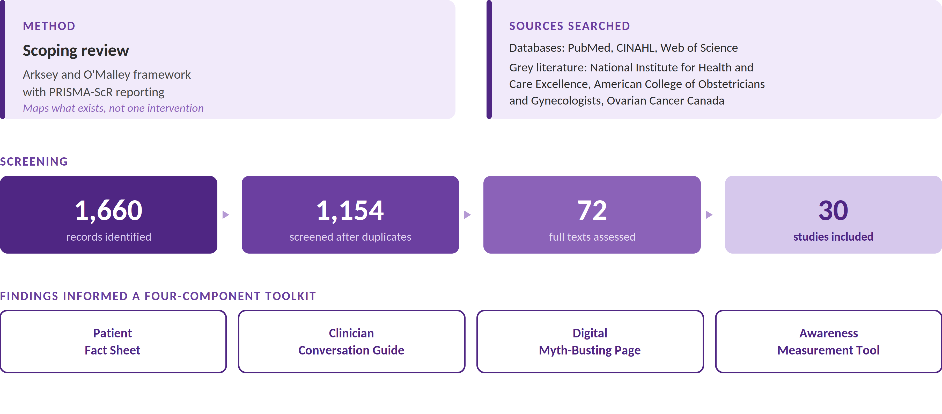
3
METHODS
How This Project Was Conducted

Slide 5
4
RESULTS
What the Evidence Tells Us
The United Kingdom Collaborative Trial of Ovarian Cancer Screening (UKCTOCS) found that routine ovarian cancer screening did not reduce deaths after 16-year follow-up and caused harm through false positives.
Public misunderstanding is widespread.
The gap extends to providers. Studies show family physicians and nurse practitioners also held incorrect beliefs about CA-125 and screening.
Symptom normalization and delayed help-seeking show why communication must happen earlier.

Slide 6
5
CONCLUSION / IMPACT
What This Means and What Comes Next
The key opportunity is earlier than oncology: symptom recognition, care-seeking, and provider communication.
The toolkit targets that earlier window: primary care, community health, and public-facing spaces, where communication can still change outcomes.
Each component answers a documented gap:
The Fact Sheet and Myth-Busting Page reduce false reassurance.
The Conversation Guide supports clear clinical messaging.
The Measurement Tool enables evaluation.
Next steps: pilot with patients and primary care providers, integrate into community settings, and study which approaches most reduce diagnostic delay.
Notes:
What this project shows is that the challenge in ovarian cancer detection happens much earlier than oncology. It begins when symptoms are first noticed, how they are understood, how quickly someone seeks care, and how clearly providers respond.
That is the window this toolkit is designed to support.
These toolkits belongs in primary care, community health, and public-facing spaces, because that is where earlier recognition and action are most likely to happen.
For next steps, I would focus on dissemination and evaluation. The toolkit could be shared through primary care clinics, community organizations, and ovarian cancer advocacy groups using handouts, QR codes, and digital links. It could then be piloted with patients and providers to see whether it improves understanding, symptom awareness, and confidence in seeking care.

