Slide 1

OPENING A NEW ART MUSEUM IN PARIS, France
By:Danah AlJar

Slide 2
Business Problem
Art is really important and many people enjoy going to art museums.
The location of the art museum is really important because that will determine if it will a scucess or a failure.
Business question: where would you recmommend opening an art museum?
Objective: to analyze and select the best location in Paris, France to open a new art museum.

Slide 3
Data
Data required:
List of neighborhoods in Paris, France
Latitude and longitude coordinates of those neighborhoods
Venue data, data realted to art museum
Data sourced:
Wikipedia page (https://en.wikipedia.org/wiki/Category:Districts_of_Paris) which contains lists of neighborhoods in Paris, France.
Python Geocoder package for latitude and longitude of the neighborhoods.
Foursquare API to get venue data for those neighborhoods.

Slide 4
Methodology
Web scarping using Python requests and beautiful soup packages to extract the list of neighborhoods
Get the geographical coordinates in the form of latitude and longitude using Python Geocoder package
Using Fourswaure API to get the venue data
Analyze each neighborhood by grouping the rows by neighborhood and taking the mean of the frequency of occurrence of each venuw category
Filter venue category by Art Museum
Perfom clustering on the data by using k-means clustering

Slide 5
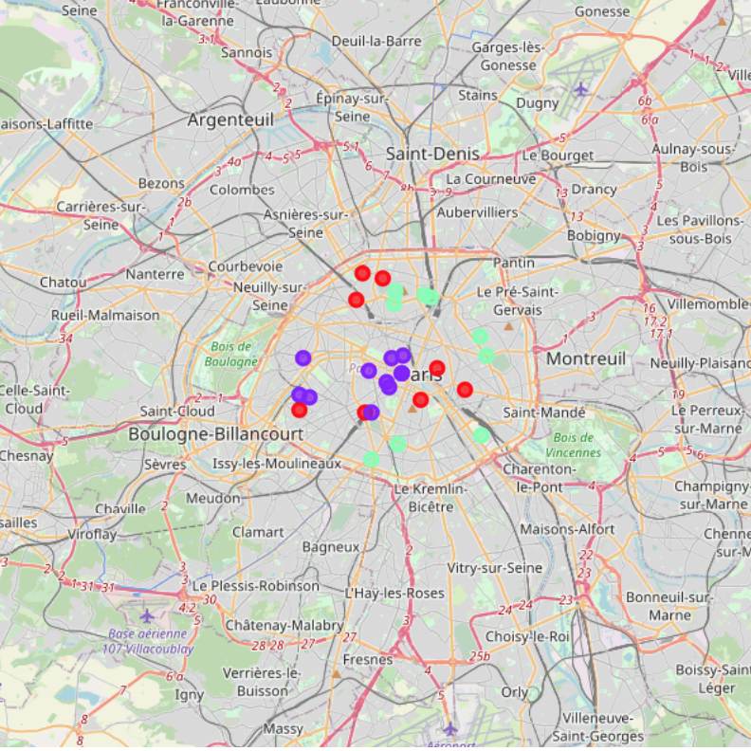
Results
Categorize the neighborhoods into 3 clusters based on the frequency of occurrence for “Art Museum”:
Cluster 0:
Neighborhoods with moderate number of art museums
Cluster 1:
Neighborhoods with low number of art museums
Cluster 2:
Neighborhoods with hig number of art museums

Slide 6
Discussion
The highest number of art museums are in cluster 2 and moderate number in cluster 0. On the other hand, cluster 1 has very low number to no art museums in the neighborhoods.

Slide 7
Conclusion
Neighborhoods in cluster 1 are the most preferred locations to open a new art museum.

