Slide 1
GES
GES Etimesheet Web app
A Smarter Way to Monitor Our Team's Time
Project Control Dept. | June 2026

Slide 2
Why We Built GES Etimesheet Web app
Objective
📋
Accurate Tracking
⚡
Less Manual Work
Capture actual man-hours spent on each project.
Monitor and balance employee workload to ensure efficient resource allocation.
Replace spreadsheets and paper forms with one digital system.
📊
Real-Time Visibility
💡
Better Planning
Compare planned versus actual resource utilization.
Allow Project Managers to forecast and plan resource requirements in advance.
Improve resource allocation and workforce planning across multiple projects.
02

Slide 3
What It Can Do
Features
Plan vs Actual
Role-Based Access
📅
Input planned and tracking actual hours side by side per project
🔐
Each person manages their own timesheet — secure & personal
Approval Workflow
Dashboard & Charts
✅
Submit → Review → Approve — clear accountability
📈
Visual summaries at a glance for individuals and managers
Smart Filtering
Favorites & Quick Access
🔍
Filter by department, project, or date range easily
⭐
Pin frequent projects for faster daily entry
03

Slide 4
How It Works — Actual Manhours
Timesheet Flow
Draft
→
Submitted
→
Approved
/
Rejected
Action
👷 Employee
📋 PD
🏢 GES Mgmt
👔 MD
⚙️ Admin
Input Hours
Own only
—
—
—
Any employee
Submit
Own only
—
—
—
Any employee
Approve
—
Own projects
—
GES-OH only
Cannot approve
Reject
—
Own projects
—
GES-OH only
—
Unlock
—
Own projects
—
—
All timesheets
🔒 Once submitted, employees cannot edit their timesheet. PD or Admin must unlock it first.
04

Slide 5
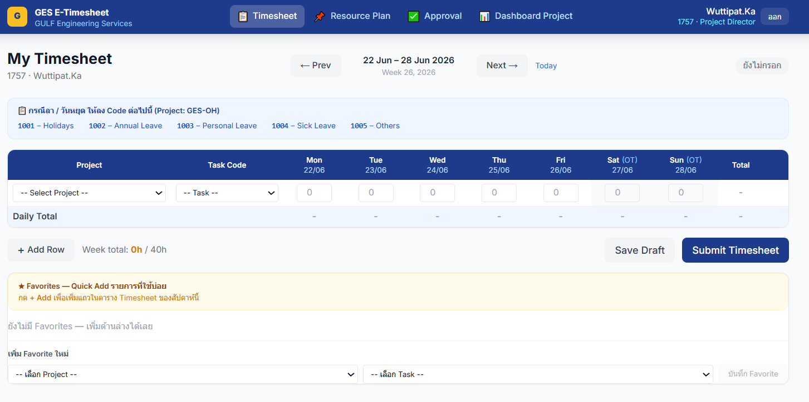
How It Works — Actual Manhours
Timesheet Flow
05

Slide 6
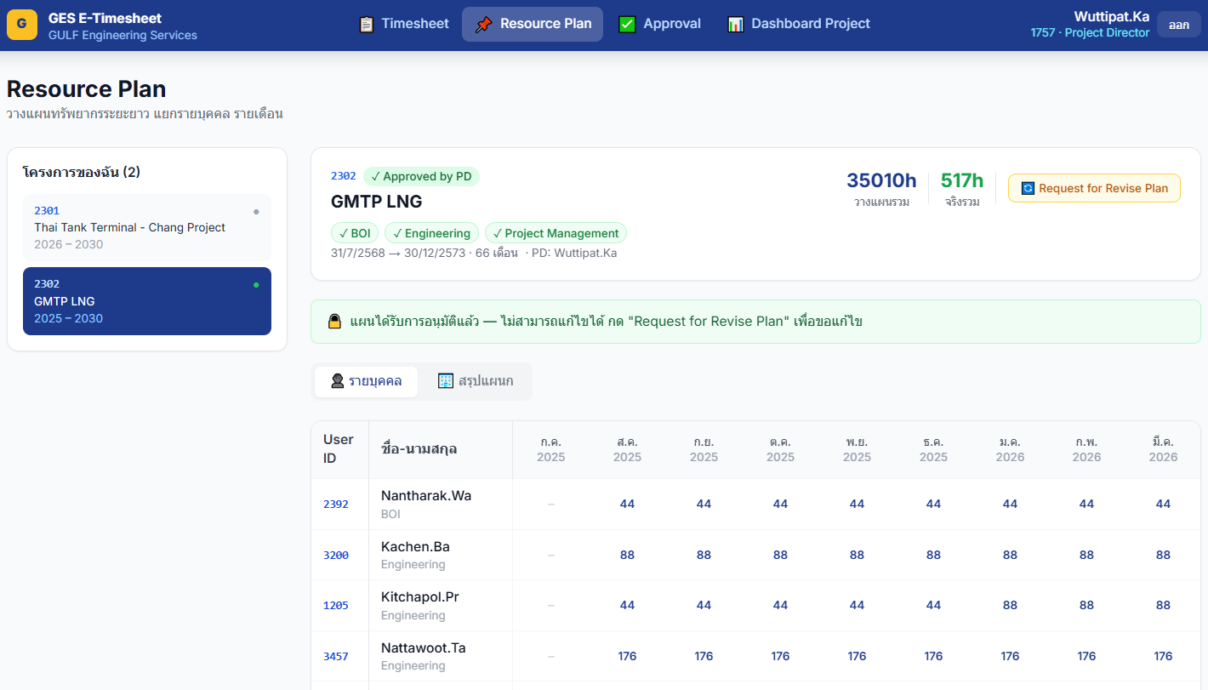
How It Works — Plan Manhours
Resource Plan
Monthly Resource Plan
Draft
Dept Approved
→
Submitted
→
→
All Approved
Input Plan
📋 PD / ges_pd Own projects (draft only)
Submit Plan
📋 PD Own projects
Approve (per dept)
🏢 GES Mgmt Own dept only
👔 MD / ⚙️ Admin (all)
Request Revision
📋 PD / ges_pd Own projects
👔 MD / ⚙️ Admin
📌 Monthly plan requires ALL departments to approve individually before the project plan is fully approved.
06

Slide 7
Dashboard — What It Shows
Overview
⏱
📅
📊
📋
🏖
Actual Hours
Planned Hours
Utilization %
Timesheets
Leave / Holiday
Work hours logged
(excl. Leave)
Hours from
Resource Plan
Actual ÷ Planned
× 100
Count submitted
timesheets
Task code
1001–1005
01
Plan vs Actual by Project
02
Task Breakdown
Bar chart comparing plan & actual per project
Red bar = exceeded plan
Doughnut chart — hours by
Task Category / Discipline
03
Utilization Trend
04
Top 10 Employees
Bar + Line — 6 weeks history
Target line at 80%
Horizontal bar — ranked by hours
Color-coded by department
05
Leave Breakdown
06
Plan vs Actual Matrix
Horizontal bar — leave hours per person
(shown only if leave data exists)
Table — 6 months history
🟢≥80% 🟡<80% 🔴>Plan ⚫No Plan
06

Slide 8
Dashboard — Filters & Who Sees What
Access Control
Filter Options
Who Sees What
📆
Week
Role
Dashboard
Charts
Project Filter
Matrix
เลือก Monday ของสัปดาห์ / Prev–Next / Today
👔 MD
Full
6/6
Any project
By Project
🗓
Month
เลือกเดือน-ปี / Prev–Next / This Month
📋 PD / ges_pd
Project View
6/6
Own projects
By Project
📁
Project
All Projects หรือเลือกรายโปรเจกต์
🏢 GES Mgmt
Dept View
4/6
Auto (own dept)
By Employee
🏢
Department
All / เลือก Dept (กรองเฉพาะ Top Employees)
⚙️ Admin
—
—
GES-OH only
—
🔖
Status
ทั้งหมด / รออนุมัติ / อนุมัติแล้ว / Draft / ยังไม่ส่ง
👷 Employee
—
—
—
—
🔍
Search
ค้นชื่อ / ID / แผนก
💡 GES Management ไม่เห็น Task Breakdown (#2) และ Utilization Trend (#3)
07

Slide 9
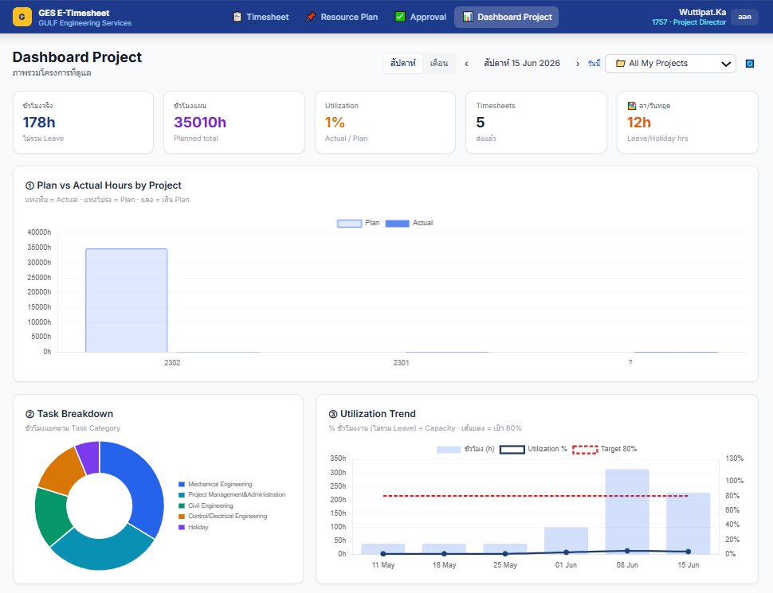
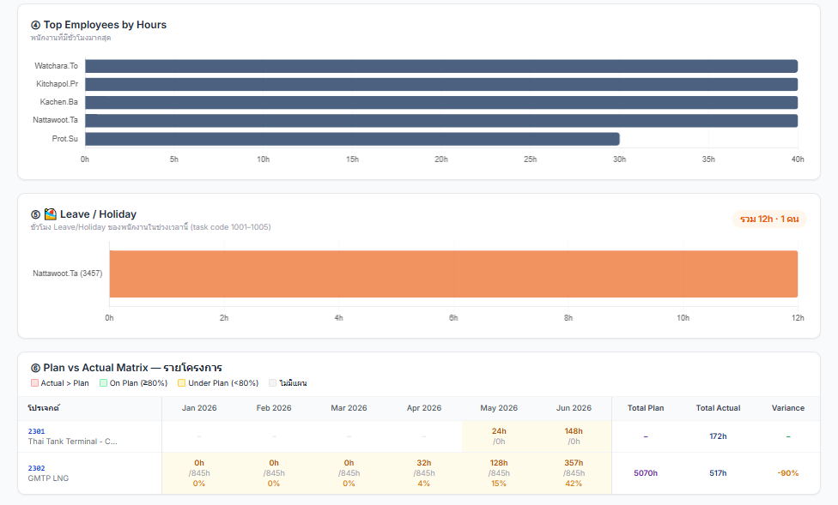
How It Works — Dashboard
Resource Plan
📌 Can adjust a dashboard
06

Slide 10
What You Get
Benefits
1
0
100%
System
Paper
for all projects
& departments
forms needed — fully digital
Audit trail for every entry
Clear Plan vs Actual comparison — know exactly where every hour goes
Better resource decisions — assign the right people to the right project
Less time on reporting — data is already in the system, ready to view
Data-driven project management — base decisions on facts, not estimates
07

Slide 11
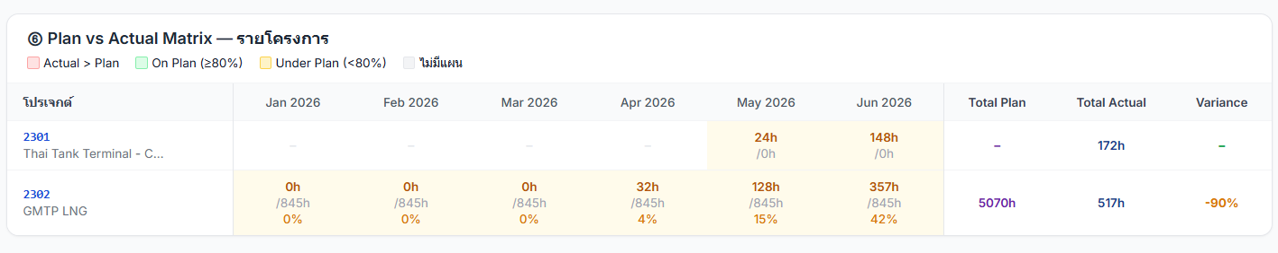
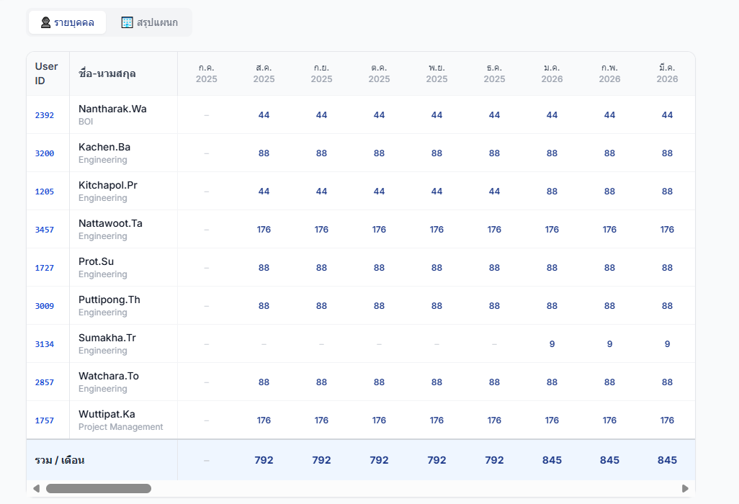
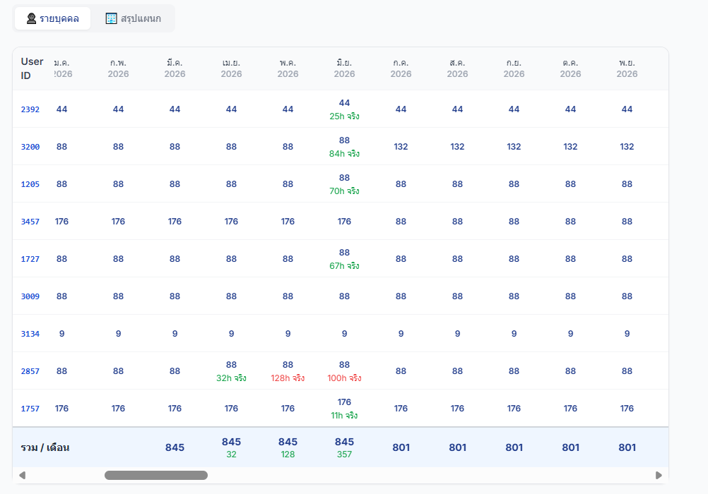
Where We Are Now
● LIVE
Currently Active In:
🏗️ GAS Project
Plan & Actual tracking — live
System Status:
✓
Plan & Actual manhour input — enabled
✓
Approval workflow — active
✓
Dashboard & reporting — available
✓
System stable and used daily
08

Slide 12
What's Next
Roadmap
Now
July 2026
Aug–Sep 2026
Ongoing
GAS & Admin
are live
Company-wide
rollout begins
Training &
onboarding all users
Improve from
user feedback
System will continue to grow based on user feedback across all departments.
09

Slide 13
?
Questions

