Slide 1
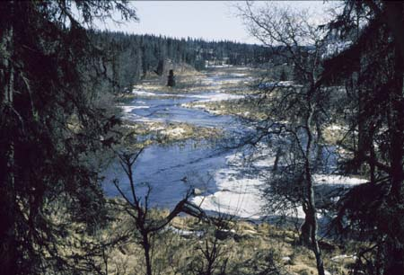
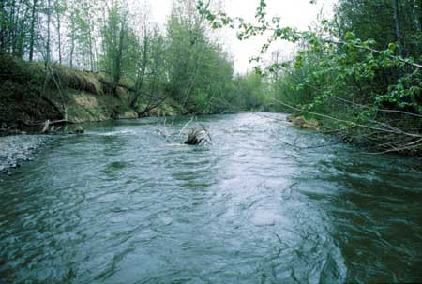
Design Flow Analysis Project
Phase One: Low-Flow Analysis Case Study
This analysis was done by EPA summer intern Graham Jonaitis in 2002.

Slide 2
Overview/Agenda
Project background and purpose
Present status of DFLOW 3.0 as tool for States
Present case study
Lay out plan for next steps of project

Slide 3
Background / Purpose
Why low flow?
  Wastewater effluent-dominated pollution typically violates chemical criteria during low streamflow
  EPA designates the biological design flow 4B3 for use in establishing discharge permits to protect aquatic life for chronic exposure
  1986 EPA analysis determined that hydrological flow statistic 7Q10 was equivalent to 4B3

Slide 4
Background / Purpose
Why revisit this analysis?
  Since 1986, 7Q10 statistic criticized as either over- or under-protective in various areas of US
  States frequently set their own hydrological low flow standards to replace 7Q10, or use flow percentiles (percent of flows in a given stream’s daily record that are less than the design flow) to impose pollution limits
  EPA desires to evaluate such limits in relation to 4B3

Slide 5
Background / Purpose
Design Flow Analysis project scope
  Phase One: Single-State Case Study
    Download and filter streamflow data from USGS
    Using the DFLOW 3.0 program, determine 4B3, 3Q2, and 7Q10 for each (valid) gage station
    Analyze relative protectiveness of 3Q2 and 7Q10
    Determine relationship between 4B3 and percentile flows
  Phase Two: Case Study Delivery
    Provide web access to DFLOW 3.0
    Provide web access to case study
      Demonstrate use of DFLOW in analyzing xQy statistics
      Demonstrate use of these analyses

Slide 6
Background / Purpose
Design Flow Analysis project scope
  Phase Three: National Study
    Download and filter national streamflow data
    Determine relationship between 4B3 and 7Q10 or other state-specific statistics
    Evaluate relationship between 4B3 and flow percentiles
    Evaluate this relationship with respect to ecoregion, stream order, previous EPA study
    Report on the above analysis

Slide 7
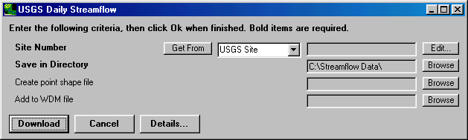
Data Acquisition
Beta-version utility designed for use with BASINS allows streamgage data to be downloaded from USGS subject to various geographic criteria
Quick – downloaded two hundred datasets in ~ 20 minutes
Data downloaded in individualized datasets, one per streamgage – format used by DFLOW

Slide 8
Data Filtering
ASCE (1980) used stations with at least 15-20 years of record for calculating hydrological design flows
All records with less than 20 years (7300 days) of observations were removed
Removal of inconsistent data
  Contacted state’s USGS district office, received spreadsheet of information about stream exceptions (regulation, urbanization, etc.)
  Removed all stations without 20 years of consistent data from statistical consideration (e.g. station with10 years unregulated, 15 years regulated would be removed)
  Kept urbanized and consistently regulated streams
74 streamgage stations remained for analysis

Slide 9
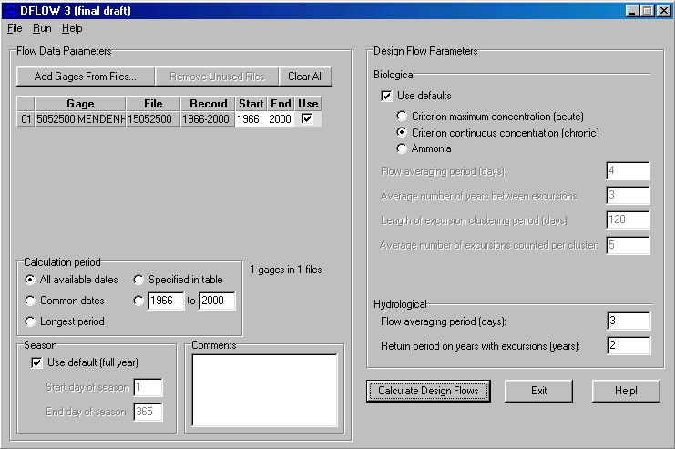
Determining Design Flow
What is DFLOW?
  Calculates xBy and xQy design flows, given historical streamflow data
  Easy to use

Slide 10
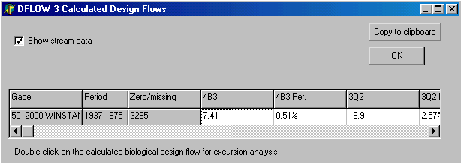
Determining Design Flow
How does DFLOW output flow statistics?
  DFLOW outputs calculations in tabular form – can be copied and pasted into spreadsheet
  For each flow value DFLOW calculates, it also outputs corresponding percentile

Slide 11
Determining Design Flow
Previous Constraints
  DFLOW Program
    Problem: Output format contains both 4B3 and 4B3 percentile in the same column
    Solution: DFLOW code altered to use separate columns
    Problem: Program bugs cause compromised output when multiple datasets run within one session of DFLOW
    Solution: Code altered to allow simultaneous runs

Slide 12
Determining Design Flow
Current Constraints
  Data acquisition
    Problem: BASINS download tool lacks filter for dataset size (i.e. number of observations)
    Temporary Solution: After download, sort dataset text files by file size, giving estimate of number of observations

Slide 13
Project Analysis
Analysis
  Examine relationship between 4B3 and 3Q2, compare to relationship between 4B3 and 7Q10
  Examine relationship between ^{3Q2}/_{4B3} and 4B3, compare to relationship between ^{7Q10}/_{4B3} and 4B3
  Explore probability distribution of 4B3 percentiles
    Attempt to fit to a standard distribution (e.g. lognormal)
    Using cumulative distribution, identify reasonable percentile to capture “most” 4B3 flow values

Slide 14
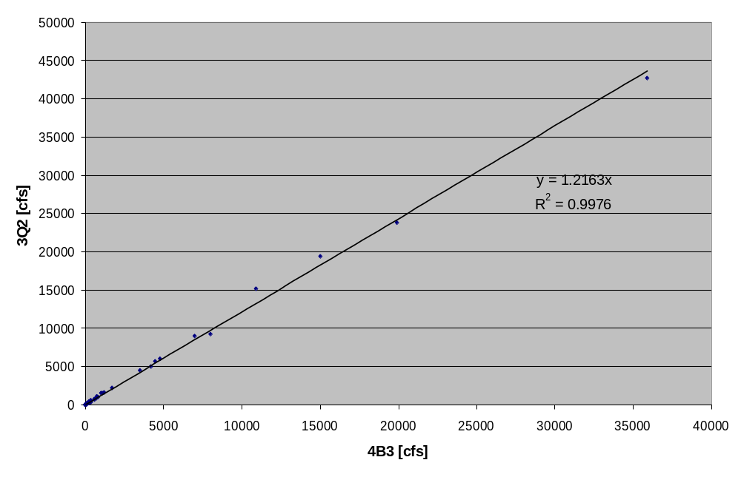
Design Flow Analysis:
3Q2 vs. 4B3 for All Streams
Observations:
  3Q2 strongly correlated with 4B3 (R² = 0.9976)
  3Q2 flow 22% greater than 4B3 (y = 1.2163x)

Slide 15
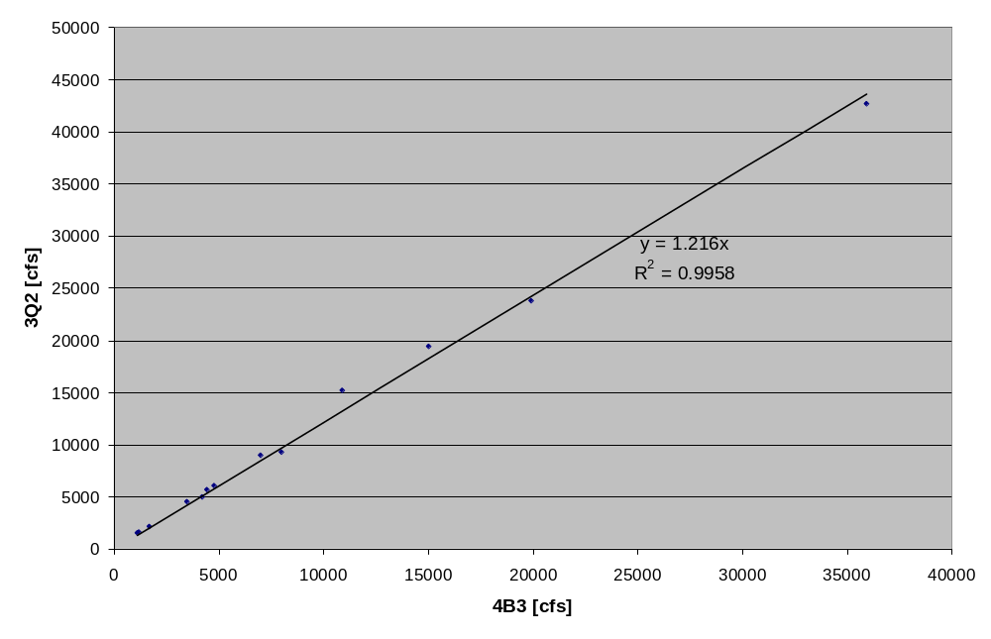
Design Flow Analysis:
3Q2 vs. 4B3 for Large-Flow Streams (1000 cfs < 4B3)
Observations:
  3Q2 strongly correlated with 4B3 (R² = 0.9958)
  3Q2 flow 22% greater than 4B3 (y = 1.216x)

Slide 16
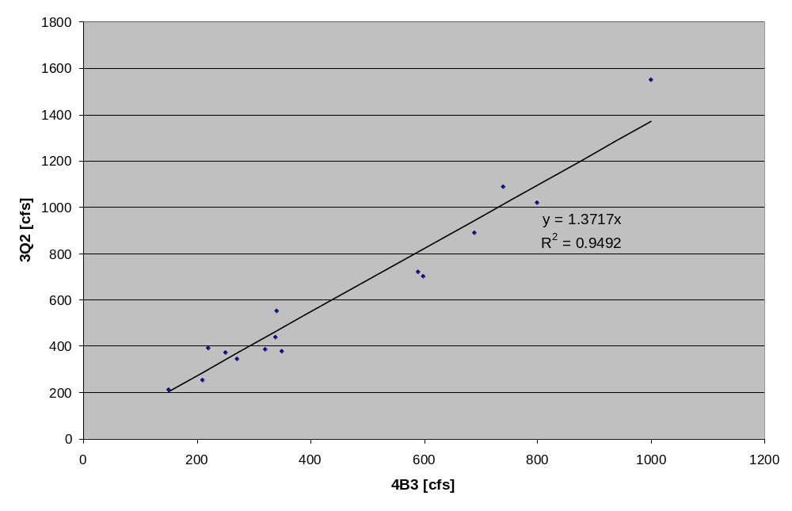
Design Flow Analysis:
3Q2 vs. 4B3 for Medium-Flow Streams (100 cfs < 4B3 < 1000 cfs)
Observations:
  3Q2 well correlated with 4B3 (R² = 0.9492)
  3Q2 flow 37% greater than 4B3 (y = 1.3717x)

Slide 17
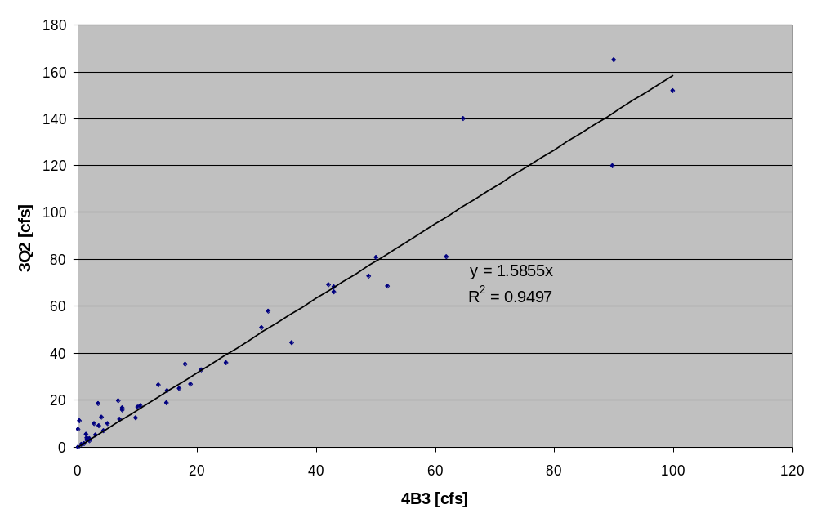
Design Flow Analysis:
3Q2 vs. 4B3 for Small-Flow Streams (4B3 < 100 cfs)
Observations:
  3Q2 well correlated with 4B3 (R² = 0.9497)
  3Q2 greatest: 59% greater than 4B3 (y = 1.5855x)

Slide 18
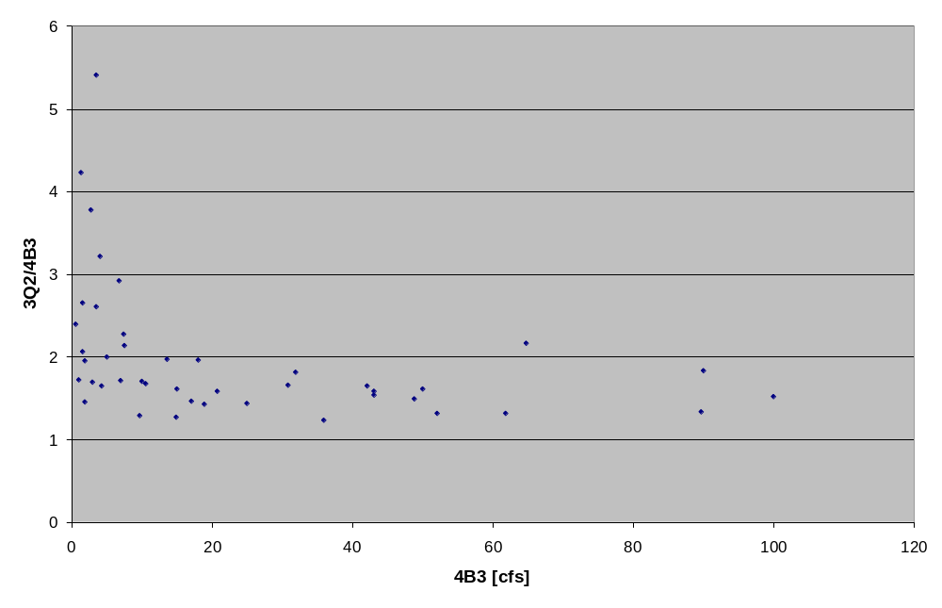
Design Flow Analysis:
^{3Q2}/_{4B3} vs. 4B3
Observation: 3Q2 dramatically higher for small streams (factor of two to five for 4B3 < 20 cfs)

Slide 19
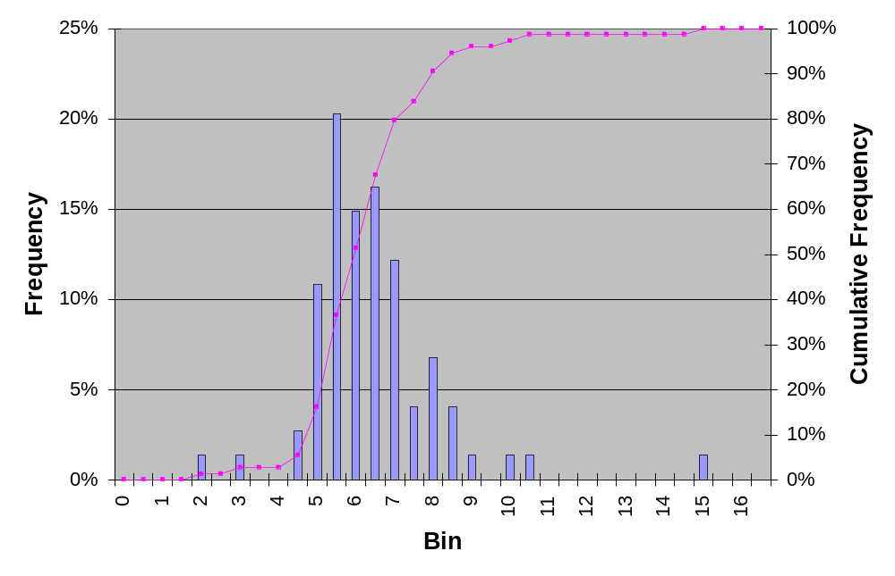
Design Flow Analysis:
Excursions Per Three Years for 3Q2
Observations
  Excursions per three years centered around six
  All stations show at least two excursions per three years

Slide 20
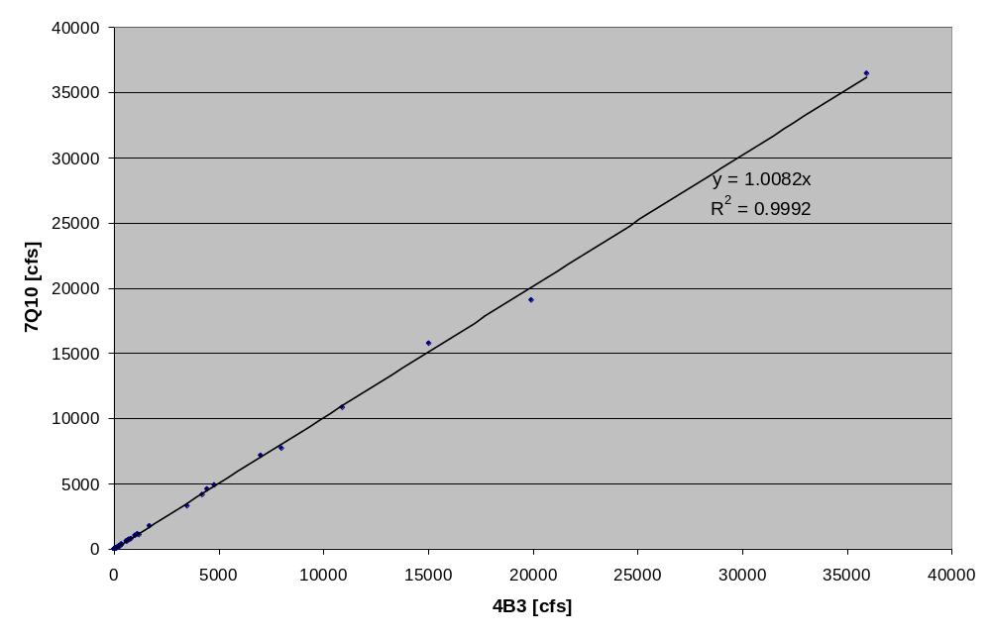
Design Flow Analysis:
7Q10 vs. 4B3 for All Streams
Observations:
  7Q10 strongly correlated with 4B3 (R² = 0.9992)
  7Q10 flow 1% greater than 4B3 (y = 1.0082x)

Slide 21
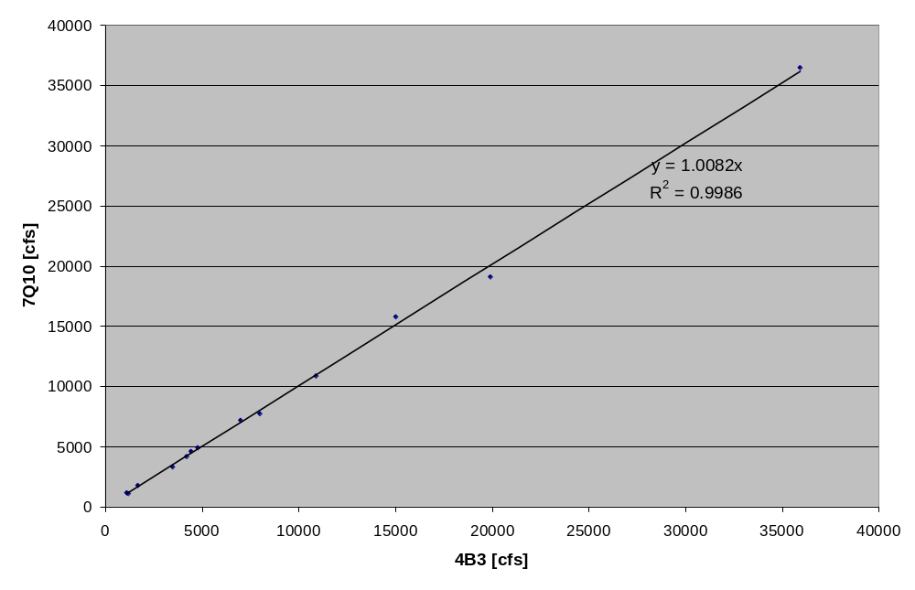
Design Flow Analysis:
7Q10 vs. 4B3 for Large-Flow Streams (1000 cfs < 4B3)
Observations:
  7Q10 strongly correlated with 4B3 (R² = 0.9986)
  7Q10 flow 1% greater than 4B3 (y=1.0082x)

Slide 22
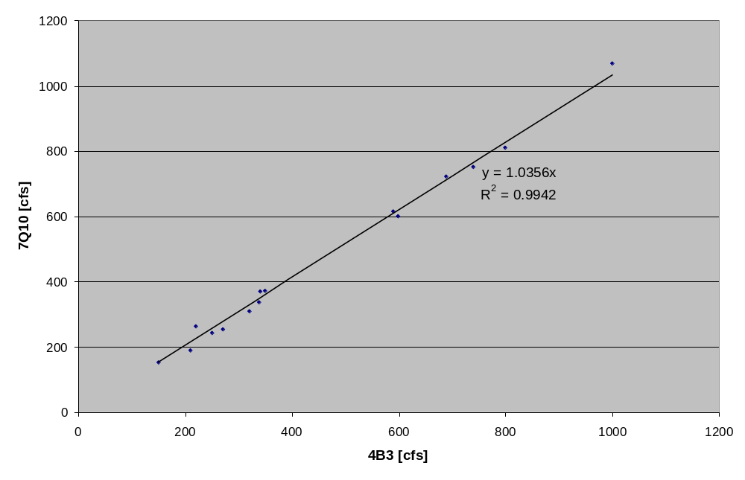
Design Flow Analysis:
7Q10 vs. 4B3 for Medium-Flow Streams (100 cfs < 4B3 < 1000 cfs)
Observations:
  7Q10 strongly correlated with 4B3 (R² = 0.9942)
  7Q10 flow 4% greater than 4B3 (y = 1.0356x)

Slide 23
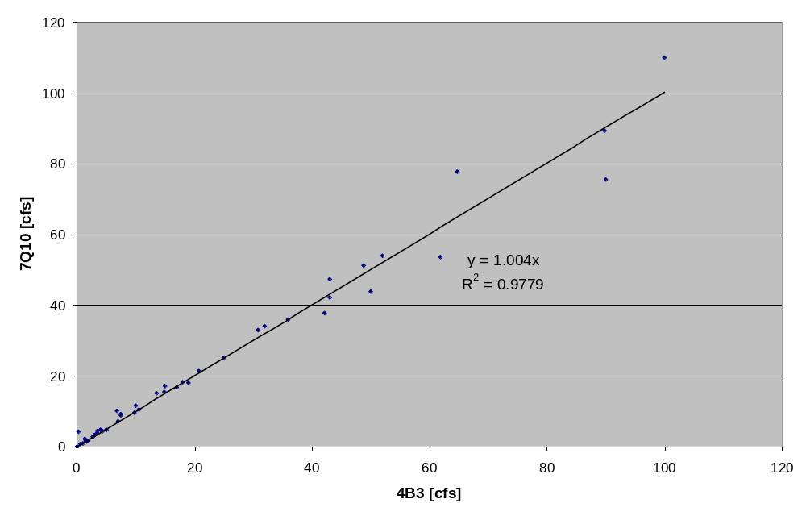
Design Flow Analysis:
7Q10 vs. 4B3 for Small-Flow Streams (4B3 < 100 cfs)
Observations:
  7Q10 slightly less correlated with 4B3 (R² = 0.9779)
  7Q10 flow 0.4% greater than 4B3 (y = 1.004x)

Slide 24
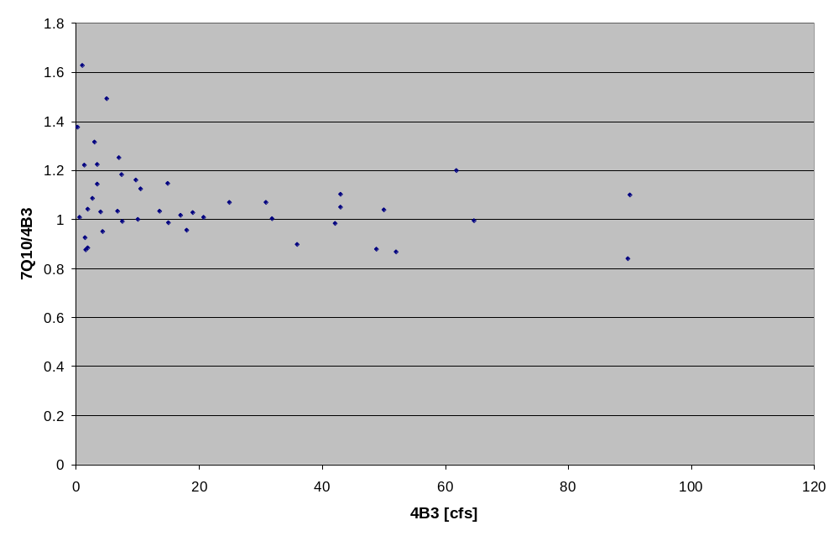
Design Flow Analysis:
^{7Q10}/_{4B3} vs. 4B3
Observation: 7Q10 clustered around 4B3 equivalence, but ratio for very small streams is as high as 1.6

Slide 25
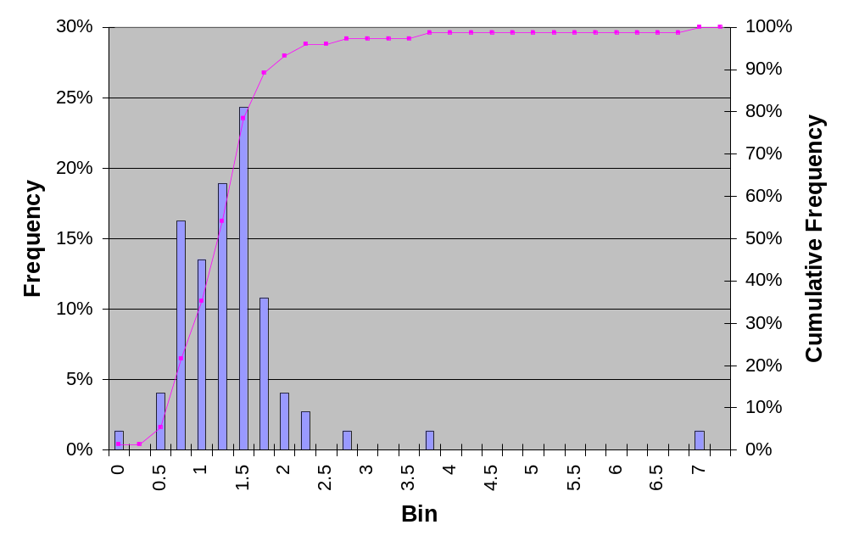
Design Flow Analysis:
Excursions Per Three Years for 7Q10
Observations
  Excursions per three years centered near one and one half
  65% of the rivers exceed criteria more than once per year

Slide 26
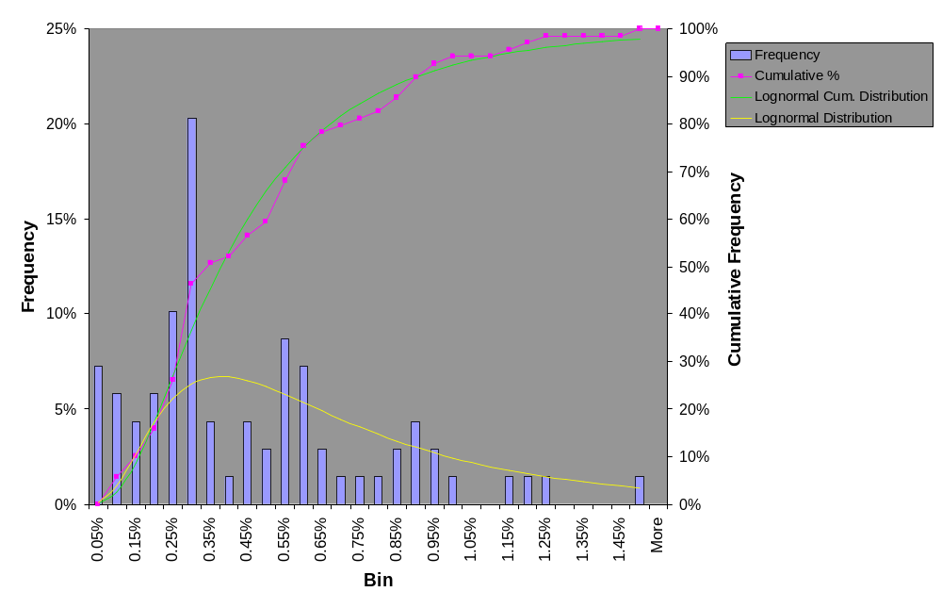
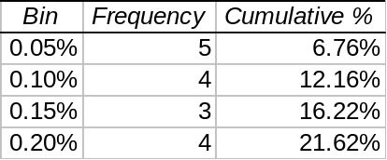
Design Flow Analysis:
Distribution of 4B3 Percentiles

Slide 27
Design Flow Analysis:
Distribution of 4B3 Percentiles
Delta-Lognormal Distribution
  Five data points (4B3% = 0%) assumed to be nondetect values, based on sensitivity of 4B3 method
    Data presumed to fit lognormal distribution, but values too low
    Retained in cumulative distribution to determine number of low-end streams protected by percentile limits
  Poor fit: p-correlation of 0.0826
  National data may show better fit
Observations
  Distribution mean = 0.48% ; mode = 0.40%
  High end of distribution = 1.40% for empirical data, 2.96% for distribution

Slide 28
Conclusions
DFLOW and download tool should make analysis easy for states to perform
3Q2 vs. 4B3
  22% greater than 4B3 across the board
  59% greater than 4B3 for small streams
  Shows 4-8 excursions per 3 years vs. 1 for 4B3
7Q10 vs. 4B3
  Generally equivalent to 4B3 (1% greater overall)
  4% less than 4B3 for medium- and small-flow streams
  Shows 0-2 excursions per 3 years

Slide 29
Conclusions
Percentile Flow
  4B3 percentiles show no clear statistical distribution
  4B3 percentiles range from 0% to 1.40% for flow data, hence any percentile limit above 1.40% will under-protect streams

Slide 30
Next Steps
Phase Two: Case Study Delivery
  Number of biological excursions per three years will be added to DFLOW output
  Make data download tool and DFLOW known and available to State water quality programs
  Web publication of case study
Phase Three: National Study
  ^{7Q10}/_{4B3} Analysis
    Separate into large, medium, and small-flow streams
    Regional variability (e.g. with states, ecoregions)

Slide 31

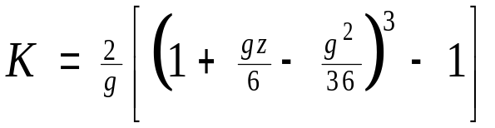

Appendix
How does DFLOW determine xQy?
  DFLOW uses the following formula:
  where u = mean of logarithms of annual low flows
  σ = standard deviation of above
  g = skewness coefficient of above
  K is calculated using:
  ;

Slide 32
Appendix
How does DFLOW determine xBy?
  Calculate total allowed excursions over flow record using number of years in record divided by y
  Use xQy design flow as an initial guess for xBy
  Identify excursion periods based on xBy
  Calculate number of excursions in each excursion period using period length divided by y
  Sum total number of excursions over record; maximum excursions in a low-flow period (120 days) is five
  True 4B3 is the greatest flow that keeps excursion sum below total allowed excursions – iterative process

Slide 33
References
ASCE Task Committee on Low-Flow Evaluation, Methods, and Needs of the Committee on Surface-Water Hydrology of the Hydraulics Division. 1980. Characteristics of Low Flows. Journal of the Hydraulics Division. 106(HY5): 717-731.
Biswas, H., and B.A. Bell. 1984. A method for establishing site-specific stream design flows for wasteload allocations. Journal – Water Pollution Control Federation 56(10): 1123-1130.
USEPA. 1986. Technical guidance manual for performing wasteload allocation; Book VI, design conditions; Chapter 1, stream design flow for steady-state modeling. Office of Water Regulations and Standards, US Environmental Protection Agency. EPA Document PB92-231178. <http://www.epa.gov/waterscience/library/modeling/wlabook6chapter1.pdf>. Accessed 2002 June 15.
USEPA. 1991. Technical support document for water quality-based toxics control. Office of Water, US Environmental Protection Agency. EPA Document EPA/505/2-90-001.
USGS. 2002. Surface-water data for the nation. <http://waterdata.usgs.gov/nwis/sw/>. Accessed 2002 June 2.

