Slide 1
StoryClime
Science Education App developed for Computer Systems, HDip Computer Science, Year 1, 2020
Dan O’Brien

Slide 2
StoryClime Logo
Clime
Story

Slide 3
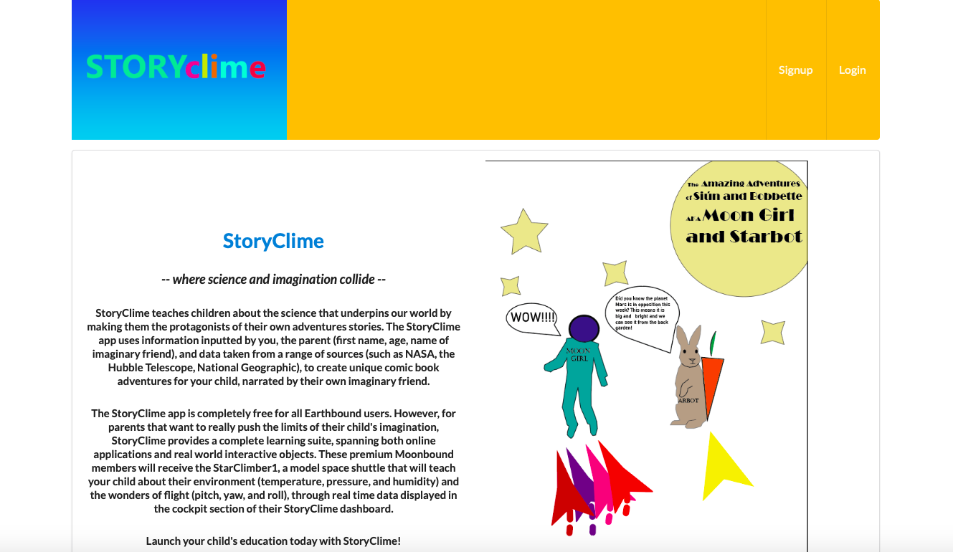
Welcome Page

Slide 4
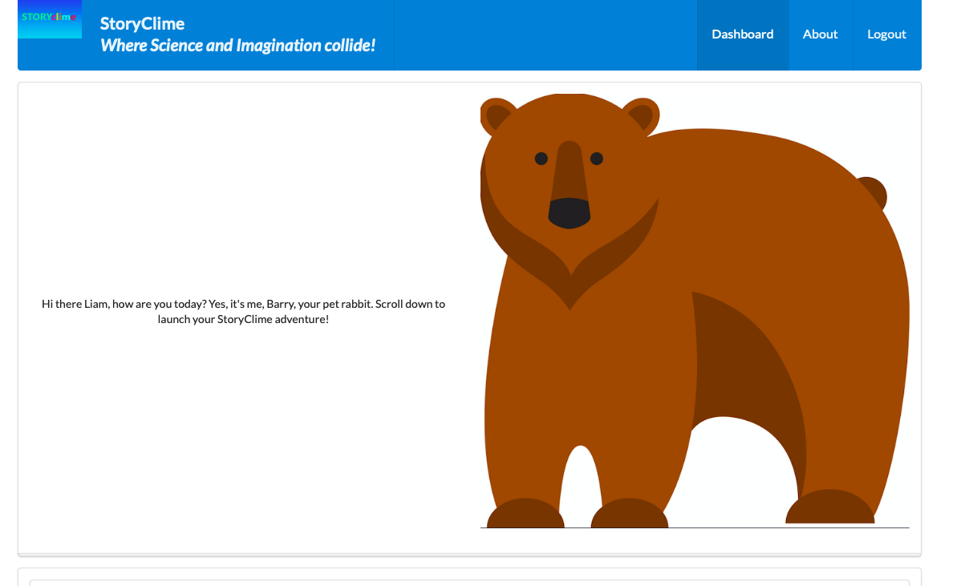
Member Dashboard

Slide 5
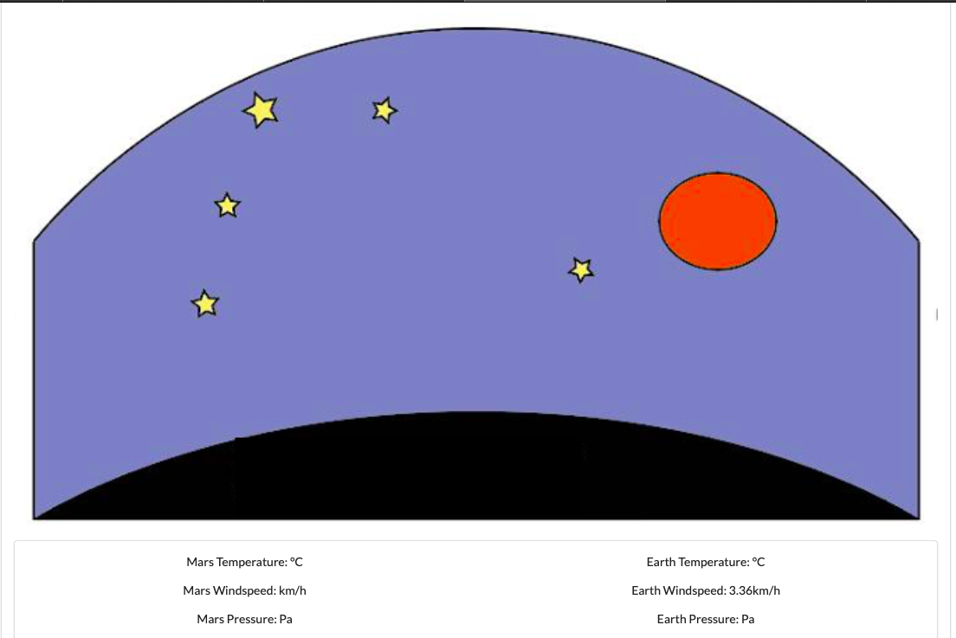
Space Shuttle Dashboard

