Slide 1
Quikit
An Android app for quick reporting of car accidents

Slide 2
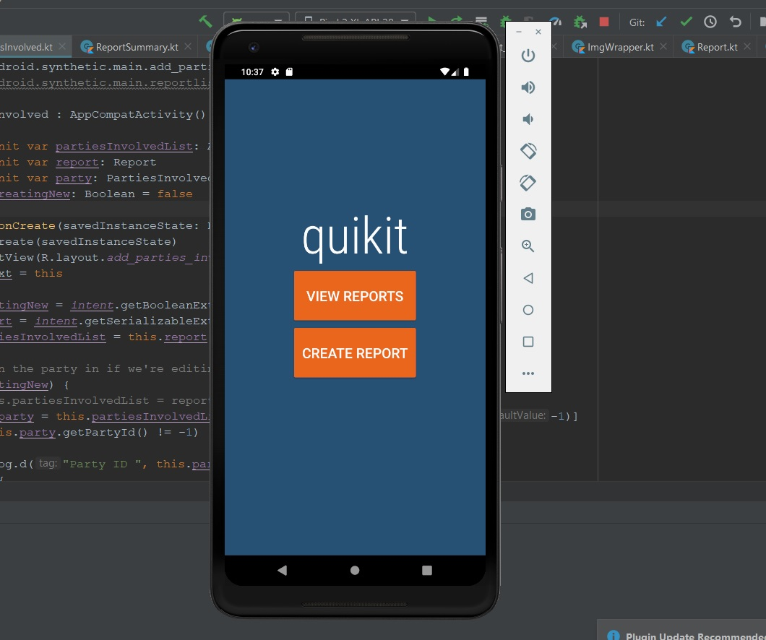
Quikit – Report generating app
Select an existing report from the database or generate a new report.
Created with Kotlin
SQLite used for storing, modifying and retrieving data
Openweather API used to retrieve local weather
ListViews used to display clickable lists of information

Slide 3
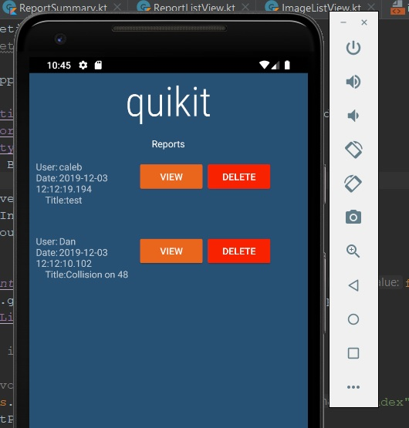
Report List
Select an existing report to view
Delete an existing report

Slide 4
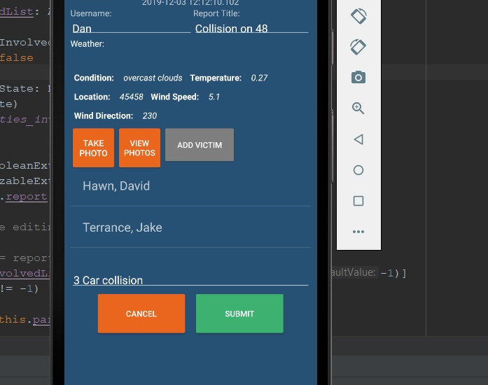
Dynamic Report Screen
Create a new report or modify an existing report.
Enter the zip code to gather local weather data.
Click add victim to enter details of each involved party
Can update any details added to the report
Click “Take Photo” to take and add photos of property damage to the report

Slide 5
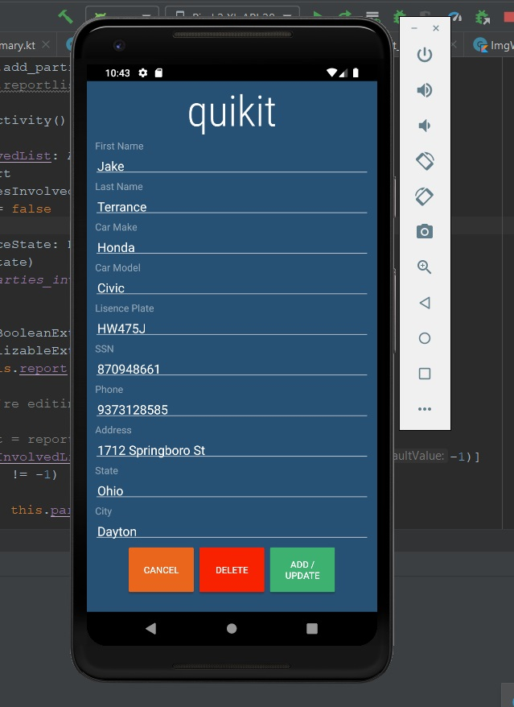
Party Involved Screen
Add details for specified victims.
Delete existing victims if necessary

Slide 6
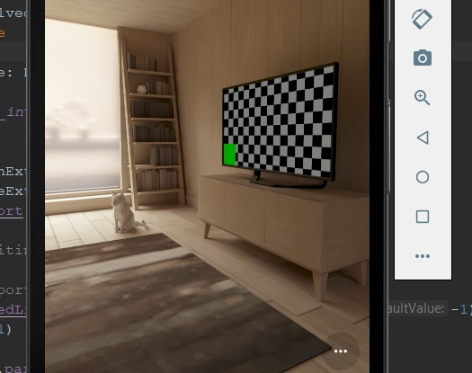
Add Photo
Take property damage photos and attach them to the report.

