Slide 1
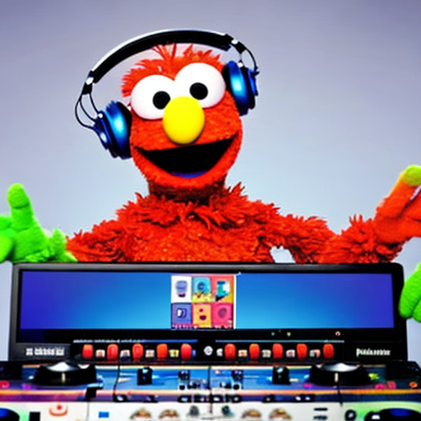
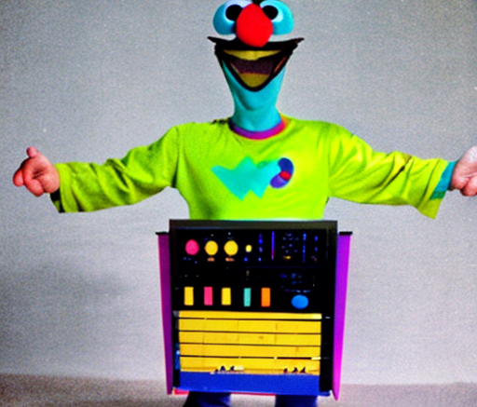
Fine tuning BERT
For Sentiment Classification

Slide 2
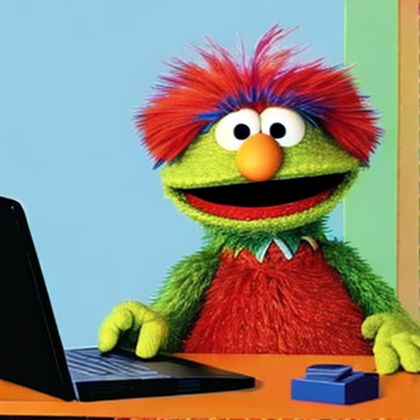
Why are you here?
Me?

Slide 3
Why are you here?
Me?

Slide 4
Tune in to Part 2:
Our case study
I’m a manager and sentiment analysis is on my roadmap for Q3.
Additional Resources:
[ Sentiment Analysis Case studies ]

Slide 5
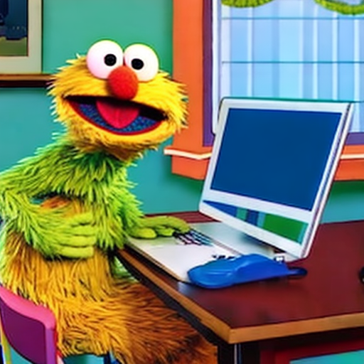
I want to specialize in NLP!
Tune in to Part 2:
Vocab
Evaluating the Tokenizer
Additional Resources:

Slide 6
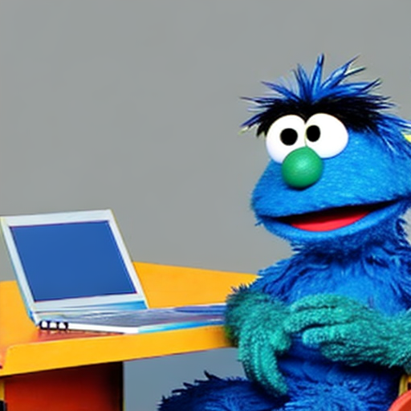
I want to understand the process of fine-tuning and apply it to other use-cases, including vision tasks
Tune in to Parts 3 and 4
Reusing our code to train on a new objective
The Landscape
Additional Resources:

Slide 7
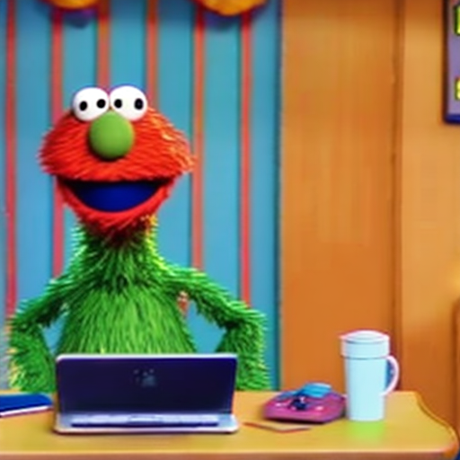
I was laid off and I want to transition from software engineering to a role in AI.
Tune in to Part 4:
Landscape
Additional Resources:
Hugging Face Youtube Series

Slide 8
Ultimately, we all follow tutorials hoping to transfer what we learn to use-cases we care about

Slide 9
Ultimately, we all follow tutorials hoping to transfer what we learn to use-cases we care about
transfer
transferlearning

Slide 10
Transfer Learning
From Wikipedia
Transfer learning (TL) is a research problem in machine learning (ML) that focuses on applying knowledge gained while solving one task to a related task.^{[1]} For example, knowledge gained while learning to recognize cars could be applied when trying to recognize trucks. This topic is related to the psychological literature on transfer of learning, although practical ties between the two fields are limited. Reusing/transferring information from previously learned tasks to new tasks has the potential to significantly improve learning efficiency.^{[2]}

Slide 11
Fine Tuning

