Slide 1
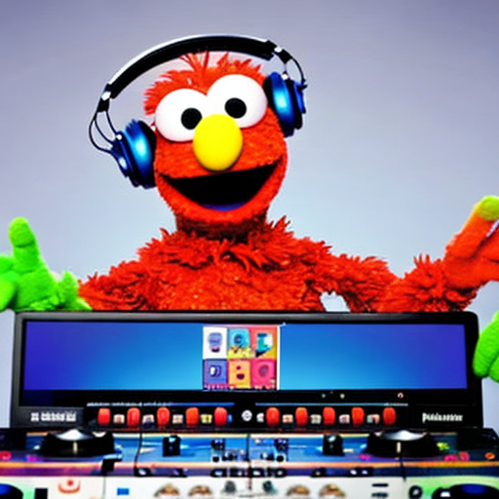
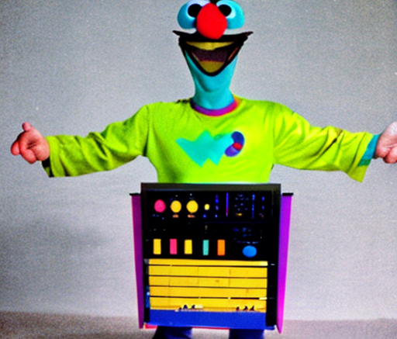
Fine tuning BERT
For Sentiment Classification
Images generated by stable-diffusion.
Prompts:
Ernie from sesame street is a DJ with headphones on one ear
Bert from sesame street dressed as a synthesizer

Slide 2
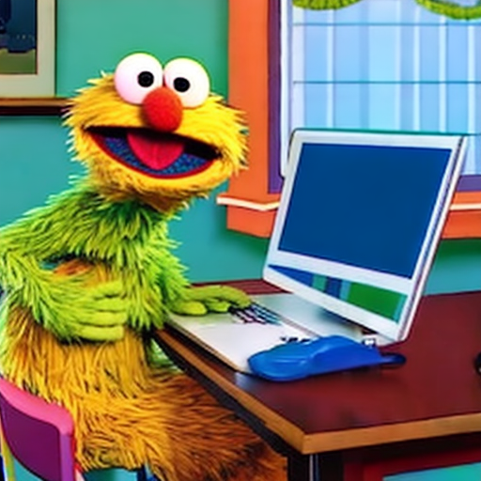
Why are you here?
Me?
Image generated by stable-diffusion.
Prompt: Sesame street character sitting at a desk

Slide 3
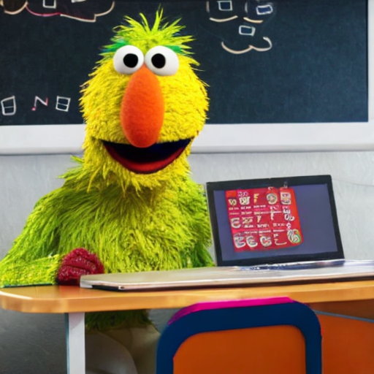
Tune in to Part 2:
Vocab
Evaluating the Tokenizer
I want to specialize in NLP!
Additional Resources:
Image generated by stable-diffusion.
Prompt: A polyglot esame street character sitting at a desk

Slide 4
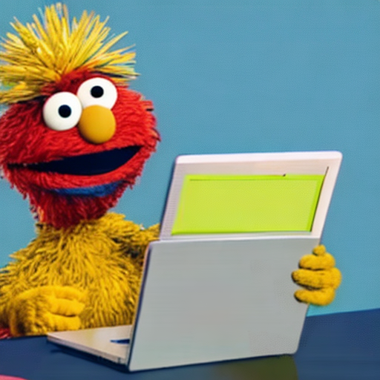
I’m a product manager and sentiment analysis is on our roadmap for Q3.
Tune in to Part 2 and 3:
Leveraging open-source datasets for your clients
Additional Resources:
[ Sentiment Analysis Case studies ]
Image generated by stable-diffusion.
Prompt: A sesame street character who is a product manager sitting at a desk

Slide 5
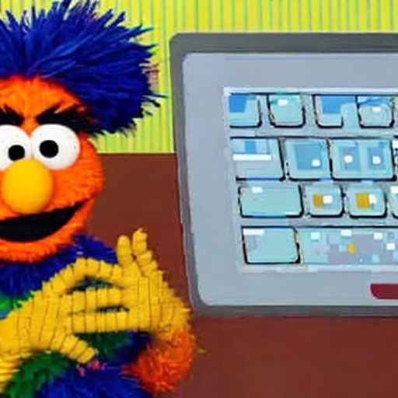
I’m a software engineer who was laid off and I want to learn fine-tuning for vision and generative models too.
Tune in to Parts 3 and 4:
Reusing our code to train on a new data set for a new objective
The SOTA Landscape
Additional Resources:
Hugging Face Youtube Series
Image generated by stable-diffusion.
Prompt: A sesame street character who is a software engineer sitting at a desk

Slide 6
Ultimately, we all follow tutorials hoping to transfer what we learn to use-cases we care about

Slide 7
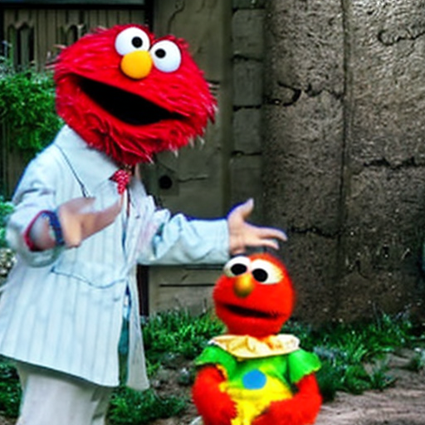
Ultimately, we all follow tutorials hoping to transfer what we learn to use-cases we care about
Transfer Learning
Image generated by stable-diffusion.
Prompt: sesame street character amazed by understanding a new concept

Slide 8
Transfer Learning
From Wikipedia
Transfer learning (TL) is a research problem in machine learning (ML) that focuses on applying knowledge gained while solving one task to a related task.^{[1]} For example, knowledge gained while learning to recognize cars could be applied when trying to recognize trucks. This topic is related to the psychological literature on transfer of learning, although practical ties between the two fields are limited. Reusing/transferring information from previously learned tasks to new tasks has the potential to significantly improve learning efficiency.^{[2]}

Slide 9
Fine Tuning

