Slide 1

FINAGG
The Autocratic Aggregators: Dana Siciliano
Aayog Koirala
Anindya Majumar
Matthew Adjin-Tettey
Kristopher Saettele
Notes:
Hello, everybody! My name is Kristopher Saettele and we are the Autocratic Aggregators

Slide 2
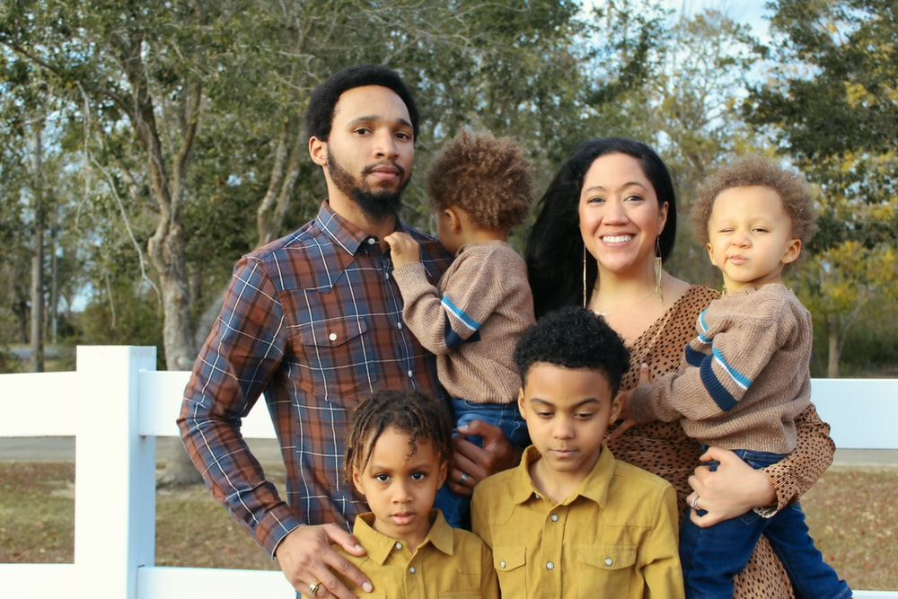

Slide 3


Slide 4


Slide 5


Slide 6


Slide 7
Solution: AI Aggregation
-State and Federal Aid Services
-Nonprofits
-Free Financial Assistance Services
-Personalized Tax Suggestions
-Overlooked opportunities
-Financial Literacy and Budgeting Resources

Slide 8

Tech Demo

Slide 9

Thank you, FIS Team and judges
All images used are under the creative commons license

