Slide 1
Python 1
윤지노 학생
Daniel Ahn

Slide 2
프로그래밍 종류
입문용 프로그래밍
Java, Python, Algorithm (기본 프로그래밍)
Web Programming (웹 프로젝트)
IoT (Internet Of Things) (사물 인터넷)
Window Application (윈도우 프로그램)
Mobile Application (모바일 프로그램)
Cloud, Big Data (클라우드, 빅데이터)

Slide 3
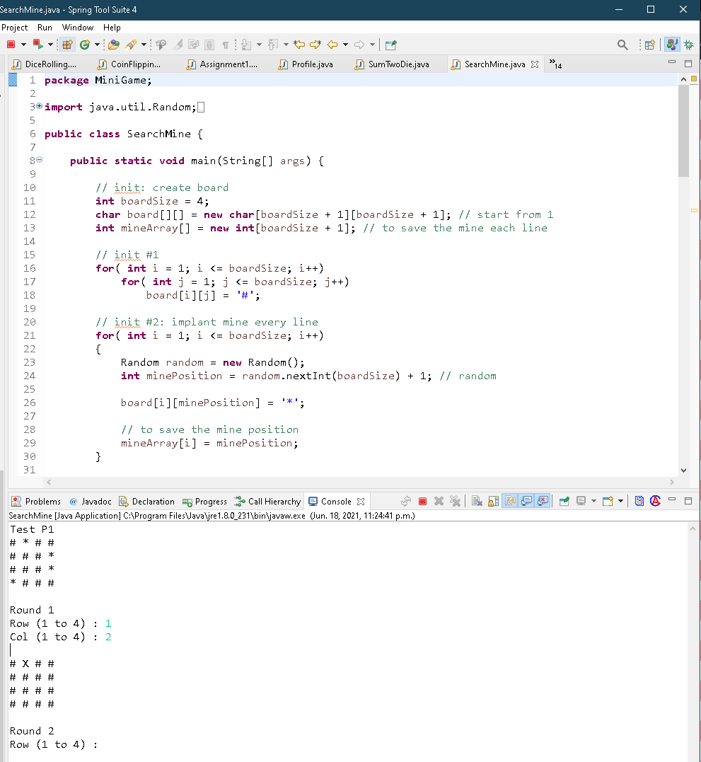
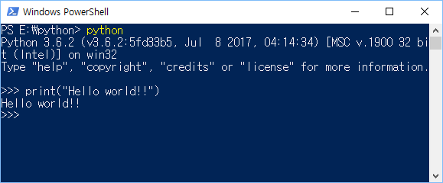
기본 프로그래밍
Python, Java, C
주사위 게임, 지뢰찾기, Tic Tac Toe, Sudoku, 계산기 등
난이도: 초급, 중급
  Secondary, University, 회사
  기본이면서 범용적으로 사용

Slide 4

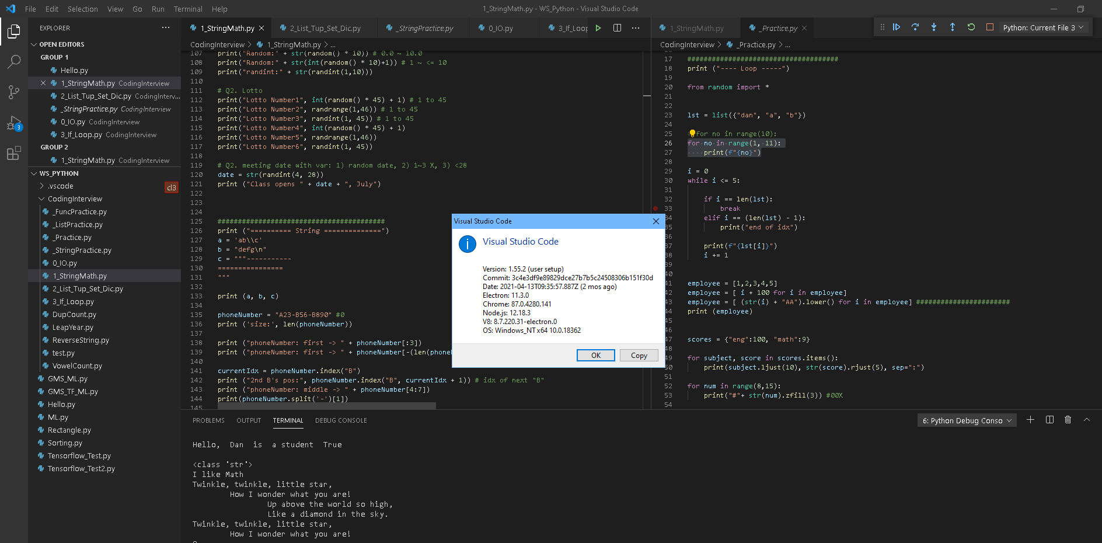
Python and IDE Setup
Python:
  https://www.python.org/downloads/
Visual Studio Code:
  https://code.visualstudio.com/download

Slide 5
Variables and Data Types
In programming, data type is an important concept.
Variables can store data of different types
different types can do different things.
Variable: e.g., name = “John”
Text Type: str
Numeric Types: int, float, complex
Boolean Type: bool

Slide 6
Print String and Number
Print (“Hello World”)
New line character: \n
Tab: \t
Special character: \\, \”

Slide 7
Casting
a = str (123) “123”
b = int (1.2) 1
c = float (1) 1.0

Slide 8
Comments
Explain the code
Make the code more readable
Prevent execution when testing code
e.g., # 1 line comment
# print (“test”)
e.g., “”” multiple lines
comments “””

Slide 9
Exercises
E1. Print your name
E2. Print your age
E3. Print your name and age
E4. Make variables: 4 types
E5. Print you are adult
E6. Add comments
E7. Print types
E8. Print with \n \t

Slide 10
Assignments 1
1. Use variables and print the sentences.
variable: subject
value: "English", "Math", "Computer"
print: "I like 'Math"

Slide 11
Assignment 2
2. Make sentences
Twinkle, twinkle, little star,
How I wonder what you are!
Up above the world so high,
Like a diamond in the sky.
Twinkle, twinkle, little star,
How I wonder what you are

