Slide 1
Playing Atari with Deep Reinforcement Learning

Slide 2
Overview of Literature
Main DQN Papers
(2013) “Playing Atari with Deep Reinforcement Learning,” NIPS Workshop
(2015) “Human-Level Control through Deep Reinforcement Learning,” Nature
(2015) “Deep Reinforcement Learning with Double Q-Learning,” AAAI Conference on AI
(2016) “Prioritized Experience Replay,” ICLR
(2016) “Dueling Network Architectures for Deep Reinforcement Learning,” arXiv
(2016) “Asynchronous Methods for Deep Reinforcement Learning,” ICML
Related Literature
(2005) “Neural Fitted Q Iteration—First Experiences with a Data Efficient Neural Reinforcement Learning Method,” ECML
(2012) “Imagenet Classification with Deep Convolutional Neural Networks,” NIPS

Slide 3
Markov Decision Process
Markov Decision Process
Set of states: S={s₁, s_{2,}...s_{n}}
Set of actions: A={a₁, a_{2,}...a_{n}}
Transition model: T=P(s_{t+1}|s_{t},a_{t})
Markov assumption
Not necessarily deterministic
May not have (model-free RL)
Reward function: R(s_{t},a_{t})
a₁; R=10
s₁
a₁; R=-2
s₂
a₂; R=-2
a₁; R=1
a₂; R=-8
a₂; R=6
s₃
a₂; R=0
s₄
a₁; R=5

Slide 4
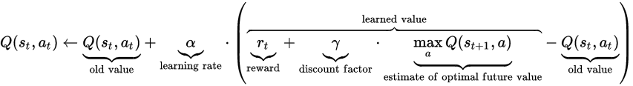
Q Learning
Find Optimal Policy
Assume some policy, a~π(s) = P(a_{t} = a | s_{t} = s)
Define action-value function Q^{π}(s,a) is the expected reward for performing action a in state s, and following policy π in the future
Q^{π}(s_{t},a_{t}) = E_{π}{Σ_{t} γ^{t} r_{t} | s_{t}, a_{t}} = r_{t} + γ Q^{π}(s_{t+1},π(s))
Optimal action-value function as Bellman equation
Q*(s,a) = R(s,a) + γ Σ_{s’} T(s,a,s’) max_{a’} (Q*(s’,a’))
Can perform value iteration (dynamic programming) to find Q

Slide 5
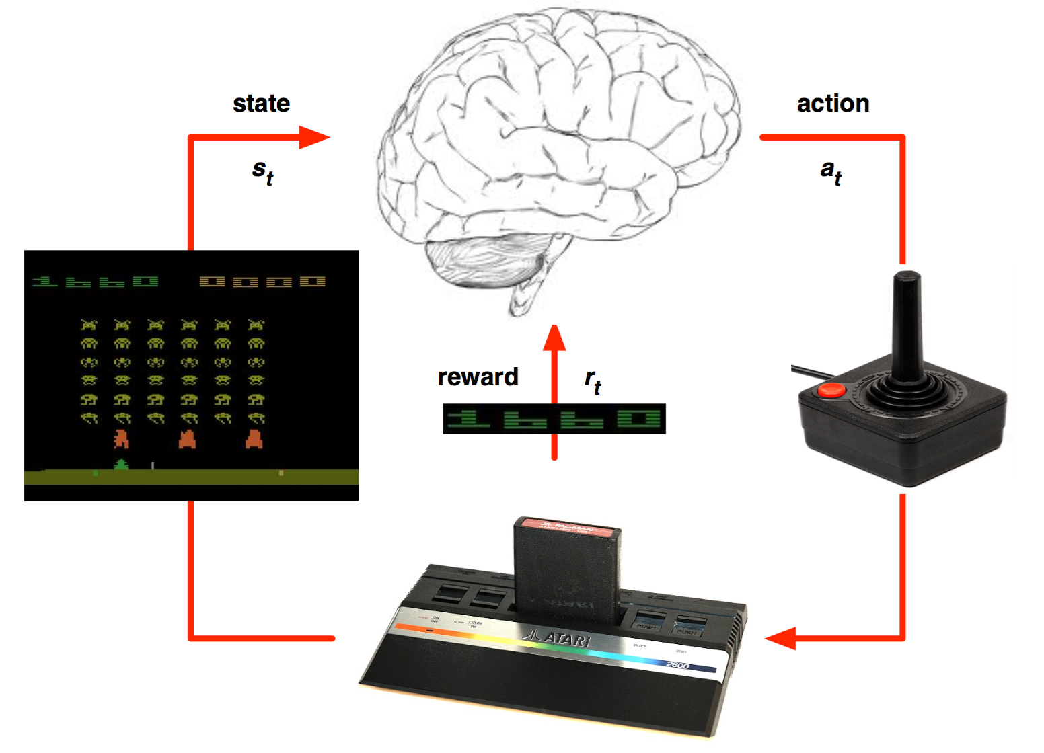
Atari Environment
Agent
State: seq of 4 frames
Actions:
UP, DOWN, FIRE, NOOP, etc.
Reward: points gained
Problem
HUGE state space
84x84 greyscale image, 4 frames
|S| = 2^{84*84*4*256} = a lot
value iteration infeasible

Slide 6
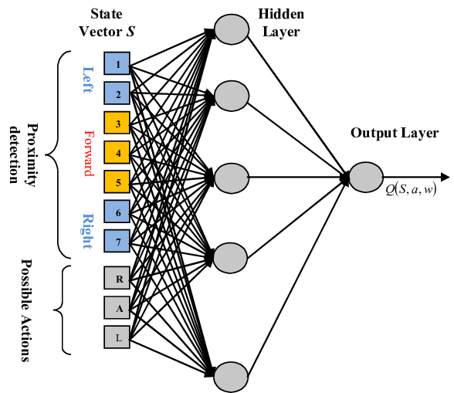
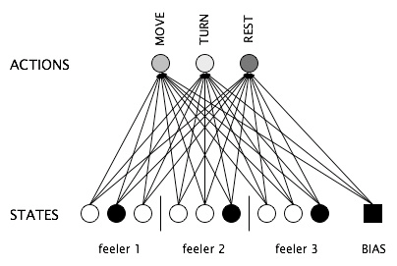
Neural Fitted Q Iteration (Riedmiller, 2005)
Possible solution:
Train neural network to approximate Q(s,a) Riedmiller, 2005

Slide 7
Neural Fitted Q Iteration
Recall the update rule
Set loss function of neural network to MSE of TD error
L = [Q(s_{t},a_{t}) – (r_{t}+γ max_{a}Q(s_{t+1},a))]²
when Q(s_{t},a_{t}) = r_{t}+γ max_{a}Q(s_{t+1},a), loss is zero
TD Error

Slide 8
Neural Fitted Q Iteration
Algorithm
Initialize a neural network, Q
Initialize empty replay memory, D
Generate a set of trajectories using Q:
Select a_{t}=max_{a} Q(s_{t},a)
Perform a_{t} on environment, receive reward r_{t}
Store (s_{t}, a_{t}, r_{t}, s_{t+1}) in D
For each experience in D, calculate target Q value
x = (s_{t}, a_{t}); y = r_{t} + γ max_{a} Q(s_{t+1},a)
Train Q with training data (x, y) using backprop
Repeat steps 2 – 6
Assume network provides
good approximations of Q to get data
Make approximation better

Slide 9
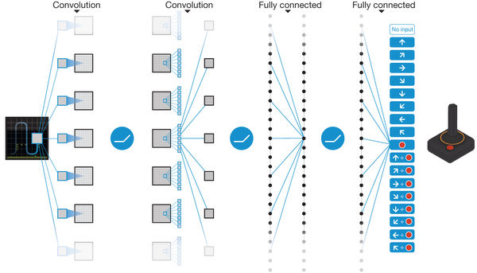
Deep Q Network (Minh 2013)
How to learn to play Atari
Use previous 4 frames* as input to the network
* each frame is pixel level max of previous 2 frames; only every 4th frame recorded. This is freaking hard to figure out from the Nature paper if you’re implementing this...
CNN – “image” features
FC – “image” features → Q values

Slide 10
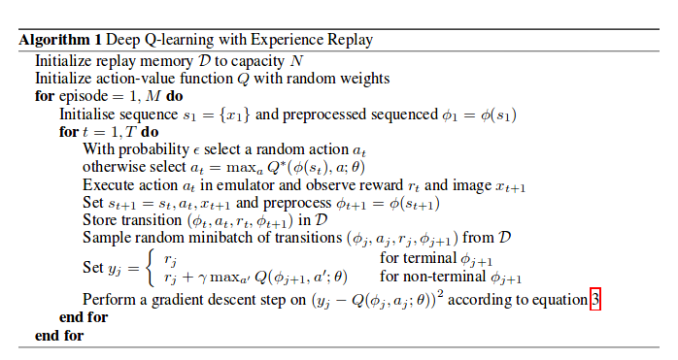
Playing Atari with Deep Reinforcement Learning
Fixed Replay Memory size
(1 million experiences)
Train using small batch randomly sampled from replay memory (32 samples)
Single gradient descent step (baby step)
ε-greedy policy: Perform random action with probability (1-ε), anneal from 1.0 to 0.1 over 1 million frames. Allow early exploration

Slide 11
Playing Atari with Deep Reinforcement Learning
Architecture
84x84x4 input image
Layer 1: (16) 8x8 filters, stride 4, ReLU
Layer 2: (32) 4x4 filters, stride 2, ReLU
Layer 3: 256 fully connected units, ReLU
Main Issue: Make training as stable as possible
Sample randomly from large set of experiences
Effectively make samples IID again
NFQI trains on all transitions at once, highly correlated samples
One training step each action, small batch

Slide 12
Playing Atari with Deep Reinforcement Learning
Results
 | Random | Contingency | Human | DQN (NIPS)
Breakout | 1.2 | 6 | 31 | 168
Seaquest | 110 | 723 | 28010 | 1705
Space Invaders | 179 | 268 | 3690 | 581
Pong | -20.4 | -17 | -3 | 20
Enduro | 0 | 159 | 368 | 470

Slide 13
Improvements
Major moving parts:
Deep-Q Learning Algorithm
Human-Level Control through Deep Reinforcement Learning
Deep Reinforcement Learning with Double Q-Learning
Replay Memory
Prioritized Experience Replay
Network Architecture
Dueling Network Architectures for Deep Reinforcement Learning
Agent(s)
Asynchronous Methods for Deep Reinforcement Learning

Slide 14
Human-Level Control through Deep Reinforcement Learning (Mnih 2015)
Nature version of DQN
Network has additional layers
Introduction of target Q-network

