Slide 1
Computer & Information Security
Practical session no. 3
Cryptography – part B

Slide 2
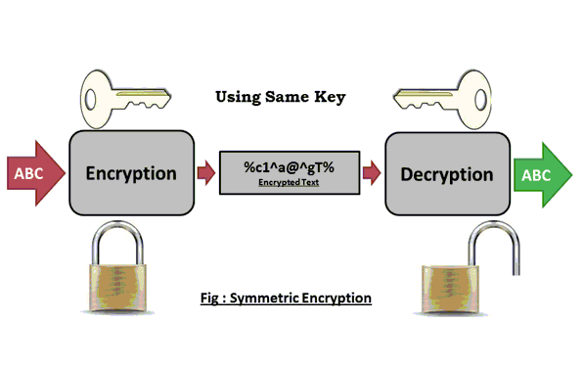
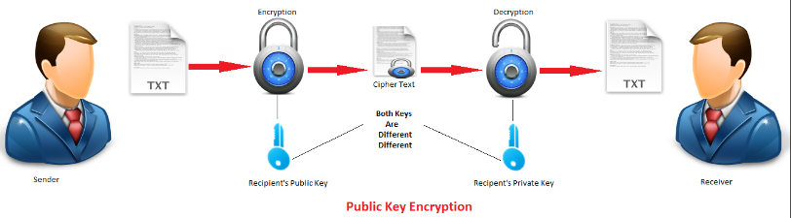
Encryption
Symmetric Encryption
Public Key Encryption

Slide 3
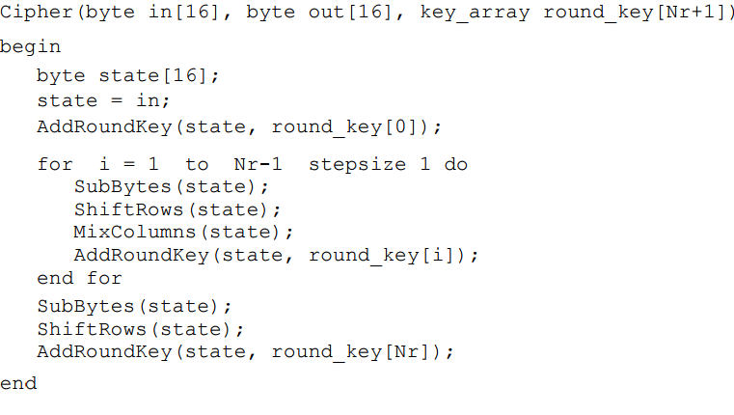
Recall: AES – Pseudo Code
Notes:
האלגוריתם בנוי מארבע תתי שלבים שמופעלים (כמעט) בכל שלב:
בשלב הראשון מבצעים רק את פעולה add round key
בשלב האחרון לא מבצעים את הפעולה mix columns

Slide 4
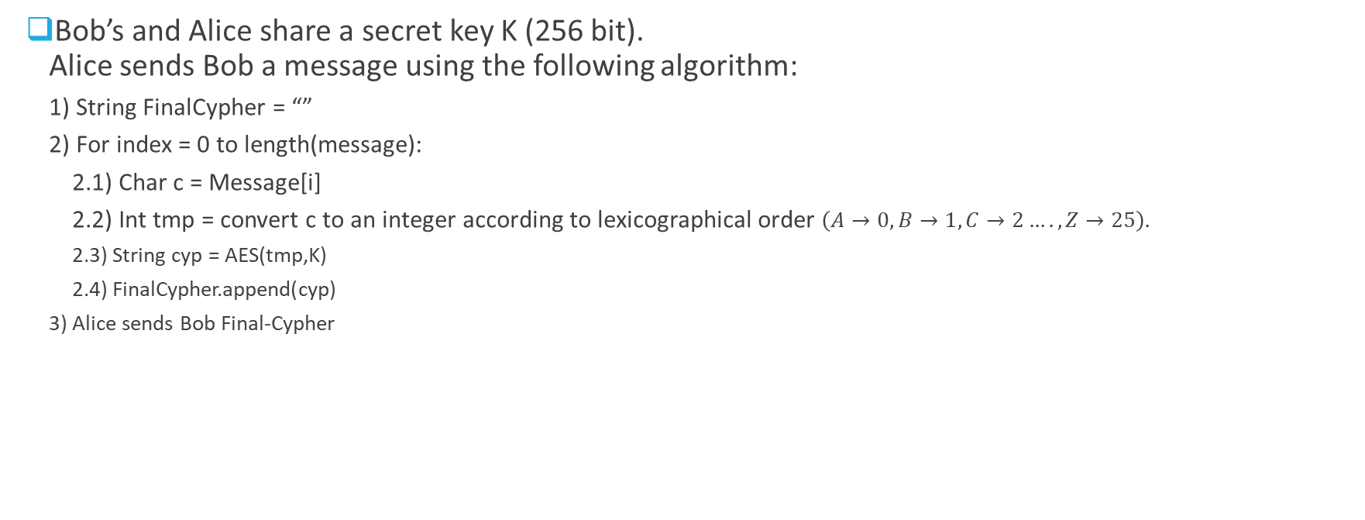
Question 1
Bob’s and Alice share a secret key K (256 bit). Alice sends Bob a message using the following algorithm:
1) String FinalCypher = “”
2) For index = 0 to length(message):
2.1) Char c = Message[i]
2.2) Int tmp = convert c to an integer according to lexicographical order $\left(A→0, B→1, C→2…., Z→25\right).$
2.3) String cyp = AES(tmp,K)
2.4) FinalCypher.append(cyp)
3) Alice sends Bob Final-Cypher

Slide 5

Question 1 - cont
Question 1A: Is the suggested protocol is secured against brute force for finding the correct key?
1) String FinalCypher = “”
2) For index = 0 to length(message):
2.1) Char c = Message[i]
2.2) Int tmp = convert c to an integer according to lexicographical order $\left(A→0, B→1, C→2…., Z→25\right).$
2.3) String cyp = AES(tmp,K)
2.4) FinalCypher.append(cyp)
3) Alice sends Bob Final-Cypher

Slide 6
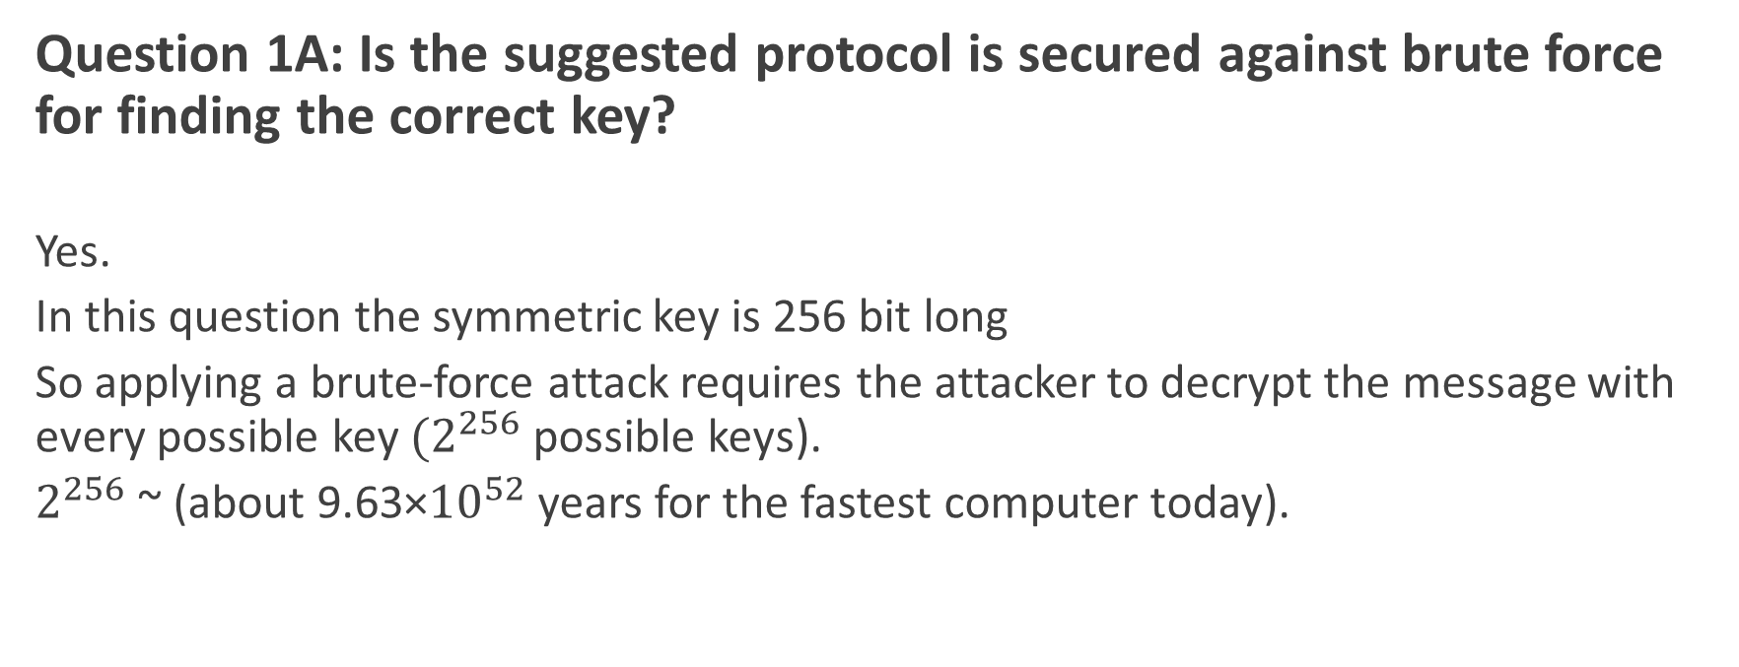
Question 1 - cont
Question 1A: Is the suggested protocol is secured against brute force for finding the correct key?
Yes.
In this question the symmetric key is 256 bit long
So applying a brute-force attack requires the attacker to decrypt the message with every possible key ${(2}^{256}$ possible keys).
$2^{256}$ ~ (about 9.63×${10}^{52}$ years for the fastest computer today).

Slide 7
Question 1 - cont
Question 1B: Is this protocol is secured?
1) String FinalCypher = “”
2) For index = 0 to length(message):
2.1) Char c = Message[i]
2.2) Int tmp = convert c to an integer according to lexicographical order $\left(A→0, B→1, C→2…., Z→25\right).$
2.3) String cyp = AES(tmp,K)
2.4) FinalCypher.append(cyp)
3) Alice sends Bob Final-Cypher

Slide 8
Question 1 - cont
Question 1B: Is this protocol is secured?
What is the size of the domain of all possible cyphers?
Size of English alphabet = |{A,B,C……..,Z}| = 26
How can attackers decrypt each of the 26 characters?
The attacker can create a histogram that counts each of the cyphers that have been seen in several messages. The size of the histogram is 26.
The attacker can infer the character that belongs to each of the cyphers by comparing the distribution of the histogram with the known distribution for English alphabet.

Slide 9
Question 1 - cont
Question 1C: How can mitigate such an attack?

Slide 10
Question 1 - cont
Question 1C: How can mitigate such an attack?
By encrypting a few characters together (e.g., 256 bit) instead of encrypting each character by its own.

Slide 11
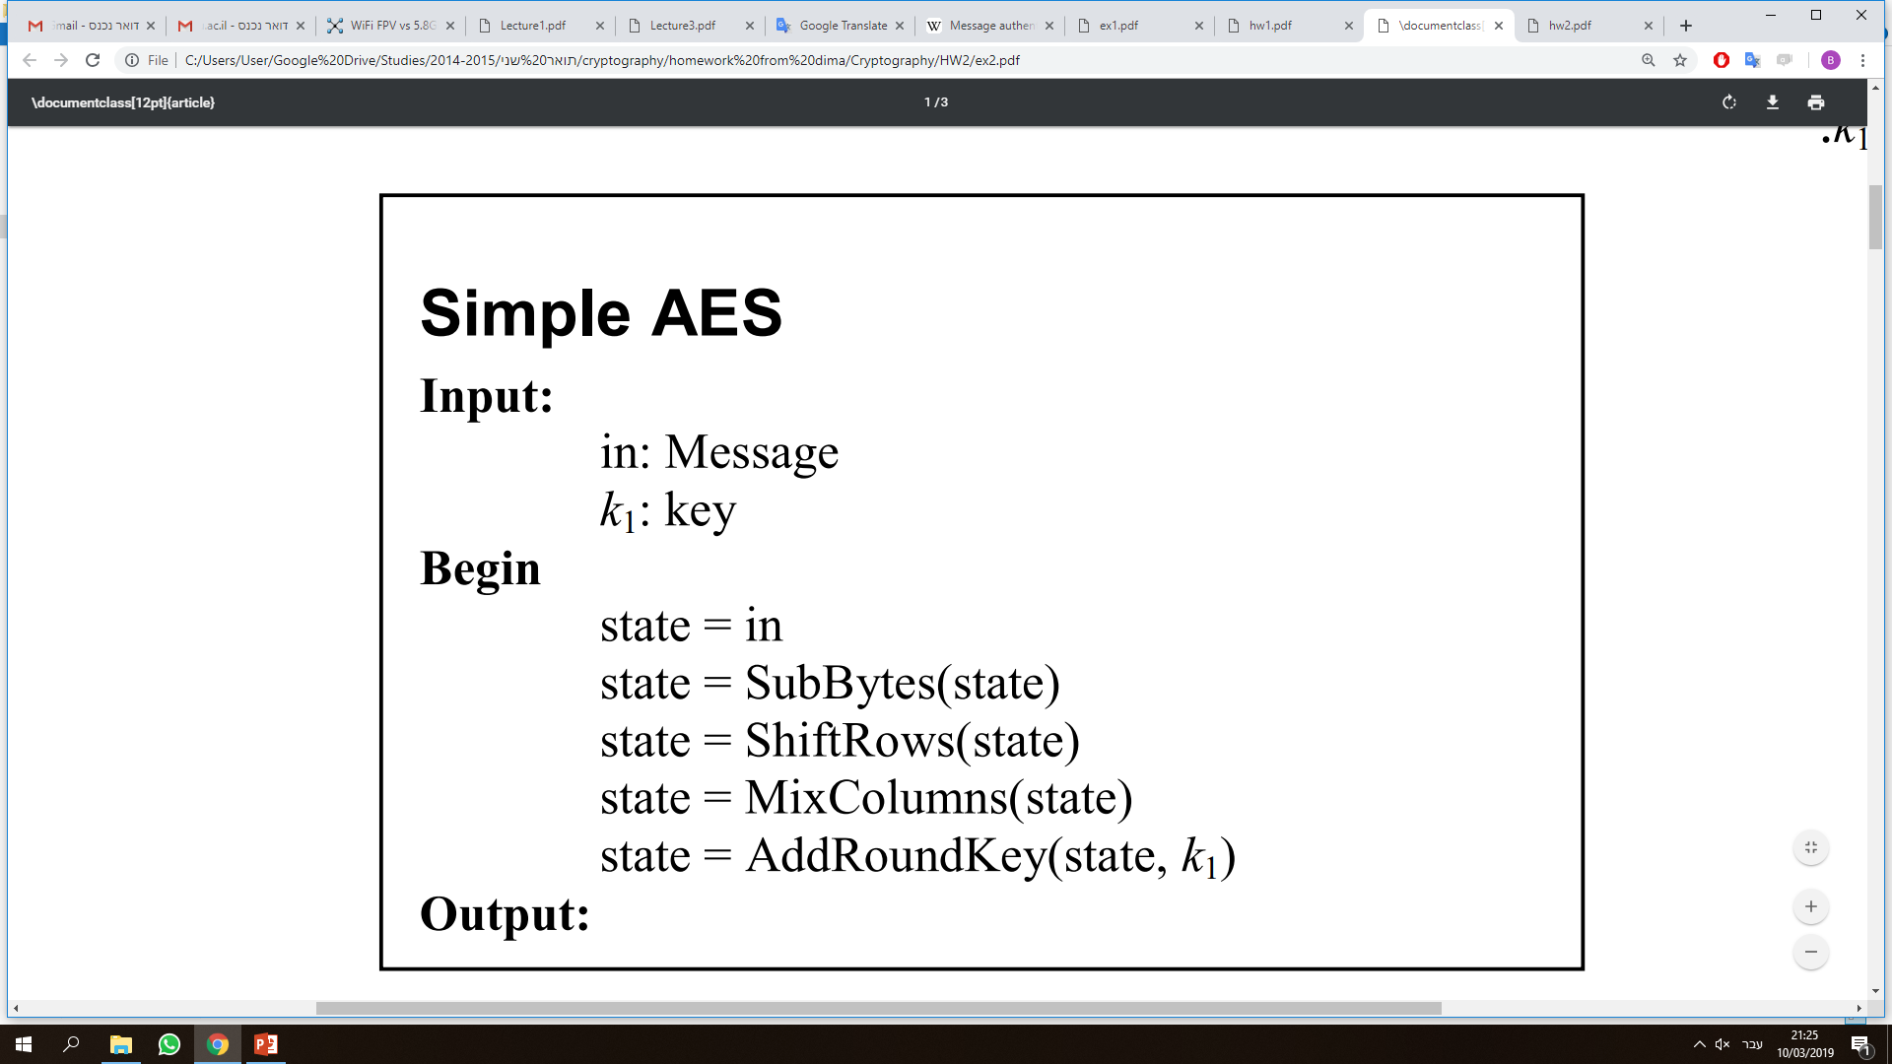
Question 2
Prove that Simple AES is vulnerable to a known plaintext attack.
Known Plaintext Attack
The attacker knows both the Plaintext and Cipher.

Slide 12
Question 2 - Solution
C = Simple_AES(M,K1) =
AddRoundKey(MixColumns(ShiftRows(SubBytes(M))),K1)

Slide 13
Question 2 - Solution
C = Simple_AES(M,K1) =
AddRoundKey(MixColumns(ShiftRows(SubBytes(M))),K1)
Lets define S as:
S = MixColumns(ShiftRows(SubBytes(M)))
=>
C = AddRoundKey(S,K1)

Slide 14
Question 2 - Solution
S = MixColumns(ShiftRows(SubBytes(M)))
The attacker can calculate S because:
The method SubBytes - is known to anyone
The method ShiftRows - is known to anyone
The method MixColumns – is known to anyone
M – is known to the attacker

Slide 15
Question 2 - Solution
The attacker can calculate S because:
C = AddRoundKey(S,K1) = SꚚK1
=>
K1 = SꚚC
We calculated S and C is known.

Slide 16
Cryptography
Message Authentication Codes (MAC)
Integrity

Slide 17
Message Authentication Codes (MAC)
MAC is a short piece of information used to authenticate a message - in other words, to confirm that the message came from the stated sender (its authenticity) and has not been changed.

Slide 18
Message Authentication Codes (MAC)
MAC is a short piece of information used to authenticate a message - in other words, to confirm that the message came from the stated sender (its authenticity) and has not been changed.
Used for:
Integrity – assuring that the message was not changed.
Authentication – authenticating the sender.

Slide 19
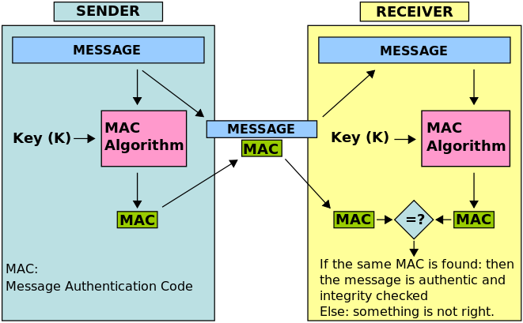
Message Authentication Codes (MAC)
There are many implementation of MAC algorithms
The following MAC algorithm is based on a symmetric key K.
Sender
Calculates MAC for a message using a symmetric MAC algorithm.
Sends the MAC and the message together.
Receiver
Calculates MAC for the received message using a symmetric MAC algorithm.
Compares the output to the received output.
MAC is required to be smaller than the original data

Slide 20
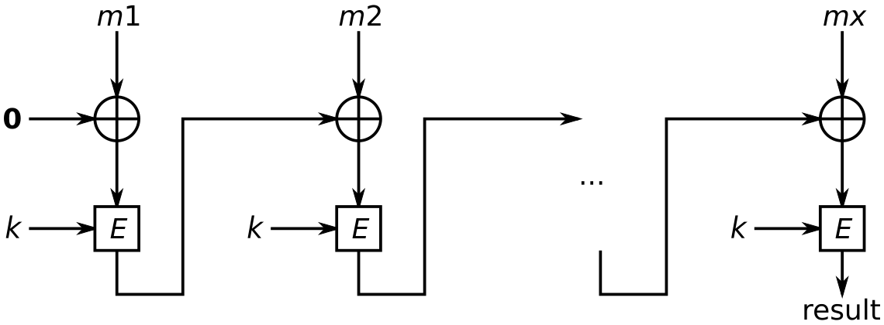
CBC-MAC Algorithm Scheme
Message = m1 m2 … mx
Symetric key K and symetric encription algortim E
Notes:
להראות דוג' על הלוח

Slide 21
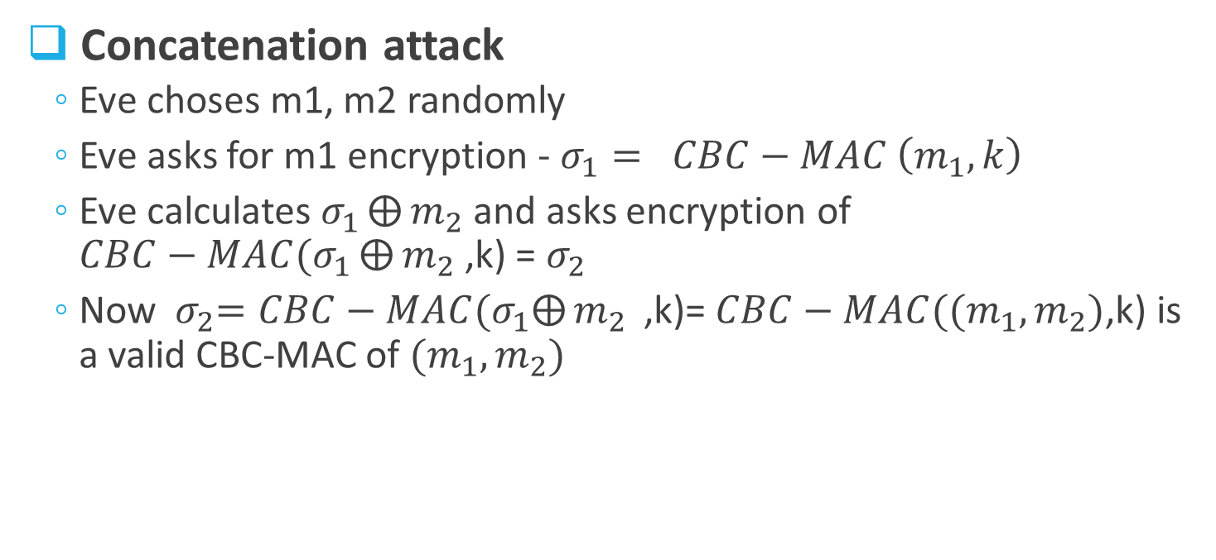


Attacks on CBC-MAC
$$σ_{1}$$
$$σ_{2}$$
Concatenation attack
Eve choses m1, m2 randomly
Eve asks for m1 encryption - $σ_{1}= CBC−MAC \left(m_{1},k\right)$
Eve calculates $σ_{1}⨁{m_{2} }$and asks encryption of $CBC−MAC(σ_{1}⨁{m_{2} }$,k) = $σ_{2}$
Now${ σ}_{2}=CBC−MAC{(σ}_{1}⨁{m_{2} }\text{,}\text{k}\text{)=}$ $CBC−MAC({(m}_{1},m_{2})\text{,}\text{k}$) is a valid CBC-MAC of ${(m}_{1},m_{2})$

Slide 22
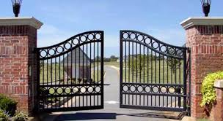
Question 3
A new system was installed on the front gate to a secret organization. When a worker wish to enter the organization and open the front gate he/she uses a dedicated application that runs the following code:
K1 is a symmetric key that is shared by the entire users of the application.
Server on the Internet
Open-Door-1(){
String command = “Open”
String cypher = AES(command,K1)
Send-command-to-server(cypher1)
}

Slide 23
Question 3
Question 3A: What is the problem with the suggested algorithm?

Slide 24
Question 3
Question 3A: What is the problem with the suggested algorithm?
The cryptogram that is sent to the server remains the same so attacker can apply a replay attack:
Attacker intercepts a message that is sent to the cloud
Attacker retransmit the message
The gate is opened

Slide 25
Question 3
Question 3B: In order to mitigate a replay attack, the developers included a message authentication code in the protocol. Is the system secured from replay attacks?
Open-Door-2(){
String command = “Open”
String cypher1 = AES-ENCRYPT(command,K1)
String cypher2 = MAC(command,K2)
Send-to-server(cypher1,cypher2)
}

Slide 26
Question 3
Question 3B: In order to mitigate a replay attack, the developers included a message authentication code in the protocol. Is the system secured from replay attacks?
No. If the attacker managed to intercept the cypher1 and cypher2 he\she can open the gate and send retransmit them and open the gate.
Open-Door-2(){
String command = “Open”
String cypher1 = AES-ENCRYPT(command,K1)
String cypher2 = MAC(command,K2)
Send-to-server(cypher1,cypher2)
}

Slide 27
Question 3
Question 3C: How can we secure the system?

Slide 28
Question 3
Question 3C: How can we secure the system?
By using a ticket: adding the time that the command was sent and limiting validity of the command to a reasonable window of time.
Sender
Open-Door-2(){
String timestamp = currentTime ()
String command = “Open”
String cypher1 = AES(command,K1)
String cypher2 = AES(timestamp,K2)
Send-to-server(cypher1,cypher2)
}
Gate
Decrypt the command and the timestamp using AES.
If more than 1 minute was not passed from the sent timestamp, than open the gate.

