Slide 1
Computer & Information Security
Practical session no. 4
Cryptography – part C

Slide 2
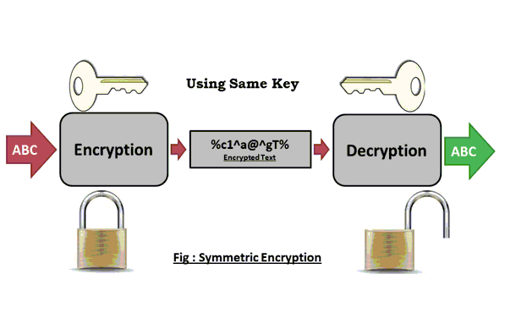
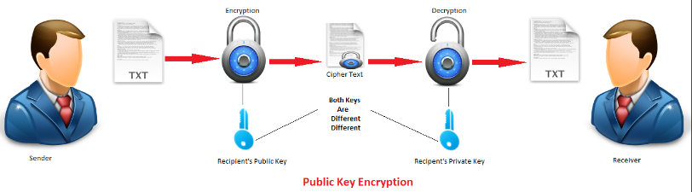
Encryption
Symmetric Encryption
Public Key Encryption

Slide 3
Public Key Encryption
Primary Motivation: It is very difficult for two parties to share a symmetric key.
How can they distribute it to each other?

Slide 4
Cryptography
RSA Algorithm (Rivest, Shamir & Adelman)
Public Key Cryptography

Slide 5
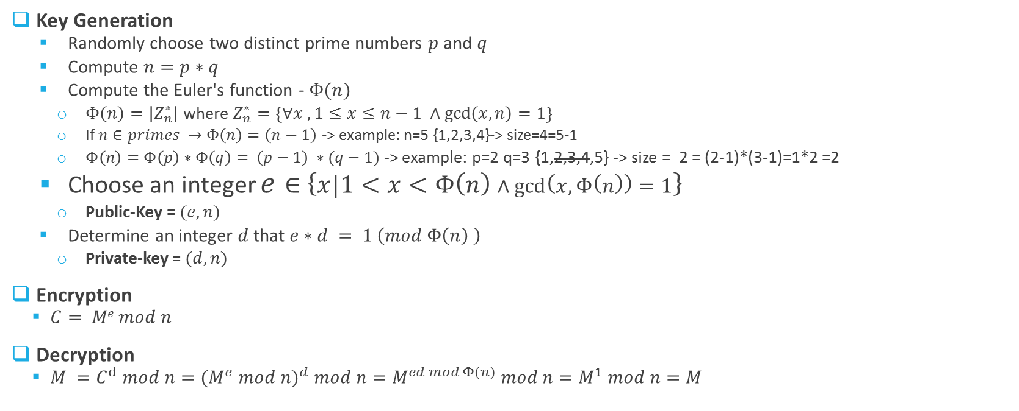
RSA Algorithm
Key Generation
Randomly choose two distinct prime numbers $p$ and $q$
Compute $n=p∗q$
Compute the Euler's function - $Φ(n)$
$Φ\left(n\right)=\left|Z_{n}^{∗}\right|$ where $Z_{n}^{∗}=\left\{∀x , 1≤x≤n−1 ∧\gcd\left(x,n\right)=1\right\}$
If $n∈primes →Φ\left(n\right)=\left(n−1\right)$ -> example: n=5 {1,2,3,4}-> size=4=5-1
$Φ\left(n\right)=Φ\left(p\right)∗Φ\left(q\right)= \left(p−1\right) ∗(q−1)$ -> example: p=2 q=3 {1,2,3,4,5} -> size = 2 = (2-1)*(3-1)=1*2 =2
Choose an integer $e∈\left\{x|1<x<Φ\left(n\right)∧\gcd\left(x,Φ\left(n\right)\right)=1\right\}$
Public-Key = $(e,n)$
Determine an integer $d$that $e∗d = 1 \left(mod Φ\left(n\right) \right)$
Private-key = $(d,n)$
Encryption
$C= Me mod n$
Decryption
$M =C^{d} mod n={{(M}^{e} mod n)}^{d} mod n=M^{ed mod Φ(n)} mod n=M^{1} mod n=M$
Notes:
פי של אן היא בעצם פונקציה שאומרת כמה מספרים קטנים מאן יש שאין להם מחלק משותף עם אן
D הוא ההופכי של e בשדה סופי

Slide 6
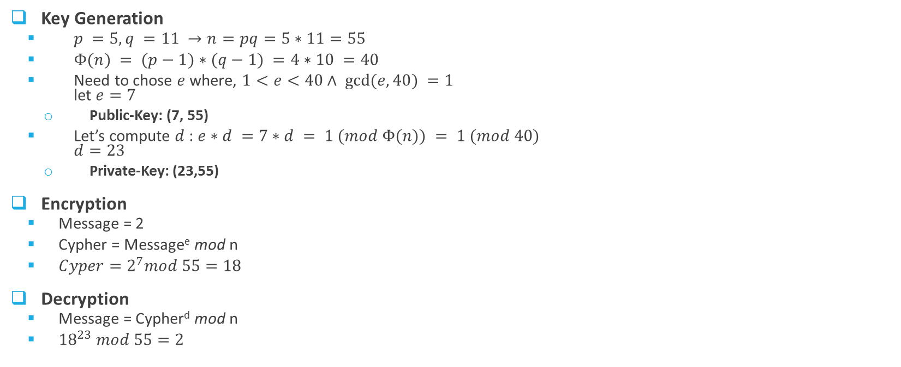


RSA- Example
Key Generation
$p =5, q =11 →n=pq=5∗11=55$
$Φ(n) = (p−1)∗(q−1) =4∗10 =40$
Need to chose $e$ where, $1<e<40∧ gcd⁡(e,40) =1$ let $e=7$
Public-Key: (7, 55)
Let’s compute $d$ : $e∗d =7∗d = 1 (mod Φ(n)) = 1 (mod 40)$ $d=23$
Private-Key: (23,55)
Encryption
Message = 2
Cypher = Message^{e} mod n
$Cyper=2^{7}mod 55=18$
Decryption
Message = Cypher^{d} mod n
${18}^{23} mod 55=2$
$$(PT^{e})mod n$$
Cipher
Plaintext
$$(CP^{d})mod n$$

Slide 7
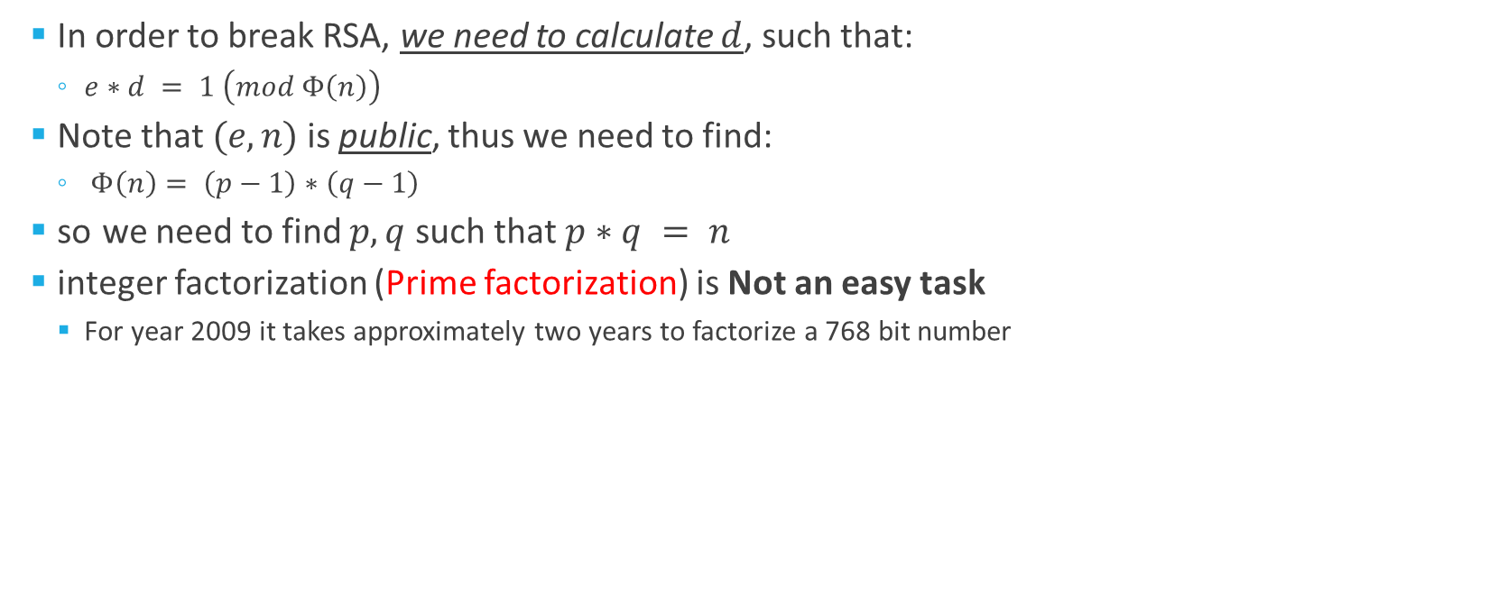
Possible attacks on RSA
In order to break RSA, we need to calculate $d$, such that:
$e∗d = 1 \left(mod Φ\left(n\right)\right)$
Note that $(e,n)$is public, thus we need to find:
$Φ\left(n\right)= \left(p−1\right)∗\left(q−1\right)$
so we need to find $p,q$ such that $p∗q = n$
integer factorization (Prime factorization) is Not an easy task
For year 2009 it takes approximately two years to factorize a 768 bit number
Notes:
בעיית הפירוק לגורמים היא בעיה קשה
אם נצליח לפרק נמצא את d (המפתח הפרטי ופרצנו את המערכת)

Slide 8
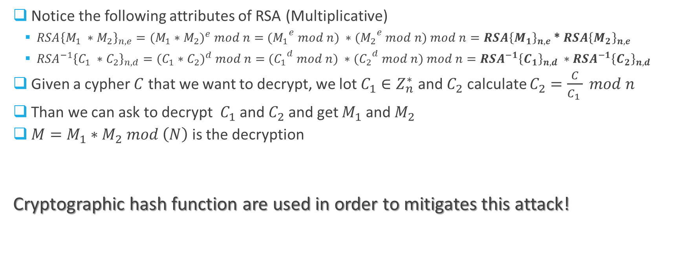
Possible attacks on RSA – chosen Cyphertext attack
Notice the following attributes of RSA (Multiplicative)
$RSA{\left\{M_{1} ∗M_{2}\right\}}_{n,e}={{(M}_{1} ∗M_{2})}^{e} mod n=$ ${{(M}_{1}}^{e} mod n) ∗{{(M}_{2}}^{e} mod n) mod n=RSA{\left\{M_{1}\right\}}_{n,e}$ * $RSA{\left\{M_{2}\right\}}_{n,e}$
${{RSA}^{−1}\left\{C_{1} ∗C_{2}\right\}}_{n,d}={{(C}_{1} ∗C_{2})}^{d} mod n=$ ${{(C}_{1}}^{d} mod n) ∗{{(C}_{2}}^{d} mod n) mod n={{RSA}^{−1}\left\{C_{1}\right\}}_{n,d} ∗{{RSA}^{−1}\left\{C_{2}\right\}}_{n,d}$
Given a cypher $C$ that we want to decrypt, we lot $C_{1}∈Z_{n}^{∗}$ and $C_{2}$ calculate $C_{2}=\frac{C}{C_{1} } mod n$
Than we can ask to decrypt $C_{1}$ and $C_{2}$and get $M_{1}$and $M_{2}$
$M=M_{1}∗M_{2} mod \left(N\right)$ is the decryption
Cryptographic hash function are used in order to mitigates this attack!

Slide 9
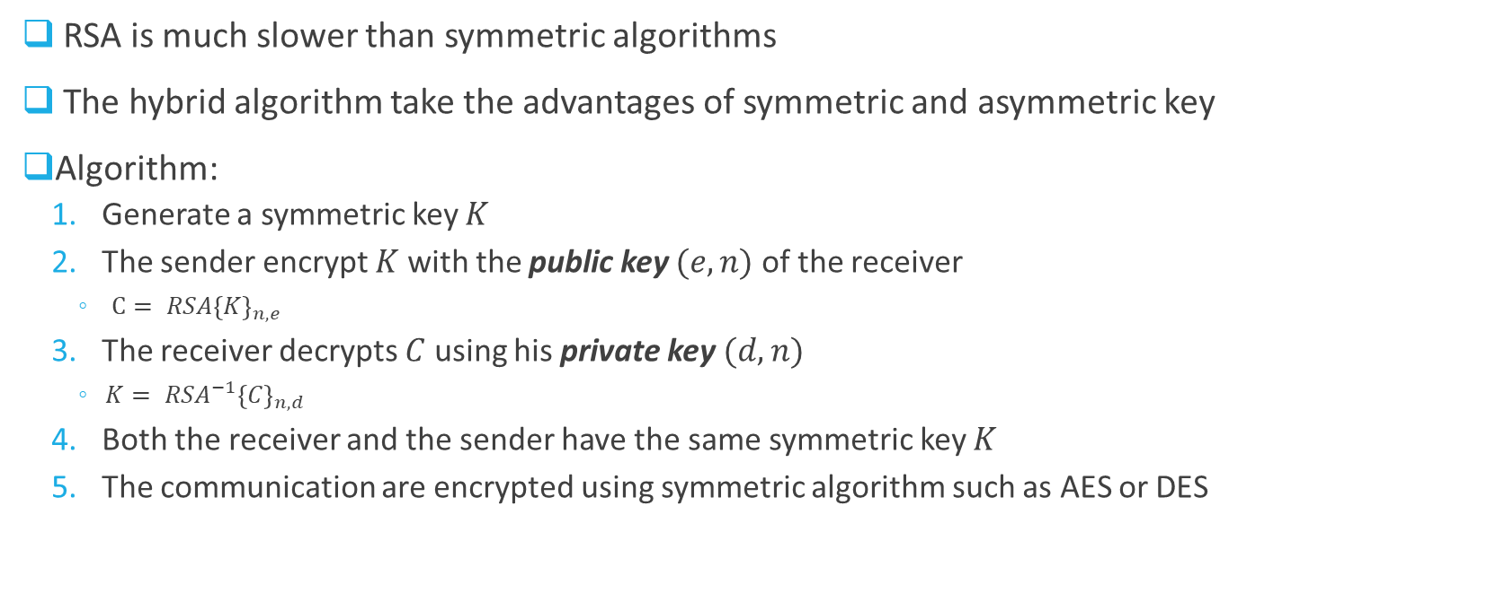
Hybrid Protocol
RSA is much slower than symmetric algorithms
The hybrid algorithm take the advantages of symmetric and asymmetric key
Algorithm:
Generate a symmetric key $K$
The sender encrypt $K$ with the public key $(e,n)$ of the receiver
$C= RSA{\left\{K\right\}}_{n,e}$
The receiver decrypts $C$ using his private key $(d,n)$
${{K= RSA}^{−1}\left\{C\right\}}_{n,d}$
Both the receiver and the sender have the same symmetric key $K$
The communication are encrypted using symmetric algorithm such as AES or DES

Slide 10
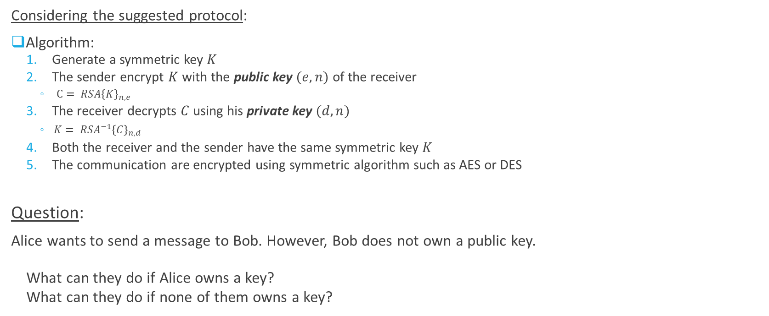
Hybrid Protocol
Considering the suggested protocol:
Algorithm:
Generate a symmetric key $K$
The sender encrypt $K$ with the public key $(e,n)$ of the receiver
$C= RSA{\left\{K\right\}}_{n,e}$
The receiver decrypts $C$ using his private key $(d,n)$
${{K= RSA}^{−1}\left\{C\right\}}_{n,d}$
Both the receiver and the sender have the same symmetric key $K$
The communication are encrypted using symmetric algorithm such as AES or DES
Question:
Alice wants to send a message to Bob. However, Bob does not own a public key.
What can they do if Alice owns a key?
What can they do if none of them owns a key?

Slide 11
Hybrid Protocol
Question:
Alice wants to send a message to Bob. However, Bob does not own a public key.
What can they do if Alice owns a key?
What can they do if none of them owns a key?
Conclusion:
At least one of the parties should maintain a public key.

Slide 12
Cryptography
Diffie – Hellman Protocol (Key Exchange)
Public Key Cryptography

Slide 13
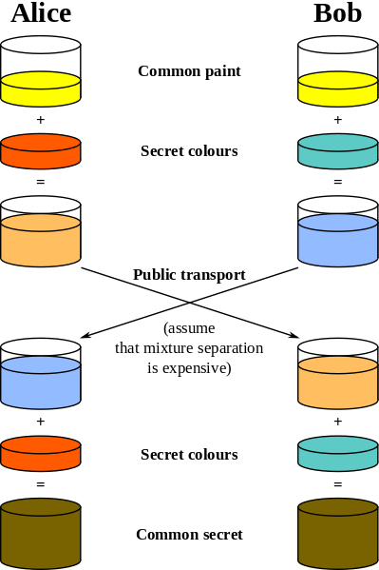
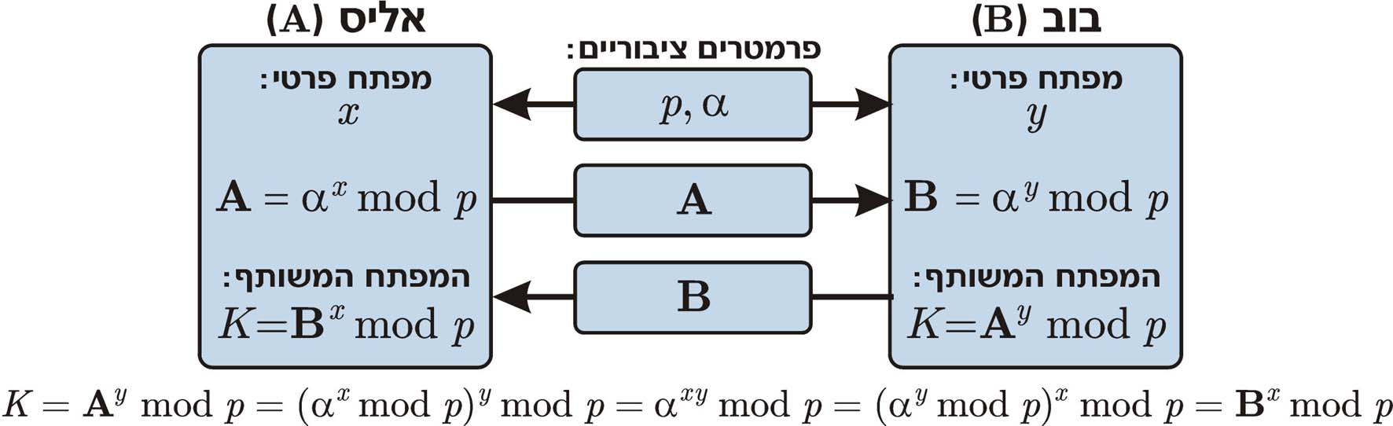
Diffie-Hellman Protocol
The first algorithm that was developed in order to enable two parties to agree about a key
The messages exchanged between two parties sent over public channel that can be eavesdropped by an attacker
Based on public key cryptography

Slide 14
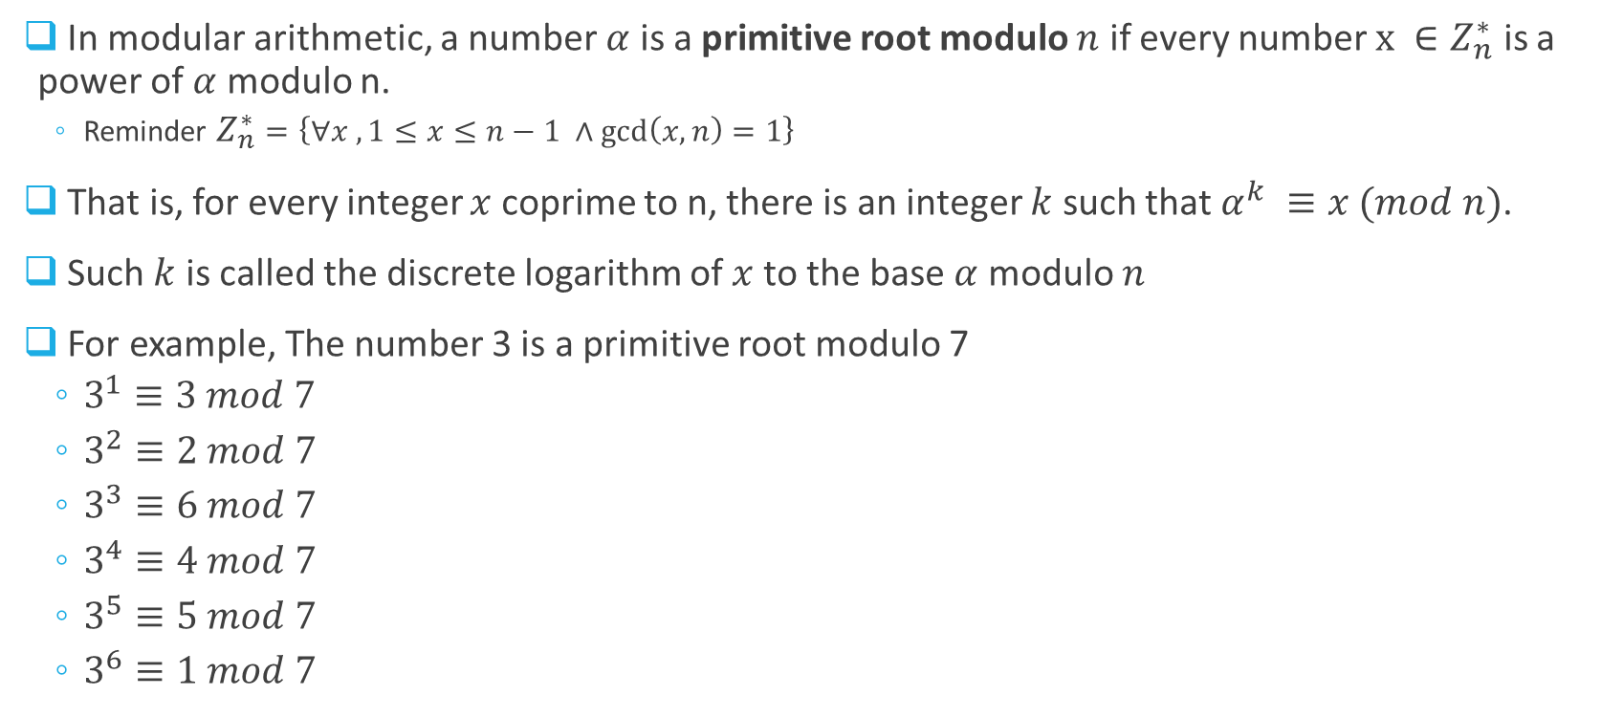
Primitive root modulo prime
In modular arithmetic, a number $α$ is a primitive root modulo $n$ if every number $x ∈Z_{n}^{∗}$ is a power of $α$ modulo n.
Reminder $Z_{n}^{∗}=\left\{∀x , 1≤x≤n−1 ∧\gcd\left(x,n\right)=1\right\}$
That is, for every integer $x$ coprime to n, there is an integer $k$ such that $α^{k} ≡x (mod n)$.
Such $k$ is called the discrete logarithm of $x$ to the base $α$ modulo $n$
For example, The number 3 is a primitive root modulo 7
$3^{1}≡3 mod 7$
$3^{2}≡2 mod 7$
$3^{3}≡6 mod 7$
$3^{4}≡4 mod 7$
$3^{5}≡5 mod 7$
$3^{6}≡1 mod 7$

Slide 15
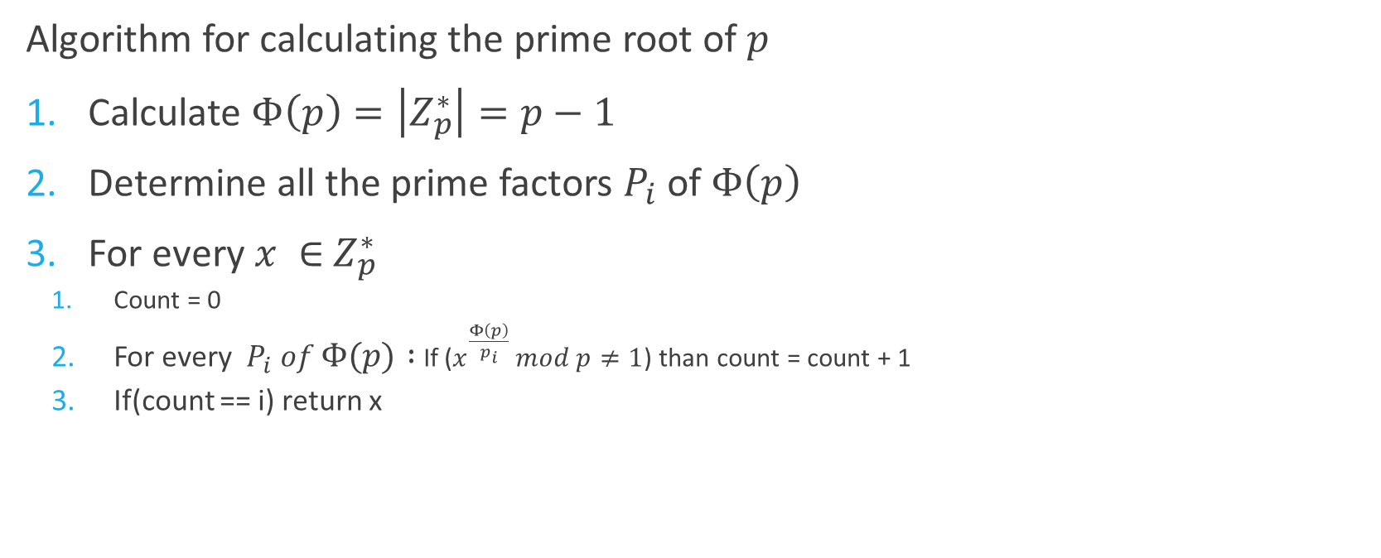
Primitive root modulo prime - Algorithm
Algorithm for calculating the prime root of $p$
Calculate $Φ\left(p\right)=\left|Z_{p}^{∗}\right|=p−1$
Determine all the prime factors $P_{i}$ of $Φ\left(p\right)$
For every $x ∈$ $Z_{p}^{∗}$
Count = 0
For every $P_{i} of Φ\left(p\right) :$If ($x^{\frac{Φ\left(p\right)}{p_{i}}} mod p≠1$) than count = count + 1
If(count == i) return x

Slide 16
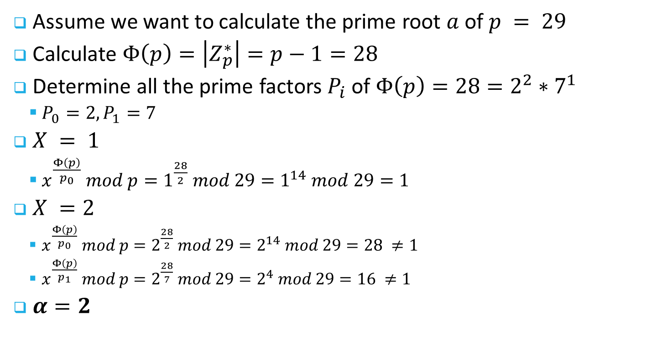
Primitive root modulo prime - example
Assume we want to calculate the prime root $a$ of $p = 29$
Calculate $Φ\left(p\right)=\left|Z_{p}^{∗}\right|=p−1=28$
Determine all the prime factors $P_{i}$ of $Φ\left(p\right)=28=2^{2}∗7^{1}$
$P_{0}=2, P_{1}=7$
$X = 1$
$x^{\frac{Φ\left(p\right)}{p_{0}}} mod p=1^{\frac{28}{2}} mod 29=1^{14} mod 29=1$
$X =2$
$x^{\frac{Φ\left(p\right)}{p_{0}}} mod p=2^{\frac{28}{2}} mod 29=2^{14} mod 29=28 ≠1$
$x^{\frac{Φ\left(p\right)}{p_{1}}} mod p=2^{\frac{28}{7}} mod 29=2^{4} mod 29=16 ≠1$
$α=2$

Slide 17
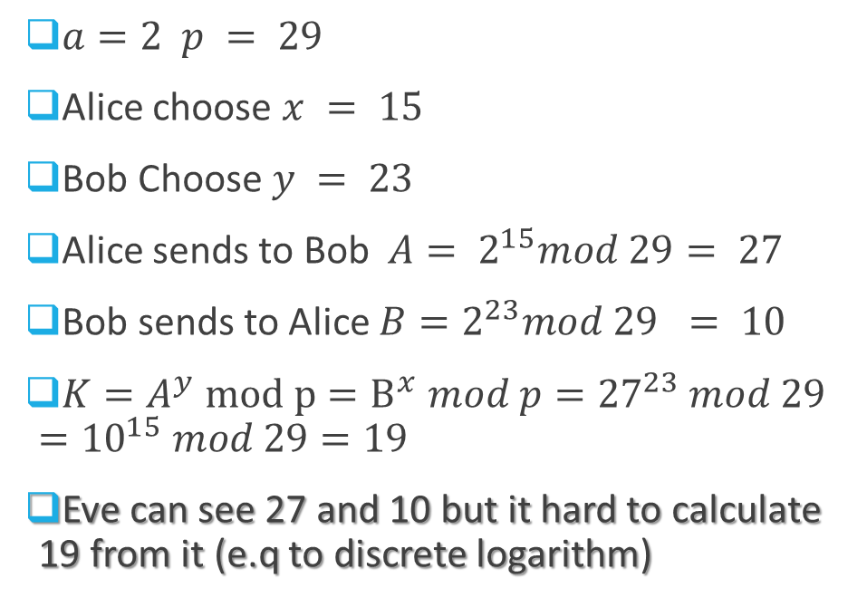
Diffie-Hellman Example
$a=2 p = 29$
Alice choose $x = 15$
Bob Choose $y = 23$
Alice sends to Bob ${ A= 2}^{15}mod 29= 27$
Bob sends to Alice ${B=2}^{23}mod 29 = 10$
$K=A^{y} mod p=B^{x} mod p={27}^{23} mod 29={10}^{15} mod 29=19$
Eve can see 27 and 10 but it hard to calculate 19 from it (e.q to discrete logarithm)
Visible to the attacker

Slide 18
Cryptography
Man In The Middle (MiM) Attack
Public Key Cryptography

Slide 19
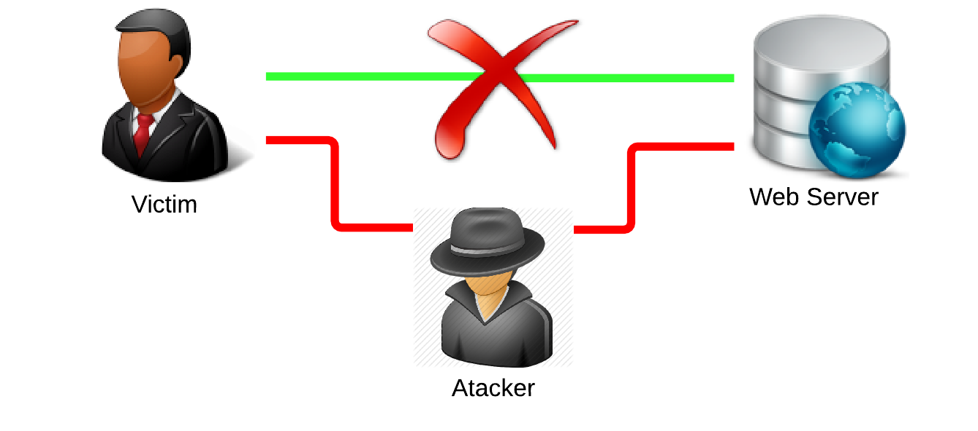
Man In the Middle
Two people can decide about public keys (like in Diffie Hellman protocol)
However, an attacker can intermediate during the key exchange and cause both sides to believe he is the other side

Slide 20




Man In the Middle
$$1.{ \text{α}}^{x} mod p$$
$${\text{2}\text{. }\text{α}}^{x′} mod p$$
3. ${\text{α}}^{y} mod p$
$$4. {\text{α}}^{y′} mod p$$

Slide 21


Man In the Middle
$$E(M,{\text{α}}^{y′x} mod p)$$
$$E(M,{\text{α}}^{yx′} mod p)$$
In the end of the attack, the attacker holds two symmetric keys (one with each party)
Problem: We don’t bind a key to its owner (identity)

Slide 22
Cryptography
Digital Signatures
Public Key Cryptography

Slide 23
Digital signatures
Goals:
Authentication -the source of the message (who is the sender)
Integrity –Nobody changed the content of the message
Non-repudiation of origin– The sender is the only one who can sign the message, the sender cannot deny signing the message
Asymmetric key cryptography uses:
Private key- the sender signs on the message
Public key- authentication of the signature

Slide 24
Digital signatures
Message
Calc msg hash
Transmit
Compare
msg. hash
Digital
Signature
Digital
Signature
decrypt signature
K_{public}
K_{private}

Slide 25
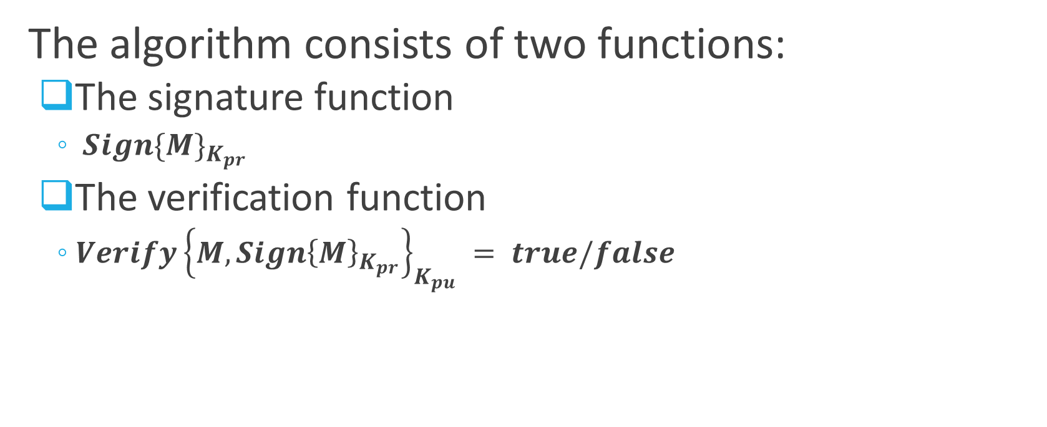
Digital signatures - Algorithm
The algorithm consists of two functions:
The signature function
$S{ign\{M\}}_{K_{pr}}$
The verification function
$Verify{\left\{M,S{ign\left\{M\right\}}_{K_{pr}}\right\}}_{K_{pu}} = true/false$
Notes:
פונקציה חתימה Sig הצפנה של הודעה M על ידי המפתח הפרטי של המשתמש u.
פונקצית V פענוח ההודעה בעזרת המפתח הפומבי של u.

Slide 26
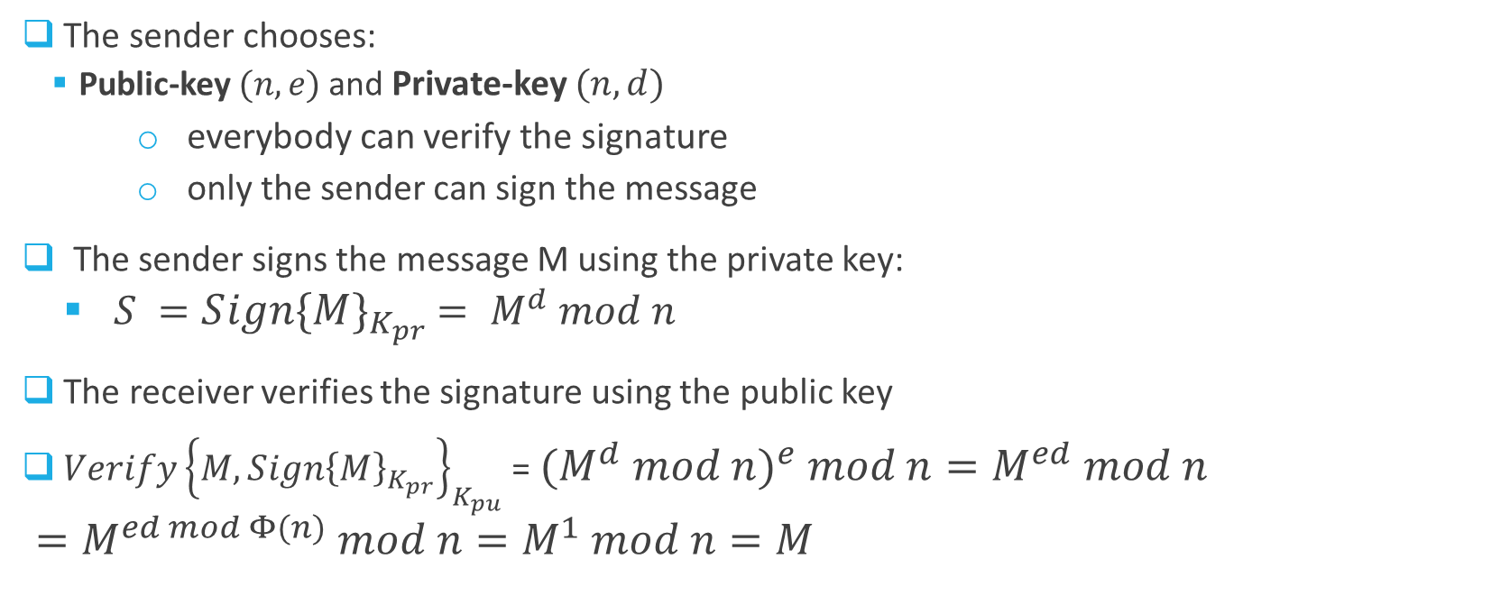
RSA Digital Signature
The sender chooses:
Public-key $(n,e)$ and Private-key $(n,d)$
everybody can verify the signature
only the sender can sign the message
The sender signs the message M using the private key:
$S =S{ign\{M\}}_{K_{pr}}$ $= M^{d} mod n$
The receiver verifies the signature using the public key
$Verify{\left\{M,S{ign\left\{M\right\}}_{K_{pr}}\right\}}_{K_{pu}}$ = ${{(M}^{d} mod n)}^{e} mod n=M^{ed} mod n=M^{ed mod Φ(n)} mod n=M^{1} mod n=M$

Slide 27
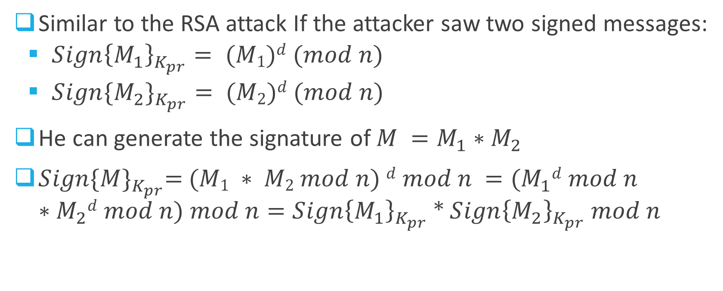
RSA Digital Signature - Attacks
Similar to the RSA attack If the attacker saw two signed messages:
$S{ign\left\{M_{1}\right\}}_{K_{pr}}= (M1)d (mod n)$
$S{ign\{M_{2}\}}_{K_{pr}}= (M2)d (mod n)$
He can generate the signature of $M =M_{1}∗M_{2}$
$S{ign\{M\}}_{K_{pr}}$=$(M1 ∗ M2 mod n) d mod n ={(M}_{1}d mod n ∗M_{2}d mod n) mod n=S{ign\left\{M_{1}\right\}}_{K_{pr}}$ * $S{ign\left\{M_{2}\right\}}_{K_{pr}} mod n$

Slide 28
Digital Signature – More Problems
When we use digital signature we enlarge the amount of data we need to transfer
Computation time of the digital signature is very long and depends on the size of the message
The verification time is long too, and also depends on the size of the message
Notes:
מגדילה את התעבורה ברשת

Slide 29
Public-Key vs Symmetric-Key Cryptography
Public-Key | Symmetric-Key
Each user has a pair of cryptographic keys. A public encryption key, and a private decryption key | The encryption and decryption keys are trivially related
The publicly available encrypting key is widely distributed and the private decrypting key is known only to the recipient (The private key cannot feasibly be derived from the public key) | The key is a secret
Very slow | Very fast
Rely on complexity of mathematic problems (for example, integer factorization, discrete log) | Do not relay on complexity of mathematic problems
Related algorithms: RSA, Elgamal, Diffie-Helman | Related algorithms: AES, DES
Uses for authentication, key agreement and integrity (digital signature) | Uses for confidentiality (encryption) and integrity (MAC)

