Slide 1
Computer & Information Security
Practical session no. 4
Authentication protocols

Slide 2

Authentication Protocol – what is it?
A communications protocol, which specifically designed to transfer authentication data between two entities.
It allows to authenticate two entities
One way authentication
Two way authentication
Most important layer of protection needed for secure communication within computer networks

Slide 3
Needham – Schroder protocol
A key transport protocols intended for use over an insecure network
Developed by Roger Needham and Michael Schroeder
A successful execution of the protocol aims to provide
Authentication: two way authentication
Confidentiality: a secret (symmetric) session-key between the two entities
Two architectures:
Symmetric Key Protocol
Public Key Protocol

Slide 4



The Actors
Alice wish to initiate a secure and authenticate communication with Bob
To do so, Alice use a server trusted by both Alice and Bob
Alice, Bob, and the trusted server can all communicate with each other.
Trusted Server
Alice
Bob

Slide 5

The Actors
Eve represents a malicious actor
Eve can intercept (stop/modify) all system communication
Alice – Server
Alice – Bob
Bob – Server
Eve cannot read encrypted data; break symmetric or asymmetric encryptions/signatures; and predict large random numbers.
Trusted Server
Eve
Eve
Alice
Bob
Eve

Slide 6
The Actors
The main objectives of Eve are either:
Read the encrypted communication between Alice and Bob
Authenticate as Alice/Bob
Trusted Server
Eve
Eve
Alice
Bob
Eve

Slide 7
Authentication Protocols
Needham – Schroder Protocol
Public-Key protocol
Symmetric protocol

Slide 8
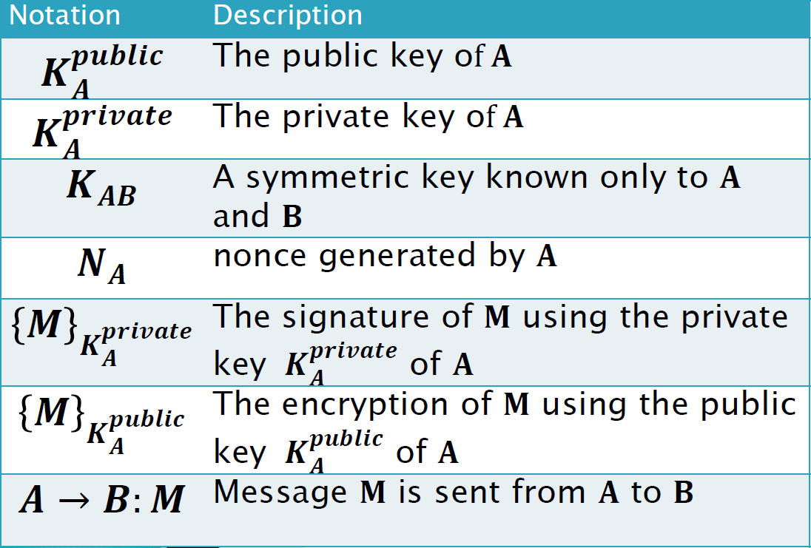
NS Public-Key protocol
Nonce: arbitrary number that may be used once. Often used as pseudo-random number issued in an authentication protocol to ensure that old communication cannot be reused.
S is a server trusted by both party – A.K.A Key Distribution Center (KDC)
Alice and Bob uses the trusted server to distribute public keys on request.
Both Alice and Bob are familiar with the public key of the trusted server

Slide 9
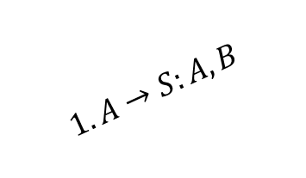
NS Public-Key protocol- example
Explanation:
1. A requests B's public keys from S
$$1. A→S:A, B$$

Slide 10
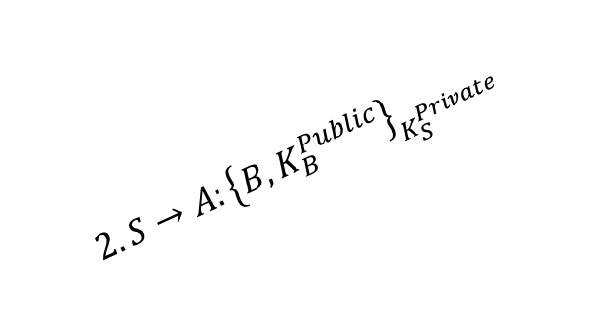
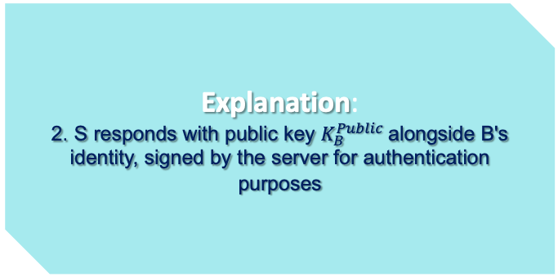
NS Public-Key protocol- example
Explanation:
2. S responds with public key $K_{B}^{Public}$alongside B's identity, signed by the server for authentication purposes
$$1. A→S:A, B$$
$$2. S→A:{\left\{B, K_{B}^{Public}\right\}}_{K_{S}^{Private}}$$
Notes:
להסביר על העובדה שהשרת חותם באמצעות הפרטי, והפתיחה באמצעות הציבורי-מוודאים כך שאכן אנחנו מדברים עם השרת ולא עם מתחזה כי רק הוא מחזיק במפתח הפרטי

Slide 11

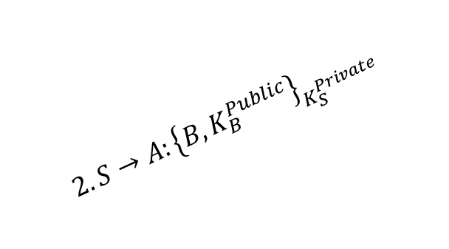
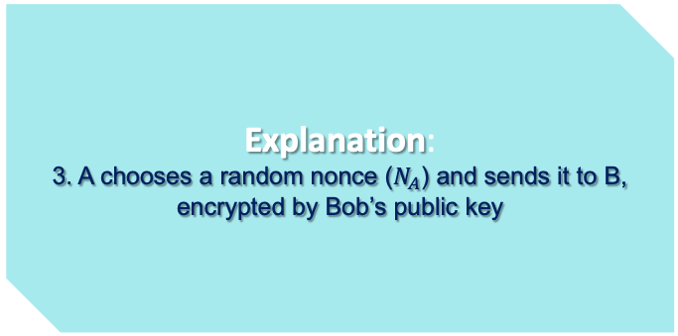
NS Public-Key protocol- example
Explanation:
3. A chooses a random nonce ($N_{A}$) and sends it to B, encrypted by Bob’s public key
$$1. A→S:A, B$$
$$2. S→A:{\left\{B, K_{B}^{Public}\right\}}_{K_{S}^{Private}}$$
$$3. A→B{:\left\{N_{A},A\right\}}_{K_{B}^{Public}}$$

Slide 12
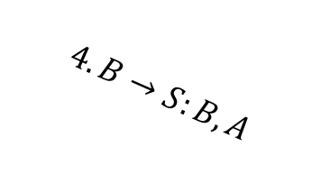
NS Public-Key protocol- example
Explanation:
4. B now knows A wants to communicate, so B requests A's public keys
$$1. A→S:A, B$$
$$4. B→S:B,A$$
$$2. S→A:{\left\{B, K_{B}^{Public}\right\}}_{K_{S}^{Private}}$$
$$3. A→B{:\left\{N_{A},A\right\}}_{K_{B}^{Public}}$$

Slide 13
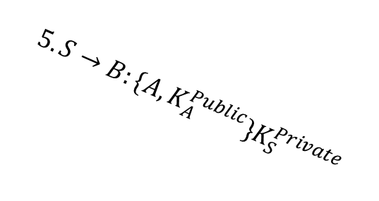
NS Public-Key protocol- example
Explanation:
5. Server responds with Alice public key, signed with his own private key
$$1. A→S:A, B$$
$$4. B→S:B,A$$
$$2. S→A:{\left\{B, K_{B}^{Public}\right\}}_{K_{S}^{Private}}$$
$$5. S→B:\{{A,K}_{A}^{Public}\}K_{S}^{Private}$$
$$3. A→B{:\left\{N_{A},A\right\}}_{K_{B}^{Public}}$$

Slide 14

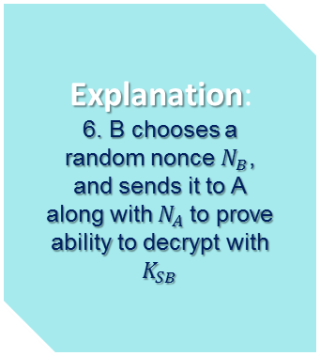
NS Public-Key protocol- example
Explanation:
6. B chooses a random nonce $N_{B}$, and sends it to A along with $N_{A}$to prove ability to decrypt with $K_{SB}$
$$1. A→S:A, B$$
$$4. B→S:B,A$$
$$2. S→A:{\left\{B, K_{B}^{Public}\right\}}_{K_{S}^{Private}}$$
$$5. S→B:\{{A,K}_{A}^{Public}\}K_{S}^{Private}$$
$$3. A→B{:\left\{N_{A},A\right\}}_{K_{B}^{Public}}$$
$$6. B→A{:\left\{N_{A},N_{B},K_{AB}\right\}}_{K_{A}^{Public}}$$

Slide 15


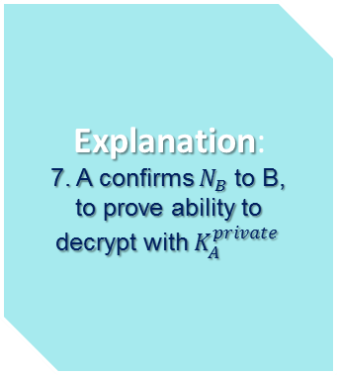
NS Public-Key protocol- example
Explanation:
7. A confirms $N_{B}$to B, to prove ability to decrypt with $K_{A}^{private}$
$$1. A→S:A, B$$
$$4. B→S:B,A$$
$$2. S→A:{\left\{B, K_{B}^{Public}\right\}}_{K_{S}^{Private}}$$
$$5. S→B:\{{A,K}_{A}^{Public}\}K_{S}^{Private}$$
$$3. A→B{:\left\{N_{A},A\right\}}_{K_{B}^{Public}}$$
$$6. B→A{:\left\{N_{A},N_{B},K_{AB}\right\}}_{K_{A}^{Public}}$$
$$7. A→B{:\left\{N_{B},K_{AB}\right\}}_{K_{B}^{Public}}$$

Slide 16

At the end…
At the end of the protocol, A and B know each other's identities, shared a session key
Does this protocol vulnerable?

Slide 17

Attack on the protocol
The protocol is vulnerable to a Man in the Middle attack
If Eve can persuade Alice to initiate a session with her, he can relay the messages to B and convince B that he is communicate with A

Slide 18
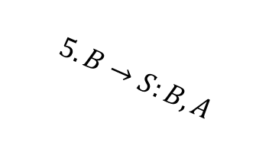


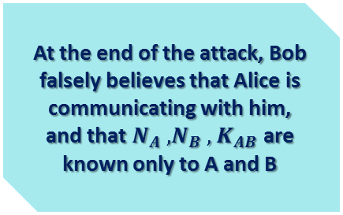
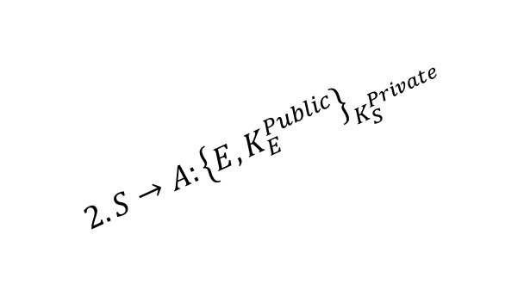

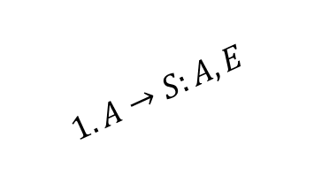


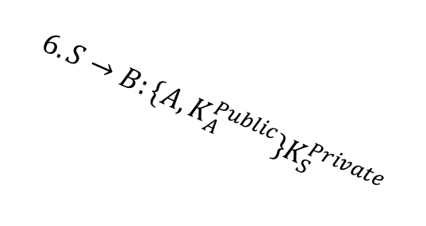

NS Public-Key protocol- MiM Attack
At the end of the attack, Bob falsely believes that Alice is communicating with him, and that $N_{A} , N_{B} , { K}_{AB}$are known only to A and B
$$1. A→S:A, E$$
$$5. B→S:B,A$$
$$2. S→A:{\left\{E, K_{E}^{Public}\right\}}_{K_{S}^{Private}}$$
$$6. S→B:\{{A,K}_{A}^{Public}\}K_{S}^{Private}$$
$$3. A→E{:\left\{N_{A},A\right\}}_{K_{E}^{Public}}$$
$$4. E→B{:\left\{N_{A},A\right\}}_{K_{B}^{Public}}$$
$$8. E→A{:\left\{N_{A},N_{B},K_{AB}\right\}}_{K_{A}^{Public}}$$
$$7. B→E{:\left\{N_{A},N_{B},K_{AB}\right\}}_{K_{A}^{Public}}$$
$$9. A→E{:\left\{N_{B},K_{AB}\right\}}_{K_{E}^{Public}}$$
$$10. E→B{:\left\{N_{B},K_{AB}\right\}}_{K_{B}^{Public}}$$

Slide 19
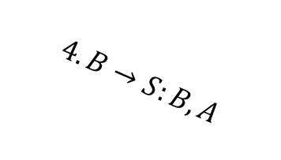

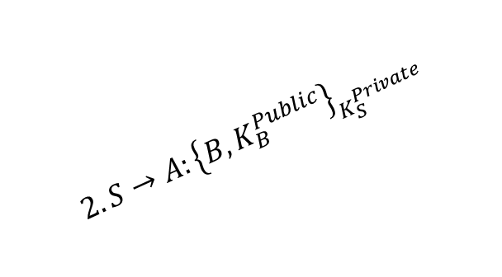

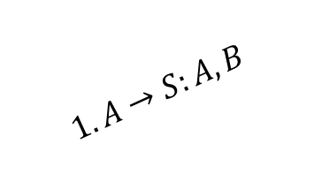

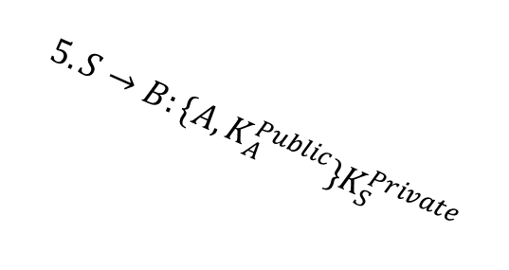
Fixing required…
Inclusion of the responder’s identity at step 6
$$1. A→S:A, B$$
$$4. B→S:B,A$$
$$2. S→A:{\left\{B, K_{B}^{Public}\right\}}_{K_{S}^{Private}}$$
$$5. S→B:\{{A,K}_{A}^{Public}\}K_{S}^{Private}$$
$$3. A→B{:\left\{N_{A},A\right\}}_{K_{B}^{Public}}$$
$$6. B→A{:\left\{N_{A},N_{B},B,K_{AB}\right\}}_{K_{A}^{Public}}$$
$$7. A→B{:\left\{N_{B},K_{AB}\right\}}_{K_{B}^{Public}}$$

Slide 20
Authentication Protocols
Needham – Schroder Protocol (Roger Needham, Michael Schroeder)
Public-Key protocol
Symmetric protocol

Slide 21
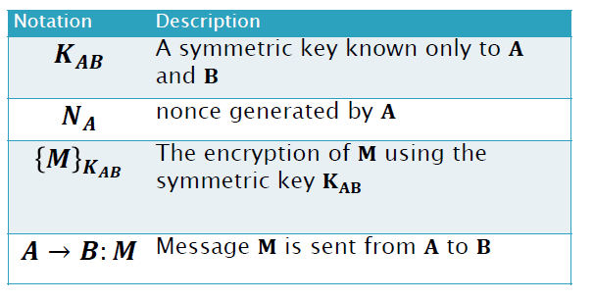
NS Symmetric Key protocol - Annotations
Nonce: an arbitrary number that may be used once. Often used as pseudo-random number issued in an authentication protocol to ensure that old communication cannot be reused
Alice initiates the communication to Bob
S is a server trusted by both party – A.K.A Key Distribution Center (KDC)
We assume that the server S have a symmetric key with all the entities in the system

Slide 22
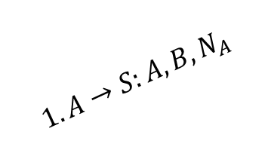
NS Symmetric key - example
Explanation:
1. Alice sends a message to the server identifying herself and Bob, telling the server she wants to communicate with Bob.
$$1. A→S:A, B, N_{A}$$

Slide 23
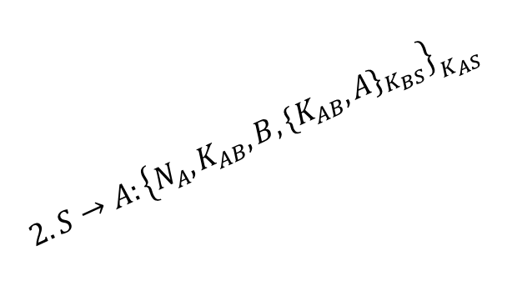
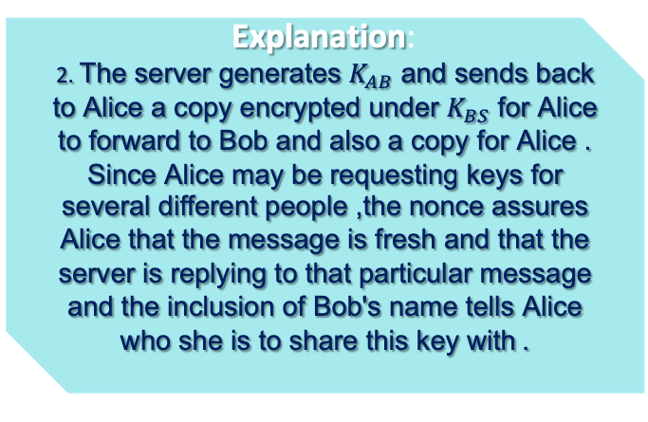
NS Symmetric key - example
Explanation:
2. The server generates $K_{AB}$ and sends back to Alice a copy encrypted under $K_{BS}$ for Alice to forward to Bob and also a copy for Alice. Since Alice may be requesting keys for several different people, the nonce assures Alice that the message is fresh and that the server is replying to that particular message and the inclusion of Bob's name tells Alice who she is to share this key with.
$$1. A→S:A, B, N_{A}$$
$$2. S→A:{\left\{N_{A}, K_{AB},B,{\{K_{AB},A\}}_{K_{BS}}\right\}}_{K_{AS}}$$

Slide 24

NS Symmetric key - example
Explanation:
3. Alice forwards the key to Bob who can decrypt it with the key he shares with the server, thus authenticating the data.
$$1. A→S:A, B, N_{A}$$
$$2. S→A:{\left\{N_{A}, K_{AB},B,{\{K_{AB},A\}}_{K_{BS}}\right\}}_{K_{AS}}$$
$$3. A→B{:\left\{K_{AB},A\right\}}_{K_{BS}}$$

Slide 25

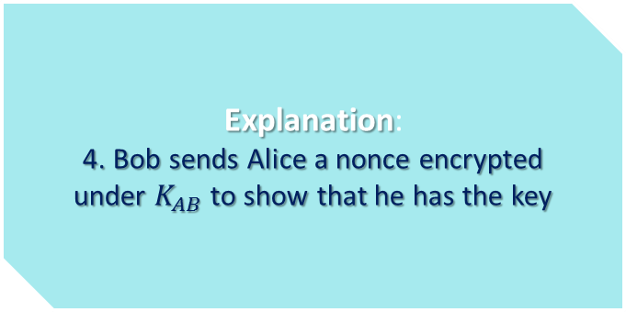

NS Symmetric key - example
Explanation:
4. Bob sends Alice a nonce encrypted under $K_{AB}$ to show that he has the key
$$1. A→S:A, B, N_{A}$$
$$2. S→A:{\left\{N_{A}, K_{AB},B,{\{K_{AB},A\}}_{K_{BS}}\right\}}_{K_{AS}}$$
$$3. A→B{:\left\{K_{AB},A\right\}}_{K_{BS}}$$
$$4. B→A:{\{N_{B}\}}_{K_{AB}}$$

Slide 26

NS Symmetric key - example
Explanation:
5. Alice performs a simple operation on the nonce, re-encrypt it and sends it back verifying that she is still alive and that she holds the key
$$1. A→S:A, B, N_{A}$$
$$2. S→A:{\left\{N_{A}, K_{AB},B,{\{K_{AB},A\}}_{K_{BS}}\right\}}_{K_{AS}}$$
$$3. A→B{:\left\{K_{AB},A\right\}}_{K_{BS}}$$
$$4. B→A:{\{N_{B}\}}_{K_{AB}}$$
$$5. A→B{:\left\{N_{B}−1\right\}}_{K_{AB}}$$

Slide 27
Does this protocol vulnerable?

Slide 28
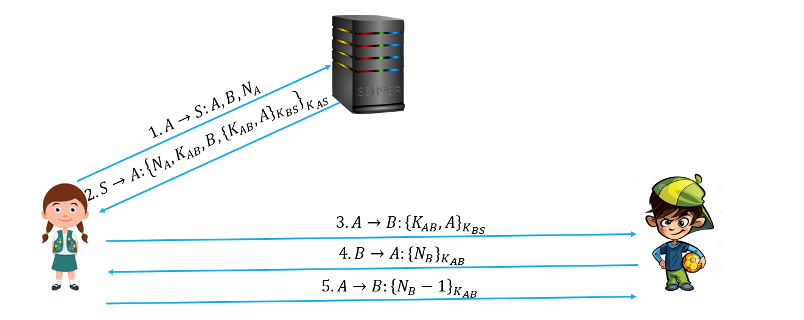
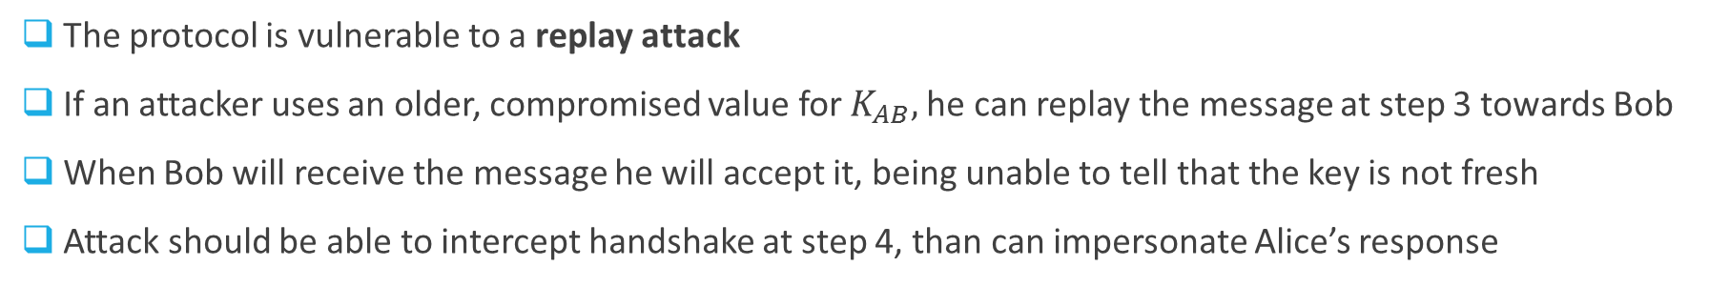
Attack on the protocol
The protocol is vulnerable to a replay attack
If an attacker uses an older, compromised value for $K_{AB},$he can replay the message at step 3 towards Bob
When Bob will receive the message he will accept it, being unable to tell that the key is not fresh
Attack should be able to intercept handshake at step 4, than can impersonate Alice’s response

Slide 29

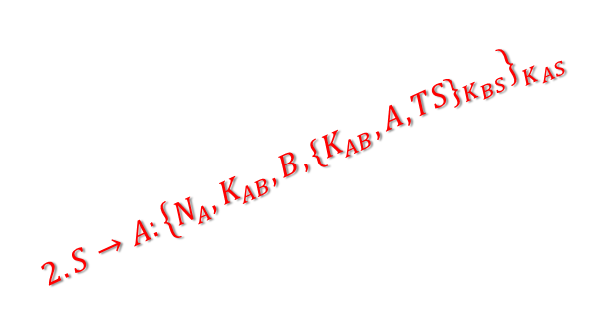
Fixing required…
Explanation:
TS is a timestamp that assures Alice and Bob that the session key has only just been generated. Thus, both Alice and Bob knows that the Server created a freshly session key.
Replay attack will be failed at step 3 due to Bob checking for untimely session key
Inclusion of a timestamp (TS)
$$1. A→S:A, B, N_{A}$$
$$2. S→A:{\left\{N_{A}, K_{AB},B,{\{K_{AB},A,TS\}}_{K_{BS}}\right\}}_{K_{AS}}$$
$$3. A→B{:\left\{K_{AB},A,TS\right\}}_{K_{BS}}$$
$$4. B→A:{\{N_{B}\}}_{K_{AB}}$$
$$5. A→B{:\left\{N_{B}−1\right\}}_{K_{AB}}$$

