Slide 1
Computer & Information Security
Practical session no. 6
FireWalls

Slide 2
General Information
Teaching Assistant
Aviad Elyashar
Email:
aviade@post.bgu.ac.il
Office Hours:
Monday 13:00 at Building 96 room 101 (1st floor)

Slide 3
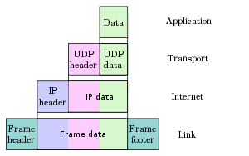
Firewalls
Effective mean of protection a local system or network of systems from incoming and outgoing security threats
Aims:
Establish a controlled link
Protect the premises network from Internet based attacks
Provide a single choke point
Design goals:
All traffic between protected entities must pass through the firewall
Only authorized (by Organization security policy) traffic will be allowed to pass
The firewall itself is immune to penetration

Slide 4

Firewalls
Firewalls
State Less
State-less Packet Filter
State-full packet Filter
Proxy Server
Iptables

Slide 5
Packet Filter Firewall
Each packet is passed through the firewall (in/out)
For each packet the firewall makes a decision regarding the packet
The decision is based on the rules tables
Advantages:
Simplicity
Transparency to users
High Speed
Disadvantages:
Difficulty of setting rules
Lack of authentication

Slide 6
Packet Filter Firewall – Rules table
Packets pass through the rules table until a rule is met
The order of the rules matters!
Simple rules should come first
Edge case and “heavy” rules should come last
“Default Deny/Allow” – If no rule is met the decision will be based in the firewall policy (Allow/Deny/Drop)
The difference between ‘Drop’ and Deny’ is that Drop won’t send a response and the Deny will send a refuse response
Rule table Example:
Action | Ack | Dst. port | Src.port | Protocol | Dst.Addr. | Src. Addr. | In/Out | Rule
Drop | * | 80 | * | TCP | * | 10.0.0.5 | in | 1
Allow | * | * | * | * | * | * | * | 2
‘*’ Sign mean wildcard for ‘any’
Notes:
SYN -> SYN ACK ->ACK
להסביר על הטבלה
Ack - האם ה- bit של ה-Ack דלוק בפקטת tcp

Slide 7
Firewalls -Stateless packet filter
Each packet considered as a single unit with no relation to other packets
Each packet will go through the rules table
The decision about the packet is based on the rules and the default policy
Possible attacks:
IP address spoofing
Tiny fragments attacks
Notes:
IP address spoofing - זיוף של כתובת הIP גורר מניפולציה על טבלת החוקים
Tiny fragments attacks – חלוקה של הפאקטה לחתיכות קטנות שלא ניתנות להרכבה בצורה טובה לאחר מכן כתוצאה מחוסר במידע. הדבר יכול לגרום לDOS או ניסיון להכניע את מנגנון הpacket filter

Slide 8
Firewalls
Firewalls
State Full
State-less Packet Filter
State-full packet Filter
Proxy Server
Iptables

Slide 9
Firewalls – State-full packet filter
Concept:
Define the allowed and forbidden connections
Only a packet that opens a connection is checked by the rules table
Retaining packets until enough information is available to make a judgement about its state
If the packet is allowed, information about the session is saved:
Source address + port
Destination address + port
Protocol
Static rules still used (as state-less), but can now contain connection state as one of their test criteria
A packet that doesn’t open a session or doesn’t belong to a session is dropped
Notes:
The session’s protocol is TCP or UDP

Slide 10
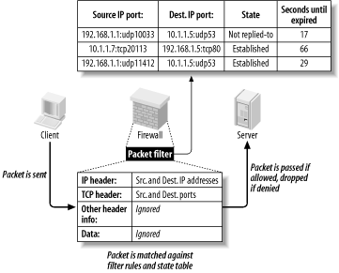
State-full packet filter - example
Client sent a packet to the Server
The Firewall intercept the packet
Check IP header against rules table
Check TCP header against rules table
Make decision according rules
Noticed the State and Second Until expires columns

Slide 11
Firewalls
Firewalls
Proxy
State-less Packet Filter
State-full packet Filter
Proxy Server
Iptables

Slide 12
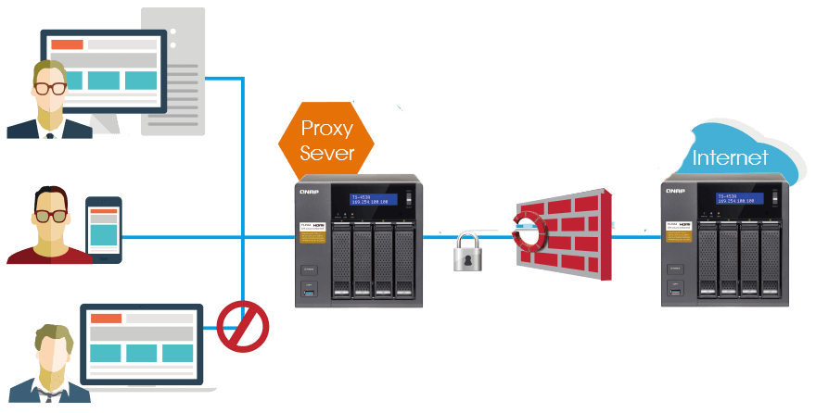
Firewalls - Proxy Server
Legal Man In the Middle – each request to the internet maintained by the proxy
Saved a cache of common request and check freshness by requests
The client communicates the proxy, and the proxy communicates with the server
Usually works on the application (TELNET/FTP/SMTP/HTTP etc.) level
Also K.A ‘Application-level Gateway’

Slide 13
Proxy Sever – Pros Vs. Cons
Advantages
Disadvantages
Higher security than packet filters
Apply access control without changing the application
No direct connection ‘outside’ world
Easy to log and audit all incoming traffic
Every application requires writing a new proxy
The server does not “see” the client
Can reduce performance (additional overhead on each connection)
Notes:
עבור כל אפליקציה יש צורך לכתוב שרת פרוקסי מתאים ז"א צריך מודול שיממש את הפרוקסי עבור כל אפליקציה ספציפית.
בדר"כ בapplication level proxy זה בעצם שהפרוקסי מתפקד כשרת אל מול הקליינט וכקליינט אל מול השרת.
וכדי לבצע את MiTM הוא צריך לממש גם קליינט וגם שרת של אותו פרוטוקול אפליקציה ולכן זה משהו שהוא ייעודי פר פרוטוקול אפליקציה.

Slide 14
Firewalls
Firewalls
Iptables
State-less Packet Filter
State-full packet Filter
Proxy Server
Iptable

Slide 15
Iptables
A user space program that allows to configure the Linux Kernel Firewall
Allows to chain firewall rules
Could define a state-full firewalls rules (based on state{ESTABLISHED/RELATED})
Other functionalities
Port Forwarding
IP Forwarding
Logging
Notes:
Port Fowarding
הדבר מאפשר למחשבים מרוחקים, אשר מחוברים לרשת האינטרנט, למשל, להתחבר למכונה מסוימת המחוברת לרשת פרטית, שאינה נגישה בדרכים רגילות.
השיטה נפוצה גם כאשר יש צורך בגישה למחשב אשר מחובר רק לרשת פנימית. אז משתמשים במחשב מתווך, המחובר גם לרשת הפנימית וגם לזו לחיצונית, אשר מעביר את התקשורת בין הצדדים. בדרך כלל התקשורת הזו מתבצעת בפרוטוקול המוצפן SSH.
IP forwarding also known as IP routing or Internet routing is a process used to determine which path a packet or datagram can be sent.The process uses routing information to make decisions and is designed to send a packet over multiple networks
Logging is the act of keeping a log. In the simplest case, messages are written to a single log file.

Slide 16
Iptables - Chains
The IP Tables firewall consist of 3 default chains:
Input - for incoming traffic
Output – for outgoing traffic
Forward – for traffic that is forwarded
It is possible to define new chains to add depth to the rules tables
Each chain has a default policy (Allow/Drop/..)
Rule 2
Rule 3
Input Chain
Rule 1
Rule 1
Rule 2
Custom Chain
Notes:
Traffic that is port forwarded to the same device will still pass through the forward chain rules

Slide 17
Iptables - Rules
Structure – a Criteria and a Target
Criteria – the things we want to make sure the packet contains (port, protocol, IP add., etc..)
Target – the action to be performed, Can either be an immediate action (Drop/Reject/Accept) or a call the another chain
We add a rule to a chain be defining the rule, its parameters and the chain
Order of the rules does matter
Example : iptables –A INPUT –p TCP --dport 80 –j ACCEPT
Notes:
-A = mean to append rule to the INPUT/OUTPUT/FORWARD chain
-j = target of the rule
-p = Port of the rule

Slide 18



Q1
We have an internal web server, used only for testing purposes, at IP address 5.6.7.8 on our internal corporate network. A packet filter firewall is situated at a single endpoint between our internal network and the rest of the Internet.
5.6.7.8

Slide 19
Q1
5.6.7.8
Q: Can a stateless firewall block all attempts by outside hosts to initiate a direct TCP connection to this internal web server? If yes, show a packet filtering rules set that provides this functionality; if no, explain why.
Action | Ack. | Dest, port | Source port | Protocol | Dest. Addr. | Source Addr. | Direction | Rule
drop | * | * | * | TCP | 5.6.7.8 | * | in | No_TCP

Slide 20
Q2
5.6.7.8
Q: Can a stateless packet filter block all incoming email containing the phrase “Make money fast”? If yes, show a packet filtering rules set that provides this functionality; if no, explain why.
A: The sentence can be sent over few packets. Stateless firewall doesn’t remember the previous state and therefore, can’t block such e-mail.

Slide 21
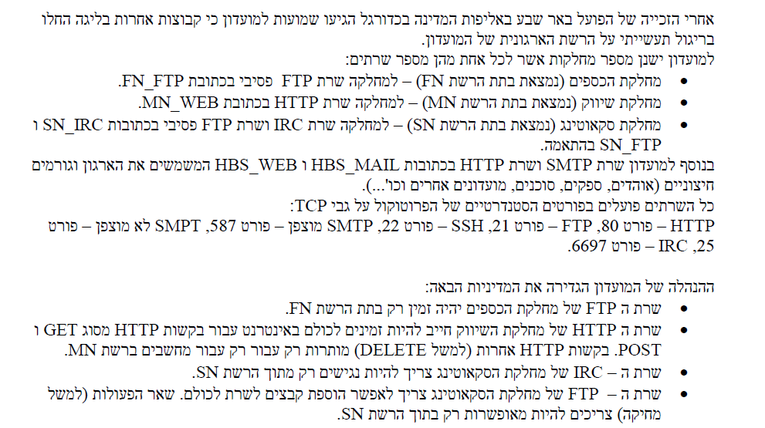
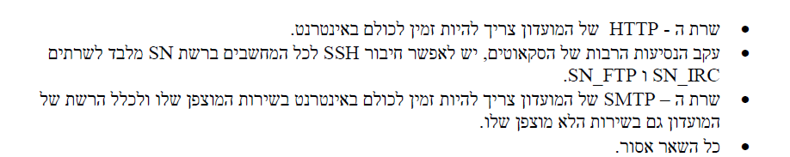
Q3

Slide 22
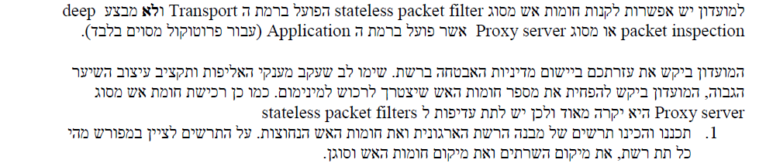

Slide 23
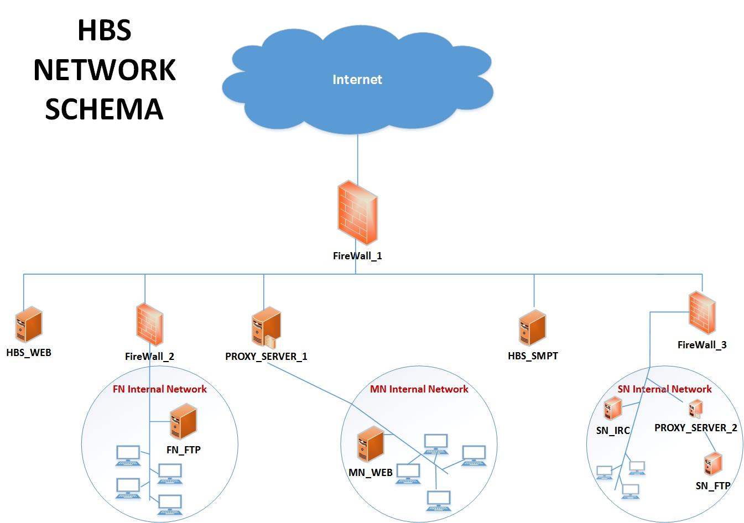
Suggested Solution

Slide 24
2. מלאו את טבלת החוקים עבור Firewall שמגן על רשת מחלקת הכספים (FN)
Action | Ack | Dest. Port | Src. Port | Protocol | Dest. Add | Src. Add | In/Out | Rule Name
Drop | * | * | * | TCP | FN_FTP | * | IN | FN_FTP_Drop
Allow | * | 80 | * | TCP | HBS_WEB | FN | OUT | Http_General
Allow | * | * | 80 | TCP | FN | HBS_WEB | IN | Http_General__IN
Allow | * | 80 | * | TCP | MN_WEB | FN | OUT | MN_WEB_OUT
Allow | * | * | 80 | TCP | FN | MN_WEB | IN | MN_WEB_IN
Allow | * | * | 25 | TCP | FN | HBS_SMTP | IN | SMTP_Mail_IN_PUBLIC
Allow | * | 25 | * | TCP | HBS_SMTP | FN | OUT | SMTP_Mail_OUT_PUBLIC
Allow | * | 587 | * | TCP | HBS_SMTP | FN | OUT | SMTP_Mail_OUT_ENCRYPT
Allow | * | * | 587 | TCP | FN | HBS_SMTP | IN | SMTP_Mail_IN_ENCRYPT
Drop | * | * | * | * | * | * | * | Default
הנחות:
נאפשר התקשרות מאובטחת ולא מאובטחת לשרת המייל מתוך רשת הכספים

Slide 25
2. מלאו את טבלת החוקים עבור Firewall המתווך בין רשת 'הפועל באר שבע' לרשת האינטרנט הציבורית
Action | Ack | Dest. Port | Src. Port | Protocol | Dest. Add | Src. Add | In/Out | Rule Name
Allow | * | 80 | * | TCP | HBS_WEB | * | IN | Http_General
Allow | * | * | 80 | TCP | * | HBS_WEB | OUT | Http_General_OUT
Allow | * | 80 | * | TCP | MN_WEB | * | IN | Http_MN
Allow | * | * | 80 | TCP | * | MN_WEB | OUT | Http_MN_OUT
Allow | * | 587 | * | TCP | HBS_SMPT | * | IN | SMPT_Mail_IN
Allow | * | * | 587 | TCP | * | HBS_SMPT | OUT | SMPT_Mail_OUT
Drop | * | * | * | * | * | * | * | Default

