Slide 1
Practice Question
Would changing the stack from growing down to growing up prevent buffer overflows?
Explain your answer

Slide 2
Buffer Overflow
Void func1() {
char[] b[64];
gets(b);
}
High Address
Void main() {
// Start of application
func1();
}
ESP
EBP
Low Address

Slide 3
Buffer Overflow
Void func1() {
char[] b[64];
gets(b);
}
High Address
Void main() {
// Start of application
func1();
}
ESP
Return Address
EBP
Low Address

Slide 4
Buffer Overflow
Void func1() {
char[] b[64];
gets(b);
}
High Address
Void main() {
// Start of application
func1();
}
ESP
EBP
Old EBP
Return Address
Low Address

Slide 5
Buffer Overflow
Void func1() {
char[] b[64];
gets(b);
}
High Address
Void main() {
// Start of application
func1();
}
ESP
b[64]
EBP
Old EBP
Return Address
Low Address

Slide 6
Buffer Overflow
Void func1() {
char[] b[64];
gets(b);
}
High Address
EBP
ESP
Old EBP
Void main() {
// Start of application
func1();
}
Return Address
b[64]
Old EBP
Return Address
Low Address

Slide 7
Buffer Overflow
Void func1() {
char[] b[64];
gets(b);
}
High Address
EBP
ESP
bbbbbbbbbbbbbbbbbbbbbbbbbbbbbbbbbbbbbbbbbbbbbbbbbbbbbbbbbbbbbbbbbbbbbbbbbbb
Void main() {
// Start of application
func1();
}
Old EBP
Return Address
Low Address

Slide 8
Computer & Information Security
Practical session no. 9
SQL Injection

Slide 9
Agenda
SQL Recap
SQL Injection
Prevention and Protection

Slide 10
SQL Recap

Slide 11
SQL Recap
SQL – Structured Query Language
The standard language for accessing and manipulation (SQL) databases
An ANSI (American National Standards Institute) and ISO (International Organization for Standardization) standard – but different versions exist:
SQL Server
MySQL
SQLite
More…
An SQL database has tabular structure

Slide 12
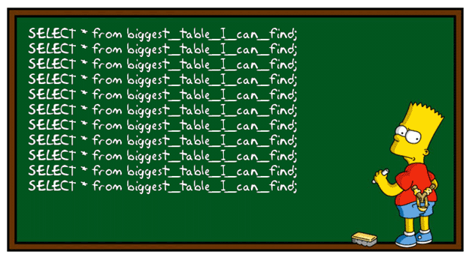
SQL Syntax Recap
SELECT:
SELECT column1, column2, …
FROM table_name
WHERE condition
Selects and returns the desired columns from the specified table which satisfy the condition.

Slide 13
SQL Syntax Recap
INSERT:
INSERT INTO table_name (column1, column2, …)
VALUES (value1, value2, …)
Insert into specified table and columns (optional) the given values.

Slide 14

SQL Syntax Recap
DELETE:
DELETE FROM table_name
WHERE condition
Delete rows which satisfy the condition from specified table.

Slide 15


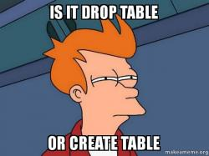
SQL Syntax Recap
DROP TABLE:
DROP TABLE table_name
DROP DATABASE:
DROP DATABASE database_name
Drops (Removes entire) tables from database or database from disk.

Slide 16

SQL Injection
How is it done

Slide 17
SQL Injection - Objectives
Three main attacker’s objectives for SQL injection:
Control application behavior based on data in the database.
Access data from the database without authorization.
Alter data in the database without authorization.

Slide 18
Reconnaissance
How does the attacker know how to attack?
What?
Database type
Database name
Tables names
Tables structures
Etc.
How?
Look at program’s / website’s code
Reverse Engineering
Send faulty queries and learn from returned error messages
Union based queries to extract information from the database
Response time attacks

Slide 19
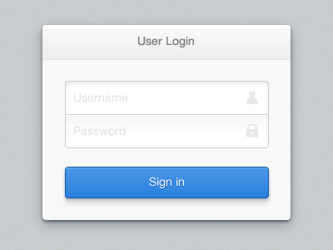
SQL Injection - Vulnerability
The vulnerability begins when software needs to access the DB, but the query is depended on user’s input.
For Example: Login into an account – user inputs details, query is built accordingly:
“SELECT *
FROM Users
WHERE username = ‘“ + username +
“’ AND password = ‘” + password + “’;”
Maccabi
*****
“SELECT *
FROM Users
WHERE username = ‘Maccabi’
AND password = ‘Haifa’;”

Slide 20
Control Application Behavior
Bypass authentication mechanism:
All users are returned – usually system look at first result.
“SELECT *
FROM Users
WHERE username = ‘“ + username +
“’ AND password = ‘” + password + “’;”
Someone’ OR 1=1; --
********
“SELECT *
FROM Users
WHERE username = ‘Someone’
OR 1=1; -- AND password = ‘paswd’;”

Slide 21
Control Application Behavior
Login as an administrator:
“SELECT *
FROM Users
WHERE username = ‘“ + username +
“’ AND password = ‘” + password + “’;”
JonSnow’; INSERT INTO group_membership (user_id, group)
VALUES ((SELECT id FROM users WHERE username='JonSnow‘), 'Administrator'); --
********
“SELECT * FROM Users
WHERE username = ‘JonSnow’; INSERT INTO group_membership (user_id, group)
VALUES ((SELECT id FROM users WHERE username='JonSnow‘) ,'Administrator’);
-- AND password = ‘paswd’;”

Slide 22
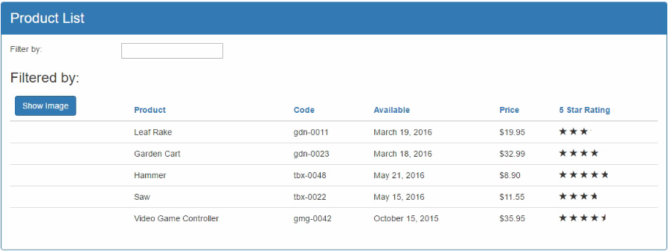
Access and Alter data
In our website we show a product list and some details about them.
It is possible to filter the list by product name.

Slide 23
Access data
Assumed filter query: “SELECT name, code, available, price, rating FROM Products WHERE name=‘” + filter + “’;”
Resulted query: “SELECT name, code, available, price, rating FROM Products WHERE name=‘Whatever’ UNION SELECT username, password, 0, 0, 0 FROM users WHERE ‘1’=‘1’;”
Whatever’ UNION SELECT username, password, 0, 0, 0 FROM users WHERE ‘1’=‘1

Slide 24
Alter data
Assumed filter query: “SELECT name, code, available, price, rating FROM Products WHERE name=‘” + filter + “’;”
Resulted query: “SELECT name, code, available, price, rating FROM Products WHERE name=‘Whatever’; DROP TABLE customers; --’;”
Whatever’; DROP TABLE customers; --

Slide 25

Prevention
How do we prevent or block SQL attacks

Slide 26
Obfuscation
First of all – take measures against reconnaissance:
Move implementation (especially DB related) to back-end
Harden reverse engineering by obfuscation techniques
Do not reveal errors to users – alert for an error with no further details

Slide 27

Reduce Attack Surface
Ensure that all excess database privileges are revoked and that only those routines that are intended for end-user access are exposed.
Though this does not entirely eliminate SQL injection vulnerabilities, it mitigates the impact of the attacks.

Slide 28

Avoid Dynamic SQL Queries
Dynamic SQL built with concatenated input values presents the easiest entry point for SQL injections.
Avoid constructing dynamic SQL this way.

Slide 29

Use Bind Arguments
Parameterize queries by using bind arguments.
Bind arguments reduce the possibility of SQL injections and enhance performance.
Examples for many different programming languages:
http://bobby-tables.com/

Slide 30
Filter and Sanitize Input
If all of the above is impossible or in addition – check input for attacker’s possible inputs.
Though this will not block all attacks, it will make the attacks harder to perform, yet sophisticated attackers will eventually find their way in.
For example:
Check for occurrences of 1=1 or in general something=something.
Sophisticated attacker will perform: 2=1+1.

Slide 31



Test your Website/Application
Many engines exist for testing websites and application for SQL injection vulnerabilities:
Checkmarx
Qualys
Acunetix
Etc.

