Slide 1
Computer & Information Security
Practical session no. 10
Web Application Security

Slide 2
Agenda
Web Application Security Introduction
XSS
Persistent XSS
Reflected XSS
CSRF
Prevention and Protection

Slide 3
Web Application Security Introduction

Slide 4
What is Web Application Security
A branch of Information Security
Deals with:
Websites (e.g. – Google)
Web Applications (e.g. – Google Calendar)
Web Services (e.g. – Google maps API)

Slide 5
Web Application Threats
Threats concerning application security:
Cross-Site Scripting (XSS)
Cross-Site Request Forgery (CSRF)
SQL Injection
Buffer Overflows
Session management flaws
Parameter tampering
Denial of Service
Insecure communication
Access control flaws
And more…

Slide 6
Web Application Players
Who are the players in the field of Web Application Security?
Attacker
Performs the attack on the owner’s website.
Expect certain value from the attack.
Anyone with the proper knowledge.
Owner
Owner of the website which is being attacked.
Might not suffer from the actual payload.
Suffers from loss of public image, customer trust, money…
Anyone who runs a website, web application or a web service.
Customer
A user that uses the website that was attacked, thus becoming target.
Mainly suffers from the actual payload.
Anyone who uses the attacked website.

Slide 7
Reconnaissance
How does the attacker know how to attack?
What?
DOM structure
Parameters to URLs
Flow of execution
Etc.
How?
Look at website’s code
Just look around the site
Trial and error

Slide 8
XSS
Cross Site Scripting

Slide 9
XSS
Cross-Site Scripting (XSS) attacks occur when:
Data enters a Web through an untrusted source, most frequently a web request.
The data is included in dynamic content that is sent to a web user without being validated for malicious content.

Slide 10
Stored XSS
Stored attacks are those where the injected script is permanently stored on the target servers.
The victim then retrieves the malicious script from the server when it requests the stored information.

Slide 11
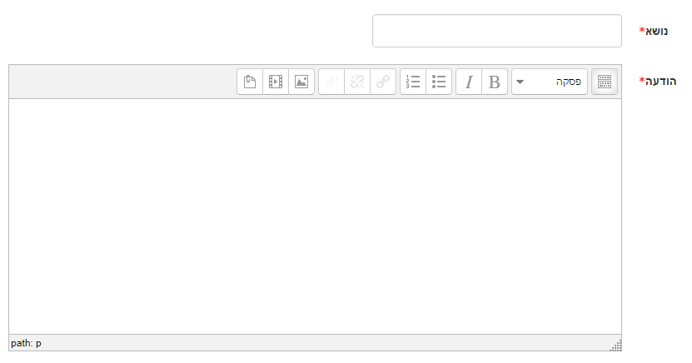
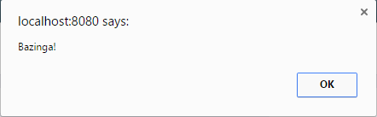
Stored XSS
Example:
JS Malicious code examples: https://aw-snap.info/articles/js-examples.php
הודלף: פתרון מבחן "אבטחת מחשבים ורשתות תקשורת" 2019
<script>
alert(“Bazinga!”);
</script>

Slide 12
Reflected XSS
Injected script is reflected off the web server (e.g. error message, search result).
Reflected attacks are delivered to victims via another route, such as in an e-mail message, or on some other web site.
When a user is tricked into clicking on a malicious link, the injected code travels to the vulnerable web site, which reflects the attack back to the user’s browser.
The browser then executes the code because it came from a "trusted" server.

Slide 13
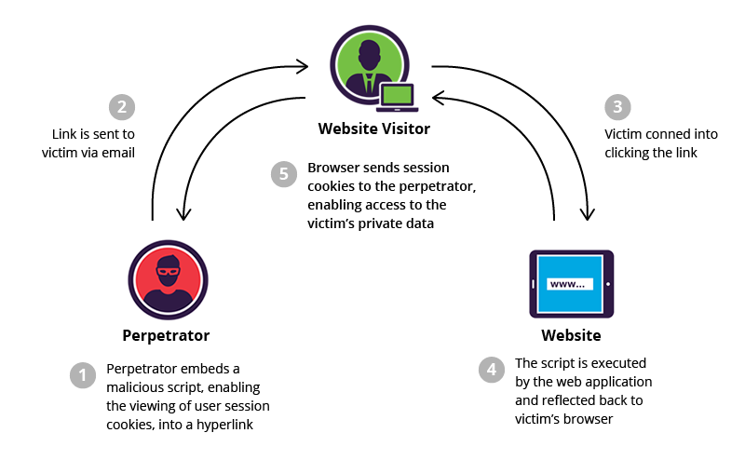
Reflected XSS
Example
https://www.google.co.il/search?noj=1&q=%3Cscript%3Ealert%28%22XSS%22%29%3B%3C%2Fscript%3E&oq

Slide 14
CSRF
Cross Site Request Forgery

Slide 15
CSRF
Forces the end user to execute unwanted actions on a web application in which they're currently authenticated.
CSRF attacks specifically target state-changing requests, not theft of data, since the attacker has no way to see the response to the forged request.
With a little help of social engineering, an attacker may trick the users of a web application into executing actions of the attacker's choosing.

Slide 16
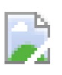
Stored
Example:
הודלף: צילום מבחן "אבטחת מחשבים ורשתות תקשורת" 2019
Picture of the upcoming test in Information Security (2019):
<img src=“InformationSecurity2019_Page1.jpg”>
<img src="www.amazon.com/?ItemId=22&Action=buy&Amount=4”>
Refresh if images are not shown

Slide 17
Prompt By-Pass CSRF
The example given before will not work in a web store that asks for further confirmation.
When additional actions are needed from the user to perform the actual transaction, a sequence of actions can be injected by the attacker.

Slide 18
Prompt By-Pass XSS
Example:
הודלף: צילום מבחן "אבטחת מחשבים ורשתות תקשורת" 2019
Picture of the upcoming test in Information Security (2019):
<script>
function confirm() {
var img = getElementById(“secondPage”);
img.src = "www.amazon.com/?ItemId=22&Action=confirm&Amount=4”
}
</script>
<img src="InformationSecurity2019_Page1.jpg“ id=“firstPage”>
<img src="www.amazon.com/?ItemId=22&Action=buy&Amount=4” id=“secondPage”
onerror=“confirm()”>
Refresh if images are not shown

Slide 19
Prevention and Protection

Slide 20
Defending and Protecting Web Applications
Never trust client-side data, filter it before.
Prevent user input from being interpreted in a dangerous context by escaping. (e.g. - < is &lt;).
Search for <script> (ASP.net)
Etc.

