Slide 1

Artificial Intelligence

Slide 2
בינה מלאכותית
דור עצמון מייל: dorat@post.bgu.ac.il שעות קבלה: יום ראשון 14:00-15:00 (בתאום מראש) 3 מטלות תכנותיות

Slide 3
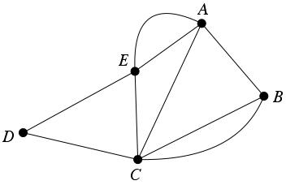

Practice session 1 Blind Search Graph Representation

Slide 4

חיפוש
בהינתן:
גרף - $G(V,E)$
קודקוד התחלתי - $v_{s}$
קודקוד סופי - $v_{g}$
מטרות:
למצוא מסלול מ-$v_{s}$ ל-$v_{g}$
לענות האם קיים מסלול מ-$v_{s}$ ל-$v_{g}$?
למצוא מסלול אופטימאלי מ-$v_{s}$ ל-$v_{g}$
למצוא את ה-$goal$
s
g

Slide 5
אלגוריתמי חיפוש
1
1
A
B
2
BFS (Breadth-first search)
DFS (Depth-first search)
UCS (Uniform Cost Search)
3
s
g
1
C
1
A
1
B
2
1
3
s
g
1
C
1
A
1
B
2
1
3
s
g
1
C
1

Slide 6
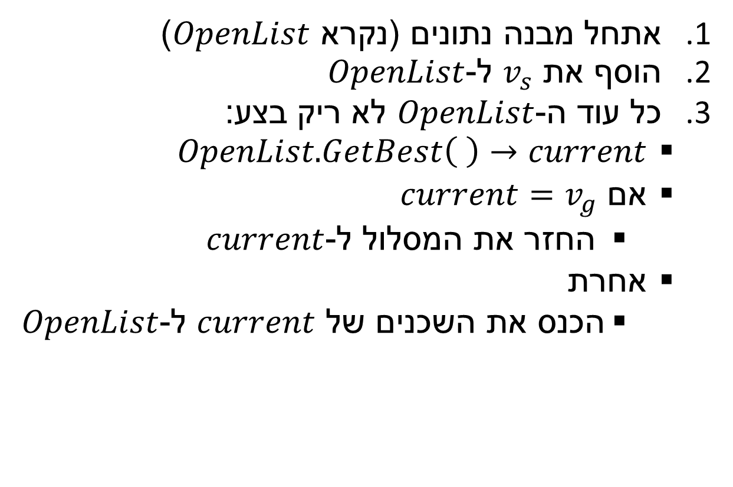
אלגוריתם חיפוש אבסטרקטי - רעיון
אתחל מבנה נתונים (נקרא $OpenList$)
הוסף את $v_{s}$ ל-$OpenList$
כל עוד ה-$OpenList$ לא ריק בצע:
$OpenList.GetBest\left( \right)→current$
אם $current=v_{g}$
החזר את המסלול ל-$current$
אחרת
הכנס את השכנים של $current$ ל-$OpenList$
A
B
S
G
C
Open List: S
Open List:
Open List: S
Open List: G, A, C
current = S S

Slide 7
אלגוריתם חיפוש אבסטרקטי - BFS
Search( G(V,E) , Vs , Vg )
1. InitOpen()
2. Vs.g = 0
3. Vs.h = hFunc( Vs , Vg )
4. Vs.prev = null
5. AddToOpen( Vs )
6. While( OpenSize() > 0 )
6.1 Current = GetBest()
6.2 If( Current == Vg )
6.2.1 Return GetPath( Current )
6.3 Else
6.3.1 Foreach neighbor Vn of Current
6.3.1.1 If(( !IsClosed( Vn ) AND !IsOpen( Vn ) ) OR Vn.g > current.g+E(current,Vn).cost)
6.3.1.1.1 Vn.g = Current.g + E(Current,Vn).cost
6.3.1.1.2 Vn.h = hFunc( Vn , Vg )
6.3.1.1.3 Vn.prev = Current
6.3.1.1.4 AddToOpen( Vn )
6.4 Close( current )
7. Return false
g=
h=
g=
h=
A
1
B
1
2
g=
h=
g=
h=
S
3
G
1
1
C
g=
h=

Slide 8
אלגוריתם חיפוש אבסטרקטי - BFS
Search( G(V,E) , Vs , Vg )
1. InitOpen()
2. Vs.g = 0
3. Vs.h = hFunc( Vs , Vg )
4. Vs.prev = null
5. AddToOpen( Vs )
6. While( OpenSize() > 0 )
6.1 Current = GetBest()
6.2 If( Current == Vg )
6.2.1 Return GetPath( Current )
6.3 Else
6.3.1 Foreach neighbor Vn of Current
6.3.1.1 If(( !IsClosed( Vn ) AND !IsOpen( Vn ) ) OR Vn.g > current.g+E(current,Vn).cost)
6.3.1.1.1 Vn.g = Current.g + E(Current,Vn).cost
6.3.1.1.2 Vn.h = hFunc( Vn , Vg )
6.3.1.1.3 Vn.prev = Current
6.3.1.1.4 AddToOpen( Vn )
6.4 Close( current )
7. Return false
g=
h=
g=
h=
A
1
B
1
2
g=
h=
g=
h=
S
3
G
1
1
C
g=
h=
Open List (Queue):

Slide 9
אלגוריתם חיפוש אבסטרקטי - BFS
Search( G(V,E) , Vs , Vg )
1. InitOpen()
2. Vs.g = 0 //Distance from Vs
3. Vs.h = hFunc( Vs , Vg ) //Evaluation of distance to goal
4. Vs.prev = null
5. AddToOpen( Vs )
6. While( OpenSize() > 0 )
6.1 Current = GetBest()
6.2 If( Current == Vg )
6.2.1 Return GetPath( Current )
6.3 Else
6.3.1 Foreach neighbor Vn of Current
6.3.1.1 If(( !IsClosed( Vn ) AND !IsOpen( Vn ) ) OR Vn.g > current.g+E(current,Vn).cost)
6.3.1.1.1 Vn.g = Current.g + E(Current,Vn).cost
6.3.1.1.2 Vn.h = hFunc( Vn , Vg )
6.3.1.1.3 Vn.prev = Current
6.3.1.1.4 AddToOpen( Vn )
6.4 Close( current )
7. Return false
g=
h=
g=
h=
A
1
B
1
2
g=
h=
g= 0
h= 0
S
3
G
1
1
C
g=
h=
Open List (Queue):

Slide 10
אלגוריתם חיפוש אבסטרקטי - BFS
Search( G(V,E) , Vs , Vg )
1. InitOpen()
2. Vs.g = 0
3. Vs.h = hFunc( Vs , Vg )
4. Vs.prev = null //The previous vertex
5. AddToOpen( Vs )
6. While( OpenSize() > 0 )
6.1 Current = GetBest()
6.2 If( Current == Vg )
6.2.1 Return GetPath( Current )
6.3 Else
6.3.1 Foreach neighbor Vn of Current
6.3.1.1 If(( !IsClosed( Vn ) AND !IsOpen( Vn ) ) OR Vn.g > current.g+E(current,Vn).cost)
6.3.1.1.1 Vn.g = Current.g + E(Current,Vn).cost
6.3.1.1.2 Vn.h = hFunc( Vn , Vg )
6.3.1.1.3 Vn.prev = Current
6.3.1.1.4 AddToOpen( Vn )
6.4 Close( current )
7. Return false
g=
h=
g=
h=
A
1
B
1
2
g=
h=
g= 0
h= 0
S
3
G
1
1
C
g=
h=
Open List (Queue):

Slide 11
אלגוריתם חיפוש אבסטרקטי - BFS
Search( G(V,E) , Vs , Vg )
1. InitOpen()
2. Vs.g = 0
3. Vs.h = hFunc( Vs , Vg )
4. Vs.prev = null
5. AddToOpen( Vs )
6. While( OpenSize() > 0 )
6.1 Current = GetBest()
6.2 If( Current == Vg )
6.2.1 Return GetPath( Current )
6.3 Else
6.3.1 Foreach neighbor Vn of Current
6.3.1.1 If(( !IsClosed( Vn ) AND !IsOpen( Vn ) ) OR Vn.g > current.g+E(current,Vn).cost)
6.3.1.1.1 Vn.g = Current.g + E(Current,Vn).cost
6.3.1.1.2 Vn.h = hFunc( Vn , Vg )
6.3.1.1.3 Vn.prev = Current
6.3.1.1.4 AddToOpen( Vn )
6.4 Close( current )
7. Return false
g=
h=
g=
h=
A
1
B
1
2
g=
h=
g= 0
h= 0
S
3
G
1
1
C
g=
h=
Open List (Queue): S

Slide 12
אלגוריתם חיפוש אבסטרקטי - BFS
Search( G(V,E) , Vs , Vg )
1. InitOpen()
2. Vs.g = 0
3. Vs.h = hFunc( Vs , Vg )
4. Vs.prev = null
5. AddToOpen( Vs )
6. While( OpenSize() > 0 )
6.1 Current = GetBest()
6.2 If( Current == Vg )
6.2.1 Return GetPath( Current )
6.3 Else
6.3.1 Foreach neighbor Vn of Current
6.3.1.1 If(( !IsClosed( Vn ) AND !IsOpen( Vn ) ) OR Vn.g > current.g+E(current,Vn).cost)
6.3.1.1.1 Vn.g = Current.g + E(Current,Vn).cost
6.3.1.1.2 Vn.h = hFunc( Vn , Vg )
6.3.1.1.3 Vn.prev = Current
6.3.1.1.4 AddToOpen( Vn )
6.4 Close( current )
7. Return false
g=
h=
g=
h=
A
1
B
1
2
g=
h=
g= 0
h= 0
S
3
G
1
1
C
g=
h=
Open List (Queue):
S
Size = 1

Slide 13
אלגוריתם חיפוש אבסטרקטי - BFS
Search( G(V,E) , Vs , Vg )
1. InitOpen()
2. Vs.g = 0
3. Vs.h = hFunc( Vs , Vg )
4. Vs.prev = null
5. AddToOpen( Vs )
6. While( OpenSize() > 0 )
6.1 Current = GetBest()
6.2 If( Current == Vg )
6.2.1 Return GetPath( Current )
6.3 Else
6.3.1 Foreach neighbor Vn of Current
6.3.1.1 If(( !IsClosed( Vn ) AND !IsOpen( Vn ) ) OR Vn.g > current.g+E(current,Vn).cost)
6.3.1.1.1 Vn.g = Current.g + E(Current,Vn).cost
6.3.1.1.2 Vn.h = hFunc( Vn , Vg )
6.3.1.1.3 Vn.prev = Current
6.3.1.1.4 AddToOpen( Vn )
6.4 Close( current )
7. Return false
g=
h=
g=
h=
A
1
B
1
2
g=
h=
g= 0
h= 0
S
3
G
1
1
C
g=
h=
Open List (Queue):
S
Current = S
Size = 0

Slide 14
אלגוריתם חיפוש אבסטרקטי - BFS
Search( G(V,E) , Vs , Vg )
1. InitOpen()
2. Vs.g = 0
3. Vs.h = hFunc( Vs , Vg )
4. Vs.prev = null
5. AddToOpen( Vs )
6. While( OpenSize() > 0 )
6.1 Current = GetBest()
6.2 If( Current == Vg ) //Goal test
6.2.1 Return GetPath( Current )
6.3 Else
6.3.1 Foreach neighbor Vn of Current
6.3.1.1 If(( !IsClosed( Vn ) AND !IsOpen( Vn ) ) OR Vn.g > current.g+E(current,Vn).cost)
6.3.1.1.1 Vn.g = Current.g + E(Current,Vn).cost
6.3.1.1.2 Vn.h = hFunc( Vn , Vg )
6.3.1.1.3 Vn.prev = Current
6.3.1.1.4 AddToOpen( Vn )
6.4 Close( current )
7. Return false
g=
h=
g=
h=
A
1
B
1
2
g=
h=
g= 0
h= 0
S
3
G
1
1
C
g=
h=
Open List (Queue):
S
Current = S
Size = 0

Slide 15
אלגוריתם חיפוש אבסטרקטי - BFS
Search( G(V,E) , Vs , Vg )
1. InitOpen()
2. Vs.g = 0
3. Vs.h = hFunc( Vs , Vg )
4. Vs.prev = null
5. AddToOpen( Vs )
6. While( OpenSize() > 0 )
6.1 Current = GetBest()
6.2 If( Current == Vg )
6.2.1 Return GetPath( Current )
6.3 Else
6.3.1 Foreach neighbor Vn of Current
6.3.1.1 If(( !IsClosed( Vn ) AND !IsOpen( Vn ) ) OR Vn.g > current.g+E(current,Vn).cost)
6.3.1.1.1 Vn.g = Current.g + E(Current,Vn).cost
6.3.1.1.2 Vn.h = hFunc( Vn , Vg )
6.3.1.1.3 Vn.prev = Current
6.3.1.1.4 AddToOpen( Vn )
6.4 Close( current )
7. Return false
g=
h=
g=
h=
A
1
B
1
2
g=
h=
g= 0
h= 0
S
3
G
1
1
C
g=
h=
Open List (Queue):
S
Current = S
Size = 0

Slide 16
אלגוריתם חיפוש אבסטרקטי - BFS
Search( G(V,E) , Vs , Vg )
1. InitOpen()
2. Vs.g = 0
3. Vs.h = hFunc( Vs , Vg )
4. Vs.prev = null
5. AddToOpen( Vs )
6. While( OpenSize() > 0 )
6.1 Current = GetBest()
6.2 If( Current == Vg )
6.2.1 Return GetPath( Current )
6.3 Else
6.3.1 Foreach neighbor Vn of Current
6.3.1.1 If(( !IsClosed( Vn ) AND !IsOpen( Vn ) ) OR Vn.g > current.g+E(current,Vn).cost)
6.3.1.1.1 Vn.g = Current.g + E(Current,Vn).cost
6.3.1.1.2 Vn.h = hFunc( Vn , Vg )
6.3.1.1.3 Vn.prev = Current
6.3.1.1.4 AddToOpen( Vn )
6.4 Close( current )
7. Return false
g=
h=
g=
h=
A
1
B
1
2
g=
h=
g= 0
h= 0
S
3
G
1
1
C
g=
h=
Close List:
Open List (Queue):
S
Current = S
Size = 0

Slide 17
אלגוריתם חיפוש אבסטרקטי - BFS
Search( G(V,E) , Vs , Vg )
1. InitOpen()
2. Vs.g = 0
3. Vs.h = hFunc( Vs , Vg )
4. Vs.prev = null
5. AddToOpen( Vs )
6. While( OpenSize() > 0 )
6.1 Current = GetBest()
6.2 If( Current == Vg )
6.2.1 Return GetPath( Current )
6.3 Else
6.3.1 Foreach neighbor Vn of Current
6.3.1.1 If(( !IsClosed( Vn ) AND !IsOpen( Vn ) ) OR Vn.g > current.g+E(current,Vn).cost)
6.3.1.1.1 Vn.g = Current.g + E(Current,Vn).cost
6.3.1.1.2 Vn.h = hFunc( Vn , Vg )
6.3.1.1.3 Vn.prev = Current
6.3.1.1.4 AddToOpen( Vn )
6.4 Close( current )
7. Return false
g=
h=
g=
h=
A
1
B
1
2
g= 3
h= 0
g= 0
h= 0
S
3
G
1
1
C
g=
h=
Close List:
Open List (Queue):
S
Current = S
Size = 0

Slide 18
אלגוריתם חיפוש אבסטרקטי - BFS
Search( G(V,E) , Vs , Vg )
1. InitOpen()
2. Vs.g = 0
3. Vs.h = hFunc( Vs , Vg )
4. Vs.prev = null
5. AddToOpen( Vs )
6. While( OpenSize() > 0 )
6.1 Current = GetBest()
6.2 If( Current == Vg )
6.2.1 Return GetPath( Current )
6.3 Else
6.3.1 Foreach neighbor Vn of Current
6.3.1.1 If(( !IsClosed( Vn ) AND !IsOpen( Vn ) ) OR Vn.g > current.g+E(current,Vn).cost)
6.3.1.1.1 Vn.g = Current.g + E(Current,Vn).cost
6.3.1.1.2 Vn.h = hFunc( Vn , Vg )
6.3.1.1.3 Vn.prev = Current
6.3.1.1.4 AddToOpen( Vn )
6.4 Close( current )
7. Return false
g=
h=
g=
h=
A
1
B
1
2
g= 3
h= 0
g= 0
h= 0
S
3
G
1
1
C
g=
h=
Close List:
Open List (Queue):
S
Current = S
Size = 0

Slide 19
אלגוריתם חיפוש אבסטרקטי - BFS
Search( G(V,E) , Vs , Vg )
1. InitOpen()
2. Vs.g = 0
3. Vs.h = hFunc( Vs , Vg )
4. Vs.prev = null
5. AddToOpen( Vs )
6. While( OpenSize() > 0 )
6.1 Current = GetBest()
6.2 If( Current == Vg )
6.2.1 Return GetPath( Current )
6.3 Else
6.3.1 Foreach neighbor Vn of Current
6.3.1.1 If(( !IsClosed( Vn ) AND !IsOpen( Vn ) ) OR Vn.g > current.g+E(current,Vn).cost)
6.3.1.1.1 Vn.g = Current.g + E(Current,Vn).cost
6.3.1.1.2 Vn.h = hFunc( Vn , Vg )
6.3.1.1.3 Vn.prev = Current
6.3.1.1.4 AddToOpen( Vn )
6.4 Close( current )
7. Return false
g=
h=
g=
h=
A
1
B
1
2
g= 3
h= 0
g= 0
h= 0
S
3
G
1
1
C
g=
h=
Close List:
Open List (Queue):
S, G
Current = S
Size = 1

Slide 20
אלגוריתם חיפוש אבסטרקטי - BFS
Search( G(V,E) , Vs , Vg )
1. InitOpen()
2. Vs.g = 0
3. Vs.h = hFunc( Vs , Vg )
4. Vs.prev = null
5. AddToOpen( Vs )
6. While( OpenSize() > 0 )
6.1 Current = GetBest()
6.2 If( Current == Vg )
6.2.1 Return GetPath( Current )
6.3 Else
6.3.1 Foreach neighbor Vn of Current
6.3.1.1 If(( !IsClosed( Vn ) AND !IsOpen( Vn ) ) OR Vn.g > current.g+E(current,Vn).cost)
6.3.1.1.1 Vn.g = Current.g + E(Current,Vn).cost
6.3.1.1.2 Vn.h = hFunc( Vn , Vg )
6.3.1.1.3 Vn.prev = Current
6.3.1.1.4 AddToOpen( Vn )
6.4 Close( current )
7. Return false
g=
h=
g=
h=
A
1
B
1
2
g= 3
h= 0
g= 0
h= 0
S
3
G
1
1
C
g=
h=
Close List:
Open List (Queue):
S, G
Current = S
Size = 1

Slide 21
אלגוריתם חיפוש אבסטרקטי - BFS
Search( G(V,E) , Vs , Vg )
1. InitOpen()
2. Vs.g = 0
3. Vs.h = hFunc( Vs , Vg )
4. Vs.prev = null
5. AddToOpen( Vs )
6. While( OpenSize() > 0 )
6.1 Current = GetBest()
6.2 If( Current == Vg )
6.2.1 Return GetPath( Current )
6.3 Else
6.3.1 Foreach neighbor Vn of Current
6.3.1.1 If(( !IsClosed( Vn ) AND !IsOpen( Vn ) ) OR Vn.g > current.g+E(current,Vn).cost)
6.3.1.1.1 Vn.g = Current.g + E(Current,Vn).cost
6.3.1.1.2 Vn.h = hFunc( Vn , Vg )
6.3.1.1.3 Vn.prev = Current
6.3.1.1.4 AddToOpen( Vn )
6.4 Close( current )
7. Return false
g=
h=
g=
h=
A
1
B
1
2
g= 3
h= 0
g= 0
h= 0
S
3
G
1
1
C
g=
h=
Close List:
Open List (Queue):
S, G
Current = S
Size = 1

Slide 22
אלגוריתם חיפוש אבסטרקטי - BFS
Search( G(V,E) , Vs , Vg )
1. InitOpen()
2. Vs.g = 0
3. Vs.h = hFunc( Vs , Vg )
4. Vs.prev = null
5. AddToOpen( Vs )
6. While( OpenSize() > 0 )
6.1 Current = GetBest()
6.2 If( Current == Vg )
6.2.1 Return GetPath( Current )
6.3 Else
6.3.1 Foreach neighbor Vn of Current
6.3.1.1 If(( !IsClosed( Vn ) AND !IsOpen( Vn ) ) OR Vn.g > current.g+E(current,Vn).cost)
6.3.1.1.1 Vn.g = Current.g + E(Current,Vn).cost
6.3.1.1.2 Vn.h = hFunc( Vn , Vg )
6.3.1.1.3 Vn.prev = Current
6.3.1.1.4 AddToOpen( Vn )
6.4 Close( current )
7. Return false
g= 1
h= 0
g=
h=
A
1
B
1
2
g= 3
h= 0
g= 0
h= 0
S
3
G
1
1
C
g=
h=
Close List:
Open List (Queue):
S, G
Current = S
Size = 1

Slide 23
אלגוריתם חיפוש אבסטרקטי - BFS
Search( G(V,E) , Vs , Vg )
1. InitOpen()
2. Vs.g = 0
3. Vs.h = hFunc( Vs , Vg )
4. Vs.prev = null
5. AddToOpen( Vs )
6. While( OpenSize() > 0 )
6.1 Current = GetBest()
6.2 If( Current == Vg )
6.2.1 Return GetPath( Current )
6.3 Else
6.3.1 Foreach neighbor Vn of Current
6.3.1.1 If(( !IsClosed( Vn ) AND !IsOpen( Vn ) ) OR Vn.g > current.g+E(current,Vn).cost)
6.3.1.1.1 Vn.g = Current.g + E(Current,Vn).cost
6.3.1.1.2 Vn.h = hFunc( Vn , Vg )
6.3.1.1.3 Vn.prev = Current
6.3.1.1.4 AddToOpen( Vn )
6.4 Close( current )
7. Return false
g= 1
h= 0
g=
h=
A
1
B
1
2
g= 3
h= 0
g= 0
h= 0
S
3
G
1
1
C
g=
h=
Close List:
Open List (Queue):
S, G
Current = S
Size = 1

Slide 24
אלגוריתם חיפוש אבסטרקטי - BFS
Search( G(V,E) , Vs , Vg )
1. InitOpen()
2. Vs.g = 0
3. Vs.h = hFunc( Vs , Vg )
4. Vs.prev = null
5. AddToOpen( Vs )
6. While( OpenSize() > 0 )
6.1 Current = GetBest()
6.2 If( Current == Vg )
6.2.1 Return GetPath( Current )
6.3 Else
6.3.1 Foreach neighbor Vn of Current
6.3.1.1 If(( !IsClosed( Vn ) AND !IsOpen( Vn ) ) OR Vn.g > current.g+E(current,Vn).cost)
6.3.1.1.1 Vn.g = Current.g + E(Current,Vn).cost
6.3.1.1.2 Vn.h = hFunc( Vn , Vg )
6.3.1.1.3 Vn.prev = Current
6.3.1.1.4 AddToOpen( Vn )
6.4 Close( current )
7. Return false
g= 1
h= 0
g=
h=
A
1
B
1
2
g= 3
h= 0
g= 0
h= 0
S
3
G
1
1
C
g=
h=
Close List:
Open List (Queue):
S, G, A
Current = S
Size = 2

Slide 25
אלגוריתם חיפוש אבסטרקטי - BFS
Search( G(V,E) , Vs , Vg )
1. InitOpen()
2. Vs.g = 0
3. Vs.h = hFunc( Vs , Vg )
4. Vs.prev = null
5. AddToOpen( Vs )
6. While( OpenSize() > 0 )
6.1 Current = GetBest()
6.2 If( Current == Vg )
6.2.1 Return GetPath( Current )
6.3 Else
6.3.1 Foreach neighbor Vn of Current
6.3.1.1 If(( !IsClosed( Vn ) AND !IsOpen( Vn ) ) OR Vn.g > current.g+E(current,Vn).cost)
6.3.1.1.1 Vn.g = Current.g + E(Current,Vn).cost
6.3.1.1.2 Vn.h = hFunc( Vn , Vg )
6.3.1.1.3 Vn.prev = Current
6.3.1.1.4 AddToOpen( Vn )
6.4 Close( current )
7. Return false
g= 1
h= 0
g=
h=
A
1
B
1
2
g= 3
h= 0
g= 0
h= 0
S
3
G
1
1
C
g=
h=
Close List:
Open List (Queue):
S, G, A
Current = S
Size = 2

Slide 26
אלגוריתם חיפוש אבסטרקטי - BFS
Search( G(V,E) , Vs , Vg )
1. InitOpen()
2. Vs.g = 0
3. Vs.h = hFunc( Vs , Vg )
4. Vs.prev = null
5. AddToOpen( Vs )
6. While( OpenSize() > 0 )
6.1 Current = GetBest()
6.2 If( Current == Vg )
6.2.1 Return GetPath( Current )
6.3 Else
6.3.1 Foreach neighbor Vn of Current
6.3.1.1 If(( !IsClosed( Vn ) AND !IsOpen( Vn ) ) OR Vn.g > current.g+E(current,Vn).cost)
6.3.1.1.1 Vn.g = Current.g + E(Current,Vn).cost
6.3.1.1.2 Vn.h = hFunc( Vn , Vg )
6.3.1.1.3 Vn.prev = Current
6.3.1.1.4 AddToOpen( Vn )
6.4 Close( current )
7. Return false
g= 1
h= 0
g=
h=
A
1
B
1
2
g= 3
h= 0
g= 0
h= 0
S
3
G
1
1
C
g=
h=
Close List:
Open List (Queue):
S, G, A
Current = S
Size = 2

Slide 27
אלגוריתם חיפוש אבסטרקטי - BFS
Search( G(V,E) , Vs , Vg )
1. InitOpen()
2. Vs.g = 0
3. Vs.h = hFunc( Vs , Vg )
4. Vs.prev = null
5. AddToOpen( Vs )
6. While( OpenSize() > 0 )
6.1 Current = GetBest()
6.2 If( Current == Vg )
6.2.1 Return GetPath( Current )
6.3 Else
6.3.1 Foreach neighbor Vn of Current
6.3.1.1 If(( !IsClosed( Vn ) AND !IsOpen( Vn ) ) OR Vn.g > current.g+E(current,Vn).cost)
6.3.1.1.1 Vn.g = Current.g + E(Current,Vn).cost
6.3.1.1.2 Vn.h = hFunc( Vn , Vg )
6.3.1.1.3 Vn.prev = Current
6.3.1.1.4 AddToOpen( Vn )
6.4 Close( current )
7. Return false
g= 1
h= 0
g=
h=
A
1
B
1
2
g= 3
h= 0
g= 0
h= 0
S
3
G
1
1
C
g= 1
h= 0
Close List:
Open List (Queue):
S, G, A
Current = S
Size = 2

Slide 28
אלגוריתם חיפוש אבסטרקטי - BFS
Search( G(V,E) , Vs , Vg )
1. InitOpen()
2. Vs.g = 0
3. Vs.h = hFunc( Vs , Vg )
4. Vs.prev = null
5. AddToOpen( Vs )
6. While( OpenSize() > 0 )
6.1 Current = GetBest()
6.2 If( Current == Vg )
6.2.1 Return GetPath( Current )
6.3 Else
6.3.1 Foreach neighbor Vn of Current
6.3.1.1 If(( !IsClosed( Vn ) AND !IsOpen( Vn ) ) OR Vn.g > current.g+E(current,Vn).cost)
6.3.1.1.1 Vn.g = Current.g + E(Current,Vn).cost
6.3.1.1.2 Vn.h = hFunc( Vn , Vg )
6.3.1.1.3 Vn.prev = Current
6.3.1.1.4 AddToOpen( Vn )
6.4 Close( current )
7. Return false
g= 1
h= 0
g=
h=
A
1
B
1
2
g= 3
h= 0
g= 0
h= 0
S
3
G
1
1
C
g= 1
h= 0
Close List:
Open List (Queue):
S, G, A
Current = S
Size = 2

Slide 29
אלגוריתם חיפוש אבסטרקטי - BFS
Search( G(V,E) , Vs , Vg )
1. InitOpen()
2. Vs.g = 0
3. Vs.h = hFunc( Vs , Vg )
4. Vs.prev = null
5. AddToOpen( Vs )
6. While( OpenSize() > 0 )
6.1 Current = GetBest()
6.2 If( Current == Vg )
6.2.1 Return GetPath( Current )
6.3 Else
6.3.1 Foreach neighbor Vn of Current
6.3.1.1 If(( !IsClosed( Vn ) AND !IsOpen( Vn ) ) OR Vn.g > current.g+E(current,Vn).cost)
6.3.1.1.1 Vn.g = Current.g + E(Current,Vn).cost
6.3.1.1.2 Vn.h = hFunc( Vn , Vg )
6.3.1.1.3 Vn.prev = Current
6.3.1.1.4 AddToOpen( Vn )
6.4 Close( current )
7. Return false
g= 1
h= 0
g=
h=
A
1
B
1
2
g= 3
h= 0
g= 0
h= 0
S
3
G
1
1
C
g= 1
h= 0
Close List:
Open List (Queue):
S, G, A, C
Current = S
Size = 3

Slide 30
אלגוריתם חיפוש אבסטרקטי - BFS
Search( G(V,E) , Vs , Vg )
1. InitOpen()
2. Vs.g = 0
3. Vs.h = hFunc( Vs , Vg )
4. Vs.prev = null
5. AddToOpen( Vs )
6. While( OpenSize() > 0 )
6.1 Current = GetBest()
6.2 If( Current == Vg )
6.2.1 Return GetPath( Current )
6.3 Else
6.3.1 Foreach neighbor Vn of Current
6.3.1.1 If(( !IsClosed( Vn ) AND !IsOpen( Vn ) ) OR Vn.g > current.g+E(current,Vn).cost)
6.3.1.1.1 Vn.g = Current.g + E(Current,Vn).cost
6.3.1.1.2 Vn.h = hFunc( Vn , Vg )
6.3.1.1.3 Vn.prev = Current
6.3.1.1.4 AddToOpen( Vn )
6.4 Close( current )
7. Return false
g= 1
h= 0
g=
h=
A
1
B
1
2
g= 3
h= 0
g= 0
h= 0
S
3
G
1
1
C
g= 1
h= 0
Close List:
S
Open List (Queue):
S, G, A, C
Current = S
Size = 3

Slide 31
אלגוריתם חיפוש אבסטרקטי - BFS
Search( G(V,E) , Vs , Vg )
1. InitOpen()
2. Vs.g = 0
3. Vs.h = hFunc( Vs , Vg )
4. Vs.prev = null
5. AddToOpen( Vs )
6. While( OpenSize() > 0 )
6.1 Current = GetBest()
6.2 If( Current == Vg )
6.2.1 Return GetPath( Current )
6.3 Else
6.3.1 Foreach neighbor Vn of Current
6.3.1.1 If(( !IsClosed( Vn ) AND !IsOpen( Vn ) ) OR Vn.g > current.g+E(current,Vn).cost)
6.3.1.1.1 Vn.g = Current.g + E(Current,Vn).cost
6.3.1.1.2 Vn.h = hFunc( Vn , Vg )
6.3.1.1.3 Vn.prev = Current
6.3.1.1.4 AddToOpen( Vn )
6.4 Close( current )
7. Return false
g= 1
h= 0
g=
h=
A
1
B
1
2
g= 3
h= 0
g= 0
h= 0
S
3
G
1
1
C
g= 1
h= 0
Close List:
S
Open List (Queue):
S, G, A, C
Current = S
Size = 3

Slide 32
אלגוריתם חיפוש אבסטרקטי - BFS
Search( G(V,E) , Vs , Vg )
1. InitOpen()
2. Vs.g = 0
3. Vs.h = hFunc( Vs , Vg )
4. Vs.prev = null
5. AddToOpen( Vs )
6. While( OpenSize() > 0 )
6.1 Current = GetBest()
6.2 If( Current == Vg )
6.2.1 Return GetPath( Current )
6.3 Else
6.3.1 Foreach neighbor Vn of Current
6.3.1.1 If(( !IsClosed( Vn ) AND !IsOpen( Vn ) ) OR Vn.g > current.g+E(current,Vn).cost)
6.3.1.1.1 Vn.g = Current.g + E(Current,Vn).cost
6.3.1.1.2 Vn.h = hFunc( Vn , Vg )
6.3.1.1.3 Vn.prev = Current
6.3.1.1.4 AddToOpen( Vn )
6.4 Close( current )
7. Return false
g= 1
h= 0
g=
h=
A
1
B
1
2
g= 3
h= 0
g= 0
h= 0
S
3
G
1
1
C
g= 1
h= 0
Close List:
S
Open List (Queue):
S, G, A, C
Current = G
Size = 3

Slide 33
אלגוריתם חיפוש אבסטרקטי - BFS
Search( G(V,E) , Vs , Vg )
1. InitOpen()
2. Vs.g = 0
3. Vs.h = hFunc( Vs , Vg )
4. Vs.prev = null
5. AddToOpen( Vs )
6. While( OpenSize() > 0 )
6.1 Current = GetBest()
6.2 If( Current == Vg )
6.2.1 Return GetPath( Current )
6.3 Else
6.3.1 Foreach neighbor Vn of Current
6.3.1.1 If(( !IsClosed( Vn ) AND !IsOpen( Vn ) ) OR Vn.g > current.g+E(current,Vn).cost)
6.3.1.1.1 Vn.g = Current.g + E(Current,Vn).cost
6.3.1.1.2 Vn.h = hFunc( Vn , Vg )
6.3.1.1.3 Vn.prev = Current
6.3.1.1.4 AddToOpen( Vn )
6.4 Close( current )
7. Return false
g= 1
h= 0
g=
h=
A
1
B
1
2
g= 3
h= 0
g= 0
h= 0
S
3
G
1
1
C
g= 1
h= 0
Close List:
S
Open List (Queue):
S, G, A, C
Current = G
Size = 3

Slide 34
אלגוריתם חיפוש אבסטרקטי - BFS
Search( G(V,E) , Vs , Vg )
1. InitOpen()
2. Vs.g = 0
3. Vs.h = hFunc( Vs , Vg )
4. Vs.prev = null
5. AddToOpen( Vs )
6. While( OpenSize() > 0 )
6.1 Current = GetBest()
6.2 If( Current == Vg )
6.2.1 Return GetPath( Current )
6.3 Else
6.3.1 Foreach neighbor Vn of Current
6.3.1.1 If(( !IsClosed( Vn ) AND !IsOpen( Vn ) ) OR Vn.g > current.g+E(current,Vn).cost)
6.3.1.1.1 Vn.g = Current.g + E(Current,Vn).cost
6.3.1.1.2 Vn.h = hFunc( Vn , Vg )
6.3.1.1.3 Vn.prev = Current
6.3.1.1.4 AddToOpen( Vn )
6.4 Close( current )
7. Return false
g= 1
h= 0
g=
h=
A
1
B
1
2
g= 3
h= 0
g= 0
h= 0
S
3
G
1
1
prev= null
C
prev= S
g= 1
h= 0
Close List:
S
Open List (Queue):
S, G, A, C
Current = G
Size = 3

Slide 35

אלגוריתם חיפוש אבסטרקטי
מה ניתן לשנות כדי שהאלגוריתם ייצג:
DFS
Uniform Cost Search (UCS)

Slide 36
אלגוריתם חיפוש אבסטרקטי
מה ניתן לשנות כדי שהאלגוריתם ייצג:
DFS OpenList - Stack
Uniform Cost Search (UCS) OpenList - Priority Queue

Slide 37
ייצוג ע"י גרף
קודקוד - מייצג מצב כלשהו
צלע - אופרטור, מייצגת מעבר ממצב למצב אחר
מצב התחלתי (1) ומצבים סופיים (לפחות 1)
בהינתן בעיה כלשהי:
נגדיר קודקודים
נגדיר צלעות
נפתור את הבעיה באמצעות אלגוריתם חיפוש

Slide 38
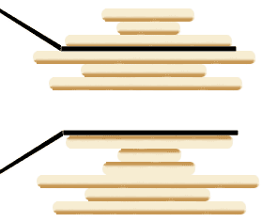
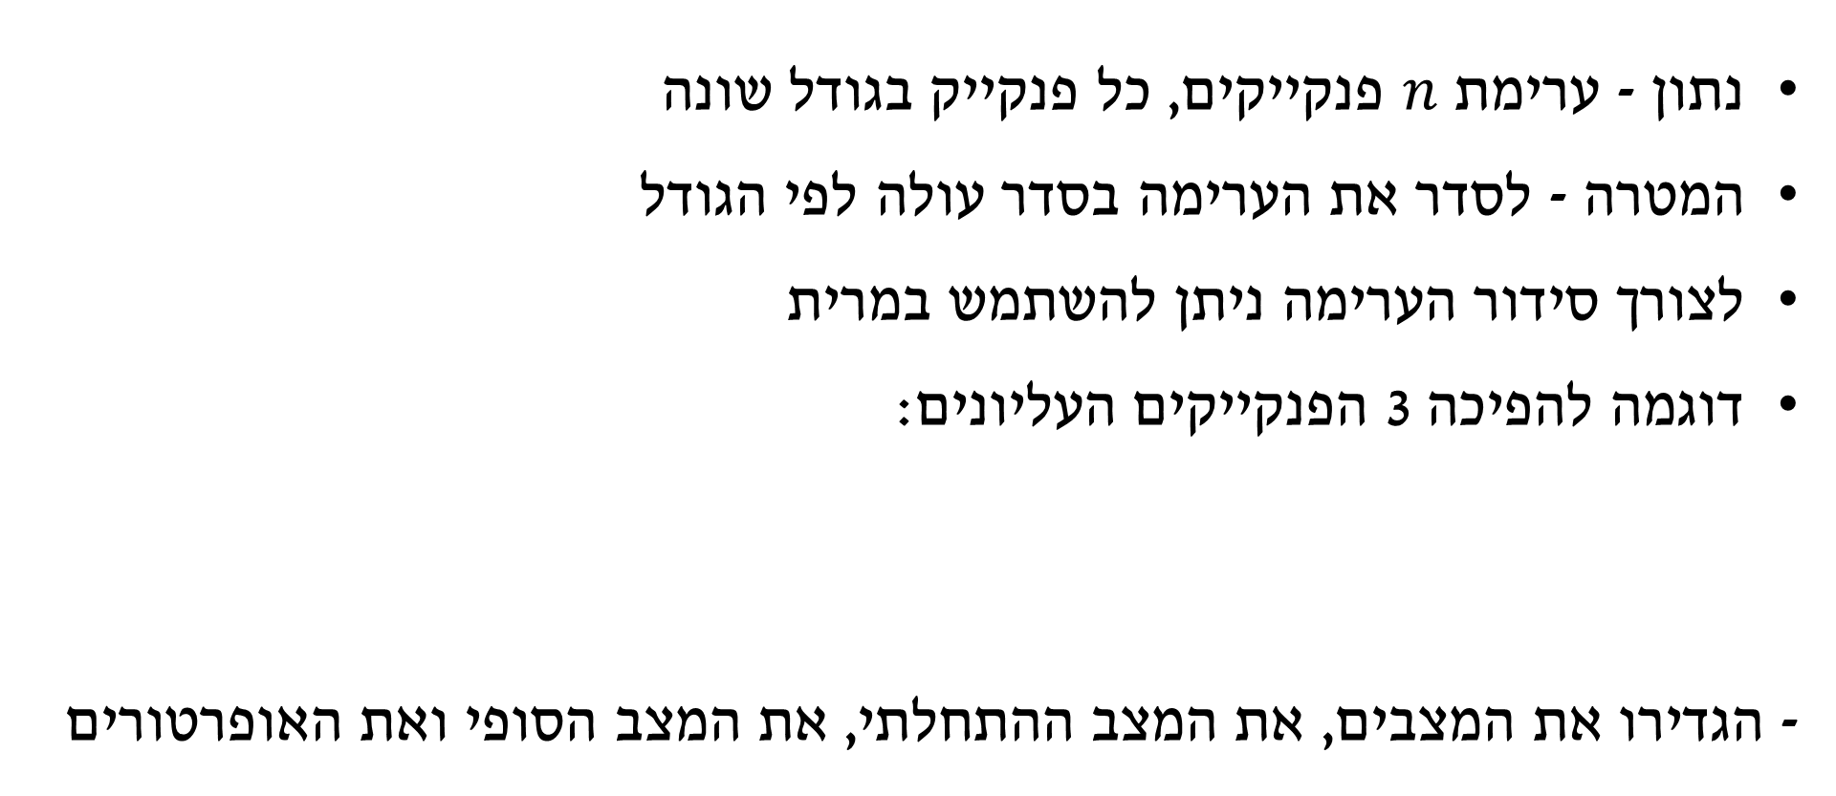
בעיית הפנקייק
נתון - ערימת $n$ פנקייקים, כל פנקייק בגודל שונה
המטרה - לסדר את הערימה בסדר עולה לפי הגודל
לצורך סידור הערימה ניתן להשתמש במרית
דוגמה להפיכה 3 הפנקייקים העליונים:
- הגדירו את המצבים, את המצב ההתחלתי, את המצב הסופי ואת האופרטורים

Slide 39
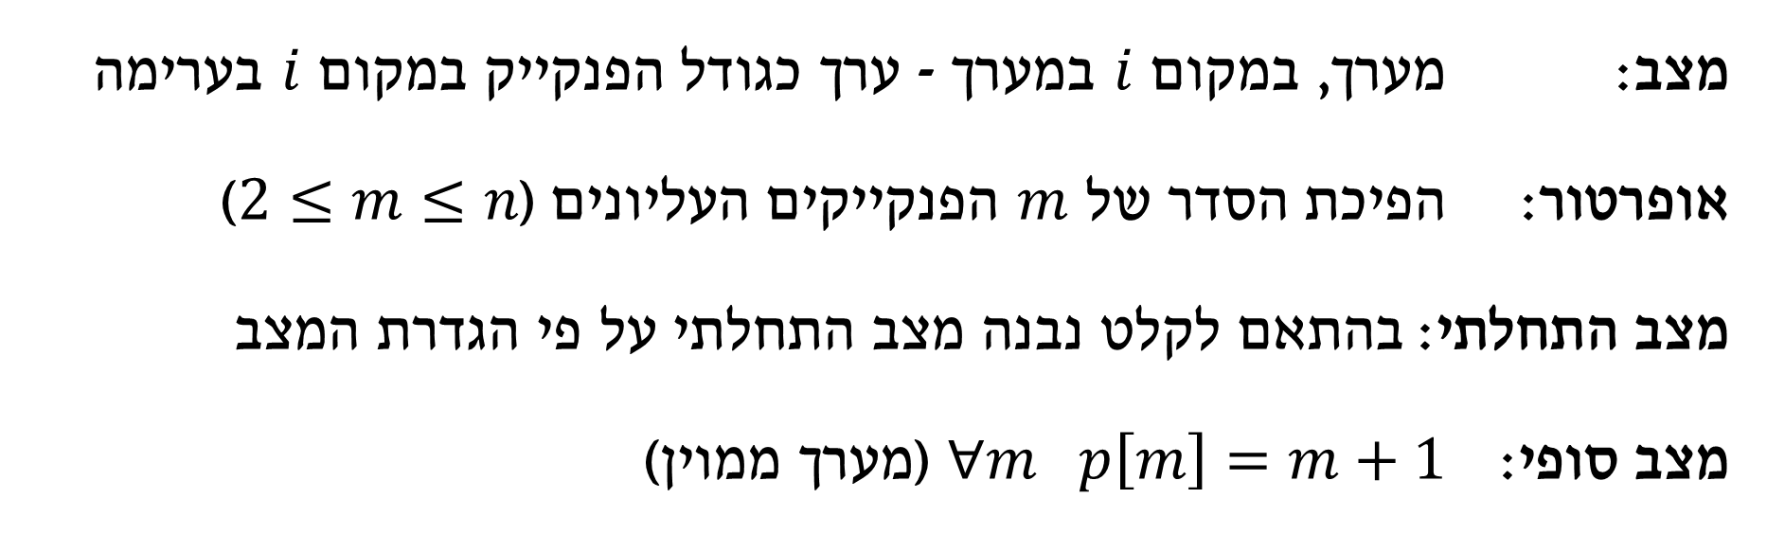
בעיית הפנקייק
מצב:
אופרטור:
מצב התחלתי:
מצב סופי:
מצב: מערך, במקום $i$ במערך - ערך כגודל הפנקייק במקום $i$ בערימה
אופרטור: הפיכת הסדר של $m$ הפנקייקים העליונים ($2≤m≤n$)
מצב התחלתי: בהתאם לקלט נבנה מצב התחלתי על פי הגדרת המצב
מצב סופי: $∀m p\left[m\right]=m+1$ (מערך ממוין)

Slide 40
ייצוג ע"י גרף
בעיית הפנקייק
Graph Representation
0 | 1 | 2 | 3 | 4 | 5
2 | 1 | 4 | 6 | 3 | 5
0 | 1 | 2 | 3 | 4 | 5
0 | 1 | 2 | 3 | 4 | 5
0 | 1 | 2 | 3 | 4 | 5
0 | 1 | 2 | 3 | 4 | 5
0 | 1 | 2 | 3 | 4 | 5
1 | 2 | 4 | 6 | 3 | 5
4 | 1 | 2 | 6 | 3 | 5
6 | 4 | 1 | 2 | 3 | 5
3 | 6 | 4 | 1 | 2 | 5
5 | 3 | 6 | 4 | 1 | 2
goal
0 | 1 | 2 | 3 | 4 | 5
1 | 2 | 3 | 4 | 5 | 6

Slide 41
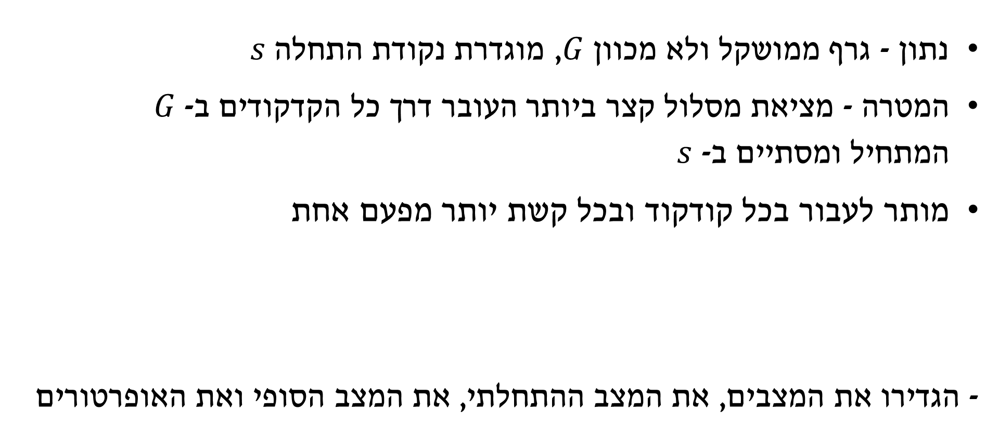
בעיית הסוכן הנוסע
נתון - גרף ממושקל ולא מכוון $G$, מוגדרת נקודת התחלה $s$
המטרה - מציאת מסלול קצר ביותר העובר דרך כל הקדקודים ב- $G$ המתחיל ומסתיים ב- $s$
מותר לעבור בכל קודקוד ובכל קשת יותר מפעם אחת
- הגדירו את המצבים, את המצב ההתחלתי, את המצב הסופי ואת האופרטורים
a
2
6
S
7
c
5
5
4
b

Slide 42


בעיית הסוכן הנוסע
מצב: 1) קבוצת הקודקודים שכבר בוקרו ($visited$) 2) מיקום נוכחי ($current$)
אופרטור: עבור כל שכן $n$ של קודקוד$current$ בגרף $G$: 1) נצרף את $current$ לקבוצת הקודקודים שבוקרו (במידה ולא נמצא שם) 2) נגדיר את $n$ כ-$current$
מצב התחלתי: 1) {} (קבוצה ריקה) 2) $s$ (קודקוד התחלה)
מצב סופי: 1) $V$ (קבוצת כל הקודקודים בגרף) 2) $s$
מצב:
אופרטור:
מצב התחלתי:
מצב סופי:

Slide 43
ייצוג ע"י גרף
בעיית הסוכן הנוסע
Graph Representation
G
{}
s
a
2
7
2
6
5
{s}
a
{s}
b
{s}
c
S
7
c
5
5
6
2
goal
5
4
{s,a}
b
{s,a}
c
{s,a}
s
{s,a,b,c}
s
b

