Slide 1


Introduction to data communications
Lecturer: Itamar Cohen
Chapter 2: Application Layer (part1)
A note on the use of these ppt slides:
We’re making these slides freely available to all (faculty, students, readers). They’re in PowerPoint form so you see the animations; and can add, modify, and delete slides (including this one) and slide content to suit your needs. They obviously represent a lot of work on our part. In return for use, we only ask the following:
Computer Networking: A Top Down Approach 6th edition Jim Kurose, Keith Ross Addison-Wesley March 2012
If you use these slides (e.g., in a class) that you mention their source (after all, we’d like people to use our book!)
If you post any slides on a www site, that you note that they are adapted from (or perhaps identical to) our slides, and note our copyright of this material.
Thanks and enjoy! JFK/KWR
All material copyright 1996-2012
J.F Kurose and K.W. Ross, All Rights Reserved
See additional references in the end of this presentation
מבוסס גם על שקפים של ד"ר בועז בן משה, פרופ' אמיר הרצברג, איציק קיטרוסר, שי אולשר, אלכס מיטנק, אליאב מנשה ופיליפ לויס

Slide 2
Network apps are everywhere
E-mail
Web
Text messaging
File sharing
Streaming
(YouTube, Netflix)
Voice over IP (e.g., Skype)
Social networking
Search
Gaming
…
How to program them?
How are they so scalable & modular?
What are theirs requirements from the lower-level protocols?

Slide 3
Chapter 2.0: outline
Motivation & Basic concepts
Client-server / peer-to-peer (P2P)
Processes communication
Requirements from the transport layer
Web

Slide 4


















Creating a network app
application
transport
network
data link
physical
write programs that:
run on (different) end systems
communicate over network
e.g., web server software communicates with browser software
no need to write software for network-core devices
network-core devices do not run user applications
applications on end systems allow for rapid app development
application
transport
network
data link
physical
application
transport
network
data link
physical

Slide 5
Client-server architecture
server:
always-on host
permanent IP address
data centers for scaling
clients:
communicate with server
may be intermittently connected
may have dynamic IP addresses
do not communicate directly with each other
client/server
Notes:
intermittently - חליפות

Slide 6
P2P architecture
no always-on server
arbitrary end systems directly communicate
peers request / provide service from / to other peers
self scalability – new peers bring new service capacity, as well as new service demands
peers are intermittently connected and change IP addresses
complex management
peer-peer

Slide 7
Hybrid of client-server and P2P
Skype
voice-over-IP P2P application
client-server connection: find address of remote party
client-client connection: call (not through server)
Instant messaging
chatting between two users is P2P
centralized service: client presence detection/location
Application 2-7

Slide 8
Chapter 2.0: outline
Motivation & Basic concepts
Client-server / peer-to-peer (P2P)
Processes communication
Requirements from the transport level
Web

Slide 9
Processes communicating
process: program running within a host
within same host, two processes communicate using inter-process communication (defined by OS)
processes in different hosts communicate by exchanging messages
Even P2P applications have client processes & server processes
client process: the initiator
server process: the responder

Slide 10

Sockets
process sends/receives messages to/from its socket
aka Application Programming Interface
socket analogous to door
sending process pushes message out door
receiving process collects the message from the door
application
socket
application
controlled by
app developer
process
process
transport
transport
network
network
controlled
by OS
link
Internet
link
physical
physical

Slide 11
Addressing processes
to receive messages, process must have identifier
host device has unique 32-bit IP address
Q: Is it enough for identifying the process?
A: no. many processes can be running on same host
identifier includes IP address and port number
Example port numbers:
HTTP server: 80
mail server: 25
to send HTTP message to gaia.cs.umass.edu web server:
IP address: 128.119.245.12
port number: 80

Slide 12
Chapter 2.0: outline
Motivation & Basic concepts
Client-server / peer-to-peer (P2P)
Processes communication
Requirements from the transport level
Web

Slide 13
App-layer protocol defines
types of messages exchanged
e.g., request, response
syntax:
what fields in messages & how fields are delineated
message semantics
meaning of information in fields
rules for when and how processes send & respond to messages
open protocols:
defined in RFCs
allows for interoperability
e.g., HTTP, SMTP
proprietary protocols:
e.g., Skype

Slide 14
Chapter 2.0: outline
Motivation
Basic concepts
Requirements from the transport level
Web

Slide 15
What transport service does an app need?
data integrity
some apps (e.g., file transfer, web transactions) require 100% reliable data transfer
other apps (e.g., audio) can tolerate some loss
throughput
some apps (e.g., multimedia) require minimum amount of throughput to be “effective”
other apps (“elastic apps” – eg, file transer) make use of whatever throughput they get
timing
some apps (e.g., VoIP, gaming) require low delay
security
encryption, data integrity, …

Slide 16
Transport service requirements: common apps
application
file transfer
e-mail
Web documents
VoIP/video conf’
Streaming stored
audio/video
text messaging
data loss
throughput
time sensitive

Slide 17
Transport service requirements: common apps
application
file transfer
e-mail
Web documents
VoIP/video conf’
Streaming stored
audio/video
text messaging
data loss
no loss
no loss
no loss
loss-tolerant
loss-tolerant
no loss
throughput
elastic
elastic
elastic (few kbps)
audio: ~10 kbps
Video: ~Mbps
same as above
elastic
time sensitive
no
no
no
yes, 100’s
msec
yes, few
secs
no

Slide 18
Transport service requirements: common apps
application
file transfer
e-mail
Web documents
VoIP/video conf’
Streaming stored
audio/video
interactive games
text messaging
data loss
no loss
no loss
no loss
loss-tolerant
loss-tolerant
loss-tolerant
no loss
throughput
elastic
elastic
elastic (few kbps)
audio: ~10 kbps
Video: ~Mbps
same as above
~10kbps
elastic
time sensitive
no
no
no
yes, 100’s
msec
yes, few
secs
yes, ~100’s msec
no

Slide 19
Internet transport protocols services
TCP service:
reliable transport between sending and receiving process
flow control: sender won’t overwhelm receiver
congestion control: throttle sender when network overloaded
does not provide: timing, minimum throughput guarantee, security
connection-oriented: setup required between client and server processes
UDP service:
unreliable data transfer between sending and receiving process
does not provide: reliability, flow / congestion control, delay / TP guarantee, security
Shortly: WYPIWYG
Q: So why UDPing?
A: 1.Because it’s cheaper
2. For Real Time apps

Slide 20
Internet apps: application, transport protocols
application
layer protocol
SMTP [RFC 2821]
Telnet [RFC 854]
HTTP [RFC 2616]
FTP [RFC 959]
HTTP (e.g., YouTube), * RTP [RFC 1889]
* SIP, RTP,
Proprietary (e.g., Skype)
underlying
transport protocol
TCP
TCP
TCP
TCP
TCP or UDP
TCP or UDP
application
e-mail
remote terminal access
Web
file transfer
streaming multimedia
Internet telephony
* SIP (Session Initiation Protocol) is used for initiating a
connection, which is later managed by RTP Real-time Transfer Protocol
Notes:
Telephony & streaming use UDP because they can tolerate some loss, and they like shorter connection setup, less o/h (as in TCP) and a minimal b/w.
However, many firewalls block (most) UDP pkts, and therefore these apps oven opens also a bkp TCP connection.

Slide 21
Securing TCP
TCP & UDP
no encryption
Secure Sockets Layer (and later, Transport Layer Security) provide encrypted TCP connection
SSL is at app layer
Apps use SSL libraries, which “talk” to TCP
Example: HTTPS – “HTTP over TLS”
Notes:
SSL / TLS: Both sides authenticate each other, and then a session key to encrypt the data. For starting the connection this way (from client side): StartTls.

Slide 22
Chapter 2.0: outline
Motivation
Basic concepts
Requirements from the transport level
Web

Slide 23
Web
a web page consists of objects (files)
object can be HTML file, JPEG image, Java applet, audio file, etc
web page consists of base HTML-file which includes several referenced objects
each object is addressable by a URL, e.g.,
www.someschool.edu/someDept/pic.gif
host name
path name

Slide 24
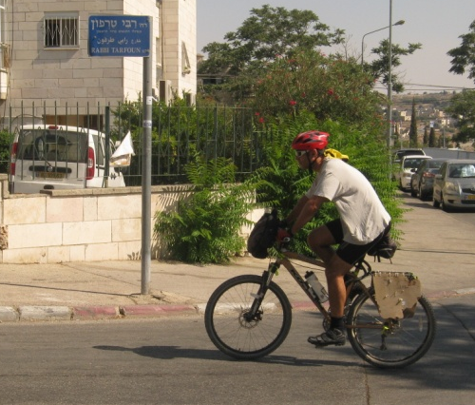
Rabbi Tarfon Ben Leitzan-Tznon
HTTP: HyperText Transfer Protocol
Hypertext – text which includes hyperlinks
HTML: HyperText Markup Language
Markup – like “markering”: how to present the text
Eg underline, bold, italic
In contrast to WYSIWYGs
Eg WORD, ppt
URL: Uniform Resource Locator
A unique location in the network

Slide 25
Confused?
URL is the location of the desired page
Eg, www.google.co.il/maps
HTTP is a protocol, which details how the user (client) requests the data, and how the server responds him
Another protocol: ftp
HTML is the language,
in which the “text” in the
requested webpage is sent

Slide 26

HTTP overview
client: browser that requests, receives and “displays” Web objects
server: sends objects in response to clients’ requests
HTTP: Determines how the browser and the web server communicate
HTTP request
PC running
Firefox browser
HTTP response
HTTP request
server
running
Apache Web
server
HTTP response
iphone running
Safari browser

Slide 27
Chapter 2.0: outline
Motivation
Basic concepts
Requirements from the transport level
Web
Stateless
(non)-persistent
HTTP Basic syntax
Cookies
Scalability

Slide 28
Stateful Vs. Stateless protocols
“state” = past history, e.g.,
Received objects
Authorizations
Shopping charts
☹ Keeping state is complex
☹ If server/client crashes, their views of “state” may be inconsistent
HTTP is “stateless”
server maintains no information about past client requests
Great for NUDNIKIM

Slide 29
Chapter 2.0: outline
Motivation
Basic concepts
Requirements from the transport level
Web
Stateless
(non)-persistent
HTTP Basic syntax
Cookies
Scalability

Slide 30
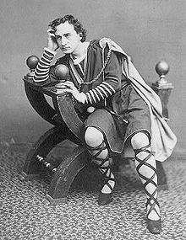
To persist or not to persist?
non-persistent HTTP
at most one object sent over TCP connection
downloading multiple objects requires multiple connections
persistent HTTP
multiple objects sent over a single TCP connection

Slide 31
Non-persistent HTTP example
User enters URL:
www.ofanan.com/MitveHaGaz.index
1a. HTTP client initiates TCP connection to HTTP server (process) at www.ofanan.com on port 80
1b. HTTP server at host www.ofanan.com waiting for TCP connection at port 80. “accepts” connection, notifying client
2. HTTP client sends via a TCP connection socket an HTTP request message, requesting for object MitveHaGaz.index
3. HTTP server receives request message, and sends a response message, containing the requested object
time
Notes:
(contains text,
references to 10
jpeg images)

Slide 32
Non-persistent HTTP (cont.)
4. HTTP server closes TCP connection.
5. HTTP client receives response message containing html file, displays and parses html file
time
6. Steps 1-5 repeated for each of the 10 referenced objects (e.g., figs., videos).

Slide 33
Response time
Round Trip Time (definition): time for a small packet to travel from client to server and back
HTTP response time:
one RTT to initiate TCP connection
one RTT for HTTP request and first few bytes of HTTP response to return
file transmission time
initiate TCP
connection
RTT
request
file
RTT
time to
transmit
file
file
received
time
time

Slide 34
Non-persistent HTTP drawbacks
☹ Long delay
Opens many TCP connections
☹ Significant overhead for the operating system
For reducing the response time, the client may open a few TCP connections in parallel, requesting one object in each of them
☹ But this even further increases overhead, especially at the server side

Slide 35

Persistent HTTP
☺ Only one RTT response time for each referenced object
☺ Less SW- and network-overhead
What happens if the client “forgets” an open connection?
KeepAlive / TimeOut
By default, HTTP is persistent
Notes:
B4 next slide, ask: How to further improve HTTP’s perf’?
Persistent HTTP:
server leaves connection open after sending response
subsequent HTTP messages between same client/server sent over open connection

Slide 36
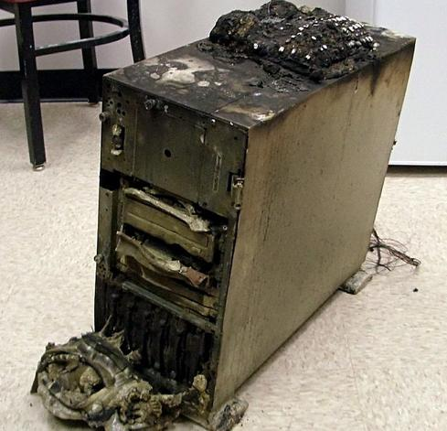
Persistent HTTP with pipelining – limitations & problems
Front-of-queue blocking
Broken servers
Middleboxes
Transparent proxies
→ The option to enable pipelining has been removed
Pic. taken from informationweek
Notes:
In-class demonstration – student “in-the-fly” come to a server.
Server is slow – generating a queue. Requires HW. Front-of-Q blocking for another, smaller, client.
R, middleboxes, proxies on the way – creates ooo.
“Broken server”: a server which (un) intentionally ignores pipeline (by meaning / error). See:
https://www.chromium.org/developers/design-documents/network-stack/http-pipelining

Slide 37

HTTP/2 improvements
Server push
Multiplexing
Headers compression

Slide 38
Chapter 2.0: outline
Motivation
Basic concepts
Requirements from the transport level
Web
Stateless
(non)-persistent
HTTP Basic syntax
Cookies
Scalability

Slide 39
HTTP request message
two types of HTTP messages: request, response
HTTP request message:
ASCII (human-readable format)
carriage return character
request line
(GET, PUT, …)
line-feed character
GET /index.html HTTP/1.1\r\n
Host: www-net.cs.umass.edu\r\n
User-Agent: Firefox/3.6.10\r\n
Accept: text/html,application/xhtml+xml\r\n
Accept-Language: en-us,en;q=0.5\r\n
Accept-Encoding: gzip,deflate\r\n
Accept-Charset: ISO-8859-1,utf-8;q=0.7\r\n
Keep-Alive: 115\r\n
Connection: keep-alive\r\n
\r\n
header
lines
indicates
end of header

Slide 40
HTTP request message format
method
sp
URL
sp
version
cr
lf
request
line
header field name
value
cr
lf
~
~
header
lines
~
~
header field name
value
cr
lf
cr
lf
~
entity body
~
body
~
~

Slide 41
Uploading form input
POST method:
web page often includes a form input
input is uploaded to server in entity body
URL method:
uses GET method
input is uploaded in URL field of request line:
www.somesite.com/animalsearch?monkeys&banana

Slide 42
HTTP methods
GET
POST
Used for web search, filling a web form etc
HEAD
Asking only for file’s meta-data
Eg, “last-modified”
Used for maintenance and debugging
PUT
uploads file in entity body to path specified in URL field
DELETE
deletes file specified in the URL field
Notes:
HEAD meta-info – eg. when was the file of interest lastly modified.
Put – similar to post but is used for a new URL.
POST- works for existing url.
POST:
Used to modify and update a resource
POST /questions/<existing_question> HTTP/1.1 Host: wahteverblahblah.com Note that the following is an error:
POST /questions/<new_question> HTTP/1.1 Host: wahteverblahblah.com If the URL is not yet created, you should not be using POST to create it while specifying the name. This should result in a 'resource not found' error because <new_question> does not exist yet. You should PUT the <new_question> resource on the server first.
You could though do something like this to create a resources using POST:
POST /questions HTTP/1.1 Host: wahteverblahblah.com Note that in this case the resource name is not specified, the new objects URL path would be returned to you.
PUT:
Used to create a resource, or overwrite it. While you specify the resources new URL.
For a new resource:
PUT /questions/<new_question> HTTP/1.1 Host: wahteverblahblah.com To overwrite an existing resource:
PUT /questions/<existing_question> HTTP/1.1 Host: wahteverblahblah.com

Slide 43
HTTP response message
status line
Entity Tag:
Alternative
to “last-mod”
HTTP/1.1 200 OK\r\n
Date: Sun, 26 Sep 2010 20:09:20 GMT\r\n
Server: Apache/2.0.52 (CentOS)\r\n
Last-Modified: Tue, 30 Oct 2007 17:00:02 GMT\r\n
ETag: "17dc6-a5c-bf716880"\r\n
Accept-Ranges: bytes\r\n
Content-Length: 2652\r\n
Keep-Alive: timeout=10, max=100\r\n
Connection: Keep-Alive\r\n
Content-Type: text/html; charset=ISO-8859-1\r\n
\r\n
data data data data data ...
header
lines
data, e.g.,
requested
HTML file
Notes:
ETag: using “last-mod.” incurs issues such as:
* sync’ between server, $.
* aging (age is either now-date_value, or age_value, calculated by $s on the path from the server.
* Storing age value.
ETag is a hash for the “version”, used as an alternative for checking whether an object is stale. See:
https://www.w3.org/Protocols/rfc2616/rfc2616-sec13.html

Slide 44
HTTP response status codes examples
200 OK
request succeeded, requested object later in this msg
301 Moved Permanently
requested object moved, new location specified later in this msg (Location:)
400 Bad Request
request msg not understood by server
404 Not Found
requested document not found on this server
505 HTTP Version Not Supported

Slide 45
HTTP response status codes
1xx Informational
2xx Success
3xx Redirection
4xx Client error
Eg bad request, do not found, too many requests sent
5xx Server error
Eg HTTP version not supported

Slide 46
Chapter 2.0: outline
Motivation
Basic concepts
Requirements from the transport level
Web & HTTP
Stateless
(non)-persistent
HTTP Basic syntax
Cookies
Scalability

Slide 47

Cookies
Used for:
User session state
Recommendations
Authorization
Shopping carts
How to keep “state”?
Maintain state at protocol endpoints over multiple transactions
Cookies: http messages carry state

Slide 48
Cookies’ components
example:
Susan accesses Amazon for the first time (next slide)
1) cookie header line of HTTP response
2) cookie header line in next HTTP request
3) cookie file kept on user’s host, managed by the browser
4) database at Web server

Slide 49
Cookies: keeping “state” (cont.)
client
server
ebay 8734
usual http request msg
Amazon server
creates ID
1678 for user
cookie file
usual http response
set-cookie: 1678
backend
database
create
entry
ebay 8734
amazon 1678
usual http request msg
cookie: 1678
cookie-
specific
action
access
usual http response msg
one week later:
access
ebay 8734
amazon 1678
usual http request msg
cookie: 1678
cookie-
specific
action
usual http response msg

Slide 50

Cookies and privacy
cookies help sites to learn a lot about you

Slide 51
Chapter 2.0: outline
Motivation
Basic concepts
Requirements from the transport level
Web & HTTP
Stateless
(non)-persistent
HTTP Basic syntax
Cookies
Scalability

Slide 52
Web Content Delivery

Slide 53
Scalability

Slide 54
Server Farms

Slide 55
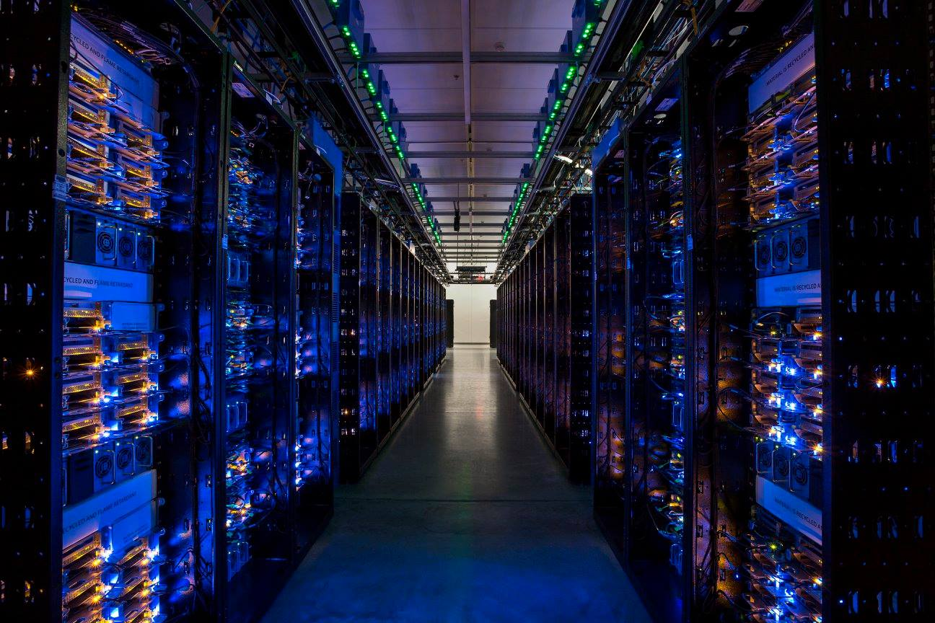
Server farms & Data centers
Facebook’s data center in Iowa. picture taken from adweek

Slide 56
Mirrors

Slide 57
Web Proxies

Slide 58

Web Proxies
Proxies play both roles
A server to the client
A client to the server
www.google.com
Proxy
www.cnn.com
Notes:
Scenario:
Client #1 requests http://www.foo.com/fun.jpg
Client sends “GET fun.jpg” to the proxy
Proxy sends “GET fun.jpg” to the server
Server sends response to the proxy
Proxy stores the response, and forwards to client
Client #2 requests http://www.foo.com/fun.jpg
Client sends “GET fun.jpg” to the proxy
Proxy sends response to the client from the cache

Slide 59
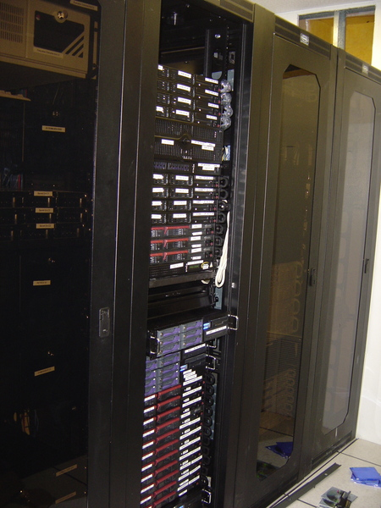
Web Proxies benefits
☺ Faster response time to the clients
☺ Lower load on the Web server
☺ Reduced BW consumption
web.mit.edu
Proxy

Slide 60
Challenges of Transparent Proxies
Must ensure all packets pass by the proxy
E.g., by placing it at the access point to the Internet
or, by a DNS manipulation
Incurs overhead
Intercept the packets as they fly by
Reconstruct and reorder the server’s responses
May violate privacy
The user may not know the proxy lies in the path
Proxy may be keeping logs of the user’s requests
Notes:
Intercept – actually done by DNS giving an adr. of the proxy / CDN, instead of the server.

Slide 61
Other Functions of Web Proxies
Anonymization
Server sees requests coming from the proxy address
… rather than the individual user IP addresses
Transcoding
Converting data from one form to another
E.g., reducing the size of images for cell-phones
Filtering
Blocking access to sites, based on URL or content

Slide 62
Cache coherency
The problem: $ should verify that it sends the client up-to-date data
First solution:
conditional GET
HTTP request:
If-modified-since: <date>
Server’s response:
HTTP/1.0 304 Not Modified
client
server
HTTP request msg
If-modified-since: <date>
object
not
modified
before
<date>
HTTP response
HTTP/1.0
304 Not Modified
HTTP request msg
If-modified-since: <date>
object
modified
after
<date>
HTTP response
HTTP/1.0 200 OK
<data>
Notes:
ראשון

Slide 63
Conditional Get: exercise
A user requests a file from a web server
The file is sent by a single large
Plot a timing diagram for each of the following cases
There’s no proxy server
There’s a proxy server, using Cond. Get, and having the up-to-date file
Now, the file is stale. What’s the change in the diagram?
Notes:
For answering this exercise, consider HW3 (2019), qstn 8.

Slide 64
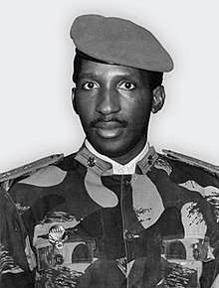
Conditional Get: exercise
For each of the following parameters, write whether increasing it increases / decreases the efficiency of using Cond. Get.
Files size
Header size
User → web server distance
Proxy server → web server link rate
Web server response time
Proxy processing time
Note: when handling larger files, things are different
Conclusion: ☹ For small files, this mechanism may even decrease performances!
Partial solution: TTL
Dilemma: which $ to access when there’re multiple $s?

Slide 65



Bloom Filters
Initialization: Array of zero bits.
Insertion: Each of the elements is hashed times, the corresponding bits are set.
Query: Hashing the element, checking that all bits are set.
False positive possible
No false negatives
At least when discarding stale updates
0
0
0
0
0
0
0
0
0
0
0
0
x
y
1
1
1
1
1
1
0
1
1
1
1
1
0
0
0
0
0
0
0
0
0
0
0
1
1
1
1
1
1
1
1
1
1
x
z
w
Notes:
65

Slide 66
Bloom Filters applications
Spell checking
Cache/Memory
Packet classification
Intrusion detection
Accounting
DNA Classification
Practical examples
Google Chrome
Google's database system BigTable
Facebook's Cassandra
Mellanox’s Infiniband Switch System
Notes:
66

Slide 67


Bloom Filters applications: DPI
Deep Packet Inspection
Suspected
V
V
V
Notes:
Another example is a common DPI practice, in which each arriving packet is scanned using a Bloom filter. If the packet is not suspected, everything is just great. However, Bloom filter has false positives, meaning that a good packet may be wrongly marked as being malicious.
In this case, the suspicious packet has to go through a thorough analysis.
The practical result of this common scenario is that the processing time of at least some of the packets is not known immediately upon arrival.

Slide 68
Network caching: additional issues
Cache insertion policy?
Cache eviction policy?
Notes:
Insertion policy:
- push (by a central ctrlr) / pull.
- Upon first request / only after multiple requests
Eviction policy:
- LRU, LFU

Slide 69



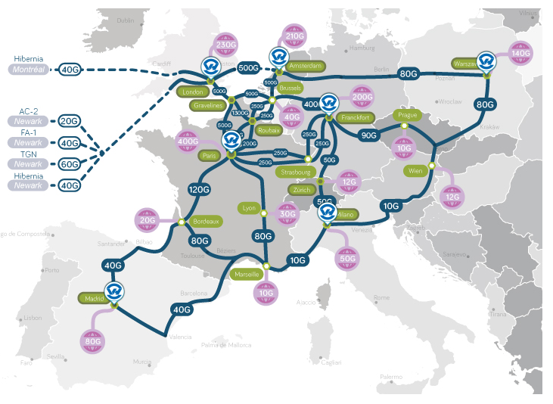
Content Delivery Networks
Proprietary, e.g.
Youtube (Google)
Netflix (partially)
CDN providers:
Akamai
OVH
AWS

