Slide 1


Introduction to data communications
Lecturer: Itamar Cohen
Chapter 2: Application Layer (part1I)
A note on the use of these ppt slides:
We’re making these slides freely available to all (faculty, students, readers). They’re in PowerPoint form so you see the animations; and can add, modify, and delete slides (including this one) and slide content to suit your needs. They obviously represent a lot of work on our part. In return for use, we only ask the following:
Computer Networking: A Top Down Approach 6th edition Jim Kurose, Keith Ross Addison-Wesley March 2012
If you use these slides (e.g., in a class) that you mention their source (after all, we’d like people to use our book!)
If you post any slides on a www site, that you note that they are adapted from (or perhaps identical to) our slides, and note our copyright of this material.
Thanks and enjoy! JFK/KWR
All material copyright 1996-2012
J.F Kurose and K.W. Ross, All Rights Reserved
See additional references in the end of this presentation
מבוסס גם על שקפים של ד"ר בועז בן משה, פרופ' אמיר הרצברג, איציק קיטרוסר, שי אולשר, אלכס מיטנק, אליאב מנשה ופיליפ לויס

Slide 2
Chapter 2.0 (reminder)
Motivation & Basic concepts
Requirements from the transport level
Web

Slide 3
Chapter 2.1: Outline
Domain Name System
Architecture
Syntax
Concluding example
P2P
FTP
E-mail

Slide 4
DNS: motivation
Internet hosts and routers are unequivocally identified by theirs IP address.
However, we give them easy-to-remember “names”, e.g., cnn.com
Q: how to map
IP adr ←→ name
Domain Name System:
distributed database
hierarchical name servers
application-layer protocol: hosts, servers communicate to resolve names (IP adr ←→ name translation)

Slide 5
why not centralize DNS?
☹ Single point of failure
☹ Large traffic volume
☹ → Doesn’t scale

Slide 6
DNS services
DNS services
Hostname → IP adr translation
host and mail server aliasing
alias →canonical names
Eg: www.Gmail.com → www.mail.google.com
Load distribution
Replicated web servers: many IP addresses correspond to one name

Slide 7
Load balancing and replicating
Simple approach: different names
www1.cnn.com, www2.cnn.com, www3.cnn.com
But this requires users to select specific replicas
More elegant approach: different IP addresses
Single name (e.g., www.cnn.com), multiple addresses
E.g., 64.236.16.20, 64.236.16.52, 64.236.16.84, …
Authoritative DNS server returns many addresses
Local DNS server selects one of them, or:
Authoritative server may vary the order of addresses

Slide 8
DNS Query in Web Download
User types or clicks on a URL
E.g., http://www.cnn.com/2019/leadstory.html
Browser extracts the site name
E.g., www.cnn.com
Browser queries the local DNS server to learn IP address
Browser contacts the Web server
Creates and connects socket
Opens TCP
Sends HTTP request
Notes:
“Browser queries the local DNS server to learn IP address” –
In practice, the browser / OS look first in their $.
Does DNS uses UDP / TCP?
DNS requests are usually via UDP. However, TCP is used when DNS servers communicate and dist’ data; and sometimes also by client (e.g., for DNSSec).

Slide 9
DNS Query in Web Download
User types or clicks on a URL
E.g., http://www.cnn.com/2019/leadstory.html
Browser extracts the site name
E.g., www.cnn.com
Browser calls getaddrinfo to learn IP address
Triggers resolver code to query the local DNS server
Eventually, the resolver gets a reply
Resolver returns the IP address(es) to the browser
The browser contacts the Web server
Creates and connects socket, and sends HTTP request

Slide 10
Multiple DNS Queries
Often a Web page has embedded objects
E.g., HTML file with embedded images
Each embedded object has its own URL
… and potentially lives on a different Web server
E.g., http://www.myimages.com/image1.jpg
Requires learning the address for www.myimages.com

Slide 11
Eliminating Unnecessary DNS Queries
Using a local (on-machine) cache
Caching a recently-used hostnames
Or the (recently-used) webpage itself
Local DNS server caches recent DNS requests

Slide 12
DNS database
Root DNS Servers
…
…
com DNS servers
org DNS servers
edu DNS servers
yahoo.com
DNS servers
pbs.org
DNS servers
poly.edu
DNS servers
umass.edu
DNS servers
amazon.com
DNS servers
client wants IP for www.amazon.com ; 1st approx:
client queries root server to find com DNS server
client queries .com DNS server to get amazon.com DNS server
client queries amazon.com DNS server to get IP address for www.amazon.com
Notes:
Use here the example illustrated in the book

Slide 13
Distributed Hierarchical Database
unnamed root
com
edu
org
il
uk
fr
arpa
generic domains
country domains
bar
ac
in-
addr
west
east
cam
12
foo
my
usr
34
my.east.bar.edu
usr.cam.ac.uk
12.34.56.0/24
56

Slide 14
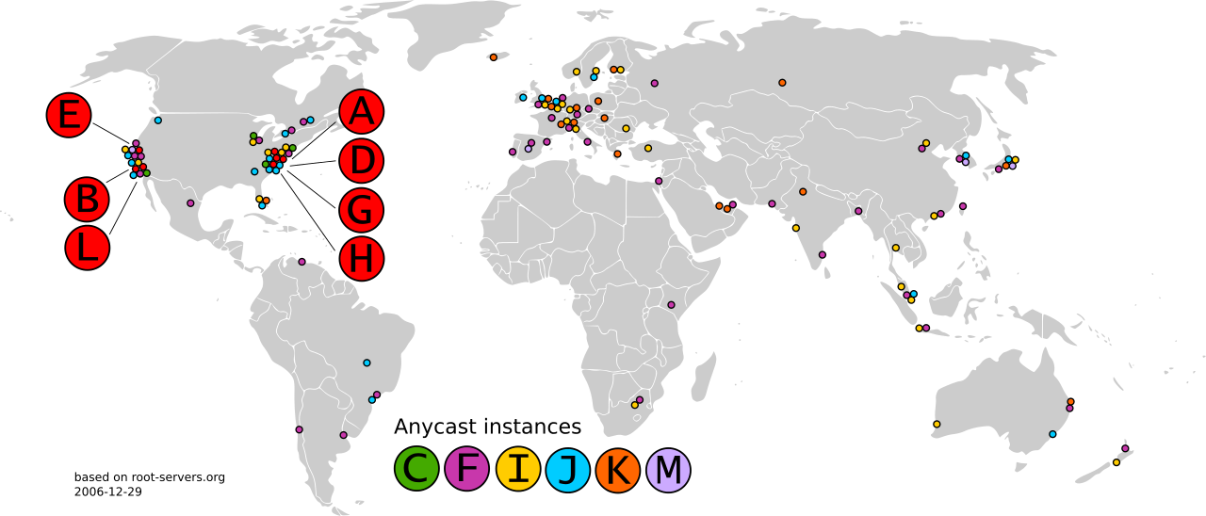
DNS: Root name servers
Set of 13 fixed IP addresses, most with multiple locations
Use anycast to reach closest server
“named” ‘A’ to ‘M’
See: http://www.root-servers.org/
Notes:
Specifying a single IP adr, but actually may get answer from any of the mirror

Slide 15
TLD, authoritative servers
Top-Level Domain (TLD) servers:
responsible for com, org, net, edu etc, and all top-level country domains, e.g.: uk, fr, ca, jp
Authoritative DNS servers:
organization’s own DNS server(s), providing authoritative hostname to IP mappings for organization’s named hosts
can be maintained by organization or service provider

Slide 16
Local (default) DNS name server
does not strictly belong to hierarchy
each ISP (residential, company, university) has one
Queries are sent to the local DNS
Acts as a proxy & local cache
Whose translations may be stale

Slide 17

DNS name resolution example (alg’ PUPTIZ)
root DNS server
2
host at cis.poly.edu wants IP address for gaia.cs.umass.edu
3
TLD DNS server
4
5
iterated query:
“I don’t know this name. Please ask this server”
local DNS server
dns.poly.edu
7
6
1
8
authoritative DNS server
dns.cs.umass.edu
requesting host
cis.poly.edu
gaia.cs.umass.edu
Notes:
Exemplify on board using next (hidden) slide’s data

Slide 18
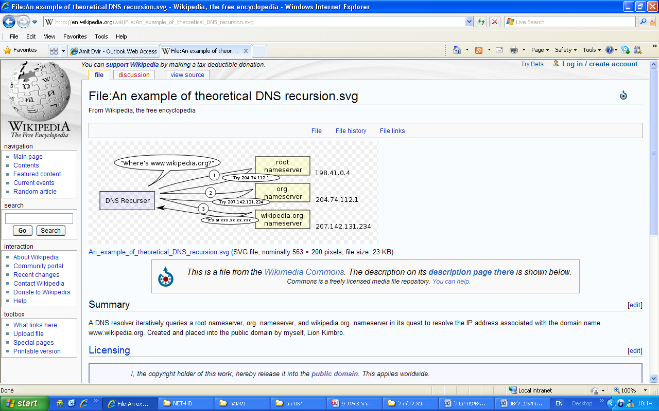

Slide 19
DNS name resolution example
root DNS server
2
3
recursive query:
(“the go-to-SHIN GIMEL Alg”)
puts burden of name resolution on contacted name server
heavy load at upper levels of hierarchy?
7
6
TLD DNS
server
local DNS server
dns.poly.edu
5
4
1
8
authoritative DNS server
dns.cs.umass.edu
requesting host
cis.poly.edu
gaia.cs.umass.edu

Slide 20
DNS: caching, updating records
Name server caches previous mappings
Cached entries timeout (disappear)
Time To Live
TLD servers typically cached in local name servers
thus root name servers not often visited
Update/notify mechanisms for updating stale cache entries [RFC 2136]

Slide 21
Chapter 2.1: Outline
Domain Name System
Architecture
Syntax
Concluding example
P2P
FTP
E-mail

Slide 22
DNS Resource Records
RRs: The TACHLES in DNS reply
RR format: (name, value, type, ttl)
type=A
Name: hostname
Value: IP address
type=NS
Name: domain
Value: hostname of authoritative name server for this domain
Usually accompanied by an additional, type-A, RR
type=CNAME
Value: canonical name
Name: alias for this canonical (the real) name
type=MX
Same as type CNAME, but here name indicates a mailserver
DNS Web tool
Notes:
Examples:
(gamad.com, 64.32.16.8, A, 3600s)
(gamad.com, dns1.gamad.com, NS, 3600). Will be accompanied by the RR: (dns1.gamad.com 64.32.16.1, A, 3600s)
CNAME: (ibm.com, servereast.backup2.ibm.com, CNAME, 3600s). Will be accompanied by the RR: (servereast.backup2.ibm.com, 4.3.2.1, A, 3600s)
Why additional type for mail servers? Because the same aliased name may be used for both the mail server and other servers. Eg, walla, google.
You may Try DNSing by Network-Tools: http://network-tools.com/nslook/

Slide 23
DNS protocol, messages
query and reply messages, both with same message format
2 bytes
2 bytes
msg header
identification: 16 bit # for query, reply to query uses same #
flags:
query or reply
recursion desired
recursion available
reply is authoritative
identification
flags
# questions
# answer RRs
# authority RRs
# additional RRs
questions (variable # of questions)
answers (variable # of RRs)
authority (variable # of RRs)
additional info (variable # of RRs)

Slide 24
DNS protocol, messages
2 bytes
2 bytes
identification
flags
# questions
# answer RRs
# authority RRs
# additional RRs
name, type fields
for a query
questions (variable # of questions)
RRs in response
to query
answers (variable # of RRs)
records for
authoritative servers
authority (variable # of RRs)
additional “helpful”
info that may be used
additional info (variable # of RRs)

Slide 25
DNS Messages
DNS protocol: send request, receive reply
Single format for requests & replies
Header | Questions | Answers | Authority | Other
ID (16 bits) | Flags
Number of questions | Number of answers
Number of authority | Number of other
Name
Type of Record
Name
Type of RR
TTL in seconds
Value
RR (Resource Record)

Slide 26
DNS Queries: Recursive, Iterative
Client
Local
Server
Root
Server
ns.com
132.3.3.4 (auth server for TLD .com)
ns1.bob.com
156.4.5.6 (auth server
for bob.com)
A: www.bob.com ?
A: www.bob.com ?
NS: .com ns.com
A: ns.com 132.3.3.4
A: www.bob.com ?
NS: bob.com ns1.bob.com A: ns1.bob.com 156.4.5.6
A: www.bob.com ?
www.bob.com A 156.6.6.6
www.bob.com A 156.6.6.6
TCP open connection to 156.6.6.6 (www.bob.com)
HTTP request to 156.6.6.6 (www.bob.com)

Slide 27
Chapter 2.1: Outline
Domain Name System
Architecture
Syntax
Concluding example
P2P
FTP
E-mail

Slide 28

Exmaple: Inserting records into DNS
Example: we’d like to register the domain startup.com
We should purchase the domain from a DNS registrar
Registrar – checks that the domain is available and registers it in DNS. Eg mydomain
The Internet Corporation for Assigned Name and Numbers (ICANN) allocates domain names
We should have our own primary and secondary authoritative nameservers
dns1.startup.com in 128.1.1.1, and
dns2.startup.com in 128.1.1.2
We should have a web server and a mail server
www1.middle-east.startup.com in 128.1.1.3
mail.startup.com in 128.1.1.4

Slide 29
Inserting records into DNS (Cont’)
We should enter to our authoritative nameservers a record for our web server
(startup.com, www1. middle-east.startup.com , NS, 7200s)
(www1.middle-east.startup.com, 128.1.1.3, A, 7200s)
… and for our mail server
(startup.com, mail.startup.com, MX, 7200s)
(mail.startup.com, 128.1.1.3, A, 7200s)

Slide 30
Inserting records into DNS (Cont’)
Our registrars adds to the .com TLD servers the records
(startup.com, dns1.startup.com, NS, 7200s)
(startup.com, dns2.startup.com, NS, 7200s)
(dns1.startup.com, 128.1.1.1, A, 7200s)
(dns2.startup.com, 128.1.1.2, A, 7200s)
This is done by an UPDATE dns command

Slide 31
Attacking DNS: Ddos attacks
DDoS attacks
Bombard root servers with traffic
Mitigations
Local DNS uses cache
Root servers filters traffic
→ Not successful to date
Bombard TLD servers
Potentially more dangerous
Another DDoS attack
Send queries with the fake source bgu.ac.il, so that BGU’s server will get plenty of (large) replies
Notes:
http://www.youtube.com/watch?v=2ZUxoi7YNgs&feature=related

Slide 32

DNS poisoning
Notes:
http://www.youtube.com/watch?v=2ZUxoi7YNgs&feature=related

Slide 33
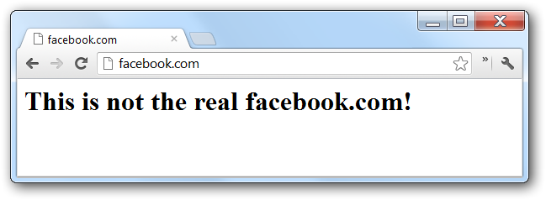

Attacking DNS: poisoning
Attacker → target DNS server: A: attacker.com ?
Target DNS server to someone: A: attacker.com ?
Attacker → target DNS server:
NS: facebook.com ns1.attacker.com
A: ns1.attacker.com 66.6.6.6
Mitigations (at the DNS server)
Verify that the reply agrees with the query
A smart attacker may force the DNS to really query for facebook.com
Verify that the source port, Query ID agree with that of the query
Windows uses 2500 DNS source ports for DNS;
There’re ____ possible QID
User will notice that attacker’s site doesn’t use https
DNSSec: DNS reply must be signed
Notes:
http://www.youtube.com/watch?v=2ZUxoi7YNgs&feature=related

Slide 34
Chapter 2.1: Outline
Domain Name System
P2P
FTP
E-mail

Slide 35


















P2P: motivation
highly-popular apps, eg
file distribution (BitTorrent)
VoIP (Skype)
Streaming
Notes:
Streaming – e.g. Xunlei Kankan

Slide 36
P2P: motivation
Reminder: in P2P -
no always-on server
arbitrary end systems directly communicate
peers are intermittently connected and change IP addresses

Slide 37
P2P: motivation
Question: how much time to distribute file (size F) from one server to N peers?
Neglecting propagation and processing delay
u_{s}: server upload capacity
u₁
d_{i}: peer i download capacity
file, size F
u_{s}
d₁
u₂
d₂
server
d_{i}
u_{N}
network (with abundant
bandwidth)
u_{i}
d_{N}
u_{i}: peer i upload capacity

Slide 38
Motivation example for P2P: File distribution time using client-server scheme
server transmission: must sequentially send (upload) N file copies: NF/u_{s}
client: each client must download file copy
d_{min} = min client download rate
F
u_{s}
d_{i}
network
u_{i}
time to distribute F
to N clients using
client-server approach
D_{c-s} > max{NF/u_{s,},F/d_{min}}
What scheduling should the server use for obtaining equality?
O(N)
Notes:
Why not sum of d/l times?
- Because the server may u/l fast the slowest-downloading client first. The netw. Equipment on the way will have to store large chunks of the file on-the-fly. While the slow client is still downloading, the server already uploads for further clients, who start downloading as well.

Slide 39
Motivation example for P2P: File distribution time using P2P scheme
server transmission: must upload at least one copy: F/u_{s}
client: each client must download a copy
min client download time: F/d_{min}
F
u_{s}
d_{i}
network
u_{i}
clients: as aggregate must download NF bits
max upload rate (limting max download rate) is u_{s} + Σu_{i}
time to distribute F
to N clients using
P2P approach
D_{P2P} > max{F/u_{s,},F/d_{min,},NF/(u_{s} + Σu_{i})}
increases linearly in N …
… but so does this, as each peer brings its upload capacity

Slide 40
Client-server vs. P2P: example
client upload rate = u, F/u = 1 hour, u_{s} = 10u, d_{min} ≥ u_{s}

Slide 41
P2P: motivation
☺ Faster download time
☺ Less HW cost (eg, link’s BW)
☺ Better resilience to failures
Transmission is not depended in a single source
☺ Less traffic fluctuations in the network

Slide 42
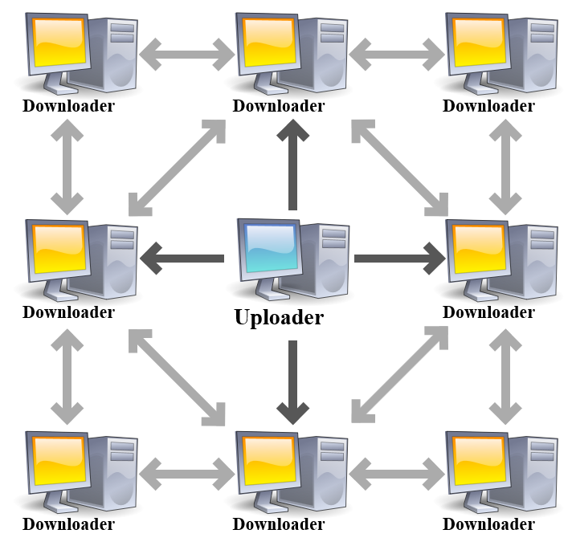

BitTorrent: basic terms
A user sharing a file: seed
File is divided into chunks
Peers usually receive the chunks ooo
Each peer which obtains a chunk, shares it, thus relieving load from the seed
The set of users sharing one file is called a swarm (aka torrent)
Once an additional peer has the entire file, it may
(selfishly) leave, OR
(altruistically) remain, becoming a new seed

Slide 43


BitTorrent: example sceanrio
tracker: tracks peers
participating in torrent
All the users here form a Torrent (aka swarm)
Alice arrives,
obtains a list
of peers from tracker,
and begins communicating with them over TCP

Slide 44


BT: rarest first
Alice
Periodically requests and receives from each neighbor a list of the chunks it has
Then, tries to obtain first the rarest chunks
Why?

Slide 45
BT: Tit-and-tat (WYGIWYG)
Alice periodically (e.g., every 10 secs) calculates the rates at which she receives bits from peers
Alice reciprocate her 4 fastest sender peers by sending them chunks
These preferred senders/receivers are said to be unchoked
Every 30 secs, Alice randomly selects additional peer to be optimistically unchoked
Other peers are choked by Alice (do not receive chunks from her)
Notes:
Tit-and-tat – מידה כנגד מידה

Slide 46

BitTorrent: tit-for-tat
(1) Alice “optimistically unchokes” Bob
(2) Alice becomes one of Bob’s top-four providers; Bob reciprocates
(3) Bob becomes one of Alice’s top-four providers
higher upload rate: find better trading partners, get file faster !
A nice applet in Wiki

Slide 47
BT security
The first seed creates a small Torrent Descriptor, which contains a cryptographic hash of the file to be shared
Each chunk is protected by the hash
Any modification done on the original chunk can be detected

Slide 48
Chapter 2.1: Outline
Domain Name System
P2P
FTP
E-mail

Slide 49
File Transfer Protocol
file transfer
FTP
user
interface
FTP
client
FTP
server
user
at host
remote file
system
local file
system
transfer file to/from remote host
client/server model
client: side that initiates transfer (either to/from remote)
server: remote host

Slide 50

FTP: Out Of Band control
The client initiates a TCP control connection, which remains open throughout the session
Upon receiving a file transfer command, server opens a TCP data connection (for file) to client
New data connection for every file transfer
FTP server maintains “state”: current directory, earlier authentication
☹ Significantly constraining # of open TCP connection
TCP control connection,
server port 21
FTP
client
TCP data connection,
server port 20
FTP
server
FTP / HTTP
* [Out-of | In] Band
* State [full | less]

Slide 51
FTP commands, responses
sample commands:
sent as ASCII text over control channel
USER username
PASS password
LIST return list of file in current directory
RETR filename retrieves (gets) file
STOR filename stores (puts) file onto remote host
sample return codes
status code and phrase (as in HTTP)
331 Username OK, password required
125 data connection already open; transfer starting
425 Can’t open data connection
452 Error writing file

Slide 52
Chapter 2.1: Outline
Domain Name System
P2P
FTP
E-mail

Slide 53
Email
outgoing
message queue
user mailbox
Three major components:
User agents
Mail servers
Simple Mail Transfer Protocol
User Agent
aka “mail reader”
e.g., Outlook, iPhone, Thunderbird, mail client
outgoing, incoming messages stored on server
user
agent
mail
server
user
agent
SMTP
mail
server
user
agent
SMTP
SMTP
user
agent
mail
server
user
agent
user
agent

Slide 54
Email: mail servers
mail servers:
mailbox contains incoming messages for user
message queue of outgoing (to be sent) mail messages
Each server is sometimes a SMTP client and sometimes a SMTP server
SMTP client: when sending a mail
SMTP server: when receiving a mail
user
agent
mail
server
user
agent
SMTP
mail
server
user
agent
SMTP
SMTP
user
agent
mail
server
user
agent
user
agent

Slide 55
Simple Message Transfer Protocol
uses TCP
three phases of transfer
handshaking (greeting)
transfer of messages
closure
command/response interaction
commands: ASCII text
response: status code and phrase

Slide 56
Scenario: Alice sends a message to Bob
1) Alice uses UA to compose message “to” bob@someschool.edu
2) Alice’s UA sends message to her mail server; message placed in message queue
3) client side of SMTP opens TCP connection with Bob’s mail server
4) SMTP client sends Alice’s message over the TCP connection
5) Bob’s mail server places the message in Bob’s mailbox
6) Bob invokes his user agent to read message
user
agent
mail
server
user
agent
1
mail
server
2
3
6
4
Alice’s mail server
5
Bob’s mail server
Notes:
STEP 6) Bob invokes his user agent to read message –commonly does NOT use SMTP (but POP, IMAP, HTTP etc).

Slide 57
SMTP Vs. HTTP
Push / Pull
Message body format: only ASCII / other formats
Always persistent / not always persistent
Multiple objects in one response msg / one object per msg
both have ASCII command/response interaction, status codes

Slide 58
Mail access protocols
user
agent
mail access
protocol
user
agent
SMTP
(push)
SMTP
(push)
(e.g., POP,
IMAP)
(pull)
sender’s mail
server
receiver’s mail
server
In the past, users used to log into a mail server
This is not the situation today → A push / pull problem
Solution: mail access protocol, for retrieving the mails from the server
POP: Post Office Protocol
IMAP: Internet Mail Access Protocol: more features, including manipulation of stored messages on server
Bob doesn’t have to be connected to the internet (but only to its local mail server)
Notes:
POP3: very simple. The mail data and operations are done on the local PC. This doesn’t support mobility.
Thus IMAP is needed.

Slide 59
Web-based email
user
agent
HTTP
(push /
Pull)
SMTP
user
agent
HTTP
(e.g., POP,
IMAP)
(push /
Pull)
sender’s mail
server
receiver’s mail
server
Eg Gmail, Yahoo!, Walla
Both Alice and Bob have to be connected to the internet
Notes:
POP3: very simple. The mail data and operations are done on the local PC. This doesn’t support mobility.
Thus IMAP is needed.

Slide 60
References
EE384x, Packet Switch Architectures – lectures slides by Nick McKeown & Balaji Prabakhar, spring 2012, Stanford University

