Slide 1


Introduction to data communications
Lecturer: Itamar Cohen
Chapter 3: The transport Layer: UDP
A note on the use of these ppt slides:
We’re making these slides freely available to all (faculty, students, readers). They’re in PowerPoint form so you see the animations; and can add, modify, and delete slides (including this one) and slide content to suit your needs. They obviously represent a lot of work on our part. In return for use, we only ask the following:
If you use these slides (e.g., in a class) that you mention their source (after all, we’d like people to use our book!)
If you post any slides on a www site, that you note that they are adapted from (or perhaps identical to) our slides, and note our copyright of this material.
Thanks and enjoy! JFK/KWR
All material copyright 1996-2012
J.F Kurose and K.W. Ross, All Rights Reserved
מבוסס גם על שקפים של ד"ר בועז בן משה, פרופ' אמיר הרצברג, איציק קיטרוסר, שי אולשר, אלכס מיטנק, אליאב מנשה, ד"ר יורם חדד ופיליפ לויס
Computer Networking: A Top Down Approach 6th edition Jim Kurose, Keith Ross Addison-Wesley March 2012

Slide 2
Chapter 3: outline
Reminder: the transport layer
UDP
Principles of reliable data transfer

Slide 3
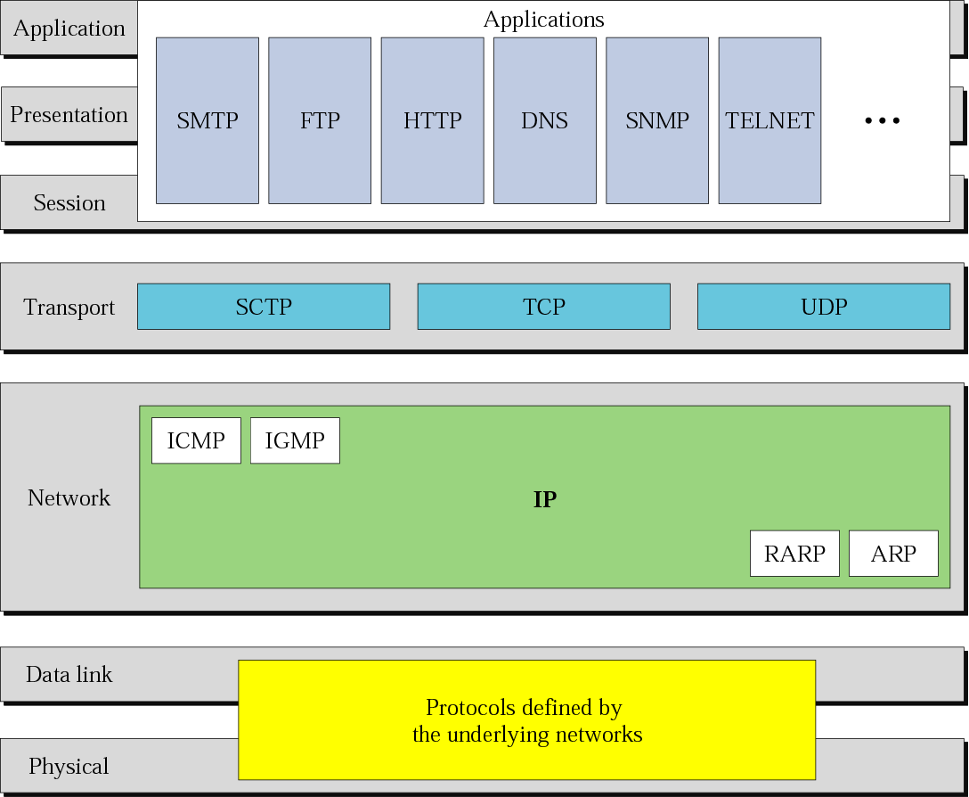
Reminder: where are we ?

Slide 4
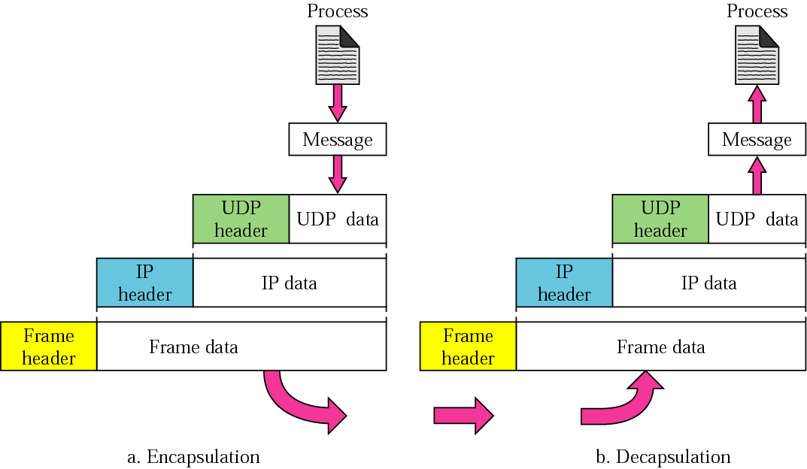
[En|de]capsulation

Slide 5


















Transport services and protocols
application
transport
network
data link
physical
provide logical communication between app processes running on different hosts
transport protocols run in end systems
send side: breaks app messages into segments, passes to network layer
rcv side: reassembles segments into messages, passes to app layer
Common transport protocols
TCP, UDP, SCTP
logical end-end transport
application
transport
network
data link
physical

Slide 6
Transport vs. network layer
network layer: logical communication between hosts
transport layer: logical communication between processes
relies on, enhances, network layer services
household analogy:
12 kids in Ann’s house sending letters to 12 kids in Bill’s house:
hosts = houses
processes = kids
app messages = letters in envelopes
transport protocol = Ann and Bill who demux to in-house siblings
network-layer protocol = postal service
Data (de)multiplexing

Slide 7

Internet transport-layer protocols
reliable, in-order delivery (TCP)
congestion control
flow control
connection setup
unreliable, unordered delivery: UDP
no-frills extension of “best-effort” IP
services not available:
delay guarantees
bandwidth guarantees
application
transport
network
data link
physical
network
data link
physical
network
data link
physical
logical end-end transport
network
data link
physical
network
data link
physical
network
data link
physical
network
data link
physical
application
transport
network
data link
physical

Slide 8
Chapter 3: outline
Reminder: the transport layer
User Datagram Protocol
Principles of reliable data transfer

Slide 9
UDP: User Datagram Protocol [RFC 768]
connectionless:
no handshaking between sender, receiver
each UDP segment handled independently
often used for streaming multimedia apps
loss tolerant
rate sensitive
Used also by
Domain Name System
Application layer may add reliability, e.g. by asking to re-send, or by error recovery
Why is there a UDP?
no overhead for connection establishment and state
small header
no congestion control: UDP can blast away as fast as desired
Notes:
UDP properties and purpose
UDP enables a connectionless communication between host
No congestion control, no acks / feedbacks
If the sender doesn’t receive a reply “on time”, it may either try again, or report the upper (application) layer it didn’t receive a reply
Example: host querying a Domain Name Server
If no reply is received, UDP may either querying another server, or report the application that it can’t get a reply
Another example: Real-Time applications
Can’t afford long delays due to congestion control
Can tolerate some data loss
Additional functionality, if needed, can be implemented directly by the application layer
Why UDPing and not FTPing?
Smaller delay
Smaller HW and SW overhead
TCP uses State variables, sending / acks numbers, receive buffers.
TCP uses longer header
No retransmitting after data is not relevant anymore
Eg real time applications
UDP is used also by Simple Network Management Protocol

Slide 10
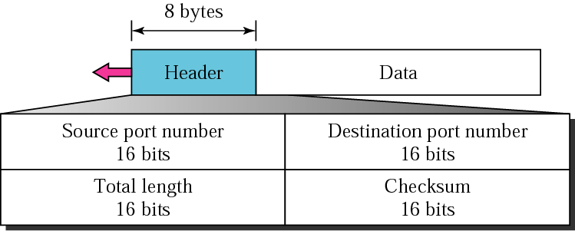
UDP segment format
Total length: in bytes, including header
Checksum is done over the all 16-b words in the segment
Why to checksum?
Lower layers not always perform error correction
Errors may happen also within the routers

Slide 11
Chapter 3: outline
Reminder: the transport layer
UDP
Principles of reliable data transfer
Stop & Wait
Go-Back-N
Selective Repeat

Slide 12
Automatic Repeat reQuest protocols: Stop & Wait
sender
receiver
first packet bit transmitted, t = 0
last packet bit transmitted, t = L / R
first packet bit arrives
RTT
last packet bit arrives, send ACK
ACK arrives, send next
packet, t = RTT + L / R
See scenarios in the comments
Utility of link: percentage of time, in which the link is busy (“utilized”). Eg: L/R = 8us, RTT=30ms →
Notes:
S & W:
* Corrupted pkt → Use Ack, Nack.
* Corrupted Acks → resend the pkt anyway → problem: 11,00,11 (corrupted Ack for 00) will be understood as 11,00,00 (duplicated pkts).
Seq. #. As we have only 1 pkt “on the fly”, 1 bit is enough.
No need for Nacks. Send merely Ack for the last pkt which arrived correctly.
Lost pkts / Acks → TimeOut. Too long: low perf’. Too short: many redundant pkt sends and duplicate pkts. Sender should ignore duplicate Acks.
Use Fig. 3.16.

Slide 13
Chapter 3: outline
Reminder: the transport layer
UDP
Principles of reliable data transfer
Stop & Wait
Go-Back-N
Selective Repeat

Slide 14
Pipelining: increased utilization
sender
receiver
first packet bit transmitted, t = 0
last bit transmitted, t = L / R
first packet bit arrives
RTT
last packet bit arrives, send ACK
last bit of 2nd packet arrives, send ACK
last bit of 3rd packet arrives, send ACK
ACK arrives, send next
packet, t = RTT + L / R
n-packet pipelining increases
utilization by a factor of n!
Utility of link: percentage of time, in which the link is busy (“utilized”). Eg: L/R = 8us, RTT=30ms →

Slide 15
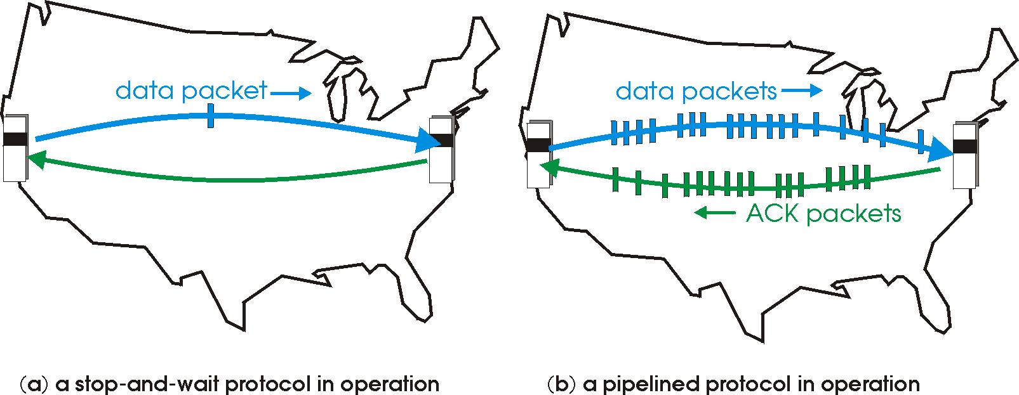

Pipelined protocols
pipelining: sender allows multiple, “in-flight”, yet-to-be-acknowledged pkts
range of sequence numbers must be increased
buffering at sender and/or receiver
two generic forms of pipelined protocols: go-Back-N, selective repeat

Slide 16
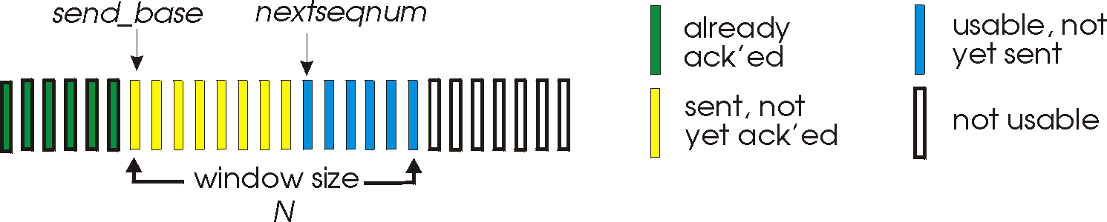
Go-Back-N: sender
k-bit seq # in pkt header
“window” of up to N consecutive unack’ed pkts
ACK(n): ACKs all pkts up to, including seq # n - “cumulative ACK”
Timer(s)* for sent pkts
If an Ack arrives and there’re pkts which were sent, but not yet acked – the timer is restarted
Upon T.O: retransmit the first non-acked pkt, and all higher seq # pkts in window

Slide 17

GBN in action
sender window (N=4)
sender
receiver
0 1 2 3 4 5 6 7 8
send pkt0
send pkt1
send pkt2
send pkt3
(wait)
0 1 2 3 4 5 6 7 8
receive pkt0, send ack0
receive pkt1, send ack1
receive pkt3, discard,
(re)send ack1
0 1 2 3 4 5 6 7 8
X
0 1 2 3 4 5 6 7 8
loss
0 1 2 3 4 5 6 7 8
rcv ack0, send pkt4
rcv ack1, send pkt5
0 1 2 3 4 5 6 7 8
receive pkt4, discard,
(re)send ack1
ignore duplicate ACK
receive pkt5, discard,
(re)send ack1
pkt 2 timeout
0 1 2 3 4 5 6 7 8
send pkt2
send pkt3
send pkt4
send pkt5
0 1 2 3 4 5 6 7 8
0 1 2 3 4 5 6 7 8
rcv pkt2, deliver, send ack2
rcv pkt3, deliver, send ack3
rcv pkt4, deliver, send ack4
rcv pkt5, deliver, send ack5
0 1 2 3 4 5 6 7 8
Youtube show
Notes:
The timeout event shown in this diagram doesn’t obey the rules in GBN’s FSM (3.20, p.251 in Ed. 7): According to the diagram there, only the oldest pkt (pkt0 in our case) restarts a timer; pkt2 should have no timer. Furthermore, once an Ack arrives (e.g., Ack 0, Ack1), the timer is restarted. These are also TCP’s re-xmt timer’s rules – see RFC 6298: https://tools.ietf.org/html/rfc6298

Slide 18
Go-Back-N pros. and cons.
☺
Easy to implement
Simple code, few variables, small receiver buffer
☹
Many unnecessary retransmission
Waste network’s resources
Decrease performances
Solution?
Selective Repeat

Slide 19
Chapter 3: outline
Reminder: the transport layer
UDP
Principles of reliable data transfer
Stop & Wait
Go-Back-N. Watch nice movie
Selective Repeat
Notes:
Examples
1. Window = 1 Mb, RTT = 10 ms. TP=?
2. BW = 10 Gbps, RTT = 100 ms. W=10 Mb.
U=?
What’s W for getting U=100%? How much data will be in flight in this case?
Answers
1. TP = W/RTT = 100 Mbps
2. A. TP = W/RTT = 100 Mbps. U=TP/BW = 1%
B. W’ = BW*RTT = 1 Gb. This is also the amount of data in flight; and of the buffers of routers on the way and / or the receiver’s reordering buffer!
This is called large BDP (Bandwidth Delay Product).

Slide 20
Selective Repeat
sender can have up to N unack’ed packets in pipeline
Rcvr individually acks each packet
Rcvr maintains a reordering buffer
Sender maintains timer for each unacked packet
when timer expires, retransmit only that packet

Slide 21
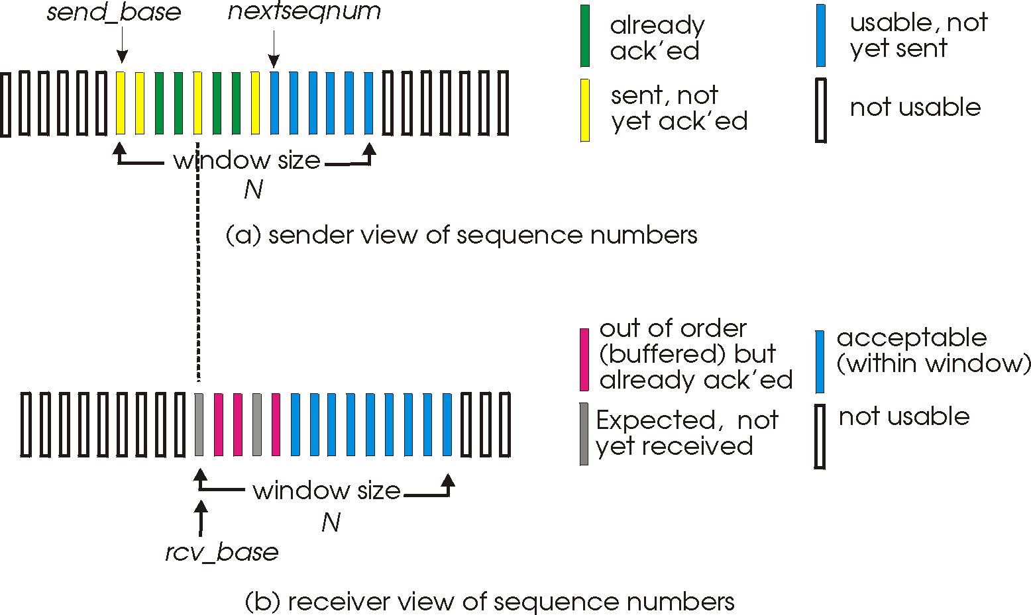
Selective Repeat

Slide 22
Selective repeat
sender
receiver
data from above:
if next available seq # in window, send pkt
timeout(n):
resend pkt n, restart timer
ACK(n) in [sendbase,sendbase+N-1]:
mark pkt n as received
if n is smallest unACKed pkt, advance window base to next unACKed seq #
pkt n in [rcvbase, rcvbase+N-1]
send ACK(n)
out-of-order: buffer
in-order: deliver all buffered, in-order pkts. advance window to next not-yet-received pkt
pkt n in [rcvbase-N,rcvbase-1]
ACK(n)
otherwise:
ignore

Slide 23
Selective repeat in action
sender window (N=4)
sender
receiver
0 1 2 3 4 5 6 7 8
send pkt0
send pkt1
send pkt2
send pkt3
(wait)
0 1 2 3 4 5 6 7 8
receive pkt0, send ack0
receive pkt1, send ack1
receive pkt3, buffer,
send ack3
0 1 2 3 4 5 6 7 8
X
0 1 2 3 4 5 6 7 8
loss
0 1 2 3 4 5 6 7 8
rcv ack0, send pkt4
rcv ack1, send pkt5
0 1 2 3 4 5 6 7 8
receive pkt4, buffer,
send ack4
record ack3 arrived
receive pkt5, buffer,
send ack5
pkt 2 timeout
0 1 2 3 4 5 6 7 8
send pkt2
0 1 2 3 4 5 6 7 8
record ack4 arrived
0 1 2 3 4 5 6 7 8
rcv pkt2; deliver pkt2,
pkt3, pkt4, pkt5; send ack2
record ack5 arrived
0 1 2 3 4 5 6 7 8
Q: what happens when ack2 arrives?

Slide 24

Too small window: dilemma
sender window
(after receipt)
receiver window
(after receipt)
0 1 2 3 0 1 2
pkt0
0 1 2 3 0 1 2
pkt1
0 1 2 3 0 1 2
example:
seq #’s: 0, 1, 2, 3
window size=3
0 1 2 3 0 1 2
pkt2
0 1 2 3 0 1 2
0 1 2 3 0 1 2
0 1 2 3 0 1 2
pkt3
X
0 1 2 3 0 1 2
pkt0
will accept packet
with seq number 0
receiver sees no difference in two scenarios!
duplicate data accepted as new in (b)
Q: what relationship between seq # size and window size to avoid problem in (b)?
(a) no problem
receiver can’t see sender side.
receiver behavior identical in both cases!
something’s (very) wrong!
0 1 2 3 0 1 2
pkt0
0 1 2 3 0 1 2
pkt1
0 1 2 3 0 1 2
0 1 2 3 0 1 2
pkt2
0 1 2 3 0 1 2
X
0 1 2 3 0 1 2
X
timeout
retransmit pkt0
X
0 1 2 3 0 1 2
pkt0
will accept packet
with seq number 0
BANG!

Slide 25
