Slide 1


Introduction to data communications
Lecturer: Itamar Cohen
Chapter 3 (Cont’): TCP
A note on the use of these ppt slides:
We’re making these slides freely available to all (faculty, students, readers). They’re in PowerPoint form so you see the animations; and can add, modify, and delete slides (including this one) and slide content to suit your needs. They obviously represent a lot of work on our part. In return for use, we only ask the following:
If you use these slides (e.g., in a class) that you mention their source (after all, we’d like people to use our book!)
If you post any slides on a www site, that you note that they are adapted from (or perhaps identical to) our slides, and note our copyright of this material.
Thanks and enjoy! JFK/KWR
All material copyright 1996-2012
J.F Kurose and K.W. Ross, All Rights Reserved
מבוסס גם על שקפים של ד"ר יורם חדאד, ד"ר בועז בן משה, פרופ' אמיר הרצברג, איציק קיטרוסר, שי אולשר, אלכס מיטנק, אליאב מנשה ופיליפ לויס
Computer Networking: A Top Down Approach 6th edition Jim Kurose, Keith Ross Addison-Wesley March 2012

Slide 2
Chapter 3: outline
Motivation
TCP highly affects both user’s experience
TCP is a jack of all trades and master of none
Segments & Acks
Reliable data transfer
Flow control
Connection management
Congestion control

Slide 3
Chapter 3: outline
Motivation
Segments & Acks
Reliable data transfer
Flow control
Connection management
Congestion control

Slide 4
Byte Stream Service
To the lower layers, TCP handles data in segments.
To the higher layers TCP handles data as a sequence of bytes and does not identify boundaries between segments

Slide 5
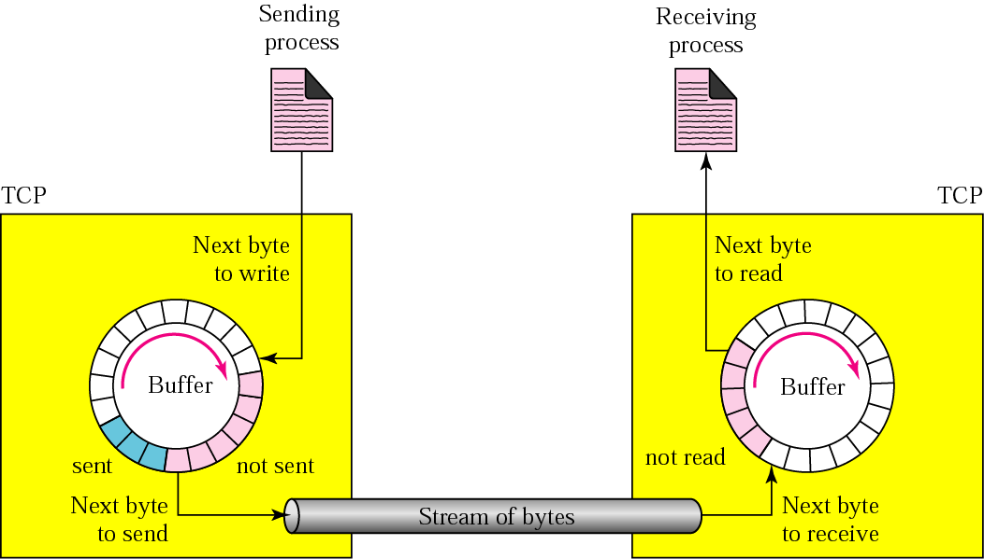
Sending and receiving buffers

Slide 6
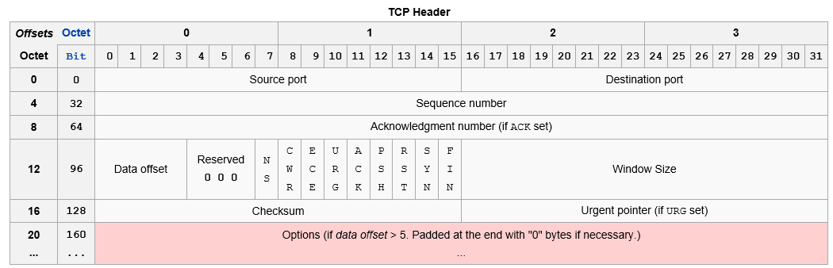
TCP Header

Slide 7
TCP seq. numbers, ACKs
Sequence #:
# of first byte in segment’s data
Acknowledgements:
seq # of next byte expected from other side
Cumulative ACK
Q: how receiver handles ooo segments
A: TCP spec doesn’t say, - up to implementation
Usually they are accepted
outgoing segment from sender
source port #
dest port #
sequence number
acknowledgement number
rwnd
checksum
urg pointer
window size
N
sender sequence number space
sent
ACKed
sent, not-yet ACKed
(“in-flight”)
usable
but not
yet sent
not
usable
incoming segment to sender
source port #
dest port #
sequence number
acknowledgement number
A
rwnd
checksum
urg pointer

Slide 8

Seq & ACK # example
Host A
Host B
User
types
‘C’
Seq=42, ACK=79, data = ‘C’
host ACKs
receipt of
‘C’, echoes
back ‘C’
Seq=79, ACK=43, data = ‘C’
host ACKs
receipt
of echoed
‘C’
Seq=43, ACK=80
simple telnet scenario
Notes:
The seq # is incremented either according to the payload’s size. If SYN or FIN flag is set, the seq # of incremented by 1. Note that when either SYN / FIN is set, the TCP set. Contains no payload.

Slide 9
Round Trip Time estimation
How to estimate RTT?
Naïve solution: measure last RTT
Problems
RTT highly varies over time
Measuring RTT for every segment sent is too costly
Better solution
Average the SampleRTT over a few last samples

Slide 10
RTT estimation: Exponential weighted moving average
EstimatedRTT = (1- α)*EstimatedRTT + α*SampleRTT
influence of past sample decreases exponentially fast
typical value: α = 0.125
RTT: gaia.cs.umass.edu to fantasia.eurecom.fr
RTT (milliseconds)
sampleRTT
EstimatedRTT
time (seconds)

Slide 11

RTT variations
In periods when the RTT highly varies, sender should wait a little further before retransmission
→ Estimate both SampleRTT and DevRTT
Youtube lecture about RTT estimation
DevRTT = (1-β)*DevRTT + β*|SampleRTT-EstimatedRTT|
(typically, β = 0.25)
TimeoutInterval = EstimatedRTT + 4*DevRTT
estimated RTT
“safety margin”

Slide 12
Chapter 3: outline
Motivation
Segments & Acks
Reliable data transfer
Flow control
Connection management
Congestion control

Slide 13
Simplified TCP sender events:
Data rcvd from app:
Create segment
seq # = first data byte in segment
start timer if not already running
think of timer as for oldest unacked segment
expiration interval: TimeOutInterval
Timeout:
retransmit segment that caused timeout
restart timer
Ack rcvd:
if ack acknowledges previously unacked segments
update what is known to be ACKed
start timer if there are still unacked segments

Slide 14
TCP sender (simplified)
data received from application above
create segment, seq. #: NextSeqNum
pass segment to IP (i.e., “send”)
NextSeqNum = NextSeqNum + length(data)
if (timer currently not running)
start timer
Λ
NextSeqNum = InitialSeqNum
SendBase = InitialSeqNum
wait
for
event
timeout
retransmit not-yet-acked segment with smallest seq. #
start timer
ACK received, with ACK field value y
if (y > SendBase) {
SendBase = y
/* SendBase–1: last cumulatively ACKed byte */
if (there are currently not-yet-acked segments)
start timer
else stop timer
}

Slide 15
TCP: retransmission scenarios
Host A
Host B
Host A
Host B
SendBase=92
Seq=92, 8 bytes of data
Seq=92, 8 bytes of data
timeout
timeout
Seq=100, 20 bytes of data
ACK=100
X
ACK=100
ACK=120
Seq=92, 8 bytes of data
Seq=92, 8
bytes of data
SendBase=100
SendBase=120
ACK=100
ACK=120
SendBase=120
lost ACK scenario
premature timeout

Slide 16
TCP: retransmission scenarios
Host A
Host B
Seq=92, 8 bytes of data
Seq=100, 20 bytes of data
timeout
ACK=100
X
ACK=120
Seq=120, 15 bytes of data
cumulative ACK

Slide 17
TCP ACK generation [RFC 1122, RFC 2581]
event at receiver
arrival of in-order segment with
expected seq #. All data up to
expected seq # already ACKed
arrival of in-order segment with
expected seq #. One other
segment has ACK pending
arrival of out-of-order segment
higher-than-expect seq. # .
Gap detected
arrival of segment that
partially or completely fills gap
TCP receiver action
delayed ACK. Wait up to a some
limit (eg, 1ms) for next segment.
If no next segment, send ACK
immediately send single cumulative
ACK, ACKing both in-order segments
immediately send duplicate ACK,
indicating seq. # of next expected byte
immediate send ACK, provided that
segment starts at lower end of gap

Slide 18
TCP ACK generations rules
If sending data, must include(piggyback) an ACK giving next sequence number expected ➔ reduce traffic
If no data to send, and received only one in-order segment, delay the ACK until another segment arrives or until period of time (e.g. 500ms) has passed ➔prevents extra traffic
If new in order segment, and past in order segment not already ACK , send immediately ACK ( straightforward of 2)
If out of order segment received, send immediately an ACK with next expected SeqNo ➔ leads to fast retransmission
When missing segment arrives, send an ACK ➔ informs sender that missing segments received
If duplicate segment arrives, send immediately ACK ➔ solve pb of lost ACK

Slide 19
TCP fast retransmit
TCP fast retransmit
time-out period often relatively long:
long delay before resending lost packet
detect lost segments via duplicate ACKs.
if segment is lost, there will likely be many duplicate ACKs.
if sender receives 3 ACKs for same data,
resend unacked segment with smallest seq #
Why?

Slide 20
TCP fast retransmit
Host A
Host B
Seq=92, 8 bytes of data
Seq=100, 20 bytes of data
X
ACK=100
timeout
ACK=100
ACK=100
Seq=100, 20 bytes of data
fast retransmit after sender
receipt of triple duplicate ACK

Slide 21
Chapter 3: outline
Motivation
Segments & Acks
Reliable data transfer
Flow control
Connection management
Congestion control

Slide 22
TCP flow control
application
process
application may
remove data from
TCP socket buffers ….
application
TCP socket
receiver buffers
OS
… slower than TCP
receiver is delivering
(sender is sending)
TCP
code
flow control
IP
code
receiver controls sender, so sender won’t overflow receiver’s buffer
from sender
receiver protocol stack

Slide 23
TCP flow control
Receiver “advertises” its free buffer space in the rwnd field in TCP header
Sender limits amount of unacked (“in-flight”) data to this value
Maximal rwnd is limited also by the field’s size in the header
16b field → Max rwnd =
Can be scaled using Header Options
to application process
RcvBuffer
buffered data
rwnd
free buffer space
TCP segment payloads
receiver-side buffering

Slide 24
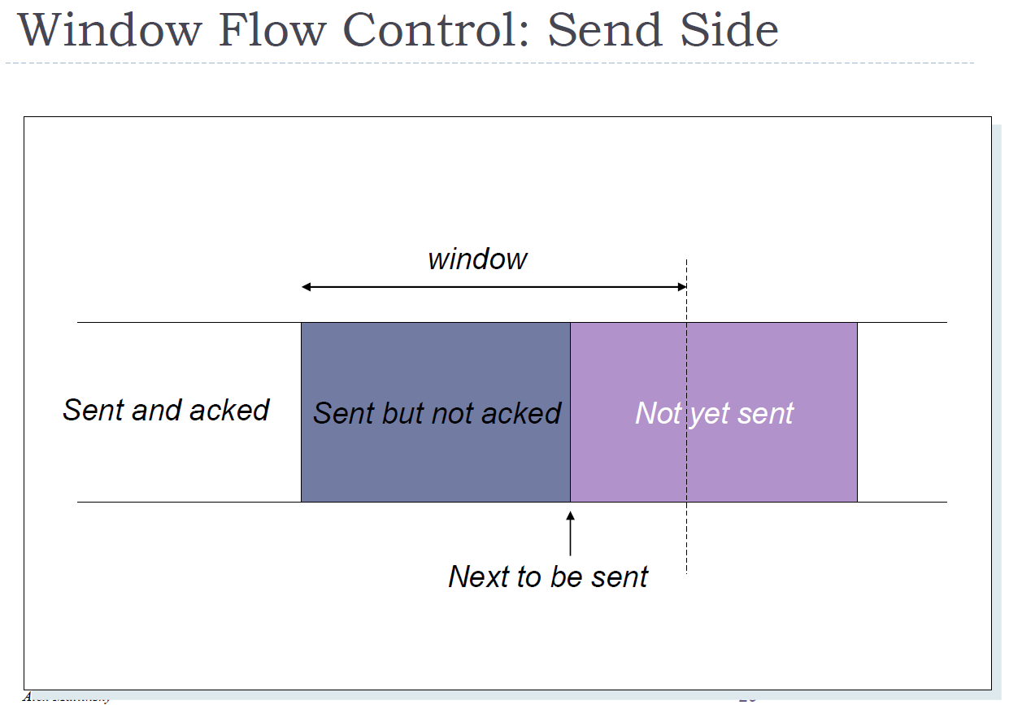

Slide 25
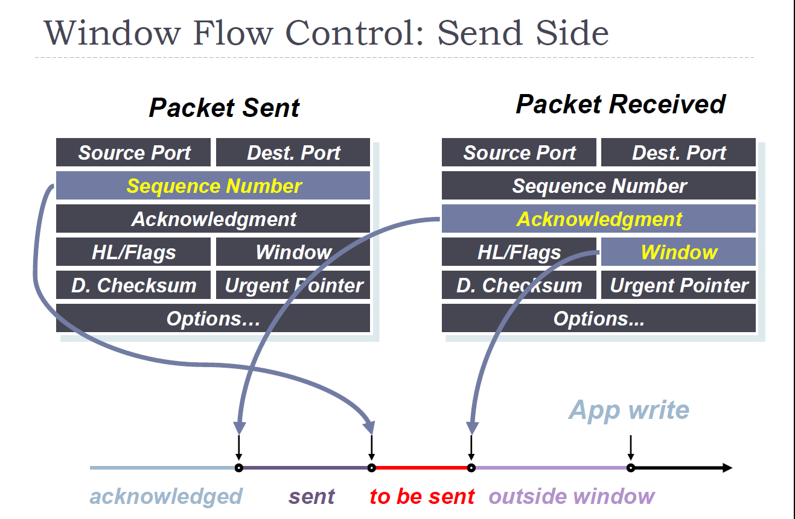

Slide 26
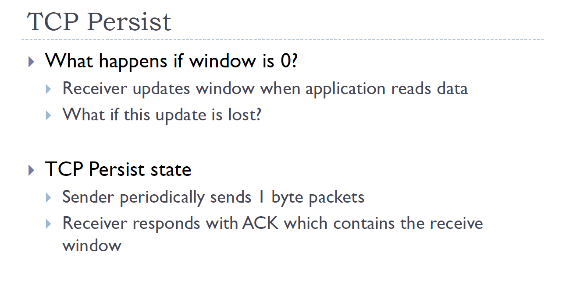

Slide 27
Flow Ctrl: Receiver side
The RcvBuffer size is set via socket options
The application may upscale it
The size of the rwnd field in TCP’s Header (16-b) also limits the maximal possible advertized value
TCP Options allow get around this limit

Slide 28
The silly window syndrome
When the receiver processes the incoming data slowly, it may repeatedly advertise very small receive window to the sender.
This may make the sender sending many tiny segments
Very inefficient
Similar problem may happen when the sending process wants to send many small data chunks.

Slide 29
The silly window syndrome: solutions
Sender side: Nagle’s algorithm:
One segment may be sent even if it is small.
For the consecutive segments, however, as long as the sender didn’t receive ACK for the previous (small) segment, the sender will send a new segment only when it has at least MSS data to send.
Receiver side: David Clark’s algorithm
The receiver advertises a new positive window only when
window >= Min (MSS, Buffer_size/2)

Slide 30
Chapter 3: outline
Motivation
Segments & Acks
Reliable data transfer
Flow control
Connection management
Establishing a connection
Closing a connection
TCP timers
Congestion control

Slide 31
Establishing a connection
Before exchanging data, sender/receiver “handshake”
Agree on connection parameters
application
application
Connection state: ESTAB
Connection variables:
client-to-server seq #
server-to-client seq #
rcvBuffer size at
server,client
TCP Options
Connection state: ESTAB
Connection variables:
client-to-server seq #
server-to-client seq #
rcvBuffer size at
server,client
TCP Options

Slide 32



2-way handshaking: why isn’t it enough?
2-way handshake:
Let’s talk
ESTAB
OK
ESTAB
choose x
req_conn(x)
ESTAB
acc_conn(x)
ESTAB

Slide 33
2-way handshaking failure scenario
choose x
choose x
req_conn(x)
req_conn(x)
ESTAB
ESTAB
retransmit
req_conn(x)
acc_conn(x)
retransmit
req_conn(x)
acc_conn(x)
ESTAB
ESTAB
data(x+1)
accept
data(x+1)
req_conn(x)
retransmit
data(x+1)
connection
x completes
connection
x completes
client terminates
server
forgets x
client terminates
server
forgets x
req_conn(x)
ESTAB
data(x+1)
ESTAB
half open connection!
(no client!)
accept
data(x+1)

Slide 34
2-way handshaking failure scenario
A user asks for a connection
Due to congestion the packet is caught in a traffic jam
The user asks again for the connection
Destination accepts 2nd connection request
User sends info to dest.
Info gets caught in a traffic jam
User sends info again
Dest receives the info
Connection is closed by both parties
The original connection request and user info find their way to the destination.
Notes:
Two issues here: ack by the initiating part (3 way handshake and not 2 way)
And the closing part.

Slide 35
TCP 3-way handshake
client state
server state
LISTEN
LISTEN
Randomizes init seq num, x
send TCP SYN msg
SYNSENT
SYNbit=1, Seq=x
Randomizes init seq num, y
send TCP SYNACK
msg, acking SYN
SYN RCVD
SYNbit=1, Seq=y
ACKbit=1; ACKnum=x+1
received SYNACK(x)
indicates server is live;
send ACK for SYNACK;
this segment may contain
client-to-server data
ESTAB
ACKbit=1, ACKnum=y+1
received ACK(y)
indicates client is live
ESTAB

Slide 36
TCP 3-way handshake: FSM
closed
Application opens server, which listens to requests
Λ
SYN(x)
Application asks to open a TCP connection
SYNACK(seq=y,ACKnum=x+1)
create new socket for
communication back to client
listen
SYN(seq=x)
SYN
rcvd
SYN
sent
SYNACK(seq=y,ACKnum=x+1)
ACK(ACKnum=y+1)
ESTAB
ACK(ACKnum=y+1)
Λ

Slide 37
Chapter 3: outline
Motivation
Segments & Acks
Reliable data transfer
Flow control
Connection management
Establishing a connection
Closing a connection
TCP timers
Congestion control

Slide 38
TCP: closing a connection
client, server each close their side of connection
send TCP segment with FIN bit = 1
respond to received FIN with ACK
on receiving FIN, ACK can be combined with own FIN
simultaneous FIN exchanges can be handled

Slide 39
TCP: closing a connection
client state
server state
ESTAB
ESTAB
clientSocket.close()
FIN_WAIT_1
can no longer
send but can
receive data
FINbit=1, seq=x
CLOSE_WAIT
ACKbit=1; ACKnum=x+1
can still
send data
FIN_WAIT_2
wait for server
close
LAST_ACK
FINbit=1, seq=y
TIMED_WAIT
can no longer
send data
ACKbit=1; ACKnum=y+1
timed wait
for 2*Max
Segment Lifetime
CLOSED
CLOSED

Slide 40
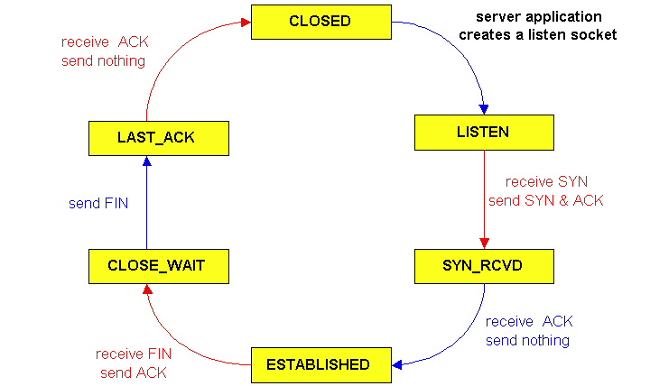
TCP server life cycle
40

Slide 41
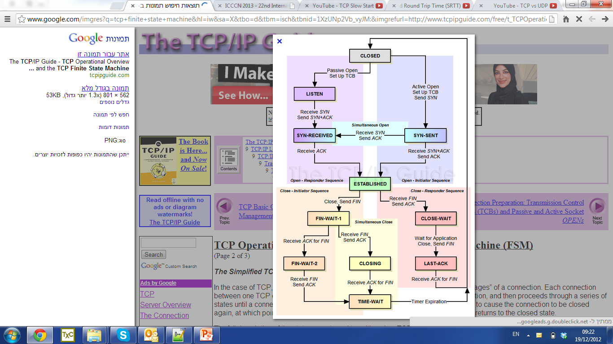
TCP’s FSM
Transmission Control Block – holds state info for one TCP connection
Ports’ numbers
Buffers’ location in memory
State variables
Windows
Seq #, ack #
Options
Notes:
- http://packetlife.net/blog/2010/jun/7/understanding-tcp-sequence-acknowledgment-numbers

Slide 42
TCP Rst
The Rst flag in the header is usually set to 0
Setting it to 1 asks the rcvr to immediately finish the connection
Used for
Case of error / crash
Prevent stale packets from old connection from re-appearing
A server saying to client “I discard your request for connection”
E.g., as a part of a firewall or ad-blocking
Or of traffic filtering & QoS
Attacks
If the attacker intercepts real TCP packets, it can forge a TCP rst packet, thus maliciously closing the connection
Notes:
TCP reset used by Comcast and by China censorship:
https://www.eff.org/deeplinks/2007/10/eff-tests-agree-ap-comcast-forging-packets-to-interfere
http://www.nbcnews.com/id/21376597/#.VlANj8fovcs
https://en.wikipedia.org/wiki/TCP_reset_attack#cite_note-5

Slide 43
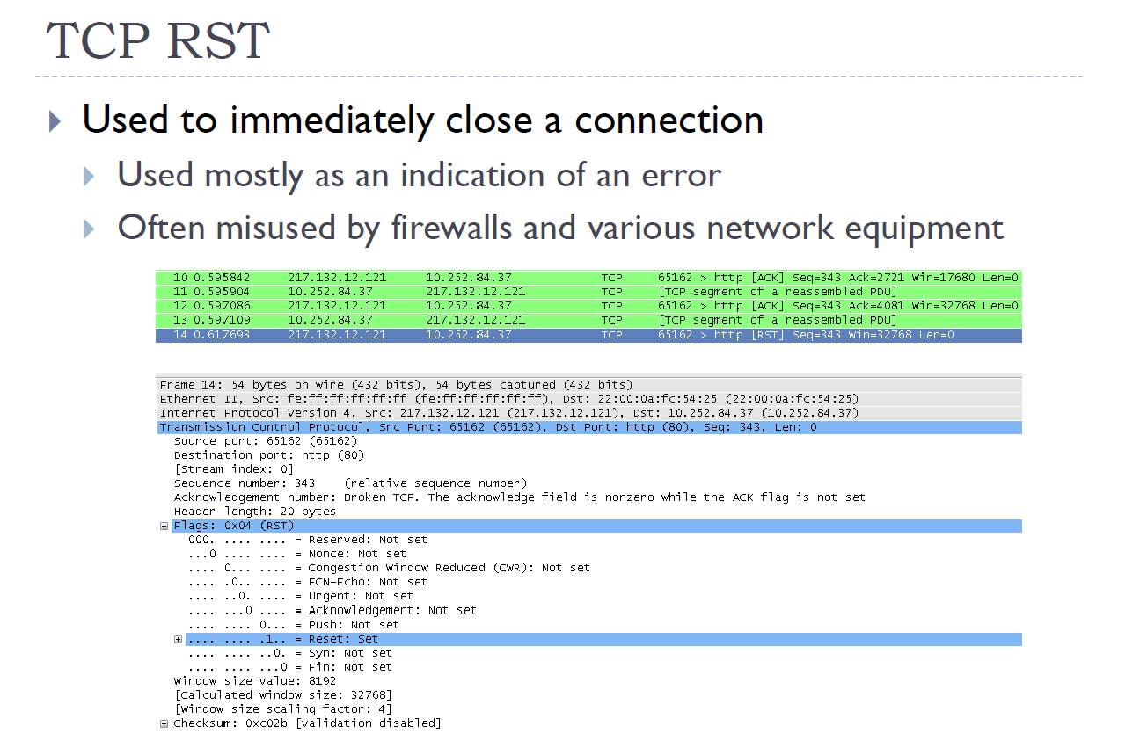

Slide 44
Chapter 3: outline
Motivation
Segments & Acks
Reliable data transfer
Flow control
Connection management
Establishing a connection
Closing a connection
TCP timers
Congestion control

Slide 45
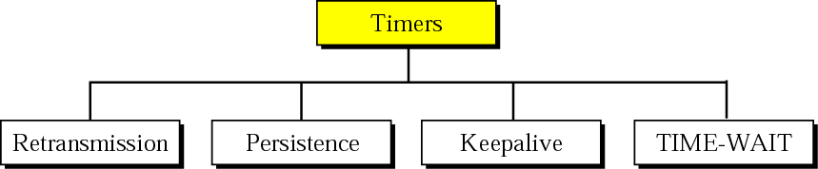
TCP timers
Retransmission TimeOut
Retransmit a packet after EstRTT + 4DevRTT
Persistence timer
Used for preventing deadlock in the case when the ack increasing the rwnd above 0 is lost
TIME-WAIT
Used during connection termination = 2*Maximum Segment Lifetime
Keepalive timer
Destined to prevent “zombie” non-active connections
If no segment was sent for a long period, each hosts periodically sends an “empty” TCP packet to its peer
If a few probes are unanswered, the connections is closed

Slide 46
Chapter 3: outline
Motivation
Segments & Acks
Reliable data transfer
Flow control
Connection management
Congestion control

Slide 47
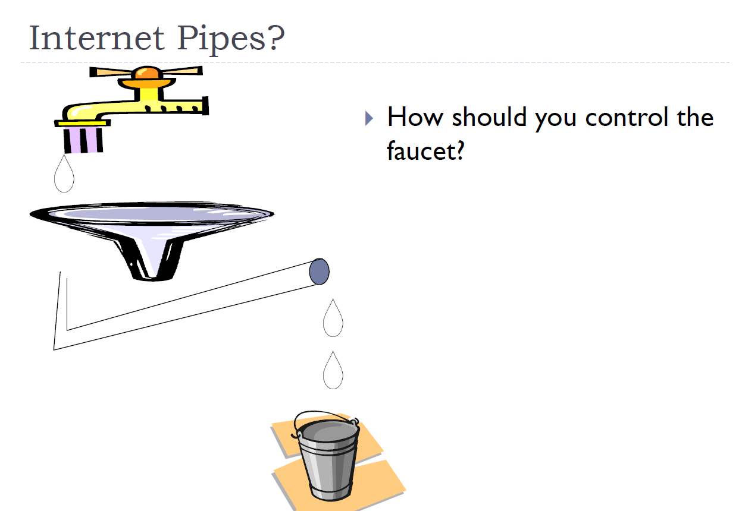

Slide 48
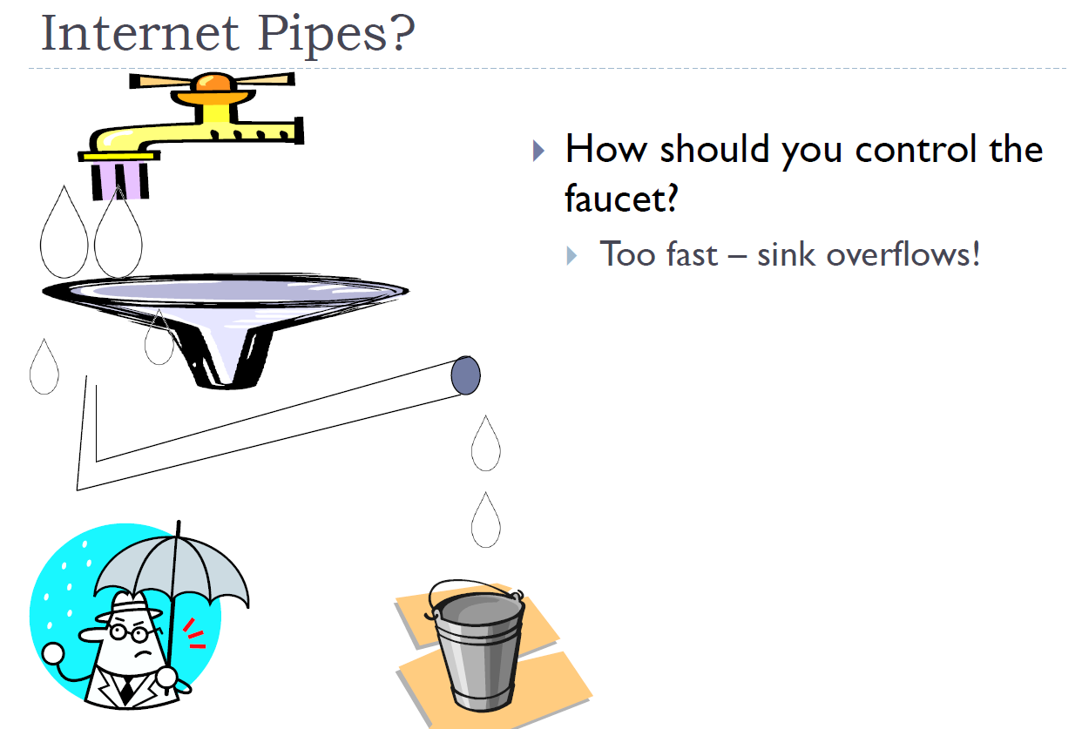

Slide 49
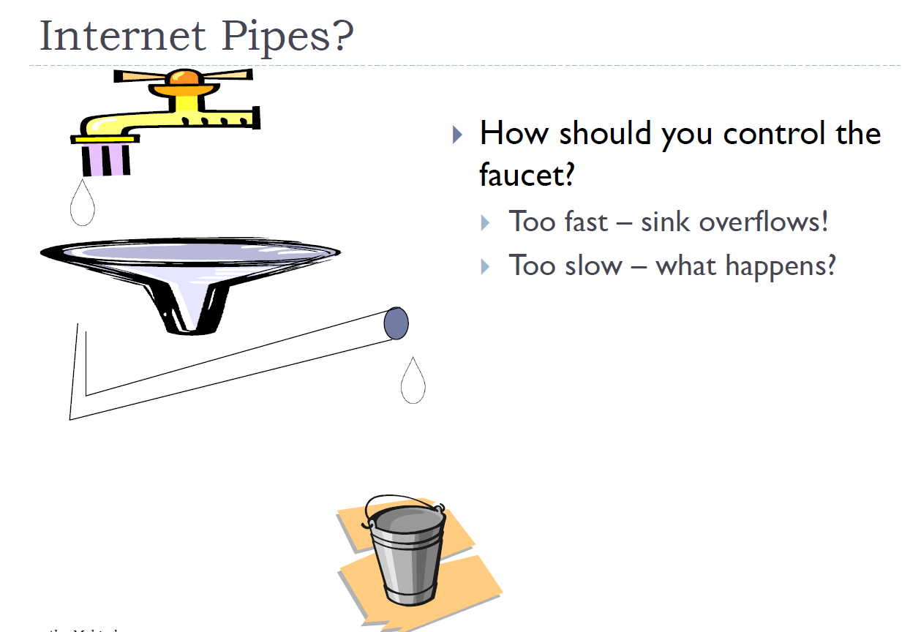

Slide 50
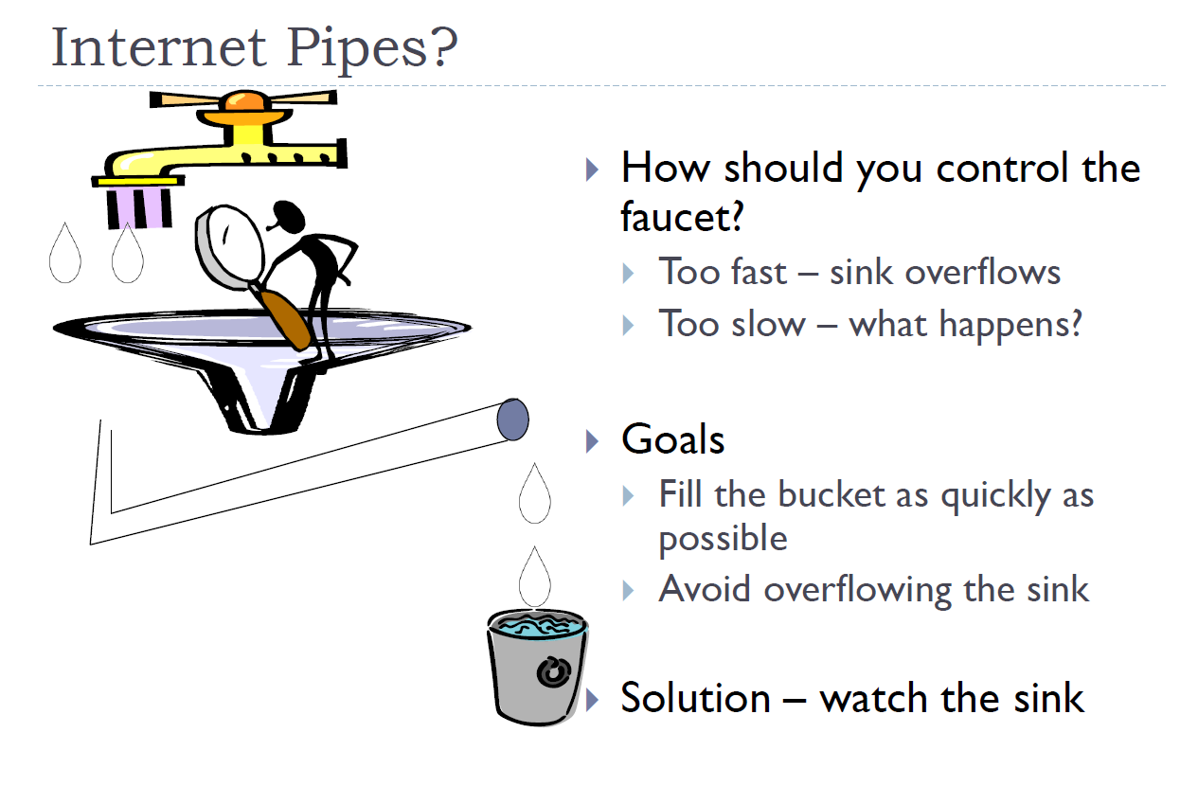

Slide 51
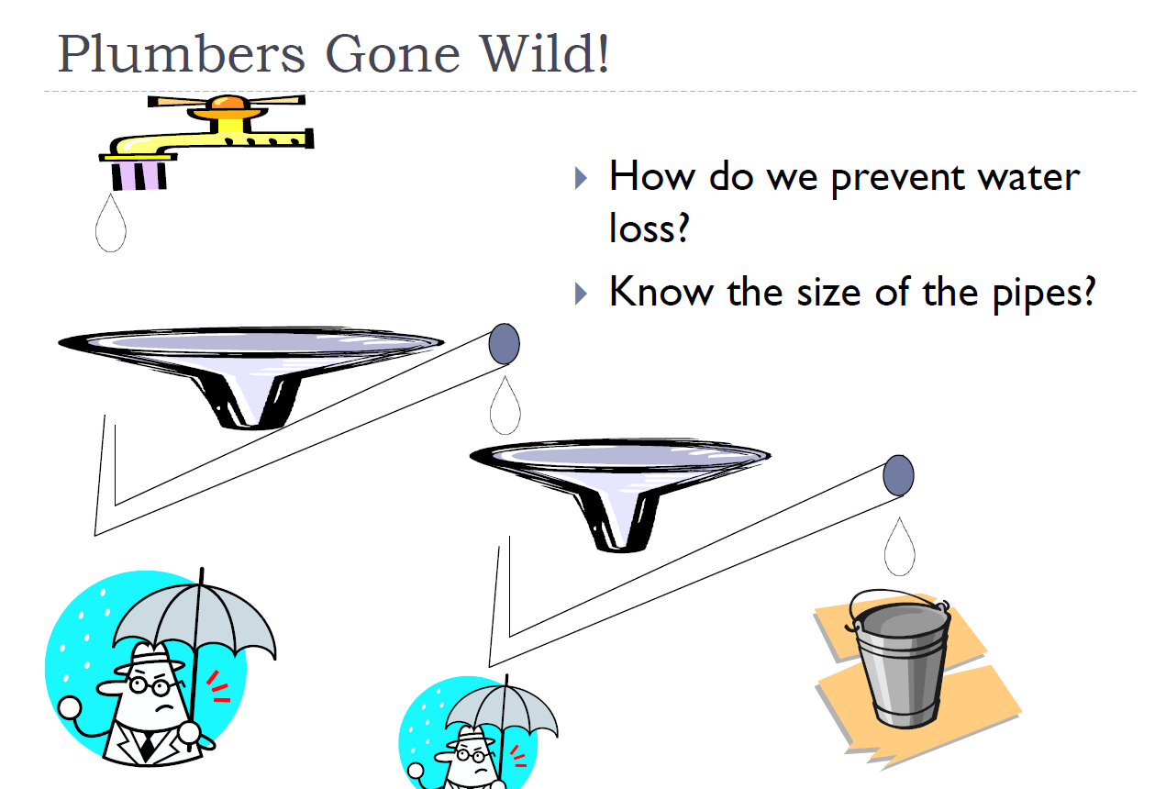

Slide 52
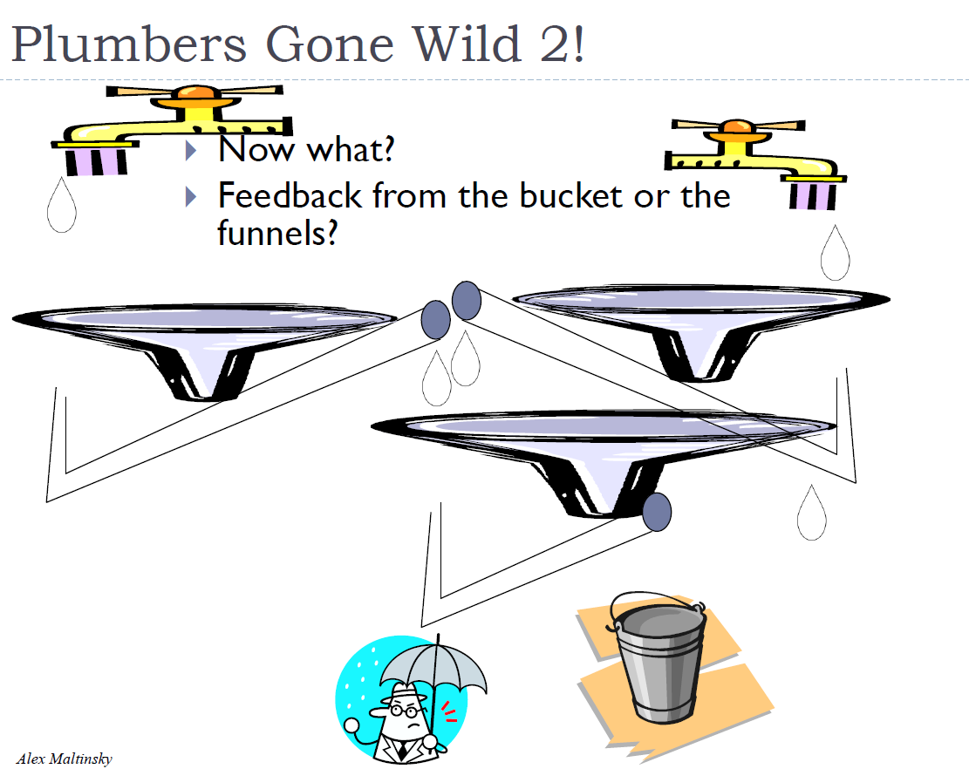
Notes:
Funnel - משפך

Slide 53
Principles of congestion control
congestion:
informally: “too many sources sending too much data too fast for network to handle”
different from flow control
manifestations:
lost packets (buffer overflow at routers)
long delays (queuing in router buffers)

Slide 54
Approaches towards congestion control
Two broad approaches towards congestion control:
end-end congestion control:
no explicit feedback from network
congestion inferred from end-system observed loss, delay
This approach obeys the E2E principle
TCP concentrates in this approach
network-assisted congestion control:
routers provide feedback to end systems
Flag bits indicating congestion
We will later (shortly) study this approach

Slide 55
CWND (Cong. Window)
sender sequence number space
TCP sending rate:
roughly: send cwnd bytes, wait RTT for ACKS, then send more bytes
cwnd
last byte
ACKed
last byte sent
sent, not-yet ACKed
(“in-flight”)
rate
cwnd
~
bytes/sec
~
RTT
LastByteSent-
LastByteAcked
cwnd
<
cwnd is dynamic, function of perceived network congestion

Slide 56
Slow Start
when connection begins, increase rate exponentially until first loss event:
Init: cwnd = 1 MSS
Increment cwnd by MSS for every ACK received
Efectively doubles cwnd every RTT
Upon reaching ssthresh (Slow Start Threshold): switch to congestion avoidance
Youtube lesson
Host A
Host B
one segment
RTT
two segments
four segments
time
Notes:
The exact formula is:
Upon reception of an Ack (assume all segments are MSS)
Cwnd += MSS

Slide 57
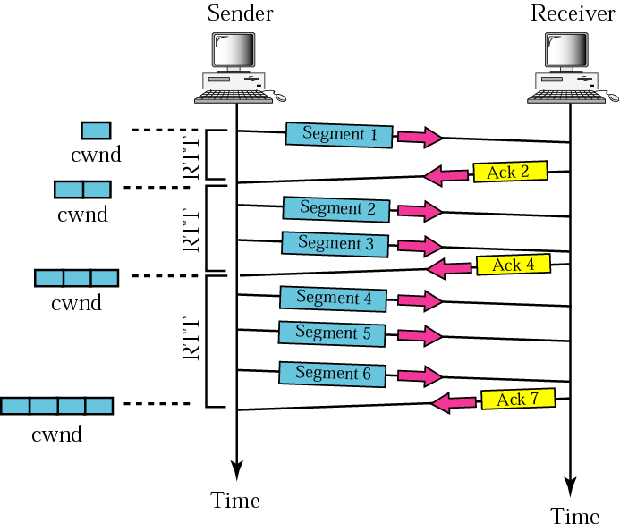
Congestion Avoidance: Additive increase
Each time segment acknowledged cwnd increased by one until congestion detected
Notes:
The exact formula is:
Upon reception of an Ack (assume all segments are MSS)
Cwnd += MSS * MSS / cwnd. See RFC 5681
https://tools.ietf.org/html/rfc5681
Eg: MSS = 100, Cwnd = 1000. Then →
Cwnd = 1000 + 100 * (100 / 1000) = 1010
Cwnd = 1010 + 100 * (100 / 1010) =~ 1020
…
The exact cwnd values are:
1000
1010
1019.901
1029.706
1039.417
1049.038
1058.571
1068.017
1077.381
1086.662
1095.865

Slide 58
Congestion avoidance: AIMD
Additive Increase: increase cwnd by 1 MSS every RTT until loss detected
Multiplicative Decrease: cut cwnd in half after loss
additively increase window size …
…. until loss occurs (then cut window in half)
AIMD saw tooth
behavior: probing
for bandwidth
cwnd: TCP sender
congestion window size
time

Slide 59
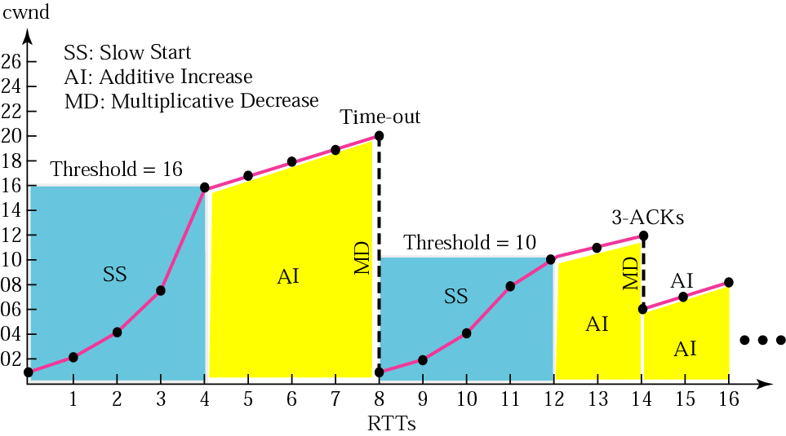
Congestion control example
3 dup-acks
What now?

Slide 60
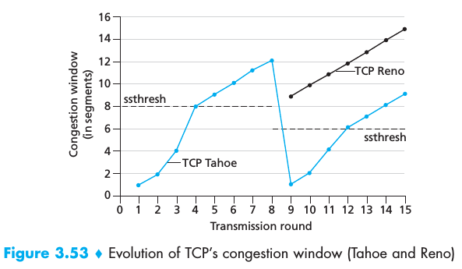

Slide 61
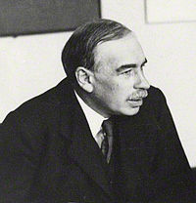
TCP Reno
Very common; replaces the obsolete TCP Tahoe
Loss indicated by timeout:
SSThresh = max {2MSS, FlightSize/2}
cwnd = 1
Slow-start again
Loss indicated by 3 duplicate ACKs
SSthresh = cwnd/2
cwnd = Ssthresh + 3 //See RFC 5681
After receiving acks for the lost segments, return to cwnd = SSthresh
Philosophy: Network is still capable to deliver some segments – no need to Slow-Start again
That’s a Keynesian view

Slide 62
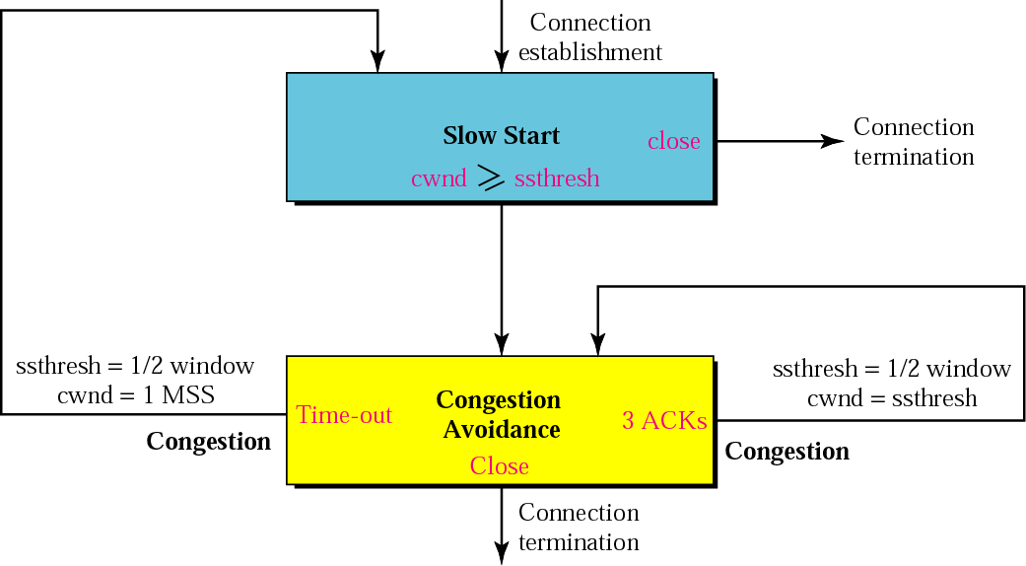
TCP congestion policy summary
*
* After receiving acks for the lost segments

Slide 63
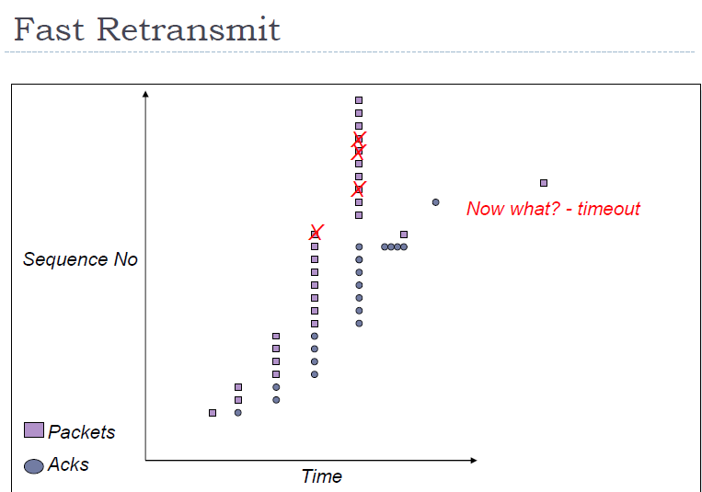

Slide 64
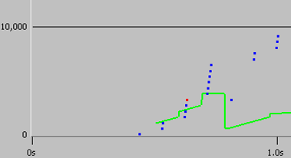
TCP Tahoe

Slide 65
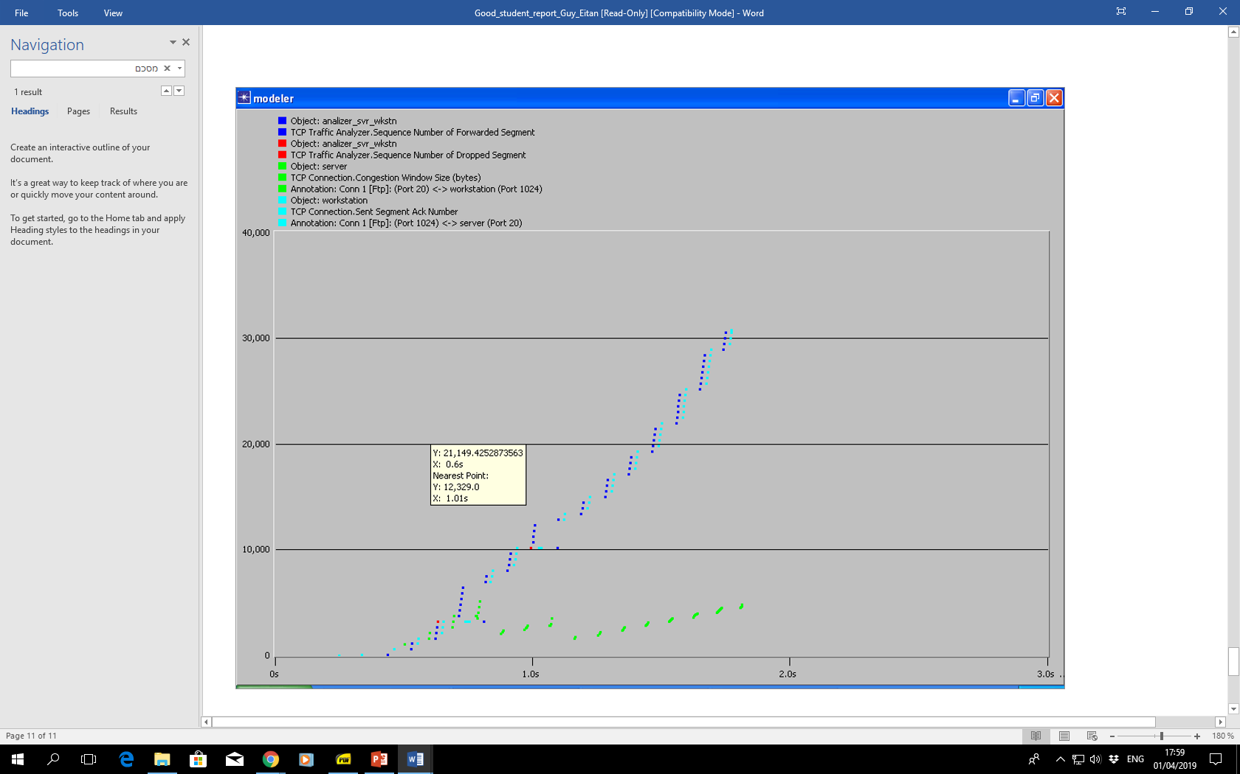
TCP Reno
Notes:
כחול – חבילה.
סיאן – Ack שנשלח
ירוק – גודל חלון.

Slide 66


TCP Reno
New
ACK!
New
ACK!
.
duplicate ACK
new ACK
dupACKcount++
new ACK
cwnd += MSS * (MSS/cwnd)
dupACKcount = 0
transmit new segment(s), as allowed
cwnd = cwnd+MSS
dupACKcount = 0
transmit new segment(s), as allowed
Λ
cwnd = 1 MSS
ssthresh = 64 KB
dupACKcount = 0
cwnd > ssthresh
slow
start
Λ
congestion
avoidance
timeout
ssthresh = cwnd/2
cwnd = 1 MSS
dupACKcount = 0
retransmit missing segment
duplicate ACK
timeout
dupACKcount++
ssthresh = cwnd/2
cwnd = 1 MSS
dupACKcount = 0
retransmit missing segment
timeout
New
ACK!
ssthresh = cwnd/2
cwnd = 1
dupACKcount = 0
retransmit missing segment
New ACK
dupACKcount == 3
cwnd = ssthresh
dupACKcount = 0
dupACKcount == 3
ssthresh= cwnd/2
cwnd = ssthresh + 3
retransmit missing segment
ssthresh= cwnd/2
cwnd = ssthresh + 3
retransmit missing segment
fast
recovery
duplicate ACK
cwnd = cwnd + MSS
transmit new segment(s), as allowed

Slide 67
TCP throughput
avg. TCP throughput as function of window size, RTT?
ignore slow start, assume always data to send
W: window size (measured in bytes) where loss occurs
W
W/2

Slide 68
TCP throughput
avg. TCP throughput as function of window size, RTT?
ignore slow start, assume always data to send
W: window size (measured in bytes) where loss occurs
avg. window size (# in-flight bytes) is ¾ W
3
W
avg TCP throughput =
RTT
bytes/sec
4
W
W/2

Slide 69
TCP Fairness
fairness goal: if K TCP sessions share same bottleneck link of bandwidth R, each should have average rate of R/K
TCP connection 1
bottleneck
router
capacity R
TCP connection 2

Slide 70
Why is TCP fair?
two competing sessions:
additive increase gives slope of 1, as throughout increases
multiplicative decrease decreases throughput proportionally
R
equal bandwidth share
loss: decrease window by factor of 2
congestion avoidance: additive increase
Connection 2 throughput
Connection 1 throughput
R

Slide 71
Fairness (more)
Fairness and UDP
multimedia apps often do not use TCP
do not want rate throttled by congestion control
instead use UDP:
send audio/video at constant rate, tolerate packet loss
Fairness, parallel TCP connections
application can open multiple parallel connections between two hosts
web browsers do this
Notes:
e.g., link of rate R with 9 existing connections:
new app asks for 1 TCP, gets rate R/10
new app asks for 11 TCPs, gets R/2 ? (I think it should be 9 TCPs)

Slide 72
Chapter 3: outline
Motivation
Segments & Acks
Reliable data transfer
Flow control
Connection management
Congestion control
TCP Options and variants

Slide 73
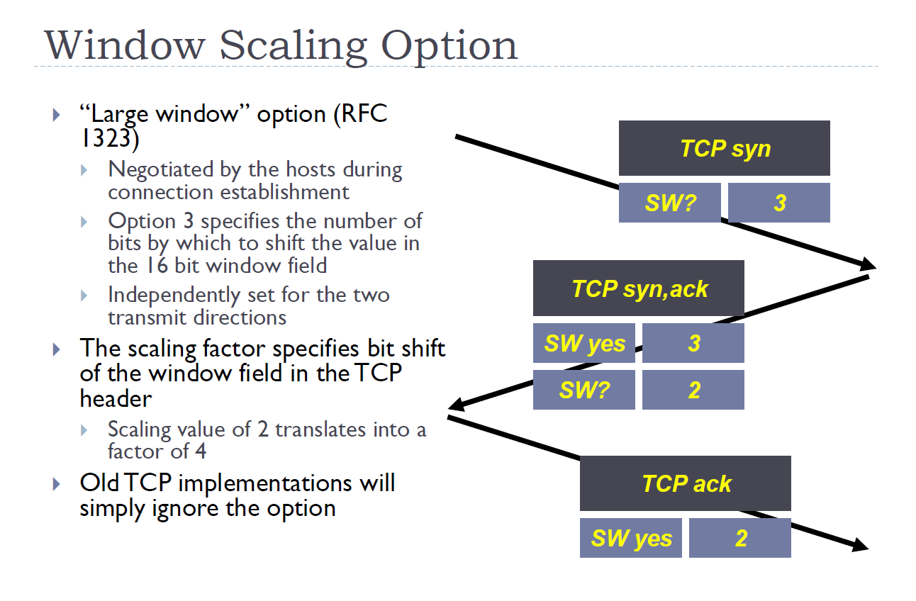

Slide 74
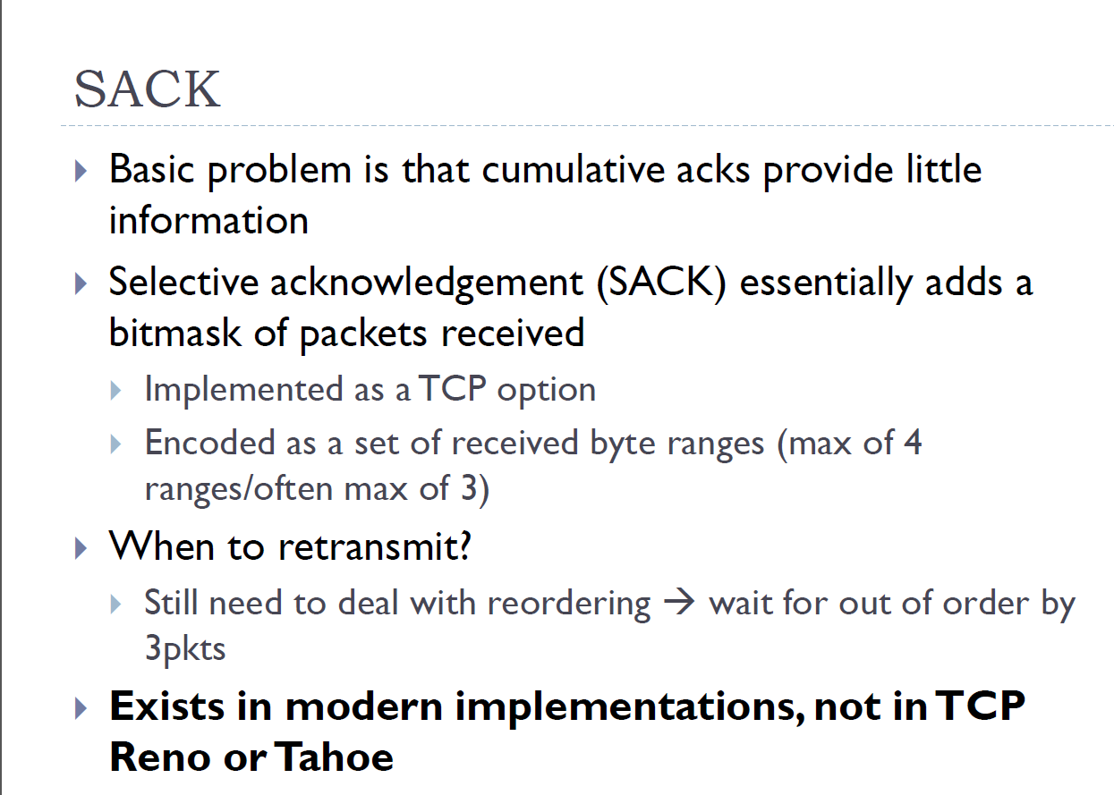

Slide 75
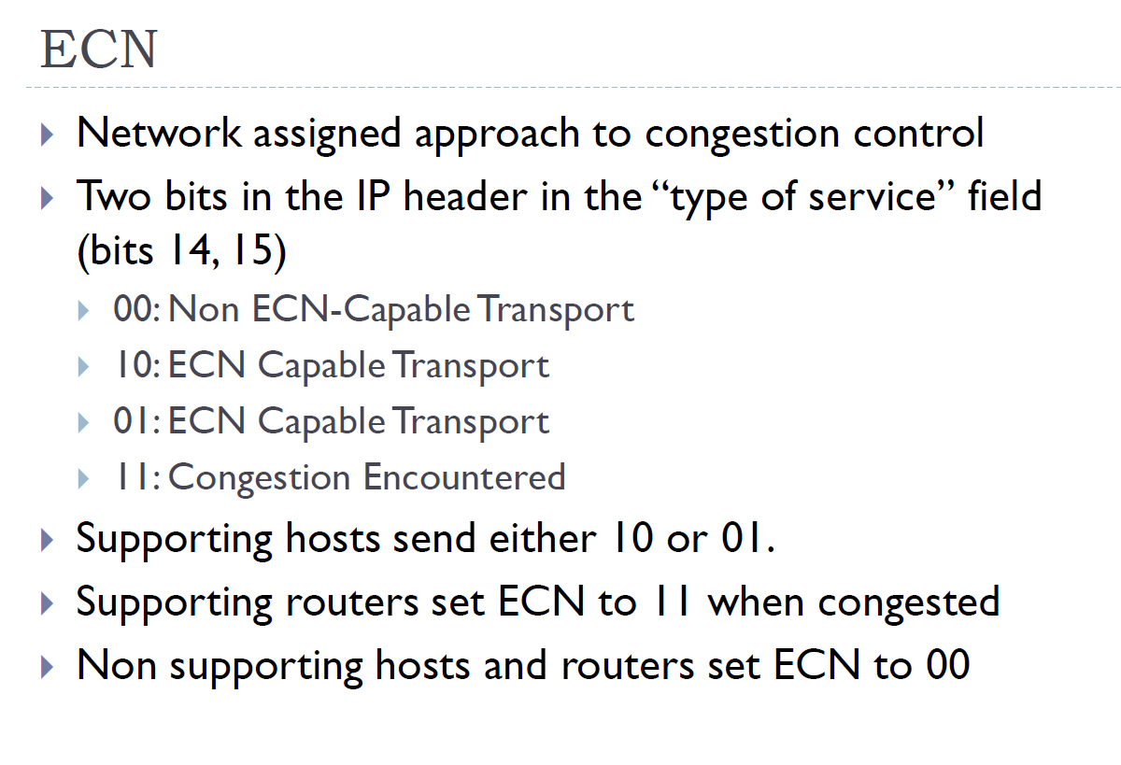

Slide 76
TPC variants
Vegas: estimate congestion based on RTT
Compound TCP: enhancement of Vegas, used by some MS OSs
BIC: Binary Increase Cong. Ctrl
Increase cwnd using binary search
CUBIC: enhancement of BIC
Used by default in some Linux & Windows servers
Data Center TCP
See HW 4 ☺

