Slide 1
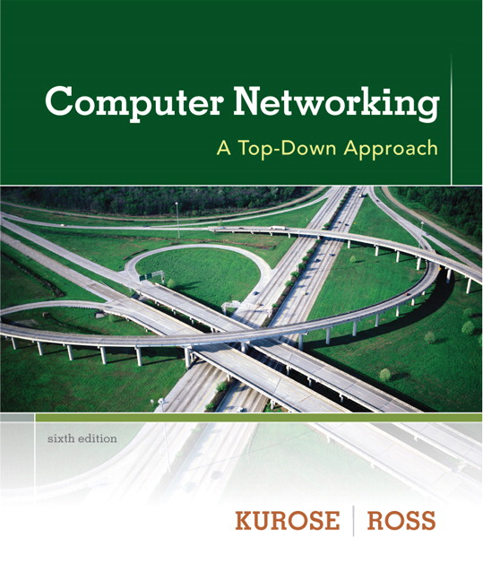

Introduction to data communications
Lecturer: Itamar Cohen
Chapter 4: the network layer
Part 1: packets and routers
Computer Networking: A Top Down Approach 6th edition Jim Kurose, Keith Ross Addison-Wesley March 2012
Based on slides by J.F Kurose and K.W. Ross, all Rights Reserved All material copyright 1996-2012

Slide 2
Outline
Introduction
Virtual circuits
Datagram networks
What’s inside a router

Slide 3

















Network layer
transport segment from sending to receiving host
on sending side encapsulates segments into datagrams
on receiving side, delivers segments to transport layer
network layer protocols in every host, router
router examines header fields in all IP datagrams passing through it
application
transport
network
data link
physical
network
data link
physical
network
data link
physical
network
data link
physical
network
data link
physical
network
data link
physical
network
data link
physical
network
data link
physical
network
data link
physical
network
data link
physical
application
transport
network
data link
physical
network
data link
physical
network
data link
physical

Slide 4
Two key network-layer functions
forwarding: move packets from router’s input to appropriate router output
routing: determine route taken by packets from source to dest.
routing algorithms
analogy:
routing: process of planning trip from source to dest
forwarding: process of getting through single interchange

Slide 5
Interplay between routing and forwarding
routing algorithm
routing algorithm determines
end-end-path through network
local forwarding table
forwarding table determines
local forwarding at this router
header value
output link
0100
0101
0111
1001
3
2
2
1
value in arriving
packet’s header
0111
1
3
2

Slide 6
Outline
Introduction
Virtual circuits
Motivation
Implementation
Datagram networks
What’s inside a router

Slide 7
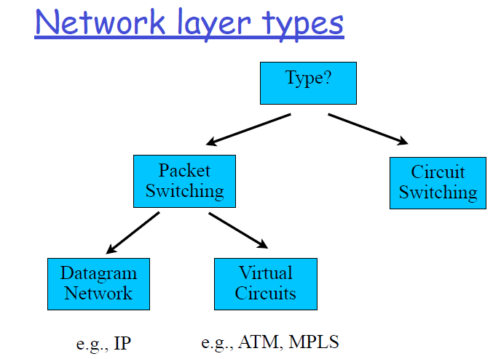

Slide 8
“Nice-to-have” network services
Guaranteed delivery
Preferably within a bounded delay
Guaranteed minimum bandwidth to flow
In-order datagram delivery
Restrictions on changes in inter-packet spacing (jitter)
Security
The Internet guarantees none of these!

Slide 9
Outline
Introduction
Virtual circuit
Motivation
Implementation
ATM
VPN & MPLS
Principles of circuit switching
Datagram networks
What’s inside a router

Slide 11
Asynchronous Transfer Mode
Designed to handle well both high-TP apps and RT apps
Used over backbone optical networks and Integrated Services Digital Networks
Obsolete

Slide 12
Asynchronous Transfer Mode - principles
ATM is parallel to the 3 bottom layers in ISO model
ATM may be thought as a hybrid of pkt-switching and circuit-switching
Use small, fixed-size packets (cells)
Like packet swithicng
Use connection setup, which builds a virtual circuit
Like circuit switching

Slide 13
Network layer service models
Network
Architecture
Internet
ATM
ATM
ATM
ATM
Service
Model
best effort
CBR
VBR
ABR
UBR
Guarantees ?
Congestion
feedback
no (inferred
via loss)
no
congestion
no
congestion
yes
no
Bandwidth
none
constant
rate
guaranteed
rate
guaranteed
minimum
none
Loss
no
yes
yes
no
no
Order
no
yes
yes
yes
yes
Timing
no
yes
yes
no
no
Notes:
Constant Bit Rate
Available Bit Rate: an average or Sustainable Cell Rate is specified. The rate can reach at most a pre-specified Peak Cell Rate, for a bounded interval.
Variable Bit Rate
Unspecified Bit Rate

Slide 14
Outline
Introduction
Virtual circuit
Motivation
Implementation
ATM
VPN & MPLS
Principles of circuit switching
Datagram networks
What’s inside a router

Slide 15
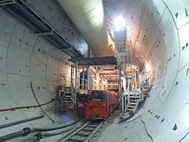
Virtual Private Network
Motivation: allow enterprise a secure, private connection over a public Wide Area Network
Large distances
Possibly wireless
Use proxy servers to improve privacy
Use tunneling and / or encryption
Tunnel’s termination points
are located either at
Customer edge
ISP’s edge

Slide 16

Virtual Private Network: Security
Security is implemented by either
App layer: Secure Shell (ssh) – which allows security over an unsecure network
Transport layer (at end-hosts): Secure-Socket Layer
Network layer: encapsulate
an IP packet within
an encrypted IPSec packet
Notes:
In addition: Legacy protocols by Cisco, Microsoft

Slide 17
Virtual Private Network: Routing
VPN may be routed using Multi Protocol Label Switching
MPLS is good also for
Traffic Engineering
Out-Of-Band control
Centralized SDNs:
Software
Defined
Networks

Slide 18
Multi Protocol Label Switching
☺ Improved privacy and security
As required by VPNs
☺ No need for expensive, complicated routing algorithms and routing tables
☺ Easier Traffic Engineering
☺ Out-Of-Band control
Usages
Virtual Private Networks
Centralized Software Defined Networks
☹ Requires packets [En | de] capsulation
☹ Central control is complex, not scalable and subject to failures
☹ Requires connection setup

Slide 19

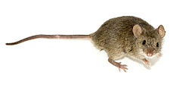
IP Datagrams on Virtual Circuits: Data Center Networks
Typical traffic pattern in Data Center
Most of the congestion is caused by few long lived flows (elephants)
Many short lived flows (mice)
Use virtual circuits either for…
all flows
only elephants
Mice use normal IP forwarding
Problem: how to identify elephants?

Slide 20
Outline
Introduction
Virtual circuit
Motivation
Implementation
ATM
VPN & MPLS
Principles of Virtual Circuits
Datagram networks
What’s inside a router

Slide 21
Call setup
“source-to-dest path behaves much like telephone circuit”
performance-wise
network actions along source-to-dest path
call setup, teardown for each call before data can flow
each packet carries VC identifier (not destination host address)
every router on source-dest path maintains “state” for each passing connection
link, router resources (bandwidth, buffers) may be allocated to VC (dedicated resources = predictable service)

Slide 22
VC implementation
a VC consists of:
path from source to destination
VC numbers, one number for each link along path
entries in forwarding tables in routers along path
packet belonging to VC carries VC number (rather than dest address)
VC number can be changed on each link.
new VC number comes from forwarding table

Slide 23

VC forwarding table
12
22
32
1
3
2
VC number
forwarding table in
northwest router:
interface
number
Incoming interface Incoming VC # Outgoing interface Outgoing VC #
1 12 3 22
2 63 1 18
3 7 2 17
1 97 3 87
… … … …
VC routers maintain connection state information!

Slide 24

Virtual circuits: signaling protocols
used to setup, maintain, teardown VC
used in ATM, frame-relay, X.25
not used in today’s Internet
application
transport
network
data link
physical
application
transport
network
data link
physical
5. data flow begins
6. receive data
4. call connected
3. accept call
1. initiate call
2. incoming call

Slide 25
Outline
Introduction
Virtual circuit
Datagram networks
What’s inside a router

Slide 26
Connection, connection-less service
datagram network provides network-layer connectionless service
virtual-circuit network provides network-layer connection service
analogous to TCP/UDP connection-oriented / connectionless transport-layer services, but:
service: host-to-host
no choice: network provides one or the other
implementation: in network core

Slide 27
Datagram networks
no call setup at network layer
routers: no state about end-to-end connections
no network-level concept of “connection”
packets forwarded using destination host address
application
transport
network
data link
physical
application
transport
network
data link
physical
1. send datagrams
2. receive datagrams

Slide 28
Datagram forwarding table
4 billion IP addresses, so rather than list individual destination address
list range of addresses
(aggregate table entries)
routing algorithm
local forwarding table
dest address
output link
address-range 1
address-range 2
address-range 3
address-range 4
3
2
2
1
IP destination address in
arriving packet’s header
1
3
2

Slide 29
Datagram Vs Virtual Circuits
Internet (datagram)
data exchange among computers
“elastic” service, no strict timing req.
many link types
different characteristics
uniform service difficult
Distributed control
ATM (VC)
evolved from telephony
human conversation:
strict timing, reliability requirements
need for guaranteed service
Central control

Slide 30
Source Routing
Alternative to Virtual Circuits and usual packet routing
The idea: list entire path in packet
Driving directions (north 3 hops, east, etc..)
Router processing
Examine first step in directions
Strip first step from packet
Forward to step just stripped off
Packet
R2, R3, R
R3, R
2
2
Sender
R1
R2
1
3
1
3
4
4
R
2
1
R3
Receiver
4
3

Slide 31
Source Routing
Advantages
Switches can be very simple and fast
Disadvantages
Variable (unbounded) header size
Sources must know or discover topology (e.g., failures)
Notes:
Typical use
Ad-hoc networks (DSR)
Machine room networks (Myrinet)

Slide 32
VC / IP address / source routing
Source Routing
Global Addresses
Virtual Circuits
Header Size
Worst
OK – Large address
Best
Router Table Size
None
Number of hosts (prefixes)
Number of circuits
Forward Overhead
Best
Prefix matching
Pretty Good
Setup Overhead
None
None
Connection Setup
Error Recovery
Tell all hosts
Tell all routers
Tell all routers and Tear down circuit and re-route

Slide 33
Outline
Introduction
Virtual circuits
Datagram networks
What’s inside a router
Architecture overview
Input ports
Switching fabric
Output ports
Present & future trends

Slide 34
Router architecture overview
two key router functions:
run routing algorithms/protocols
forwarding datagrams from incoming to outgoing link
forwarding tables computed,
pushed to input ports
routing
processor
routing, management
control plane (software)
forwarding data plane (hardware)
high-seed
switching
fabric
router input ports
router output ports

Slide 35
Outline
Introduction
Virtual circuit
Datagram networks
What’s inside a router
Architecture overview
Input ports
Switching fabric
Output ports
Present & future trends

Slide 36
Input port functions
lookup,
forwarding
queueing
line
termination
link
layer
protocol
(receive)
switch
fabric
physical layer:
bit-level reception
data link layer:
e.g., Ethernet,
WiFi
decentralized switching:
given datagram dest., lookup output port using forwarding table in input port memory (“match plus action”)
goal: complete input port processing at ‘line speed’
queuing: if datagrams arrive faster than forwarding rate into switch fabric

Slide 37
Forwarding table
Destination Address Range
11001000 00010111 00010000 00000000
through
11001000 00010111 00010111 11111111
11001000 00010111 00011000 00000000
through
11001000 00010111 00011000 11111111
11001000 00010111 00011001 00000000
through
11001000 00010111 00011111 11111111
otherwise
Link Interface
0
1
2
3
Q: but what happens if ranges don’t divide up so nicely?

Slide 38
Longest Prefix Matching
longest prefix matching
when looking for forwarding table entry for given destination address, use longest address prefix that matches destination address.
Destination Address Range
11001000 00010111 00010*** *********
11001000 00010111 00011000 *********
11001000 00010111 00011*** *********
otherwise
Link interface
0
1
2
3
examples:
DA: 11001000 00010111 00010110 10100001
which interface?
DA: 11001000 00010111 00011000 10101010
which interface?

Slide 39
Address Lookup: Binary Tries
0
1
Example Prefixes:
a) 00001
b) 00010
c) 00011
d) 001
g
e) 0101
d
f
f) 011
g) 100
h
i
h) 1010
e
i) 1100
a
b
c
j) 11110000
j

Slide 40
Address Lookup: TCAM
(Ternary) Content Addressable Memory
Destination Address Range
11001000 00010111 00010*** *********
11001000 00010111 00011000 *********
11001000 00010111 00011*** *********
otherwise
Link interface
0
1
2
3

Slide 41
Input port queuing and HoL blocking
Speedup=k: at each cycle:
Each input queue can transfer at most k packets
Each output queue can accept at most k packets
Head-of-the-Line (HOL) blocking: queued datagram at front of queue prevents others in queue from moving forward
switch
fabric
When speedup=1 the green packet experiences HoL blocking

Slide 42
Outline
Introduction
Virtual circuit
Datagram networks
What’s inside a router
Architecture overview
Input ports
Switching fabric
Output ports
Present & future trends

Slide 43
Switching fabrics
transfer packet from input buffer to appropriate output buffer
switching rate: rate at which packets can be transfer from inputs to outputs
often measured as multiple of input/output line rate
N inputs: switching rate N times line rate desirable
three types of switching fabrics
Shared
memory
memory
bus
crossbar

Slide 44
Switching via a bus
datagram from input port memory
to output port memory via a shared bus
bus contention: switching speed limited by bus bandwidth
32 Gbps bus, Cisco 5600: sufficient speed for access and enterprise routers
bus

Slide 45
Switching via interconnection network
Overcome bus bandwidth limitations
Solutions to the scalability problem
Hierarchical Xbar
Fragmenting datagram into fixed length cells, switch cells through the fabric
Sophisticated (perfect / wegihted) matching algorithms
crossbar

Slide 46
Switching fabrics
Transfer packet from input buffer to appropriate output buffer
Most common implementation: Xbar
Speedup=k: at each cycle:
Each input queue can transfer at most k packets
Each output queue can accept at most k packets
By default, speedup=1
A work conserving algorithm: if at some cycle there’s a packet destined to output port j, then at cycle, output port will transmit a packet
Very hard to guarantee
Can mitigate non-conserving cycles using VOQs and / or speedup > 1
crossbar

Slide 47
Outline
Introduction
Virtual circuit
Datagram networks
What’s inside a router
Architecture overview
Input ports
Switching fabric
Output ports
Present & future trends

Slide 48
Output ports
datagram
buffer
queueing
switch
fabric
link
layer
protocol
(send)
line
termination
buffering required when datagrams arrive from fabric faster than the transmission rate
scheduling discipline chooses among queued datagrams for transmission
Datagram (packets) can be lost due to congestion, lack of buffers
Priority scheduling – who gets best performance, network neutrality

Slide 49

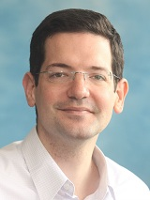
Output queuing: buffer size
The “rule of thumb” (RFC 3439):
Buffer size = RTT * BW
Intuition: assume “full TCP window”
e.g., BW = 10 Gpbs, RTT=250ms → Buff 2.5 Gb
Major improvement [Keslassy et. al]: when there’re N flows destined to the same output, buffering equal to
is “enough”
.
RTT BW
N

Slide 50
Output queuing: max-min fairness
Consider 4 clients, with demands: 2, 2.6, 4, 5
Capacity: 10
How to allocate the capacity fairly?
A one minute film showing the exact calculation

Slide 51
Output queuing: scheduling
Round Robin
Weighted Round Robin
Generalized Processor Sharing (“bitwise RR”)
Weighted Fair Queuing
Deficit Round Robin

Slide 52
Outline
Introduction
Virtual circuit
Datagram networks
What’s inside a router
Architecture overview
Input ports
Switching fabric
Output ports
Present & future trends

Slide 53
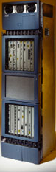
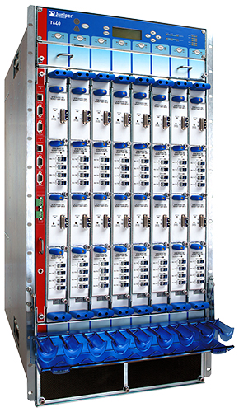
Router Chassis
Cisco GSR 12816
Juniper T640
Capacity: 640Gb/s Power: 5kW
Capacity: 320Gb/s Power: 3kW
50 cm
50 cm
2m
1m
60cm
75 cm

Slide 54
Router Design
Many trade-offs: power, $$$, throughput, reliability, flexibility
Important bottlenecks on fast path
Longest prefix match
Cross-bar scheduling
Trends: Central control → distributed control
High-end HW routers
and… back to centralized control
Software Defined Networks
and… back again to dist’ control
Edge computing

Slide 55
Network Processors: motivation
Motivation: Packets should pass through multiple processing stages
IP lookup & forwarding
Header updating
Time To Live
Error Congestion Notification
Re-calculation of Checksum
Filtering
Deep Packet Inspection
Multi-Protocol Label Switching [en|de]capsulation
[En|de]cryption
Software: too slow
Hardware: not flexible

Slide 56

Network Processors
Combination of Software-Hardware
Multi-phase pipelined / parallel processing
Challenges
Variable processing time
Variable gains from packets
Processing-time and gain from packet not necessarily known when it arrives

