Slide 1


Introduction to data communications
Lecturer: Itamar Cohen
Chapter 4: the network layer
Part 2: IP
Computer Networking: A Top Down Approach 6th edition Jim Kurose, Keith Ross Addison-Wesley March 2012
Based on slides by
Dr. Yoram Haddad, JCT
J.F Kurose and K.W. Ross, all Rights Reserved
All material copyright 1996-2012

Slide 2
The Internet network layer
host, router network layer functions:
transport layer: TCP, UDP
routing protocols
path selection
RIP, OSPF, BGP
ICMP protocol
error reporting
router signaling
network
layer
IP protocol
addressing conventions
datagram format
packet handling conventions
forwarding
table
link layer
physical layer

Slide 3
Outline
IPv4 Header format
IPv4 addressing
ICMP
IPv6

Slide 4
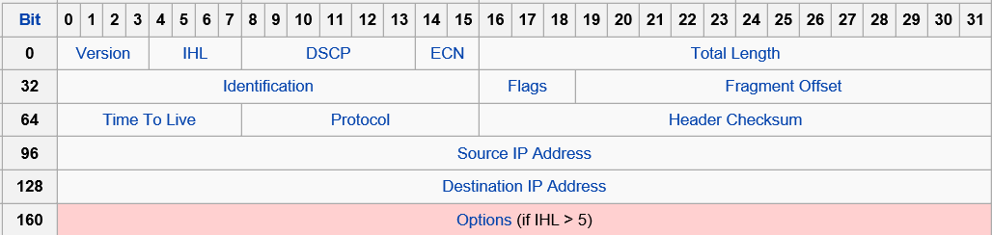
IPv4 Header
Notes:
DSCP – Differentiated Service Code Point – used for QoS. Replaces the outdated Type of Service.
IHL – Internet Header Length – size of the IP hdr (in 32-b words).
ID – used for identifying fragments of the same seg’.
Flags: reserved; don’t fragment; more fragments.
Prot’: TCP, UDP, DCCP; ICMP, OSPF, IGRP (private intra-AS routing prot’), IP-in-IP (encap’), IGMP, …

Slide 5

Fragmentation & Reassembly
Max Transfer Unit differs among various link types
When needed, a large IP datagram is fragmented
and reassembled at final destination
IP header bits used to identify, order related fragments
…
fragmentation:
in: one large datagram
out: 3 smaller datagrams
reassembly
…

Slide 6
IP fragmentation, reassembly
length
=4000
ID
=x
fragflag
=0
offset
=0
example:
4000 byte datagram
MTU = 1500 bytes
one large datagram becomes
several smaller datagrams
1480 bytes in data field
length
=1500
ID
=x
fragflag
=1
offset
=0
offset =
1480/8
length
=1500
ID
=x
fragflag
=1
offset
=185
length
=1040
ID
=x
fragflag
=0
offset
=370

Slide 7
Outline
Header format
IPv4 addressing
Subnets and prefixes
DHCP
NAT
ICMP
IPv6

Slide 8
IPv4 addressing: introduction
223.1.1.1
IP address: 32-bit identifier for host, router interface
interface: connection between host/router and physical link
router’s typically have multiple interfaces
host typically has one or two interfaces (e.g., wired Ethernet, wireless 802.11)
IP addresses associated with each interface
223.1.2.1
223.1.1.2
223.1.1.4
223.1.2.9
223.1.1.3
223.1.3.27
223.1.2.2
223.1.3.1
223.1.3.2
223.1.1.1 = 11011111 00000001 00000001 00000001
223
1
1
1

Slide 9
Subnets
IP address:
subnet part - high order bits
host part - low order bits
what’s a subnet ?
device interfaces with same subnet part of IP address
can physically reach each other without intervening router
223.1.1.1
223.1.1.2
223.1.2.1
223.1.1.4
223.1.2.9
223.1.2.2
223.1.1.3
223.1.3.27
subnet
223.1.3.1
223.1.3.2
network consisting of 3 subnets

Slide 10
Subnet mask
223.1.1.0/24
223.1.2.0/24
The mask is the longest prefix (starting from the MSB) which is common to all hosts in the same subnet
223.1.1.1
223.1.1.2
223.1.2.1
223.1.1.4
223.1.2.9
223.1.2.2
223.1.1.3
223.1.3.27
subnet
223.1.3.1
223.1.3.2
223.1.3.0/24
subnet mask: /24

Slide 11
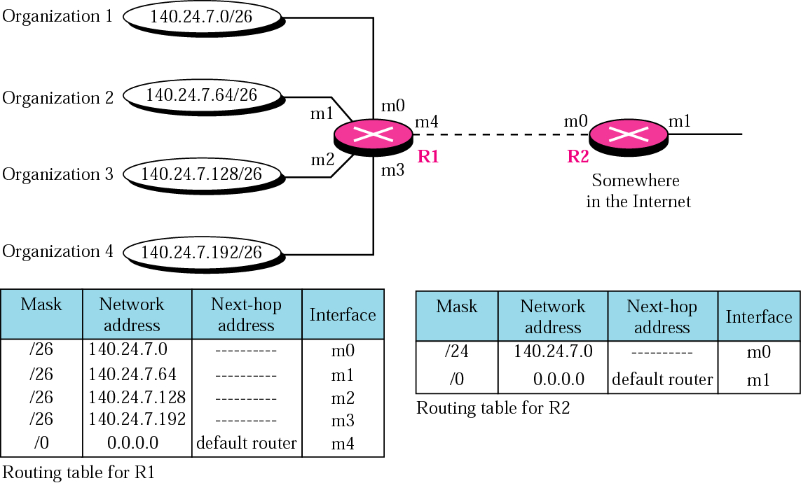
Address aggregation

Slide 12
Address aggregation

Slide 13
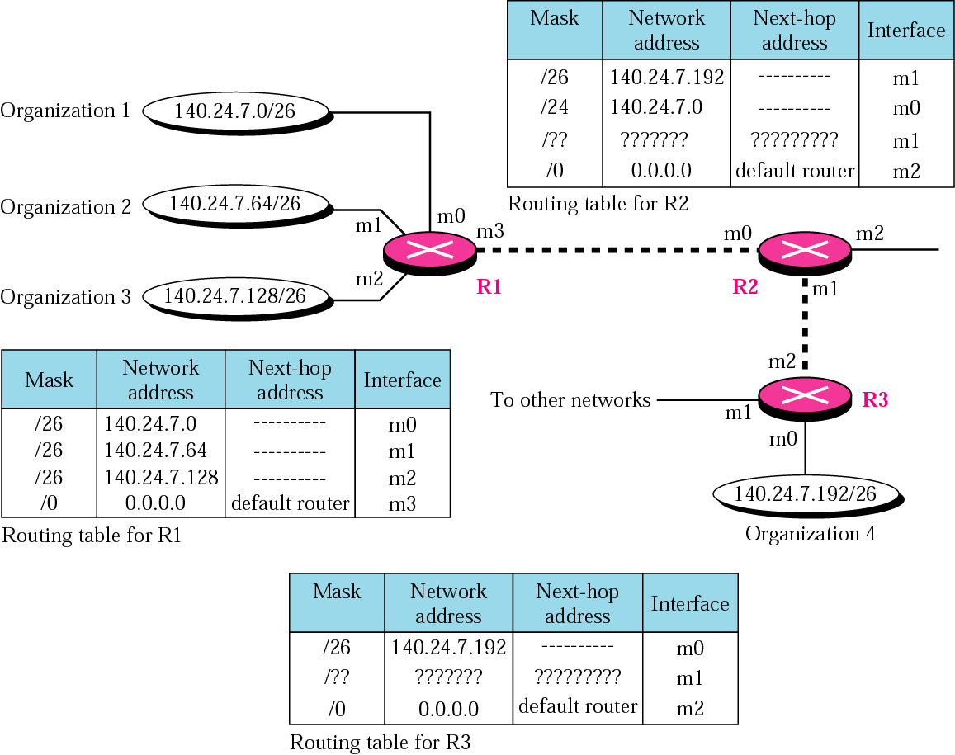
Longest mask matching
Notes:
Explanation for R2’s Routing table:
First row:
Org 4: 1000_1100 . 0001_1000 . 0000_0111 . 11XX_XXXX
Row 2:
Org 1: 1000_1100 . 0001_1000 . 0000_0111 . 00XX_XXXX
Org 2: 1000_1100 . 0001_1000 . 0000_0111 . 01XX_XXXX
Org 3: 1000_1100 . 0001_1000 . 0000_0111 . 10XX_XXXX
Row 3: “To other networks” at the diagram.
Row 4: Default Router.

Slide 14
Longest mask matching
R1
R4
R2
R4
140.24.6.0/24
R3
Notes:
R2’s Routing table
/24 1000_1100 . 0001_1000 . 0000_0110 . XXXX_XXXX, R3, m1
/26 1000_1100 . 0001_1000 . 0000_0111 . 11XX_XXXX, R3, m1
/24 1000_1100 . 0001_1000 . 0000_0110 . XXXX_XXXX, R1, m0
/0 0.0.0.0, R4, m2
R3’s Routing table
/24 1000_1100 . 0001_1000 . 0000_0110 . XXXX_XXXX, -, m1
/26 1000_1100 . 0001_1000 . 0000_0111 . 11XX_XXXX, -, m0
/0 0.0.0.0, R2, m2

Slide 15
Longest mask matching
R1
R4
R2
R4
140.24.6.0/24
R3
Notes:
Explanation for R2’s Routing table:
First row:
Org 4: 1000_1100 . 0001_1000 . 0000_0111 . 11XX_XXXX
Row 2:
Org 1: 1000_1100 . 0001_1000 . 0000_0111 . 00XX_XXXX
Org 2: 1000_1100 . 0001_1000 . 0000_0111 . 01XX_XXXX
Org 3: 1000_1100 . 0001_1000 . 0000_0111 . 10XX_XXXX
Row 3: “To other networks” at the diagram.
Row 4: Default Router.

Slide 16
Subnets
223.1.1.2
223.1.1.1
223.1.1.4
223.1.1.3
223.1.9.2
223.1.7.0
223.1.9.1
223.1.7.1
223.1.8.1
223.1.8.0
223.1.2.6
223.1.3.27
223.1.2.1
223.1.2.2
223.1.3.1
223.1.3.2

Slide 17
Classful addressing (obsolete)
In the past, IP addresses were divided to classes, with fixed-size prefixes of 8,16 or 24 bits
E.g. a class with prefix of only 8 bits was huge – allowing ___ devices in it
This led to significant waste of IP addresses, which were allocated to classes, and therefore was replaced by CIDR (see next slide)

Slide 18
Classless Inter Domain Routing
CIDR: Classless InterDomain Routing
subnet portion of address of arbitrary length
address format: a.b.c.d/x, where x is # bits in subnet portion of address
subnet
part
host
part
11001000 00010111 00010000 00000000
200.23.16.0/23

Slide 19
Outline
Header format
IPv4 addressing
Subnets and prefixes
DHCP
NAT
ICMP
IPv6

Slide 20
IP addresses: how to get one?
Q: How does a host get IP address?
hard-coded by system admin in a file
DHCP: Dynamic Host Configuration Protocol: dynamically get address from as server
“plug-and-play”

Slide 21
DHCP: Dynamic Host Configuration Protocol
Goal: allow host to dynamically obtain an IP address
can renew its lease on address in use
allows reuse of addresses (only hold address while connected/“on”)
support for mobile dynamic users
DHCP informs a new host in the network about its:
IP address
Subnet mask
Default gateway
Address of local DNS server

Slide 22
DHCP: Dynamic Host Configuration Protocol
goal: allow host to dynamically obtain an IP address
can renew its lease on address in use
allows reuse of addresses (only hold address while connected/“on”)
support for mobile dynamic users
DHCP overview:
host broadcasts “DHCP discover” msg [optional]
DHCP server responds with “DHCP offer” msg [optional]
host requests IP address: “DHCP request” msg
DHCP server sends address: “DHCP ack” msg

Slide 23


DHCP client-server scenario
DHCP
server
223.1.1.0/24
223.1.1.1
223.1.2.1
223.1.1.2
arriving DHCP
client needs
address in this
network
223.1.1.4
223.1.2.9
223.1.3.27
223.1.2.2
223.1.1.3
223.1.2.0/24
223.1.3.1
223.1.3.2
223.1.3.0/24

Slide 24
DHCP client-server scenario
DHCP server: 223.1.2.5
DHCP discover
arriving
client
src : 0.0.0.0, 68
dest.: 255.255.255.255,67
yiaddr: 0.0.0.0
transaction ID: 654
Broadcast: is there a DHCP server out there?
DHCP offer
src: 223.1.2.5, 67
dest: 255.255.255.255, 68
yiaddrr: 223.1.2.4
transaction ID: 654
lifetime: 3600 secs
Broadcast: I’m a DHCP server! Here’s an IP address you can use
DHCP request
src: 0.0.0.0, 68
dest:: 255.255.255.255, 67
yiaddrr: 223.1.2.4
transaction ID: 655
lifetime: 3600 secs
Broadcast: OK. I’ll take that IP address!
DHCP ACK
src: 223.1.2.5, 67
dest: 255.255.255.255, 68
yiaddrr: 223.1.2.4
transaction ID: 655
lifetime: 3600 secs
Broadcast: OK. You’ve got that IP address!
Notes:
Why b/c?
Discover: because the DHCP server’s addr is unknown.
Offer: because the arriving client doesn’t know yet its allocated addresses.
Req: & Ack actually, not necessary. Maybe for informing other hosts and DHCP servers in the network.

Slide 25


DHCP: example
DHCP
DHCP
UDP
IP
Eth
Phy
connecting laptop needs its IP address, addr of first-hop router, addr of DNS server: use DHCP
DHCP
DHCP
DHCP
DHCP
DHCP request encapsulated in UDP, encapsulated in IP, encapsulated in 802.1 Ethernet
DHCP
DHCP
UDP
IP
Eth
Phy
168.1.1.1
DHCP
DHCP
DHCP
Ethernet frame broadcast (dest: FFFFFFFFFFFF) on LAN, received at router running DHCP server
DHCP
router with DHCP
server built into
router
Ethernet demuxed to IP demuxed, UDP demuxed to DHCP

Slide 26
DHCP: example
DHCP
UDP
IP
Eth
Phy
DCP server formulates DHCP ACK containing client’s IP address, IP address of first-hop router for client, name & IP address of DNS server
DHCP
DHCP
DHCP
DHCP
encapsulation of DHCP server, frame forwarded to client, demuxing up to DHCP at client
DHCP
DHCP
UDP
IP
Eth
Phy
DHCP
DHCP
DHCP
router with DHCP
server built into
router
client now knows its IP address, name and IP address of DSN server, IP address of its first-hop router
DHCP

Slide 27
IP addresses: how to get one?
Q: how does network get subnet part of IP addr?
A: gets allocated portion of its provider ISP’s address space
ISP's block 11001000 00010111 00010000 00000000 200.23.16.0/20
Organization 0 11001000 00010111 00010000 00000000 200.23.16.0/23
Organization 1 11001000 00010111 00010010 00000000 200.23.18.0/23
Organization 2 11001000 00010111 00010100 00000000 200.23.20.0/23
... ….. …. ….
Organization 7 11001000 00010111 00011110 00000000 200.23.30.0/23

Slide 28

IP addresses: how to get one?
Internet Corporation for Assigned Names and Numbers (ICANN)
Allocates addresses
Assigns domain names, resolves disputes
Manages DNS

Slide 29
Outline
Header format
IPv4 addressing
Subnets and prefixes
DHCP
NAT
ICMP
IPv6

Slide 30
Network Address Translation: Motivation
Lack of IP addresses
Ease work of ISPs
No need to allocate huge range of addresses, while many of them are actually not in use
Hierarchical work – decreases complexity
Separation between change in local network and changes (inc. even changing ISP) in outside world
Devices inside local net not explicitly addressable, visible by outside world (a security plus)

Slide 31
Network Address Translation
rest of
Internet
local network
(e.g., home network)
10.0.0/24
10.0.0.1
10.0.0.4
10.0.0.2
138.76.29.7
10.0.0.3
all datagrams leaving local
network have same single source NAT IP address: 138.76.29.7,different source port numbers
datagrams with source or
destination in this network
have 10.0.0/24 address for
source, destination (as usual)

Slide 32
NAT: network address translation
NAT translation table
WAN side addr LAN side addr
2: NAT router
changes datagram
source addr from
10.0.0.1, 3345 to
138.76.29.7, 5001,
updates table
1: host 10.0.0.1
sends datagram to
128.119.40.186, 80
138.76.29.7, 5001 10.0.0.1, 3345
…… ……
S: 10.0.0.1, 3345
D: 128.119.40.186, 80
10.0.0.1
1
2
S: 138.76.29.7, 5001
D: 128.119.40.186, 80
10.0.0.4
10.0.0.2
138.76.29.7
S: 128.119.40.186, 80
D: 10.0.0.1, 3345
4
S: 128.119.40.186, 80
D: 138.76.29.7, 5001
3
10.0.0.3
4: NAT router
changes datagram
dest addr from
138.76.29.7, 5001 to 10.0.0.1, 3345
3: reply arrives
dest. address:
138.76.29.7, 5001

Slide 33
NAT: network address translation
16-bit port-number field:
~64k simultaneous connections with a single LAN-side address
NAT is controversial:
Routers should only process up to layer 3
End-to-end argument
Address shortage should be solved by IPv6
NAT disturbs app designers, e.g., P2P apps
See next slide

Slide 34
NAT traversal problem
client wants to connect to server with address 10.0.0.1
server address 10.0.0.1 local to LAN (client can’t use it as destination addr)
only one externally visible NATed address: 138.76.29.7
solution1: statically configure NAT to forward incoming connection requests at given port to server
e.g., (123.76.29.7, port 2500) always forwarded to 10.0.0.1 port 25000
10.0.0.1
client
?
10.0.0.4
138.76.29.7
NAT
router

Slide 35
NAT traversal problem
solution 2: Universal Plug and Play (UPnP) Internet Gateway Device (IGD) Protocol. Allows NATed host to:
learn public IP address (138.76.29.7)
add/remove port mappings (with lease times)
10.0.0.1
NAT
router

Slide 36



NAT traversal problem
solution 3: relaying (used in Skype)
NATed client establishes connection to relay
external client connects to relay
relay bridges packets between to connections
1. connection to
relay initiated
by client
2. connection to
relay initiated
by NATed host
10.0.0.1
client
3. relaying
established
138.76.29.7
NAT
router
Notes:
Why cannot the clients continue communicate directly after the connection is established?
Because NAT not only hide theirs addresses / ports from each other, but also disallows every NATed client accepting sessions initiated from outside.
If A connects B directly, that would be a new session.
שיטות אחרות לחציית NAT הן וריאציות שונות על שתי השיטות שראינו – קרי, קינפוג סטטי של נתב ה-NAT, ושימוש בשרת מקשר.

Slide 37
NAT traversal problem
solution 4:
Similar to solution 3, but after generating the initial connection, peers communicate directly
Details
Bonus HW: generate animation for your lazy lecturer
1. connection to
relay initiated
by client
2. connection to
relay initiated
by NATed host
10.0.0.1
client
3. relaying
established
138.76.29.7
NAT
router

Slide 38
Is NAT secure?
Is NAT secure?
Notes:
Why cannot the clients continue communicate directly after the connection is established?
Because NAT not only hide theirs addresses / ports from each other, but also disallows every NATed client accepting sessions initiated from outside.
If A connects B directly, that would be a new session.
שיטות אחרות לחציית NAT הן וריאציות שונות על שתי השיטות שראינו – קרי, קינפוג סטטי של נתב ה-NAT, ושימוש בשרת מקשר. עם זאת, ישנה שיטה, שבה השרת רק יוצר את ה"היכרות הראשונית" בין המחשבים שמאחורי ה-NATs – ומשם והלאה הם מתקשרים ישירות, ולא דרך השרת. יתכן, שבפועל זה מסתדר כי השרת "מקנפג" את הקצוות או את נתב ה-NAT בהתאם:
http://www.mindcontrol.org/~hplus/nat-punch.html

Slide 39
Outline
IPv4 Header format
IPv4 addressing
Internet Control Message Protocol
IPv6

Slide 40
ICMP: internet control message protocol
Usage
Error reporting
Checking the network
Eg, echo (used by ping)
Layer “3.5“
ICMP msgs carried in IP datagrams
ICMP message
Type
Code
Header & first 8 bytes of the IP datagram causing error
Type Code description
0 0 echo reply (ping)
3 0 dest. network unreachable
3 1 dest host unreachable
3 2 dest protocol unreachable
3 3 dest port unreachable
3 6 dest network unknown
3 7 dest host unknown
4 0 source quench (congestion
control - not used)
8 0 echo request (ping)
9 0 route advertisement
10 0 router discovery
11 0 TTL expired
12 0 bad IP header
Notes:
error reporting: unreachable host, network, port, protocol
echo request/reply (used by ping)

Slide 41
Traceroute and ICMP
source sends a series of UDP segments to dest
first set has TTL =1
second set has TTL=2, etc.
unlikely port number
when n^{th} set of datagrams arrives to n^{th} router:
router discards datagrams
and sends source ICMP messages (type 11, code 0)
ICMP messages includes name of router & IP address
when ICMP messages arrives, source records RTTs
stopping criteria:
UDP segment eventually arrives at destination host
destination returns ICMP “port unreachable” message (type 3, code 3)
source stops
3 probes
3 probes
3 probes

Slide 42
Outline
IPv4 Header format
IPv4 addressing
Internet Control Message Protocol
IPv6

Slide 43
IPv6: motivation
IPv4’s 32-bit address space does not suffice.
IPv4’s header size and format are too varying and complex → hard for speed processing at HW
IPv6 datagram format:
fixed-length 40 byte header
no fragmentation allowed

Slide 44
IPv6 datagram format
priority: identify priority among datagrams in flow
flow Label: identify datagrams in same “flow.”
(concept of “flow” not well defined).
next header: identify upper layer protocol for data
ver
pri
flow label
payload len
next hdr
hop limit
source address
(128 bits)
destination address
(128 bits)
data
32 bits
Notes:
Next header – same as “protocol” in IPv4. Usually, it will be TCP / UDP. However, it may be either merely “options” of IPv4 – that’s a way to have fast-processable-options field.

Slide 45
Other changes from IPv4
checksum: removed entirely to reduce processing time at each hop
options: allowed, but outside of header, indicated by “Next Header” field
ICMPv6: new version of ICMP
additional message types, e.g. “Packet Too Big”
multicast group management functions
Notes:
ICMPv6 – contains inside the older IGMP.

Slide 46
Transition from IPv4 to IPv6
not all routers can be upgraded simultaneously
no “flag days”
how will network operate with mixed IPv4 and IPv6 routers?
tunneling: IPv6 datagram carried as payload in IPv4 datagram among IPv4 routers
IPv4 header fields
IPv6 header fields
IPv4 payload
IPv4 source, dest addr
IPv6 source dest addr
UDP/TCP payload
IPv6 datagram
IPv4 datagram

Slide 47
Tunneling
A
B
IPv4 tunnel
connecting IPv6 routers
E
F
logical view:
IPv6
IPv6
IPv6
IPv6
A
B
C
D
E
F
physical view:
IPv6
IPv6
IPv4
IPv4
IPv6
IPv6

Slide 48
Tunneling
A
B
IPv4 tunnel
connecting IPv6 routers
E
F
logical view:
IPv6
IPv6
IPv6
IPv6
A
B
C
D
E
F
physical view:
IPv6
IPv6
IPv4
IPv4
IPv6
IPv6
flow: X
src: A
dest: F
data
src:B
dest: E
src:B
dest: E
flow: X
src: A
dest: F
data
Flow: X
Src: A
Dest: F
data
Flow: X
Src: A
Dest: F
data
A-to-B:
IPv6
B-to-C:
IPv6 inside
IPv4
B-to-C:
IPv6 inside
IPv4
E-to-F:
IPv6
Notes:
שאלת סטודנט:
כשלמדנו על IP V6 וההתמודדות שלו עם העברת החבילות שלו דרך נתבים שלא תומכים בגרסה זו, הוסבר שהנתב עוטף את החבילה במעטפת של IP V4 ושולח אותו דרך הנתבים,
האם החבילה ממשיכה עד ליעדה בתור חבילה במעטפת של V4? או עד שהיא מגיעה לנתב הראשון שתומך בגרסת V6 והנתב מפרק את החבילה וממשיך לנתב אותה בתור V6? וגם איך הנתב יודע איזה כתובת איי פי לשים במעטפת ה V4 כאשר אין מקום ב header של ה V6 שמכיל את המידע הזה?
תשובה:
יש שיטות רבות, מגוונות ומורכבות ליצירת "מנהרה" לצורך העברת חבילת V6 בתוך V4; הן מפורטות ב-RFC 7059:
https://tools.ietf.org/html/rfc7059
בקצרה, את המנהרה יוצרים לרוב מראש. זה עשוי להיות באמצעות קינפוג ידני, או באמצעות Tunnel Setup Protocol – שבאמצעותו הנתבים שבשני קצוות המנהרה מסכימים ביניהם מראש על הקמת המנהרה. בשני המקרים, מאחר שהמנהרה מוקמת מראש ובמתכוון, ברור שיודעים מהי כתובת ה-V4 שיש לציין בסוף המנהרה; וכן ניתן לבחור ביעילות היכן בדיוק להוציא את חבילת ה-V6 מתוך המעטפת של ה-V4, ולהמשיך לנתב הלאה; בפרט, ניתן, למשל, להשתדל למנוע מצב גרוע שבו אותה חבילת V6 נעטפת בתוך V4 לחלק מסויים מהמסלול, יוצאת מהעטיפה, נכנסת שום למעטפת V4 לחלק נוסף מהמסלול וחוזר חלילה.
בקורס לא נכנסנו לכל הפרטים הנ"ל, והסתפקנו בהיכרות ובתיאור כללי של מנגנון ה"מנהור", שהוא מושג מרכזי ברשתות מחשבים.

Slide 49
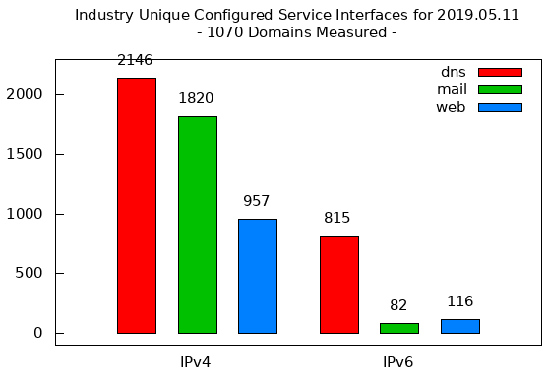
IPv6: adoption
Long (long!) time for deployment, use
20 years and counting
think of application-level changes in last 20 years: WWW, Facebook, …
Why?
Source:
National Institute of Standards and Technology, US Government

