Slide 1
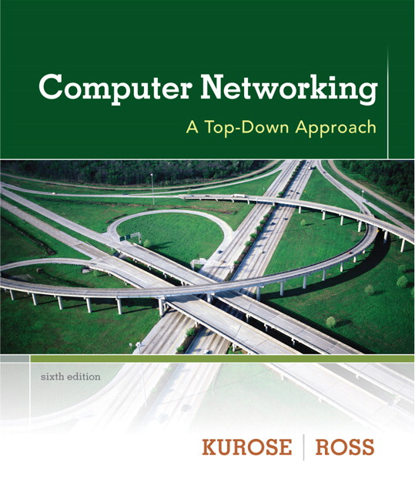

Introduction to data communications
Lecturer: Itamar Cohen
Chapter 4: the network layer
Part 3: Routing
Computer Networking: A Top Down Approach 6th edition Jim Kurose, Keith Ross Addison-Wesley March 2012
Based on slides by
Dr. Yoram Haddad, JCT
J.F Kurose and K.W. Ross, all Rights Reserved
All material copyright 1996-2012

Slide 2
Outline
Routing algorithms
Routing protocols

Slide 3
Graph abstraction
5
v
3
w
2
5
u
2
1
z
3
1
2
x
y
1
graph: G = (N,E)
N = set of routers = { u, v, w, x, y, z }
E = set of links ={ (u,v), (u,x), (v,x), (v,w), (x,w), (x,y), (w,y), (w,z), (y,z) }
Notes:
aside: graph abstraction is useful in other network contexts, e.g.,
P2P, where N is set of peers and E is set of TCP connections

Slide 4
Graph abstraction: costs
c(x,x’) = cost of link (x,x’)
e.g., c(w,z) = 5
Cost may be
Always 1
Proportional to congestion, or to geographical distance
Inversely proportional to BW
5
v
3
w
2
5
u
2
1
z
3
1
2
x
y
1
cost of path (x₁, x₂, x₃,…, x_{p}) = c(x₁,x₂) + c(x₂,x₃) + … + c(x_{p-1},x_{p})
key question: what is the least-cost path between u and z ?
routing algorithm: algorithm that finds that least cost path

Slide 5
Routing algorithm classification
Q: global or decentralized information?
global:
all routers have complete topology, link cost info
“Link State” algorithms
decentralized:
router knows only physically-connected neighbors, link costs to neighbors
“distance vector” algorithms
Q: static or dynamic?
static:
routes change slowly
dynamic:
routes change quickly
periodic update
in response to link cost changes

Slide 6
Outline
Routing algorithms
Link-state
Distance-vector
Hierarchical routing
Routing protocols

Slide 7
A Link-State Routing Algorithm
Dijkstra’s algorithm
Centralized
All nodes know whole net topology
“link state broadcast”
computes minimal paths from one node (‘source”) to all other nodes
iterative: after k iterations, know least cost path to k dest.’s
notation:
c(x,y): link cost from node x to y; = ∞ if not direct neighbors
D(v): current value of cost of path from source to dest. v
p(v): predecessor node along path from source to v
N': set of nodes whose least cost path definitively known

Slide 8

Dijsktra’s Algorithm
1 Initialization:
2 N' = {u}
3 for all nodes v
4 if v adjacent to u
5 then D(v) = c(u,v)
6 else D(v) = ∞
7
8 Loop
9 find w not in N' such that D(w) is a minimum
10 add w to N'
11 update D(v) for all v adjacent to w and not in N' :
12 D(v) = min( D(v), D(w) + c(w,v) )
13 /* new cost to v is either old cost to v or known
14 shortest path cost to w plus cost from w to v */
15 until all nodes in N'
Edsger Wybe Dijkstra

Slide 9
Dijkstra’s algorithm: example
D(v)
p(v)
D(w)
p(w)
D(x)
p(x)
D(y)
p(y)
D(z)
p(z)
Step
N'
0
u
7,u
3,u
5,u
∞
∞
1
uw
6,w
5,u
11,w
∞
2
uwx
6,w
11,w
14,x
3
uwxv
10,v
14,x
4
uwxvy
12,y
5
uwxvyz
x
9
notes:
construct shortest path tree by tracing predecessor nodes
ties can exist (can be broken arbitrarily)
5
7
4
8
u
3
w
y
z
2
3
7
4
v

Slide 10
Dijkstra’s algorithm: example (2)
Step
0
1
2
3
4
5
N'
u
ux
uxy
uxyv
uxyvw
uxyvwz
D(v),p(v)
2,u
2,u
2,u
D(w),p(w)
5,u
4,x
3,y
3,y
D(x),p(x)
1,u
D(y),p(y)
∞
2,x
D(z),p(z)
∞
∞
4,y
4,y
4,y
5
v
3
w
2
5
u
2
1
z
3
1
2
x
y
1

Slide 11
Dijkstra’s algorithm: example (2)
resulting shortest-path tree from u:
v
w
u
z
x
y
resulting forwarding table in u:
destination
link
v
(u,v)
x
(u,x)
y
(u,x)
w
(u,x)
z
(u,x)

Slide 12
Dijkstra’s algorithm complexity
n nodes
each iteration: need to check all nodes, w, not in N
Naïve implementation: n(n+1)/2 comparisons: O(n²)
Optimized complexity: O(nlog(n))

Slide 13
Dijkstra’s algorithm: oscillations
e.g., when link cost equals amount of carried traffic
A
1
1+e
D
B
0
0
0
C
e
1
1
e
initially

Slide 14
Dijkstra’s algorithm: oscillations
e.g., when link cost equals amount of carried traffic
A
1
1+e
D
B
0
0
0
C
e
1
1
e
initially

Slide 15
Dijkstra’s algorithm: oscillations
e.g., when link cost equals amount of carried traffic
A
A
1
1+e
2+e
0
D
B
D
B
0
0
1+e
1
0
C
e
0
0
1
C
1
e
initially
given these costs,
find new routing….
resulting in new costs

Slide 16
Dijkstra’s algorithm: oscillations
e.g., when link cost equals amount of carried traffic
A
A
A
1
1+e
2+e
0
0
2+e
D
B
D
B
D
B
0
0
1+e
1
0
0
0
C
e
0
0
1
1
C
C
1+e
1
e
initially
given these costs,
find new routing….
resulting in new costs
given these costs,
find new routing….
resulting in new costs

Slide 17
Dijkstra’s algorithm: oscillations
e.g., when link cost equals amount of carried traffic
A
A
A
A
1
1+e
2+e
0
0
2+e
2+e
0
D
B
D
B
D
B
D
B
0
0
1+e
1
0
0
1+e
1
0
C
e
0
0
1
0
0
1
C
C
1+e
C
1
e
initially
given these costs,
find new routing….
resulting in new costs
given these costs,
find new routing….
resulting in new costs
given these costs,
find new routing….
resulting in new costs

Slide 18
Dijkstra’s algorithm: oscillations
e.g., when link cost equals amount of carried traffic
Mitigate this problem using
More sophisticated link costs
Async’ runs and updates
A
A
A
A
1
1+e
2+e
0
0
2+e
2+e
0
D
B
D
B
D
B
D
B
0
0
1+e
1
0
0
1+e
1
0
C
e
0
0
1
0
0
1
C
C
1+e
C
1
e
initially
given these costs,
find new routing….
resulting in new costs
given these costs,
find new routing….
resulting in new costs
given these costs,
find new routing….
resulting in new costs

Slide 19
Outline
Routing algorithms
Link-state
Distance-vector
Hierarchical routing
Routing protocols

Slide 20
Distance vector algorithm
Bellman-Ford equation (dynamic programming)
let
d_{x}(y) := cost of least-cost path from x to y
then
d_{x}(y) = min {c(x,v) + d_{v}(y) }
v
cost from neighbor v to destination y
cost to neighbor v
min taken over all neighbors v of x

Slide 21
Bellman-Ford example
5
clearly, d_{v}(z) = 5, d_{x}(z) = 3, d_{w}(z) = 3
v
3
w
2
5
u
z
B-F equation says:
2
1
3
1
2
d_{u}(z) = min { c(u,v) + d_{v}(z),
c(u,x) + d_{x}(z),
c(u,w) + d_{w}(z) }
= min {2 + 5,
1 + 3,
5 + 3} = 4
x
y
1
node achieving minimum is next
hop in shortest path, used in forwarding table

Slide 22
Distance vector algorithm
D_{x}(y) = estimate of least cost from x to y
x maintains distance vector D_{x} = [D_{x}(y): y є N ]
node x:
knows cost to each neighbor v: c(x,v)
maintains its neighbors’ distance vectors. For each neighbor v, x maintains D_{v} = [D_{v}(y): y є N ]

Slide 23
Distance vector algorithm
key idea:
from time-to-time, each node sends its own distance vector estimate to neighbors
when x receives new DV estimate from neighbor, it updates its own DV using B-F equation:
D_{x}(y) ← min_{v}{c(x,v) + D_{v}(y)} for each node y ∊ N
under minor, natural conditions, the estimate D_{x}(y) converges to the actual least cost d_{x}(y)

Slide 24
Distance vector algorithm
iterative, asynchronous: each local iteration caused by:
local link cost change
DV update message from neighbor
distributed:
each node notifies neighbors only when its DV changes
neighbors then notify their neighbors if necessary
each node:
wait for (change in local link cost or msg from neighbor)
recompute estimates
if DV to any dest has changed, notify neighbors

Slide 25
D_{x}(z) = min{c(x,y) + D_{y}(z), c(x,z) + D_{z}(z)}
= min{2+1 , 7+0} = 3
D_{x}(y) = min{c(x,y) + D_{y}(y), c(x,z) + D_{z}(y)} = min{2+0 , 7+1} = 2
node x
table
cost to
cost to
x y z
x y z
x
0 2 7
x
0
2
3
y
y
2 0 1
from
∞
∞
∞
from
z
∞
∞
∞
z
7 1 0
node y
table
cost to
x y z
y
2
1
x
∞
∞
z
∞
2 0 1
x
from
y
7
z
∞
∞
∞
node z
table
cost to
x y z
x
∞ ∞ ∞
from
y
∞
∞
∞
z
7
1
0
time

Slide 26
D_{x}(z) = min{c(x,y) + D_{y}(z), c(x,z) + D_{z}(z)}
= min{2+1 , 7+0} = 3
D_{x}(y) = min{c(x,y) + D_{y}(y), c(x,z) + D_{z}(y)} = min{2+0 , 7+1} = 2
node x
table
cost to
cost to
cost to
x y z
x y z
x y z
x
0 2 7
x
0
2
3
x
0 2 3
y
y
2 0 1
from
∞
∞
∞
from
y
2 0 1
z
z
from
∞
∞
∞
7 1 0
z
3 1 0
node y
table
cost to
cost to
cost to
x y z
x y z
x y z
y
2
1
x
∞
∞
x
0 2 7
∞
2 0 1
x
0 2 3
x
z
from
y
y
2 0 1
y
7
from
from
2 0 1
z
∞
∞
∞
z
7 1 0
z
3 1 0
node z
table
cost to
cost to
cost to
x y z
x y z
x y z
x
∞ ∞ ∞
x
0 2 7
x
0 2 3
y
y
2 0 1
from
y
∞
∞
from
2 0 1
from
∞
z
z
3 1 0
z
3 1 0
7
1
0
time
time

Slide 27
Distance vector: count to infinity
link cost changes:
node detects local link cost change
bad news travels slow
44 iterations before algorithm stabilizes: see good short film
60
y
4
1
x
z
50
poisoned reverse:
If Z routes through Y to get to X :
Z tells Y its (Z’s) distance to X is infinite (so Y won’t route to X via Z)
will this completely solve count to infinity problem?

Slide 28
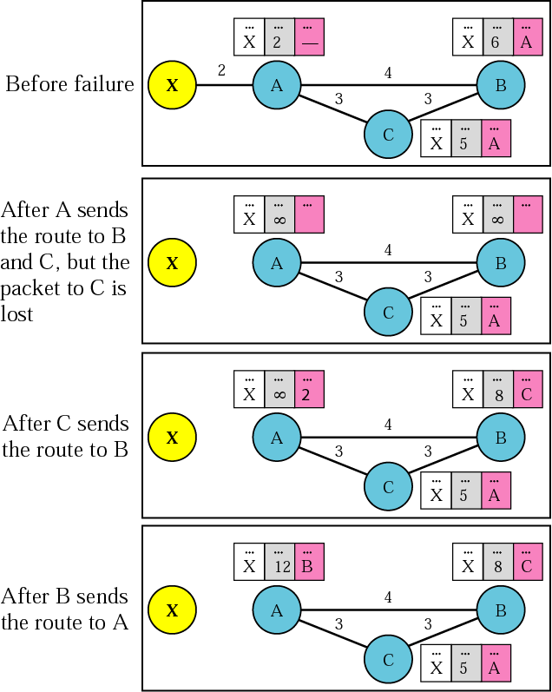
Three-node instability

Slide 29
Three-node instability

Slide 30
Outline
Routing algorithms
Link-state
Distance-vector
Hierarchical routing
Routing protocols

Slide 31
Hierarchical routing - motivation
Scaling
Give autonomy to networks

Slide 32

Hierarchical routing
Aggregate routers into regions, “autonomous systems” (AS)
ASs number assigned by IANA
Routers in same AS run same routing protocol
“intra-AS” routing protocol
routers in different AS can run different intra-AS routing protocol
gateway routers, at the “edge” the AS, have links to routers in another AS
And therefore should run also a common inter-routing protocol
Notes:
Iana is run by icann. See
http://icannwiki.com/Internet_Assigned_Numbers_Authority#IANA_vs_ICANN

Slide 33
Interconnected ASes
3c
3a
2c
3b
AS3
2a
1c
2b
AS2
1a
1b
1d
AS1
forwarding table configured by both intra- and inter-AS routing algorithm
intra-AS sets entries for internal dests
inter-AS & intra-AS sets entries for external dests
Intra-AS
Routing
algorithm
Inter-AS
Routing
algorithm
Forwarding
table

Slide 34
Inter-AS tasks
suppose router in AS1 receives datagram destined outside of AS1:
router should forward packet to gateway router, but which one?
AS1 must:
learn which dests are reachable through AS2, which through AS3
propagate this reachability info to all routers in AS1
job of inter-AS routing!
3c
3a
3b
AS3
2c
other
networks
1c
2a
other
networks
1a
2b
1b
AS2
AS1
1d

Slide 35
Outline
Routing algorithms
Routing protocols
Intra - Autonomous System
Inter- Autonomous Systems

Slide 36
Intra-AS Routing
Also known as interior gateway protocols (IGP)
Most common intra-AS routing protocols:
Routing Information Protocol (simple, obsolete)
OSPF: Open Shortest Path First
IS-IS – similar to OSPF
IGRP: Interior Gateway Routing Protocol (Cisco proprietary)
Notes:
IS-IS - Intermediate Sys – Intermediate Sys

Slide 37
OSPF (Open Shortest Path First)
“Open”: publicly available
uses link state algorithm
LS packet dissemination
Topology map at each node
Route computation using Dijkstra’s algorithm
OSPF advertisement carries one entry per neighbor
Advertisements flooded to entire AS
Carried in OSPF messages directly over IP (rather than TCP / UDP)
→ OSPF should verify itself a reliable transfer

Slide 38
OSPF “advanced” features (not in RIP)
Security: all OSPF messages authenticated
The packet’s content is hashed, using a secret key
Only a trusted source can generate the correct hash
For preventing re-play, the hashed content includes a seq #
Equal Cost Multi Path allowed
Better load-balancing
For each link, multiple cost metrics for different ToS (e.g., satellite link cost set “low” for best effort ToS; high for real time ToS)
Multicast OSPF adds a multicast support
Hierarchical OSPF in large domains.

Slide 39
Hierarchical OSPF
boundary router
backbone router
backbone
area
border
routers
area 3
internal
routers
area 1
area 2

Slide 40
Hierarchical OSPF
Two-level hierarchy: local area, backbone.
link-state advertisements only in area
Each internal node has
detailed area topology
Partial (only shortest path direction) about other areas
Area border routers: “summarize” distances to nets in own area, advertise to other Area Border routers.
Backbone routers: run OSPF routing limited to backbone.
Boundary routers: connect to other AS’s.
Notes:
Area identifiers: each area is labeled by a 32-b area identifier, commonly written in a Dot-Decimal-Notation, same as IPv4 addresses.
However, this are NOT IP addresses!
The backbone area is commonly labeled 0.0.0.0
Other areas may be labeled by the IPv4 address of the main router.

Slide 41
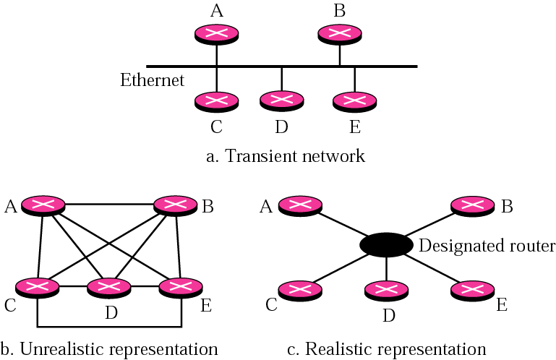
Designated Routers
Naively, each router should advertise each update to all other routers in its area.
In order to reduce the traffic overhead, the routers select a designated router - a “master”, which maintains a complete topology table, and multicasts updates to all the other routers.
A Backup DR is elected as well, to be used in case that the DR fails.
Notes:
Dissemination –
פִּזּוּר, הֲפָצָה; זְרִיָּה

Slide 42
Oblivious routing
If the [In | E] gress traffic is limited, it is possible to calculate an optimal oblivious algorithm
And then, to use “reverse engineering” for calculating links’ weights, which would lead to this routing
Notes:
יש שתי גישות עקריות לניתוב.
גישה אחת היא ניתוב מסתגל. כלומר - אם מזהים עומס, משנים את הניתוב כדי לעקוף את הקישורים או הנתבים העמוסים - כמו WAYZ, לצורך העניין. בעוד שהשיטה הזו היא אינטואיטיבית, ובתאוריה יכולה להיות אופטימלית, בפועל יש לה חסרונות משמעותיים. זאת, משום שכדי ליישמה ביעילות צריך ידע מושלם על העומסים ודרישות התעבורה (מי שולח / מתכוון לשלוח כמה למי) בכל רגע, וכמובן, יכולת חישוב משמעותית, כדי לשנות את הניתוב בהתאם. בפועל, קשה מאוד למדוד את העומס על כל קישור וכל נתב בכל רגע, וקשה עוד יותר לחזות מה יקרה בעתיד. כמו כן, שינויי ניתוב תכופים גורמים לבעיות, כגון הגעה של חבילות שלא לפי הסדר; וכן, זה דורש מהנתבים / מבקר מרכזי לבצע חישובים מורכבים, דבר שמגדיל את זמן השהייה של כל חבילה בתוך הנתב, עד שיודעים איך לנתב אותה.
הפתרון לבעיות הנ"ל היא הגישה של ניתוב "חסר זיכרון" - oblivious. בניתוב זה, קובעים מראש מה יהיה מסלול הניתוב* בין כל שני צמתים, ולא משנים אותו, גם אם המסלול הזה נהיה עמוס. המקרה היחיד שבו משנים מסלול ניתוב, הוא כאשר יש שינוי בטופולוגיה של הרשת (נפילה של קישור / נתב, או הוספת קישור או נתב חדש). זה פותר את כל הבעיות של הניתוב המסתגל, שציינתי למעלה. כמובן, החיסרון הוא, שכך עלולים להיווצר עומסים רגעיים; אך גם על כך ניתן להתגבר, אם מקצים מראש את המשאבים (רוחב הפס של הקישורים) ובוחרים ניתובים באופן חכם.
כמו כן, ניתוב חסר זיכרון מתאים רק לרשתות שמשתנות לעתים נדירות - למשל, רשת הליבה הקווית של בזק, שלא משתנה כל שתי דקות. זה לא מתאים לרשתות דינמיות, כגון רשתות אלחוטיות, שהטופולוגיה שלהן משתנה כל הזמן.
* בפועל זה לא חייב להיות "מסלול ניתוב" בין כל 2 נקודות, אלא אפשר לקבוע, למשל, ש-50% מהזרימות (flows) בין נקודות A ו-B יעברו במסלול א', ו-50% הנותרים במסלול ב'. כך מצד אחד מפזרים את העומס ברשת; ומצד שני, אין חשש של הגעת חבילות שלא לפי הסדר, כי מה שחשוב הוא רק סדר החבילות בתוך כל זרימה, ולא בין זרימות שונות.

Slide 43
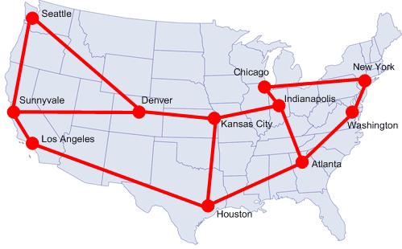
Oblivious routing in a backbone network
Notes:
Slide # doesn’t work!

Slide 44
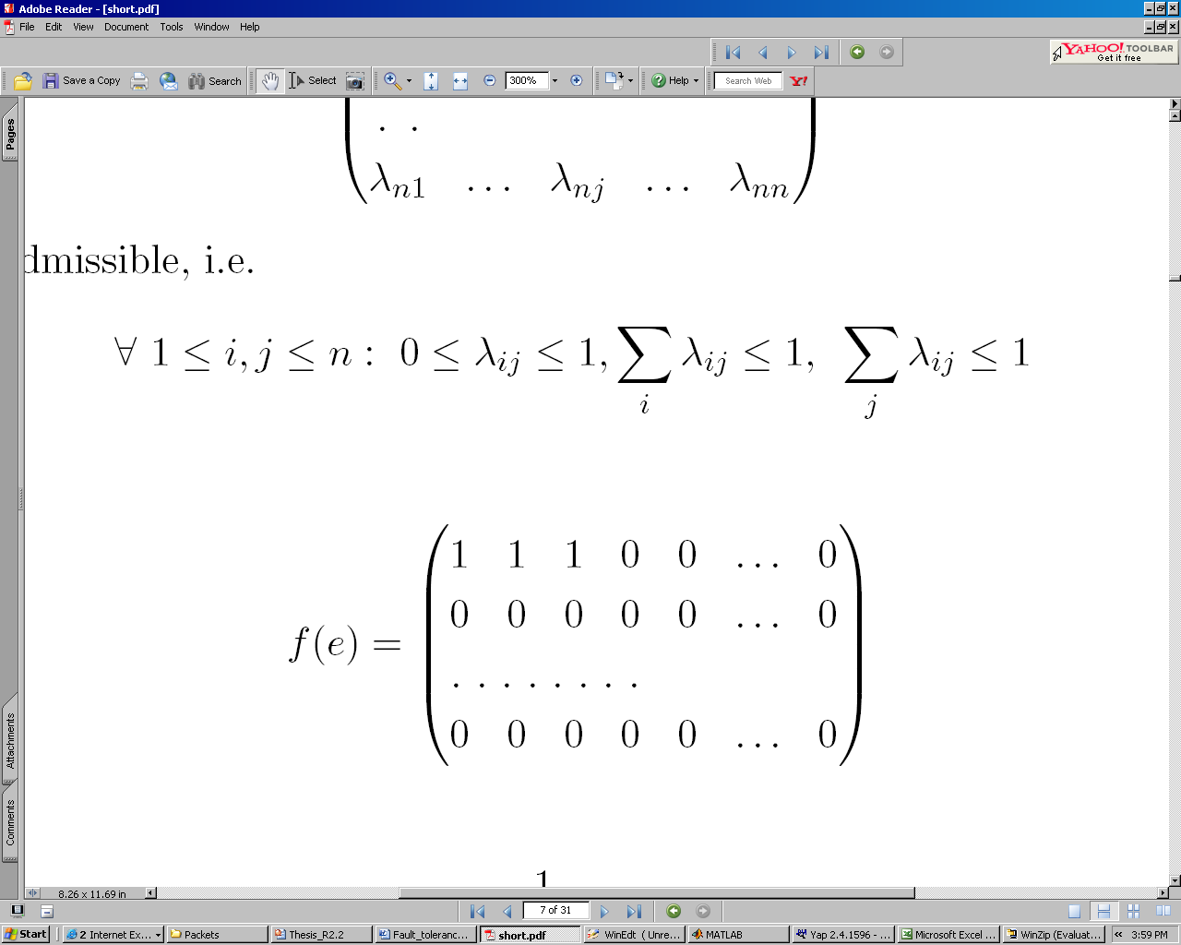
Every node is an ingress/egress point
i

Slide 45
Outline
Routing algorithms
Routing protocols
Intra - Autonomous System
Inter- Autonomous Systems
Border Gateway Protocol

Slide 46
Internet inter-AS routing: BGP
BGP (Border Gateway Protocol): the de facto inter-domain routing protocol
“glue that holds the Internet together”
BGP provides each AS a means to:
eBGP: obtain subnet reachability information from neighboring ASs.
iBGP: propagate reachability information to all AS-internal routers.
determine “good” routes to other networks based on reachability information and policy.
allows subnet to advertise its existence to rest of Internet: “I am here”

Slide 47
BGP basics
BGP session: two BGP routers (“peers”) exchange BGP messages:
advertising paths to different destination network prefixes (“path vector” protocol)
exchanged over semi-permanent TCP connections
when AS3 advertises a prefix to AS1:
AS3 promises it will forward datagrams towards that prefix
AS3 can aggregate prefixes in its advertisement
3c
3a
BGP
message
3b
AS3
2c
other
networks
1c
2a
other
networks
1a
2b
1b
AS2
AS1
1d

Slide 48
BGP basics: distributing path information
using eBGP session between 3a and 1c, AS3 sends prefix reachability info to AS1.
1c can then use iBGP do distribute new prefix info to all routers in AS1
1b can then re-advertise new reachability info to AS2 over 1b-to-2a eBGP session
when router learns of new prefix, it creates entry for prefix in its forwarding table.
eBGP session
3a
3b
iBGP session
AS3
2c
other
networks
1c
2a
other
networks
1a
2b
1b
AS2
AS1
1d

Slide 49
Path attributes and BGP routes
advertised prefix includes BGP attributes
prefix + attributes = “route”
two important attributes:
AS-PATH: contains ASs through which prefix advertisement has passed: e.g., AS 67, AS 17
NEXT-HOP: indicates specific internal-AS router to next-hop AS. (may be multiple links from current AS to next-hop-AS)
gateway router receiving route advertisement uses import policy to accept/decline
e.g., never route through AS x
policy-based routing

Slide 50
BGP advertising policy – local preferences
legend:
provider
B
network
X
W
A
customer
C
network:
Y
A,B,C are provider networks
X,W,Y are customer (of provider networks)
X is dual-homed: attached to two networks
X does not want to route from B via X to C
.. so X will not advertise to B a route to C

Slide 51
BGP advertising policy – local preferences
legend:
provider
B
network
X
W
A
customer
C
network:
Y
A advertises path AW to B
B advertises path BAW to X
Should B advertise path BAW to C?
No way! B gets no “revenue” for routing CBAW since neither W nor C are B’s customers
B wants to force C to route to w via A
B wants to route only to/from its customers!

Slide 52
BGP route selection
router may learn about more than 1 route to destination AS, selects route based on:
Local preferences (mainly economical): prefer a customer over a peer, and a peer over a provider.
Shortest AS-PATH
Closest NEXT-HOP router: hot potato routing
(Additional criteria)

Slide 53
Putting it Altogether: How Does an Entry Get Into a Router’s Forwarding Table?
Answer is complicated!
Ties together
Hierarchical routing
Intra-AS routing (eg OSPF)
Inter-AS routing (BGP)
Provides nice overview of BGP!

Slide 54
How does entry get in forwarding table?
routing algorithms
Assume prefix is in another AS.
local forwarding table
entry
prefix
output port
138.16.64/22
124.12/16
212/8
…………..
3
2
4
…
1
Dest IP
3
2

Slide 55
How does entry get in forwarding table?
High-level overview
Router becomes aware of prefix
Router determines output port for prefix
Router enters prefix-port in forwarding table

Slide 56
Router becomes aware of prefix
3c
3a
BGP
message
3b
AS3
2c
other
networks
1c
2a
other
networks
1a
2b
1b
AS2
AS1
1d
BGP message contains “routes”
“route” is a prefix and attributes: AS-PATH, NEXT-HOP,…
Example: route:
Prefix:138.16.64/22 ; AS-PATH: AS3 AS131 ; NEXT-HOP: 201.44.13.125

Slide 57
Router may receive multiple routes
3c
3a
BGP
message
3b
AS3
2c
other
networks
1c
2a
other
networks
1a
2b
1b
AS2
AS1
1d
Router may receive multiple routes for same prefix
Has to select one route

Slide 58
Select best BGP route to prefix
If both paths have the same local preferences: break ties by selecting shortest AS-PATH
Example:
AS2 AS17 to 138.16.64/22
AS3 AS131 AS201 to 138.16.64/22
What if there is still a tie? We’ll come back to that!
select

Slide 59
Find best intra-route to BGP route
Use selected route’s NEXT-HOP attribute
Route’s NEXT-HOP attribute is the IP address of the router interface that begins the AS PATH.
Example:
AS-PATH: AS2 AS17 ; NEXT-HOP: 111.99.86.55
Router uses OSPF to find shortest path from 1c to 111.99.86.55
3c
3a
3b
111.99.86.55
AS3
2c
other
networks
1c
2a
other
networks
1a
2b
1b
AS2
AS1
1d

Slide 60

Hot Potato routing
Suppose there’re AS1 may route to AS 9, via peers:
Either via AS2, or via AS3
Both are 2-hops paths
Which path should 1d choose?
Answer: hop potato
Fig. taken from 101fundraising.org
3c
3a
3b
111.99.86.55
AS3
2c
other
networks
1c
2a
other
networks
1a
2b
1b
AS2
AS1
1d

Slide 61
Router identifies port for route
Identifies port along the OSPF shortest path
Adds prefix-port entry to its forwarding table:
(138.16.64/22 , port 4)
3c
router port
3a
3b
AS3
1
2c
other
networks
1c
4
2a
2
3
2b
other
networks
1a
1b
AS1
1d
AS2

Slide 62
Hot Potato Routing
Suppose there two or more best inter-routes.
Then choose route with closest NEXT-HOP
Use OSPF to determine which gateway is closest
Q: From 1c, chose AS3 AS131 or AS2 AS17?
A: route AS3 AS201 since it is closer
3c
3a
3b
AS3
2c
other
networks
1c
2a
other
networks
1a
2b
1b
AS2
AS1
1d

Slide 63
How does entry get in forwarding table?
Summary
Router becomes aware of prefix
via BGP route advertisements from other routers
Determine router output port for prefix
Use BGP route selection to find best inter-AS route
Use OSPF to find best intra-AS route leading to best inter-AS route
Router identifies router port for that best route
Enter prefix-port entry in forwarding table

Slide 64
Why different Intra-, Inter-AS routing ?
policy:
inter-AS: admin wants control over how its traffic routed, who routes through its net.
intra-AS: single admin, so no policy decisions needed
scale:
Reduce table size and update traffic
performance:
intra-AS: can focus on performance
inter-AS: policy may dominate over performance

