Slide 1


Introduction to data communications
Lecturer: Itamar Cohen
Chapter 5: The link layer
Computer Networking: A Top Down Approach
6th edition
Jim Kurose, Keith Ross
Addison-Wesley
March 2012
Based on slides by J.F Kurose and K.W. Ross, all Rights Reserved All material copyright 1996-2012

Slide 2
Outline
Link layer services
Error detection & correction
Multiple access protocols
Link layer addressing
Ethernet
Local Area Networks

Slide 3
Link layer: Motivation
Deliver a datagram transferred by different link types and protocols, e.g.
  Ethernet on cables
  WiFi
  Data center networks
transportation analogy:
Trip plan → L3.5’s routing (OSPF, BGP)
Selecting the correct turn in an interchange → L3’s forwarding
Comply the rules of each means of transportation (buy a ticket, sit in train / bus, drive at allowed speed) → L2.

Slide 4
Link layer services
Framing
  Adding a header, and possibly a trailer
Reliable transfer, error detection / correction
  ☺ Saves E2E re-delivery
  ☹ Overhead
  → Used mainly in links with high error rate, eg mobile
Node-to-node flow control
Medium access protocol
  In the case of shared medium
Half- / full-duplex

Slide 5



Network Interface Card
Aka network adaptor
Implements link, physical layer
Implemented on HW
  However, interfaces higher layers via SW
  Eg, interrupts for arrival of frames, error conditions etc.
application
transport
network
link
cpu
memory
link
physical
host
bus
(e.g., PCI)
controller
physical
transmission
network adapter
card

Slide 6
Outline
Link layer services
Error detection & correction
Multiple access protocols
Link layer addressing
Ethernet
Local Area Networks

Slide 7

Error detection
EDC= Error Detection and Correction bits (redundancy)
D = Data protected by error checking, may include header fields
Error detection is never 100% reliable!
  Trade-off: (undetected) error rate / overhead
otherwise

Slide 8


Parity checking
single bit parity:
detect single bit errors
two-dimensional bit parity:
detect and correct single bit errors
0
0

Slide 9

Cyclic Redundancy Check
More powerful then Checksum
view data bits, D, as a binary number
choose r+1 bit pattern (generator), G
goal: choose r CRC bits, R, such that
  <D,R> exactly divisible by G (modulo 2)
  receiver knows G, divides <D,R> by G. If non-zero remainder: error detected!
  can detect all burst errors less than r+1 bits
widely used in practice (Ethernet, 802.11 WiFi, ATM)

Slide 10
CRC example
want:
  D.2^{r} XOR R = nG
equivalently:
  D.2^{r} = nG XOR R
equivalently:
if we divide D.2^{r} by G, want remainder R to satisfy:
G
D
r = 3
1
01000
1001
101110000
.
.
.
D.2^{r}
G
R
R = remainder[ ]
011

Slide 11
Outline
Link layer services
Error detection & correction
Multiple access protocols
  Channel partitioning
    TDM & FDM
  Random access
  Taking turn
Link layer addressing
Ethernet
Local Area Networks

Slide 12






Multiple access links, protocols
Two types of “links”:
point-to-point
Broadcast (shared wire or medium)
shared wire (e.g.,
cabled Ethernet)
shared RF
(e.g., 802.11 WiFi)
shared RF
(satellite)
humans at a
cocktail party
(shared air, acoustical)

Slide 13
Multiple access protocols
Single shared broadcast channel
Multiple simultaneous transmissions: interference
  A node receives multiple signals simultaneously: collision
multiple access protocol
Algorithm that determines when each node can transmit
Communication about channel sharing uses channel itself!
  no out-of-band channel for coordination

Slide 14
Outline
Link layer services
Error detection & correction
Multiple access protocols
  Channel partitioning
    TDM & FDM
  Random access
  Taking turn
Link layer addressing
Ethernet
Local Area Networks

Slide 15
Time Division Multiple Access
Time is divided to fixed length slot (length = pkt trans time)
Round Robin
☹ Unnecessary idle times (not work conservative)
6-slot
frame
6-slot
frame
1
3
4
1
3
4

Slide 16
Frequency Division Multiple Access
Similar to TDMA, but now the channel spectrum is divided into “slots” - frequency bands
☹ Similar drawback as TDMA: unnecessary unused channels
time
frequency bands
FDM cable

Slide 17
Outline
Link layer services
Error detection & correction
Multiple access protocols
  Channel partitioning
  Random access
  Taking turn
Link layer addressing
Ethernet
Local Area Networks

Slide 18
Random access protocols
Nodes transmit at full channel rate R.
  No a priori coordination among nodes
Two or more transmitting nodes ➜ “collision” Random access MAC protocol specifies:
  How to detect collisions
  How to recover from collisions

Slide 19
Outline
Link layer services
Error detection & correction
Multiple access protocols
  Channel partitioning
  Random access
    Aloha
    CSMA
  Taking turn
Link layer addressing
Ethernet
Local Area Networks

Slide 20

Slotted ALOHA
Assumptions:
all frames same size
Time is slotted
  Slot: time to transmit a single frame
Nodes are synchronized
Nodes start to transmit only slot beginning
If multiple nodes transmit simultaneously, all nodes detect collision
Operation:
Nodes try to transmit
  if collision happen: node retransmits frame in each subsequent slot with prob. p until success

Slide 21
Slotted ALOHA
Legend
Collision
Empty
Successful
node 1
1
1
1
1
node 2
2
2
2
node 3
3
3
3
C
E
C
S
E
C
E
S
S
Pros:
Single active node can continuously transmit at full rate of channel
Highly decentralized: only slots in nodes need to be in sync
Simple
Cons:
When highly active: many collisions → wasting slots
When lowly active: many idle slots
Even when detecting collision at the beginning of the slot, necessary to wait (at least) until the next slot
Requires clock synchronization

Slide 22
Slotted ALOHA efficiency
node 1
1
1
1
1
node 2
2
2
2
node 3
3
3
3
C
E
C
S
E
C
E
S
S
Probabilistic analysis shows that even when optimizing p (the retransmission probability), the expected maximal % of successfully used slots is
1/e =~ 37%
In Unslotted ALOHA, where nodes are not synchronized, the efficiency decreases to
1/2e =~ 18%

Slide 23
Outline
Link layer services
Error detection & correction
Multiple access protocols
  Channel partitioning
  Random access
    Aloha
    CSMA
  Taking turn
Link layer addressing
Ethernet
Local Area Networks

Slide 24
Carrier Sense Multiple Access
CSMA: listen before transmit:
if channel sensed idle: transmit entire frame
if channel sensed busy: defer transmission
human analogy: don’t interrupt others!

Slide 25

CSMA collisions
spatial layout of nodes
collisions can still occur: propagation delay means two nodes may not hear each other’s transmission
collision: entire packet transmission time wasted
  collision probability determined by distance & propagation delay

Slide 26

CSMA/CD (collision detection)
spatial layout of nodes

Slide 27
CSMA/CD (Collision Detection)
CSMA/CD: carrier sensing, deferral as in CSMA
  Collisions detected within short time
  Colliding transmissions aborted, reducing channel wastage
collision detection:
  Easy in wired LANs: measure signal strengths, compare transmitted, received signals
  Difficult in wireless LANs: received signal strength overwhelmed by local transmission strength
Human analogy: the polite conversationalist

Slide 28
Ethernet CSMA/CD algorithm
1. if channel is idle, start transmission.
2. If NIC detects a collision, abort regular transmission and send jam signal // so that neighbors will recognize the collision too
4. After aborting, NIC enters binary (exponential) backoff:
  After m-th collision, choose K at random from {0,1,2, …, 2^{m}-1}, and wait K delay units. Delay unit – time of transmitting 512 bits
  Increment counter
  Return to 1

Slide 29
CSMA/CD efficiency
T_{prop} = max prop delay between 2 nodes in LAN
t_{trans} = time to transmit max-size frame
Efficiency goes to 1 as…
  t_{prop} goes to 0
  or t_{trans} goes to infinity
Better performance than ALOHA: and simple, cheap, decentralized!

Slide 30
Outline
Link layer services
Error detection & correction
Multiple access protocols
  Channel partitioning
  Random access
  Taking turn
Link layer addressing
Ethernet
Local Area Networks

Slide 31
“Taking turns” MAC protocols
polling:
Master node “invites” slave nodes to transmit in turn
Typically used with “dumb” slave devices
  Eg, Bluetooth’s Piconet
☺ Doesn’t waste time / slots for inactive users
☹ Polling overhead & latency
☹ Single point of failure (master)
☹ Doesn’t scale well
data
poll
master
data
slaves

Slide 32
Outline
Link layer services
Error detection & correction
Multiple access protocols
Link layer addressing
  Motivation
  ARP
Ethernet
Local Area Networks

Slide 33
MAC adr: motivation
An L2 device doesn’t necessarily have a higher-level address
  E.g., Intra-net
Keep the layering model
  Eg, so that the network layer could change its addressing (IPv4, IPv6, IPX…) without need to change in the link layer’s addressing
Algorithm Ofanan HaShachechan
  Need to remember the previous hop
    Not only the final source / target
  E.g., for error correction, per-link flow control
Save interrupts to the link-layer protocol (IP) every time a packet is recognized on the (possibly shared) channel

Slide 34
MAC adr Vs. IP adr
Analogy
  MAC address: like ID (01234567)
  IP address: like postal address (Hertzl 17, J-m)
  MAC addresses are flat: cannot use masks / Longest Prefix Matching

Slide 35

MAC address
Aka physical address, LAN address
  LAN: Local Area Nework
  Burned in the NIC (per-interface)
Originally designed to be permanent, like chassis #
  Though, in fact, nowadays it’s reconfigurable
Most common (in Ethernet, WiFi): a 48-bits adr
  e.g.: 1A-2F-BB-76-09-AD
  24-bits blocks are allocated to companies by IEEE
    Institute of Electrical and Electronics Engineers
Used ‘locally”
Switches know only this address
  Not IP address!

Slide 36
MAC addresses example
each adapter on LAN has unique LAN address
1A-2F-BB-76-09-AD
LAN
(wired or
wireless)
adapter
71-65-F7-2B-08-53
58-23-D7-FA-20-B0
0C-C4-11-6F-E3-98

Slide 37
Outline
Link layer services
Error detection & correction
Multiple access protocols
Link layer addressing
  Motivation
  ARP
Ethernet
Local Area Networks

Slide 38


Address Resolution Protocol
Question: how to determine
interface’s MAC address, knowing its IP address?
ARP table
  Mappings for some LAN nodes:
< IP address; MAC address; TTL>
  TTL (Time To Live): time after which address mapping will be forgotten (typically 20 min)
137.196.7.78
1A-2F-BB-76-09-AD
137.196.7.23
137.196.7.14
LAN
71-65-F7-2B-08-53
58-23-D7-FA-20-B0
0C-C4-11-6F-E3-98
137.196.7.88

Slide 39
ARP protocol: same LAN
A wants to send datagram to B
  B’s MAC address not in A’s ARP table.
A broadcasts ARP query packet, containing B's IP address
  dest MAC address = FF-FF-FF-FF-FF-FF
  all nodes on LAN receive ARP query
B receives ARP packet, replies to A with its (B's) MAC address
  frame sent to A’s MAC address (unicast)
A caches (saves) IP-to-MAC address pair in its ARP table until times out
  soft state: information that times out (goes away) unless refreshed
ARP is “plug-and-play”:
  nodes create their ARP tables without intervention from net administrator

Slide 40
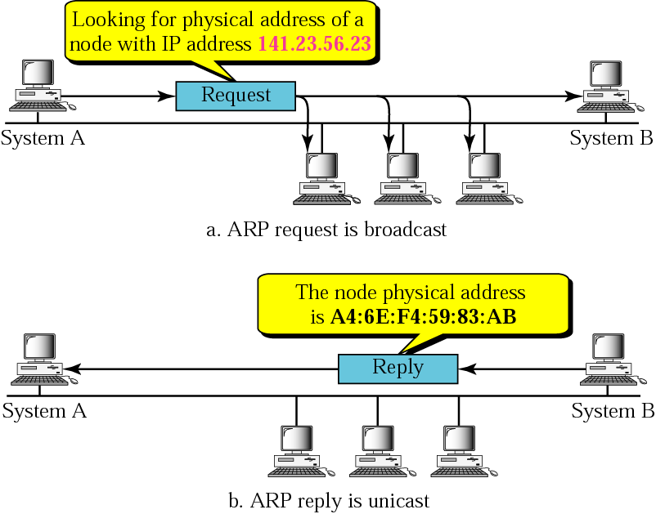
ARP operation
Notes:
Help for the animation:
The animation shows PING (Packet INternet Groper; grope – למשש, לגשש) – an administrative utility for checking the round-trip time to a given IP / URL. PING is performed by ICMP – Internet Control Message Protocol.

Slide 41
Addressing: routing to another LAN
Scenario: A wanna send a datagram to B
  A knows B’s IP address
  A knows IP address of first hop router, R (how?)
  A knows R’s MAC address (how?)
A
B
R
111.111.111.111
222.222.222.222
74-29-9C-E8-FF-55
49-BD-D2-C7-56-2A
222.222.222.220
1A-23-F9-CD-06-9B
111.111.111.112
111.111.111.110
222.222.222.221
CC-49-DE-D0-AB-7D
E6-E9-00-17-BB-4B
88-B2-2F-54-1A-0F

Slide 42
Addressing: routing to another LAN
A creates IP datagram with IP source A, destination B
A creates link-layer frame with R's MAC address as dest, frame contains A-to-B IP datagram
MAC src: 74-29-9C-E8-FF-55
MAC dest: E6-E9-00-17-BB-4B
IP
Eth
Phy
IP src: 111.111.111.111
IP dest: 222.222.222.222
A
B
R
111.111.111.111
222.222.222.222
74-29-9C-E8-FF-55
49-BD-D2-C7-56-2A
222.222.222.220
1A-23-F9-CD-06-9B
111.111.111.112
111.111.111.110
222.222.222.221
CC-49-DE-D0-AB-7D
E6-E9-00-17-BB-4B
88-B2-2F-54-1A-0F

Slide 43
Addressing: routing to another LAN
frame sent from A to R
frame received at R, datagram removed, passed up to IP
MAC src: 74-29-9C-E8-FF-55
MAC dest: E6-E9-00-17-BB-4B
IP src: 111.111.111.111
IP dest: 222.222.222.222
IP
Eth
Phy
IP src: 111.111.111.111
IP dest: 222.222.222.222
IP
Eth
Phy
A
B
R
111.111.111.111
222.222.222.222
74-29-9C-E8-FF-55
49-BD-D2-C7-56-2A
222.222.222.220
1A-23-F9-CD-06-9B
111.111.111.112
111.111.111.110
222.222.222.221
CC-49-DE-D0-AB-7D
E6-E9-00-17-BB-4B
88-B2-2F-54-1A-0F

Slide 44
Addressing: routing to another LAN
R forwards datagram with IP source A, destination B
R creates link-layer frame with B's MAC address as dest, frame contains A-to-B IP datagram
MAC src: 1A-23-F9-CD-06-9B
MAC dest: 49-BD-D2-C7-56-2A
IP
Eth
Phy
IP
Eth
Phy
IP src: 111.111.111.111
IP dest: 222.222.222.222
A
B
R
111.111.111.111
222.222.222.222
74-29-9C-E8-FF-55
49-BD-D2-C7-56-2A
222.222.222.220
1A-23-F9-CD-06-9B
111.111.111.112
111.111.111.110
222.222.222.221
CC-49-DE-D0-AB-7D
E6-E9-00-17-BB-4B
88-B2-2F-54-1A-0F

Slide 45
Addressing: routing to another LAN
R forwards datagram with IP source A, destination B
R creates link-layer frame with B's MAC address as dest, frame contains A-to-B IP datagram
MAC src: 1A-23-F9-CD-06-9B
MAC dest: 49-BD-D2-C7-56-2A
IP
Eth
Phy
IP
Eth
Phy
IP src: 111.111.111.111
IP dest: 222.222.222.222
A
B
R
111.111.111.111
222.222.222.222
74-29-9C-E8-FF-55
49-BD-D2-C7-56-2A
222.222.222.220
1A-23-F9-CD-06-9B
111.111.111.112
111.111.111.110
222.222.222.221
CC-49-DE-D0-AB-7D
E6-E9-00-17-BB-4B
88-B2-2F-54-1A-0F

Slide 46
Addressing: routing to another LAN
R forwards datagram with IP source A, destination B
R creates link-layer frame with B's MAC address as dest, frame contains A-to-B IP datagram
MAC src: 1A-23-F9-CD-06-9B
MAC dest: 49-BD-D2-C7-56-2A
IP src: 111.111.111.111
IP dest: 222.222.222.222
IP
Eth
Phy
A
B
R
111.111.111.111
222.222.222.222
74-29-9C-E8-FF-55
49-BD-D2-C7-56-2A
222.222.222.220
1A-23-F9-CD-06-9B
111.111.111.112
111.111.111.110
222.222.222.221
CC-49-DE-D0-AB-7D
E6-E9-00-17-BB-4B
88-B2-2F-54-1A-0F

Slide 47
Outline
Link layer services
Error detection & correction
Multiple access protocols
Link layer addressing
  Motivation
  ARP
    ARP spoofing
Ethernet
Local Area Networks

Slide 48

ARP spoofing (aka poisoning)
ARP is NOT authenticated
ARP is stateless: a new reply overwrites an older cache entry, even it hasn’t been expired yet
Attacker can easily associate an IP adr to his MAC adr
Then, the attacker can easily intercept, modify or stop all the traffic
These attacks are limited to within the LAN

Slide 49
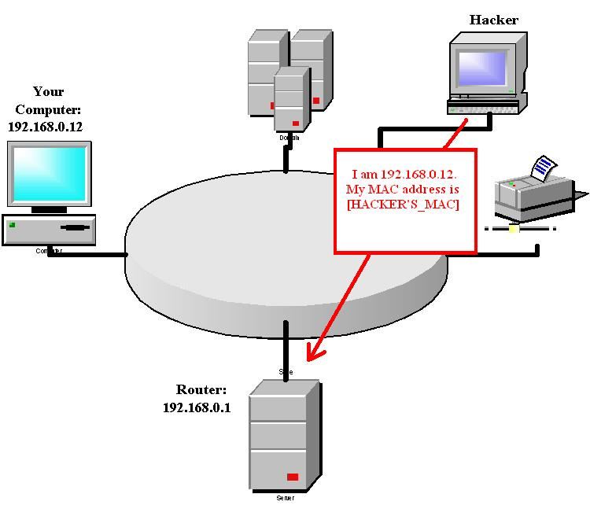
ARP Poisoning – Man-In-The-Middle

Slide 50
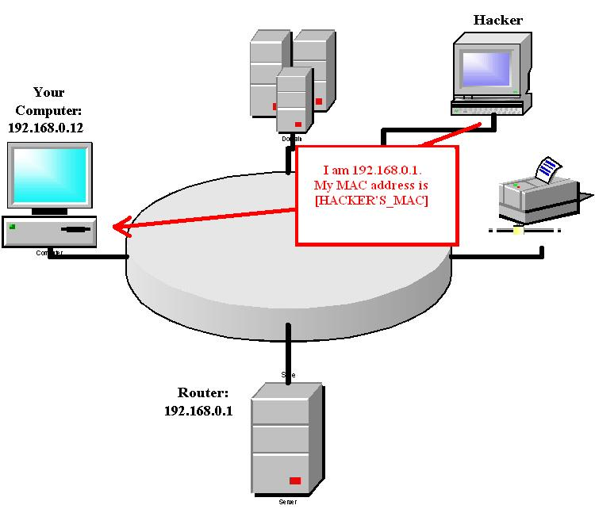
ARP Poisoning – Man-In-The-Middle

Slide 51
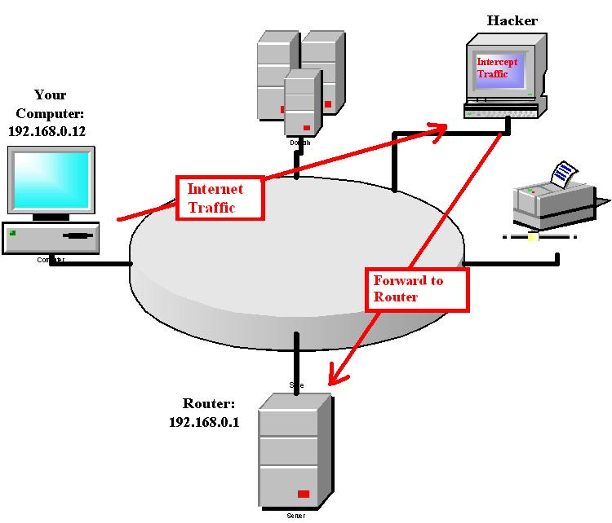
ARP Poisoning – Man-In-The-Middle

Slide 52
Prevent Arp Poisoning
  Static Arp Cache table
  ☹ Does not scale
Update ARP entries only after timeout / reply to request
Arpwatch: kind of “Wireshark” for ARP
  checks for multiple physical addresses responding to a given IP address
  May mail notifications to the network administrator
In IPv6: Neighbor Discovery Protocol replaces ICMP & ARP, and has SEND: SEcure Neighbor Discovery protocol

Slide 53
Attack on Behavior Analysis
Assume node disregards “abnormal” ARP activity, e.g.
  If MAC x sends many ARP replies with IP y then node assumes that MAC x is not IP y
Attack:
  Attacker spoofs gateway MAC (in Ethernet and ARP headers)
  Attacker mimics “bad” behavior for gateway
  Node disregards gateway
  Attacker sends single reply with its own MAC and gateway IP
Notes:
* Suggested in class by Alex Shulman and Kostya Zhuruev

Slide 54
Outline
Link layer services
Error detection & correction
Multiple access protocols
Link layer addressing
Ethernet
Local Area Networks

Slide 55

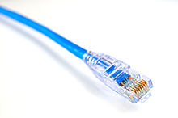
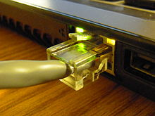
Ethernet
Most common wired LAN technology
Simple & cheap equipment
kept up with speed race

Slide 56

Topology
bus: (obsolete)
  Single collision domain
  CSMA / CD
star: prevails today
  Star’s center:
    In the past: hub (“dumb” repeater, collisions may happen)
    Today: switch: a “layer 2 router” (packet processing, forwarding)
switch
star
bus: coaxial cable

Slide 57
Ethernet frame structure
preamble:
7B with pattern 10101010 , followed by
1B Start Frame Delimiter - pattern 10101011
used for
  Synchronize receiver, sender clock rates
  Recognize the beginning of a new packet
type
preamble
dest.
address
source
address
data (payload)
CRC

Slide 58
Ethernet frame: header
Src, dst MAC Adr: 6B each
  The NIC accepts only frames with matching destination address, or with broadcast address
Type: indicates higher layer protocol
  Mostly IP, but maybe also Novell IPX, AppleTalk, ARP
  Type below 1500 indicated frame length
  Larger frames are indicated by the preamble
CRC: cyclic redundancy check at receiver
  error detected: frame is dropped
type
preamble
dest.
address
source
address
data (payload)
CRC

Slide 59
Ethernet: unreliable, connectionless
Connectionless and unreliable
  No handshaking, no Acks
  Just like UDP
In the past: unslotted CSMA/CD with binary backoff
Today: collision-free full-duplex

Slide 60
Outline
Link layer services
Error detection & correction
Multiple access protocols
Link layer addressing
Ethernet
Local Area Networks
  Switch
  VLAN

Slide 61
Switch
Role
  Store & forward Ethernet frames
Transparent
  hosts are unaware of presence of switches
Plug-and-play, self-learning
  switches do not need to be configured
A pure L2 switch doesn’t have an ARP table!
  See the comments part
Notes:
A pure L2 switch doesn’t have an ARP table!
שלום
בסיטואציה בה יש host A שרוצה לשלוח הודעה לhost B. כל אחד מהם מחובר למתג, ושני המתגים מחוברים לאותו הנתב. וכמו כן כל טבלאות הARP ריקות.
A צריך לדעת מה כתובת הMAC של B. מה מהבאים הוא נכון?
1. A שולח בקשת ARP עם הMAC המבוקש (של B). ז"א שA שולח בקשת ARP. המתג מעביר אותה הלאה בbroadcast, ורק לאחר שA יודע את הMAC של B (או של הראוטר), הוא שולח את החבילה עצמה.
2. A שולח חבילה ללא MAC לswitch שאליו הוא מחובר. הswitch מבין שהוא אינו יודע את הMAC של היעד, ואז זה שולח בקשת ARP עם IP היעד, ורק לאחר שהוא מקבל את הMAC של B (או של הראוטר) הוא שולח את החבילה המלאה הלאה?
אני שואל מכיוון שראיתי כמה סתירות בכל מיני מקומות - מצד אחד בהרצאה כתוב "המתג אינו יודע היכן יושב B ולאיזה מוצא עליו להוציא את הFRAME, ולכן שולח בקשת ARP בbroadcast.
מצד שני במבחן מ2010 ראינו תשובה שקיבלה את כל הנקודות שבה התלמיד לגמרי התעלם מפעולת הSWITCH, והHOST שלח את בקשת הARP
If I understand well the scenario, there is a router between A and B. Therefore, it's not accurate to say that A should know B's MAC address for sending him a message. It's more accurate to say, that A should know B's IP adr, and a respective MAC adr.
Therefore, A sends an ARP request with B's IP adr. The switch broadcasts this request. The router answers the ARP's request with its own MAC adr.
Then, A can already send the IP pkt to B. When this pkt reaches the switch, the switch sends it to the router.
The various replies you mentioned are not exactly contradicting. The replies you saw are correct: if the switch doesn't know to whom it should destined any packet (no matter whether it's ARP, or any other pkt), it broadcasts it to all interfaces (beside the interface from which the pkt arrived). The student is also correct in that sense, that the switch doesn't "send" an APR request; in fact, a pure Layer2 switch doesn't even have an ARP table, but only a forwarding table, which maps MAC adr to interface (but not MAC-to-IP). See, eg, here and here.
https://supportforums.cisco.com/document/68421/overview-layer-2-switched-networks-and-communication
https://supportforums.cisco.com/discussion/10813786/arp-table-layer2-switch
The dest IP is part of the ARP's message. Note that ARP is in layer "2.5" – it's below layer 3, so actually this packet doesn't have an IP header (with fragmentation, offset etc.) at all.

Slide 62
Switch forwarding table
Each entry contains
  < MAC address of host, output port, time stamp>
  Similar to a routing table
  The switch is an autodidact
  Upon receiving of a frame, learns the sender’ s location
    And records it in its table
A
C’
B
6
1
2
5
4
3
B’
C
A’
switch with six interfaces
(1,2,3,4,5,6)

Slide 63
Switch: self-learning
Source: A
Dest: A’
switch learns which hosts can be reached through which interfaces
  when frame received, switch “learns” location of sender: incoming LAN segment
  records sender/location pair in switch table
A
A A’
C’
B
6
1
2
5
4
3
B’
C
A’
MAC addr interface TTL
A
1
60
Switch table
(initially empty)

Slide 64
Switch: frame filtering/forwarding
when frame received at switch:
  1. record incoming link, MAC address of sending host
  2. index switch table using MAC destination address
  3. if entry found for destination
  then {
  if destination on segment from which frame arrived
  then drop frame
  else forward frame on interface indicated by entry
  }
  else flood /* forward on all interfaces except arriving
  interface */

Slide 65
Self-learning, forwarding: example
Source: A
Dest: A’
A
A A’
frame destination, A’, locaton unknown:
flood
C’
B
destination A location known:
6
1
2
A A’
A A’
A A’
A A’
selectively send
on just one link
A A’
5
4
3
B’
C
A’ A
A’
MAC addr interface TTL
A
1
60
switch table
(initially empty)
A’
4
60

Slide 66

Interconnecting switches
switches can be connected together
S₄
S₁
S₃
A
S₂
F
I
B
C
D
E
G
H
Q: sending from A to G - how does S₁ know to forward frame destined to F via S₄ and S₃?
A: self learning! (works exactly the same as in single-switch case!)

Slide 67
Self-learning - interconnected switches
Scenario: A sends frame to G, G responds to A
S₄
S₁
S₃
A
S₂
F
I
B
C
D
E
G
H

Slide 68
Institutional network
mail server
to external
network
router
web server
IP subnet

Slide 69
Switches vs. routers
application
transport
network
link
physical
both have forwarding tables:
Routers: compute tables using routing algorithms, IP addresses
switches: learn forwarding table using flooding, learning, MAC addresses
datagram
frame
link
physical
frame
switch
network
link
physical
datagram
frame
application
transport
network
link
physical

Slide 70
Switches ☺‘s and ☹’s
☺ Simple
☺ Plug & Play
☺ Processing time is commonly short, because a switch processes only up to L2
☹ Necessitates topology of a spanning tree
  So as to prevent routing loops
☹ Too large switched, L2 network, requires large ARP table
☹ Do not suggest the additional functionalities of nowadays router
  NAT, DHCP, DNS, firewall, …

Slide 71
Outline
Link layer services
Error detection & correction
Multiple access protocols
Link layer addressing
Ethernet
Local Area Networks
  Switch
  VLAN

Slide 72


VLANs: motivation
☹ In regular LAN, Broadcast traffic (ARP, DHCP, unknown location of destination MAC address) still crosses the entire LAN
☹ Security/privacy issues
☹ Inefficient: e.g., if every switch has 10 ports, we need 1 whole switch even for a 3-hosts LAN
Computer
Science
Computer
Engineering
Electrical
Engineering
Notes:
The hierarchical structure saves only group traffic.

Slide 73

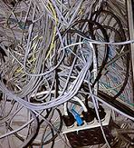
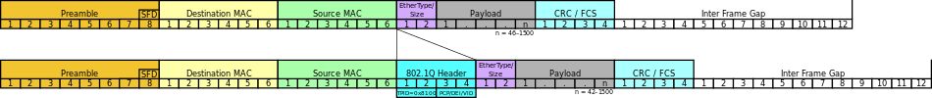
VLANs: motivation (Cont’)
In regular network, every time a user changes department, or when any other topological change is required, the network administrator should physically re-cable
Fig taken from
cablesandchipsnationalpromotions.com
Fig taken from
www.clipartbest.com
Notes:
The Ethernet header contains optionally a VLAN tagVirtual Local Area Network allows

Slide 74
802.1Q VLAN frame format
type
preamble
dest.
address
source
address
data (payload)
CRC
802.1 frame
type
preamble
dest.
address
source
address
data (payload)
CRC
802.1Q frame
2-byte Tag Protocol Identifier
(value: 81-00), which should
be unused by the Type field
Recomputed
CRC
Tag Control Information: 12 bit VLAN ID field,
3 bit priority field (like IP TOS)

Slide 75
VLANs
port-based VLAN: switch ports grouped (by switch management software) so that single physical switch ……
Virtual Local
Area Network
1
7
9
15
2
8
10
16
switch(es) supporting VLAN capabilities can be configured to define multiple virtual LANS over single physical LAN infrastructure.
…
…
Electrical Engineering
(VLAN ports 1-8)
Computer Science
(VLAN ports 9-15)
… operates as multiple virtual switches
1
7
9
15
2
8
10
16
…
…
Electrical Engineering
(VLAN ports 1-8)
Computer Science
(VLAN ports 9-16)

Slide 76

Port-based VLAN
router
traffic isolation: frames to/from ports 1-8 can only reach ports 1-8
1
7
9
15
2
8
10
16
Dynamic membership: ports can be dynamically assigned among VLANs
…
…
Electrical Engineering
(VLAN ports 1-8)
Computer Science
(VLAN ports 9-15)
Forwarding between VLANS: done via routing (just as with separate switches)
  In practice, vendors sell a combined switch + router

Slide 77
VLANS spanning multiple switches
1
7
9
15
1
3
5
7
2
8
10
16
2
4
6
8
…
…
Electrical Engineering
(VLAN ports 1-8)
Computer Science
(VLAN ports 9-15)
Ports 2,3,5 belong to EE VLAN
Ports 4,6,7,8 belong to CS VLAN
trunk port: carries frames between VLANS defined over multiple physical switches
  frames forwarded within VLAN between switches carry a VLAN ID
  802.1Q protocol adds/removed additional header fields for frames forwarded between trunk ports

Slide 78
Appendix: cross-layers issues
Data Center Networks
A day in the life of a web request

Slide 79


Data center networks
~100K hosts, closely coupled, in close proximity:
  e-business (e.g. Amazon)
  content-servers (e.g., YouTube, Akamai, Apple, Microsoft)
  search engines, data mining (e.g., Google)
challenges:
  multiple applications, each serving massive numbers of clients
  Load balancing
  Real time
  North-south traffic
A data center of Microsoft

Slide 80
Data center networks
load balancer: application-layer routing
receives external client requests
directs workload within data center
returns results to external client (hiding data center internals from client)
Internet
Border router
Load
balancer
Load
balancer
Access router
B
Tier-1 switches
A
C
Tier-2 switches
TOR switches
Server racks
1
2
3
4
5
6
7
8

Slide 81
Data center netw.: load balancing
The supermarket alg’
The power of two choices
Internet
Border router
Load
balancer
Load
balancer
Access router
B
Tier-1 switches
A
C
Tier-2 switches
TOR switches
Server racks
1
2
3
4
5
6
7
8

Slide 82
Data center networks: fat tree
Rich interconnection among switches, racks
  increased throughput
  increased reliability
Reduce topology to save energy [ElasticTree]
  reversing the supermarket
Tier-1 switches
Tier-2 switches
TOR switches
Server racks
1
2
3
4
5
6
7
8

Slide 83
Data center networks: dynamic conf’
Migration used for
  Fixes / maintenance
  Bringing VMs of the same client closer to each other
  Shutting down parts of the network
Addressing may be based on pseudo-MAC addresses, possibly positional [PortLand]
Tier-1 switches
Tier-2 switches
TOR switches
Server racks
1
2
3
4
5
6
7
8

Slide 84
Appendix: cross-layers issues
Data Center Networks
A day in the life of a web request

Slide 85
Synthesis: a day in the life of a web request
putting-it-all-together: synthesis!
  goal: identify, review, understand protocols (at all layers) involved in seemingly simple scenario: requesting www page
  scenario: student attaches laptop to campus network, requests/receives www.google.com

Slide 86




A day in the life: scenario
browser
DNS server
Comcast network
68.80.0.0/13
school network
68.80.2.0/24
web page
web server
Google’s network
64.233.160.0/19
64.233.169.105

Slide 87
A day in the life… connecting to the Internet
DHCP
DHCP
UDP
IP
Eth
Phy
connecting laptop needs to get its own IP address, addr of first-hop router, addr of DNS server: use DHCP
DHCP
DHCP
DHCP
DHCP
DHCP request encapsulated in UDP, encapsulated in IP, encapsulated in 802.3 Ethernet
DHCP
DHCP
UDP
IP
Eth
Phy
DHCP
DHCP
DHCP
DHCP
router
(runs DHCP)
Ethernet frame broadcast (dest: FFFFFFFFFFFF) on LAN, received at router running DHCP server
Ethernet demuxed to IP demuxed, UDP demuxed to DHCP

Slide 88
A day in the life… connecting to the Internet
DHCP
DHCP
UDP
IP
Eth
Phy
DHCP server formulates DHCP ACK containing client’s IP address, IP address of first-hop router for client, name & IP address of DNS server
DHCP
DHCP
DHCP
encapsulation at DHCP server, frame forwarded (switch learning) through LAN, demultiplexing at client
DHCP
DHCP
UDP
IP
Eth
Phy
DHCP
DHCP
DHCP
router
(runs DHCP)
DHCP
DHCP client receives DHCP ACK reply
Client now has IP address, knows name & addr of DNS
server, IP address of its first-hop router

Slide 89
A day in the life… ARP (before DNS, before HTTP)
DNS
UDP
IP
Eth
Phy
before sending HTTP request, need IP address of www.google.com: DNS
DNS
DNS
DNS
ARP
ARP query
DNS query created, encapsulated in UDP, encapsulated in IP, encapsulated in Eth. To send frame to router, need MAC address of router interface: ARP
ARP
ARP reply
Eth
Phy
router
(runs DHCP)
ARP query broadcast, received by router, which replies with ARP reply giving MAC address of router interface
client now knows MAC address of first hop router, so can now send frame containing DNS query

Slide 90
A day in the life… using DNS
DNS
DNS
UDP
IP
Eth
Phy
DNS
DNS server
DNS
UDP
IP
Eth
Phy
DNS
DNS
DNS
DNS
DNS
DNS
DNS
Comcast network
68.80.0.0/13
IP datagram forwarded from campus network into comcast network, routed (tables created by RIP, OSPF, IS-IS and/or BGP routing protocols) to DNS server
router
(runs DHCP)
IP datagram containing DNS query forwarded via LAN switch from client to 1st hop router
demux’ed to DNS server
DNS server replies to client with IP address of www.google.com

Slide 91
A day in the life…TCP connection carrying HTTP
HTTP
HTTP
TCP
IP
Eth
Phy
SYNACK
SYN
SYNACK
SYN
SYNACK
SYN
SYN
to send HTTP request, client first opens TCP socket to web server
router
(runs DHCP)
TCP SYN segment (step 1 in 3-way handshake) inter-domain routed to web server
TCP
IP
Eth
Phy
SYNACK
SYN
SYNACK
SYN
SYNACK
SYNACK
SYN
web server responds with TCP SYNACK (step 2 in 3-way handshake)
web server
64.233.169.105
TCP connection established!

Slide 92
A day in the life… HTTP request/reply
HTTP
HTTP
TCP
IP
Eth
Phy
web page finally (!) displayed
HTTP
HTTP
HTTP
HTTP
HTTP
HTTP
HTTP
HTTP
HTTP request sent into TCP socket
router
(runs DHCP)
IP datagram containing HTTP request routed to www.google.com
HTTP
HTTP
TCP
IP
Eth
Phy
HTTP
HTTP
HTTP
web server responds with HTTP reply (containing web page)
HTTP
web server
64.233.169.105
IP datagram containing HTTP reply routed back to client

Slide 93
Course conclusion
Appreciation
Higher degrees
Blood pipe

