Slide 1


Introduction to Computer Networks
Practice #1
Hasidi Netanel

Slide 2
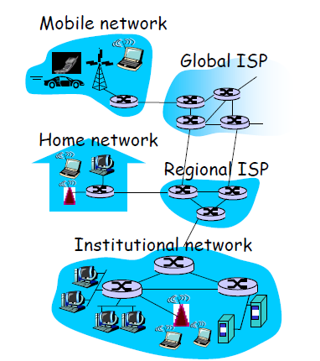
What is the Objective of Networking?
Enable communication between applications on different computers.
Two computers are said to be interconnected if they are able to exchange information.
The Internet is a collection of interconnected networks.
End systems are connected together by a network of communication links.
End systems access the internet thorough ISPs.

Slide 3
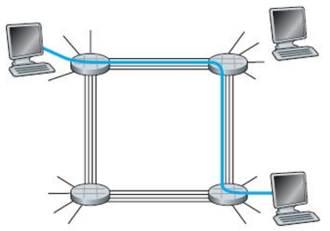
2 ways to share:
Circuit Switching
It’s the method used by telephone network.
All resources (e.g. communication links) needed by call dedicated to that call for duration
A call has three phases:
1. Establish circuit from end-to-end (“dialing”).
2. Communicate.
3. Close circuit (“tear down”).
“Wasteful” – dedicated circuits are idle during silent periods.

Slide 4
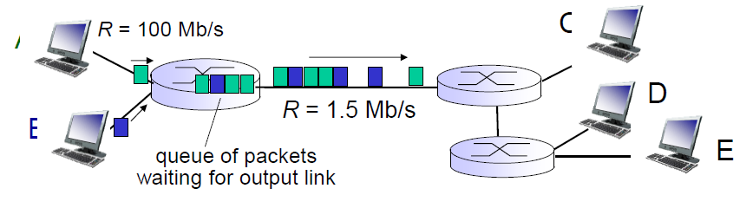
Packet Switching
Used in the Internet
Data is sent in Packets (header contains control info, e.g., source and destination addresses)
Per-packet routing
At each node the entire packet is received, stored, and then forwarded (store-and-forward)
Packets in a flow may not follow the same path
No resources are allocated
Header
Data
Queuing and loos:
if arrival rate (in bits) to links exceeds transmission rate of link for a period of time:
- packet will queue, wait to be transmitted on link.
- packets can be dropped (lost) if memory (buffer) fills up.

Slide 5
Differences Between Circuit & Packet Switching
Circuit-switching | Packet-Switching
Guaranteed capacity | No guarantees (best effort)
Capacity is wasted if data is bursty | More efficient
Before sending data establishes a path | Send data immediately
All data in a single flow follow one path | Different packets might follow different paths
No reordering; constant delay; no pkt drops | Packets may be reordered, delayed, or dropped

Slide 6
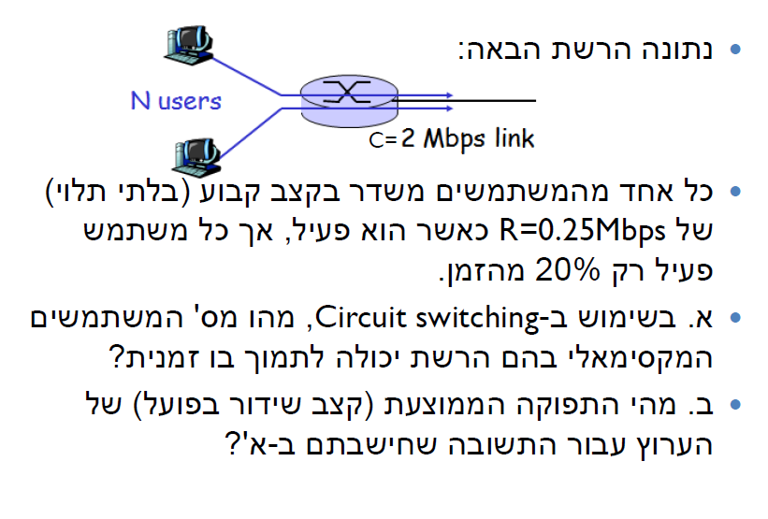
Q1
256kbps

Slide 7
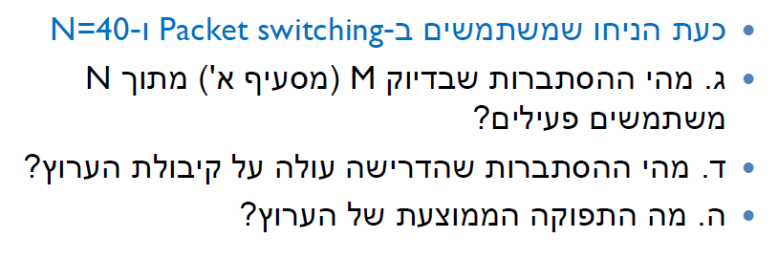
Q1

Slide 8
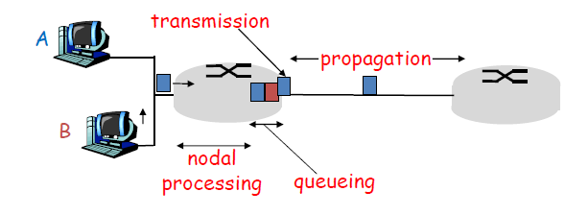
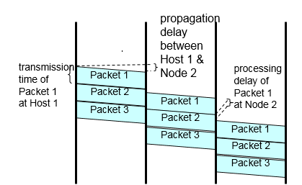

Types of Delay
Processing Delay – the time to examine the packet and determine where to direct it.
Queuing Delay- the time that packet can wait if the traffic is heavy and other packets are also waiting to be transmitted.
Transmission Delay- the amount of time it requires to push all the packet’s bits into the link.
depends on the Bandwidth (R) and the length of the packet (L)

Slide 9



Types of Delay
Propagation Delay- the time since all the bits pushed into the link till all the packet propagate to the end of the link.
depend on the physical medium of the link (fiber optics, twisted pair..) and on its range.

Slide 10
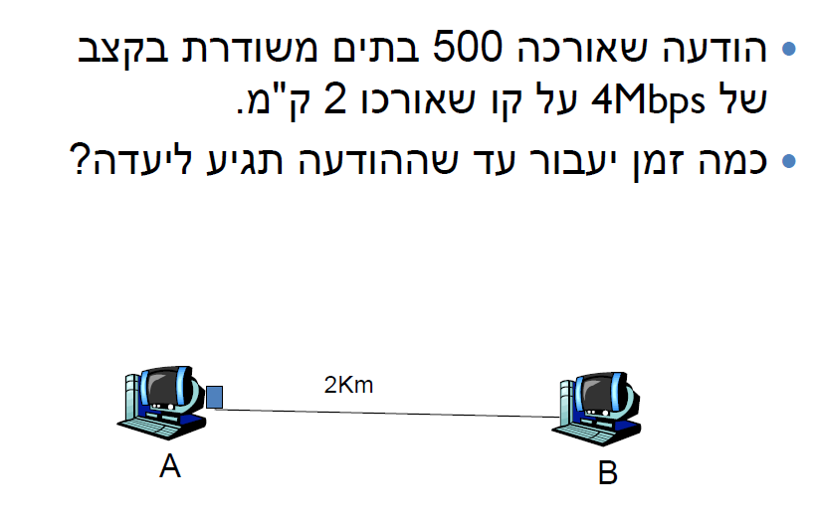
Q2

