Slide 1


Introduction to Computer Networks
Practice #10
Hasidi Netanel

Slide 2
Today:
Link State.
Distance Vector.
Application
Transport
Network
Link
Physical

Slide 3
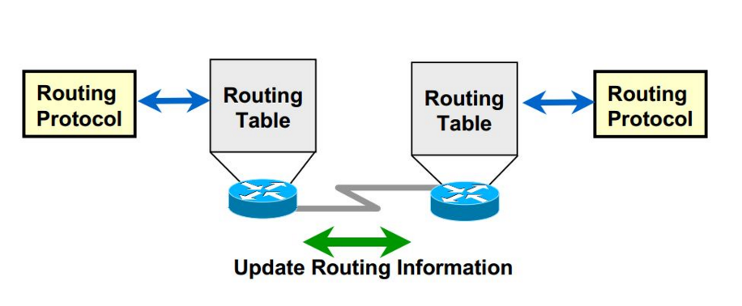
Routing Algorithms
The purpose of a routing algorithm is to find a “good” path from source router to destination router.
Need to consider also policy issues.
A global routing algorithm computes the least-cost path between a source and destination using complete, global knowledge about the network (such as link state).
In a decentralized routing algorithm, the calculation of the least-cost path is carried out in an iterative, distributed manner. (such as distance vector)

Slide 4
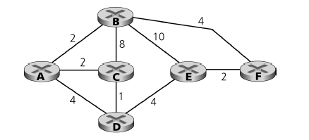
Link State
Is a global algorithm – every node has the net topology and link costs known to all nodes.
Computes least cost paths from one node (‘source”) to all other nodes.
Iterative: after k iterations, know least cost path to k destination.
כיצד מחשב האלגוריתם את המסלול הקל ביותר מקודקוד D (למשל) לכל שאר הצמתים ברשת?
Notes:
ייצוג של הרשת כגרף. הקודקודים הם הראוטרים והצלעות זה המחיר במעבר

Slide 5

Distance Vector
Each node maintains a Vector which estimate the distances to all other nodes.
It’s Distributed - each node receives some information from one or more of its directly attached neighbors, performs a calculation, and then distributes the results of its calculation back to its neighbors.
It is iterative - the process continues on until no more information is exchanged between neighbors.
Is asynchronous in that it does not require all of the nodes to operate in lockstep with each other.
When a node x receives new DV estimate from neighbor, it updates its own DV using B-F equation:
IF there was a change in the DV, the node send it’s new DV to it’s neighbors.
An iteration can also caused by local link cost change.
Notes:
Distribued- כל נתב מקבל אינפורמציה מכל השכנים הקרובים אליו, הוא מבצע חישוב ואז מחזיר את החישוב שלו לשכנים.
iterative- התהליך הוא איטרטיבי. ממשיכים בחישובים עד להתכנסות

Slide 6
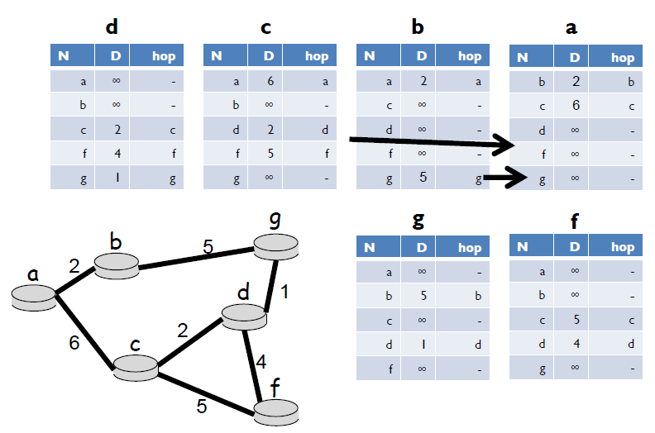
Distance Vector
Initiation Stage:

Slide 7
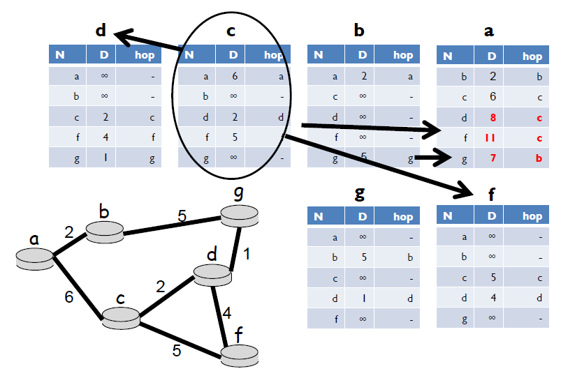
Distance Vector
C and B send their DV, causing a DV update of node A.

Slide 8
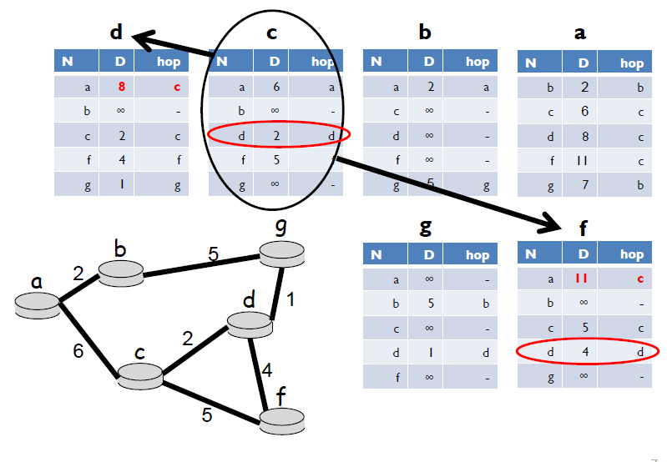
Distance Vector
C send its DV to D and F, causing their DV update.

Slide 9
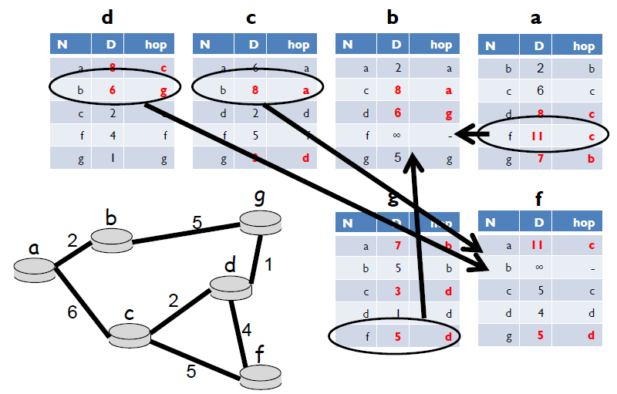
Distance Vector
After first iteration.

Slide 10
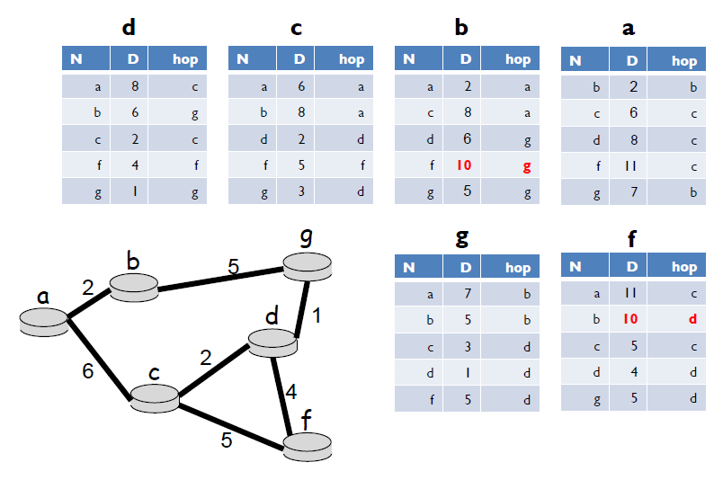
Distance Vector
After second iteration.
מדוע באיטרציה השנייה f "מכיר" את b ?
Notes:
G שלח ל B וגרם לו להכיר את f, לפני האיטרציה הראשונה הוא לא הכיר אותו.
G שלח ל D וגרם לו להכיא את B, כך D מגלה ל F באיטרציה השניה על B

Slide 11
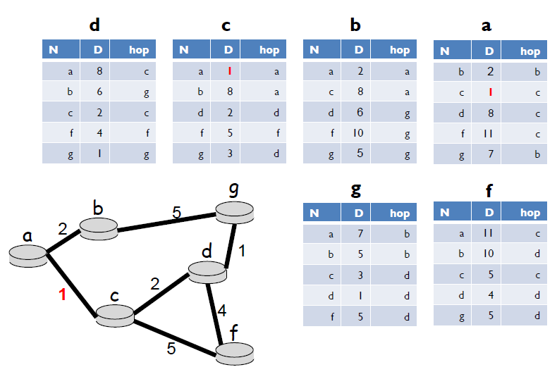
Distance Vector
GNTF – Good News Travels Fast:
We decrease an edge and see that after 2 iterations distances converge.
מי שולח את הוקטור שלו בעקבות העדכון?
Notes:
גם A וגם C

Slide 12
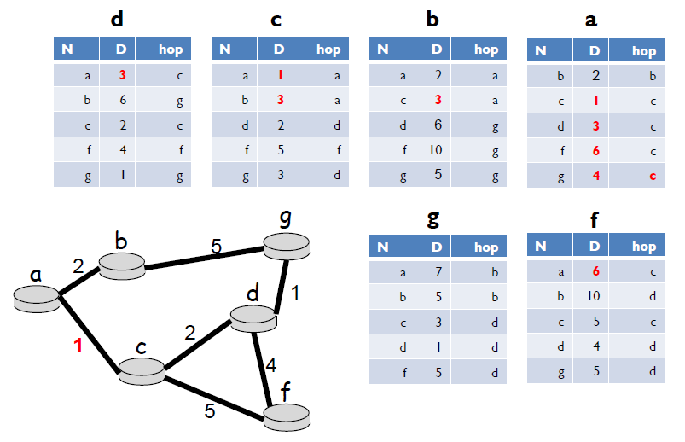
Distance Vector
GNTF – Good News Travels Fast:
After second iteration.
Notes:
לחפש בטבלאות שהשתנו רק את הצמתים ששלחו את הוקטור כאילו שהם גרמו לשינוי.

Slide 13
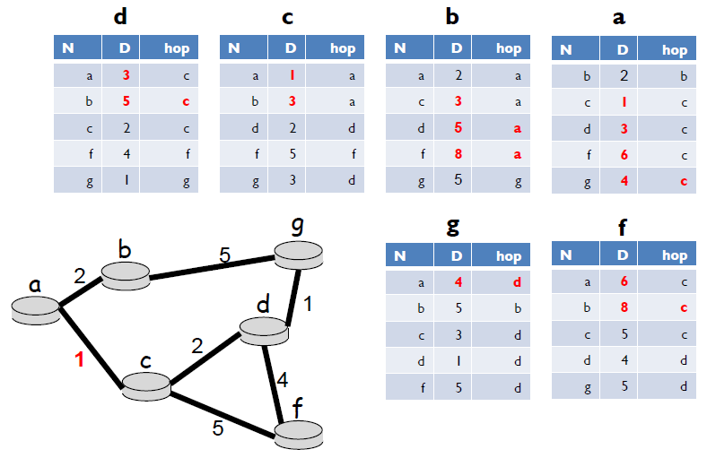
Distance Vector
GNTF – Good News Travels Fast:
After second iteration.

Slide 14
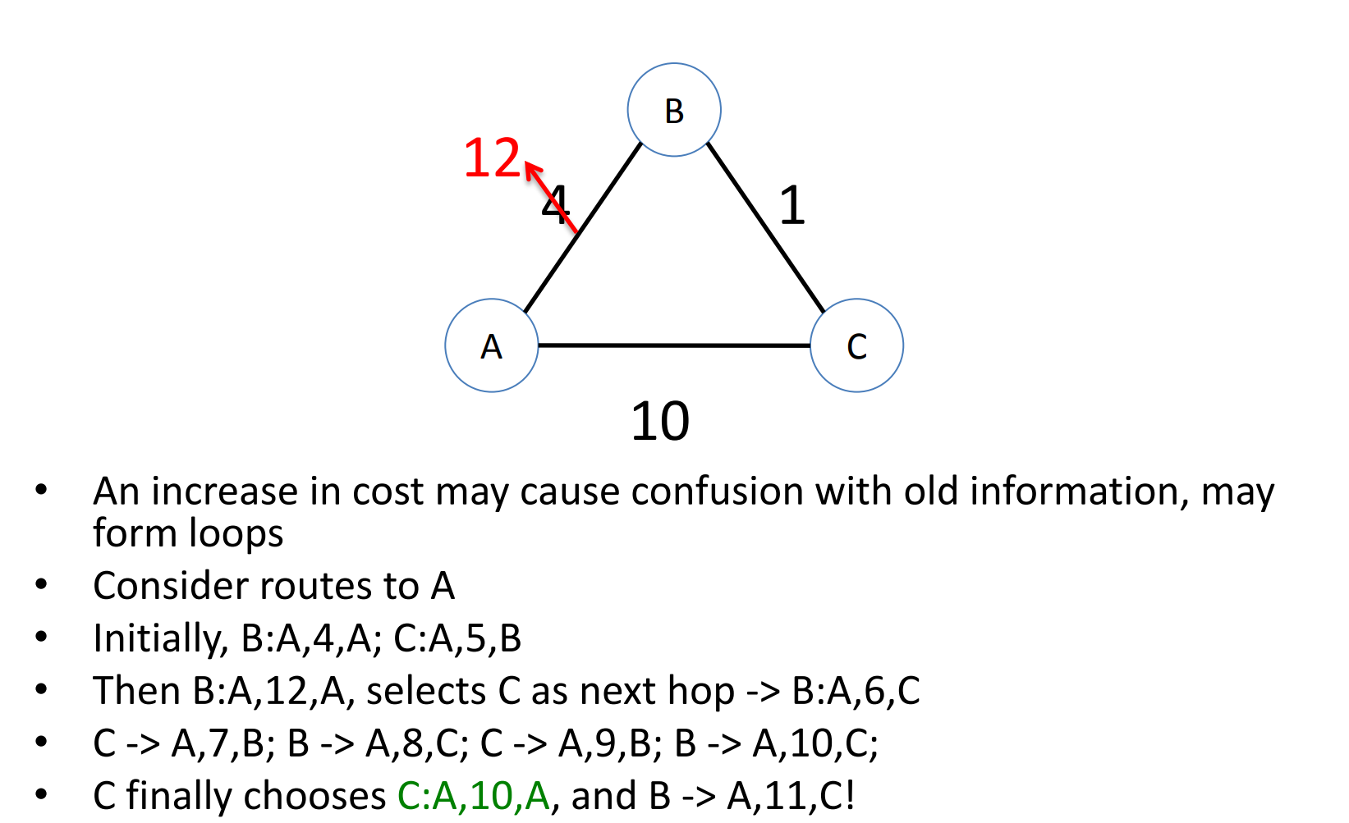
Distance Vector
BNTS– Bad News Travels Slow.
Known as Routing Loop Problem.

Slide 15
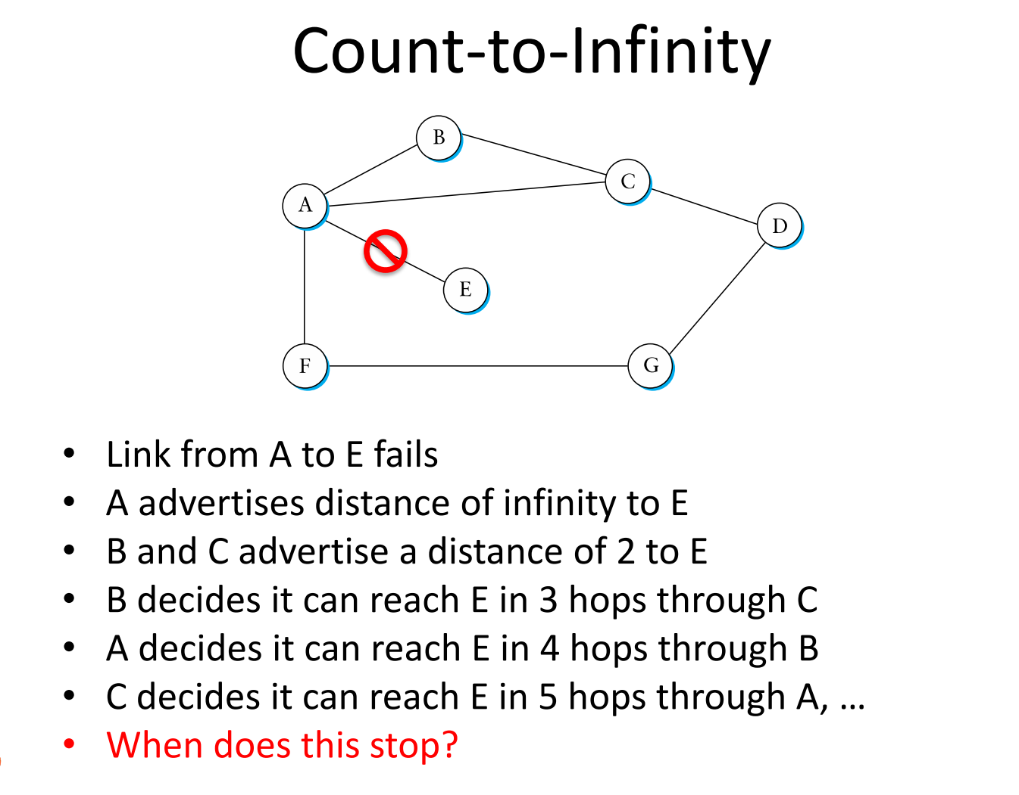
Distance Vector
BNTS– Bad News Travels Slow.
Can lead to Count to infinity problem - occurs when a node is removed from the network and the “gateway” to the removed node believes it can still reach it via a neighbor (who unknowingly is using himself as the access route).

Slide 16
Distance Vector
BNTS– Bad News Travels Slow.
Solutions:
Split Horizon with Poisoned reverse: If Z routes through Y to get to X: tells Y its (Z’s) distance to X is infinite (so Y won’t route to X via Z) . Doesn't always solve the count to infinity problem
Defining Infinity (RIP defines 16 as an infinity) – when reaching to this number we can conclude that the node isn’t reachable.
Notes:
כש-Z רוצה לשלוח הודעה ל-X דרך Y אז נגיד ל-Y שהמרחק בין Z ל-X הוא אינסוף. כך שבעצם נדאג ש-Y לא ינתב את ההודעה ל-X דרך Z.

