Slide 1


Introduction to Computer Networks
Practice #2
Hasidi Netanel

Slide 2
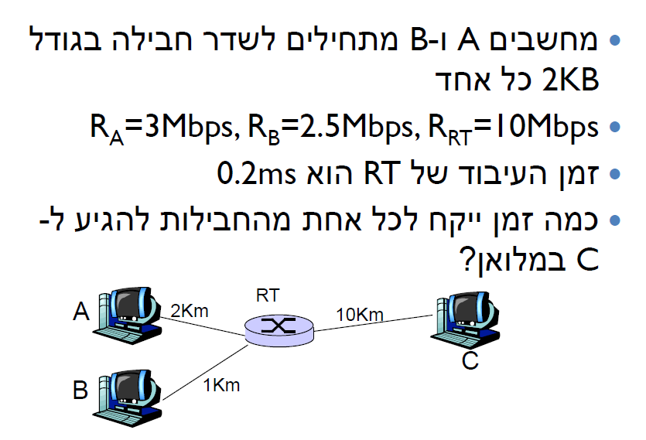
Q3

Slide 3
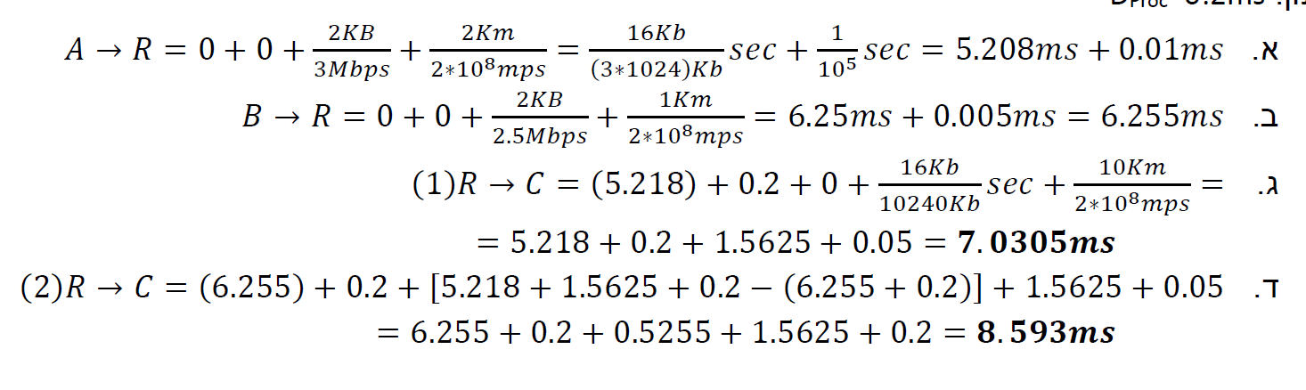
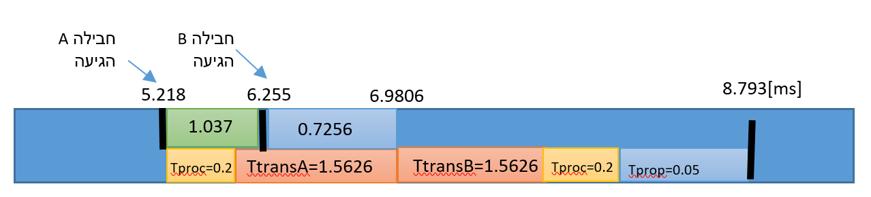

Slide 4
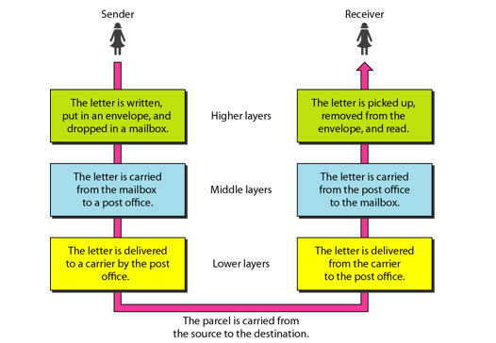
Why layering?
We use the concept of layers in our daily life.
let us consider two friends who communicate through postal mail. The process of sending a letter to a friend would be complex if there were no services available from the post office.
Using explicit structure allows identification & relationship of complex system’s pieces.
  change of implementation of layer’s service transparent to rest of system.

Slide 5
Protocols
  A protocol is an agreement between the communicating parties on how communication is to proceed.
  Protocols are set of rules.
  A protocol defines the format and the order of messages exchanged between two or more communicating entities as well as the actions taken on the transmission and/or receipt of a message or other event.
  Questions a protocol can answer:
  1. What do you want to do? (Application).
  2. Where are you going? (Addressing).
  3. How do you get there? (Media types).
  4. Did you get there? (Acknowledgments, Error checking).

Slide 6
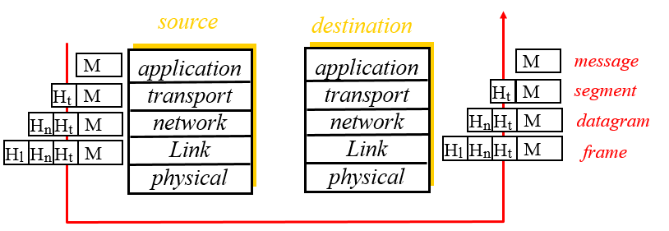
Protocol Layering
  To reduce their design complexity, most networks are organized as a stack of layers or levels, each one built upon the one below it.
  The purpose of each layer is to offer certain services to the higher layers, shielding those layers from the details of how the offered services are actually implemented.
  Encapsulation
  the process of each layer at the sending computer adding its own header information, in the form of meta-data to the actual payload (the data from the layer above). Ex: the network layer inserts a header with source and destination IPs.

Slide 7

The Application Layer
Responsibility:
  Enables users to access the network.
  Providing user interfaces and services.
  Providing understandable language between two applications on multiple end systems.
Issues:
  appropriate selection of “type of service”.
  Data encryption, conversion and compression.
  Authentication.

Slide 8
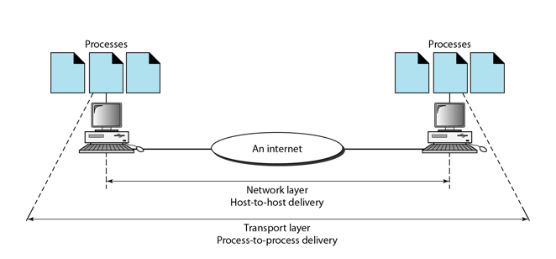
The Transport Layer
Responsibilities:
  provides virtual end-to-end links between peer processes- delivering messages from one process to another.
Issues:
  error detection.
  reliable communication.
  packets reordering.
  end-to-end flow control.

Slide 9
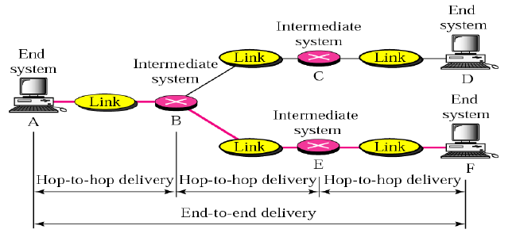
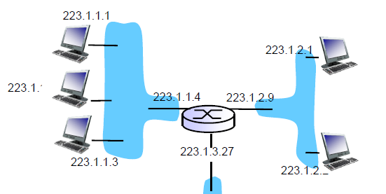
The Network Layer
Responsibilities:
  Pass packets from one local Network to another- from the source host to the destination host.
  fragmentation & reassembly
  translation between different network types.
Issues:
  path selection between end-systems (routing).
  Error reporting (status messages).

Slide 10
The Data Link Layer
Responsibility:
  Connect machines on the same networks.
  Framing (dividing data into chunks) and moving it from one hop (node) to another.
  Controls how data is placed into the media and is received from the media- who can transmit, when and for how long.
Issues:
  Reliable Delivery
  Flow Control
  Error Detection
  Error Correction
  Half/Full Duplex
10110110101
01100010011
10110000001

Slide 11
The Physical Layer
Responsibility:
  Encode binary digits into signals and transmit it over a communication channel.
Issues:
  mechanical and electrical interfaces
  time per bit
  distances

Slide 12
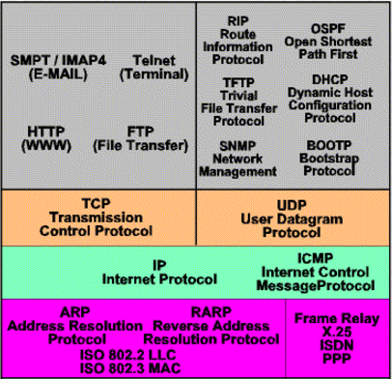
Transfer Units Types
Protocols Examples
Application Layer
Messages
Transport Layer
Segments
Network Layer
Datagrams
Data Link Layer
Frames

Slide 13
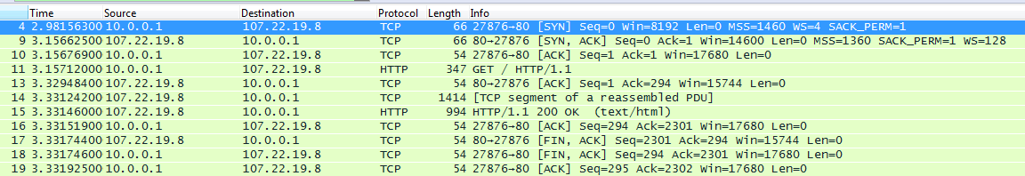
Example Wireshark

Slide 14

  An end-system processes up to which layer?
  A router processes up to which layer?
  A link-layer switch processes up to which layer?

Slide 15
Keep in mind
Data-Link: communication between machines on the same network (two adjacent nodes).
Network: communication between machines on possibly different networks.
Transport: communication between processes (running on machines on possibly different networks).

