Slide 1
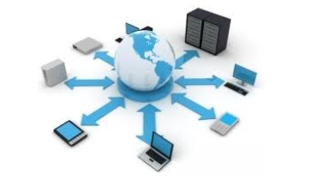

Introduction to Computer Networks
Practice #3
Hasidi Netanel

Slide 2
Today:
Network Applications Architectures (Client Server vs. P2P).
Http protocol.
Web Cache (Proxy Server).
Application
Transport
Network
Link
Physical

Slide 3
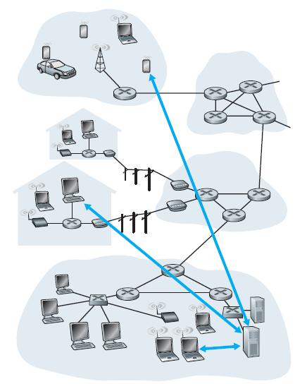
Client-Server
There is an always-on host called Server, which services requests from many other hosts, called Clients.
Client hosts can be either sometimes-on or always-on.
Servers are powerful computers and clients rely on Server for resources such as files, devices and even processing power.

Slide 4
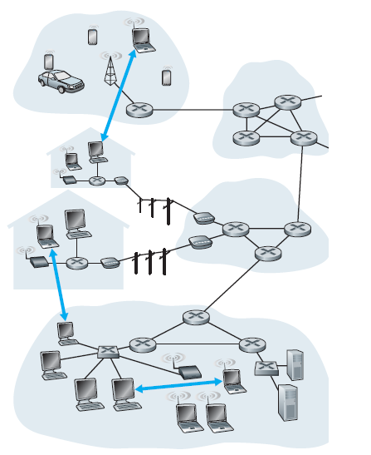
P2P (Peer to Peer)
There is minimal (or no) reliance on always-on infrastructure servers.
There is direct communication between pairs of intermittently connected hosts, called peers.
The peers communicate without passing through a dedicated server.
P2P architecture is self-scalability- one does not only requesting service but also adds service capacity to the system by distributing files to other peers.

Slide 5
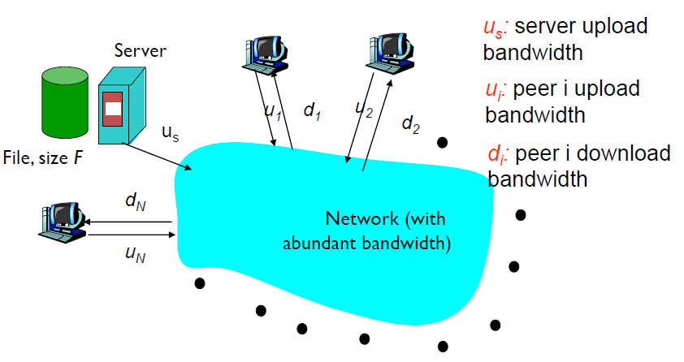



Distribute Files - Client-Sever :
Minimum Time Required to the Server to send one copy of the file
$${ \frac{F}{u}}_{s}$$
$${ \frac{F}{d}}_{i}$$
Minimum Time Require to one Client to download the file
Total time Require to distribute the files
$$\max{(\frac{N⋅F}{u_{s}}}, \frac{F}{min⁡(d_{i})})$$

Slide 6

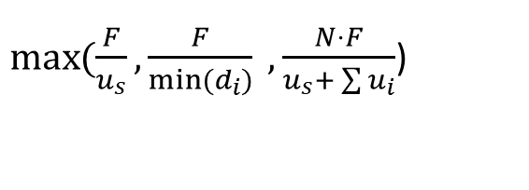


Distribute Files – P2P :
Minimum Time Required to the Server to send the first copy of the file
$${ \frac{F}{u}}_{s}$$
Minimum Time Require to the slowest Client to download the file
$$\frac{F}{min⁡(d_{i})}$$
Minimum time distributing the files
$$\frac{N⋅F}{u_{s}+ \sum{u_{i}}}$$
Minimum total time Require to distribute the files
$\max{(\frac{F}{u_{s}}}, \frac{F}{min⁡(d_{i})} , \frac{N⋅F}{u_{s}+ \sum{u_{i}}}$)

Slide 7
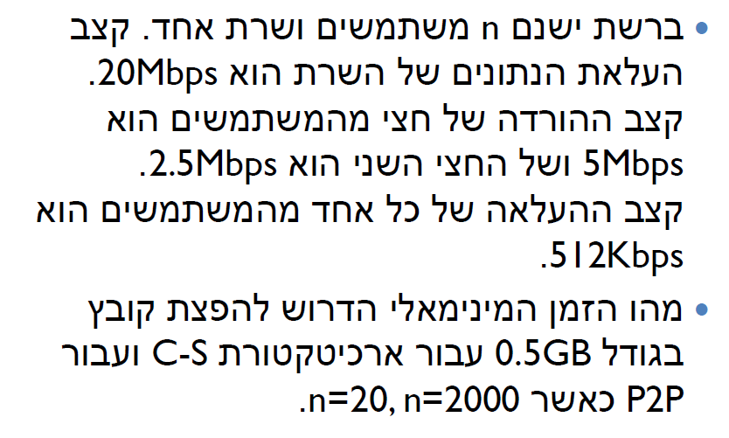
Q1

Slide 8

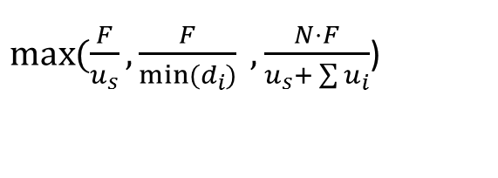
C-S:
$$\max{(\frac{N⋅F}{u_{s}}}, \frac{F}{min⁡(d_{i})})$$
P2P:
$\max{(\frac{F}{u_{s}}}, \frac{F}{min⁡(d_{i})} , \frac{N⋅F}{u_{s}+ \sum{u_{i}}}$)

Slide 9
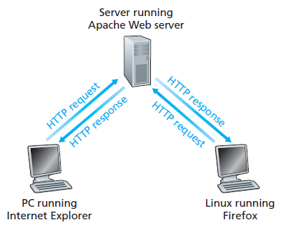
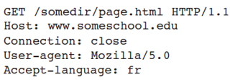
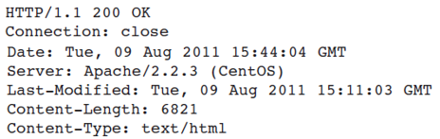
HTTP Protocol
HTTP defines how Web clients request Web pages from Web servers and how servers transfer Web pages to clients.
HTTP is implemented in two programs: a client program and a server program. The client program and server program, executing on different end systems, talk to each other by exchanging HTTP messages.
HTTP uses TCP as its underlying transport protocol.
HTTP Request Message
HTTP Response Message
Notes:
הוא פרוטוקול תקשורת שנועד להעברת דפי HTMLואובייקטים שהם מכילים (כמו תמונות, קובצי קול, סרטוני פלאש וכו') ברשת האינטרנט וברשתות אינטראנט. הפרוטוקול פועל בשכבת היישום של מודל ה-OSI ובשכבת היישום של מודל TCP/IP. שרתי HTTP הם שרתי התוכן המרכזיים ברשת האינטרנט ודפדפנים הם תוכנות הלקוח הנפוצות ביותר לפרוטוקול HTTP.

Slide 10
Web Cache (Proxy Server)
Is a network entity that satisfies HTTP requests on the behalf of an origin Web server.
The Web cache has its own disk storage and keeps copies of recently requested objects in this storage.
A user’s browser can be configured so that all of the user’s HTTP requests are first directed to the Web cache.
Once a browser is configured, each browser request for an object is first directed to the Web cache.
What is good for:
It stores common objects near to the client and reduce the network traffic which allow more quick services. Also it reduce the Web traffic in the internet as a whole.
Notes:
שדה entity tag
An ETag is an opaque identifier assigned by a web server to a specific version of a resource found at a URL. If the resource representation at that URL ever changes, a new and different ETag is assigned.

Slide 11
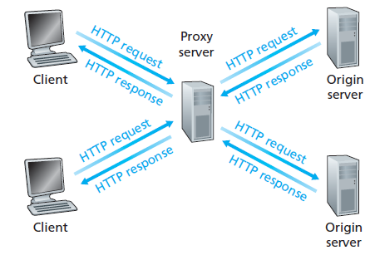
Web Cache (Proxy Server)
The Process:
The browser establishes a TCP connection to the Web cache and sends an HTTP request for the object to the Web cache.
The Web cache checks to see if it has a copy of the object stored locally. If it does, the Web cache returns the object within an HTTP response message to the client browser.
If the web cache does not have the object it opens a TCP connection to the origin server and sends an HTTP request for the object.
The origin server sends the object to the web cache which stores a copy on its local storage.
The web cache then send the object within an HTTP response message to the client browser.

Slide 12
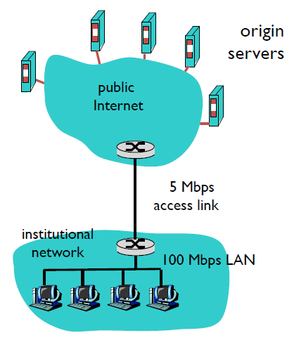
File Distribution Delays
Internet Delay – the amount of time it takes from when the router on the Internet side of the access link forwards an HTTP request until it receives the response.
Access Delay – the time it takes to transfer files from the internet to the local network.
LAN Delay - the time it takes to transfer files from the local network to the local host.
Note : all those delays including all the delays we’ve studied in practice #1.

Slide 13
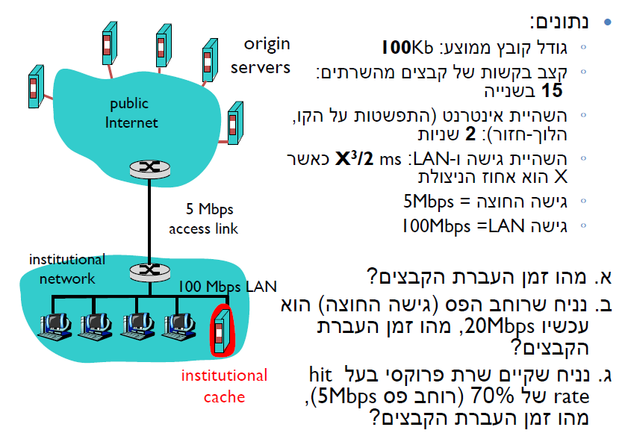
Q2
B+0.5 sec כאשר
B זמן השידור T trans. ב LAN אין 0.5

Slide 14
B+0.5 sec כאשר
B זמן השידור T trans . ב LAN אין 0.5

