Slide 1
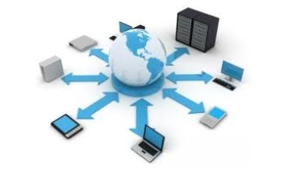

Introduction to Computer Networks
Practice #4
Hasidi Netanel

Slide 2
Today:
Persistent & Non-Persistent Http.
The Connection between Application & Transport Layers.
DNS Hierarchy
Wireshark.
Application
Transport
Network
Link
Physical

Slide 3
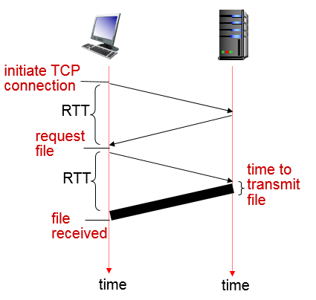
Persistent & Non-Persistent Http
RTT (Round Trip Time)
is the time it takes for a small packet to travel from client to server and then back to the client.
The RTT includes packet-propagation delays, packet queuing delays in intermediate routers and switches, and packet-processing delays

Slide 4
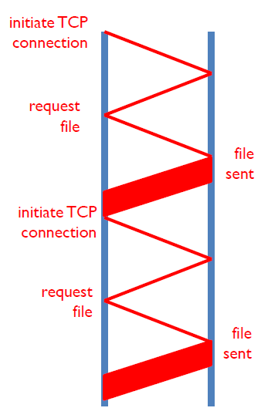

Persistent & Non-Persistent Http
Non Persistent Http
A connection which only one object sent per tcp connection.
Downloading multiple objects required multiple connections
Initiate tcp connection, transfer object and then close the connection.
Connection field = close.
Execution Time =
$$\left(2⋅RTT+T_{Trans}\right)⋅\#Files$$

Slide 5
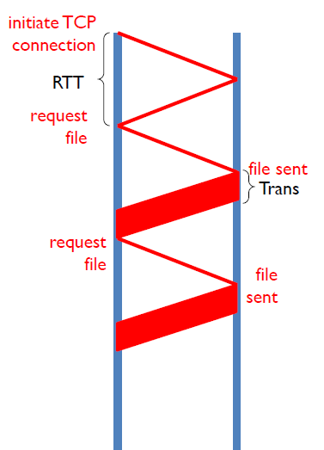
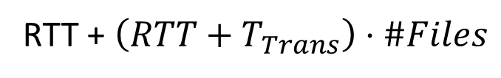
Persistent & Non-Persistent Http
Persistent Http
multiple objects can be sent over single TCP connection between client and server.
Initiate tcp connection only at the beginning, transfer objects and then close the connection.
Default field in http 1.1 .
Connection field = Keep-Alive.
Execution Time =
RTT + $\left(RTT+T_{Trans}\right)⋅\#Files$

Slide 6
The Connection between Application & Transport
Layers
The Transport Layer provide logical communication between app processes running on different hosts.
Services on application layer may need
Transport layer can provide
Data integrity – some apps need 100 % reliable transfer, some can tolerate some loss.
Reliable Transfer.
Flow Control.
Timing – low delay.
Congestion Control.
Security – encryption.
Connection Setup.
Not Provide:
Throughput.
Delay guarantees.
Bandwidth guarantees.
Notes:
Throughput- the max rate the application can process the data.
Flow control – prevents the receiver from being overwhelmed by the data.
Congestion control - prevents the network from getting congested.

Slide 7
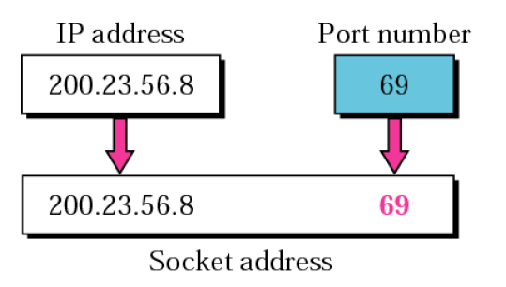
The Connection between Application & Transport
Layers
Port Number - A port number is a way to identify a specific process to which an Internet or other network message is to be forwarded.
Socket - A network socket is one endpoint in a communication flow between two programs running over a network.
Socket contains 4 tuples – source IP, Dest. IP, source Port, Dest. Port.

Slide 8
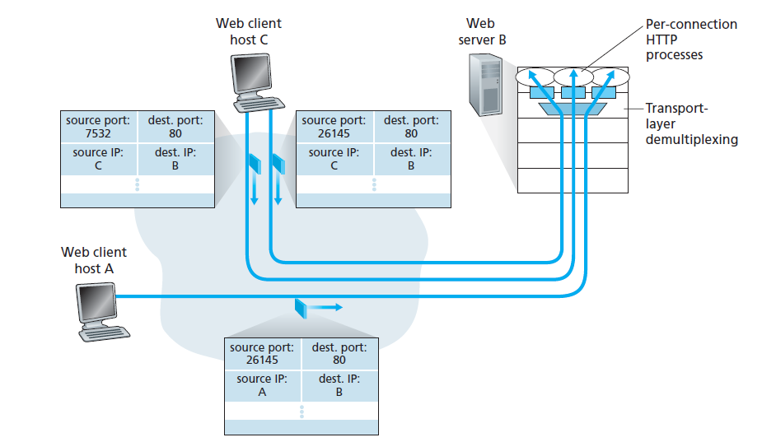
The Connection between Application & Transport
Layers
Two clients, using the same destination port to communicate with the same web server application.

Slide 9
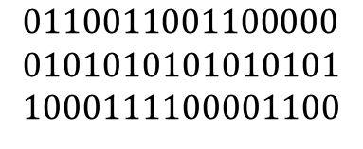

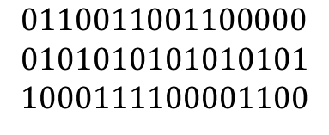






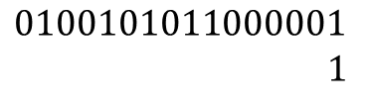
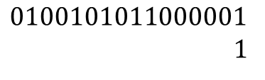
Checksum
Provide error detection.
Sender
Receiver
$$0110011001100000$$
0101010101010101
1000111100001100
$$0110011001100000$$
0101010101010101
1000111100001100
$$1$$
$$0100101011000001$$
1
$$1$$
$$0100101011000001$$
1
$$0100101011000010$$
$$0100101011000010$$
checksum
$$1011010100111101$$
Checksum:
$$1011010100111101$$
$$1111111111111111$$
No errors

Slide 10
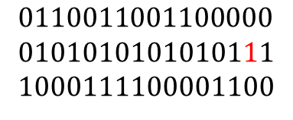




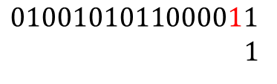

Checksum
Provide error detection.
Sender
Receiver
$$0110011001100000$$
0101010101010101
1000111100001100
$$0110011001100000$$
0101010101010111
1000111100001100
$$1$$
$$0100101011000001$$
1
$$1$$
$$0100101011000011$$
1
$$0100101011000010$$
$$0100101011000100$$
checksum
$$1011010100111101$$
Checksum:
$$1011010100111101$$
$$1$$
$$0000000000000001$$
$$1$$
$$0000000000000010$$
Error Detection !

Slide 11
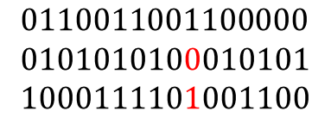
Checksum
Provide error detection.
Sender
Receiver
$$0110011001100000$$
0101010101010101
1000111100001100
$$0110011001100000$$
0101010100010101
1000111101001100
$$1$$
$$0100101011000001$$
1
$$1$$
$$0100101011000001$$
1
$$0100101011000010$$
$$0100101011000010$$
checksum
$$1011010100111101$$
Checksum:
$$1011010100111101$$
$$1111111111111111$$
No error Detection !
But there is an Error!
Notes:
TCP Checksum is a 16-bit field in TCP header used for error detection. It is computed over the TCP segment (might plus some padding) and a 12-byte TCP pseudo header created on the fly.
UDP Checksum calculation is similar to TCP Checksum computation. It’s also a 16-bit field of one’s complement of one’s complement sum of a pseudo UDP header + UDP datagram.

Slide 12
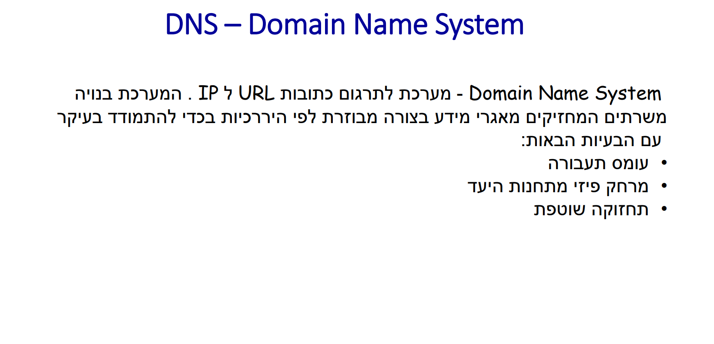

Slide 13
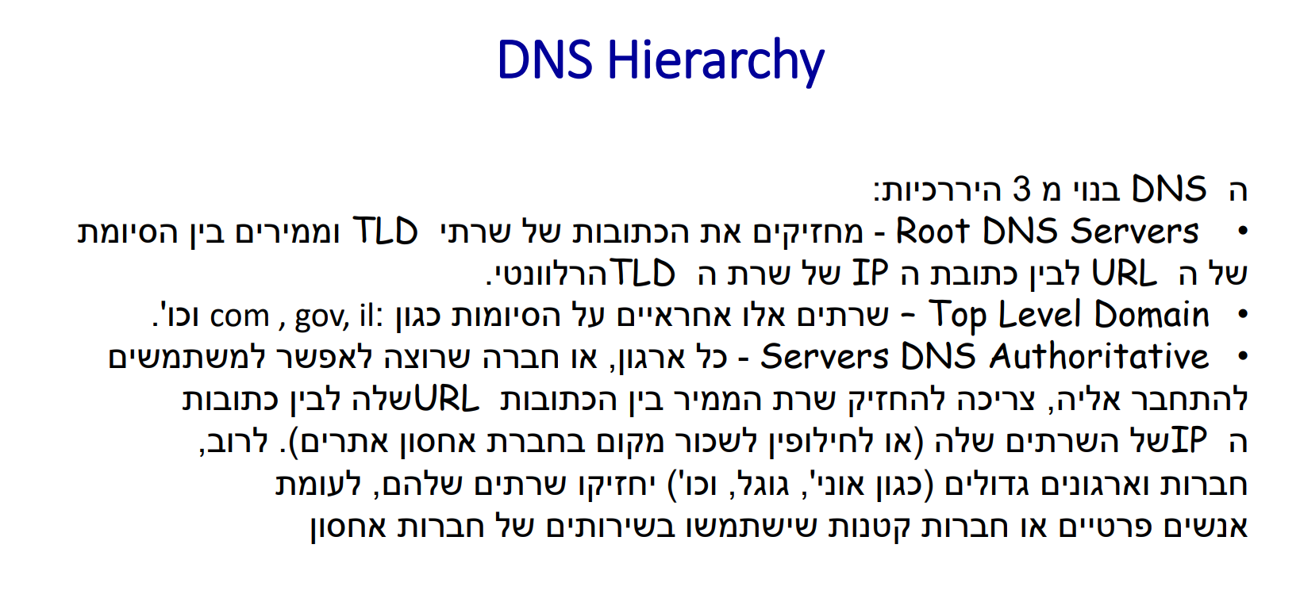

Slide 14
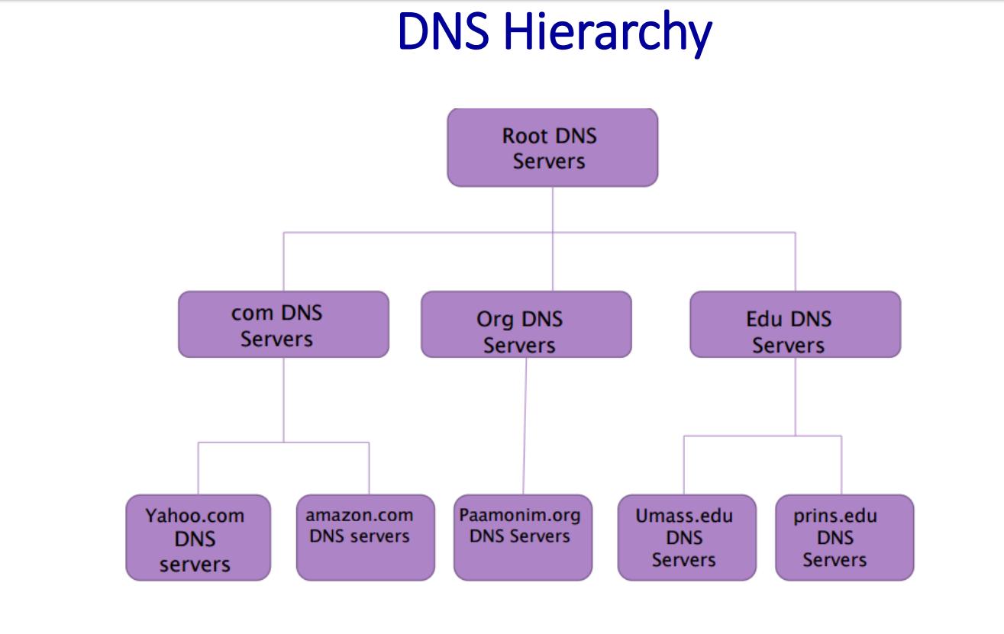

Slide 15
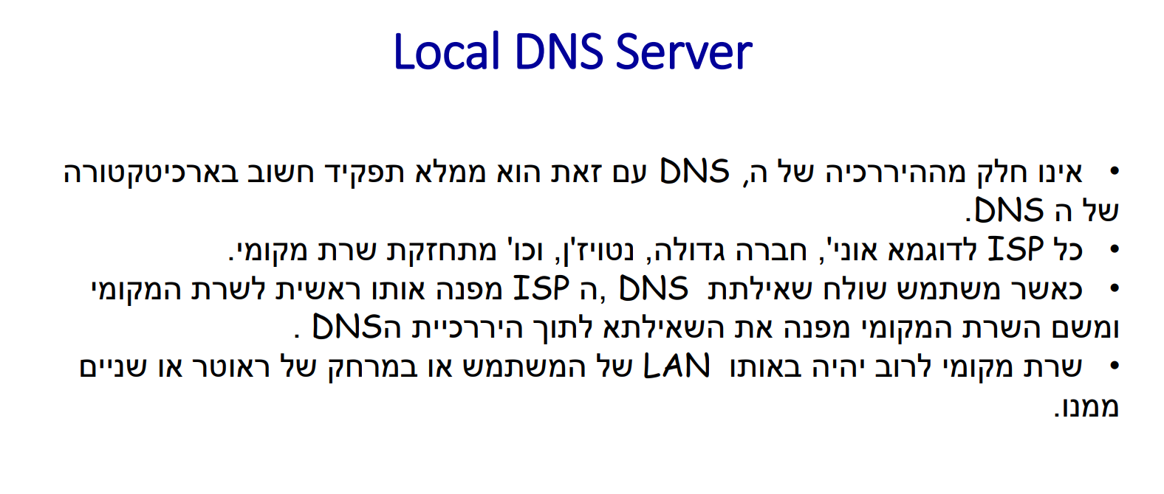

Slide 16
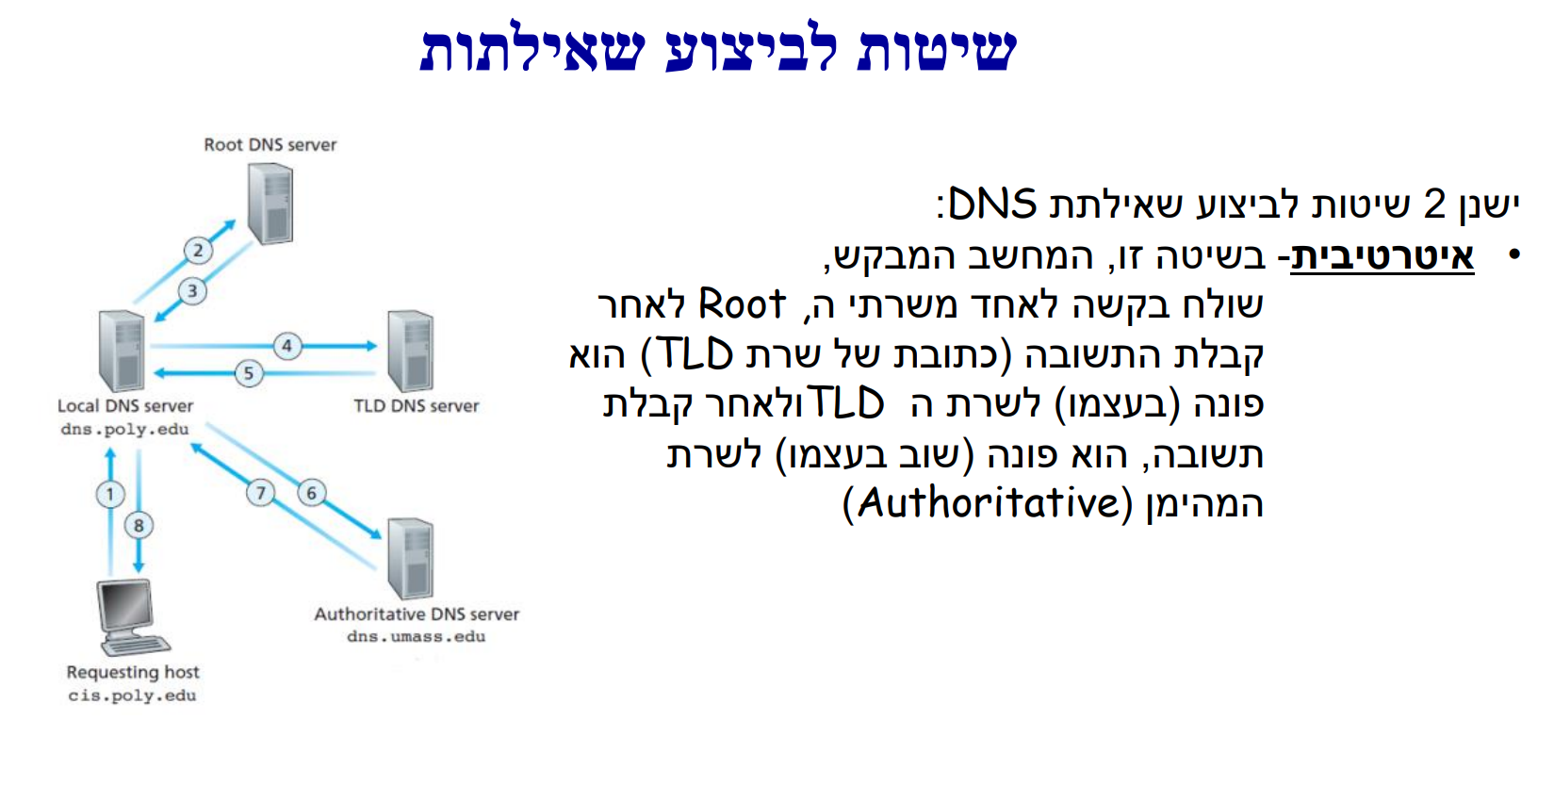

Slide 17
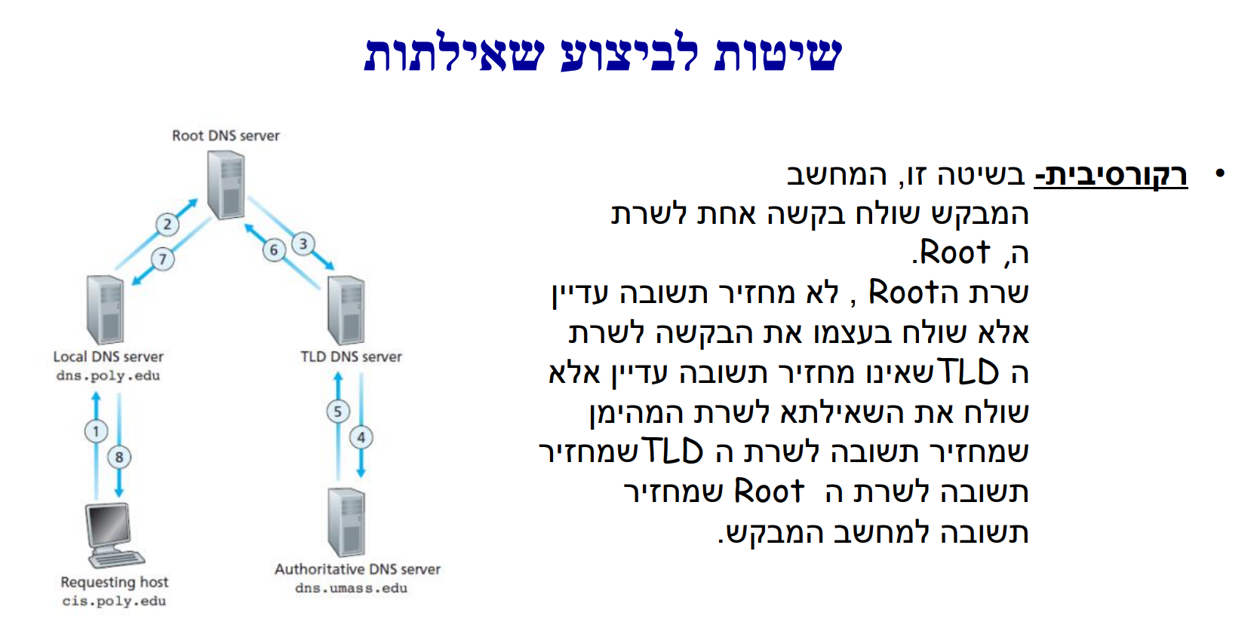

Slide 18

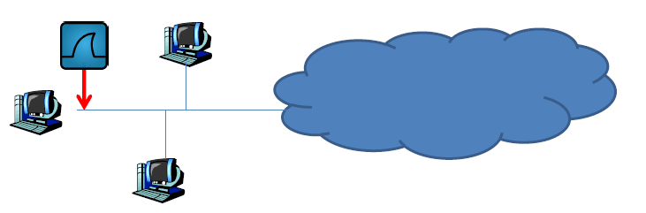
Wireshark
Wireshark is a free and open source network protocol analyzer that enables users to interactively browse the data traffic on a computer network.
it is used to analyze the structure of different network protocols and has the ability to demonstrate encapsulation.

Slide 19
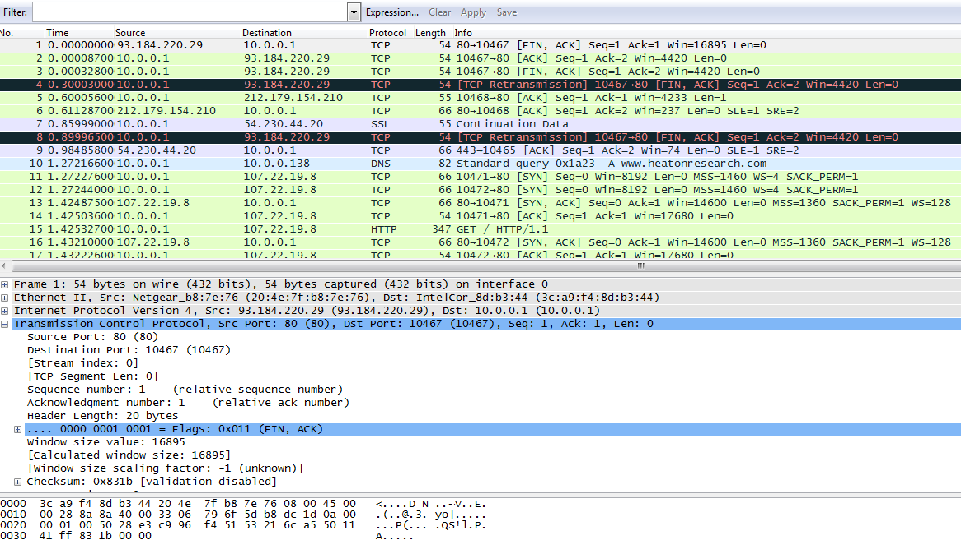
Wireshark
Source IP
Dest. IP
Packet Length
Time sent
Listing of captured packets
Details of selected Protocol Header
properties in Hexadecimal
Some data can be encrypted

Slide 20
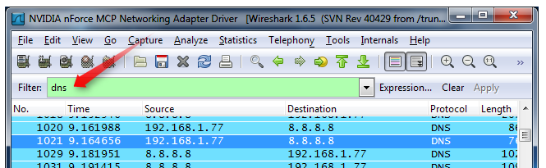
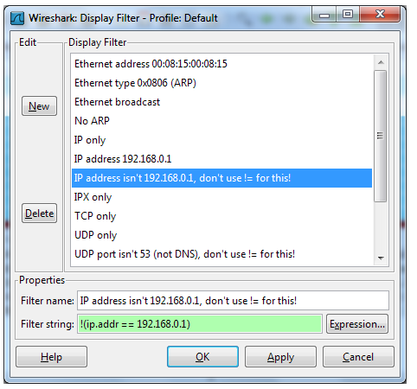
Wireshark
You can filter packets by their top layer protocol name
You can use the filter expression editor

Slide 21
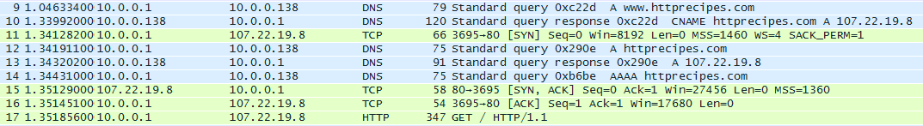
Wireshark
כמה שכבות לוקחות חלק בפאקטות 9,10,12,13,14?
וכמה לוקחות חלק ב 11,15,16?
מדוע בקשת הדף היא האחרונה בסדרת חבילות זו?

Slide 22
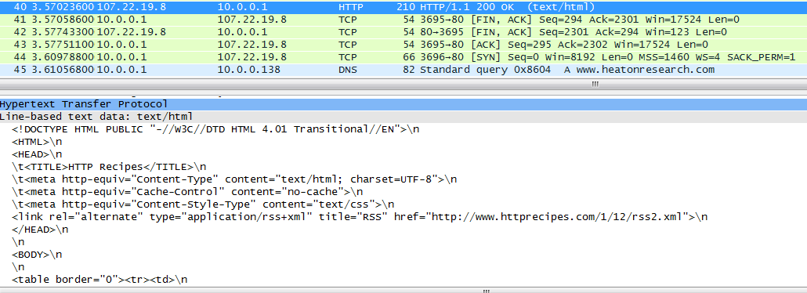
Wireshark
האם בקשת דף האינטרנט הצליחה ומה סוג התוכן שאתם מבחינים בו?

Slide 23
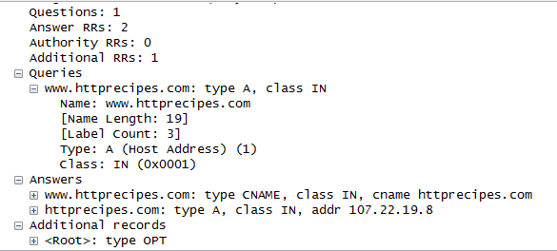
Wireshark
מה התוכן של הודעה זו?
איזה שכבה משרתת סוג תוכן זה?

