Slide 1


Introduction to Computer Networks
Practice #5
Hasidi Netanel

Slide 2
Today:
ARQ Protocols.
Application
Transport
Network
Link
Physical

Slide 3
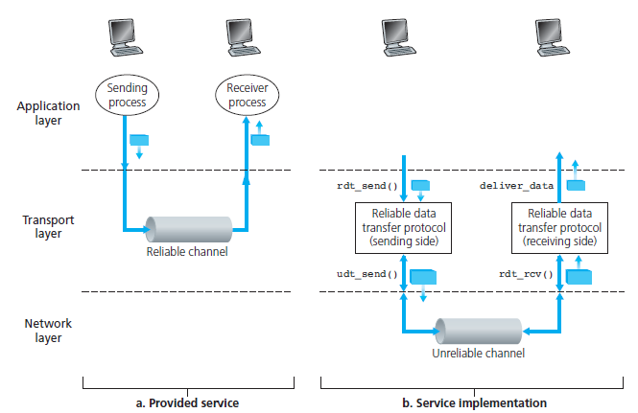
What is Reliable Data Transfer?
Reliable Channel
With a reliable channel, no transferred data bits are corrupted or lost, and all are delivered in the order in which they were sent.
It is the responsibility of a reliable data transfer protocol to implement this service abstraction.
Notes:
ערוץ אמין הוא ערוץ שבו הביטים מגיעים כפי שהם נשלחו – החבילות לא מגיעות תקולות.
וכולם מגיעים בסדר שבו הם נשלחים.

Slide 4
ARQ (Automatic Repeat reQuest) Protocols
We know now the channel isn’t reliable so we need to find a way that allows the receiver to let the sender know what has been received correctly, and what has been received in error and thus requires repeating.
If the information didn’t received properly, it must be send again.
Reliable data transfer protocols based on this technique (retransmission) knows as ARQ protocols.
We can estimate the protocol based on Utilization,
$$U=\frac{transmission time takes without loss}{actual time till ack}$$
Notes:
$$\frac{\# packets recived properly}{\# packets sent}$$

Slide 5
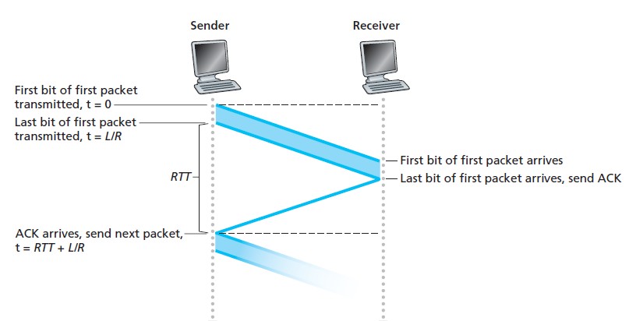
Stop & Wait ARQ
Send one packet and wait for ACK.
If the ACK has arrived, send another packet.
If the ACK has lost, sent the packet again.

Slide 6
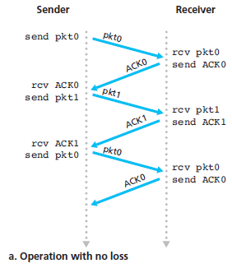
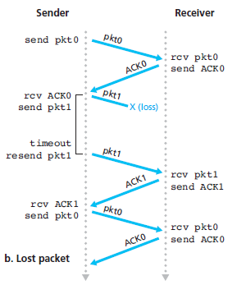
Stop & Wait ARQ

Slide 7
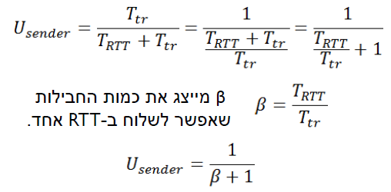
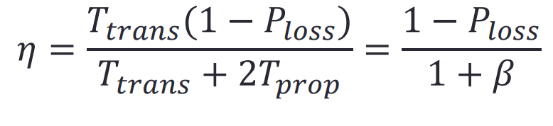
Stop & Wait ARQ
Without loss
With loss
Pr(loss packet) = p
זאת אומרת, הסת' לשידור מוצלח היא 1-p.
Notes:
utilization : fraction of time sender is busy sending
התוחלת- מספר הפעמים הממוצע שנשדר חבילה

Slide 8
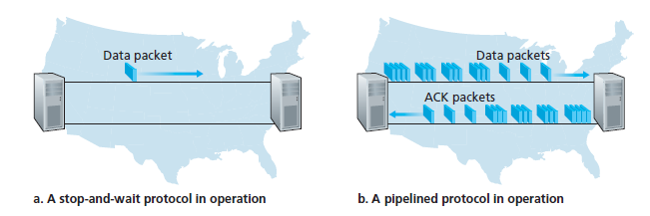
ARQ Protocols
Pipelining technique
Rather than operate in a stop-and-wait manner, the sender is allowed to send multiple packets without waiting for acknowledgments.
The sender and receiver sides of the protocols may have to buffer more than one packet.

Slide 9
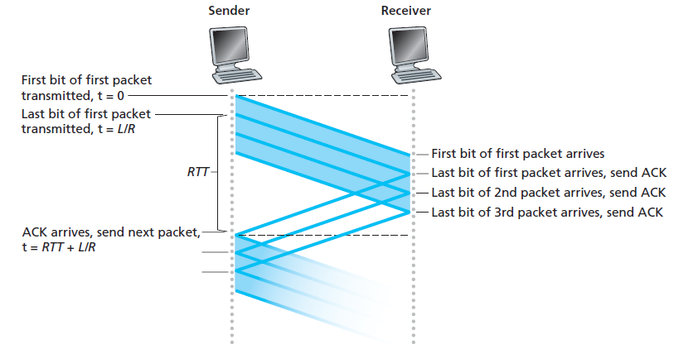
GBN (Go Back N) ARQ
The sender is allowed to transmit multiple packets (when available) without waiting for an acknowledgment, but is constrained to have no more than some maximum allowable number, N, of unacknowledged packets in the pipeline.
An acknowledgment for a packet with sequence number n will be taken to be a cumulative acknowledgment, indicating that all packets with a sequence number up to and including n have been correctly received at the receiver.
If a timeout occurs, the sender resends all packets that have been previously sent but that have not yet been acknowledged.

Slide 10
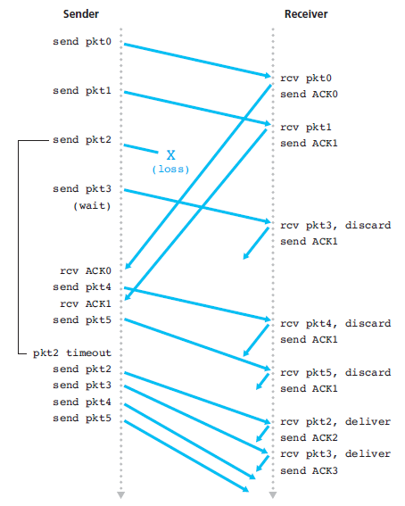
GBN (Go Back N) ARQ

Slide 11
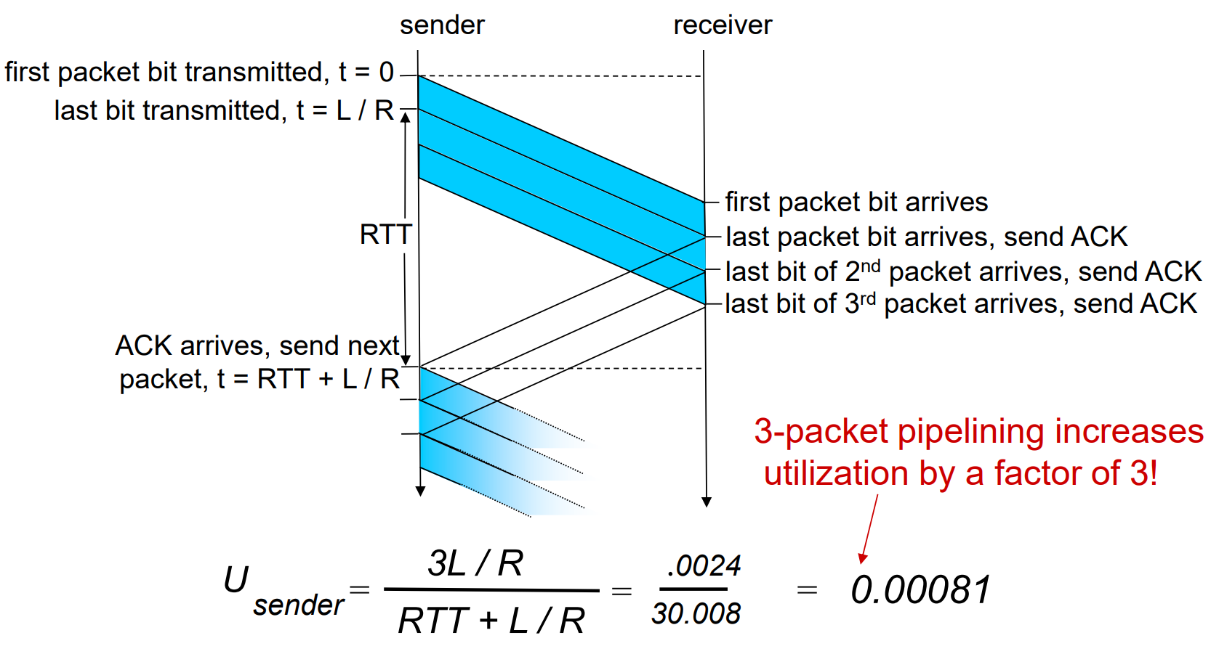
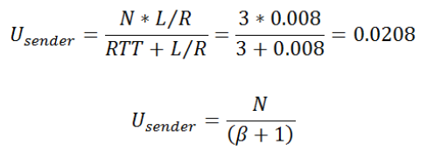
GBN (Go Back N) ARQ
Without loss

Slide 12
SR(Selective Repeat) ARQ
Retransmit only what is really need !
The SR receiver will acknowledge a correctly received packet (individually) whether or not it is in order.
Out-of-order packets are buffered until any missing packets are received, at which point a batch of packets can be delivered in order to the upper layer.

Slide 13
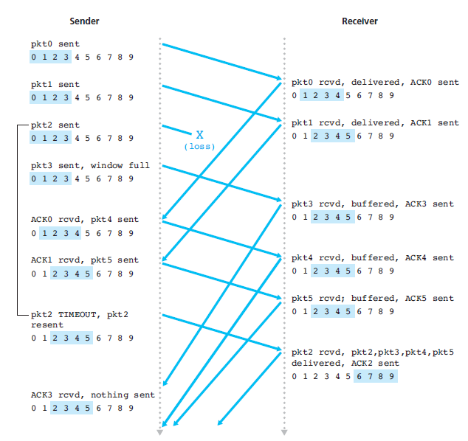
SR(Selective Repeat) ARQ

Slide 14
תרגיל:
קו לווייני בעל רוחב פס BW 1Mbps מחבר שתי תחנות קרקעיות.
המרחק בין כל תחנה קרקעית ללוויין הוא 36504km ומהירות האות s=3*10^8.
מה צריך להיות גודל הפקטה לניצול 25% מהחיבור הלווייני בפרוטוקול Go Back N כאשר N=127.

Slide 15
נתונים
BW = 1 Mbps
d = 2 x 36504 km = 73008 km
S= 3 x 10⁸ m/sec
Efficiency (η) = 25% = 1/4
N = 127

