Slide 1
מעבדות מדעי הנתונים
מעבדה 5
Unsupervised Learning
Written by Noa Eyal

Slide 2
Unsupervised learning
What happens if we don’t know the actual label of the record?
We need to discover the label in advance.
We can do that by using cluster analysis.

Slide 3
K-means
kmeans(x, centers, iter.max = 10, nstart = 1, algorithm = c("Hartigan-Wong", "Lloyd", "Forgy", "MacQueen"), trace=FALSE)
x - numeric matrix of data
centers – the number of clusters (k)
iter.max - the maximum number of iterations allowed.
nstart - how many random sets should be chosen
Notes:
תיאור הפונקציה kmeans

Slide 4
K-means
>data(iris)
>iris.features<-iris
>iris.features$Species<-NULL #delets the class column
>results<-kmeans(iris.features, 3) #builds kmeans model with iris dataset and k=3
K-means clustering with 3 clusters of sizes 38, 50, 62
Cluster means:
Sepal.Length Sepal.Width Petal.Length Petal.Width
1 6.850000 3.073684 5.742105 2.071053
2 5.006000 3.428000 1.462000 0.246000
3 5.901613 2.748387 4.393548 1.433871
Clustering vector:
[1] 2 2 2 2 2 2 2 2 2 2 2 2 2 2 2 2 2 2 2 2 2 2 2 2 2 2 2 2 2 2 2 2 2 2 2 2 2 2 2 2 2 2 2 2 2 2 2 2 2 2 3 3 1 3 3 3 3 3 3 3
[61] 3 3 3 3 3 3 3 3 3 3 3 3 3 3 3 3 3 1 3 3 3 3 3 3 3 3 3 3 3 3 3 3 3 3 3 3 3 3 3 3 1 3 1 1 1 1 3 1 1 1 1 1 1 3 3 1 1 1 1 3
[121] 1 3 1 3 1 1 3 3 1 1 1 1 1 3 1 1 1 1 3 1 1 1 3 1 1 1 3 1 1 3
Within cluster sum of squares by cluster:
[1] 23.87947 15.15100 39.82097
(between_SS / total_SS = 88.4 %)
Available components:
[1] "cluster" "centers" "totss" "withinss" "tot.withinss" "betweenss" "size" "iter"
[9] "ifault"
The size of each cluster
Cluster assignment for each record
Notes:
האלגוריתם מסתמך על החלוקה הראשונית לקלסטרים ולכן בכל הרצה נקבל תוצאות קצת שונות...
ניתן לראות את גודל הקלסטרים ע"י results$size ולווקטור השתייכות הרשומות לקלסטרים באמצעות results$cluster

Slide 5
K-means
We can attach the vector of the clusters to the iris table by:
> c_iris<-cbind(iris.features, results$cluster)
And than continue with supervised learning
> head(c_iris)
Sepal.Length Sepal.Width Petal.Length Petal.Width results$cluster
1 5.1 3.5 1.4 0.2 3
2 4.9 3.0 1.4 0.2 3
3 4.7 3.2 1.3 0.2 3
4 4.6 3.1 1.5 0.2 3
5 5.0 3.6 1.4 0.2 3
6 5.4 3.9 1.7 0.4 3

Slide 6
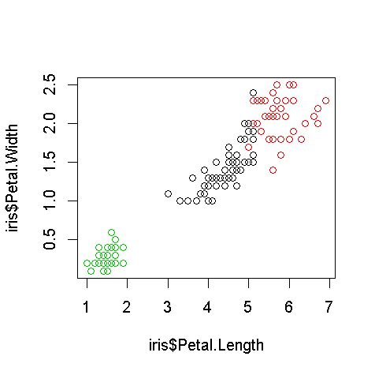
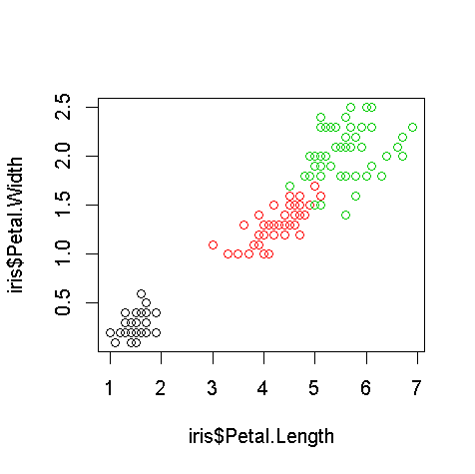
K-means performance evaluation
Let’s create a table containing the affiliation of each record to the real and kmeans clusters:
> table(iris$Species, results$cluster)
3 | 2 | 1
0 | 0 | 50 | Setosa
2 | 48 | 0 | Versicolor
36 | 14 | 0 | virginica
Real cluster
Predicted cluster
>plot(iris$Petal.Length,iris$Petal.Width,col=results$cluster)
>plot(iris$Petal.Length,iris$Petal.Width,col=iris$Species)
Notes:
כפי שניתן לראות, קלסטר 1 כנראה מייצג את Setosa, קלסטר 2 כנראה מייצג את Versicolor ו-קלסטר 3 כנראה מייצג את virginica .
** המספרים בטבלה יכולים טיפה להשתנות.
ניתן לראות ש-14 רשומות נכנסו לקלסטר 3 למרות שבמציאות הן מסווגות כ-virginica .
כלומר החלוקה שהאלגוריתם עשה קרובה לאמת אך לא מדוייקת ב-100%.
הגרף מצד שמאל מראה את ההפרדה בין הקלסטרים תוך שימוש בקלסטרים שיצרנו (כל צבע מייצג קלסטר), הגרף מצד ימין מראה את אותו פיזור אך הצבעים מייצגים את הסוג האמיתי של האירוס.

Slide 7
Hierarchical clustering
Hierarchical clustering is a method of cluster analysis which seeks to build a hierarchy of clusters.

Slide 8
Distance matrix
We need to find the distance matrix between the records in the dataset.
Let’s look on the first 5 rows in iris:
> irisSample <- iris[1:5,]
We can use the function “dist” to calculate the distance between the records
iris_distance<-dist(irisSample)
Sepal.Length Sepal.Width Petal.Length Petal.Width Species
1 5.1 3.5 1.4 0.2 setosa
2 4.9 3.0 1.4 0.2 setosa
3 4.7 3.2 1.3 0.2 setosa
4 4.6 3.1 1.5 0.2 setosa
5 5.0 3.6 1.4 0.2 setosa
4 | 3 | 2 | 1
 |  |  | 0.5385165 | 2
 |  | 0.3000000 | 0.5099020 | 3
 | 0.2449490 | 0.3316625 | 0.6480741 | 4
0.6480741 | 0.5099020 | 0.6082763 | 0.1414214 | 5
Notes:
על מנת להשתמש ב-hclust יש צורך לחשב את מטריצת המרחקים של כל זוג רשומות ב-dataset.
טבלת המרחקים נראית כמשולש מכיוון שאין צורך במשולש המשלים (המרחק בין רשומה 1 ל-2 הוא אותו מרחק כמו מרשומה 2 ל-1)

Slide 9
hclust
hclust (d, method = "complete", members = NULL)
d – the distance matrix
method – options:
Complete - the longest distance from any member of A to any member of B
Average - the average distance from any member of A to any member of B
Single - the shortest distance from any member of A to any member of B.

Slide 10
Additional Reading Association rules

Slide 11
Titanic.raw dataset
> load("titanic.raw.rdata")
> str(titanic.raw)
'data.frame': 2201 obs. of 4 variables: $ Class : Factor w/ 4 levels "1st","2nd","3rd",..: 3 3 3 3 3 3 3 3 3 3 ... $ Sex : Factor w/ 2 levels "Female","Male": 2 2 2 2 2 2 2 2 2 2 ... $ Age : Factor w/ 2 levels "Adult","Child": 2 2 2 2 2 2 2 2 2 2 ... $ Survived: Factor w/ 2 levels "No","Yes": 1 1 1 1 1 1 1 1 1 1 ...
Notes:
In order to use the following functions an installation of arules and arulesViz packages is necessary using:
utils:::menuInstallPkgs()

Slide 12
arules
We will first find all association rules:
> library(arules) > rules <- apriori(titanic.raw) > inspect(rules)
lhs rhs support confidence lift 1 {} => {Age=Adult} 0.9504771 0.9504771 1.0000000 2 {Class=2nd} => {Age=Adult} 0.1185825 0.9157895 0.9635051 3 {Class=1st} => {Age=Adult} 0.1449341 0.9815385 1.0326798 4 {Sex=Female} => {Age=Adult} 0.1930940 0.9042553 0.9513700 5 {Class=3rd} => {Age=Adult} 0.2848705 0.8881020 0.9343750 6 {Survived=Yes} => {Age=Adult} 0.2971377 0.9198312 0.9677574
7 {Class=Crew} => {Sex=Male} 0.3916402 0.9740113 1.2384742
…

Slide 13
arules
We can also choose to generate only rules with rhs containing “Survived” only:
> rules <- apriori(titanic.raw, parameter = list(minlen=2, supp=0.005, conf=0.8), appearance = list(rhs=c("Survived=No", "Survived=Yes"), default="lhs"), control = list(verbose=F)) > rules.sorted <- sort(rules, by="lift") > inspect(rules.sorted)
lhs rhs support confidence lift
1 {Class=2nd, Age=Child} => {Survived=Yes} 0.010904134 1.0000000 3.095640
2 {Class=2nd, Sex=Female, Age=Child} => {Survived=Yes} 0.005906406 1.0000000 3.095640
3 {Class=1st, Sex=Female} => {Survived=Yes} 0.064061790 0.9724138 3.010243
4 {Class=1st, Sex=Female, Age=Adult} => {Survived=Yes} 0.063607451 0.9722222 3.009650
5 {Class=2nd, Sex=Female} => {Survived=Yes} 0.042253521 0.8773585 2.715986
6 {Class=Crew, Sex=Female} => {Survived=Yes} 0.009086779 0.8695652 2.691861

Slide 14
Pruning Redundant Rules
Notice rule no. 2 provides no extra knowledge, given rule no. 1.
Loosing redundant rules is required:
> subset.matrix <- is.subset(rules.sorted, rules.sorted) > subset.matrix[lower.tri(subset.matrix, diag=T)] <- NA > redundant <- colSums(subset.matrix, na.rm=T) >= 1 > which(redundant) [1] 2 4 7 8 > # remove redundant rules > rules.pruned <- rules.sorted[!redundant] > inspect(rules.pruned)
Notes:
** The lhs of rule no.1 in the previous slide is contained in rule no. 2.

Slide 15
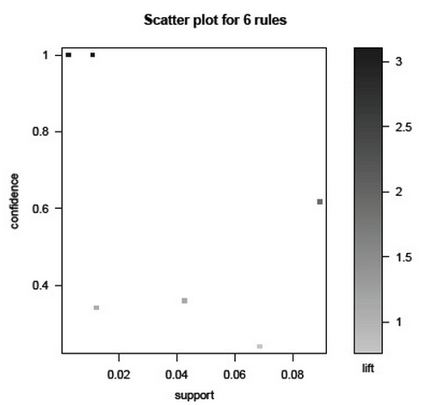
Visualizing Association Rules
> library(arulesViz) > plot(rules)

Slide 16
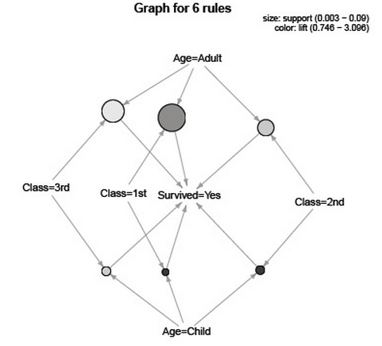
Visualizing Association Rules
> plot(rules, method="graph", control=list(type="items"))

Slide 17
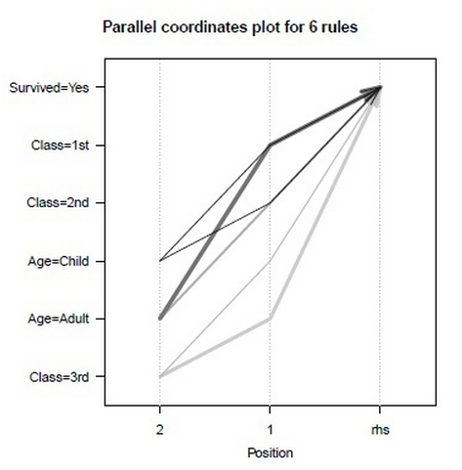
Visualizing Association Rules
> plot(rules, method="paracoord", control=list(reorder=TRUE))

