Slide 1
Data Analysis in Python
Pre processing 1

Slide 2
Anaconda
Python distribution for scientific data analysis tasks:
Developed by Continuum Analytics, Inc.
Cross-Platform, available on Windows, Linux, Mac OS X.
Includes many data analysis packages, such as NumPy, SciPy, Pandas, IPython and other.
Includes the Python development environment : Spyder
Includes the Python platform-independent package manager: Conda

Slide 3


Pandas
http://pandas.pydata.org/
Pandas is an open source project, providing high-performance, easy-to-use data structures and data analysis tools for Python.
handling of missing data (represented as NaN)
columns can be inserted and deleted from DataFrame
slicing, fancy indexing, and subsetting of large data sets
Robust IO tools for loading data from flat files (CSV and delimited), Excel files, databases
Categorical variable analysis
Predictive Modeling
Plots
Wikipedia

Slide 4
Data Exploration
https://www.analyticsvidhya.com/blog/2016/01/complete-tutorial-learn-data-science-python-scratch-2/
Import the required packages and libraries: pandas, numpy
read the training data file (in csv format) using the read.csv(“path”)
For the non-numerical values, use value_counts() for frequency analysis
Access particular column in data set using dfname[‘column_name’]
import pandas as pd import numpy as np import matplotlib as plt df = pd.read_csv("C:\Users\user\Desktop\\train_Loan.csv") # Reading the dataset in a dataframe using Pandas print(df.head(10)) # Print the first 10 rows of the data set print("\n Summary of numeircal variables:") print(df.describe()) # Get summary of numerical variables print("\n Frequency Distribution of Property_Area attribute:") print(df['Property_Area'].value_counts()) # Frequency distribution for non-numerical attributes print("\n Frequency Distribution of Credit_History attribute:") print(df['Credit_History'].value_counts())
Notes:
Import pandas+numpy through PieCharm:
File -> Settings -> Project Interpreter -> “+” button -> search “pandas” -> install package
Import pandas+numpy through Terminal commands:
conda install pandas
conda install numpy
https://docs.anaconda.com/anaconda/navigator/tutorials/pandas/

Slide 5
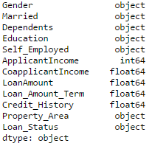
Data Exploration
Iterating over rows of a dataframe requires sometimes to know the column types.
‘object’ type is used for representing nominal variables in Pandas.
Column can be modified to ‘object’ type using the astype(np.object) function
# print the data types of the attributes in the DataFrame print(df.dtypes)
# Modify the Credit_History column to ‘object’ type df['Credit_History'] = df['Credit_History'].astype(np.object) print(df.dtypes)

Slide 6
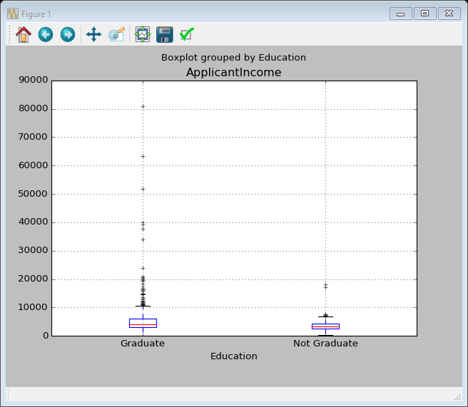
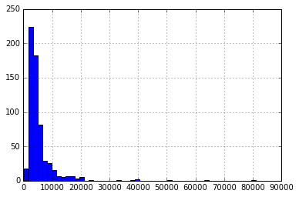
Distribution analysis
Plotting the histogram of some numeric attribute using hist(‘#number of bins’)
Plotting boxplot using boxplot(column=‘name of column’, [by=‘name of column’])
df['ApplicantIncome'].hist(bins=50) df.boxplot(column='ApplicantIncome') df.boxplot(column='ApplicantIncome', by='Education')

Slide 7
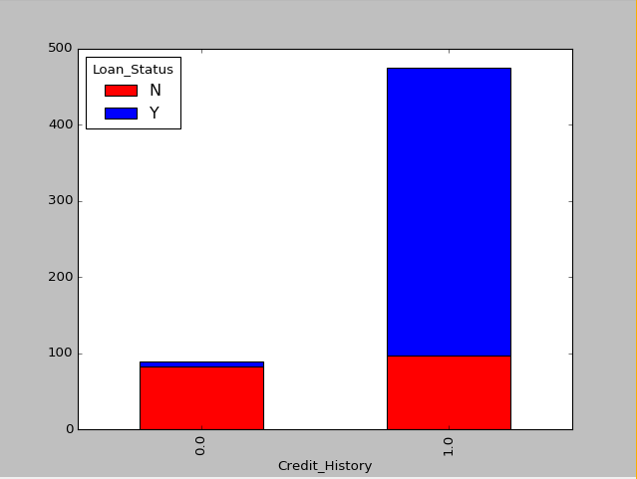
Categorical variable analysis
Generate pivot table on categorical analysis like in Excel using
pivot_table(values, index, aggFunc)
Can be plotted using the “matplotlib” library.
temp1 = df['Credit_History'].value_counts(ascending=True) temp2 = df.pivot_table(values='Loan_Status',index=['Credit_History'],aggfunc=lambda x: x.map({'Y':1,'N':0}).mean()) print 'Frequency Table for Credit History:' print temp1 print '\n Probability of getting loan for each Credit History class:' print temp2
temp3 = pd.crosstab(df['Credit_History'], df['Loan_Status']) temp3.plot(kind='bar', stacked=True, color=['red','blue'], grid=False)

Slide 8
Pre-Processing : missing values
Output number of NaN/ null values in data set using dt.apply(lambda x: sum(x.isnull()),axis=0)
Fill missing values in some attribute : fillna(‘new value’, inplace=True)
Use mean value, or specific value, or build a supervised learning model
Use the mode of the column for filling missing values (mode(data[‘column Name’])
Treat for extreme values in distribution using log or other math operators
print(mode(df['Gender']).mode[0]) df['Gender'].fillna(mode(df['Gender']).mode[0], inplace=True)
print(df.apply(lambda x: sum(x.isnull()),axis=0)) df['LoanAmount'].fillna(df['LoanAmount'].mean(), inplace=True) df['Self_Employed'].fillna('No', inplace=True) df['LoanAmount_log'] = np.log(df['LoanAmount']) df['LoanAmount_log'].hist(bins=20) df['TotalIncome'] = df['ApplicantIncome'] + df['CoapplicantIncome'] df['TotalIncome_log'] = np.log(df['TotalIncome']) df['TotalIncome_log'].hist(bins=20)

Slide 9
Pre-Processing : Discretization
Discretize continuous values into bins for further processing, using the cut function.
Define the bins and cut point
cut(DataFrame[‘Attribute name’], cut_points, labels)
def binning(col, cut_points, labels=None): # Define min and max values: minval = col.min() maxval = col.max() # create list by adding min and max to cut_points break_points = [minval] + cut_points + [maxval] # if no labels provided, use default labels 0 ... (n-1) if not labels: labels = range(len(cut_points)+1) # Binning using cut function of pandas colBin = pd.cut(col, bins=break_points, labels=labels, include_lowest=True) return colBin

Slide 10
Pre-Processing : Discretization
Discretize continuous values into bins for further processing, using the cut function.
Define the bins and cut point
cut(DataFrame[‘Attribute name’], cut_points, labels)
# Define bins as 0<=x<100, 100<=x<200, 200<=x<300, x>=300 bins = [100, 200, 300] group_names = ['Low', 'Medium', 'High', 'Extreme'] # Discretize the values in LoanAmount attribute df["LoanAmount_Bin"] = binning(df["LoanAmount"], bins, group_names) # Count the number of observations which each value print pd.value_counts(df["LoanAmount_Bin"], sort=False) print(df)

Slide 11
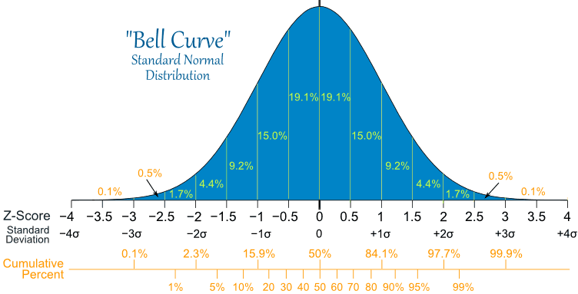
Pre-Processing : Outlier Detection
Outlier is an observation that appears far away and diverges from an overall pattern
Data Entry Errors
Measurement Error
Experimental Error
Data Processing Error
Natural Outlier
# Keep only the ones that are within +3 to -3 standard deviations in the column 'LoanAmount'. print(df[(np.abs(df.LoanAmount-df.LoanAmount.mean()) <= (3*df.LoanAmount.std()))])

Slide 12
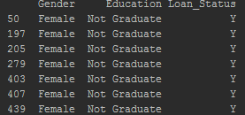
Indexing and Selecting Data
Filter values of a column based on conditions from another set of columns.
Use the loc(conditions, column to display)
# filter values of a column based on conditions from another set of columns # for example, females who are not graduate and got a loan print(df.loc[(df["Gender"] == "Female") & (df["Education"] == "Not Graduate") & (df["Loan_Status"] == "Y"), ["Gender", "Education", "Loan_Status"]])

