Slide 1
Data Science and Business Intelligence
#1 - Data Pre-Processing
nivah@post.bgu.ac.il

Slide 2
Data preprocessing steps:
Data cleaning
Data integration
Data transformation
Data reduction

Slide 3
Data transformation
Transform data into forms appropriate for mining.
Smoothing
Aggregation
Generalization
Normalization
Feature construction

Slide 4
Data Transformation: Normalization
Normalization: scaled to fall within a small, specified range.
May improve the accuracy and efficiency of mining algorithms involving distance measurements.
Min-max normalization
Z-score normalization
Normalization by decimal scaling

Slide 5
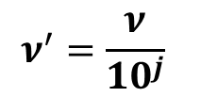
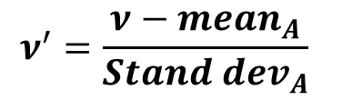
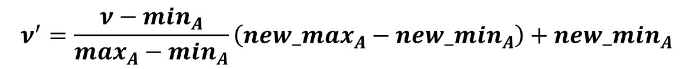

Data Transformation: Normalization
Min-max normalization
Z-score normalization
Normalization by decimal scaling
$$ν^{′}=\frac{ν−\min_{A}}{\max_{A}−\min_{A}}\left(new_\max_{A}−new_\min_{A}\right)+new_\min_{A}$$
$$ν^{′}=\frac{ν−{mean}_{A}}{{Stand dev}_{A}}$$
$$ν^{′}=\frac{ν}{{10}^{j}}$$
Where j is the smallest integer such that Max(| |)<1
$$ν^{′}$$
Notes:
A – attribute
תכונה, פיצ'ר

Slide 6
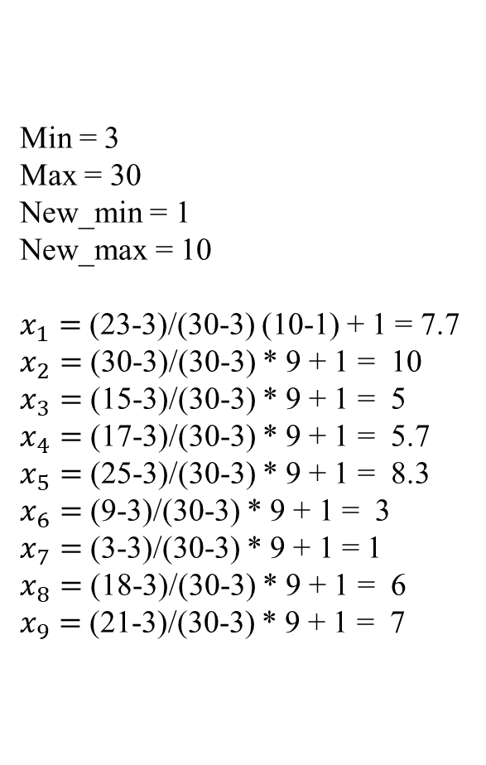
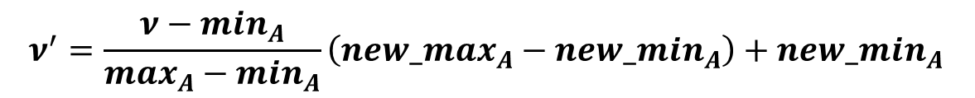
Example – min-max normalization
$$ν^{′}=\frac{ν−\min_{A}}{\max_{A}−\min_{A}}\left(new_\max_{A}−new_\min_{A}\right)+new_\min_{A}$$
Min = 3
Max = 30
New_min = 1
New_max = 10
$x_{1}=$ (23-3)/(30-3) (10-1) + 1 = 7.7
$x_{2}=$ (30-3)/(30-3) * 9 + 1 = 10
$x_{3}=$ (15-3)/(30-3) * 9 + 1 = 5
$x_{4}=$ (17-3)/(30-3) * 9 + 1 = 5.7
$x_{5}=$ (25-3)/(30-3) * 9 + 1 = 8.3
$x_{6}=$ (9-3)/(30-3) * 9 + 1 = 3
$x_{7}=$ (3-3)/(30-3) * 9 + 1 = 1
$x_{8}=$ (18-3)/(30-3) * 9 + 1 = 6
$x_{9}=$ (21-3)/(30-3) * 9 + 1 = 7
min-max | X | id
7.7 | 23 | 1
10 | 30 | 2
5 | 15 | 3
5.7 | 17 | 4
8.3 | 25 | 5
3 | 9 | 6
1 | 3 | 7
6 | 18 | 8
7 | 21 | 9

Slide 7
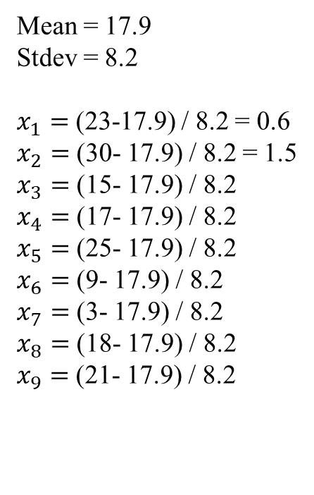
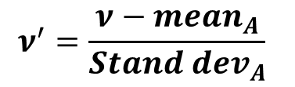
Example - z-score normalization
$$ν^{′}=\frac{ν−{mean}_{A}}{{Stand dev}_{A}}$$
Mean = 17.9
Stdev = 8.2
$x_{1}=$ (23-17.9) / 8.2 = 0.6
$x_{2}=$ (30- 17.9) / 8.2 = 1.5
$x_{3}=$ (15- 17.9) / 8.2
$x_{4}=$ (17- 17.9) / 8.2
$x_{5}=$ (25- 17.9) / 8.2
$x_{6}=$ (9- 17.9) / 8.2
$x_{7}=$ (3- 17.9) / 8.2
$x_{8}=$ (18- 17.9) / 8.2
$x_{9}=$ (21- 17.9) / 8.2
z-score | X | id
0.6 | 23 | 1
1.5 | 30 | 2
-0.4 | 15 | 3
-0.1 | 17 | 4
0.9 | 25 | 5
-1.1 | 9 | 6
-1.8 | 3 | 7
0.0 | 18 | 8
0.4 | 21 | 9

Slide 8
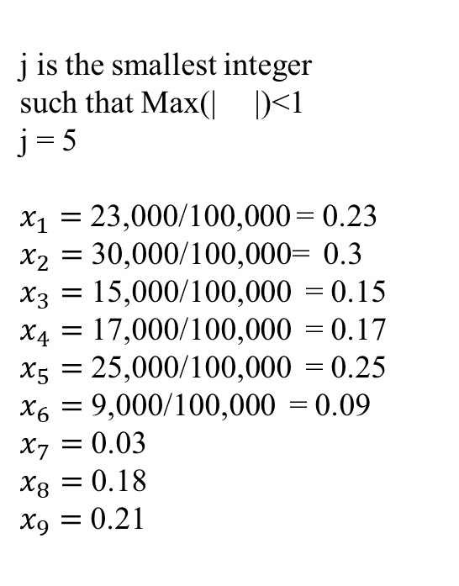

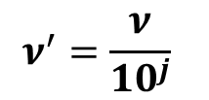
Example - normalization by decimal scaling
$$ν^{′}=\frac{ν}{{10}^{j}}$$
j is the smallest integer
such that Max(| |)<1
j = 5
$x_{1}=$ 23,000/100,000 = 0.23
$x_{2}=$ 30,000/100,000= 0.3
$x_{3}=$ 15,000/100,000 = 0.15
$x_{4}=$ 17,000/100,000 = 0.17
$x_{5}=$ 25,000/100,000 = 0.25
$x_{6}=$ 9,000/100,000 = 0.09
$x_{7}=$ 0.03
$x_{8}=$ 0.18
$x_{9}=$ 0.21
decimal scaling | X | id
0.23 | 23,000 | 1
0.30 | 30,000 | 2
0.15 | 15,000 | 3
0.17 | 17,000 | 4
0.25 | 25,000 | 5
0.09 | 9,000 | 6
0.03 | 3,000 | 7
0.18 | 18,000 | 8
0.21 | 21,000 | 9
$$ν^{′}$$

Slide 9
Moving Average Methods
Goal
Determining the trend of time series data
Most common methods
Simple Moving Average
Weighted Moving Average
Exponential Moving Average

Slide 10
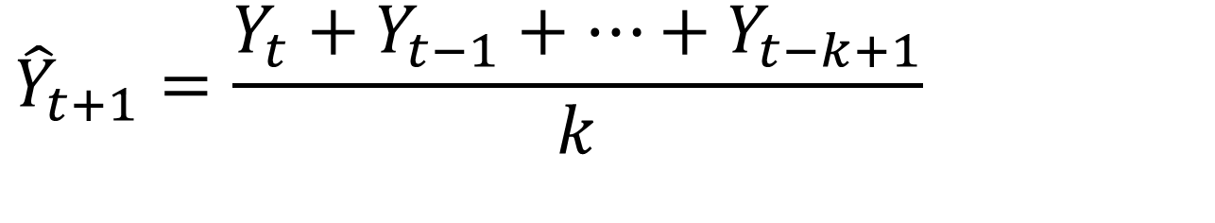
Simple Moving Average
The forecast is simply the average of the most recent k observations:
$${\hat{Y}}_{t+1}=\frac{Y_{t}+Y_{t−1}+…+Y_{t−k+1}}{k}$$

Slide 11
Selecting k
Smoothing effect (large k)
Responsiveness (small k)
Useful to compare results with different k values

Slide 12
Example - SMA
Position | Value | SMA2 | SMA3 | SMA4 | SMA5
1 | 0.1338
2 | 0.4622
3 | 0.1448 | 0.2980
4 | 0.6538 | 0.3035 | 0.2469
5 | 0.0752 | 0.3993 | 0.4203 | 0.3487
6 | 0.2482 | 0.3645 | 0.2913 | 0.3340 | 0.2940
7 | 0.4114 | 0.1617 | 0.3257 | 0.2805 | 0.3168
8 | 0.3598 | 0.3298 | 0.2449 | 0.3472 | 0.3067
9 | 0.7809 | 0.3856 | 0.3398 | 0.2737 | 0.3497
10 | 0.5369 | 0.5704 | 0.5174 | 0.4501 | 0.3751
11 | 0.7889 | 0.6589 | 0.5592 | 0.5223 | 0.4674
12 | 0.1234 | 0.6629 | 0.7022 | 0.6166 | 0.5756
13 | 0.1335 | 0.4562 | 0.4831 | 0.5575 | 0.5180
14 | 0.3555 | 0.1285 | 0.3486 | 0.3957 | 0.4727
15 | 0.1444 | 0.2445 | 0.2041 | 0.3503 | 0.3876
Ave(0.1338,0.4622,0.1448)

Slide 14
Weighted Moving Average
Moving average where each value in the window is assigned a unique weight:

Slide 15
Selecting Weights
Sum is 1.0
More recent data is often more important
Other knowledge may skew weights
Equal weights is the same as single moving average (w=1/k)

Slide 16
Example - WMA
Position | Value | WMA2 | WMA3 | WMA4 | WMA5
1 | 0.1338
2 | 0.4622
3 | 0.1448 | 0.3801
4 | 0.6538 | 0.22415 | 0.2274
5 | 0.0752 | 0.52655 | 0.4991 | 0.4128
6 | 0.2482 | 0.21985 | 0.2353 | 0.2928 | 0.2967
7 | 0.4114 | 0.20495 | 0.2455 | 0.2692 | 0.2833
8 | 0.3598 | 0.3706 | 0.3327 | 0.3337 | 0.3161
9 | 0.7809 | 0.3727 | 0.3616 | 0.3138 | 0.3332
10 | 0.5369 | 0.675625 | 0.6306 | 0.5263 | 0.4797
11 | 0.7889 | 0.5979 | 0.5825 | 0.5497 | 0.5306
12 | 0.1234 | 0.7259 | 0.7215 | 0.6641 | 0.6392
13 | 0.1335 | 0.289775 | 0.3429 | 0.4678 | 0.4834
14 | 0.3555 | 0.130975 | 0.2003 | 0.3139 | 0.3566
15 | 0.1444 | 0.3 | 0.2723 | 0.3081 | 0.3201
0.106*0.1338+0.264*0.4622+0.630*0.1448

Slide 18
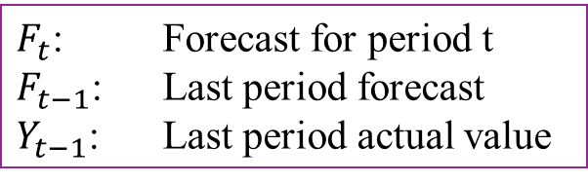
Exponential Moving Average
A higher α discounts older observations faster
$F_{t}$: Forecast for period t
$F_{t−1}$: Last period forecast
$Y_{t−1}$: Last period actual value

Slide 19
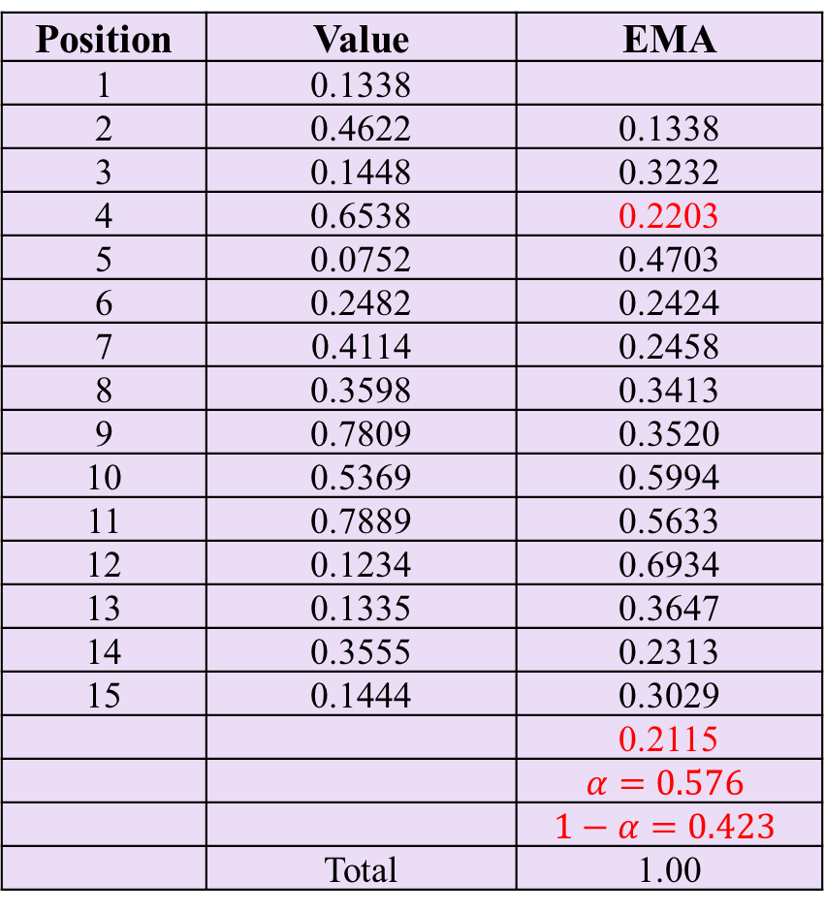
Example - EMA
Position | Value | EMA
1 | 0.1338
2 | 0.4622 | 0.1338
3 | 0.1448 | 0.3232
4 | 0.6538 | 0.2203
5 | 0.0752 | 0.4703
6 | 0.2482 | 0.2424
7 | 0.4114 | 0.2458
8 | 0.3598 | 0.3413
9 | 0.7809 | 0.3520
10 | 0.5369 | 0.5994
11 | 0.7889 | 0.5633
12 | 0.1234 | 0.6934
13 | 0.1335 | 0.3647
14 | 0.3555 | 0.2313
15 | 0.1444 | 0.3029
 |  | 0.2115
 |  | $$α=0.576$$
 |  | $1−α=0.423$
 | Total | 1.00
0.576*0.1448+0.423*0.323=0.2203

Slide 21
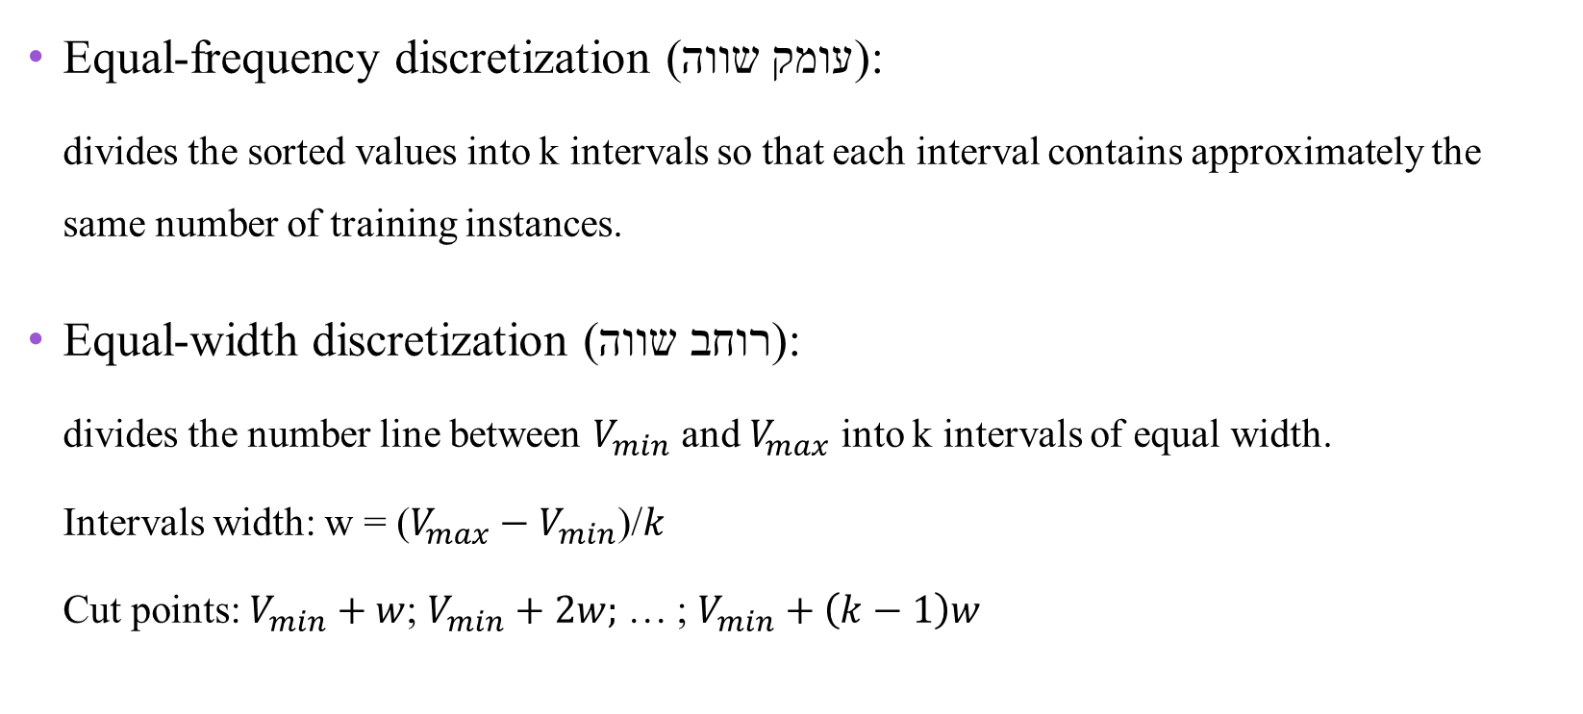
Discretization using Binning
Equal-frequency discretization (עומק שווה):
divides the sorted values into k intervals so that each interval contains approximately the same number of training instances.
Equal-width discretization (רוחב שווה):
divides the number line between $V_{min}$ and $V_{max}$ into k intervals of equal width.
Intervals width: w = ($V_{max}−V_{min}$)/$k$
Cut points: $V_{min}+w$; $V_{min}+2w;$ … ; $V_{min}+\left(k−1\right)w$

Slide 22
Example – equal width
Values of attribute ‘Age’: 0, 4, 12, 16, 16, 18, 23, 26, 28
Bin width = 10
Bin # | Bin elements | Bin boundaries
1 | (0,4) | X <= 10
2 | (12,16,16,18) | 10 < x <= 20
3 | (23,26,28) | X > 20

Slide 23
Example – equal depth
Values of attribute ‘Age’: 0, 4, 12, 16, 16, 18, 23, 26, 28
Bin depth = 3
Bin # | Bin elements | Bin boundaries
1 | (0,4,12) | X <= 12
2 | (16,16,18) | 12 < x <= 18
3 | (23,26,28) | X > 18

Slide 24
Binning Method for Data Smoothing
Values: 4, 8, 9, 15, 21, 21, 24, 25, 26, 28, 29, 34
Partition into equal-depth bins:
Bin 1: 4, 8, 9, 15
Bin 2: 21, 21, 24, 25
Bin 3: 26, 28, 29, 34
Smoothing by bin means:
Bin 1: 9, 9, 9, 9
Bin 2: 23, 23, 23, 23
Bin 3: 29, 29, 29
Smoothing by bin boundaries:
Bin 1: 4, 4, 4, 15
Bin 2: 21, 21, 25, 25
Bin 3: 26, 26, 26, 34

Slide 25
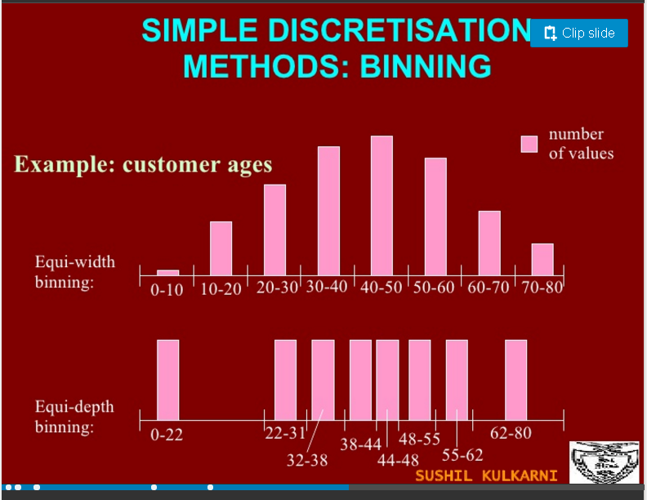
Example
https://www.slideshare.net/sushil.kulkarni/ch-1-intro-to-data-mining-presentation

Slide 26
Example - Discretization
Equal-frequency (depth) discretization:
Sort
28

Slide 27
Example - Discretization
Equal-width discretization:
Two intervals cut point: 25 + (35-25)/2 = 30
Interval 1: X ≤ 30
Interval 2: X > 30
Width

