Slide 1
Data Science and Business Intelligence
#2 - Information Theory
nivah@post.bgu.ac.il

Slide 2
מציאת תבניות אינפורמטיביות
אנו זקוקים לקריטריון על מנת לבחור תבניות אינפורמטיביות מתוך כלל התבניות הקיימות במסד הנתונים.
תורת האינפורמציה מספקת מסגרת מתמטית פורמלית שמאפשרת לנו לזהות תבניות אינפורמטיביות, ולהעריך את מידת האינפורמטיביות שלהן ביחס לתבניות אחרות.

Slide 3
תורת האינפורמציה
אי-וודאות: המידע המוגבל שיש לנו לגבי תוצאה של אירוע כלשהו, בד"כ אירוע עתידי.
אנטרופיה: המטרה של מדד זה היא להעריך את אי-הוודאות של משתנה מקרי כלשהו (X).

Slide 4
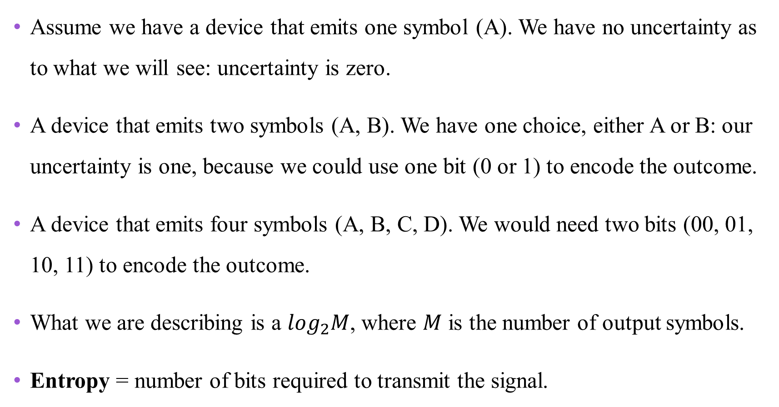
Motivating Entropy
Assume we have a device that emits one symbol (A). We have no uncertainty as to what we will see: uncertainty is zero.
A device that emits two symbols (A, B). We have one choice, either A or B: our uncertainty is one, because we could use one bit (0 or 1) to encode the outcome.
A device that emits four symbols (A, B, C, D). We would need two bits (00, 01, 10, 11) to encode the outcome.
What we are describing is a $\log_{2}M$, where $M$ is the number of output symbols.
Entropy = number of bits required to transmit the signal.

Slide 5
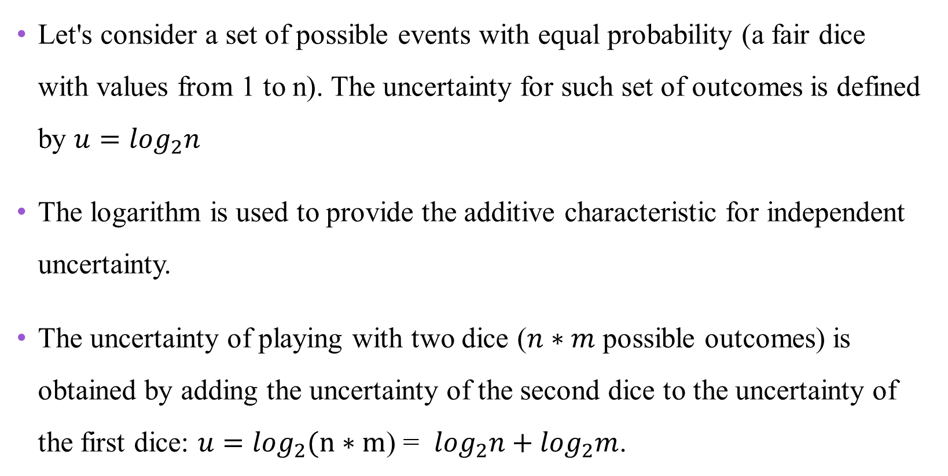
Entropy explained
Let's consider a set of possible events with equal probability (a fair dice with values from 1 to n). The uncertainty for such set of outcomes is defined by $u=\log_{2}n$
The logarithm is used to provide the additive characteristic for independent uncertainty.
The uncertainty of playing with two dice ($n∗m$ possible outcomes) is obtained by adding the uncertainty of the second dice to the uncertainty of the first dice: $u=\log_{2}(n∗m$) = $\log_{2}n+\log_{2}m$.

Slide 6
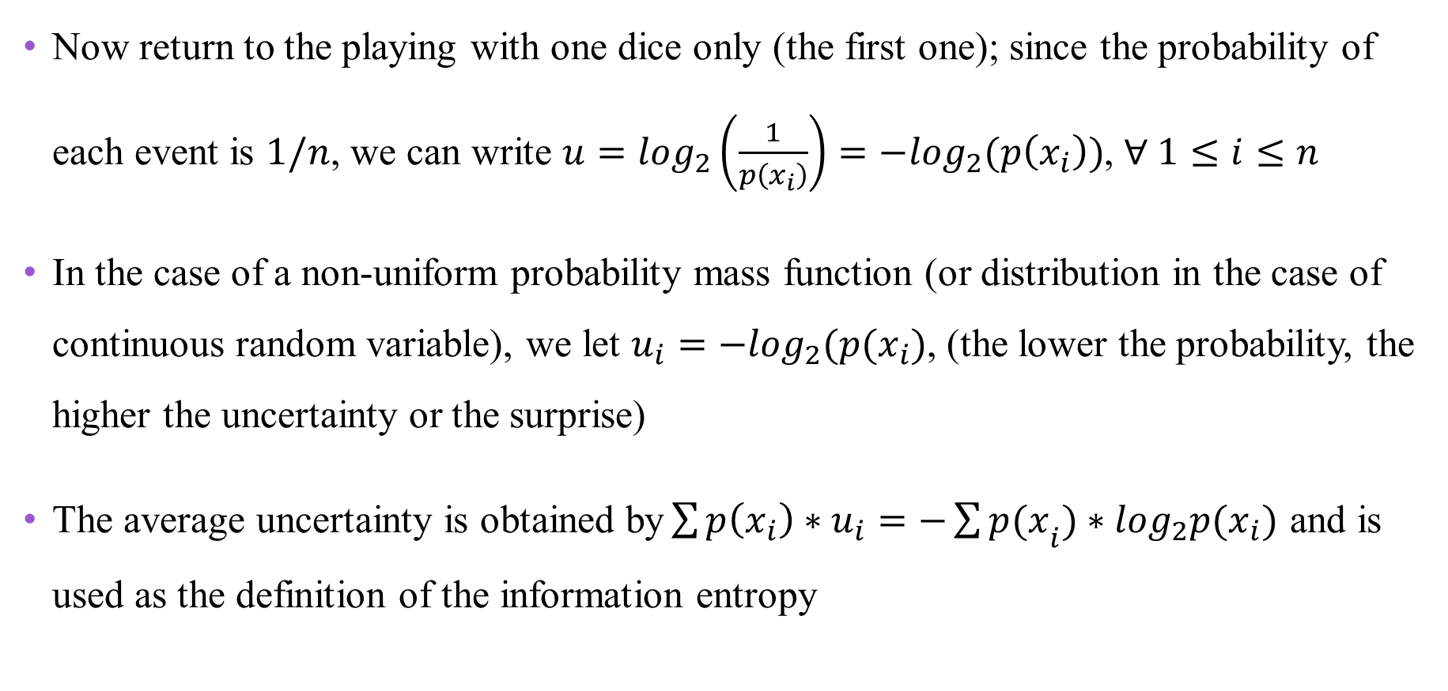
Entropy explained, cont.
Now return to the playing with one dice only (the first one); since the probability of each event is $1/n$, we can write $u=\log_{2}\left(\frac{1}{p\left(x_{i}\right)}\right)=−\log_{2}(p\left(x_{i}\right))$, $∀ 1≤i≤n$
In the case of a non-uniform probability mass function (or distribution in the case of continuous random variable), we let $u_{i}=−\log_{2}(p(x_{i})$, (the lower the probability, the higher the uncertainty or the surprise)
The average uncertainty is obtained by$\sum{p\left(x_{i}\right)∗u_{i}}=−{\sum{p(x}}_{i})∗\log_{2}p(x_{i})$ and is used as the definition of the information entropy

Slide 7
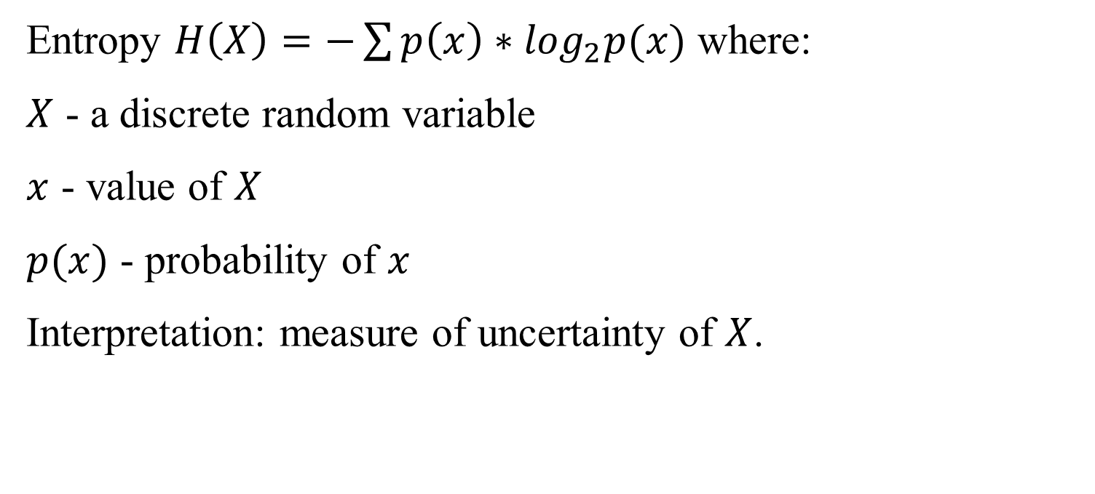
Entropy
Entropy $H\left(X\right)=−\sum{p\left(x\right)∗\log_{2}p(x)}$ where:
$X$ - a discrete random variable
$x$ - value of $X$
$p(x)$ - probability of $x$
Interpretation: measure of uncertainty of $X$.

Slide 8
Entropy
אם לכל ערכי המשתנה X יש את אותה הסתברות, האנטרופיה היא פונקציה מונוטונית עולה.

Slide 9
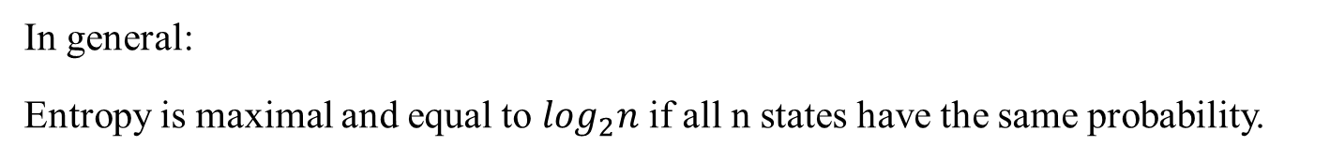
Entropy - two states
In general:
Entropy is maximal and equal to $\log_{2}n$ if all n states have the same probability.

Slide 10


Entropy - Illustration
Highest
Lowest

Slide 11
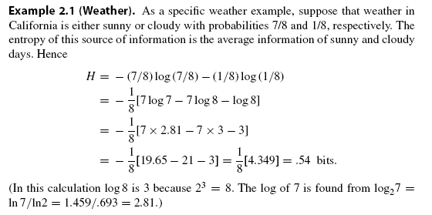
Entropy – Small Examples
$$−0.2∗\log_{2}\left(0.2\right)−0.8∗\log_{2}\left(0.8\right)=0.72$$

Slide 12
Entropy – Examples
H(X)
H(Y)

Slide 13
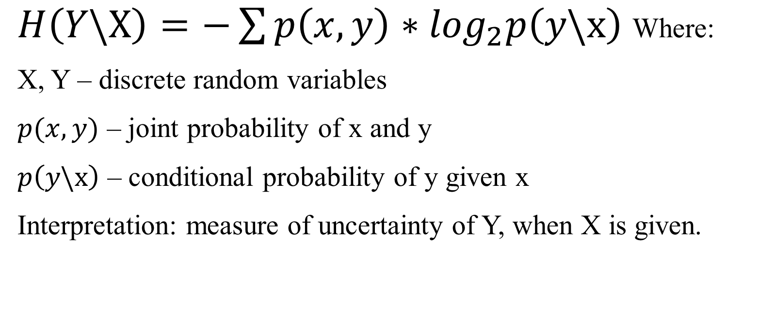
Conditional Entropy
$H\left(Y\backslash X\right)=−\sum{p\left(x,y\right)∗\log_{2}p\left(y\backslash x\right)}$Where:
X, Y – discrete random variables
$p(x,y)$ – joint probability of x and y
$p\left(y\backslash x\right)$ – conditional probability of y given x
Interpretation: measure of uncertainty of Y, when X is given.

Slide 14
Conditional Entropy
If Y(X) → H(Y|X)=0
If Y not dependent on X → H(Y|X)=H(Y)

Slide 15
Conditional Entropy – Example
H(Y)=1.85
H(Y|X)

Slide 16
Conditional Entropy – Example
H(X)=1.96
H(X|Y)

Slide 17
Mutual Information
Mutual Information (of variables X and Y)
I(X;Y) = H(Y) - H(Y/X) =
Interpretation: the reduction in the uncertainty of Y as a result of knowing X.

Slide 18
Mutual Information - Symmetry
I(X;Y) =
I(X;Y) =
I(X;Y) = H(Y) - H(Y|X) = I(Y;X) = H(X) – H(X|Y)

Slide 19
Mutual information
Symmetry → I(X;Y)= I(Y;X)
MI always positive or zero
Max(MI) → Y function of X
Min(MI) → No connection between Y and X

Slide 20
Mutual Information - Example
I(X;Y)

Slide 21
Mutual Information – Another way to calculate
y=A
y=B
y=C
y=D
Total
P(y)
44/100
24/100
13/100
19/100
100/100
I(X;Y) = H(Y)-H(Y|X) = 1.85 - 1.67 = 0.18

Slide 22
Mutual Information – Example
x=A
x=B
x=C
ס=D
Total
P(x)
21/100
33/100
19/100
27/100
100/100
y=A
y=B
y=C
y=D
Total
H(Y)=-P(y)*log(P(y))
0.47
0.53
0.46
0.51
1.96
I(Y;X) = H(X)-H(X|Y) = 1.96 - 1.78 = 0.18

Slide 23
