Slide 1
Data Science and Business Intelligence
#3 – Statistical hypothesis testing and decision tree learning
nivah@post.bgu.ac.il

Slide 2
Model Estimation
Dataset
Train set
Test set
Train accuracy (=100-Train error)
Test accuracy (=100-Test error)
Majority Rule

Slide 3
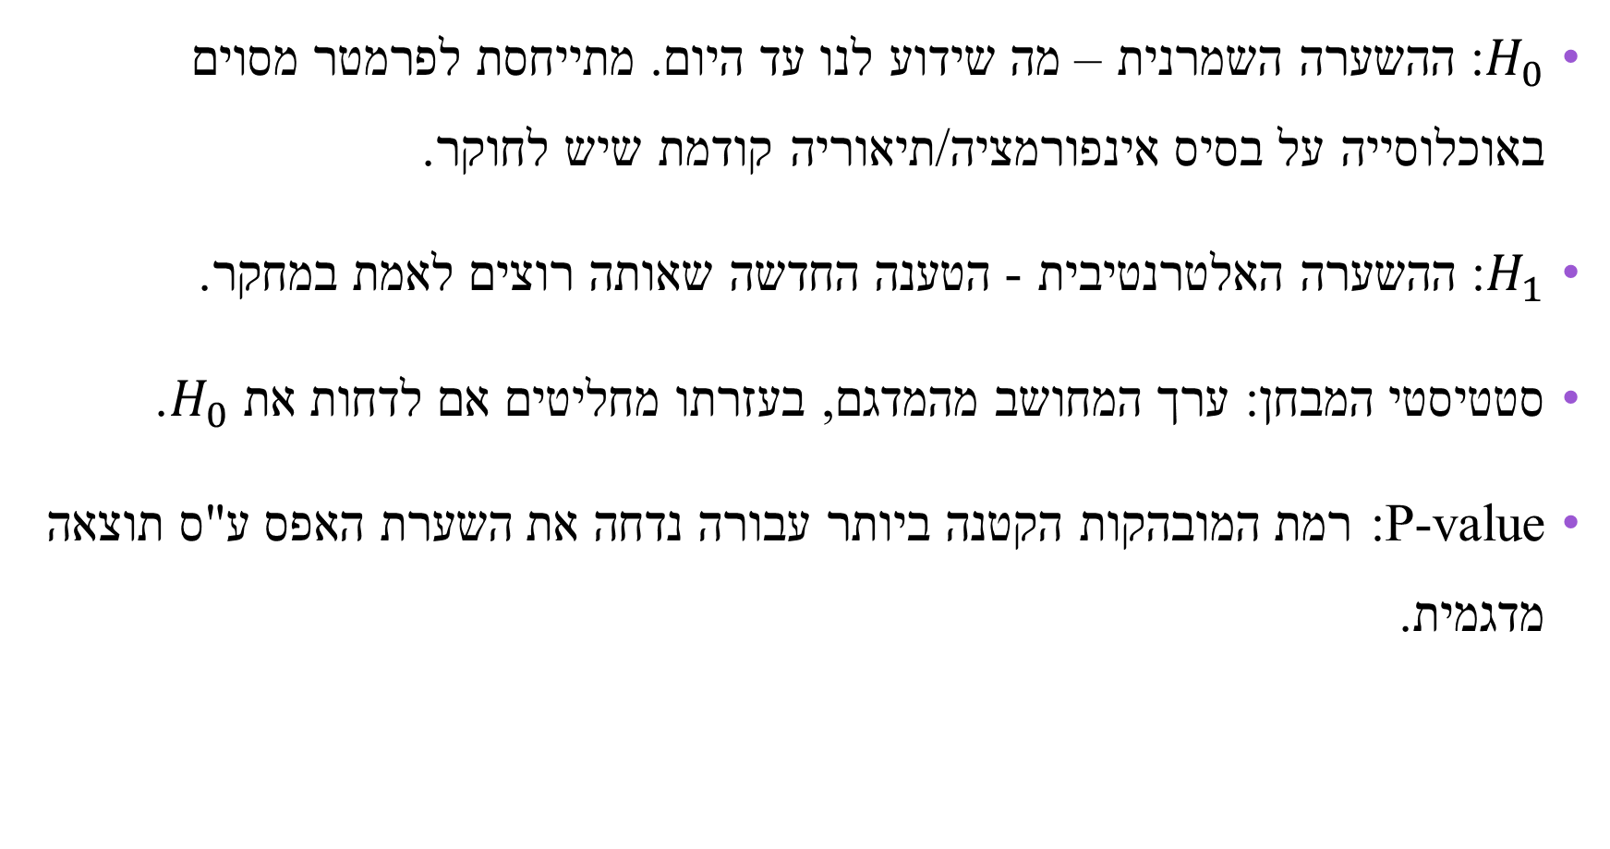
Statistical Hypothesis Testing
$H_{0}$: ההשערה השמרנית – מה שידוע לנו עד היום. מתייחסת לפרמטר מסוים באוכלוסייה על בסיס אינפורמציה/תיאוריה קודמת שיש לחוקר.
$H_{1}$: ההשערה האלטרנטיבית - הטענה החדשה שאותה רוצים לאמת במחקר.
סטטיסטי המבחן: ערך המחושב מהמדגם, בעזרתו מחליטים אם לדחות את $H_{0}$.
P-value: רמת המובהקות הקטנה ביותר עבורה נדחה את השערת האפס ע"ס תוצאה מדגמית.

Slide 4
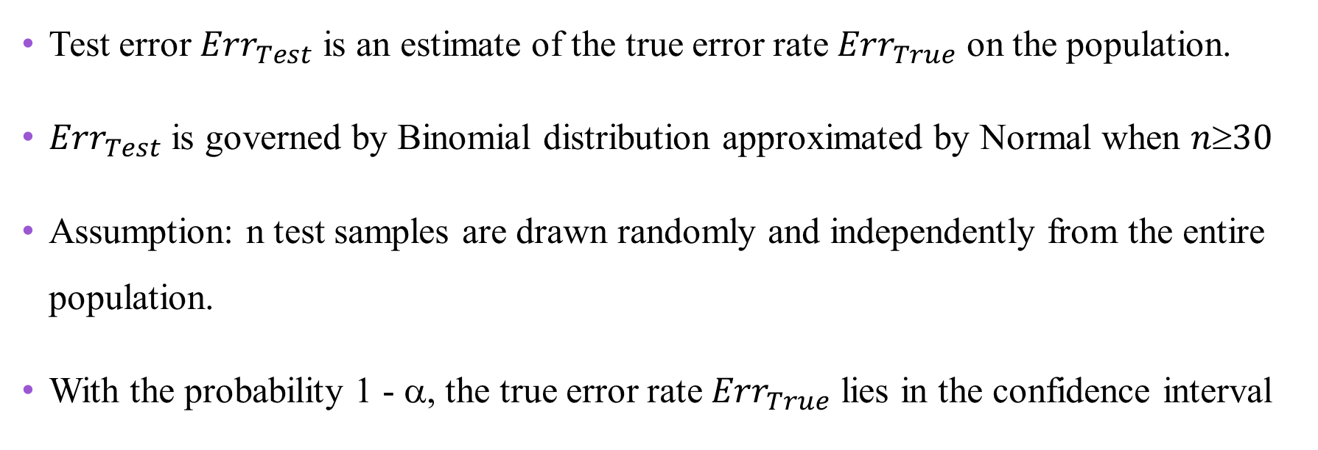
Confidence Interval for an Error Rate
Test error ${Err}_{Test}$ is an estimate of the true error rate ${Err}_{True}$ on the population.
${Err}_{Test}$ is governed by Binomial distribution approximated by Normal when $n30$
Assumption: n test samples are drawn randomly and independently from the entire population.
With the probability 1 - α, the true error rate ${Err}_{True}$ lies in the confidence interval
4
Notes:
Data Mining (BGU) - Lecture No. 10
March 25, 2019
Dr. Mark Last
4

Slide 5
Confidence Interval - Example
Min.
Error
Max.
Notes:
Data Mining (BGU) - Lecture No. 10
March 25, 2019
Dr. Mark Last
5
Alpha or alpha/2?
Explain z_alpha with a chart of the Normal distribution

Slide 6
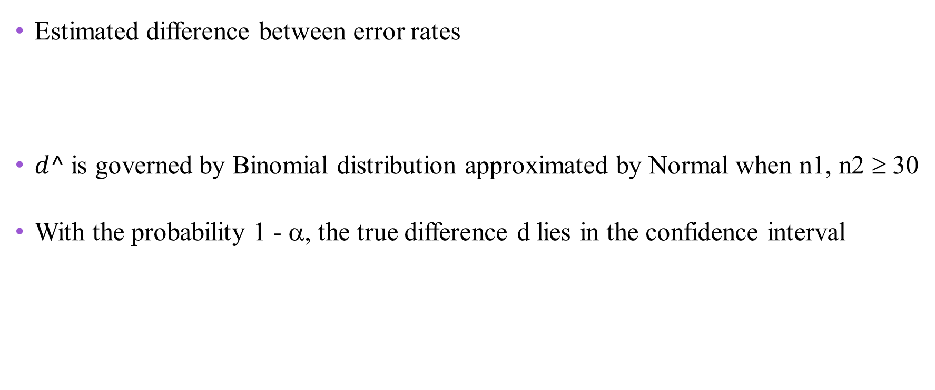
Difference between Classifiers
Estimated difference between error rates
$d^$is governed by Binomial distribution approximated by Normal when n1, n2 ≥ 30
With the probability 1 - α, the true difference d lies in the confidence interval
6
Notes:
Data Mining (BGU) - Lecture No. 10
March 25, 2019
Dr. Mark Last
6
Alpha or alpha/2?

Slide 7
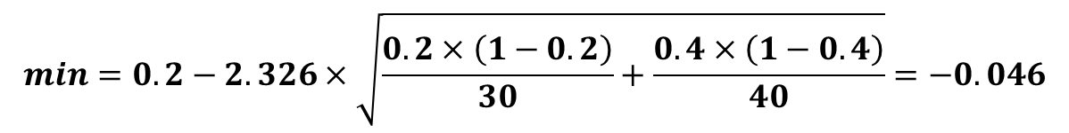
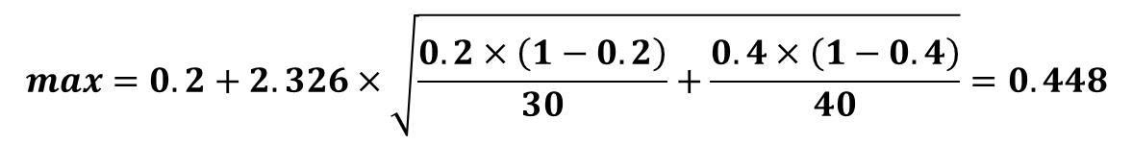
Difference between Classifiers - Example
Error1
n1
Error2
n2
d
alpha
z_alpha
min.
max.
0.200
30
0.400
40
0.20
0.010
2.326
-0.046
0.448
0.200
30
0.400
40
0.20
0.050
1.645
0.025
0.375
0.200
30
0.400
40
0.20
0.100
1.282
0.064
0.336
If α=0.01, we are not confident that model 1 is really more accurate than model 2
7
Notes:
Data Mining (BGU) - Lecture No. 10
March 25, 2019
Dr. Mark Last
7

Slide 8
Algorithm for Decision Tree Induction
Basic algorithm (greedy)
Tree is constructed in a top-down recursive divide-and-conquer manner
At start, all the training examples are at the root
Attributes are categorical (if continuous-valued, discretized in advance)
Examples are partitioned recursively based on selected attributes
Test attributes are selected on the basis of a heuristic or a statistical measure (e.g., information gain)
Conditions to stop partitioning
All samples for a given node belong to the same class
There are no remaining attributes – majority voting is employed for classifying the leaf
There are no samples left - majority voting

Slide 9
Basic Decision Tree Learning ID3 Algorithm (based on Quinlan, Induction of Decision Trees, 1986)
Create a root node for the tree
If all examples have the same target value, return the single-node tree root labeled by that value
If there no attributes left, return the single-node tree root labeled by the most common value in the examples
Otherwise begin

Slide 10
ID3 Algorithm (cont’d)
Select the attribute A that best classifies the examples
Repeat for each possible value of A
Split the tree (add a new branch to the tree corresponding to each value v of the attribute A)
If there are no examples having value v for the attribute A
Add a leaf node below this branch labeled by the most common value in the examples
Else
Create a subtree below this new branch

Slide 11
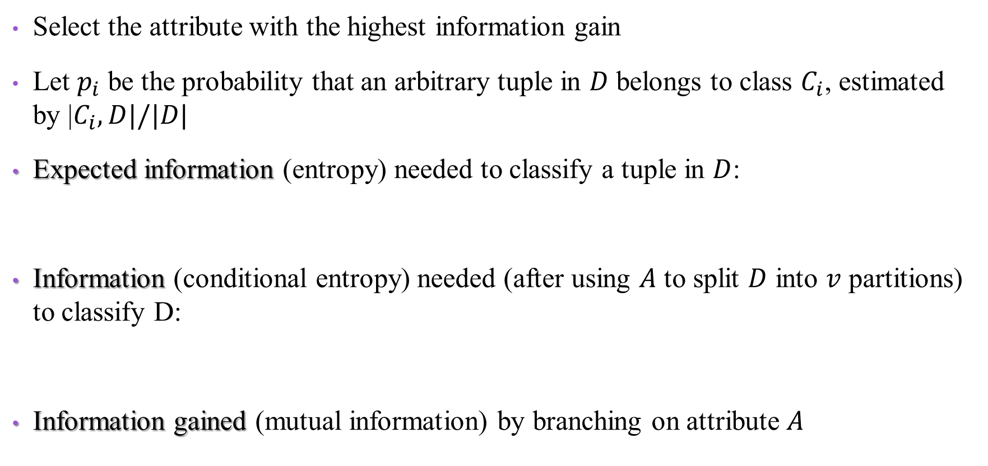
Attribute Selection in ID3 : Information Gain
Select the attribute with the highest information gain
Let $p_{i}$ be the probability that an arbitrary tuple in $D$ belongs to class $C_{i}$, estimated by |$C_{i}, D|/|D|$
Expected information (entropy) needed to classify a tuple in $D$:
Information (conditional entropy) needed (after using $A$ to split $D$ into $v$ partitions) to classify D:
Information gained (mutual information) by branching on attribute $A$

Slide 12
ID3
A1
A2
A3
Root node
A3
Value 1
Value 2
A2
A1
Value 1
Value 2
Value 1
Value 2
Value 3
A2
Value 1
Value 2

Slide 13
An Example…
Meaningless
Week
Weather
Parents
Money
Decision (Class)
W1
Sunny
Yes
Rich
Cinema
W2
Sunny
No
Rich
Tennis
W3
Windy
Yes
Rich
Cinema
W4
Rainy
Yes
Poor
Cinema
W5
Rainy
No
Rich
Stay in
W6
Rainy
Yes
Poor
Cinema
W7
Windy
No
Poor
Cinema
W8
Windy
No
Rich
Shopping
W9
Windy
Yes
Rich
Cinema
W10
Sunny
No
Rich
Tennis

Slide 14
ID3 Example
Root node
C=6,T=2,Si=1, Sh=1

Slide 15
ID3 to build a decision tree
Figure out which attribute will be put into the node at the top of our tree:
Weather, Parents or Money.
To do this, we first need to calculate:
$Info(D)$= $−pcinema log2(pcinema) −ptennis log2(ptennis) −pshopping log2(pshopping) −pstay_in log2(pstay_in)$
$$= −(6/10) ∗ log2(6/10) −(2/10) ∗ log2(2/10) −(1/10) ∗ log2(1/10) −(1/10) ∗ log2(1/10) \\ = 1.571$$

Slide 16
Now lets calculate the gain for the weather attribute:
Gain(D, weather) = 1.571 – Info_{weather}(D)
Info_{weather}(D) = (|D_{sunny}|/10)*Info(D_{sunny}) + (|D_{windy}|/10)*Info(D_{windy}) + (|D_{rainy}|/10)*Info(D_{rainy})
Where,
Info(D_{sunny}) = -p_{cinema|sunny}log₂(p_{cinema|sunny})-p_{tennis|sunny}log₂(p_{tennis|sunny})
= -(1/3)*log₂ (1/3)-(2/3)*log₂ (2/3) = 0.918
Info(D_{windy}) = -p_{cinema|windy}log₂(p_{cinema|windy}) –p_{shopping|windy}log₂(p_{shopping|windy})
= -(3/4)*log₂ (3/4)-(1/4)*log₂ (1/4) = 0.811
Info(D_{rainy}) = -p_{cinema|rainy}log₂(p_{cinema|wind}) –p_{stay_in|rainy}log₂(p_{stay_in|rainy})
= -(2/3)*log₂ (2/3)-(1/3)*log₂ (1/3) = 0.918
Gain(D, weather) = 1.571 - (3/10)*Info(D_{sunny}) - (4/10)*Info(D_{windy}) - (3/10)*Info(D_{rainy}) = 0.69
(2,1,0,0)
(3,0,1,0)
(2,0,0,1)

Slide 17
Now lets calculate the gain for the parents attribute:
Gain(D, parents) = 1.571 - (|D_{yes}|/10)*Info(D_{yes}) - (|D_{no}|/10)*Info(D_{no})
Where,
Info(D_{yes}) = -p_{cinema|yes}log₂(p_{cinema|yes})
= -(5/5)*log₂(5/5)= 0
Info(D_{no}) = -p_{tennis|no}log₂(p_{tennis|no}) –p_{stay_in|no}log₂(p_{stay_in|no}) -p_{cinema|no}log₂(p_{cinenema|no}) p_{shopping|no}log₂(p_{shopping|no})
= -(2/5)*log₂ (2/5)-(1/5)*log₂ (1/5)- (1/5)*log₂ (1/5)-(1/5)*log₂(1/5) = 1.922
Gain(D, parents) = 1.571 - (5/10)*Info(D_{yes}) - (5/10)*Info(D_{no}) = 0.61

Slide 18
Now lets calculate the gain for the money attribute:
Gain(D, money) = 1.571 - (|D_{rich}|/10)*Info(D_{rich}) - (|D_{poor}|/10)*Info(D_{poor})
Where,
Info(D_{rich}) = -p_{cinema|rich}log₂(p_{cinema|rich}) -p_{tennis|rich}log₂(p_{tennis|rich}) –p_{stay_in|rich}log₂(p_{stay_in|rich}) -p_{shopping}log₂(p_{shopping})
= -(3/7)*log₂(3/7)-(2/7)*log₂(2/7)-(1/7)*log₂(1/7)-(1/7)*log₂(1/7)= 1.842
Info(D_{poor}) = -p_{cinema|no}log₂(p_{cinema|no})
= -(3/3)*log₂ (3/3) = 0
Gain(D, money) = 1.571 - (7/10)* Info(D_{rich}) - (3/10)* Info(D_{poor}) = 0.28

Slide 19
Information Gain | Attribute
0.69 | Weather
0.61 | Parents
0.28 | Money

Slide 20
The first node in the decision tree will be the weather attribute.
Now we look at the first branch. S_{sunny} = {W1, W2, W10}.
We do not put a default categorization leaf node here (Why?).
Root node
C=6,T=2,Si=1, Sh=1
Weather
Windy (n=4)
C=3, T=0, Sh=1, Si=0
Rainy
C=2, T=0, Sh=0, Si=1
Sunny (n=3)
C=1, T=2, Sh=0, Si=0

Slide 21

Now we have to fill in the choice of attribute $A$, which we know cannot be weather, because we've already removed that from the list of attributes to use.
So, we need to calculate the values for $Gain(Dsunny, parents)$and $Gain(Dsunny, money)$.
Decision
Week
Weather
Parents
Money
(Category)
W1
Sunny
Yes
Rich
Cinema
W2
Sunny
No
Rich
Tennis
W10
Sunny
No
Rich
Tennis

Slide 22
Hence we can calculate:
Gain(D_{sunny},parents) = 0.918 - (|D_{yes}|/|D_{sunny}|)*Info(D_{yes}) - (|D_{no}|/|D_{sunny}|)*Info(D_{no}) = 0.918 - (1/3)*0 - (2/3)*0 = 0.918
Gain(D_{sunny},money) = 0.918 - (|D_{rich}|/|D_{sunny}|)*Info(D_{rich}) - (|D_{poor}|/|D_{sunny}|)*Info(D_{poor}) = 0.918 - (3/3)*0.918 - 0 = 0.918 - 0.918 = 0
Note: Info(D_{yes}) and Info(D_{no}) were both zero, because D_{yes} and D_{no} contains examples which are all in the same category (cinema, tennis).
This should make it more obvious why we use information gain to choose attributes.
Info(D_{sunny})

Slide 23

Given our calculations, attribute $A$ should be taken as parents.
Root node
C=6,T=2,Si=1, Sh=1
Weather
Sunny (n=3)
C=1, T=2, Sh=0, Si=0
Windy (n=4)
C=3, T=0, Sh=1, Si=0
Rainy
C=2, T=0, Sh=0, Si=1
Parents
Yes (n=1)
C=1
No (n=2)
T=2

Slide 24
Now we need to calculate the values for Gain(D_{windy}, parents) and Gain(D_{windy}, money).
Decision
Week
Weather
Parents
Money
(Category)
W3
Windy
Yes
Rich
Cinema
W7
Windy
No
Poor
Cinema
W8
Windy
No
Rich
Shopping
W9
Windy
Yes
Rich
Cinema

Slide 25
Gain(D_{windy},parents) = 0.811 - (|D_{yes}|/|D_{windy}|)*Info(D_{yes}) - (|D_{no}|/|D_{windy}|)*Info(D_{no}) = 0.811 - (2/4)*0 - (2/4)*1 = 0.311
Gain(D_{windy},money)=0.811- (|D_{rich}|/|D_{windy}|)*Info(D_{rich}) - (|D_{poor}|/|D_{windy}|)*Info(D_{poor}) = 0.811 - (3/4)*0.918 - (1/4)*0 = 0.122
Meaning that this node will be split by parents too.
After calculating the Gain for rainy too, the final tree is…

Slide 26
Root node
C=6,T=2,Si=1, Sh=1
Weather
Sunny (n=3)
C=1, T=2, Sh=0, Si=0
Windy (n=4)
C=3, T=0, Sh=1, Si=0
Rainy
C=2, T=0, Sh=0, Si=1
Money
Parents
Parents
Yes (n=1)
C=1
No (n=2)
T=2
Yes (n=2)
C=2
No (n=2)
C=1, Sh=1
Rich (n=1)
Si=1
Poor (n=2)
C=2
Money
Rich (n=1)
Sh=1
Poor (n=1)
C=1

Slide 27
Accuracy Estimation
Training Accuracy Rate
The percentage of training set samples that are correctly classified by the model.
Testing Accuracy Rate
The percentage of test set samples that are correctly classified by the model.
Test set is independent of training set, otherwise over-fitting will occur.
Majority Rule Accuracy
To select a class for a terminal node, select the class having the most examples (in training set).
Majority rule accuracy = |D_{A}|/|D|
The classification model should be more accurate than the majority rule.
Notes:
תצפיות

Slide 28
Accuracy Estimation
In our example, training accuracy is 10/10 = 100 %
Take the following testing set for example:
Testing accuracy is: 3/4 = 75%
Majority rule accuracy = 6/10 = 60%

Slide 29

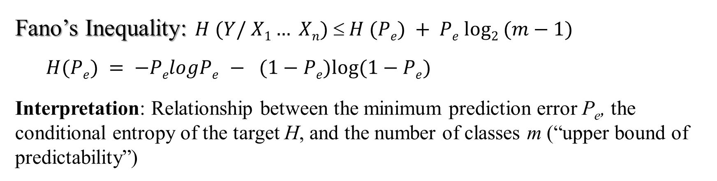
Fano’s Inequality
Fano’s Inequality: $H (Y/ X1… Xn)  H (Pe) + Pe log2 (m−1)$
$$H(Pe) = −PelogPe − (1−Pe)log⁡(1−Pe)$$
Interpretation: Relationship between the minimum prediction error P_{e}, the conditional entropy of the target H, and the number of classes m (“upper bound of predictability”(
$$H(Class|Weather)=0.881$$
$$0.881=−Pelog2(Pe)−(1−Pe)log2(1−Pe)+Pelog2(4−1)$$
Root node
C=6,T=2,Si=1, Sh=1
P_{e} ≈ 0.158 max test accuracy = 84.2%
Weather
Sunny (n=3)
C=1, T=2, Sh=0, Si=0
Windy (n=4)
C=3, T=0, Sh=1, Si=0
Rainy
C=2, T=0, Sh=0, Si=1

