Slide 1
Data Science and Business Intelligence
#5 – Decision tree learning (cont.)
nivah@post.bgu.ac.il

Slide 2
Splitting Rules
Possible splitting functions (rules)
Entropy (Information Gain and Gain Ratio)
Gini Index
Twoing

Slide 3
Information Gain Ratio
The problem with multi-valued and continuous attributes in noisy databases
The probability of a subset of examples to have the same class increases monotonically with a decrease in the subset size
The extreme case is a subset of one example
The average size of a subset decreases with an increase in the total number of attribute values (e.g., attribute Date)
Conclusion
Information gain is biased towards multi-valued and continuous attributes
Notes:
ההסתברות לדגימה שכל הרשומות בה עם אותו סיווג גדלה ככל שגודל הדגימה קטן.
גודל הדגימה הממוצע קטן ככל שיש יותר ערכים אפשריים לתכונה (כשמחלקים את הנתונים לדגימות לפי אותה תכונה).
מסקנה – infoGain מוטה לטובת תכונות בעלות הרבה ערכים אפשריים.

Slide 4
The Gain Ratio Approach
The Gain Ratio Approach
“Punish” the multi-valued attributes via dividing (normalizing) their information gain by the Split Information:
The Split Information represents the entropy of the tested attribute (in contrast to the entropy of the target attribute)
The Gain Ratio: Gain(A)/SplitInfo(A)

Slide 5
The Gain Ratio Approach - Example
Notes:
IV = intrinsic value = SplitInfo

Slide 6
The Gain Ratio Approach - Example
Info(Decision) = Info(1,2,3) =
-1/6log₂1/6 -2/6log₂2/6 -3/6log₂3/6 = 1.46
Info_{Temperature}(Decision) = 1/6*0 + 2/6*1 + 1/6*0 +1/6*0 + 1/6*0 = 0.33
Gain(Temperature) = 1.46-0.33 = 1.13
The Gain Ratio: Gain(A) / IV(A)
Gain Ratio (Temperature) = 1.13/2.25 = 0.502

Slide 7
The Gain Ratio Approach - Example
Info_{Humidity}(Decision) = 2/6*0 + 1/6*0 + 2/6*0 +1/6*0 = 0
Gain(Humidity) = 1.46-0 = 1.46
Gain Ratio (Humidity) = 1.46/1.92 = 0.76
0.76 > 0.502 → We’ll prefer the Humidity attribute.

Slide 8

The Gain Ratio Split
$Info (A)= Info (1,2,1,1)= −1/5\log_{2}1/5 −2/5\log_{2}2/5 −1/5\log_{2}1/5 −1/5\log_{2}1/5 = 1.92$
$Info (D)= Info (2,3) = 0.971$
Record | Attribute | Class
1 | 1 | 0
2 | 1.5 | 1
3 | 1.5 | 0
4 | 1.7 | 1
5 | 2.1 | 1

Slide 9
The Gain Ratio Split
Record | Attribute | Class
1 | 1 | 0
2 | 1.5 | 1
3 | 1.5 | 0
4 | 1.7 | 1
5 | 2.1 | 1
_{Classes}
N(L,R) | 0 |  | 1 |  | Total
 | L | R | L | R | L | R
1 | 1 | 1 | 0 | 3 | 1 | 4
1.5 | 2 | 0 | 1 | 2 | 3 | 2
1.7 | 2 | 0 | 2 | 1 | 4 | 1
2.1 | 2 | 0 | 3 | 0 | 5 | 0

Slide 10
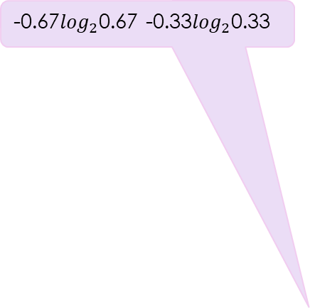
The Gain Ratio Split
-0.67$\log_{2}$0.67 -0.33$\log_{2}$0.33
0.971-(3/5)*0.92-(2/5)*0
P(L,R)+ | 0 |  | 1 |  | Entropy |  | Gain | G.R.
 | L | R | L | R | L | R
1 (1,4) | 1 | =(1/4) =0.25 | 0 | 0.75 | 0 | 0.81 | 0.32 | 0.17
1.5 (3,2) | 0.67 | 0 | 0.33 | 1 | 0.92 | 0 | 0.42 | 0.22
1.7 (4,1) | 0.5 | 0 | =(2/4) =0.5 | 1 | 1 | 0 | 0.17 | 0.09
2.1 (5,0) | 0.4 | 0 | 0.6 | 0 | 0.97 | 0 | 0 | 0
0.17/1.92

Slide 11
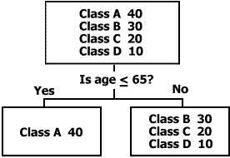
Gini Index
Looks for the largest class in the data set and strives to isolate it from all other classes

Slide 12
Gini Index
If a data set T contains examples from n classes, gini index, gini(T) is defined as:
where p_{j} is the relative frequency of class j in T.
If a data set T is split into two subsets T₁ and T₂ with sizes N₁ and N₂ respectively, the gini index of the split data contains examples from n classes, the gini index gini(T) is defined as:
The attribute provides the smallest gini_{split}(T) is chosen to split the node (need to enumerate all possible splitting points for each attribute).
Reduction in Impurity:

Slide 13
Gini Index - Example
Record | Attribute | Class
1 | 1 | 0
2 | 1.5 | 1
3 | 1.5 | 0
4 | 1.7 | 1
5 | 2.1 | 1
_{Classes}
N(L,R) | 0 |  | 1 |  | Total
 | L | R | L | R | L | R
1 | 1 | 1 | 0 | 3 | 1 | 4
1.5 | 2 | 0 | 1 | 2 | 3 | 2
1.7 | 2 | 0 | 2 | 1 | 4 | 1
2.1 | 2 | 0 | 3 | 0 | 5 | 0

Slide 14
1-((1/4)²+(3/4)²)
P(L,R)+ | 0 |  | 1 |  | Gini(A) |  | Gini Split
 | L | R | L | R | L | R
1 (1,4) | =1/1 | 1/4 | =0/1 | =3/4 | 0 | 0.38 | 0.3
1.5 (3,2) | 0.67 | 0 | 0.33 | 1 | 0.44 | 0 | 0.27
1.7 (4,1) | 0.5 | 0 | =2/4 | 1 | 0.5 | 0 | 0.4
2.1 (5,0) | =2/5 | 0 | =3/5=0.6 | 0 | 0.48 | 1 | 0.48
1-(2/5)²+(3/5)²)
((3/5)*0.44+(2/5)*0)

Slide 15
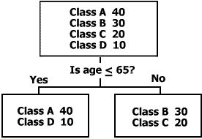
Twoing
Attempts to find groups of up to 50% of the data each

Slide 16
The Twoing Split Example
=|1-0.25|
P(L,R)+ | 0 |  | 1 |  | |PL-PR| |  | Total | Twoing
 | L | R | L | R | 0 | 1
1 (1,4) | 1 | 0.25 | 0 | 0.75 | 0.75 | 0.75 | 1.5 | 0.09
1.5 (3,2) | 0.67 | 0 | 0.33 | 1 | 0.67 | 0.67 | 1.33 | 0.107
1.7 (4,1) | 0.5 | 0 | 0.50 | 1 | 0.5 | 0.5 | 1 | 0.04
2.1 (5,0) | 0.4 | 0 | 0.60 | 0 | 0.4 | 0.6 | 1 | 0

Slide 17
CART – Classification and Regression Tree
Objective: minimizing the cost-complexity function
T - a tree
R (T) - the training error rate of a tree
R_{α} (T) - the cost-complexity of a tree
- number of terminal nodes in a tree
α - complexity parameter (real number, greater than zero)

Slide 18
CART - Example
Week | Weather | Parents | Money | Decision
W1 | Sunny | Yes | Rich | Cinema
W2 | Sunny | No | Rich | Tennis
W3 | Windy | Yes | Rich | Cinema
W4 | Rainy | Yes | Poor | Cinema
W5 | Rainy | No | Rich | Stay in
W6 | Rainy | Yes | Poor | Cinema
W7 | Windy | No | Poor | Cinema
W8 | Windy | No | Rich | Shopping
W9 | Windy | Yes | Rich | Cinema
W10 | Sunny | No | Rich | Tennis
W11 | Windy | No | Rich | Shopping
W12 | Windy | No | Rich | Shopping
W13 | Windy | Yes | Poor | Cinema

Slide 19
CART – Example Maximal Tree (α = 0)
Error:
Before pruning: 0%
After pruning: 33%
Weather
Sunny
Rainy
Windy
Parents
Parents
Money
Yes
No
No
Yes
Rich
Poor
Cinema
(W1)
Tennis
(W2,W10)
Money
Cinema
(W3,W9, W13)
Stay in
(W5)
Cinema
(W4,W6)
Poor
Rich
Cinema
(W7)
Shopping
(W8, W11, W12)

Slide 20
CART – Example
Cost-complexity of the single node t
R_{α}({t}) = R(t) + α*1 = 0.33 + α // After Pruning
Cost-complexity of the branch T_{t}
R_{α}(T_{t}) = R(T_{t}) + α*|Ť_{t}| = 0 +α*2 // Before Pruning
The critical value of α
R_{α}({t}) = R_{α}(T_{t})
0.33 + α = 2 α
α = 0.33

Slide 21
CART – Example Maximal Tree (α = 0)
Error:
Before pruning: 0%
After pruning: 25%
Weather
Sunny
Rainy
Windy
Parents
Parents
Money
Yes
No
No
Yes
Rich
Poor
Cinema
(W1)
Tennis
(W2,W10)
Money
Cinema
(W3,W9, W13)
Stay in
(W5)
Cinema
(W4,W6)
Poor
Rich
Cinema
(W7)
Shopping
(W8, W11, W12)

Slide 22
CART – Example
Cost-complexity of the single node t
R_{α}({t}) = R(t) + α*1 = 0.25 + α
Cost-complexity of the branch T_{t}
R_{α}(T_{t}) = R(T_{t}) + α*|Ť_{t}| = 0 +α*2
The critical value of α
R_{α}({t}) = R_{α}(T_{t})
0.25 + α = 2 α
α = 0.25

Slide 23
CART – Example Maximal Tree (α = 0)
Error:
Before pruning: 0%
After pruning: 33%
Weather
Sunny
Rainy
Windy
Parents
Parents
Money
Yes
No
No
Yes
Rich
Poor
Cinema
(W1)
Tennis
(W2,W10)
Money
Cinema
(W3,W9, W13)
Stay in
(W5)
Cinema
(W4,W6)
Poor
Rich
Cinema
(W7)
Shopping
(W8, W11, W12)

Slide 24
CART – Example
Cost-complexity of the single node t
R_{α}({t}) = R(t) + α*1 = 0.33 + α
Cost-complexity of the branch T_{t}
R_{α}(T_{t}) = R(T_{t}) + α*|Ť_{t}| = 0 +α*2
The critical value of α
R_{α}({t}) = R_{α}(T_{t})
0.33 + α = 2 α
α = 0.33

Slide 25
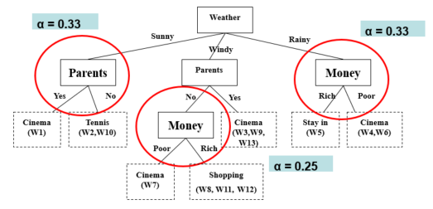
CART – Example Maximal Tree (α = 0)

Slide 26
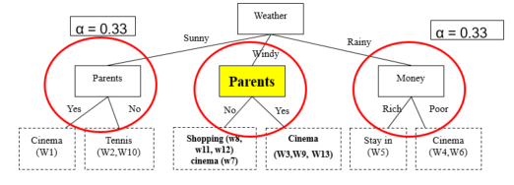
CART – Example Optimal Tree #1(α = 0.25)
Error:
Before pruning: ~14%
After pruning: ~43%

Slide 27
CART – Example
Cost-complexity of the single node t
R_{α}({t}) = R(t) + α*1 = 0.43 + α
Cost-complexity of the branch T_{t}
R_{α}(T_{t}) = R(T_{t}) + α*|Ť_{t}| = 0.14 +α*2
The critical value of α
R_{α}({t}) = R_{α}(T_{t})
0.43 + α = 0.14 + 2 α
α = 0.29

Slide 28
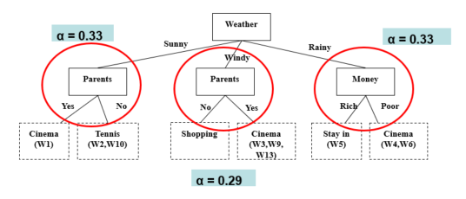
CART – Example Optimal Tree #1(α = 0.25)

Slide 29
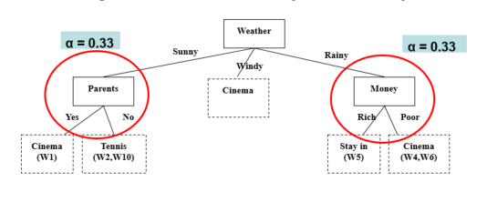
CART – Example Optimal Tree #2(α = 0.29)

Slide 30
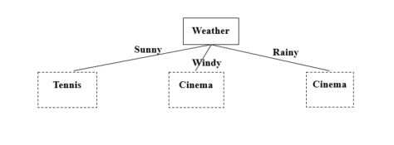
CART – Example Optimal Tree #3 (α = 0.33)

Slide 31
Compare Trees using Test Set
Weekend
Decision
(Example)
Weather
Parents
Money
(Class)
W14
Sunny
Yes
Poor
Cinema
W15
Sunny
No
Rich
Tennis
W16
Windy
No
Rich
Cinema
W17
Rainy
Yes
Poor
Cinema
#1
Test Set Accuracy = ¾ = 75 %
Weather
Sunny
Rainy
Windy
Parents
Parents
Money
Yes
No
No
Yes
Rich
Poor
Cinema
(W1)
Tennis
(W2,W10)
Shopping
Cinema
(W3,W9, W13)
Stay in
(W5)
Cinema
(W4,W6)

Slide 32
Compare Trees using Test Set
Weekend
Decision
(Example)
Weather
Parents
Money
(Class)
W14
Sunny
Yes
Poor
Cinema
W15
Sunny
No
Rich
Tennis
W16
Windy
No
Rich
Cinema
Cinema
W17
Rainy
Yes
Poor
Stay in
#2
Test Set Accuracy = 4/4 = 100 %
Weather
Sunny
Rainy
Windy
Parents
Cinema
Money
Yes
No
Rich
Poor
Cinema
(W1)
Tennis
(W2,W10)
Stay in
(W5)
Cinema
(W4,W6)

Slide 33
Compare Trees using Test Set
Weekend
Decision
(Example)
Weather
Parents
Money
(Class)
W14
Sunny
Yes
Poor
Cinema
W15
Sunny
No
Rich
Tennis
W16
Windy
No
Rich
Cinema
Cinema
W17
Rainy
Yes
Poor
Stay in
#3
Test Set Accuracy =3/4 = 75%
Weather
Sunny
Rainy
Windy
Tennis
Cinema
Cinema

Slide 34
Compare Trees using Test Set
Weekend
Decision
(Example)
Weather
Parents
Money
(Class)
W14
Sunny
Yes
Poor
Cinema
W15
Sunny
No
Rich
Tennis
W16
Windy
No
Rich
Cinema
Cinema
W17
Rainy
Yes
Poor
Stay in
Original Tree
Test Set Accuracy =3/4 = 75%
Weather
Sunny
Rainy
Windy
Parents
Parents
Money
Yes
No
No
Yes
Rich
Poor
Cinema
(W1)
Tennis
(W2,W10)
Money
Cinema
(W3,W9, W13)
Stay in
(W5)
Cinema
(W4,W6)
Poor
Rich
Cinema
(W7)
Shopping
(W8, W11, W12)

Slide 35
The Optimal Tree
Tree # 2
Weather
Sunny
Rainy
Windy
Parents
Cinema
Money
Yes
No
Rich
Poor
Cinema
(W1)
Tennis
(W2,W10)
Stay in
(W5)
Cinema
(W4,W6)

