Slide 1
Context-Free Languages

Slide 2




Regular Languages

Slide 3
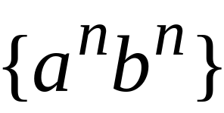
Context-Free Languages
Regular Languages

Slide 4
Context-Free Languages
Context-Free
Grammars
Pushdown
Automata
stack
automaton

Slide 5
Context-Free Grammars

Slide 6

Grammars
Grammars express languages
Example: the English language

Slide 7
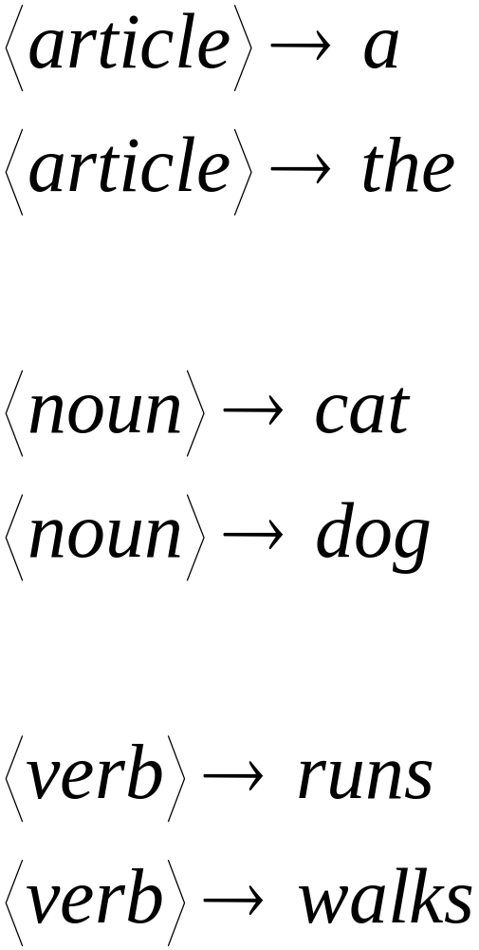

Slide 8
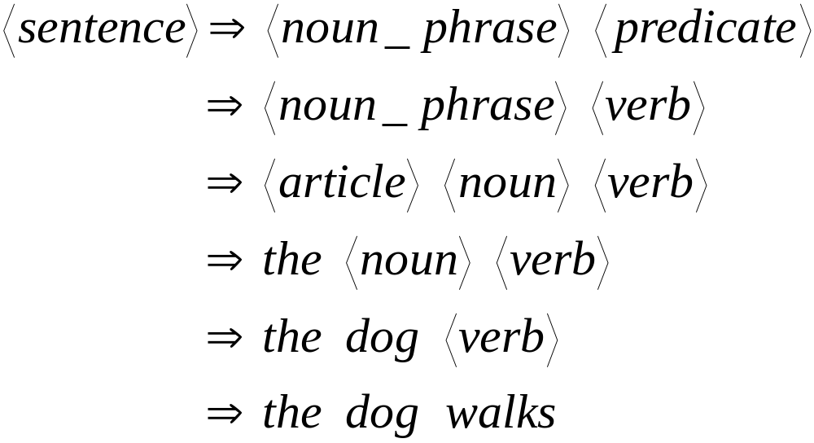
A derivation of “the dog walks”:

Slide 9
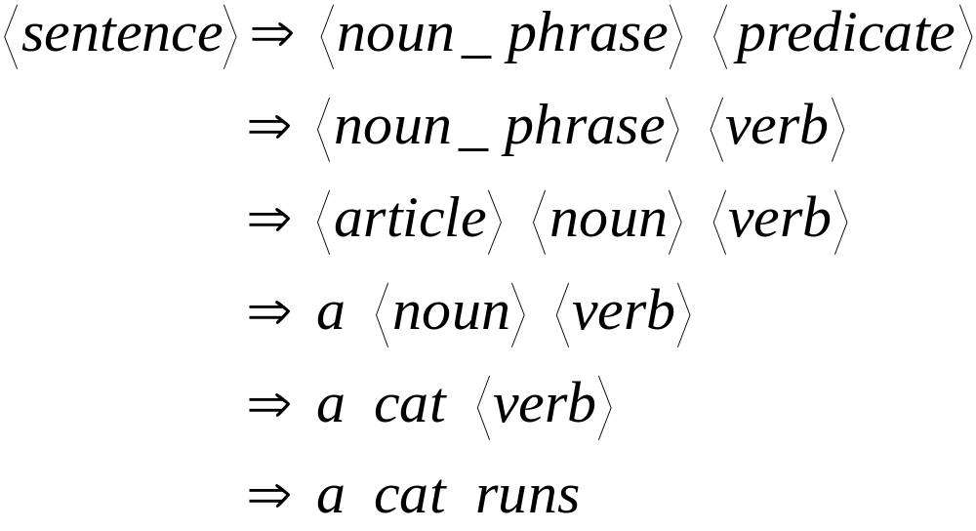
A derivation of “a cat runs”:

Slide 10
Language of the grammar:
L = { “a cat runs”,
“a cat walks”,
“the cat runs”,
“the cat walks”,
“a dog runs”,
“a dog walks”,
“the dog runs”,
“the dog walks” }

Slide 11
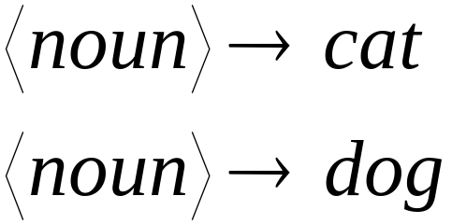
Notation
Production Rules
Variable
Terminal

Slide 12





Another Example
Grammar:
Derivation of sentence :

Slide 13



Grammar:
Derivation of sentence :

Slide 14

Other derivations:

Slide 15

Language of the grammar

Slide 16





More Notation
Grammar
Set of variables
Set of terminal symbols
Start variable
Set of Production rules

Slide 17




Example
Grammar :

Slide 18
More Notation
Sentential Form:
A sentence that contains
variables and terminals
Example:
Sentential Forms
sentence

Slide 19

We write:
Instead of:

Slide 20

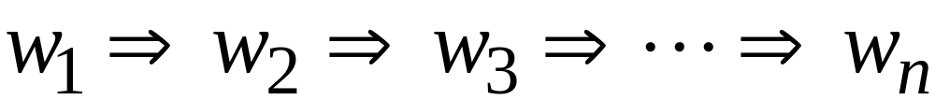
In general we write:
If:

Slide 21
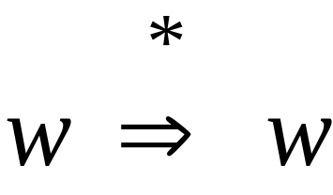
By default:

Slide 22
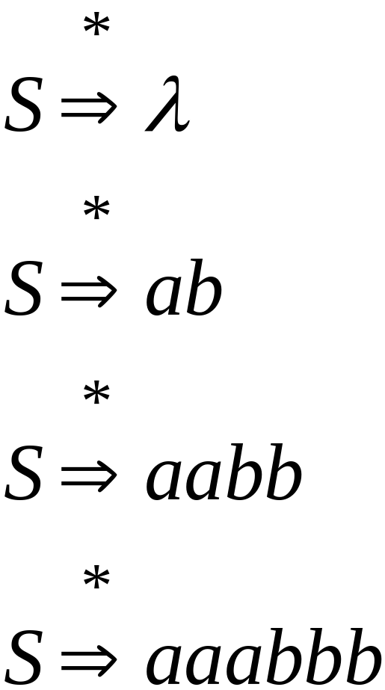
Example
Grammar
Derivations

Slide 23
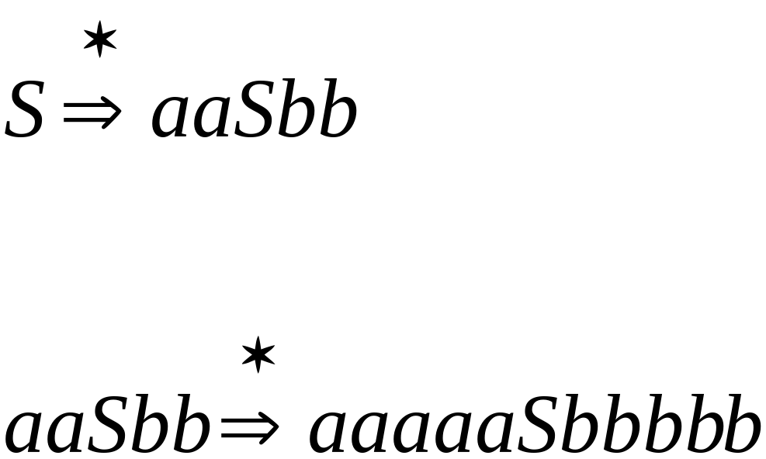
Example
Grammar
Derivations

Slide 24
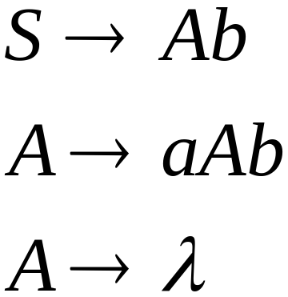
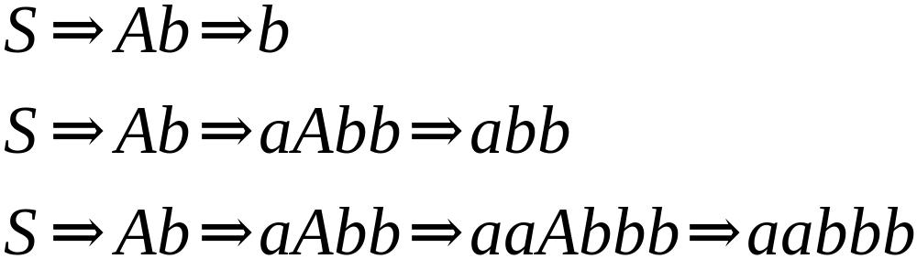
Another Grammar Example
Grammar :
Derivations:

Slide 25
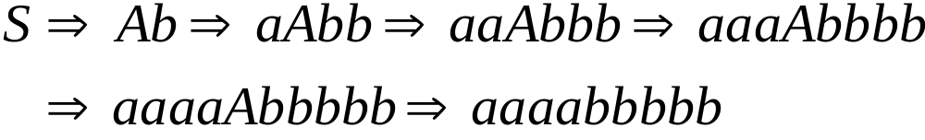
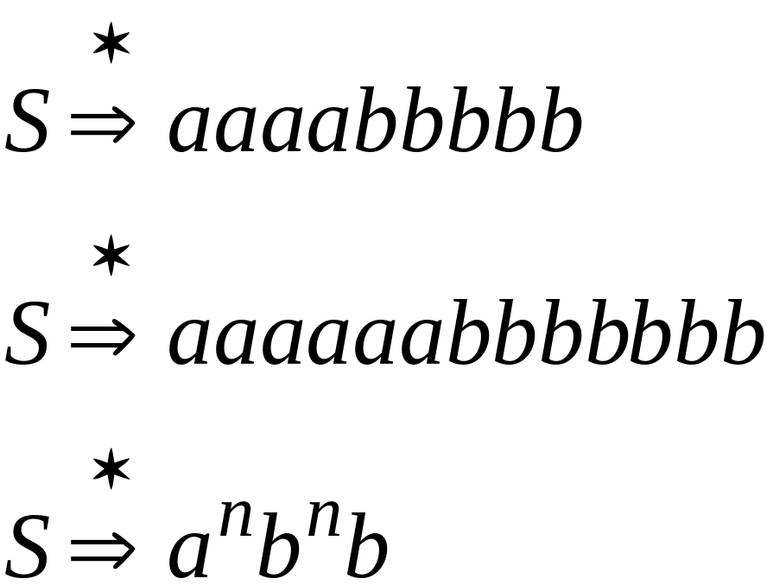
More Derivations

Slide 26

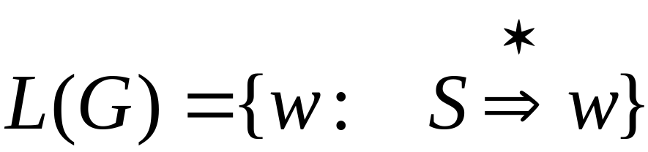
Language of a Grammar
For a grammar
with start variable :
String of terminals

Slide 27

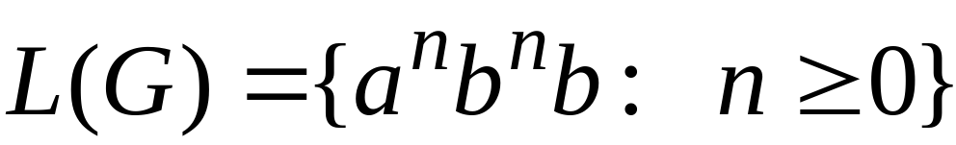
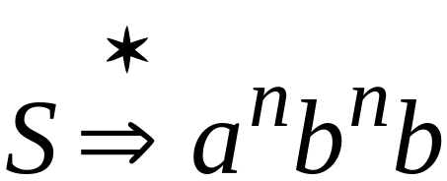
Example
For grammar :
Since:

Slide 28
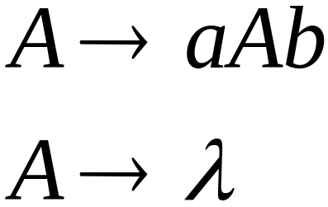
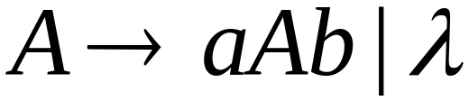
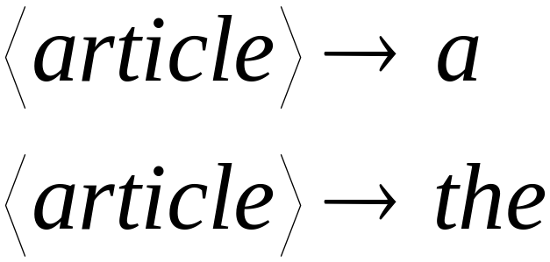
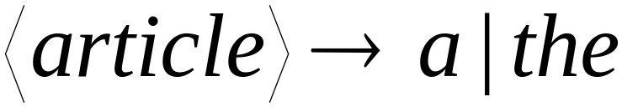
A Convenient Notation

Slide 29
Example
A context-free grammar :
A derivation:

Slide 30
A context-free grammar :
Another derivation:

Slide 31


Describes parentheses:
(((( ))))

Slide 32
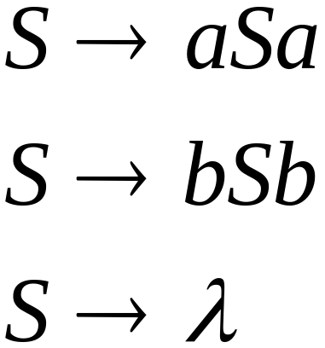
Example
A context-free grammar :
A derivation:

Slide 33
A context-free grammar :
Another derivation:

Slide 34


Slide 35
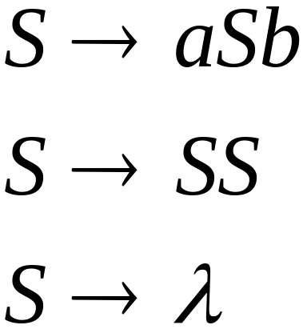
Example
A context-free grammar :
A derivation:

Slide 36
A context-free grammar :
A derivation:

Slide 37
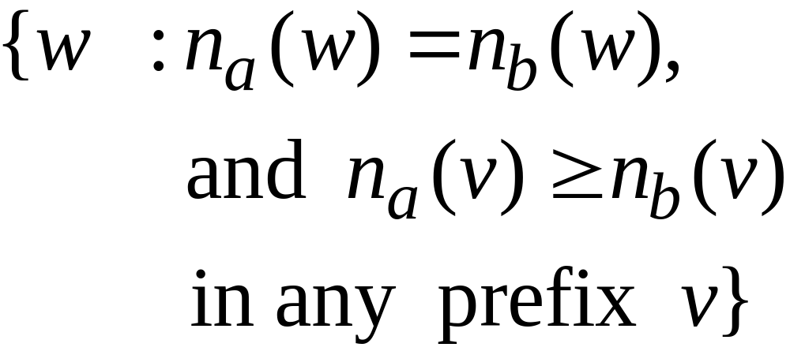
Describes
matched
parentheses:
() ((( ))) (( ))

Slide 38


Definition: Context-Free Grammars
Grammar
Variables
Terminal
symbols
Start
variable
Productions of the form:
Variable
String of variables
and terminals

Slide 39


Slide 40

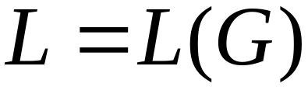
Definition: Context-Free Languages
A language is context-free
if and only if
there is a context-free grammar
with

Slide 41
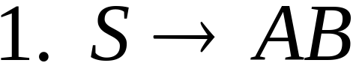
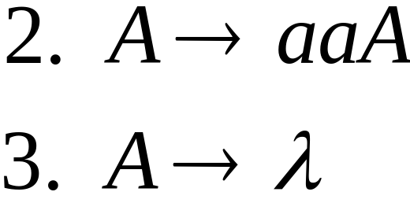
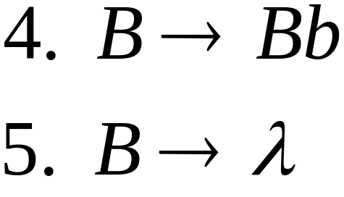


Derivation Order
Leftmost derivation:
Rightmost derivation:

Slide 42
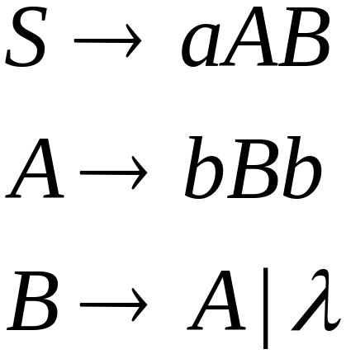
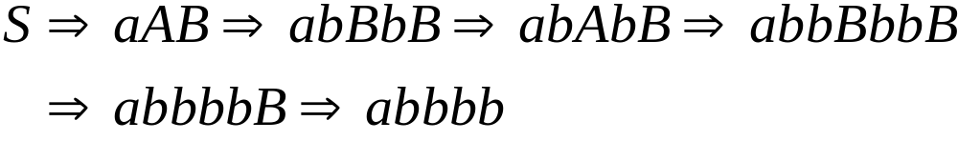
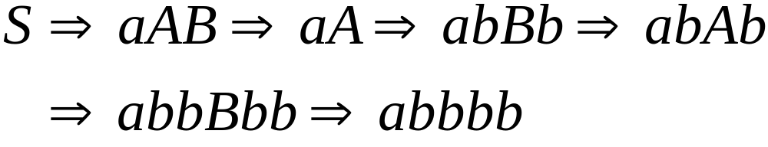
Leftmost derivation:
Rightmost derivation:

Slide 43
Derivation Trees

Slide 44

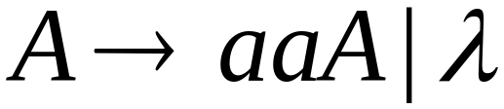
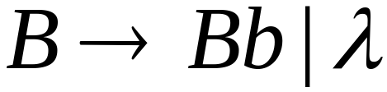





Slide 45



Slide 46


Slide 47


Slide 48
Derivation Tree

Slide 49
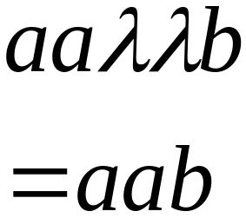
Derivation Tree
yield

Slide 50
Partial Derivation Trees
Partial derivation tree

Slide 51
Partial derivation tree

Slide 52

sentential
form
Partial derivation tree
yield

Slide 53
Sometimes, derivation order doesn’t matter
Leftmost:
Rightmost:
Same derivation tree

Slide 54
Compilers

Slide 55
Machine Code
Program
Add v,v,0
cmp v,5
jmplt ELSE
THEN:
add x, 12,v
ELSE:
WHILE:
cmp x,3
...
v = 5;
if (v>5)
x = 12 + v;
while (x !=3) {
x = x - 3;
v = 10;
}
......
Compiler

Slide 56
Compiler
Lexical
analyzer
symbols
tree
Code
generator
parser
input
output
machine
code
program

Slide 57
A parser knows the grammar
of the programming language
Input: 1) Context free grammar
2) Symbols of a program
Output: Derivation tree.

Slide 58

Parser
PROGRAM STMT_LIST
STMT_LIST STMT; STMT_LIST | STMT;
STMT EXPR | IF_STMT | WHILE_STMT
| { STMT_LIST }
EXPR EXPR + EXPR | EXPR - EXPR | ID
IF_STMT if (EXPR) then STMT
| if (EXPR) then STMT else STMT
WHILE_STMT while (EXPR) do STMT

Slide 59
The parser finds the derivation
of a particular input
derivation
Parser
input
E => E + E
=> E + E * E
=> 10 + E*E
=> 10 + 2 * E
=> 10 + 2 * 5
E -> E + E
| E * E
| INT
10 + 2 * 5

Slide 60
derivation tree
derivation
E
E => E + E
=> E + E * E
=> 10 + E*E
=> 10 + 2 * E
=> 10 + 2 * 5
+
E
E
10
E
*
E
2
5

Slide 61
derivation tree
E
machine code
E
+
E
mult a, 2, 5
add b, 10, a
10
E
*
E
2
5

Slide 62
Ambiguity

Slide 63





leftmost derivation

Slide 64

leftmost derivation

Slide 65
Two derivation trees

Slide 66
The grammar
is ambiguous:
string
has two derivation trees

Slide 67
The grammar
is ambiguous:
string
has two leftmost derivations

Slide 68

Definition:
A context-free grammar is ambiguous
if some string has:
two or more derivation trees

Slide 69
In other words:
A context-free grammar is ambiguous
if some string has:
two or more leftmost derivations
(or rightmost)

Slide 70

Why do we care about ambiguity?
take

Slide 71



Slide 72






Slide 73
Correct result:

Slide 74
Ambiguity is bad for programming languages
We want to remove ambiguity

Slide 75
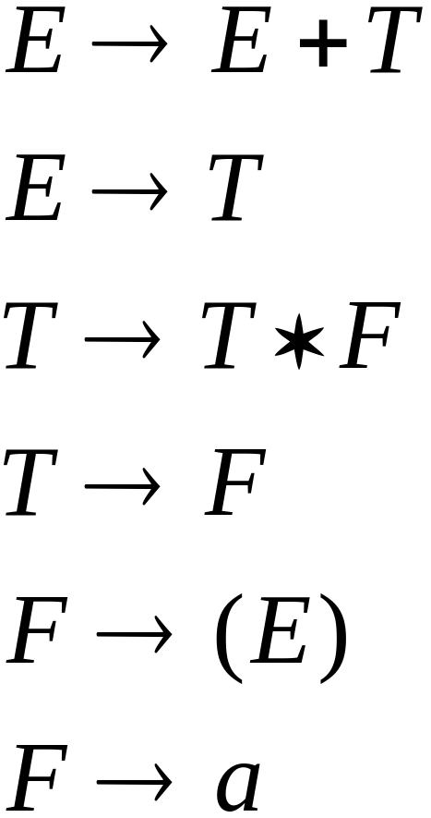
We fix the ambiguous grammar:
New non-ambiguous grammar:

Slide 76




Slide 77
Unique derivation tree

Slide 78
The grammar :
is non-ambiguous:
Every string has
a unique derivation tree

