Slide 1
PDAs Accept
Context-Free Languages

Slide 2

Theorem:
Context-Free
Languages
(Grammars)
Languages
Accepted by
PDAs

Slide 3
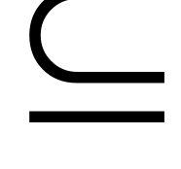



Proof - Step 1:
Context-Free
Languages
(Grammars)
Languages
Accepted by
PDAs
Convert any context-free grammar
to a PDA with:

Slide 4

Proof - Step 2:
Context-Free
Languages
(Grammars)
Languages
Accepted by
PDAs
Convert any PDA to a context-free
grammar with:

Slide 5
Converting
Context-Free Grammars to
PDAs
Proof - step 1

Slide 6
Context-Free
Languages
(Grammars)
Languages
Accepted by
PDAs
Convert any context-free grammar
to a PDA with:

Slide 7


We will convert grammar
to a PDA such that:
simulates leftmost derivations of

Slide 8



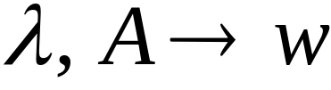
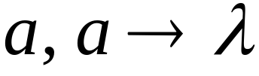
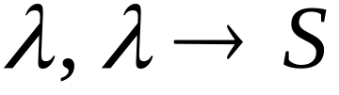




Convert grammar to PDA
Production in
Terminal in

Slide 9
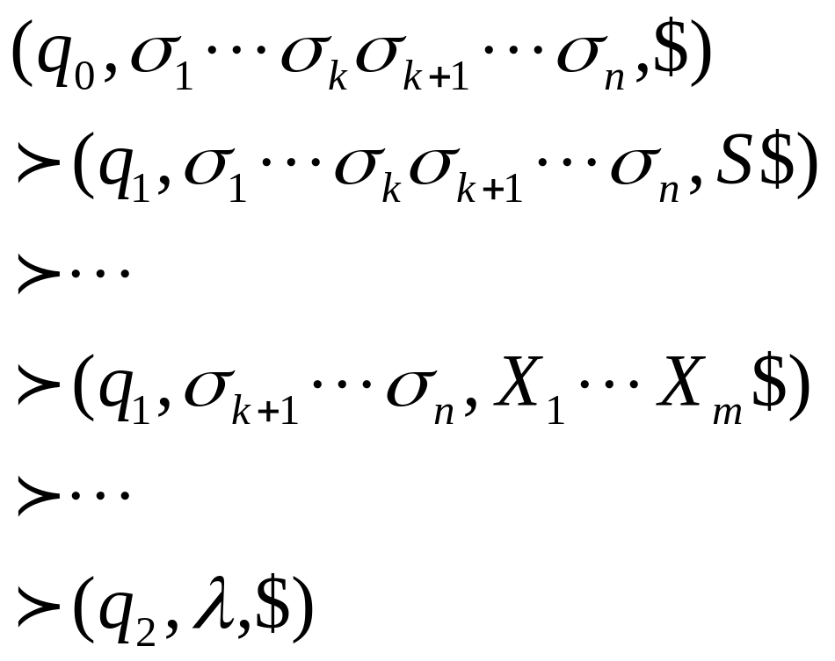
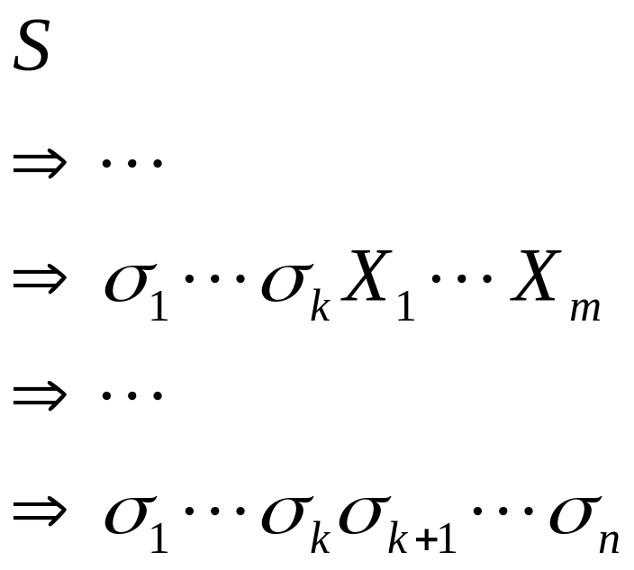
Grammar
leftmost
derivation
PDA computation
Simulates grammar
leftmost derivations
Leftmost
variable

Slide 10
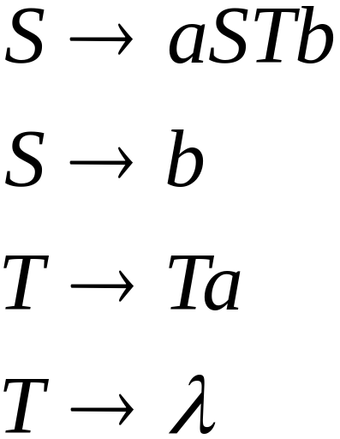
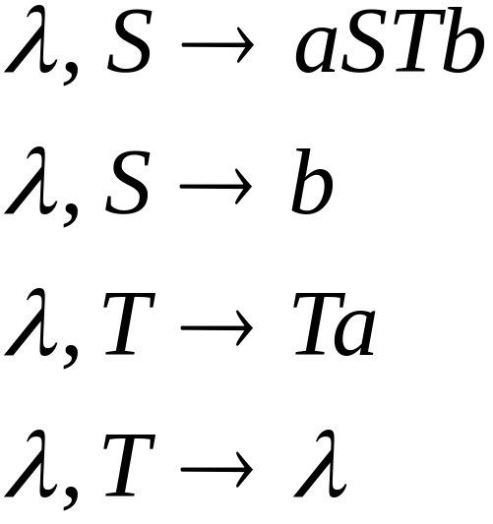
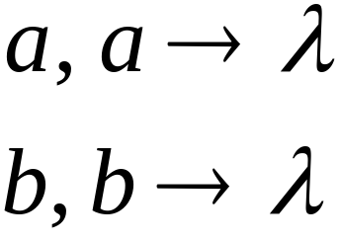
Example
Grammar
PDA

Slide 11
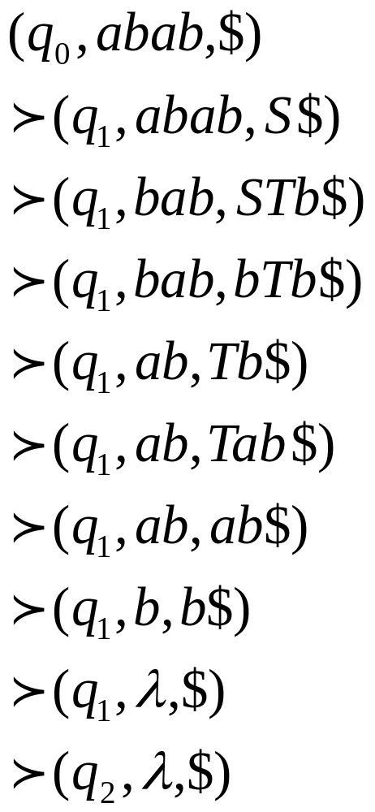
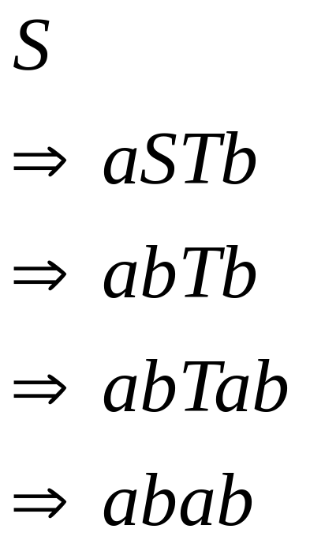
Grammar
derivation
PDA computation

Slide 12




Derivation:
Input
Time 0
Stack

Slide 13


Derivation:
Input
Time 0
Stack

Slide 14


Derivation:
Input
Time 1
Stack

Slide 15
Derivation:
Input
Time 2
Stack

Slide 16

Derivation:
Input
Time 3
Stack

Slide 17
Derivation:
Input
Time 4
Stack

Slide 18
Derivation:
Input
Time 5
Stack

Slide 19
Derivation:
Input
Time 6
Stack

Slide 20
Derivation:
Input
Time 7
Stack

Slide 21
Derivation:
Input
Time 8
Stack

Slide 22
Derivation:
Input
Time 9
Stack
accept

Slide 23
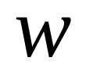
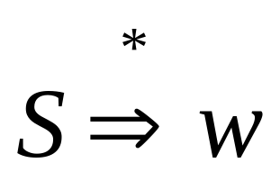
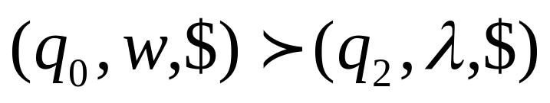
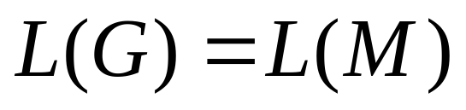
Grammar
generates
string
If and
Only if
PDA
accepts
Therefore

Slide 24

Therefore:
For any context-free language
there is a PDA that accepts
Context-Free
Languages
(Grammars)
Languages
Accepted by
PDAs

Slide 25
Converting
PDAs to
Context-Free Grammars
Proof - step 2

Slide 26
Context-Free
Languages
(Grammars)
Languages
Accepted by
PDAs
Convert any PDA to a context-free
grammar with:

Slide 27
We will convert PDA to
a context-free grammar such that:
simulates computations of
with leftmost derivations

Slide 28

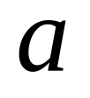
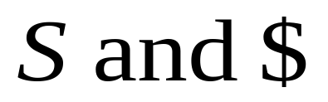
Grammar Construction
In grammar :
Variables:
PDA stack symbols
Terminals:
PDA input symbols
Start Variable:
Stack bottom symbol

Slide 29
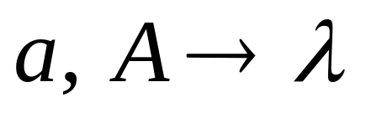
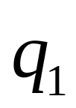

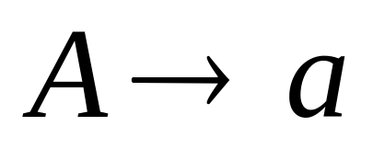
PDA transition
Grammar production

Slide 30
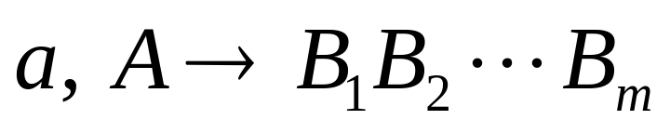

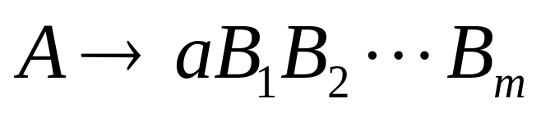
PDA transition
Grammar production

Slide 31
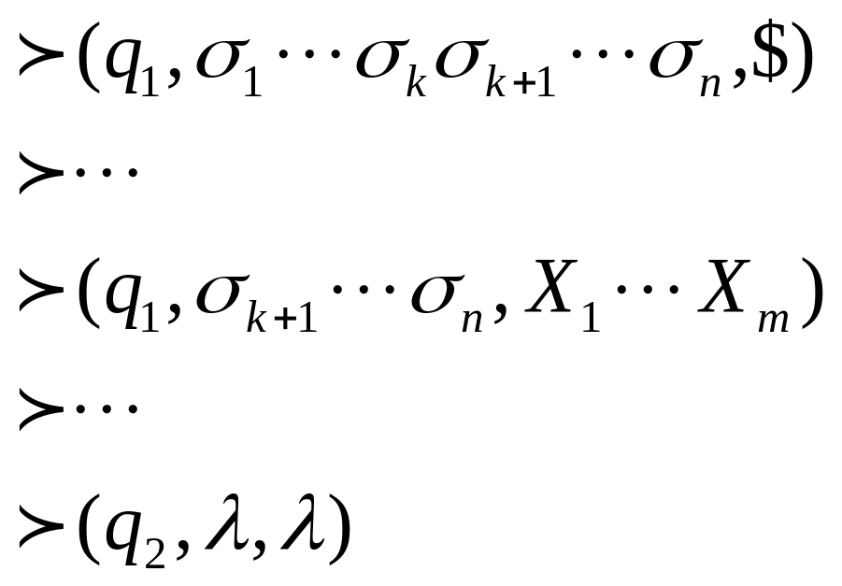
Grammar
leftmost
derivation
PDA computation
Leftmost
variable

Slide 32






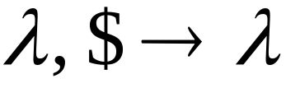

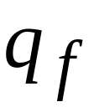
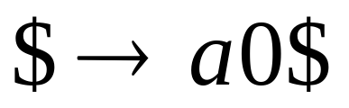
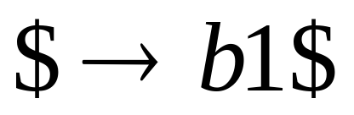
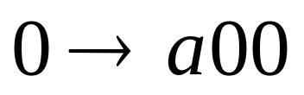
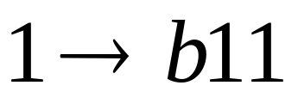
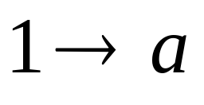
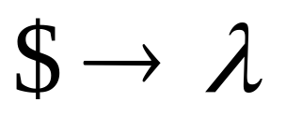

Example PDA:
Grammar:

Slide 33
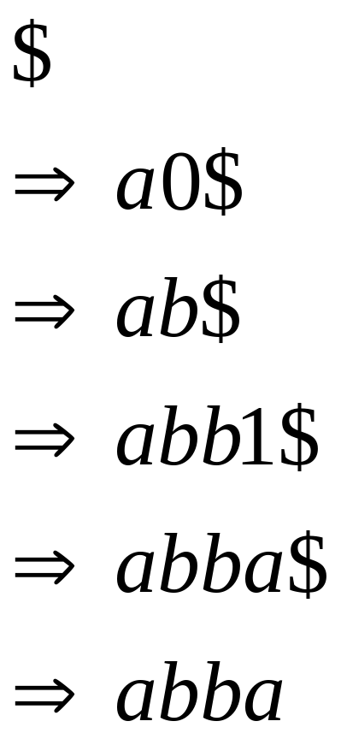
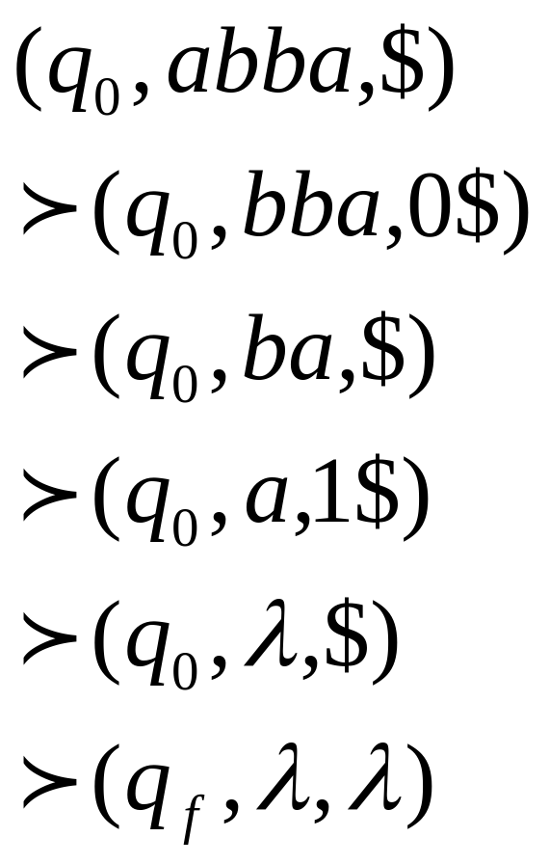
Grammar
Leftmost
derivation:
PDA
Computation:

Slide 34

Derivation:
Time 0

Slide 35
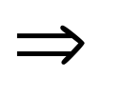


Derivation:
Time 1
Stack

Slide 36
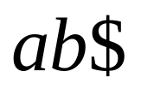
Derivation:
Time 2
Stack

Slide 37


Derivation:
Time 3
Stack

Slide 38

Derivation:
Time 4
Stack

Slide 39

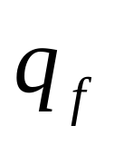
Derivation:
Time 5
empty
Stack

Slide 40
Therefore:
For any PDA
there is a context-free grammar
that accepts the same language
Context-Free
Languages
(Grammars)
Languages
Accepted by
PDAs

Slide 41
Deterministic PDAs - DPDAs

Slide 42
PDAs
Have More Power than
DPDAs
Only sketch: no proofs

Slide 43
It holds that:
Deterministic
Context-Free
Languages
(DPDA)
Context-Free
Languages
PDAs
Since every DPDA is also a PDA

Slide 44
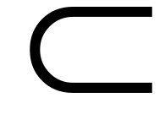

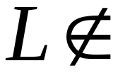

We will actually show:
Deterministic
Context-Free
Languages
(DPDA)
Context-Free
Languages
(PDA)
We will show that there exists
a context-free language which is not
accepted by any DPDA

Slide 45
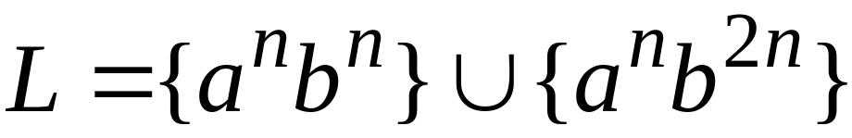

The language is:
We can show:
is context-free
is not deterministic context-free

Slide 46
The Pumping Lemma for
Context-Free Languages
We will only state it. No proof.

Slide 47


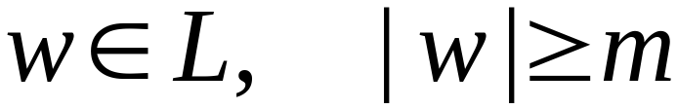

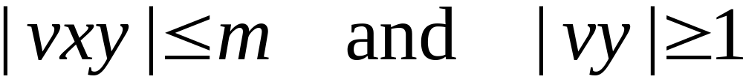
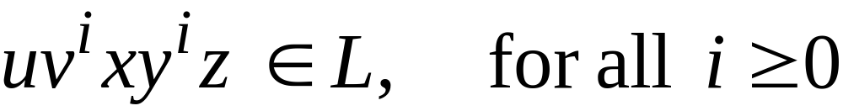
The Pumping Lemma:
For infinite context-free language
there exists an integer such that
for any string
we can write
with lengths
and it must be:

Slide 48
Applications of
The Pumping Lemma

Slide 49
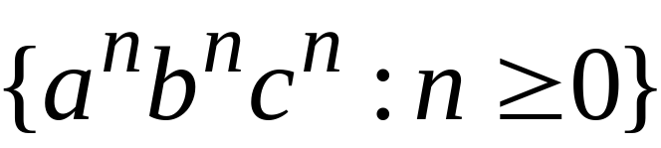

Non-context free languages
Context-free languages

Slide 50
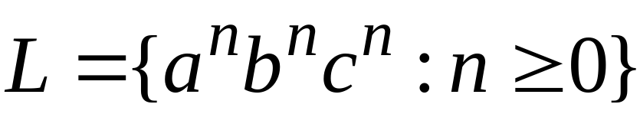
Theorem:
The language
is not context free
Proof:
Use the Pumping Lemma
for context-free languages

