Slide 1
Variations of the
Turing Machine

Slide 2




The Standard Model
Infinite Tape
Read-Write Head
(Left or Right)
Control Unit
Deterministic

Slide 3
Variations of the Standard Model
Turing machines with:
Stay-Option
Semi-Infinite Tape
Off-Line
Multitape
Multidimensional
Nondeterministic

Slide 4
The variations form different
Turing Machine Classes
We want to prove:
Each Class has the same
power with the Standard Model

Slide 5
Same Power of two classes means:
Both classes of Turing machines accept
the same languages

Slide 6
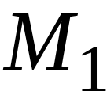
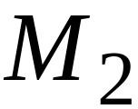
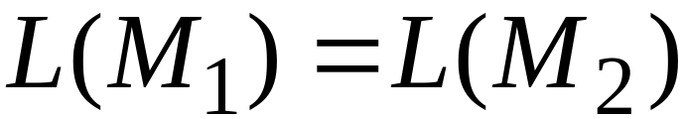
Same Power of two classes means:
For any machine of first class
there is a machine of second class
such that:
And vice-versa

Slide 7
Simulation:
a technique to prove same power
Simulate the machine of one class
with a machine of the other class
Second Class
Simulation Machine
First Class
Original Machine

Slide 8
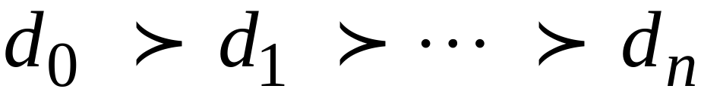
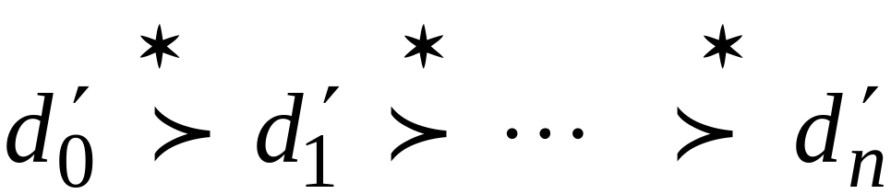
Configurations in the Original Machine
correspond to configurations
in the Simulation Machine
Original Machine:
Simulation Machine:

Slide 9
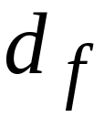
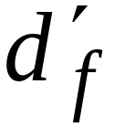
Final Configuration
Original Machine:
Simulation Machine:
The Simulation Machine
and the Original Machine
accept the same language

Slide 10
Turing Machines with Stay-Option
The head can stay in the same position
Left, Right, Stay
L,R,S: moves

Slide 11



Example:
Time 1
Time 2

Slide 12
Theorem:
Stay-Option Machines
have the same power with
Standard Turing machines

Slide 13
Proof:
Part 1: Stay-Option Machines
are at least as powerful as
Standard machines
Proof:
a Standard machine is also
a Stay-Option machine
(that never uses the S move)

Slide 14
Proof:
Part 2: Standard Machines
are at least as powerful as
Stay-Option machines
Proof:
a standard machine can simulate
a Stay-Option machine

Slide 15

Stay-Option Machine
Simulation in Standard Machine
Similar for Right moves

Slide 16

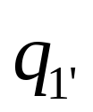
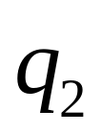

Stay-Option Machine
Simulation in Standard Machine
For every symbol

Slide 17

Example
Stay-Option Machine:
1
2
Simulation in Standard Machine:
1
2
3

Slide 18

Standard Machine--Multiple Track Tape
track 1
track 2
one symbol

Slide 19
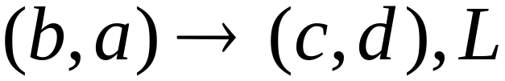
track 1
track 2
track 1
track 2

Slide 20

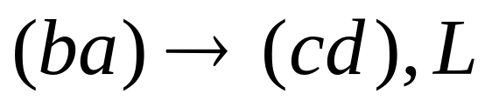
Standard Machine--Multiple Track Tape
Direction 1: a Multiple track tape machine is also a standard machine (Ignore all but the first tape)
Direction 2: Use a standard machine with alphabet
Will now be

Slide 21

Semi-Infinite Tape
.........
Hint: fold the two sides into one side…
Exact proof will be shown in the exersize

Slide 22
Semi-Infinite Tape
.........
Direction 1: (easy) an infinite machine can certainly simulate a semi-infinite machine. You just never go left of the leftmost #.

Slide 23



























Semi-Infinite Tape
Direction 2: (harder): Let T be a standard machine. We want to built T’ which is a semi-Infinite machine.
→ The trick is to fold the machine.
Location +n in T becomes location 2n-1 in T’
Location –n in T becomes location 2n in T’

Slide 24

Semi-Infinite Tape
Two cases (sets of states)
Negative and Positive
In Positive states in T:
Right in T becomes double right in T’
Left in T becomes double left in T’
In negative States:
Left in T becomes double right in T’
Right in T becomes double left in T’
  We switch between positive and negative if we hit 0 when going left in T’ both cases.
  That is: when going left in T (when this is double left in T’ when positive) or when going right in T (when this is double left in T’ when negative)

Slide 25


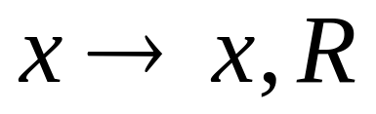
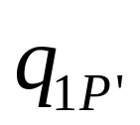
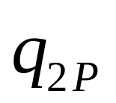
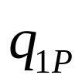

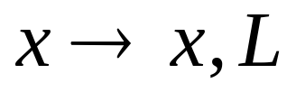
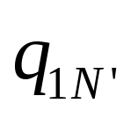
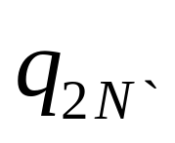
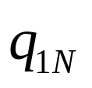
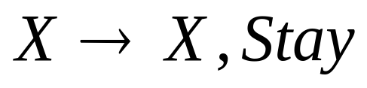
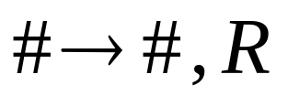
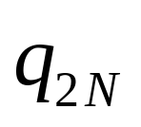
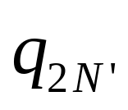
Going Right
In T becomes →
In T’ when
positive
In T’ when
Negative
In T’ when
Negative

Slide 26

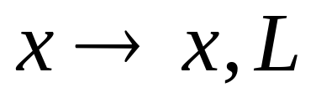
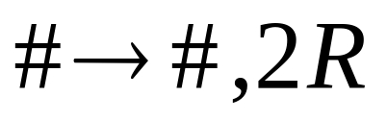
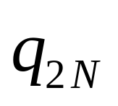

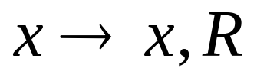
Going Left
In T becomes →
In T’ when
positive
In T’ when
Negative

Slide 27



Multitape Turing Machines
Control unit
Tape 1
Tape 2
Input

Slide 28
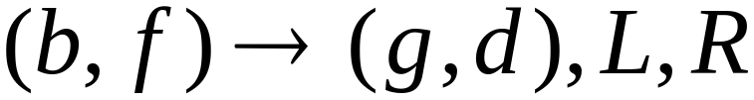
Tape 1
Time 1
Tape 2
Time 2

Slide 29
Multitape machines simulate
Standard Machines:
Use just one tape

Slide 30
Standard machines simulate
Multitape machines:
Standard machine:
Use a multi-track tape
A tape of the Multiple tape machine
corresponds to a pair of tracks

Slide 31



Multitape Machine
Tape 1
Tape 2
Standard machine with four track tape
Tape 1
head position
Tape 2
head position

Slide 32
Reference point
Tape 1
head position
Tape 2
head position
Repeat for each state transition:
Return to reference point
Find current symbol in Tape 1
Find current symbol in Tape 2
Make transition

Slide 33
Theorem:
Multi-tape machines
have the same power with
Standard Turing Machines

Slide 34
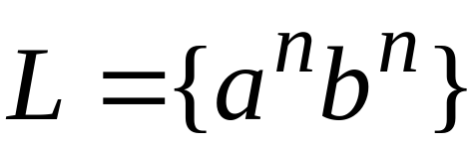
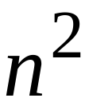

Same power doesn’t imply same speed:
Language
Acceptance Time
Standard machine
Two-tape machine

Slide 35

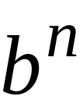

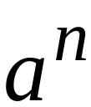
Standard machine:
Go back and forth times
Two-tape machine:
Copy to tape 2
( steps)
Leave on tape 1
( steps)
Compare tape 1 and tape 2
( steps)

Slide 36


MultiDimensional Turing Machines
Two-dimensional tape
MOVES: L,R,U,D
HEAD
U: up D: down
Position: +2, -1

Slide 37
A Universal Turing Machine

Slide 38
A limitation of Turing Machines:
Turing Machines are “hardwired”
they execute
only one program
Real Computers are re-programmable

Slide 39
Solution:
Universal Turing Machine
Attributes:
Reprogrammable machine
Simulates any other Turing Machine

Slide 40

Universal Turing Machine
simulates any other Turing Machine
Input of Universal Turing Machine:
Description of transitions of
Initial tape contents of

Slide 41
Tape 1
Three tapes
Description of
Universal
Turing
Machine
Tape 2
Tape Contents of
Tape 3
State of

Slide 42
Tape 1
Description of
We describe Turing machine
as a string of symbols:
We encode as a string of symbols

Slide 43







Alphabet Encoding
Symbols:
Encoding:

Slide 44



State Encoding
States:
Encoding:
Head Move Encoding
Move:
Encoding:

Slide 45
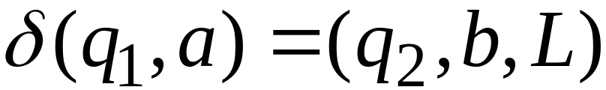
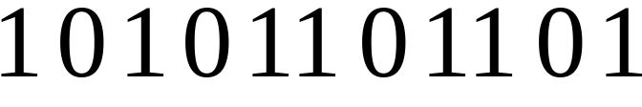
Transition Encoding
Transition:
Encoding:
separator

Slide 46
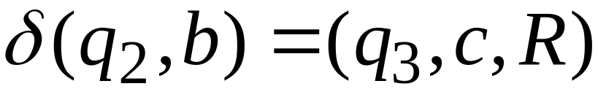

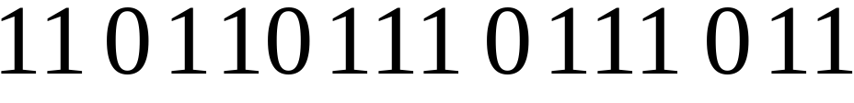
Machine Encoding
Transitions:
Encoding:
separator

Slide 47
Tape 1 contents of Universal Turing Machine:
encoding of the simulated machine
as a binary string of 0’s and 1’s

Slide 48
A Turing Machine is described
with a binary string of 0’s and 1’s
Therefore:
The set of Turing machines forms a language:
each string of the language is
the binary encoding of a Turing Machine

Slide 49
Universal Turing Machine
We now need to build a hardware that executes the program (the encoding of the Turing machine)
We simply follow each step according to the program on the three tapes.
Similar to the fetch-execute cycle.

Slide 50
Universal Turing machine
Overview of the states in the Universal Turing machine.:
Q1: read the state of M from tape 3
Q2: read the letter of M from Tape 2.
Q3: go right in tape 1 until you see the state of tape 3
Q4: go right in tape 1 until you see the letter from tape 2
Q5: read the letter at tape 1
Q6: perform change at tape 2.
Q7: read the direction (left,right) at tape 1
Q8: move head of tape 2 accordingly
Q9: read the new state at tape 1
Q10: write it at tape 3
Q11:go left on tape 3 until the first

Slide 51
Church-Turing’s Thesis

Slide 52
Church-Turing’s thesis:
Any computation carried out
by mechanical means
can be performed by a Turing Machine
(1930)

Slide 53
Computer Science Law:
A computation is mechanical
if and only if
it can be performed by a Turing Machine
There is no known model of computation
more powerful than Turing Machines

Slide 54
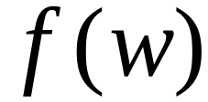
Definition of Algorithm:
An algorithm for function
is a
Turing Machine which computes

Slide 55
Algorithms are Turing Machines
When we say:
There exists an algorithm
We mean:
There exists a Turing Machine
that executes the algorithm

Slide 56
Proof for Turing Thesis
There is no formal proof.
We have intuitively shown that any algorithm can be modified to Turing machine!!
This is an intuitive thesis!!!

