Slide 1
DFA=NFA=Regular Languages

Slide 2


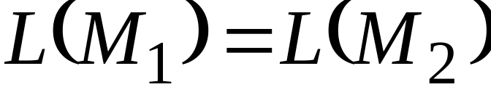
Equivalence of Machines
Definition:
Machine is equivalent to machine
if

Slide 3

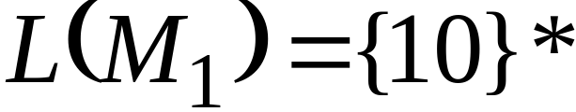




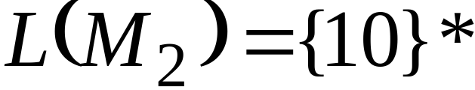

Example of equivalent machines
NFA
FA

Slide 4

We will prove:
Languages
accepted
by DFAs
Languages
accepted
by NFAs
Regular
Languages

Slide 5


NFA=DFA
Theorem 1: NFAs and FAs have the same computation power
Step 1:
DFA
NFA
Proof:
Every DFA is trivially an NFA
Any language accepted by a DFA
is also accepted by an NFA

Slide 6
DFA=NFA
Step 2:
NFA
DFA
Proof:
Any NFA can be converted to an
equivalent DFA
Any language accepted by an NFA
is also accepted by a DFA

Slide 7


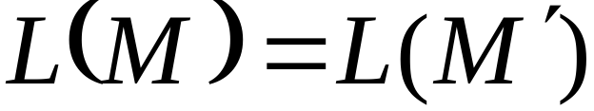
NFA to FA: Remarks
We are given an NFA
We want to convert it
to an equivalent FA
With

Slide 8
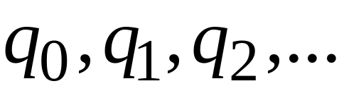
If the NFA has states
the FA has states in the powerset

Slide 9
Procedure NFA to FA
First be ready to use some of all possible 2^n states
  1) Extend the NFA to hold garbage states
2) Convert the initial state
3) Repeat (until no more transitions)
Convert the transitions
4) Determine the accepting states

Slide 10
Procedure NFA to FA
  1. Add a garbage state
NFA
NFA

Slide 11
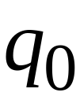
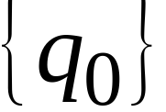
Procedure NFA to FA
2. Initial state of NFA:
Initial state of FA:

Slide 12
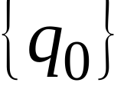
Example
NFA
NFA
FA

Slide 13
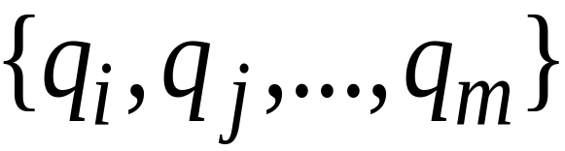
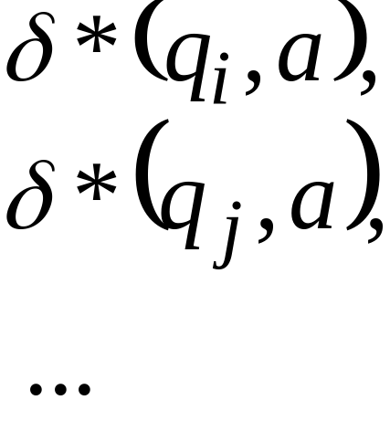

Procedure NFA to FA
3. For every FA’s state
Compute in the NFA
Add transition to FA

Slide 14



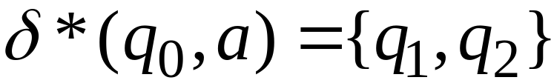
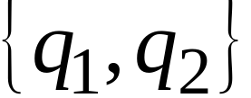
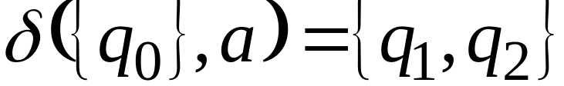
Example
NFA
FA

Slide 15
Procedure NFA to FA
Repeat Step 3 for all letters in alphabet,
until
no more transitions can be added.

Slide 16

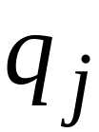
Procedure NFA to FA
4. For any FA state
If is accepting state in NFA
Then,
is accepting state in FA

Slide 17
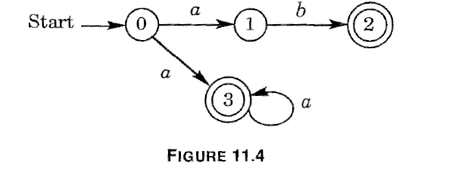
EX: convert this NFA

Slide 18
Step 1. Add garbage state.
New NFA (state 4 added)
a,b
a
a
b
0
1
2
a
b
3
4
b
a,b
a

Slide 19
Steps 2,3,4
We get this DFA
a,b
a
b
0
1,3
2,4
b
a
4
3,4
b
a,b
a

Slide 20
Proof:Convert NFA to FA
It is easy (trivial) to see that
L(M)=L(M’)
Why: if w is accepted by the NFA M, then there exists a path that accepts it in M where Qx is the accepted state. By the way we built the DFA Qx is in the subset of accepted in NFA, so any state with Qx is an acceting state in the DFA.
Similarly, if w is not accepted but the NFA, there is no such Qx, and w will not be accpeted by the DFA.

Slide 21
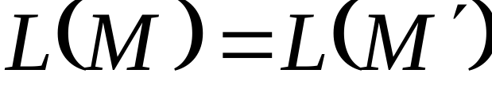
Theorem
Take NFA
Apply procedure to obtain FA
Then and are equivalent :

Slide 22
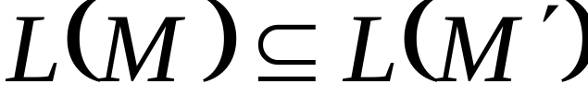
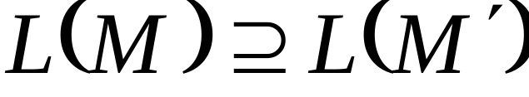
Proof
AND

Slide 23
Single Accepting
State for NFAs

Slide 24
Any NFA can be converted
to an equivalent NFA
with a single accepting state

Slide 25
Example
NFA
Equivalent NFA

Slide 26
In General
NFA
Equivalent NFA
Single
accepting
state

Slide 27
Extreme Case
NFA without accepting state
Add an accepting state
without transitions

