Slide 1
NFA=Regular Languages
We want to show that
DFA=NFA=Regular Languages
In chapter 4 we proved that DFA=NFA
In this chapter (5) we will show that: NFA=Regular Languages
Again by constructive proof.

Slide 2
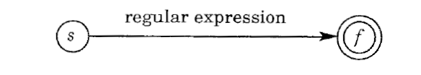
Transforming regular expression to NFA
Given a regular expression, we will build a relevant NFA
We start with a trivial NFA
For each type of “operator” of the regular expression we enhance the above NFA.
We apply the following rules until the NFA is complete.

Slide 3
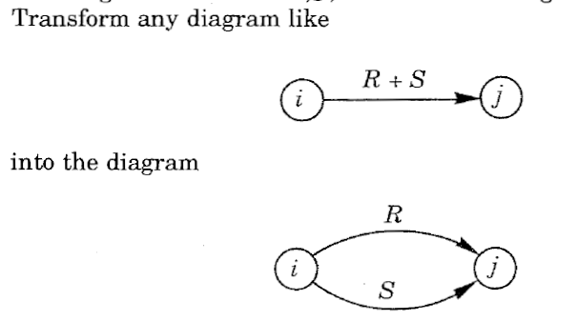
Transforming regular expression to NFA
0. Erase edges that lead to the empty set.
Handling the + operator (R+S)

Slide 4
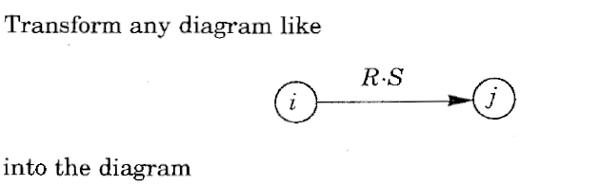
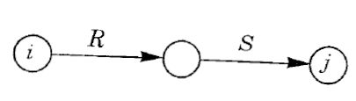
2. Handling the x operator (RxS)

Slide 5
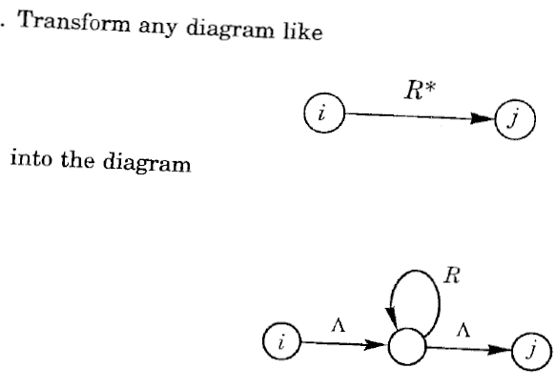
3. Handling the * operator (R*)

Slide 6

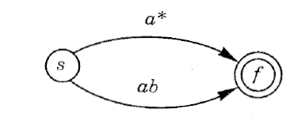
Example
Suppose we want to build a NFA for a*+ab
We start with:
We apply the + rule and get:

Slide 7
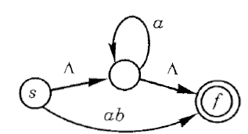
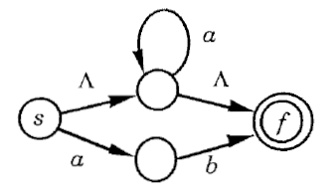
We apply the * rule and get
We apply the x rule and get:

Slide 8
Transforming NFA to regular expression
Create a new state S and draw new edges of LAMBDA from S to the original starting state
Create a new final state F and draw new edges of LAMBDA from all original accepting states to F
Unify separate edges from every i,j (a,b) to a single edge (a+b)
Eliminate one state K at each time until only state S and F are left.

Slide 9
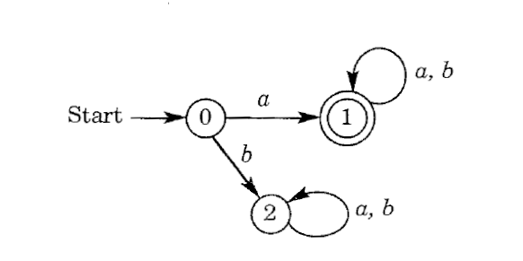
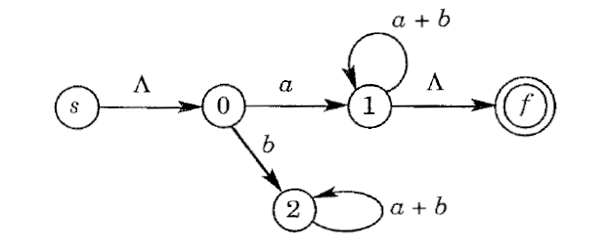
Transforming NFA to regular expression
The first three rules are applied and we get:

Slide 10
Step 4: eliminating state K.
We go over all pairs of states (i,j)|k Such that i→k and k→j new(i,j)=old(i,j)+old(i,k)old(k,k)*old(k,j)
Repeat step 4 for all intermediate states until you are left with S and F only
a
a+bc*d
j
i
j
i
b
k
d
c

Slide 11
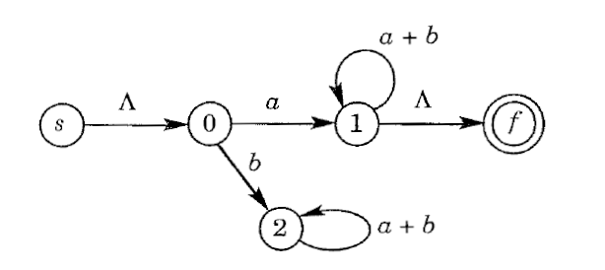
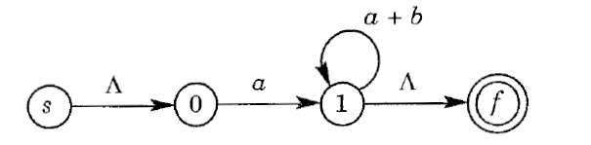
Step 4: eliminating state K.
Eliminate state 2: (no such i,j)

Slide 12
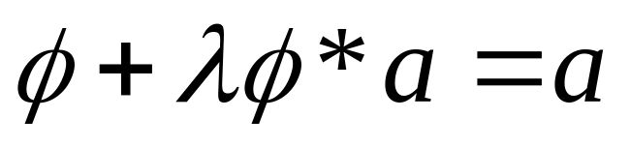
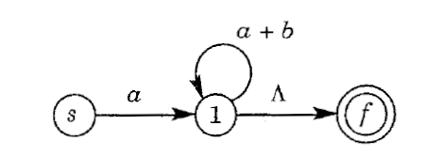
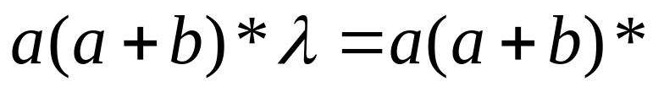

Eliminate state 0
New(s,1)=old(s,1)+old(s,0)old(0,0)*old(0,1)=
Eliminate state 1:
New(s,f)=old(s,f)+old(s,1)old(1,1)*old(1,f)
=

Slide 13
Summary
All of the following are equivalent!!!
Regular languages
Regular expression
NFA
DFA

Slide 14
Non-regular languages

Slide 15
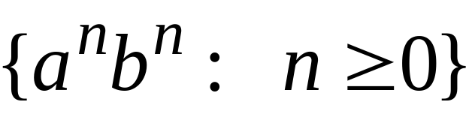
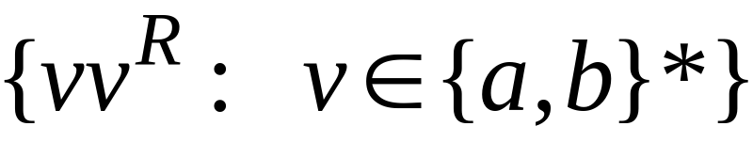


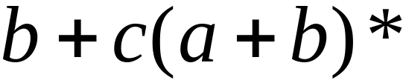

Non-regular languages
Regular languages

Slide 16

How can we prove that a language
is not regular?
Prove that there is no DFA that accepts
Problem: this is not easy to prove
Solution: the Pumping Lemma !!!

Slide 17

The Pigeonhole Principle

Slide 18


pigeons
pigeonholes

Slide 19
A pigeonhole must
contain at least two pigeons

Slide 20



pigeons
...........
pigeonholes
...........

Slide 21
The Pigeonhole Principle
pigeons
pigeonholes
There is a pigeonhole
with at least 2 pigeons
...........

Slide 22
The Pigeonhole Principle and
DFAs

Slide 23




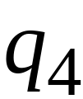


DFA with states

Slide 24
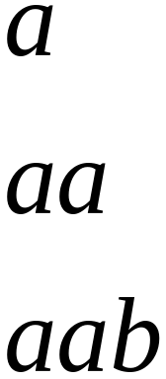
In walks of strings:
no state
is repeated

Slide 25
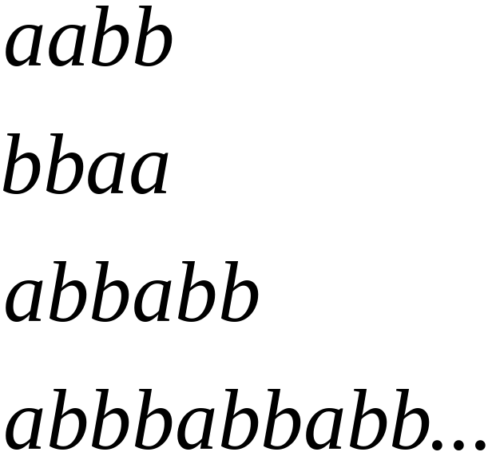
In walks of strings:
a state
is repeated

Slide 26
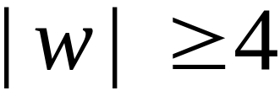

If string has length :
Then the transitions of string
are more than the states of the DFA
Thus, a state must be repeated

Slide 27



In general, for any DFA:
String has length number of states
A state must be repeated in the walk of
walk of
......
......
Repeated state

Slide 28
In other words for a string :
transitions are pigeons
states are pigeonholes
walk of
......
......
Repeated state

Slide 29
The Pumping Lemma

Slide 30

Take an infinite regular language
There exists a DFA that accepts
states

Slide 31

Take string with
There is a walk with label :
.........
walk

Slide 32
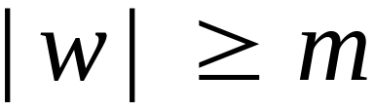
If string has length
(number
of states
of DFA)
then, from the pigeonhole principle:
a state is repeated in the walk
......
......
walk

Slide 33
Let be the first state repeated in the
walk of
......
......
walk

Slide 34




Write
......
......

Slide 35


Observations:
length
number
of states
of DFA
length
......
......

Slide 36

Observation:
The string
is accepted
......
......

Slide 37

Observation:
The string
is accepted
......
......

Slide 38

Observation:
The string
is accepted
......
......

Slide 39
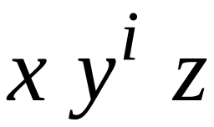

In General:
The string
is accepted
......
......

Slide 40
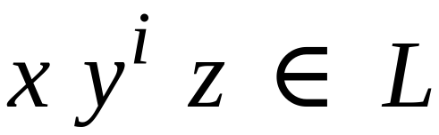
In General:
Language accepted by the DFA
......
......

Slide 41
In other words, we described:
The Pumping Lemma !!!

Slide 42


The Pumping Lemma:
Given a infinite regular language
there exists an integer
for any string with length
we can write
with and
such that:

Slide 43
Applications of the Pumping Lemma

Slide 44

Theorem:
The language
is not regular
Proof:
Use the Pumping Lemma

Slide 45
Assume for contradiction
that is a regular language
Since is infinite
we can apply the Pumping Lemma

Slide 46

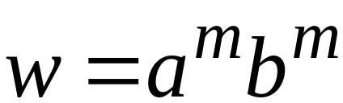
Let be the integer in the Pumping Lemma
Pick a string such that:
length
We pick

Slide 47
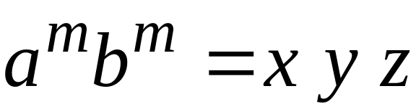

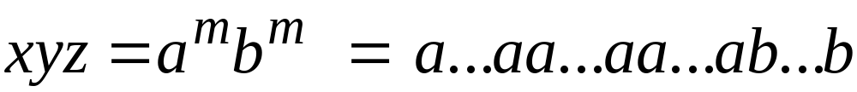
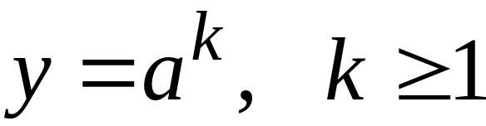
Write:
From the Pumping Lemma
it must be that length
Thus:

Slide 48
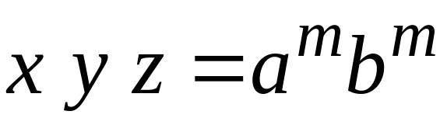

From the Pumping Lemma:
Thus:

Slide 49

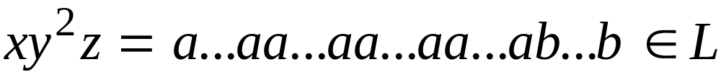
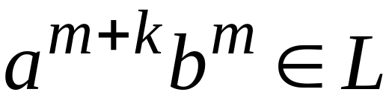
From the Pumping Lemma:
Thus:

Slide 50
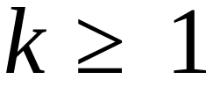
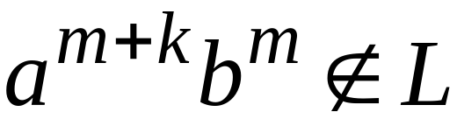
BUT:
CONTRADICTION!!!

Slide 51
Therefore:
Our assumption that
is a regular language is not true
Conclusion:
is not a regular language

Slide 52
Non-regular languages
Regular languages

Slide 53
Pumping Lemma
For each w in L such that |w|≤m
there exists a place of k atoms (before m atoms)
that can be duplicated for all i=0, 2, …. ∞ times
Negation
There exists w in L (such that |w|≤m)
but for every place of every possible k atoms (before m atoms) there exists a given i (i=0 or i=2 or i=3 ….) such that the duplication will give a word w’ where w’ is not in L

Slide 54
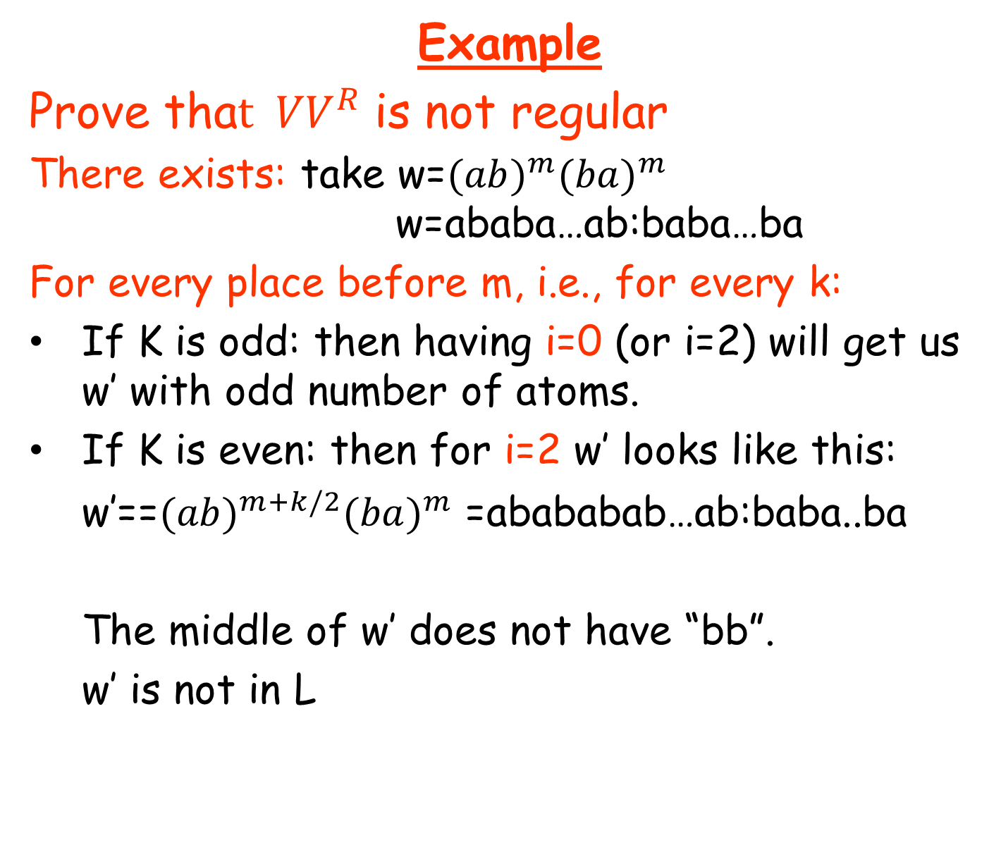
k

