Slide 1
Object Oriented Analysis and Design
Practical Session No. 1
Introduction & User Stories
Spring 2019

Slide 2
Staff
Instructor:
Dr. Arnon Sturm – sturm.bgu.ac.il
TA:
Eliran Nachmani – nachamni@post.bgu.ac.il
Homework Grader:
Yotam Intrator – yotamin@post.bgu.ac.il
Course Site: Moodle
Office Hour:
Monday, 12pm
Building 96, office 321
Please coordinate by e-mail

Slide 3

Homework and Grading
Homework – 20% (4 Assignments)
Submission in group of four
2 Quizzes– 80% (40% each)

Slide 4
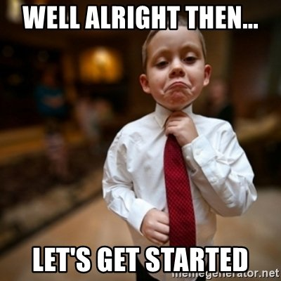
Questions?

Slide 5
What is a User Story?
A concise, written description of a piece of functionality that will be valuable to a user (or owner) of the software.
Stories are:
User’s needs
Product descriptions
Planning items
Tokens for a conversation
Notes:
WHAT are we trying to build, WHO wants or will use it, and WHY do they need it
Business case creates line of traceability, justifies the feature, and lets dev team know why they are doing what they do

Slide 6
Common User Story Pattern
As a [user role] I want to [goal] so I can [benefit]
As a [type of user] I want to [perform some task] so that I can [reach some goal]
Examples:
As a repeat customer I want to access old orders so that I can rapidly purchase the same products again
As a registered user I want to log in so I can access subscriber-only content
Notes:
Quality User Story Framework:
Well-formed - A user story includes at least a role and an action
Atomic - A user story expresses a requirement for exactly one feature
Minimal - A user story contains nothing more than role, action and benefit
Conceptually sound –The action expresses a feature and the benefit expresses a rationale
Problem-oriented - A user story only specifies the problem, not the solution to it
Unambiguous - A user story avoids terms or abstractions that lead to multiple interpretations
Full sentence - A user story is a well-formed full sentence
Estimatable - A story does not denote an unrefined requirement that is hard to plan and prioritize
SET :
Conflict-free - A user story should not be inconsistent with any other user story
Unique - Every user story is unique, duplicates are avoided
Uniform - All user stories in a specification employ the same template
Independent - The user story is self-contained and has no inherent dependencies on other stories
Complete - Implementing a set of user stories creates a feature-complete application, no steps are missing

Slide 7
What User Stories are NOT
User stories ≠ Tasks
Tasks are about implementation; User Stories are about definition
User stories ≠ requirements document
The format of the user stories enables teams to better understand the task and how is it relates to the other parts of the product
Bad Examples:
As a user I want to have my previous orders stored in the database So they will be there permanently
As a stakeholder I want page load times to conform to current standards so that patients will be able to use the system in a dial-up connection
Update the database table to support payments
Notes:
Writing AS A product owner I WANT something SO THAT value isn’t a user story.
As the Database/System… is also NOT a User Story
Problem-oriented - A user story only specifies the problem, not the solution to it
Full sentence - A user story is a well-formed full sentence

Slide 8
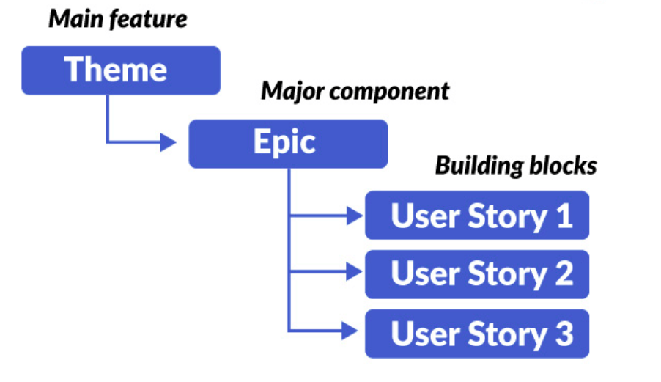
Themes and Epics
Epic is a large Story that most likely will be broken down into multiple User Stories.
Theme is a container of Stories that may be grouped by function feature or any other common criteria the product owner decides upon. Theme usually corresponds to one or more Epics.

Slide 9
Themes and Epics - Example
Let assume the scenario of an online shop to sell video games.
Theme:
Adding items into shopping cart
Epic:
As a user, I should be able to check out the items I have added in my cart
User Stories:
As a first time user, I will be asked to either register or purchase as a guest user when I check out the items I have added in my cart
As a registered user, I will be shown the items added in my wish list so that if I want I can add them to my cart when I check out

Slide 10
תרגיל
נניח כי אנחנו לוקחים חלק בפיתוח אפליקציה לחיפוש מקומות לינה ובתי מלון.
להלן רשימה חלקית של מאפיינים בהן המערכת נדרשת לתמוך:
רישום משתמשים חדשים
התחברות עבור משתמשים קיימים
חיפוש מלונות לפי מיקום
הזמנת חדרים במלונות
יש להגדיר Epics ו-User Stories עבור הנושאים שהמערכת צפויה לתמוך.

Slide 11
פתרון – רישום משתמש חדש
As a guest, I want to create an account for the application by entering my name, email address and a password so that I can start using the application.
As a guest, I am required to enter a strong password when creating my account
As a guest I want the app will prompt me if I will insert an illegal
e-mail address

Slide 12
פתרון – ביצוע התחברות למערכת
As an offline user, I want to log in using my account e-mail and password so that I can start using the application.
As an offline user I can request a password reminder so that I can log in if I forget mine
As an offline user I am required to log in so that I can access to the system
As an offline user I want my account to be locked after 6 consecutive failed login attempts
As an offline user I want the app will prompt me if my account is wrong or does not exist

Slide 13
פתרון – חיפוש מלונות
As an app visitor, I able to search for hotels, so I can quickly find available booking options
As an app visitor I want to view detailed information about the hotel, so that I can choose the desired hotel easily
As an app visitor user I want to be able to search a hotel by city and price range
As an app visitor I want to restrict search so I only see hotels with available rooms
As an app visitor I want to search booking options for that particular time

Slide 14
פתרון – הזמנת מלונות
As a registered user I want to make hotel reservation
As a registered user I want be able to choose either the payment will be via the application or in hotel’s reception
As a registered user I get an information about the hotel’s Cancellation policy so that I’ll know the terms before make a reservation
As a registered user I want to get a booking confirmation mail after confirm the reservation, so that I know the reservation is confirmed
As a registered user I want to choose if the room is standard or superior

