Slide 1
Object Oriented Analysis and Design
Practical Session No. 4
Object Constraint Language
Spring 2019

Slide 2
What is OCL?
The Object Constraint Language (OCL) intended for the specification of additional requirements (constrains) which cannot or be expressed graphically.
Constraint is an invariant condition that must hold for the system being modeled.
OCL provides a way to develop more precise models using UML
OCL constraints have formal semantics, hence, can be used to reduce the ambiguity in the UML models

Slide 3
OCL Types
Three types of constraints in OCL: invariants, preconditions, and postconditions
An invariant must always evaluate to true for all instance objects of a class, regardless of what operation is invoked and in what order
applies to a class attribute
A precondition is a predicate that is checked before an operation is executed
applies to a specific operation; used to validate input parameters
A postcondition is a predicate that must be true after an operation is executed
also applies to a specific operation; describes how the object’s state was changed by an operation

Slide 4
OCL Types
Three types of constraints in OCL: invariants, preconditions, and postconditions
An invariant must always evaluate to true for all instance objects of a class, regardless of what operation is invoked and in what order
applies to a class attribute
A precondition is a predicate that is checked before an operation is executed
applies to a specific operation; used to validate input parameters
A postcondition is a predicate that must be true after an operation is executed
also applies to a specific operation; describes how the object’s state was changed by an operation

Slide 5
Constraint Structure
context TypeName c_type [name]:
<OCL- expression>
The context is keyword introduces the context for the expression. Each OCL expression is written in the context of an instance of a specific type.
Typename is the name of the type or the class for which the invariant constraint applies.
c_type is the type of the constraint:
invariant, pre/post-condition, guard.
[name] – optional, the names of the constraint.
OCL- expression should accept value “true” for all instances of Typename.

Slide 6
Basic Data Types
Several basic types with operations
Type | Values | Operations
Boolean | false, true | or, and, xor, not, =, <>, implies
Integer | -10, 0, 10, … | =, <>, <, >, <=, >=, +, -, *, /, mod(), div(), abs(), max(), min(), round(), floor(), sum()
Real | -1.5, 3.14, …
String | ‘Carmen’ | =, <>, concat(), size(), toLower(), toUpper(), substring()

Slide 7
Collections
Set : The mathematical set.
It is not ordered and does not contain duplicate elements.
Bag : A container.
It is not ordered and contain duplicate elements.
Sequence : A container.
It is ordered and contain duplicate elements.

Slide 8
‘implies’ Operator vs. ‘→’ Operator
Implies:
→:
Operations on collections.
Do not mix ‘→’ with ‘implies’ as in logical notation!
 | A=T, B=T | A=T, B=F | A=F, B=T | A=F, B=F
A Implies B | T | F | T | T

Slide 9
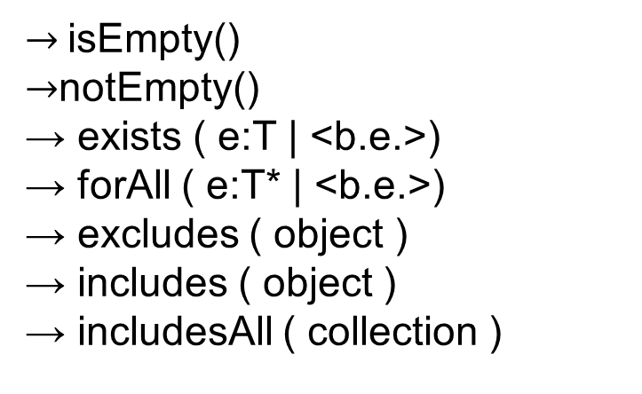
Collection Operations
<collection> → …
$→$isEmpty()
$→$notEmpty()
→ exists ( e:T | <b.e.>)
→ forAll ( e:T* | <b.e.>)
→ excludes ( object )
→ includes ( object )
→ includesAll ( collection )
Boolean:
Generic :
→ iterate ( e:T1; r:T2 = <v.e.> | <v.e.>)
b.e. stands for boolean expression
v.e. stands for value expression

Slide 10
Collection Operations
<collection> → …
→ count ( object )
→ size ( )
→ sum ( )
Numeral :
→ select ( e:T | <b.e.>)
→ reject ( e:T | <b.e.>)
→ collect ( e:T | <v.e.>)
→ intersection(collection)
Collections :
b.e. stands for boolean expression
v.e. stands for value expression

Slide 11
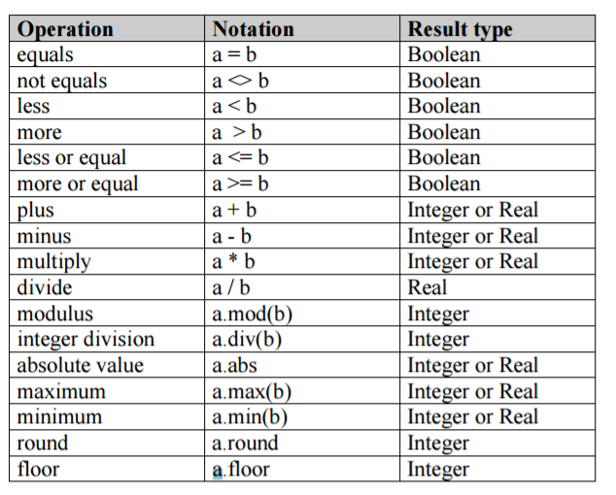
Real and Integer

Slide 12
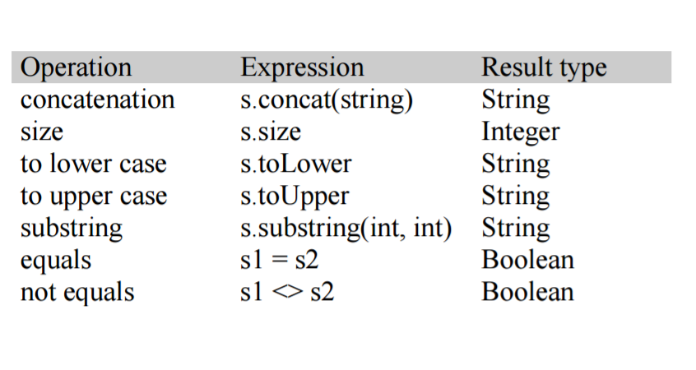
String

Slide 13
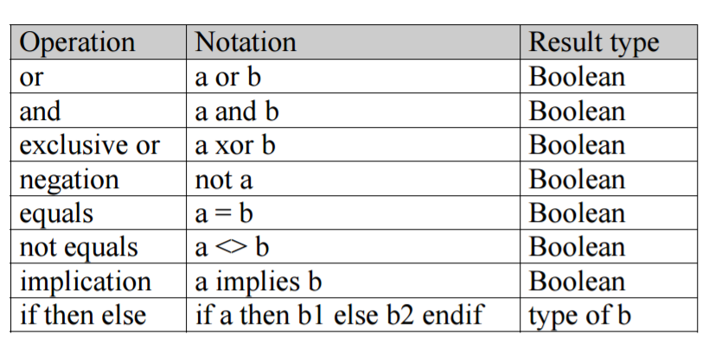
Boolean

Slide 14
Instance Operations
Instances have the following operations:
self.isOclTypeOf(T) :
Returns true iff self is of type T
self.isOclKindOf(T):
Returns true iff (self is of type T) OR (self’s subtype of T)
Types have the ‘allInstances’ member:
T.allInstances
returns a collection of all T instances.

Slide 15
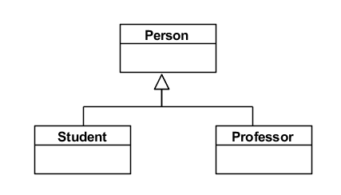
oclIsKindOf vs. oclIsTypeOf
Context Person
self.oclIsKindOf(Person) -> true
self.oclIsTypeOf(Person) -> true
self.oclIsKindOf(Student) -> false
self.oclIsTypeOf(Student) -> false
Context Student
self.oclIsKindOf(Person) -> true
self.oclIsTypeOf(Person) -> false
self.oclIsKindOf(Student) -> true
self.oclIsTypeOf(Student) -> true
self.oclIsKindOf(Professor) -> false
self.oclIsTypeOf(Professor) -> false

Slide 16
Navigating to collections
Customer
Account
Transaction
0..*
0..*
context Customer account produces a set of Accounts
context Customer account.transaction produces a bag of transactions
If we want to use this as a set we have to do the following
account.transaction -> asSet

Slide 17
Example
במערכת לניהול טורנירים של משחק הכדורגל, קבוצות (Team) משתתפות בתחרויות (Competition), מעסיקות שחקנים(Player) ומשחקות באצטדיונן הביתי(Stadium). בכל משחק (Match) משתתפות 2 קבוצות ואת המשחק שופטים בין 4 ל-6 שופטים (Referee)
(ה-VAR טרם נכנס).
התחרויות שבהן הקבוצות משתתפות הן גביע(Domestic Cup) או ליגה(League). לכל קבוצה יכול להיות מספר מפרסמים (Advertiser) הנותנים חסות לקבוצה. החסות מתועדת באמצעות הסכם (Agreement). באותו אופן, גם לתחרות מסוג ליגה יש מפרסם. בדומה לקבוצות, לאצטדיון יכולים להיות מספר מפרסמים.

Slide 18
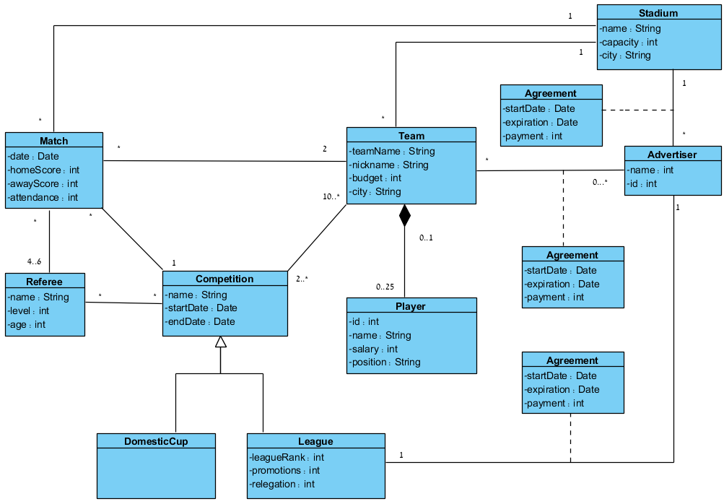
Example

Slide 19
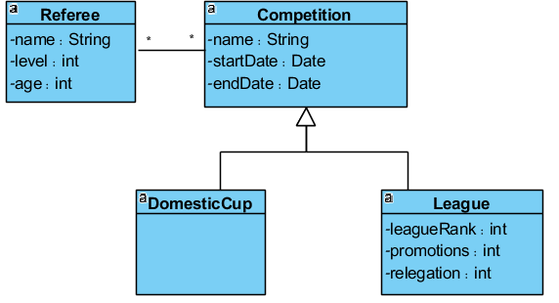
Example
הגיל המקסימלי של השופטים בליגות 5 ומטה הוא 45
context Referee inv:
Self.age <= 45 or self.competition->select(OCLType=Laegue)-> forALL(l:League | l.leagueRank > 5)

Slide 20
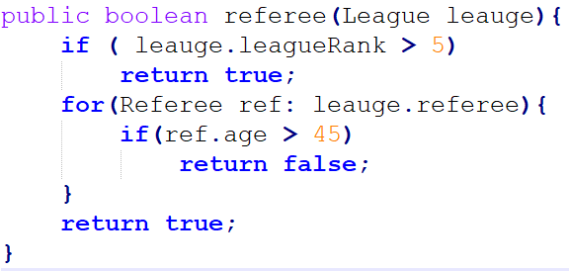
Example
הגיל המקסימלי של השופטים בליגות 5 ומטה הוא 45
context Referee inv:
Self.age <= 45 or self.competition->select(OCLType=Laegue)-> forALL(l:League | l.leagueRank > 5)

Slide 21
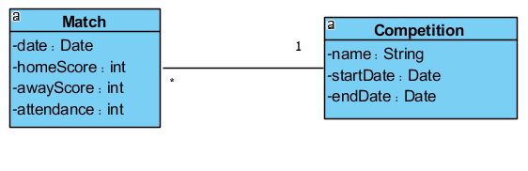
Example
כל המשחקים בתחרות מתקיימים במסגרת הזמן שהתחרות מתנהלת
context Competition inv:
self.Matches->forAll( m: Match | m.date.after(startDate) and m.date.before(endDate))

Slide 22
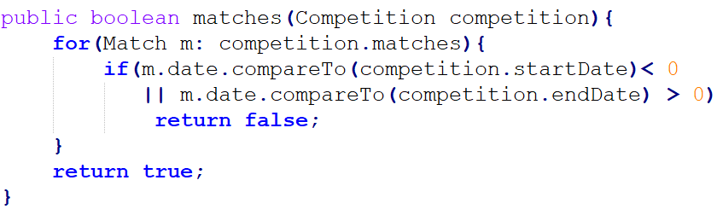
Example
כל המשחקים בתחרות מתקיימים במסגרת הזמן שהתחרות מתנהלת
context Competition inv:
self.Matches->forAll( m: Match | m.date.after(startDate) and m.date.before(endDate))

Slide 23
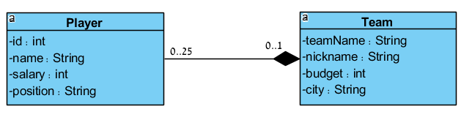
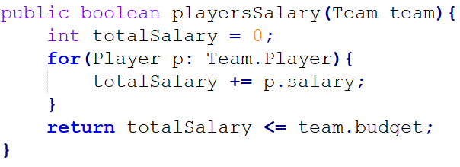
Example
סכום שכר השחקנים של קבוצה יהיה קטן מהתקציב שלה
context Team inv:
self.Player->collect(p:Player | p.salary)->sum() < self.budget

Slide 24
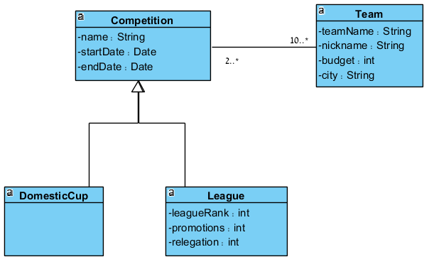
Example
קבוצה יכולה להשתייך לליגה אחת בלבד
context Team inv:
self.Competition->select(OCLType=Laegue)->size() = 1

Slide 25
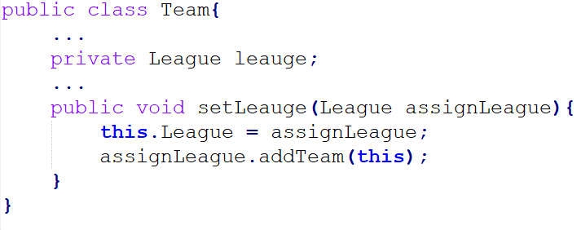
Example
קבוצה יכולה להשתייך לליגה אחת בלבד
context Team inv:
self.Competition->select(OCLType=Laegue)->size() = 1

Slide 26
Example
בכל קבוצה יהיו 3 שוערים
context Team inv:
self.Player->iterate( p: Player; acc: Integer =0 | if (p.position = ‘Goalkeeper’) then acc + 1 else acc endif) = 3
אילו היינו דורשים שבכל קבוצה יהיו 2 או 3 שוערים היה כדאי לכתוב זאת כך:
context Team inv:
Let amountOfGK : Integer =
self.player->select( p: Player | p.position = “goalkeeper”) -> size()
In
amountOfGK = 2 or amountOfGK = 3

Slide 27
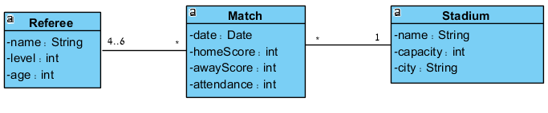
Example
במשחקים באצטדיונים המכילים 30,000 מקומות ומעלה בצוות השופטים יהיה שופט מרמה 2 או 1.
context Match inv:
self.Stadium.capacity > 29,000 implies Referee->exists(r : Referee | r.level < 3)

Slide 28
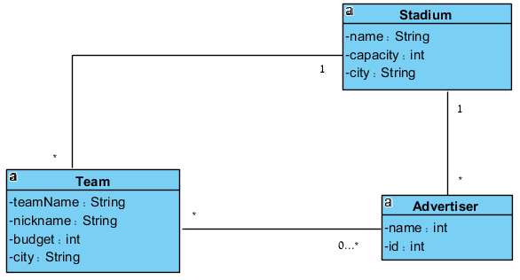
Example
קבוצה לא יכולה לשחק באצטדיון בו תומך הספונסר (Advertiser) שלה
context Team inv:
self.Stadium.Advertiser->intersection(self.Advertiser)->isEmpty()

Slide 29
Example
באצטדיון הביתי של קבוצה תומכים כל הספונסרים שלה.
context Team inv:
self.Stadium.Advertiser->includesAll(self.Advertiser)

Slide 30
Example
לא קיימים שחקנים בעלי אותו השכר
context Player inv:
allInstances-> forALL(p1,p2 : Player | p1.salary <> p2.salary)

Slide 31
Example
שם קבוצה הוא ייחודי
context Team inv:
Self.teamName->isUnique(teamName)

Slide 32
Reference
You can find more explanations and operations in:
https://wiki.eclipse.org/Acceleo/OCL_Operations_Reference

