Slide 1
Object Oriented Analysis and Design
Practical Session No. 5
Sequence Diagram
Spring 2019

Slide 2
UML Diagrams
Structure diagram
Class diagram
Object diagram
Behaviour diagram
Use Case diagram
Interaction diagram
Sequence diagram
Communication Diagram
x
y
z
a
b
c

Slide 3
Sequence Diagram
Describe the flow of messages, events, actions between objects
Show concurrent processes and activations
Show time sequences that are not easily depicted in other diagrams
Typically used during analysis and design to document and understand the logical flow of your system
Emphasizes time ordering of messages.

Slide 4
Sequence Diagram
Describe the flow of messages, events, actions between objects
Show concurrent processes and activations
Show time sequences that are not easily depicted in other diagrams
Typically used during analysis and design to document and understand the logical flow of your system
Emphasizes time ordering of messages.

Slide 5
A Sequence Diagram
X-Axis (objects)
obj1 : Class1
obj2 : Class2
user
Object Creation
operate()
Y-Axis (time)
do (…)
create (…)
Message
: Class3
Messages to self
foo()
Object Destruction
Return Message
Life line

Slide 6
Representing Objects
Write object's name if it clarifies the diagram
syntax: [instanceName] [:className]
Object's "life line" represented by dashed vert. line
r : Room
: Room
rooms: Room
Object
Anonymous Object
Collection of Objects

Slide 7
Messages
An interaction between two objects is performed as a message sent from one object to another (simple operation call, Signaling)
If object obj1 sends a message to another object obj2 some link must exist between those two objects
s : Sender
r : Receiver
message(parameters)
returnedValue

Slide 8
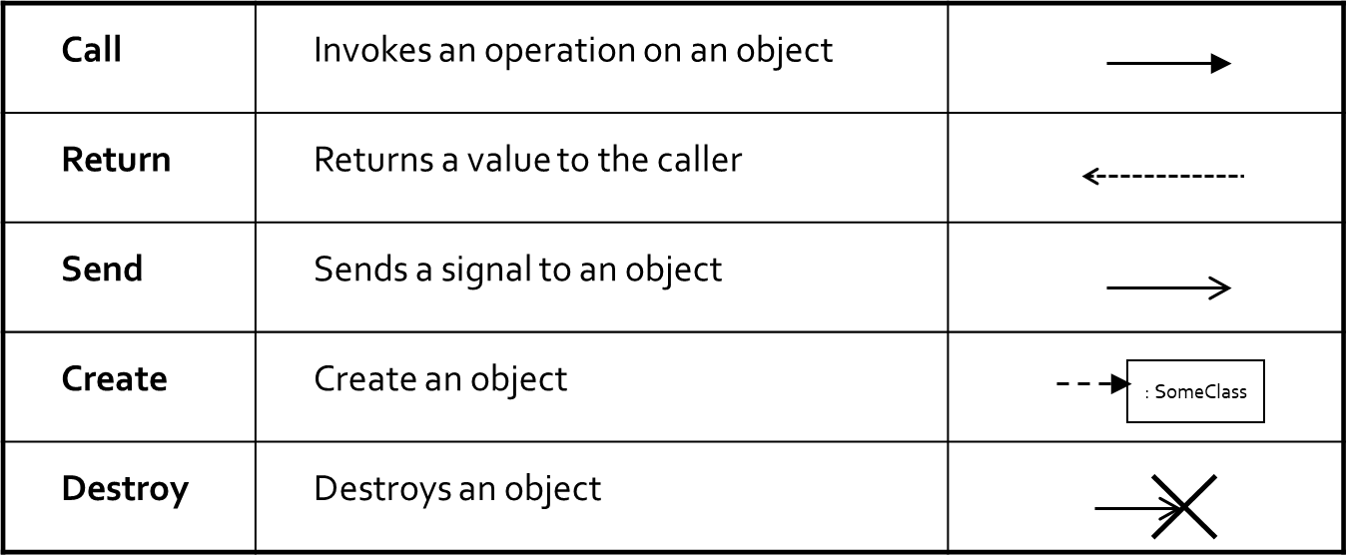
Messages Types
8

Slide 9
Messages (cont.)
Synchronous
Asynchronous
A message is represented by an arrow between the life lines of two objects.
Self calls are also allowed
The time required by the receiver object to process the message is denoted by an activation-box.
A message is labeled at minimum with the message name.
Arguments and control information (conditions, iteration) may be included.
:A
:B
doYouUnderstand()

Slide 10
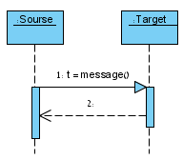
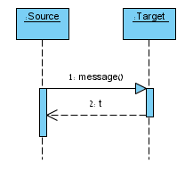
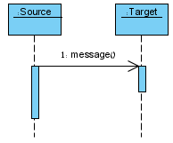
Synchronous & Asynchronous
What is the difference?
a)
b)
c)
Notes:
Notice that while VP employs some numbering convention in its models, we do not enforce such numbering in the course, so you can omit / ignore the numbers.
Also: different versions of VP underline (or don’t) object names. It does not matter in our case.
Reveals the inner structure of Source: ‘t’ is used for storing the return value of message().
Reveals the inner structure of Target: ‘t’ is used as a return value for message(). We do not know if Source even stores it.
Notice the empty arrowhead, meaning this is a signal passing (non-blocking, asynchronous) rather than method invocation (in which the operating thread moves its focus from Source to Target and back to Source when done. Return value from asynchronous message is the same as synchronous return message. Since the return value is not synchronized, we can’t use this value

Slide 11
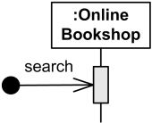
Found Message
A message sent from an unknown recipient, shown by an arrow from an endpoint to a lifeline.
In this kind of message the receiving event is known, but there is no (known) sending event.
This may for example be noise or other activity that we do not want to describe in detail.
For example: An Online Bookshop gets search message of unknown origin.

Slide 12
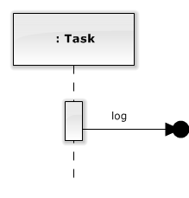
Lost Message
A message sent to an unknown recipient.
A lost message can occur when a message is sent to an element outside the scope of the Sequence Diagram.
This also allows the modeler to consider the possible impact of a message’s being lost.
For example: A Task sends log to unknown participant.

Slide 13
Return Values
Optionally indicated using a dashed arrow with a label indicating the return value.
Don’t model a return value when it is obvious what is being returned, e.g. getTotal()
Prefer modeling return values as part of a method invocation, e.g. ok = isValid()
Model a return value when you need to refer to it elsewhere, e.g. as a parameter passed in another message.
:A
:B
doYouUnderstand()
return (optional)
Caller Blocked
yes

Slide 14
Object Creation
<<create>>
:SomeClass
An object may create another object via a <<create>> message.
:A
New(x)
:B
Constructor

Slide 15
Object Destruction
<<destroy>>
An object may destroy another object via a <<destroy>> message.
An object may destroy itself.
Avoid modeling object destruction unless memory management is critical.
:A
:B
Destroy()
15

Slide 16
Guards
Condition
syntax: ‘[‘ expression ’]’ message-label
The message is sent only if the condition is true
s : Sender
r : Receiver
[condition] message(parameters)
message is only sent if condition is met
16

Slide 17
Guards ( Cont.)
Iteration
syntax: ‘ * [‘ expression ’]’ message-label
This corresponds to an iteration over the elements in the collection, where each element receives the message
For each element, the condition is evaluated before the message is sent
s : Sender
: Receiver
* [condition] message(parameters)
message will be sent one element after the other for as long as condition holds
17
Notes:
Usually though, the condition is used as a filter that selects elements from the collection (e.g. 'all', 'adults', 'new customers' as filters for a collection of Person objects). Only elements selected by the filter will receive the message.

Slide 18
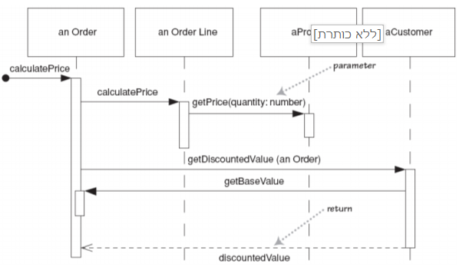
Distributed vs Centralized
18

Slide 19
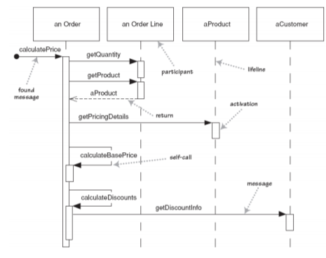
Distributed vs Centralized
19

Slide 20
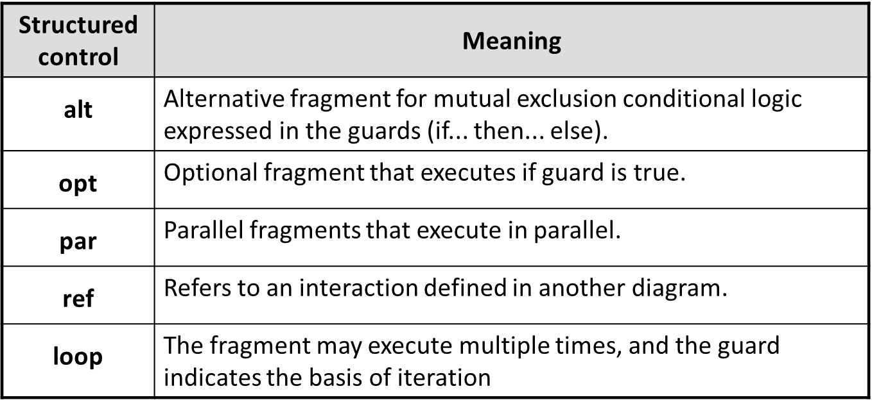
Combined Fragments
Common Sequence Diagrams' structured controls:
20

Slide 21
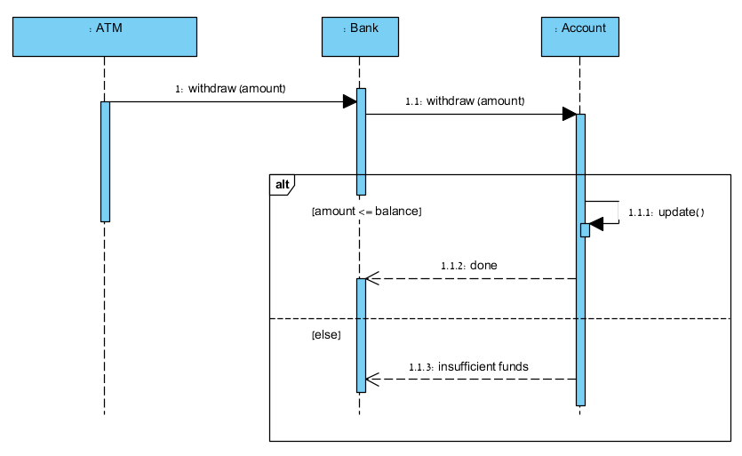
alt
21
Notes:
The Account checks that the amount <= balance
All the objects that part of the alt are delimited in the alt’s frame
Notice that the gaps in the life line represent the focus of control – the time this object is acting and performing operations relevant to our Sequence Diagram. It does not mean the object disappears (destroyed) and re-created or anything like it! Notice how the diagram’s readability is greater thanks to the gap in “ar”.

Slide 22
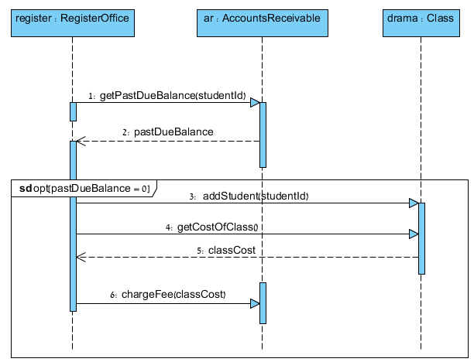
opt
22
Notes:
[opt] is used for optional frames; all interactions.

Slide 23
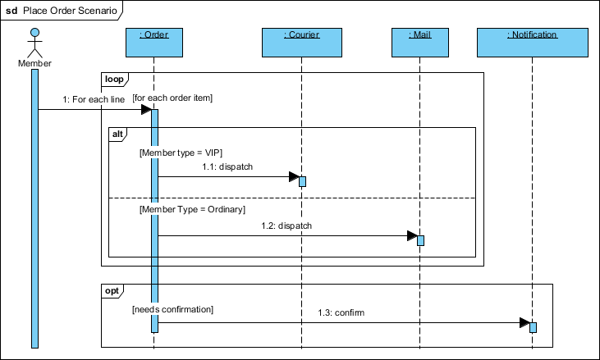
Loop(1)
23
Notes:
The dispatch is object were passed through

Slide 24
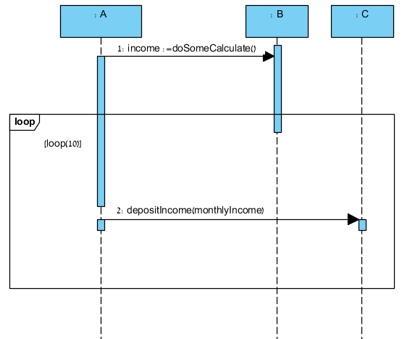
loop (2)
24

Slide 25
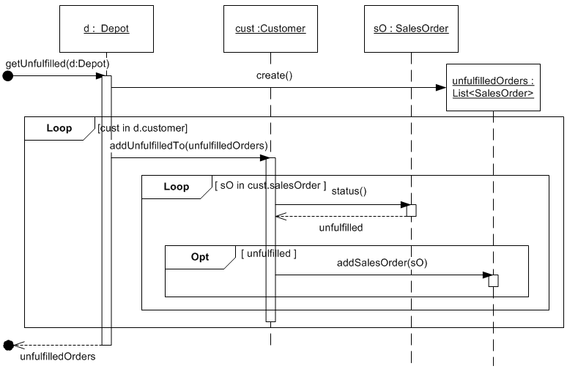
loop (3)
25
Notes:
Use without collection
http://wiremea.com/sequence-diagram-iteration.html
We know that Depot class has collection of Customer objects. We iterate on each Customer object (called “cust” in the diagram). In this example there is no representation for the collection.

Slide 26
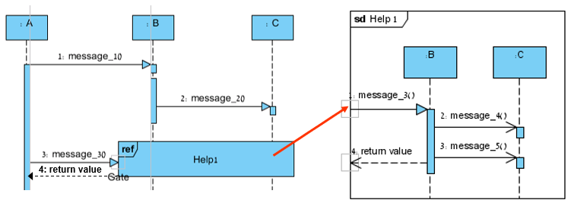
Nested diagrams
26
Notes:
“Gate” is the entry point (and exit point) of

Slide 27
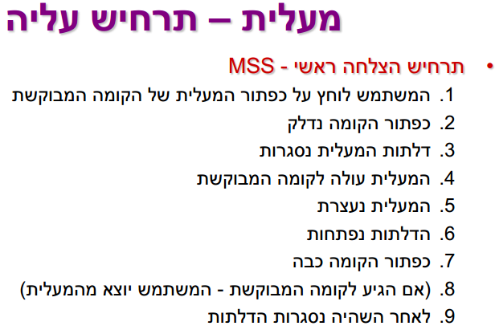
תרגיל 1
27

Slide 28
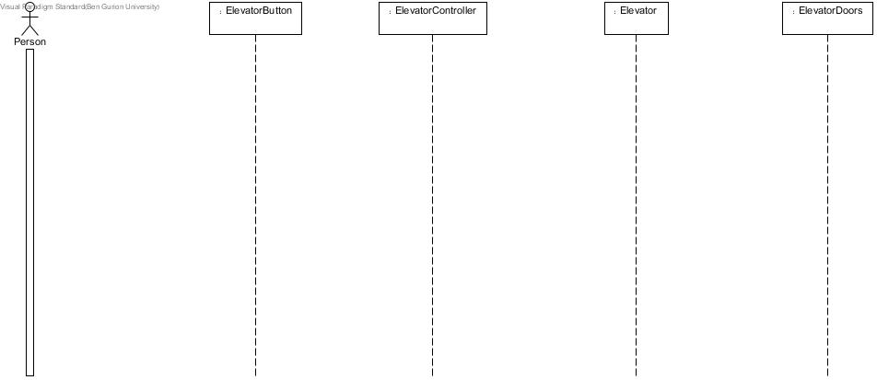
תרגיל 1 - פתרון
28

Slide 29
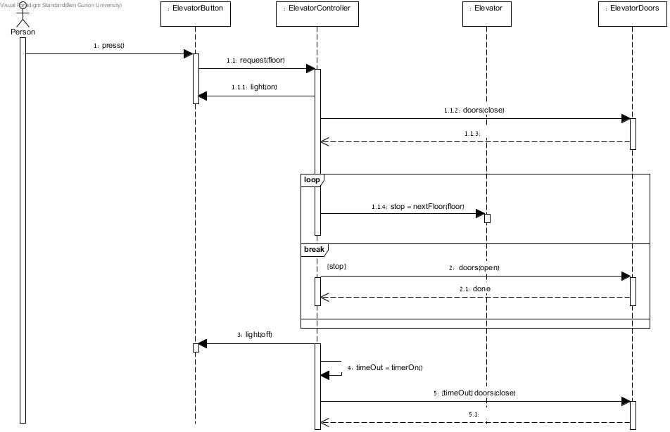
תרגיל 1 - פתרון
29

Slide 30
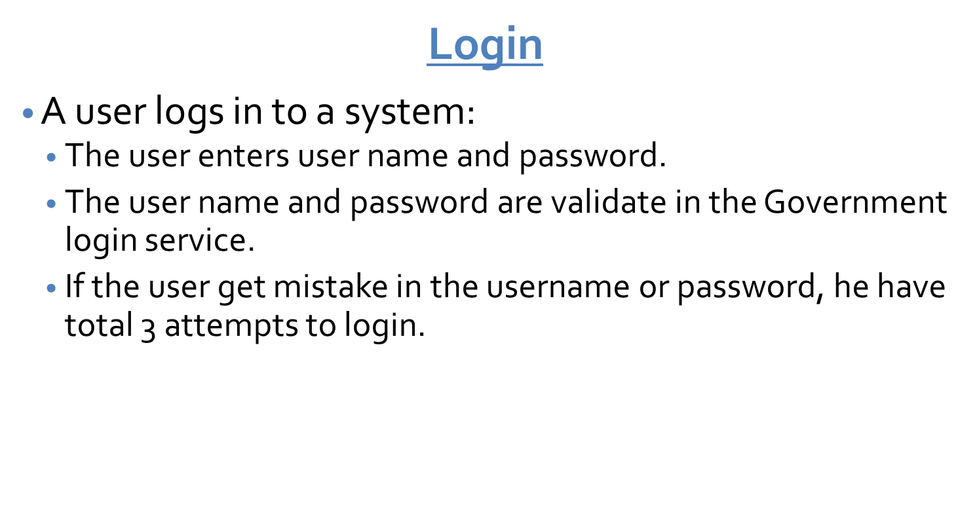
תרגיל 2
30

Slide 31
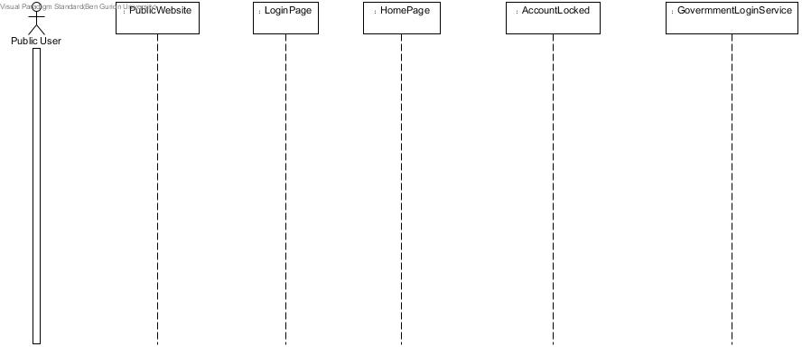
תרגיל - פתרון 2
31

Slide 32
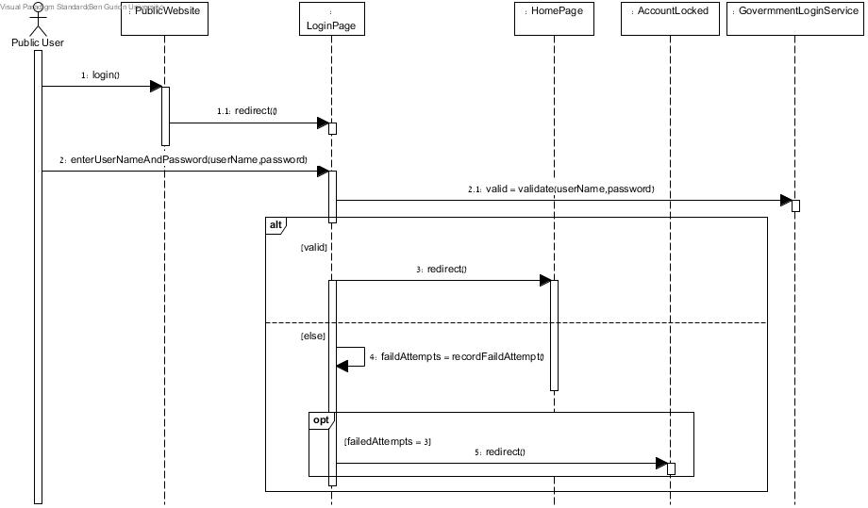
תרגיל - פתרון 2
32

