Slide 1
Software Development Lifecycle using Viewpoints and Perspective Architectural Approach
Boris Giterman,
Director, Software Engineering, Dell EMC November , 2018

Slide 2
Agenda
Stakeholders
Product Requirements Definition
Solution Architecture and Design
Views and Viewpoints
Qualities and Perspectives

Slide 3
Development Phases
Requirements Phase
Design Phase
Implementation Phase
Integration Phase
System Test Phase
Release Operations
Product Manager
System Requirements
High Level Architecture & Use Cases
Integration Plan
Solution
Architect
Technical Expert
Detailed Design
Coding
Software Components Integration
Software Developers
Unit Testing
Packaging
Integration
Test
Config. Manager
CM Planning & Implementation
Deployment Engineer
System Deployment
QA Engineer
System Testing Plan
System Testing Design
Sys.Test Execution
Perf. Engineer
Perf. Testing Plan
Perf. Testing Design
Perf. Test Execution
Technical Writers
Documentation Plan
Documentation Writing
Documentation Deliverables

Slide 4
Stakeholders
Identifying Stakeholders
People, Group, Entities
Those who have an interest in or concerns about the realization of the architecture
Importance of Stakeholders
Architecture are built for stakeholders
Decision must reflect stakeholder needs
Involving a wide stakeholder community increases your chances of success
Attributes of a good stakeholder
Informed, to allow them to make good decisions
Committed – to the process
Authorized, to make decisions
Representative, of their stakeholder group so that they present its views validly

Slide 5
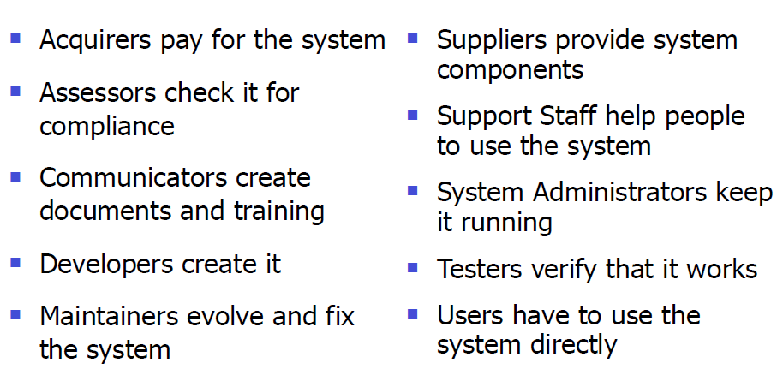
Stakeholders Groups

Slide 6
Project Requirements Definition
Functional Requirements
The functional requirements define the capabilities and functions that a System must be able to perform successfully.
Functional Requirements should include:
Descriptions of data to be entered into the system
Descriptions of operations performed by each screen
Descriptions of work-flows performed by the system
Descriptions of system reports or other outputs
Who can enter the data into the system.

Slide 7
Product Requirements Definition
Functional Requirements (examples)
Manage Users Accounts (Credentials)
The system is required to store and maintain a list of client accounts in a persistent repository (add users, remove users, store user details, etc.)
Exchange Medical Data
The system must be able to transfer / receive medical data to /from external systems using well-known data formats (schemas) for medical domains (for example, Medications). Access to this information sets will be provided through the web-based public interfaces (web services API).
Expose Medical Data
The system must be able to provide read-only medical data to external systems using well-known data formats (schemas) for medical domains (for example, Medications).
Apply Business Rules
The system must provide an ability to inject / apply business rules to the medical datasets as a part of the process model. Data filtering, data aggregation and calculation, applying user security profile provide examples of such business rules and must be planned on the early steps of design phase

Slide 8
Product Requirements Definition
Non-Functional Requirements (examples)
Non-functional requirements relate to qualities of the system that cut across user facing features, such as security, reliability, and performance. A non-functional requirement is a requirement that specifies criteria that can be used to judge the operation of a system, rather than specific behaviors.
Extensibility
System must be extendible to cope with new functionality such as new medical domains and different data conveyed to end users.
Logging and tracing
System must save log records for any type of provided information in the context of user security profiles.
System must trace user activities and will be able to create tracing reports , based on the saved data.
Performance
There needs to be reasonable data access speed on the Client side as well as the staff user side of the application.
The response time must be no longer than X seconds

Slide 9
Project Requirements Definition
Non-Functional Requirements (examples) - Continued
Security
All information provided to the end users or external applications over web services or mobile services must be kept secure.
Interoperability
System server side interfaces must have a universal data stream format (for example, JSON) that will be consumed and presented by different target platform / devices (like Android, iOS, Windows) in the similar way
See Requirements Model example (Enterprise Architect Model document)
See Requirements Template Example (Word based document)

Slide 10
Analysis Scope
Analysis scope will provide a detailed definition of user scenarios (uses cases) and system elements, modules and UI composition, supporting it. For instance, for the medical data retrieval process, it will describe how the user is connected to the system (authenticated and authorized) and what will be the main steps of the data preparation flow.
This paragraph should also contain the proposed UI layout and screenshots.

Slide 11
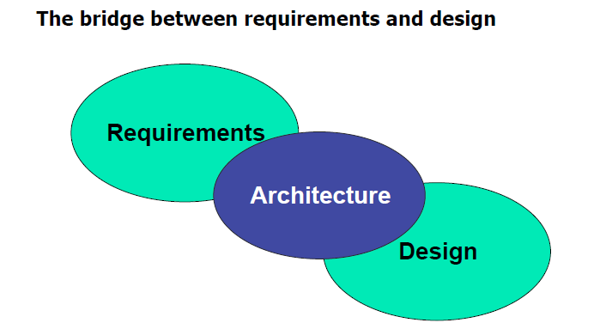
Solution Architecture and Design
A common definition…
“The software architecture of computing system is the structure or structures of the system, which comprise software elements, the externally visible properties of those elements, and the relationships among them. “

Slide 12
Solution Architecture and Design
Requirements And Architecture
Requirements are input to architecture
Requirements frame the architectural problem
Stakeholder needs and desires
Architecture must influence requirements
Stakeholder understanding of risk/cost
Stakeholder understanding of possibilities
Architecture & Design
Architecture frames design
Capture the system wide decisions

Slide 13

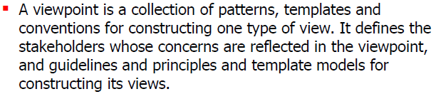
Solution Architecture and Design
.. or, in another words - the views are used to describe the system from the viewpoint of different stakeholders, such as end-users, developers and project managers.
Architectural Views and View Points
…or, in another words – the viewpoints provide a realization of specific view in format of different software artifacts (classes, components, diagrams, schemas, etc.)

Slide 14
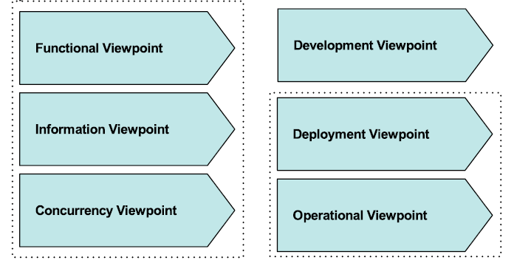
Solution Architecture and Design
Architectural Views and View Points
Describes the system’s functional elements, their responsibilities, interfaces, and primary interactions.
Describes the architecture that supports the software development process.
Describes the way that the architecture stores, manipulates, manages, and distributes information. The objective of this analysis is to answer the big questions around content, structure, ownership, latency, data migration.
Describes the environment into which the system will be deployed, including capturing the dependencies the system has on its runtime environment (hardware environment, network interconnections, and disk storage, etc.)
Describes the concurrency structure of the system, shows the process and thread structures that the system will use and the interprocess communication mechanisms used to coordinate their operation.
Describes how the system will be operated, administered, and supported when it is running in its production environment.

Slide 15
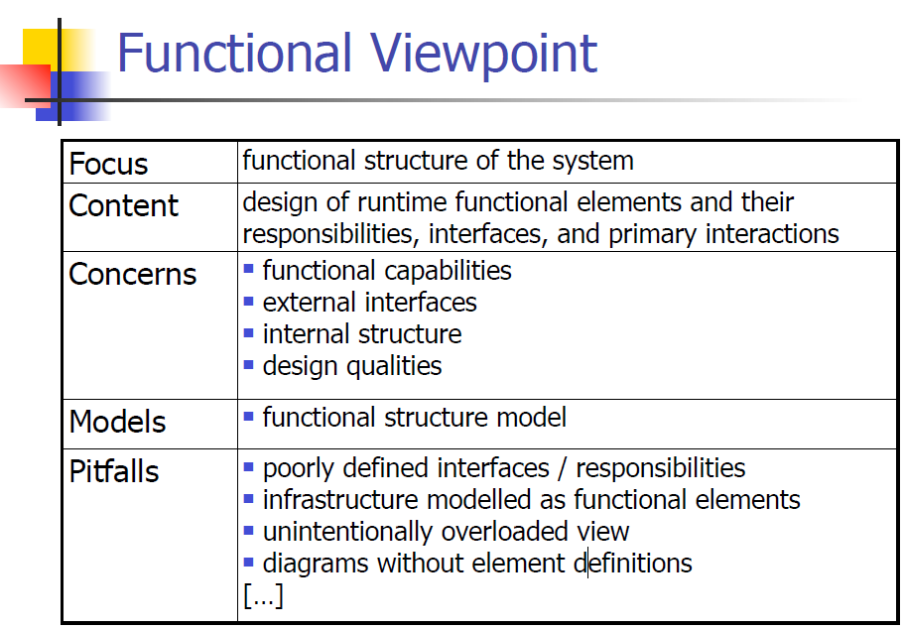
Solution Architecture and Design

Slide 16
Solution Architecture and Design
Functional View Fragment

Slide 17
Solution Architecture and Design
Functional Viewpoint Example
Business Logic Components
Business components should expose functionality in a way that is agnostic to the data stores and services needed to perform the work, and should be composed in meaningful and transactionally consistent ways
Business components invoked by the user process layer, service interfaces, and other business processes, typically with some business data to operate on, expressed as a complex data structure
Business components can be root of transactions
Should validate input and output

Slide 18
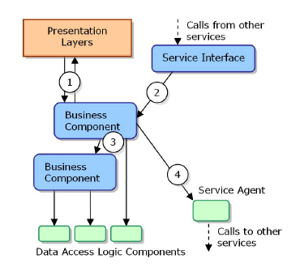
Solution Architecture and Design
Functional View Example
Business Logic Components – typical interacting with data access logic components, service interfaces, service agents, and other business components

Slide 19
Solution Architecture and Design
Functional View Fragment
Business Logic Components

Slide 20
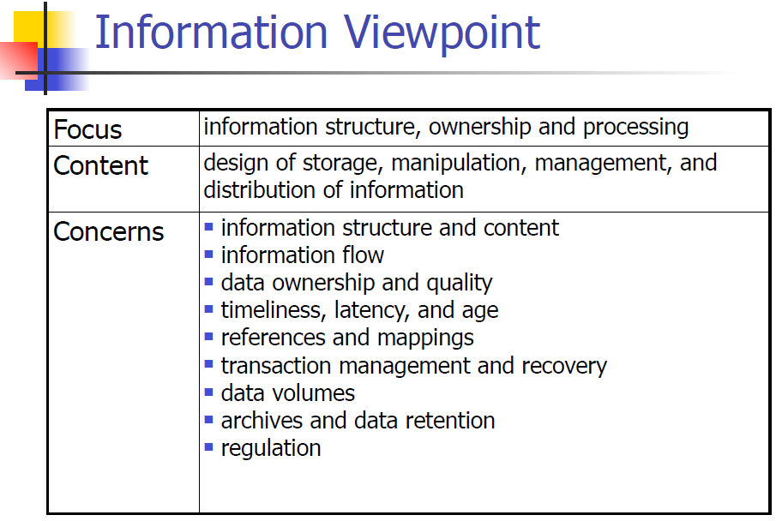
Solution Architecture and Design

Slide 21
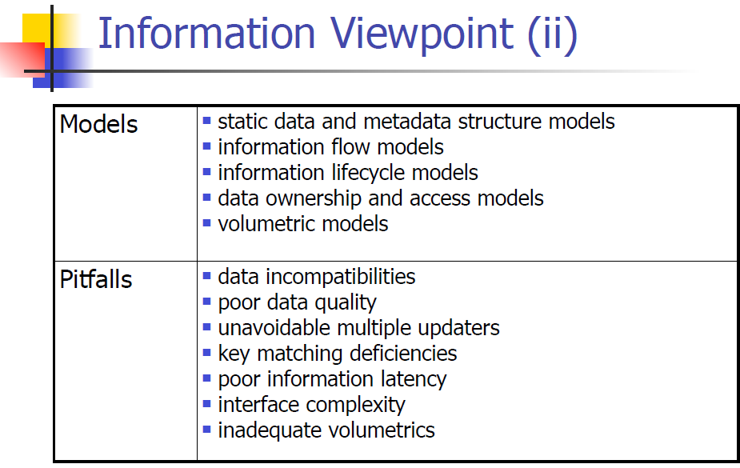
Solution Architecture and Design

Slide 22
Solution Architecture and Design
Information Viewpoint Example
Data Access Components
Data access logic components usually implement a stateless design pattern that separates the business processing from the data access logic.
Each data access logic component typically provides methods to perform Create, Read, Update, and Delete (CRUD) operations relating to a specific business entity in the application (for example, PatientInfo)
Implementing data access logic in data access logic components allows you to encapsulate all the data access logic for the entire application in a single, central location, making the application easier to maintain or extend.

Slide 23
Solution Architecture and Design
Information Viewpoint Fragment
Data Access Components Diagram

Slide 24
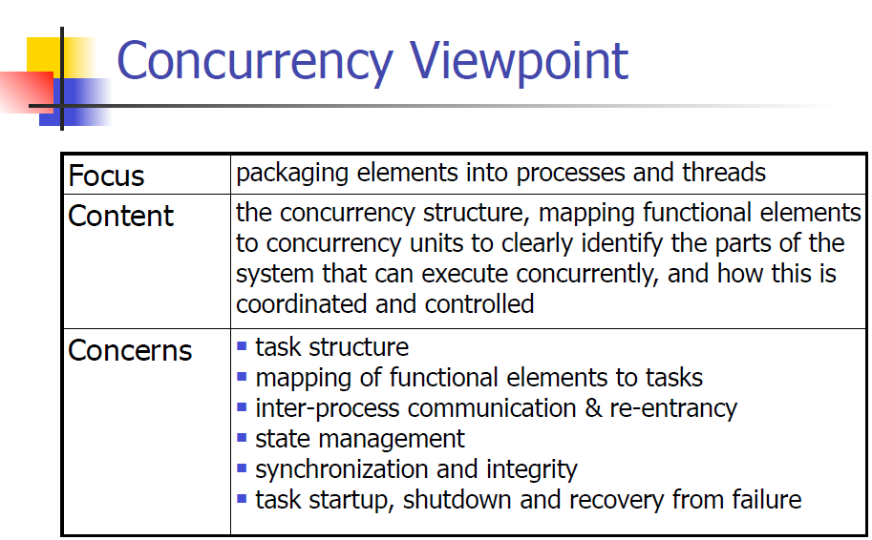
Solution Architecture and Design

Slide 25
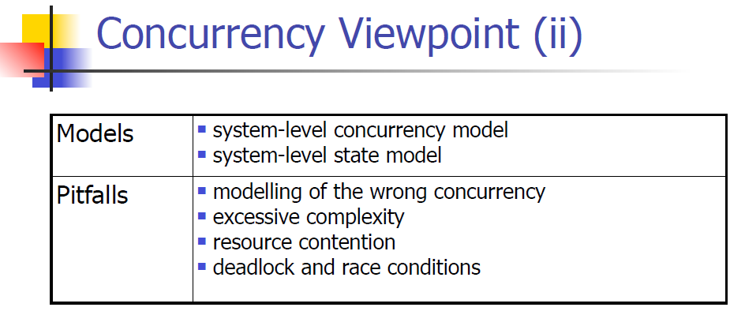
Solution Architecture and Design

Slide 26
Solution Architecture and Design
Concurrency Viewpoint Fragment
Session State Management Example

Slide 27
Viewpoints and Views Recap
Viewpoints
A store of knowledge and experience
A guide to the architect
Templates to guide development process
Views
A structure for description
A separation of concerns
Aid to stakeholder communication

Slide 28
Limitations of Viewpoints
Quality properties are critical
Most viewpoint sets don’t explicitly consider qualities (performance, security, etc.)
Quality properties usually need cross – view consideration
Viewpoints are relatively independent
Viewpoint focus may lead to late consideration of quality properties
Architects focus on desired structures not qualities
Qualities are often expensive to add later

Slide 29
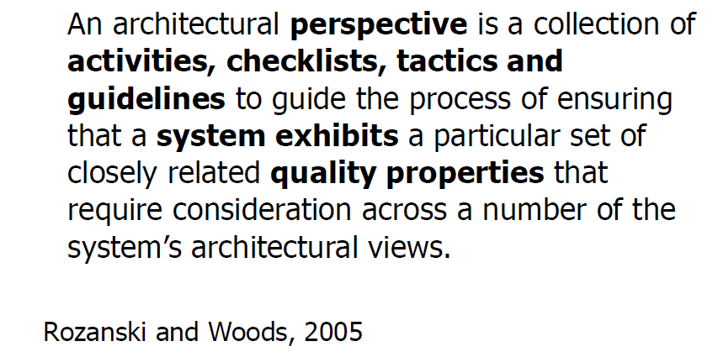
Qualities and Perspectives
Which quality properties are crucial to your systems?
Which views are going to be impacted by considering each such quality property?
We have a new concept called a “perspective” to cover the system qualities:

Slide 30
Possible Qualities To Consider
Performance
Scalability
Security
Availability
Localization
Reliability
Supportability
Maintainability
Safety
Cost
….

Slide 31
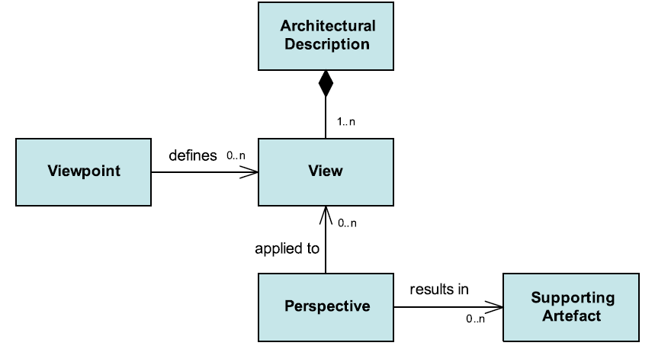
Adding Perspectives

Slide 32
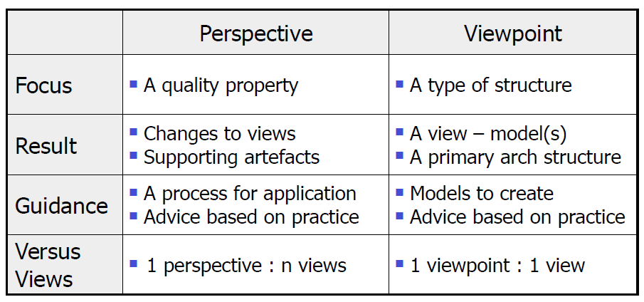
Perspectives vs. Viewpoints

Slide 33
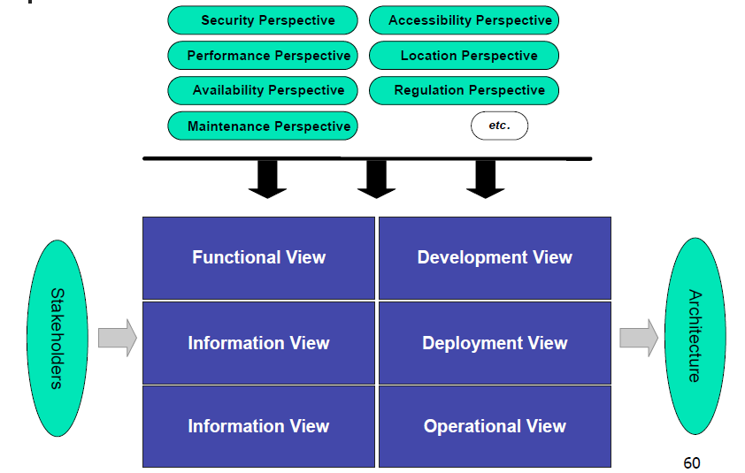
Perspectives and Views

Slide 34
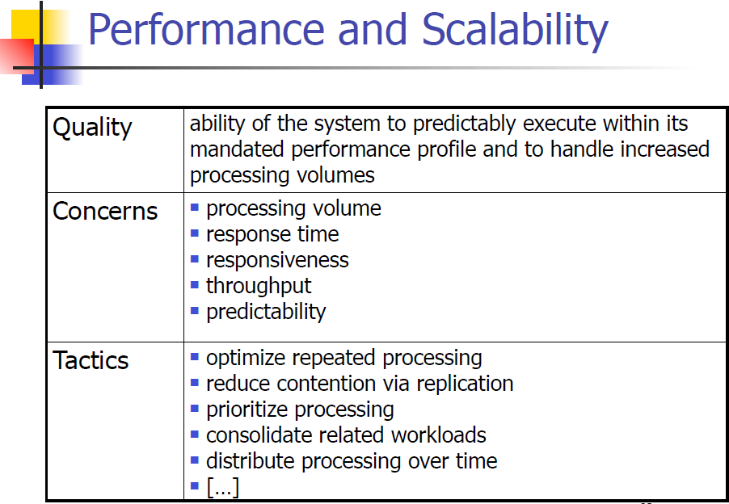
Perspectives and Views

Slide 35
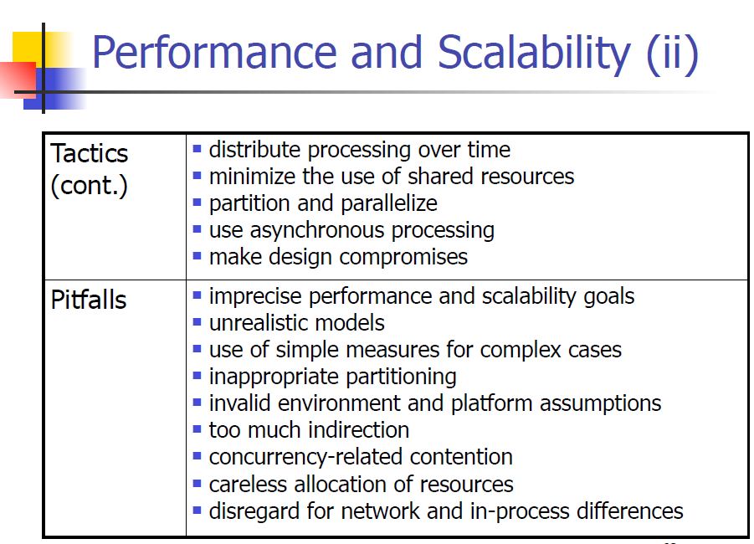
Perspectives and Views

Slide 36
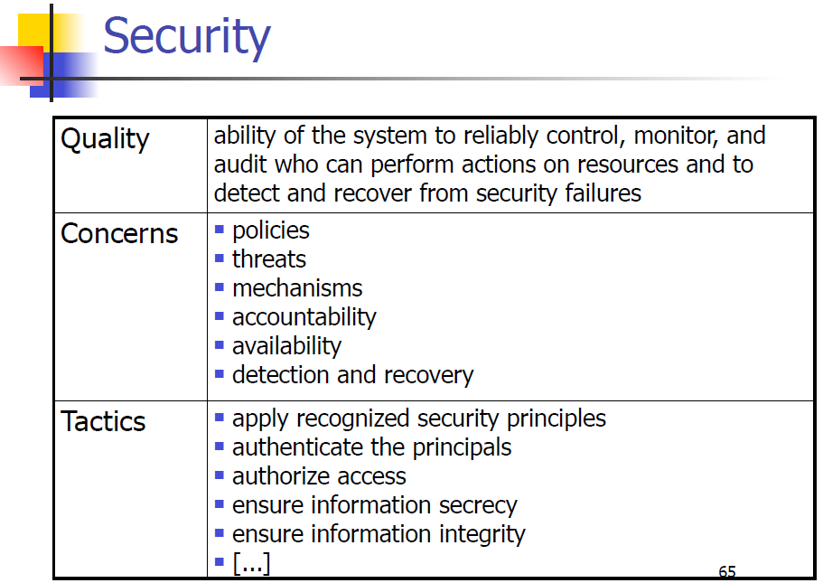
Perspectives and Views

Slide 37
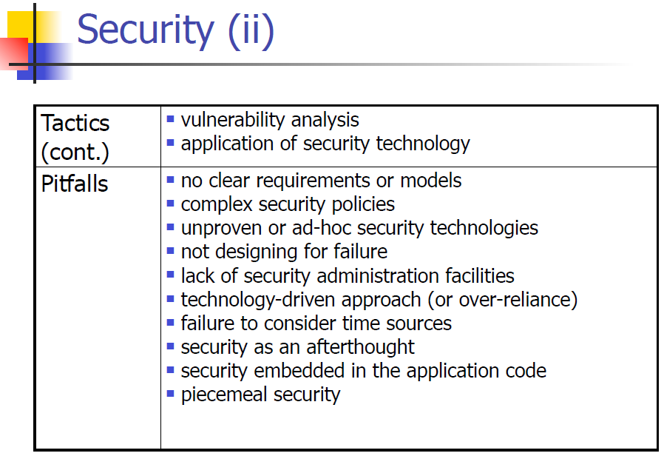
Perspectives and Views

Slide 38
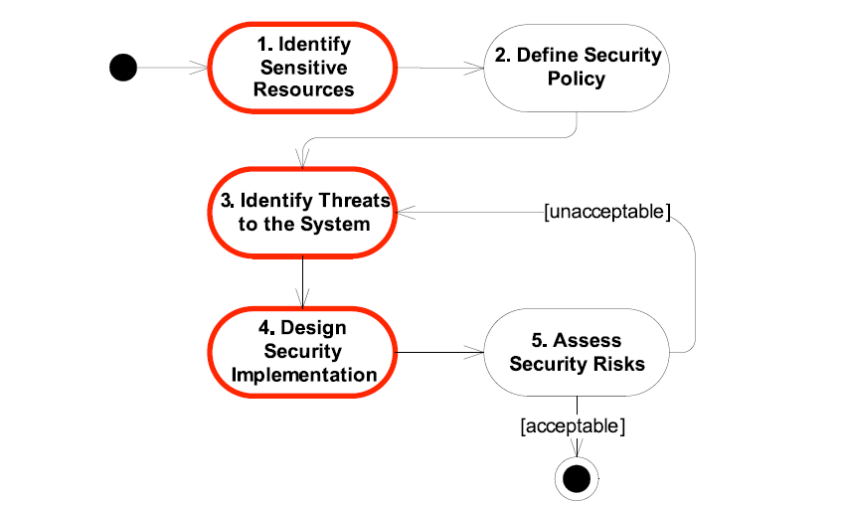
Example: Applying Security Perspectives
Decision Flow

Slide 39
Example: Applying Security Perspectives
Sensitive Resources
The data in the database
Visual elements and content on the screen
Security Threats
Operators stealing backups
Administrators querying data, seeing private data
Crack/guess passwords for user accounts
Internal attack on the database via network
Security Countermeasures
Organization policy and Regulations
User profile management system
Firewalls, defending tools…

Slide 40
Example: Applying Security Perspectives
Impact on functional view…

Slide 41
Summary
Using Views and Perspectives
A framework for organizing work
A store of knowledge
Document proven practice
Help standardize language and approach
Viewpoints and Views
Views provide a convenient approach for effective architectural description
Viewpoints standardize views by defining their content
Viewpoints contain proven architectural knowledge for a particular domain

Slide 42
Summary (ii)
Using Views and Perspectives
Perspectives
Viewpoints handle structure well, less convinced about quality properties
Perspectives provide similar guidance and knowledge sharing for quality properties
Perspectives suggest the design activities required to achieve a property
Perspectives provide proven practice, pitfalls, solutions and checklists to share experience
Applying perspectives modifies views

Slide 43
Comments and Questions?

